Slide 1
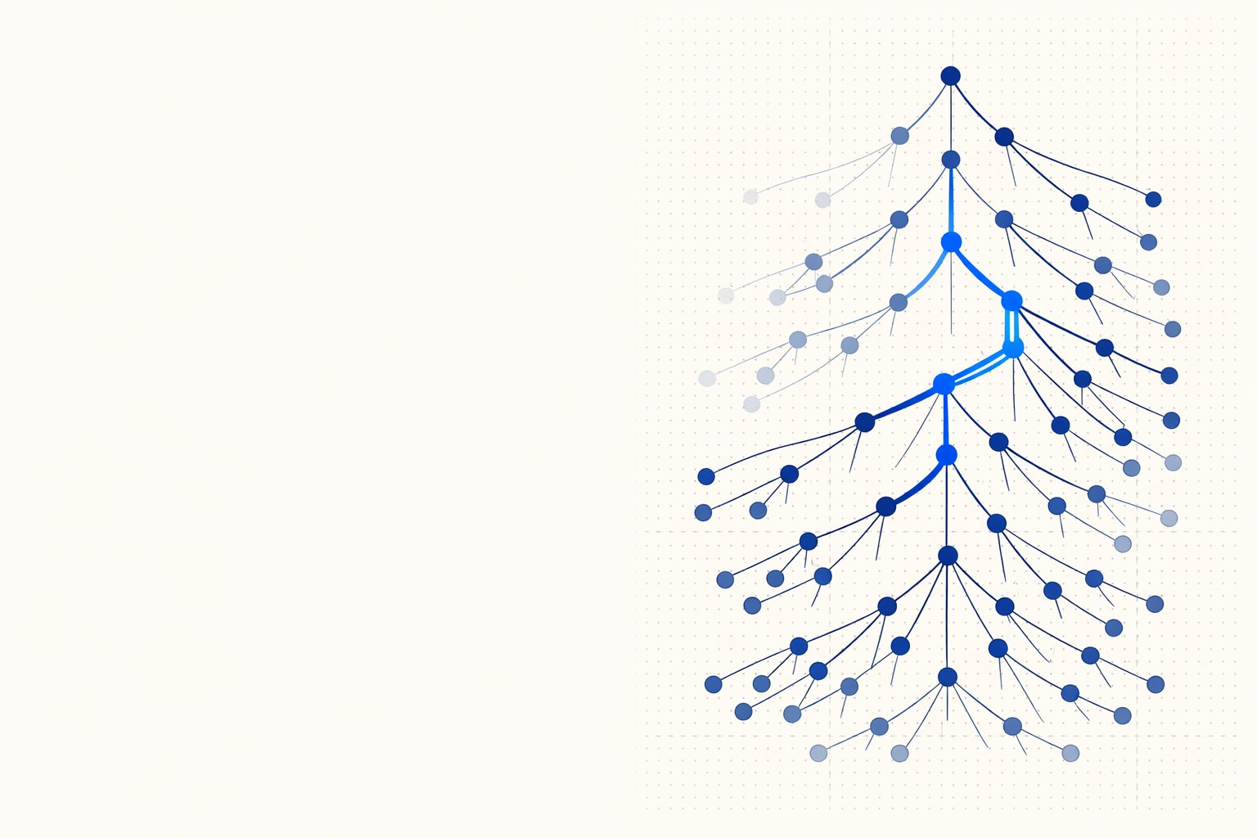

PAPER · DEEP READ
Nature 2026 · arXiv:2501.12948 · DeepSeek-AI
DeepSeek-R1
Incentivizing reasoning in LLMs
via reinforcement learning
DeepSeek-AI
research@deepseek.com · weights + 6 distilled models under MIT
THE 2025 IDEA
Incentivize reasoning through pure
reinforcement learning — no human traces.
Roche Blue exemplar · built from scratch with ppt-master · technical-formula style
Notes:
Welcome. Today we do a deep read of DeepSeek-R1 — a 2026 paper showing that a large language model can be taught to reason through pure reinforcement learning, without human-written reasoning traces. It matches OpenAI's o1 on reasoning, ships open weights under MIT, and distills down to models you can run on modest hardware.
Key points: Frame the talk: pure RL, open weights, distillation.
Time: 0:45

Slide 2
Frontier reasoning, open weights, a fraction of the cost
WHY THIS PAPER MATTERS · MATCHES OPENAI-o1-1217 ON REASONING
AIME 2024 · PASS@1
CODEFORCES · RATING
LICENSE
R1-ZERO · AIME 2024
competition mathematics
competitive programming
weights + 6 distilled models
pure RL, zero SFT
79.8%
2029
MIT
77.9%
on par with o1-1217
96.3 pctl · expert level
fully open · on HuggingFace
up from 15.6% — self-taught
THE HEADLINE
An open-weights model reaches o1-level reasoning — driven by
reinforcement learning, not human-annotated reasoning traces.
The rest of the paper explains how pure RL incentivizes reasoning, how a multi-stage
pipeline makes it usable, and how the ability distills all the way down to 1.5B parameters.
Source: DeepSeek-AI 2026, §4 (benchmarks), Abstract; AIME/Codeforces = Table 3 and main comparison table
02
Notes:
Four numbers set the stakes. On AIME 2024 R1 scores 79.8% pass@1 — on par with o1-1217. On Codeforces it hits a 2029 rating, expert territory. It's fully open under MIT with six distilled models. And R1-Zero — the pure-RL variant — jumped AIME from 15.6% to 77.9% teaching itself.
Key points: AIME 79.8 · Codeforces 2029 · MIT open · self-taught 15.6->77.9.
Time: 1:00

Slide 3
Skip supervised fine-tuning — let RL discover reasoning
THE CENTRAL IDEA · §1 INTRODUCTION · §2
CONVENTIONAL POST-TRAINING
DEEPSEEK-R1-ZERO
Pre-trained LLM
DeepSeek-V3-Base
SFT on human chain-of-thought
SFT stage
imitate human-written reasoning
bypassed — no human priors
RL fine-tune
Pure RL (GRPO)
VS
reward = final-answer correctness
THE CEILING
THE PAYOFF
Capped by human demonstrations.
Reasoning emerges on its own.
Depends on annotated traces — costly to scale,
With only the right incentive, the model learns
introduces cognitive bias, and constrains the
reflection, verification and alternative-path
model to human-like reasoning pathways.
search — beyond human-written examples.
Source: DeepSeek-AI 2026, §1 Introduction and §2 (DeepSeek-R1-Zero); GRPO = §2.1
03
Notes:
The central bet: skip supervised fine-tuning. Conventional post-training imitates human chain-of-thought, which caps the model at human demonstrations and injects bias. R1-Zero drops SFT entirely — pure RL with a reward that only checks final-answer correctness — and reasoning emerges beyond human examples.
Key points: Conventional (SFT-capped) vs R1-Zero (pure RL, emergent).
Time: 1:00

Slide 4
Two models: the proof of concept, and the usable one
DEEPSEEK-R1-ZERO (§2) VS DEEPSEEK-R1 (§3)
DeepSeek-R1-Zero
DeepSeek-R1
PURE RL
MULTI-STAGE
V3-Base + GRPO with rule-based rewards — no SFT stage.
Cold-start CoT + reasoning RL + rejection-sampling SFT + RL.
WHAT WORKS
WHAT IT ADDS
Strong reasoning — AIME 77.9%, self-taught via RL.
Inherits R1-Zero's reasoning — still top-tier.
Emergent reflection, verification, alternative search.
Readable CoT, language-consistent, human-aligned.
Broad — writing, open-domain QA, helpfulness + safety.
THE TRADE-OFFS
Poor readability of the chain-of-thought.
HOW
Language mixing (English / Chinese in one CoT).
A pipeline that layers alignment on top of reasoning.
Narrow — weak on writing and open-domain QA.
Intermediate checkpoints: Dev1 → Dev2 → Dev3.
The proof that RL alone can incentivize reasoning.
The version that turns the proof into a product.
THE THROUGH-LINE
R1-Zero answers "can RL alone teach reasoning?" — R1 answers "can it be made usable?"
Source: DeepSeek-AI 2026, §2 (R1-Zero) and §3 (R1)
04
Notes:
Two models. R1-Zero is the proof of concept: pure RL, strong reasoning, but poor readability, language mixing, and narrow scope. R1 is the usable version: a multi-stage pipeline that keeps the reasoning while adding readability, language consistency, and broad capability.
Key points: R1-Zero = proof; R1 = product.
Time: 0:55

Slide 5
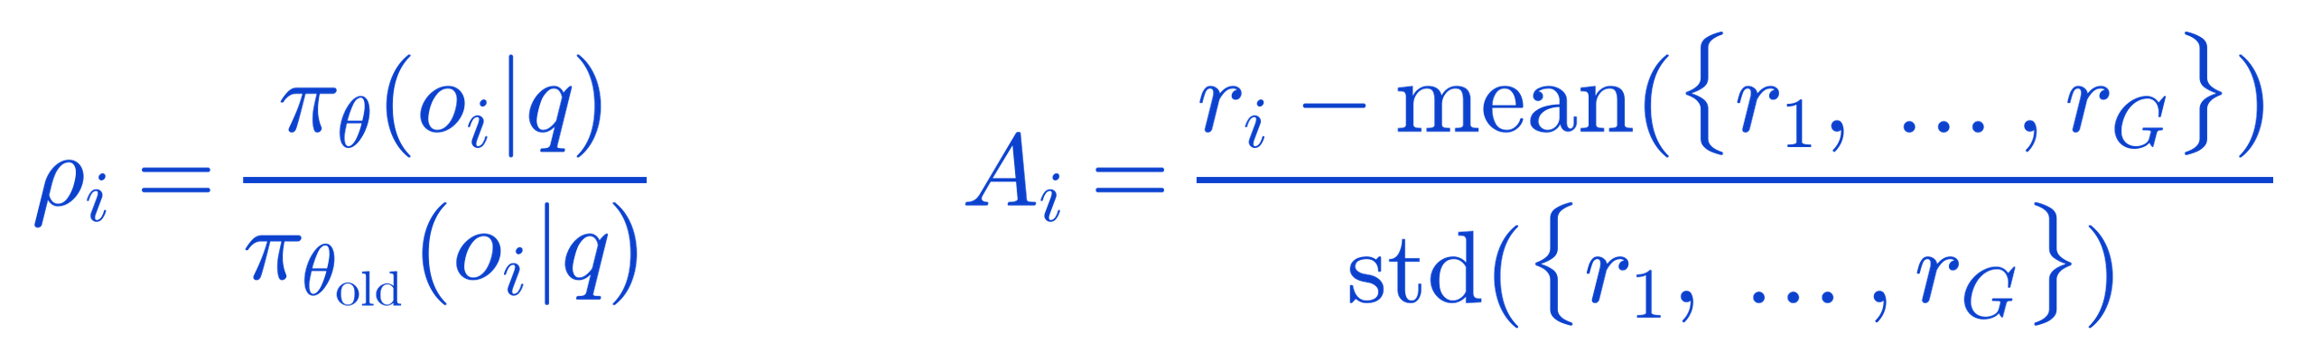
GRPO — a critic-free policy-gradient objective
GROUP RELATIVE POLICY OPTIMIZATION · §2.1 · EQ. (1)–(3)
THE OBJECTIVE · MAXIMIZED OVER THE POLICY · LaTeX-rendered
HOW IT READS
Sample a group
WHERE THE TERMS COME FROM
1
For each question, draw G outputs from the old policy.
2
Score each output
Rule-based reward per output — correctness + format.
Normalize within the group
THE KEY MOVE
3
Advantage = reward minus group mean, over group std.
GRPO drops PPO's value network — the group mean
is the baseline, so there is one fewer large model to train.
4
Update with a clipped ratio
Clip the ratio to a trust region, regularize by KL to a ref.
SETTINGS (R1-ZERO)
lr 3e-6 · KL β 0.001 · G = 16 samples / question
Source: DeepSeek-AI 2026, §2.1 (GRPO), Eq. (1)–(3) · block formulas rendered via LaTeX (Computer Modern)
05
Notes:
The RL algorithm is GRPO. For each question it samples a group of outputs, scores each with a rule-based reward, and normalizes rewards within the group to get the advantage. The key move: the group mean is the baseline, so GRPO drops PPO's value network — one fewer large model to train.
Key points: GRPO = clipped ratio + KL; group-mean baseline, no critic.
Time: 1:10

Slide 6
The reward is a rule, not a neural network
REWARD DESIGN · §2.2 · EQ. (4) · RULE-BASED = ACCURACY + FORMAT
HOW A RESPONSE IS SCORED
Accuracy reward
math → boxed-answer rule check
Model response
code → compiler runs test cases
Reward = R_acc + R_format
to a question q
equal weight · Eq. (4)
Format reward
wrap reasoning in <think> … </think>
+ language-consistency reward added for DeepSeek-R1
→ interpretable, easy to parse
WHY NOT A NEURAL REWARD MODEL
ONE EXTRA REWARD FOR R1
Neural RMs get reward-hacked at scale.
Language-consistency reward.
For reasoning tasks the authors avoid both outcome- and
Measured as the share of target-language words in the CoT,
process-based neural rewards: large-scale RL exploits them,
it curbs the English/Chinese mixing seen in R1-Zero.
and retraining them adds cost and pipeline complexity.
Ablation shows a slight accuracy cost —
Rules give precise, verifiable feedback that can't be gamed.
traded for readability that aligns with human preference.
Source: DeepSeek-AI 2026, §2.2 (Reward Design), Eq. (4), and §3.2 (language-consistency reward, Eq. 7)
06
Notes:
The reward is a rule, not a neural network. Accuracy: math checked against a boxed answer, code run through a compiler. Format: reasoning wrapped in think tags. Neural reward models are avoided — at scale they get reward-hacked. R1 adds one more: a language-consistency reward to curb English/Chinese mixing.
Key points: Rule-based: accuracy + format; no neural RM (hacking).
Time: 1:00

Slide 7
R1-Zero teaches itself — accuracy and thinking rise together
SELF-EVOLUTION DURING RL · §2.3 · REDRAWN FROM FIGURE 1
AIME 2024 · PASS@1
AVG RESPONSE LENGTH
accuracy vs training steps
tokens per response vs training steps
100
20k
~20k tokens
86.7% cons@16
77.9%
75
15k
50
10k
25
15.6%
5k
~0.5k
0
0
training steps · up to ~10,400
the model chooses to think longer — no one told it to
WHAT EMERGED — WITH NO EXPLICIT TEACHING
Reflection
Alternative-path search
A sharp jump at the
8.2k step in both curves —
Verification
Longer deliberate reasoning
accuracy and thinking time rise as one.
Source: DeepSeek-AI 2026, §2.3, Figure 1 (a) accuracy, (b) response length — curves stylized as native vector
07
Notes:
Watch R1-Zero teach itself. AIME accuracy climbs from 15.6 to 77.9% — and with self-consistency, 86.7%. In parallel, response length grows on its own to ~20k tokens: the model chooses to think longer. Reflection, verification and alternative-path search all emerge, with a sharp jump around the 8.2k step.
Key points: Accuracy and thinking length rise together; emergent behaviors.
Time: 1:05

Slide 8
The "aha moment" — reasoning it was never taught
EMERGENT SELF-REFLECTION · §2.3 · TABLE 2
“
CoT EXCERPT · ABRIDGED
<think>
Wait, wait. Wait.
square both sides, isolate the inner
square-root term, rearrange to a
That's an aha moment
quartic in x ...
I can flag here.
Wait, wait. Wait. That's an aha
moment I can flag here.
let's re-evaluate step by step ...
restart from the original equation,
An intermediate DeepSeek-R1-Zero
square again, treat carefully ...
mid-derivation, solving for the real roots of an equation
</think>
WHY IT MATTERS
No one rewarded the pause. RL scores only the final answer —
yet the model discovered on its own that stopping to re-check its work pays off.
Source: DeepSeek-AI 2026, §2.3, Table 2 (an "aha moment" of an intermediate R1-Zero) — excerpt abridged
08
Notes:
The famous aha moment. Mid-derivation, an intermediate R1-Zero writes 'Wait, wait. Wait. That's an aha moment' and restarts its reasoning. No one rewarded the pause — RL scores only the final answer — yet the model discovered that stopping to re-check pays off.
Key points: Emergent self-reflection; not taught, discovered.
Time: 0:55

Slide 9
Strong at reasoning, not yet ready to use
FROM R1-ZERO TO R1 · §3 · WHY A PIPELINE WAS NEEDED
WHAT HELD R1-ZERO BACK
THE DESIGN RESPONSE
Keep the reasoning core.
Poor readability
Wrap alignment around it.
The chain-of-thought is effective but hard to
follow — not written for a human reader.
R1 surrounds R1-Zero's RL with a human-aligned
cold start and alternating SFT / RL stages — so it
stays a top reasoner while becoming readable,
Language mixing
language-consistent and broadly capable.
English and Chinese blend within a single
FOUR STAGES
reasoning trace (V3-Base is bilingual).
1 · Cold start
2 · Reasoning RL
human-aligned long CoT
rules + language reward
Narrow competence
Rule-based RL targets verifiable tasks — weak
3 · Reject-sample + SFT
4 · All-scenario RL
on writing and open-domain question answering.
add non-reasoning data
helpfulness + safety
The full pipeline is on the next page.
Source: DeepSeek-AI 2026, §3 (DeepSeek-R1)
09
Notes:
Strong at reasoning, not yet ready to use. R1-Zero has three issues: poor readability, language mixing, narrow competence. The design response: keep the reasoning core, wrap alignment around it with a cold start and alternating SFT/RL stages.
Key points: Three problems -> the four-stage fix.
Time: 0:55

Slide 10
The multi-stage training pipeline
DEEPSEEK-R1 · §3 · REDRAWN FROM FIGURE 2
1
STAGE
2
STAGE
3
STAGE
4
STAGE
DeepSeek
Cold start
Reasoning RL
Reject-sample + SFT
All-scenario RL
DeepSeek
V3-Base
R1
671B / 37B act.
Thousands of long-CoT
GRPO rule-based rewards
Filter best traces, add
Rule rewards for reasoning
examples; a human-aligned
on math / code / logic,
non-reasoning data
+ preference rewards for
SFT warm-up.
+ language consistency.
(writing, QA).
helpfulness & safety.
readable start
sharpen reasoning
broaden skills
align everywhere
INTERMEDIATE CHECKPOINTS
Zero
Dev1
Dev2
Dev3
R1
pure-RL base
cold start + RL
+ reasoning gains
+ SFT breadth
final alignment
The next page tracks how each checkpoint scores across benchmarks.
Source: DeepSeek-AI 2026, §3, Figure 2 (multi-stage pipeline) — redrawn as native vector
10
Notes:
The pipeline, redrawn from Figure 2. From V3-Base: stage 1 cold start (long-CoT SFT), stage 2 reasoning RL, stage 3 rejection sampling plus SFT with non-reasoning data, stage 4 all-scenario RL. Intermediate checkpoints Dev1, Dev2, Dev3 track progress into the final R1.
Key points: Four stages; Dev checkpoints between.
Time: 1:05

Slide 11
Read the four stages, one by one
WHAT EACH STAGE DOES — AND WHY · §3.1–3.2
Cold start
1
Fine-tune V3-Base on thousands of curated long-CoT examples with a conversational, human-aligned style —
fixing R1-Zero's readability before any RL begins.
Reasoning-oriented RL
2
Apply GRPO with rule-based rewards on math, code and logic, plus a language-consistency reward —
pushing reasoning hard while keeping each chain-of-thought in a single language.
Rejection sampling + SFT
3
Sample from the current model, keep the best trajectories, and mix in non-reasoning data (writing, QA).
Re-run SFT to broaden competence beyond verifiable tasks.
All-scenario RL
4
A final RL stage combining rule rewards (reasoning) with model-based preference rewards (helpfulness, safety)
BY THE NUMBERS
V3-Base 671B total / 37B activated (MoE)
R1-Zero RL ~198 h · R1 ~80 h on 64×8 H800
RM data 66k helpful + 106k safety
Source: DeepSeek-AI 2026, §3.1–3.2 (training details), Supplementary B (data, cost)
11
Notes:
Reading the stages one by one. Cold start fixes readability. Reasoning RL sharpens with rule rewards plus language consistency. Rejection sampling plus SFT broadens beyond verifiable tasks. All-scenario RL aligns for helpfulness and safety. By the numbers: V3-Base is 671B/37B MoE; R1-Zero RL ran ~198h, R1 ~80h on 64x8 H800.
Key points: Why each stage; training cost facts.
Time: 1:05

Slide 12
On reasoning, R1 stands with OpenAI-o1-1217
DEEPSEEK-R1 VS BASELINES · §4 · PASS@1 UNLESS NOTED
BENCHMARK
Claude-3.5
GPT-4o
DeepSeek
o1-mini
o1-1217
DeepSeek
Sonnet
V3
R1
AIME 2024
16.0
9.3
39.2
63.6
79.2
79.8
MATH-500
78.3
74.6
90.2
90.0
96.4
97.3
GPQA Diamond
65.0
49.9
59.1
60.0
75.7
71.5
LiveCodeBench
38.9
32.9
36.2
53.8
63.4
65.9
Codeforces rating
717
759
1134
1820
2061
2029
MMLU EM
88.3
87.2
88.5
85.2
91.8
90.8
READ THE TABLE LIKE THIS
R1 edges past o1-1217 on AIME, MATH-500 and LiveCodeBench; it trails slightly on GPQA and Codeforces —
an open-weights model trading blows with the closed frontier, and far ahead of GPT-4o and Claude-3.5 on reasoning.
Source: DeepSeek-AI 2026, §4 main comparison table (o1-1217 from official report)
12
Notes:
Head to head. R1 edges past o1-1217 on AIME, MATH-500 and LiveCodeBench, and trails only slightly on GPQA and Codeforces. It's far ahead of GPT-4o and Claude-3.5 on reasoning — an open-weights model trading blows with the closed frontier.
Key points: R1 vs o1-1217 and baselines; green = R1 wins.
Time: 1:00

Slide 13
Each stage lifts alignment without losing reasoning
CHECKPOINT PROGRESSION · §4 · TABLE 3
BENCHMARK
R1-Zero
Dev1
Dev2
Dev3
DeepSeek
R1
AIME 2024
77.9
59.0
74.0
78.1
79.8
MATH-500
95.9
94.2
95.9
95.4
97.3
Codeforces rating
1444
1534
1687
1746
2029
GPQA Diamond
75.8
66.1
70.7
71.2
71.5
AlpacaEval 2.0
24.7
50.1
55.8
62.1
87.6
ArenaHard
53.6
77.0
73.2
75.6
92.3
READ THE TABLE LIKE THIS
Reasoning is already high at R1-Zero; later stages mostly lift alignment — AlpacaEval and ArenaHard
climb steeply into the final R1 (+25% and +17% at the last step), while math and code hold or improve. Nothing is traded away.
Source: DeepSeek-AI 2026, §4, Table 3 (results at each developmental stage)
13
Notes:
This table tracks each checkpoint. Reasoning is already high at R1-Zero. The later stages mostly lift alignment — AlpacaEval and ArenaHard climb steeply into the final R1, +25% and +17% at the last step — while math and code hold or improve. Nothing is traded away.
Key points: Reasoning early; alignment lifts late.
Time: 1:00

Slide 14
Reasoning transfers: one big teacher, six small students
DISTILLATION · §F · SFT-ONLY KNOWLEDGE TRANSFER
SIX OPEN MODELS DISTILLED · Qwen & Llama
Qwen-1.5B
Qwen-7B
Qwen-14B
R1
800k
base: Qwen2.5-Math
base: Qwen2.5-Math
base: Qwen2.5
the teacher
reasoning traces
SFT only · no RL
671B reasoning model
Qwen-32B
Llama-8B
Llama-70B
base: Qwen2.5
base: Llama-3.1
base: Llama-3.3
WHY DISTILL
THE KEY FINDING
Democratize powerful reasoning.
Distilling beats training small with RL.
Frontier LLMs are energy- and compute-heavy. Distilling
Models distilled from a strong teacher's outputs outperform
R1's reasoning into small open models puts strong
the same small models trained directly on human data —
reasoning within reach of modest hardware.
the discovered reasoning patterns transfer.
RL is left to the community — SFT alone already carries far.
The next page shows how far the small models actually get.
Source: DeepSeek-AI 2026, §F (Distillation), Supplementary B.4.3 (base models, 800k SFT data)
14
Notes:
Reasoning transfers. R1, the 671B teacher, generates 800k reasoning traces used to SFT six small open models — four Qwen and two Llama sizes. SFT only, no RL. The motivation is democratization; the finding is that distilling from a strong teacher beats training the same small model directly.
Key points: Teacher -> 800k traces -> six students, SFT only.
Time: 1:00

Slide 15
Small distilled models outrun much larger ones
DISTILLED MODELS VS GPT-4o & CLAUDE-3.5 · §F · TABLE 15 · PASS@1
MODEL
AIME 2024
MATH-500
GPQA Diamond
LiveCodeBench
Codeforces
GPT-4o-0513
BASELINES
9.3
74.6
49.9
32.9
759
Claude-3.5-Sonnet
16.0
78.3
65.0
38.9
717
R1-Distill-Qwen-1.5B
28.9
83.9
33.8
16.9
954
R1-Distill-Qwen-7B
55.5
92.8
49.1
37.6
1189
R1-Distill-Qwen-14B
69.7
93.9
59.1
53.1
1481
R1-Distill-Qwen-32B
72.6
94.3
62.1
57.2
1691
R1-Distill-Llama-8B
50.4
89.1
49.0
39.6
1205
R1-Distill-Llama-70B
70.0
94.5
65.2
57.5
1633
READ THE TABLE LIKE THIS
Even the 7B distill crushes GPT-4o on math (92.8 vs 74.6, AIME 55.5 vs 9.3); the 32B / 70B reach o1-mini territory —
reasoning learned by a 671B teacher survives compression into models 20–400× smaller, with SFT alone.
Source: DeepSeek-AI 2026, §F, Table 15 (distilled models on reasoning benchmarks) · green = best in column
15
Notes:
How far do the small models get? Even the 7B distill crushes GPT-4o on math — 92.8 vs 74.6, AIME 55.5 vs 9.3. The 32B and 70B reach o1-mini territory. Reasoning learned by a 671B teacher survives compression into models 20 to 400 times smaller, with SFT alone.
Key points: 7B beats GPT-4o on math; 32B/70B near o1-mini.
Time: 1:00

Slide 16
What it means — and what it still can't do
CONCLUSION, LIMITATIONS & FUTURE WORK · §6
WHAT TO TAKE AWAY
KNOWN LIMITATIONS
RL alone can incentivize reasoning
Structured output & tool use
1
Still weak; can't yet call search engines or calculators.
The key is hard problems + a reliable verifier + enough
compute — not large-scale human annotation.
Token efficiency
Complex behaviors emerge
Overthinks simple questions — room to trim reasoning length.
2
Self-verification, reflection and alternative-path search
Language mixing
appear organically during RL — none of it hand-coded.
Optimized for English & Chinese; may mix on other languages.
Distillation democratizes it
Prompt sensitivity
3
The reasoning transfers to small open models, bringing
Few-shot prompting hurts — the authors recommend zero-shot.
frontier-level capability to modest hardware.
"Provide the right incentive — the model does the rest."
Frontier results, with honest, well-scoped limitations.
THE ONE-LINE TAKEAWAY
Give a model hard problems, a reliable verifier and compute — and reasoning will follow.
Source: DeepSeek-AI 2026, §6 (Conclusion, Limitation, and Future Work)
16
Notes:
To close. Three takeaways: RL alone can incentivize reasoning given hard problems, a reliable verifier and compute; complex behaviors emerge organically; distillation democratizes it. Honest limitations remain — structured output and tool use, token efficiency, language mixing, prompt sensitivity. The one-liner: give a model hard problems, a reliable verifier and compute, and reasoning will follow.
Key points: Three takeaways + four limitations; the one-liner.
Time: 1:10

