Slide 1
Simulating Cell Division – Two Minimum Heritable Factor Model
Feng Feng
Kepler’s Group
4/26/2011

Slide 2
Cell Divsion
Germinal Center Reaction
  Clonal expansion, leading to increased number of B cells by many hundred fold.
  Contraction, cessation of expansion and ≈95% of the newly generated cells die by apoptosis
  The coordinated regulation of cell division and death by apoptosis
Notes:
after exposure to pathogens
The coordinated regulation of cell proliferation and apoptosis is a striking feature of the adaptive response of lymphocytes after exposure to pathogens. The initially quiescent lymphocytes are stimulated to undergo a series of proliferation cycles that increase the number of reactive cells many hundredfold. After a period the response peaks, cells stop dividing, and ≈95% of the newly generated cells die by apoptosis (1, 2).
During the adaptive immune response, lymphocyte populations undergo a characteristic three-phase process: expansion through a series of cell divisions; cessation of expansion; and, finally, most of the accumulated lymphocytes die by apoptosis.

Slide 3
Model
Literature
  A minimum of two distinct heritable factors are required to explain correlation structures in proliferating lymphocytes. Markham JF, et al. J R Soc Interface. 2010 July 6; 7(48):
  A single-cell pedigree analysis of alternative stochastic lymphocyte fates. E. D. Hawkinsa, J. F. Markhama,b, L. P. McGuinnessa and P. D. Hodgkina.PNAS August 11, 2009 vol. 106 no. 32
  Hawkins ED, Turner ML, Dowling MR, van Gend C, Hodgkin PD (2007) A model of immune regulation as a consequence of randomized lymphocyte division and death times. Proc Natl Acad Sci USA 104:5032–5037
  A G1 rate model accounts for cell-cycle kinetics attributed to 'transition probability'. Laroy N. Castor. Nature. 1980. 287, 857 - 859

Slide 4

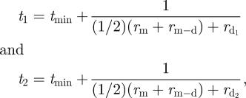
Division time
  A modified rate-based model
  Founder Cells:
  Daughter Cells:

Slide 5

Model
Death Time

Slide 6
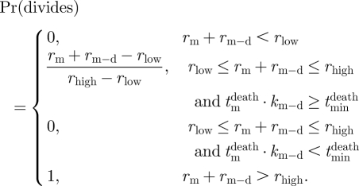
Model
Cell Fate Determination

Slide 7
Cell Division Destiny
Maximum Division Limit/Number
  Decided by the founder cells
    in 45.1% of cases all of the progeny of single founders died in the same division number
    in 90.2% of cases all progeny died within adjacent division rounds.
    probability of 1) or 2) by chance is less than 10⁻¹⁴
    We apply a truncated discrete Normal distribution to decide the division destiny of founder cells.
    divDestiny ~ truncated N(Dμ, Dσ).
Notes:
Given the population data we calculate the probability that, by chance, 8 or more of the 75 founder cells would have all of their progeny die in division 1 and at the same time 13 or more founders would have all of their progeny die in division 2 is 1.6 × 10⁻¹⁴

Slide 8
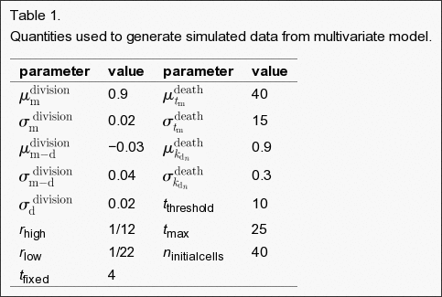
Simulation Parameters

Slide 9
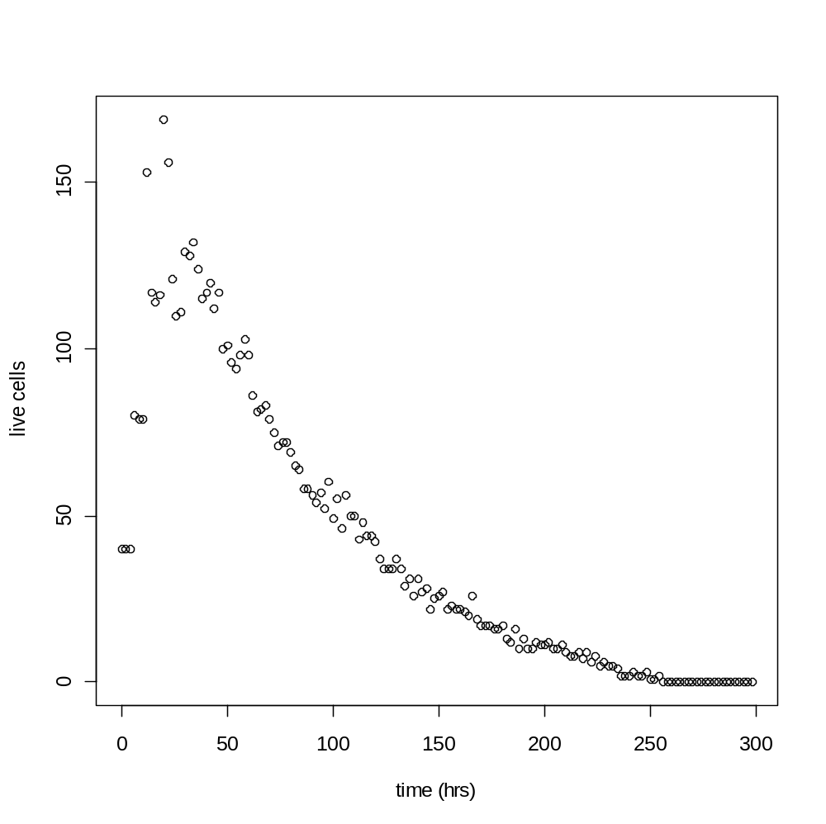
Results
Live Cells

Slide 10
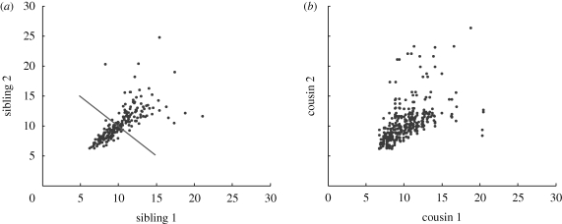
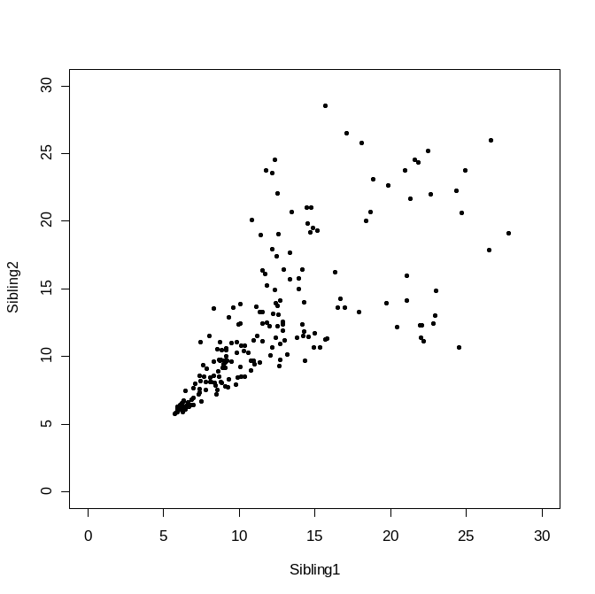
Results
R=0.71
Markham JF, et al. J R Soc Interface. 2010
R=0.72

Slide 11
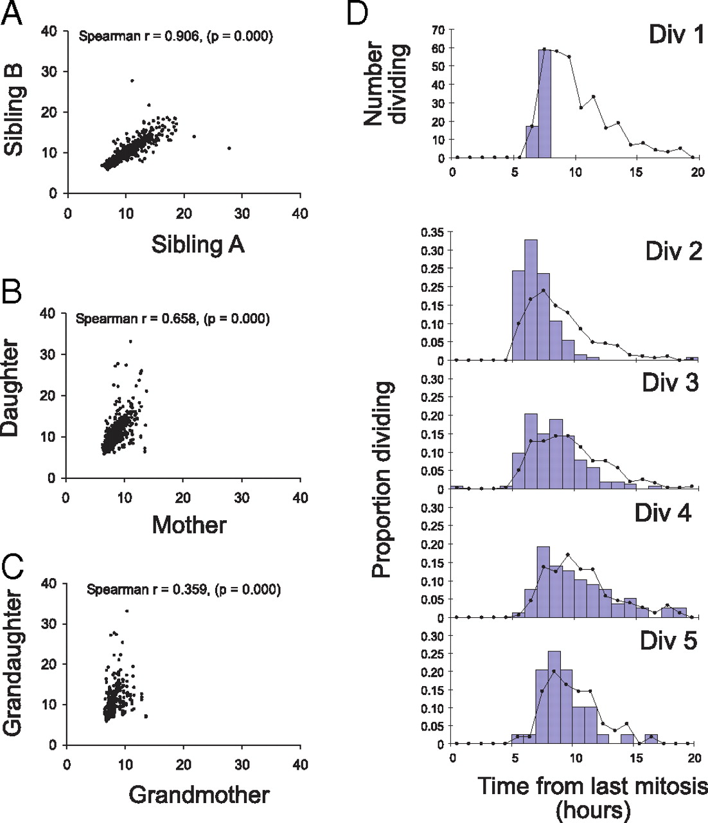
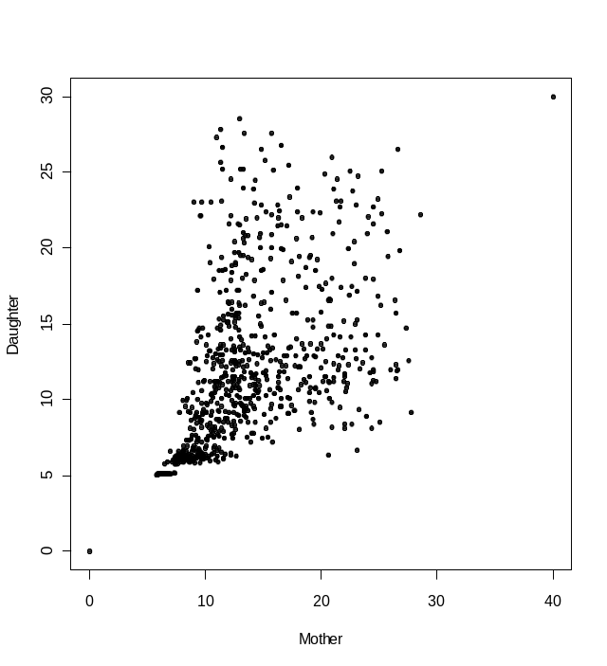
Results
Hawkins E D et al. PNAS 2009;106:13457-13462
R=0.67

Slide 12
Simulation

