Slide 1
Simulating Cell Division – A Minimum Two Heritable Factor Model
Feng Feng
Kepler Lab Meeting
6/21/2011

Slide 2
Cell Division
Germinal Center Reaction
  Clonal expansion, leading to increased number of B cells by many hundred fold.
  Contraction, cessation of expansion and ≈95% of the newly generated cells die by apoptosis
  The coordinated regulation of cell division and death by apoptosis
Notes:
The reason that we are intersted in the cell division is because our contract project we try to simulate the germinal center reaction. The coordinated regulation of cell proliferation and apoptosis is a striking feature of the germinal center reaction as well as other immune responses. During the adaptive response of lymphocytes, after the exposure to pathogens or antigens, the initially resting lymphocytes are stimulated to undergo a rapid clonal expansion, which increase the number of reactive cells many hundred fold. After a period the response peaks, cells stop dividing and reach the contraction phase of the response, and ≈95% of the newly generated cells die by apoptosis. Only a small number of cells survive and become lastlasting memory cells.
after exposure to pathogens
The coordinated regulation of cell proliferation and apoptosis is a striking feature of the adaptive response of lymphocytes after exposure to pathogens. The initially quiescent lymphocytes are stimulated to undergo a series of proliferation cycles that increase the number of reactive cells many hundredfold. After a period the response peaks, cells stop dividing, and ≈95% of the newly generated cells die by apoptosis (1, 2).
During the adaptive immune response, lymphocyte populations undergo a characteristic three-phase process: expansion through a series of cell divisions; cessation of expansion; and, finally, most of the accumulated lymphocytes die by apoptosis.

Slide 3
Model
Literature
  A minimum of two distinct heritable factors are required to explain correlation structures in proliferating lymphocytes. Markham JF, et al. J R Soc Interface. 2010 July 6; 7(48):
  A single-cell pedigree analysis of alternative stochastic lymphocyte fates. E. D. Hawkinsa, J. F. Markhama,b, L. P. McGuinnessa and P. D. Hodgkina. PNAS August 11, 2009 vol. 106 no. 32
  Hawkins ED, Turner ML, Dowling MR, van Gend C, Hodgkin PD (2007) A model of immune regulation as a consequence of randomized lymphocyte division and death times. Proc Natl Acad Sci USA 104:5032–5037
  A G1 rate model accounts for cell-cycle kinetics attributed to 'transition probability'. Laroy N. Castor. Nature. 1980. 287, 857 – 859
  A cellular calculus for signal integration by T cells. Amanda Gett and Philip Hodgkin. Nautrue Immunology. 2000. vol 1 no 3.

Slide 4

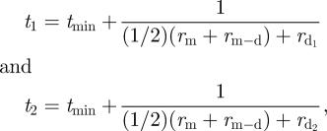
Division time
  A modified rate-based model
  Founder Cells:
  Daughter Cells:

Slide 5
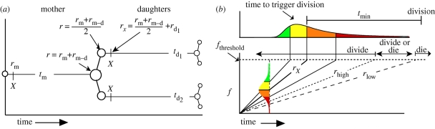
Division Time

Slide 6

Model
Death Time
— Right skewed distribution.
— A trend to decreasing tdie in later generations.
— Correlated tdie for siblings and inheritance as demonstrated by correlation of cousin death times.

Slide 7
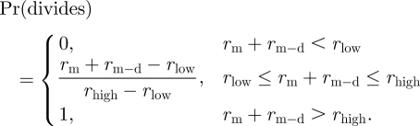
Model
Cell Fate Determination
Notes:
we need to keep in mind the growth data from Hawkins et al. (2009), which suggest that cell fate is determined at, or soon after, cell division. Or at least very early during the life cycle of the cell.
To summarize, if rm + rm−d is more than rhigh, then both siblings divide. If rm + rm−dis less than rlow, then both siblings die. If rm + rm−d is in between rlow and rhigh, then each cell has a stochastic outcome dependent on the value of r that it has associated with it. In this intermediate region, we propose that the probability of division increases linearly with rm + rm−d to effect a smooth transition.

Slide 8
Cell Division Destiny (Progeny Destiny)
Maximum Division Limit/Number
  Decided by the founder cells
    in 45.1% of cases all of the progeny of single founders died in the same division number
    in 90.2% of cases all progeny died within adjacent division rounds.
    probability of 1) or 2) by chance is less than 10⁻¹⁴
    We apply a truncated discrete Normal distribution to decide the division destiny of founder cells.
    divDestiny ~ truncated N(Dμ, Dσ).
Notes:
Given the population data we calculate the probability that, by chance, 8 or more of the 75 founder cells would have all of their progeny die in division 1 and at the same time 13 or more founders would have all of their progeny die in division 2 is 1.6 × 10⁻¹⁴

Slide 9
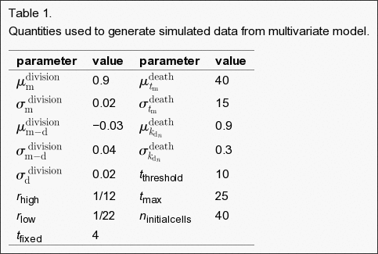
Simulation Parameters

Slide 10
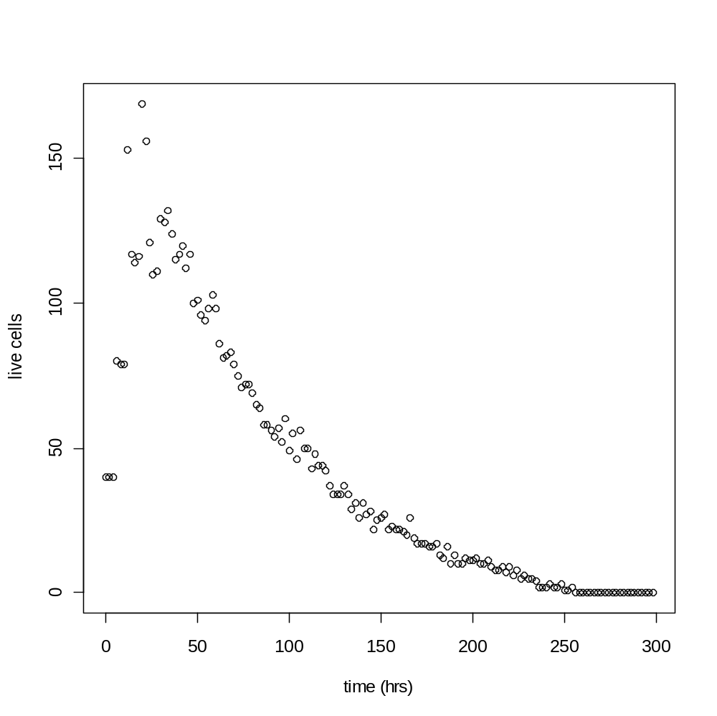
Results
Live Cells

Slide 11
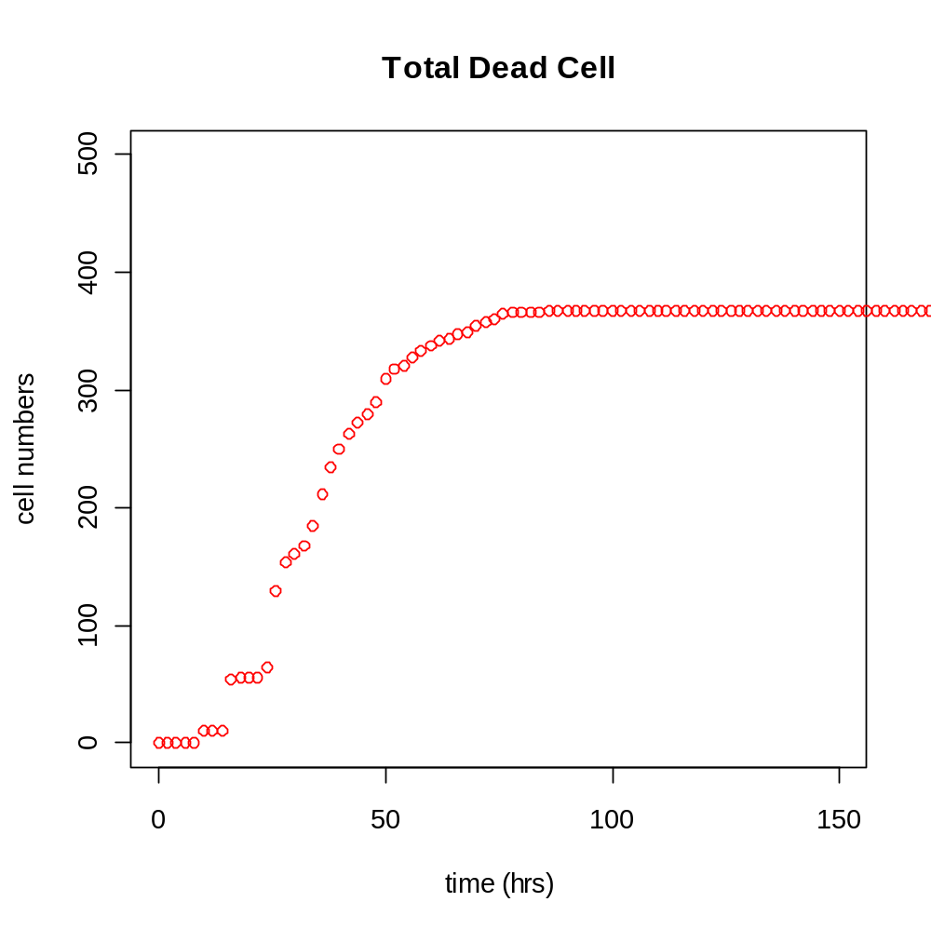
Results
Dead Cells

Slide 12
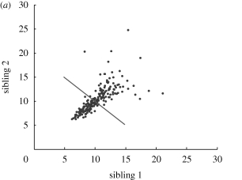
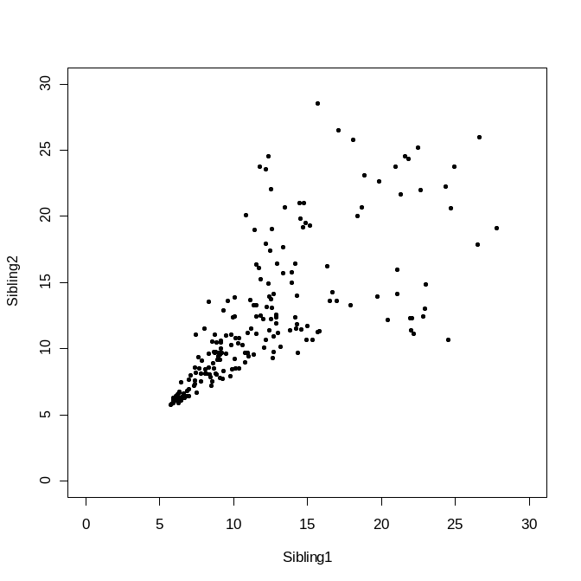
Results
R=0.71
Markham JF, et al. J R Soc Interface. 2010
R=0.72

Slide 13
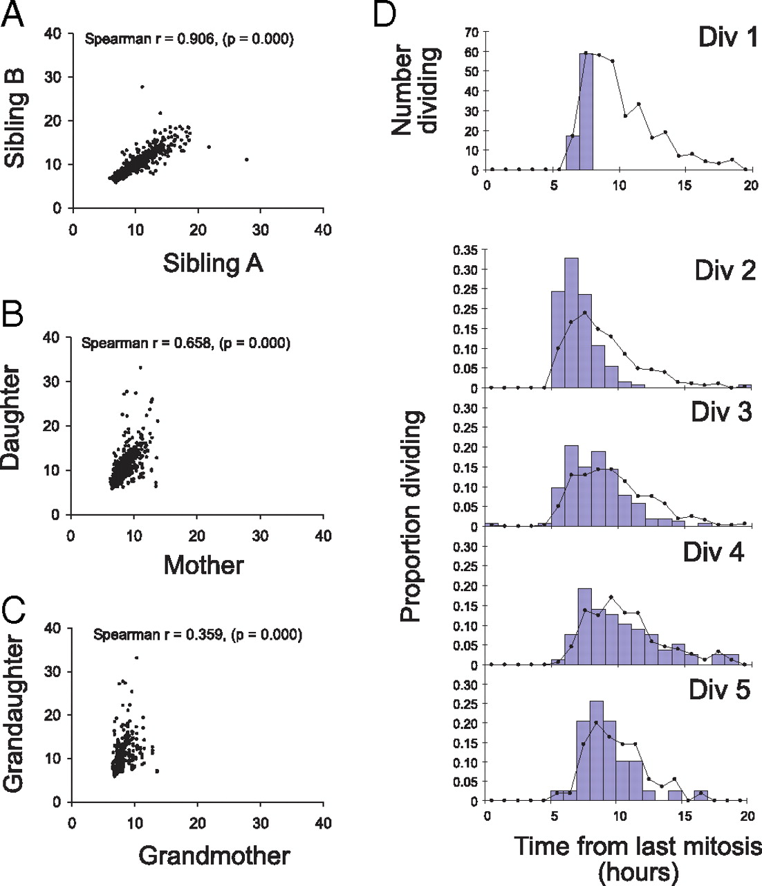
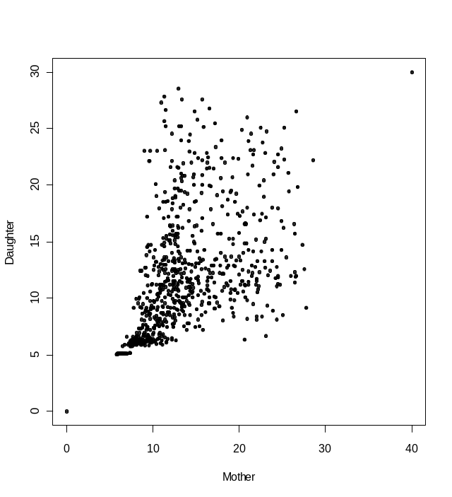
Results
Hawkins E D et al. PNAS 2009;106:13457-13462
R=0.67

Slide 14
Cell Division and Immune Responses
More Simulation Results.

Slide 15
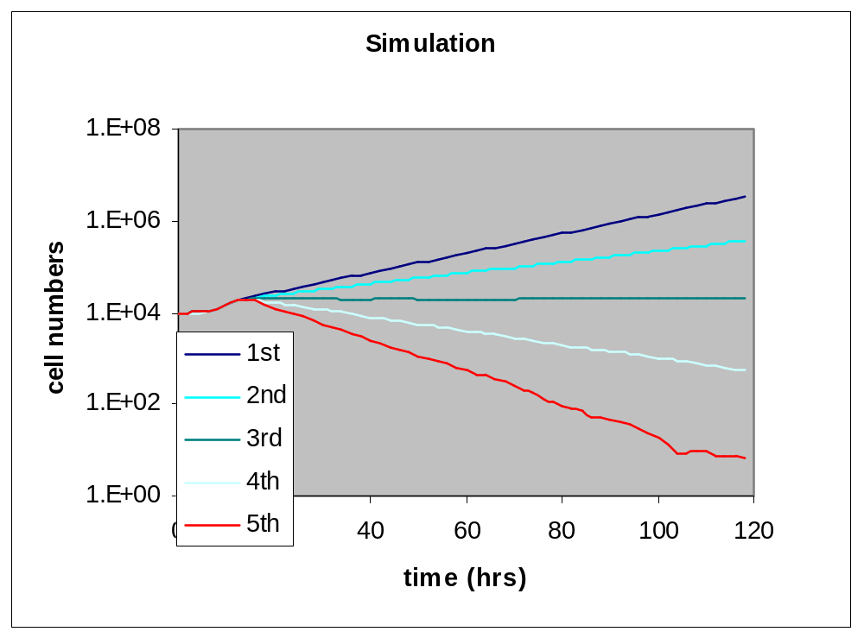
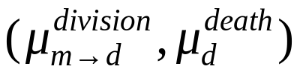
Regulation of immune responses by cell division and death
1st: (0.09, 1.5)
2nd: (0.06, 1.3)
3rd: (0.03, 1.1)
4th: (0.00, 0.9)
5th: (-0.03, 0.7)
Smaller time to division
Bigger time to death
bigger time to division
smaller time to death

Slide 16
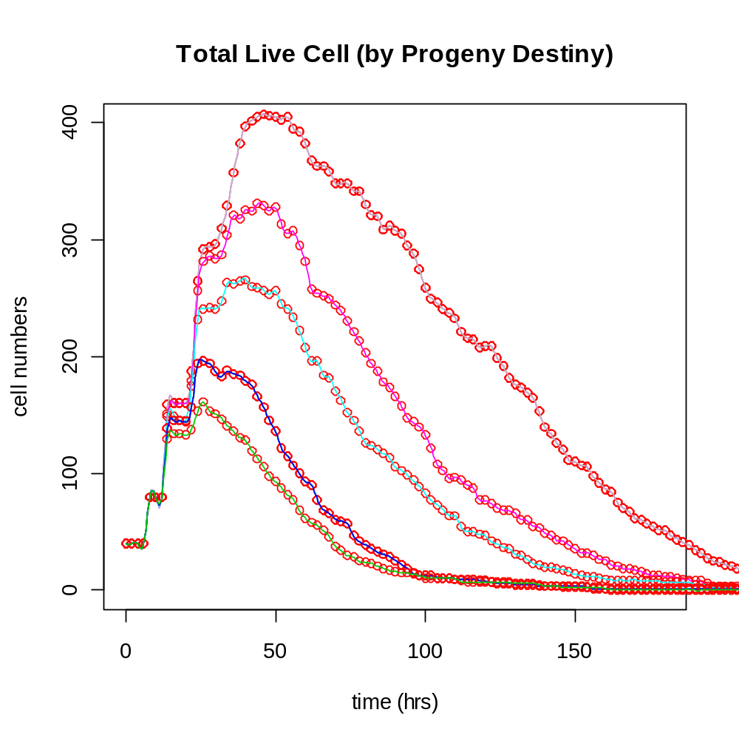
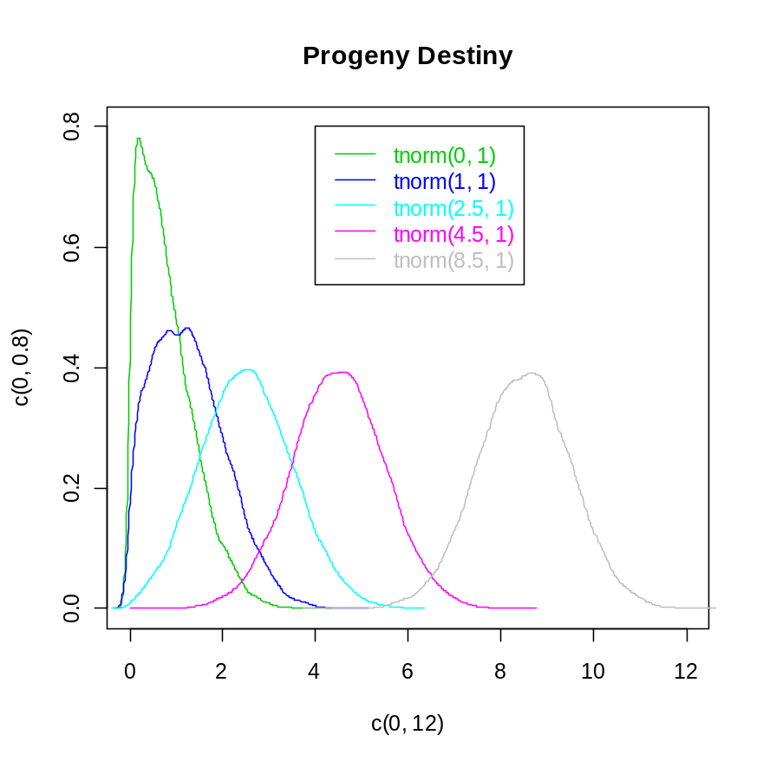
Controlling the number of divisions
    divDestiny ~ truncated N(Dμ, Dσ).

Slide 17
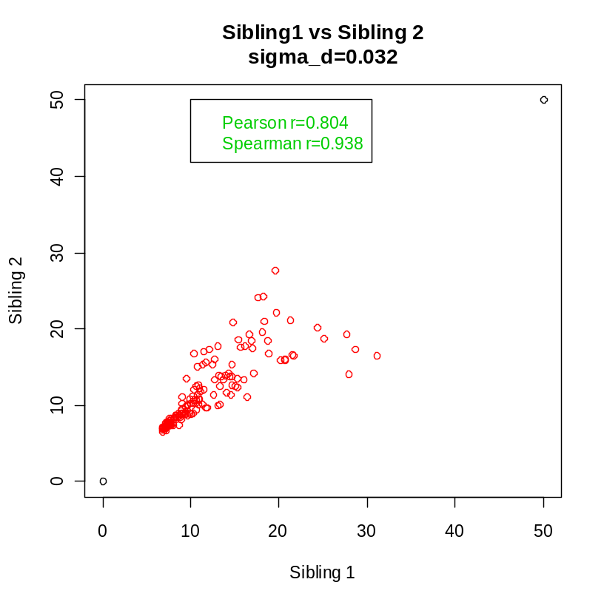
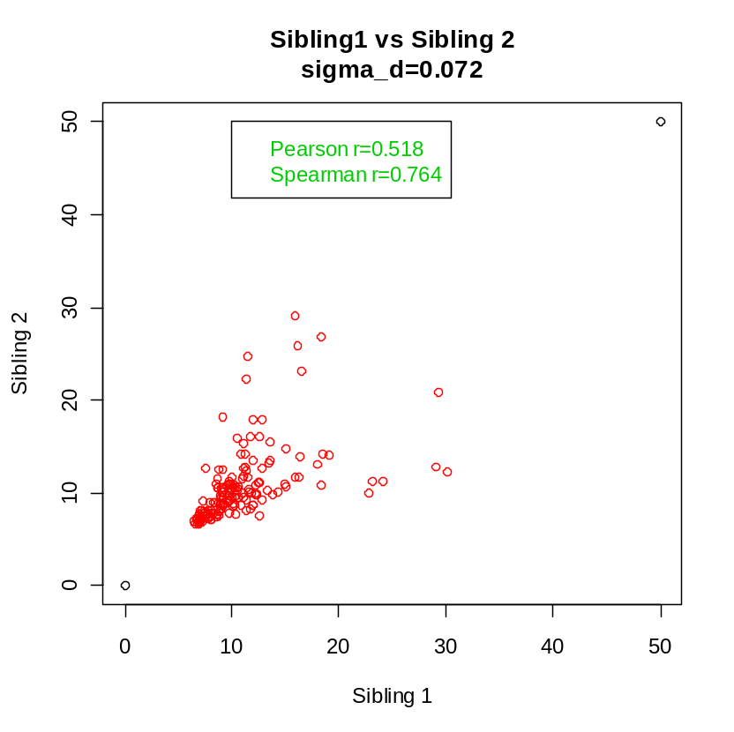
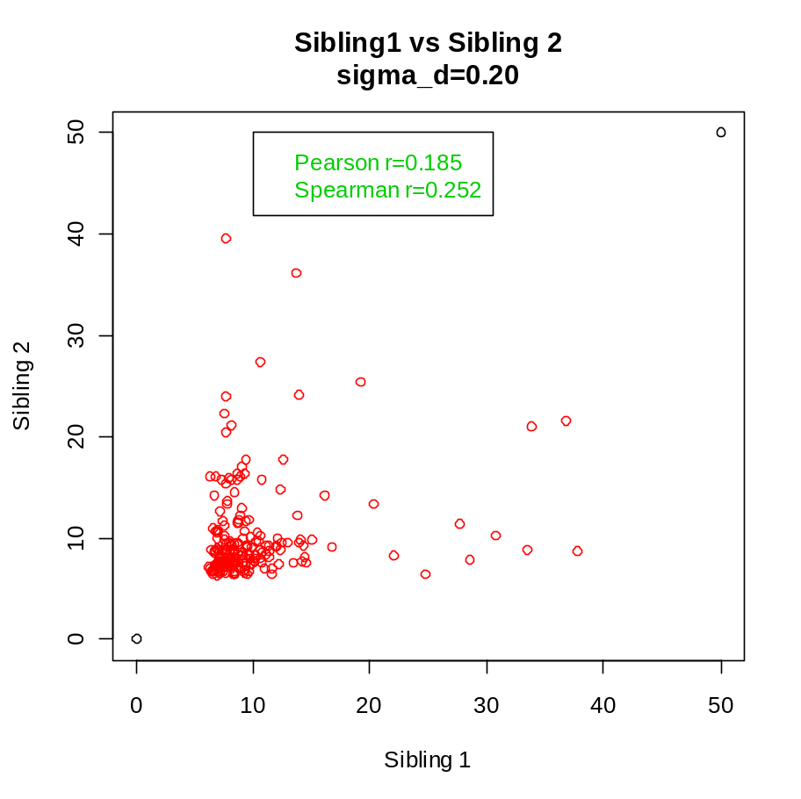

Slide 18
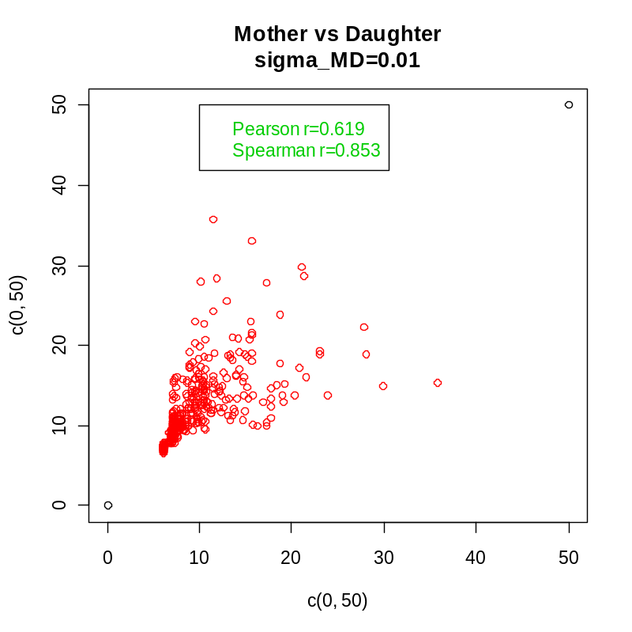
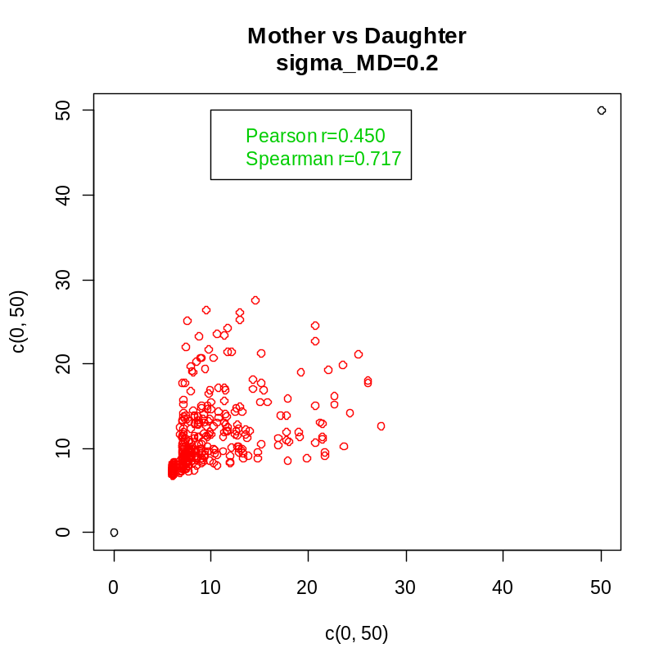
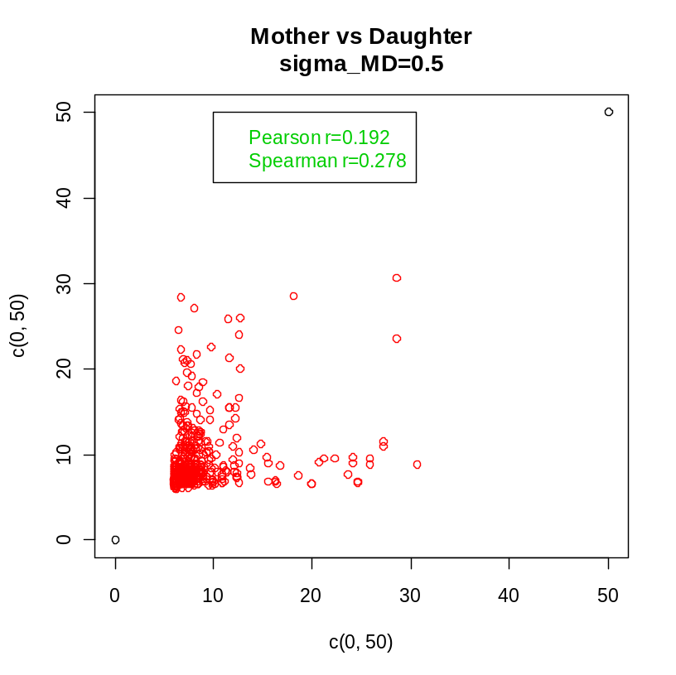

Slide 19
Software application, Plaza Sur – Cell Division Module
Demo

Slide 20
What to do next….
Different cell division model
  e.g. differential equation based cell division model.
Interface in the Plaza Sur to allow user adjust the division parameters.
More pre-defined analysis of cell division.

