Slide 1
Simulating Cell Division – the ODE Model
Feng Feng
Kepler Lab Meeting
11/16/2011

Slide 2
Cell Division
Germinal Center Reaction
  The coordinated regulation of cell division and death by apoptosis
A birth-death dynamical model that combines an intracellular protein abundance dynamical model with a discrete Markov Chain model governed by hazard functions that are themselves functions of the intracellular protein abundances.
Notes:
The reason that we are intersted in the cell division is because our contract project we try to simulate the germinal center reaction. The coordinated regulation of cell proliferation and apoptosis is a striking feature of the germinal center reaction as well as other immune responses. During the adaptive response of lymphocytes, after the exposure to pathogens or antigens, the initially resting lymphocytes are stimulated to undergo a rapid clonal expansion, which increase the number of reactive cells many hundred fold. After a period the response peaks, cells stop dividing and reach the contraction phase of the response, and ≈95% of the newly generated cells die by apoptosis. Only a small number of cells survive and become lastlasting memory cells.
after exposure to pathogens
The coordinated regulation of cell proliferation and apoptosis is a striking feature of the adaptive response of lymphocytes after exposure to pathogens. The initially quiescent lymphocytes are stimulated to undergo a series of proliferation cycles that increase the number of reactive cells many hundredfold. After a period the response peaks, cells stop dividing, and ≈95% of the newly generated cells die by apoptosis (1, 2).
During the adaptive immune response, lymphocyte populations undergo a characteristic three-phase process: expansion through a series of cell divisions; cessation of expansion; and, finally, most of the accumulated lymphocytes die by apoptosis.

Slide 3
Model
Literature
  A minimum of two distinct heritable factors are required to explain correlation structures in proliferating lymphocytes. Markham JF, et al. J R Soc Interface. 2010 July 6; 7(48):
  A single-cell pedigree analysis of alternative stochastic lymphocyte fates. E. D. Hawkinsa, J. F. Markhama,b, L. P. McGuinnessa and P. D. Hodgkina. PNAS August 11, 2009 vol. 106 no. 32
  Hawkins ED, Turner ML, Dowling MR, van Gend C, Hodgkin PD (2007) A model of immune regulation as a consequence of randomized lymphocyte division and death times. Proc Natl Acad Sci USA 104:5032–5037
  A G1 rate model accounts for cell-cycle kinetics attributed to 'transition probability'. Laroy N. Castor. Nature. 1980. 287, 857 – 859
  A cellular calculus for signal integration by T cells. Amanda Gett and Philip Hodgkin. Nautrue Immunology. 2000. vol 1 no 3.
  Predicative modeling of the microbial lag phase. Swinnen, IAM, et al. International Journal of Food Microbiology. 2004. vol 94. 137

Slide 4


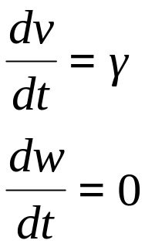

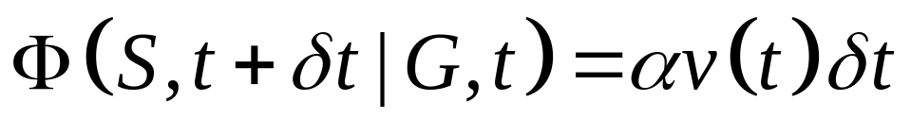
ODE Model
Simplified case: two states referred to and , and two control proteins v and w.
  In state G,
  the probability of is proportional to v
Notes:
ODE model with more meaningful biological explanations

Slide 5
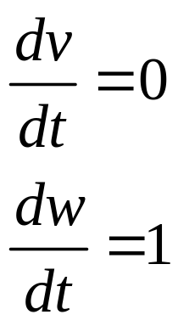

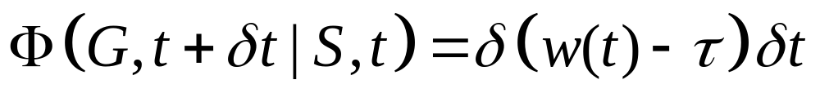
ODE Model
  In state S
  For the transition, suppose that the transition is much sharper,
    v is cut in half as the corresponding protein is divided to the two daughter.

Slide 6

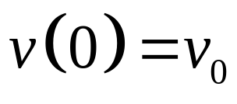


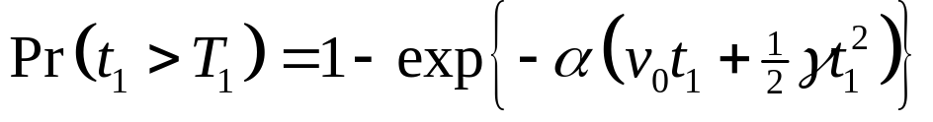
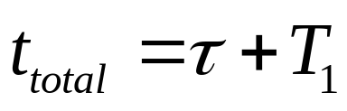
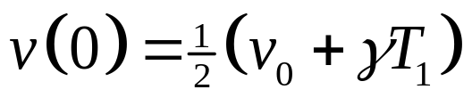
ODE Model
  Suppose the initial value of is . Then , the time to the transition,
  the total time is
  At the beginning of the next cell cycle (resetting the clock to ), we have .

Slide 7
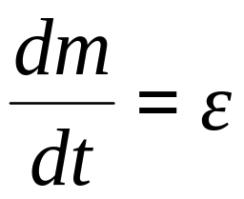


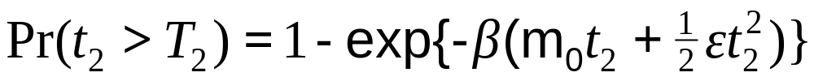
ODE Model – Death Time
Death event
  Protein m
  Probablity of
  Then T₂ the time to the ,

Slide 8
Cell Fate Determination
Experimental evidence
  Division and Death are independent
(Hawkins, PNAS, 2007)
Cell Fate Determination
  The two timed processes within the cell are unaware of each other
  Whichever cellular outcome is reached first determines the fate of the cell.
Notes:
we need to keep in mind the growth data from Hawkins et al. (2009), which suggest that cell fate is determined at, or soon after, cell division. Or at least very early during the life cycle of the cell.
To summarize, if rm + rm−d is more than rhigh, then both siblings divide. If rm + rm−dis less than rlow, then both siblings die. If rm + rm−d is in between rlow and rhigh, then each cell has a stochastic outcome dependent on the value of r that it has associated with it. In this intermediate region, we propose that the probability of division increases linearly with rm + rm−d to effect a smooth transition.

Slide 9
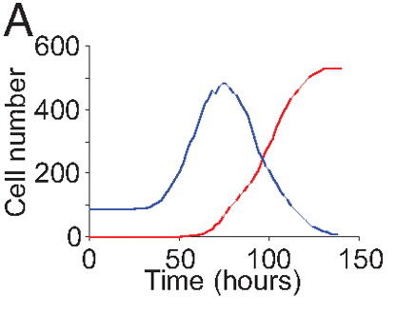
Parameters Estimation
Bayesian Approach
  MCMC and Metropolis-Hasting Algorithm
  Division, α,γ; cell death,β,ε
Experimental data
(Hawkins, PNAS, 2009)
Notes:
we need to keep in mind the growth data from Hawkins et al. (2009), which suggest that cell fate is determined at, or soon after, cell division. Or at least very early during the life cycle of the cell.
To summarize, if rm + rm−d is more than rhigh, then both siblings divide. If rm + rm−dis less than rlow, then both siblings die. If rm + rm−d is in between rlow and rhigh, then each cell has a stochastic outcome dependent on the value of r that it has associated with it. In this intermediate region, we propose that the probability of division increases linearly with rm + rm−d to effect a smooth transition.

Slide 10
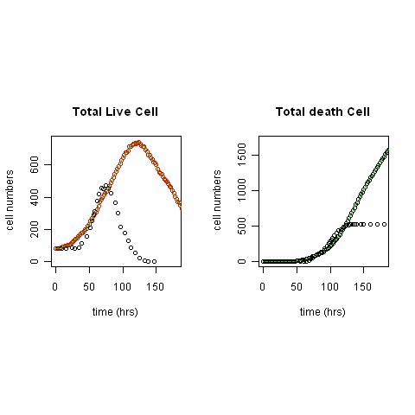
Simulation – First Try
Division Destiny
  Maximum generation number
Notes:
we need to keep in mind the growth data from Hawkins et al. (2009), which suggest that cell fate is determined at, or soon after, cell division. Or at least very early during the life cycle of the cell.
To summarize, if rm + rm−d is more than rhigh, then both siblings divide. If rm + rm−dis less than rlow, then both siblings die. If rm + rm−d is in between rlow and rhigh, then each cell has a stochastic outcome dependent on the value of r that it has associated with it. In this intermediate region, we propose that the probability of division increases linearly with rm + rm−d to effect a smooth transition.

Slide 11
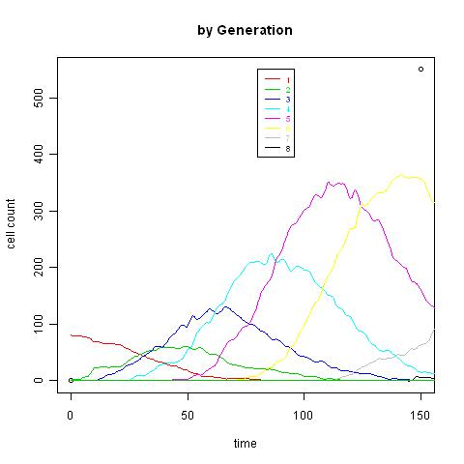

Slide 12
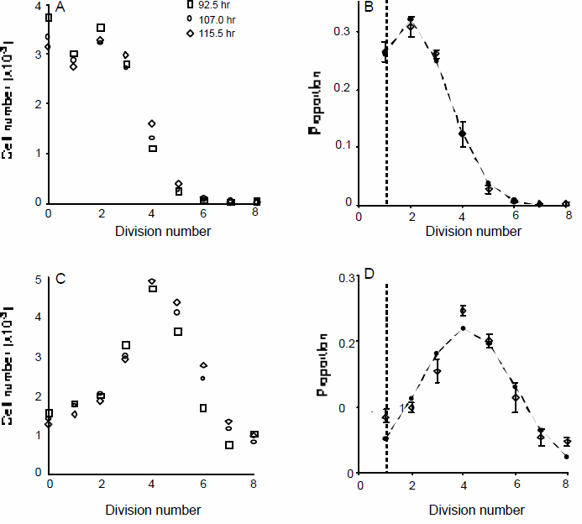
Cell Division Destiny (Maximum Division Limit/Number)
(Hawkins, PNAS, 2007)
Notes:
Given the population data we calculate the probability that, by chance, 8 or more of the 75 founder cells would have all of their progeny die in division 1 and at the same time 13 or more founders would have all of their progeny die in division 2 is 1.6 × 10⁻¹⁴

Slide 13
Cell Division Destiny (Progeny Destiny)
Maximum Division Limit/Number
  Decided by the founder cells
    in 45.1% of cases all of the progeny of single founders died in the same division number
    in 90.2% of cases all progeny died within adjacent division rounds.
    probability of 1) or 2) by chance is less than 10⁻¹⁴
    We apply a truncated discrete Normal distribution to decide the division destiny of founder cells.
Notes:
Given the population data we calculate the probability that, by chance, 8 or more of the 75 founder cells would have all of their progeny die in division 1 and at the same time 13 or more founders would have all of their progeny die in division 2 is 1.6 × 10⁻¹⁴

Slide 14
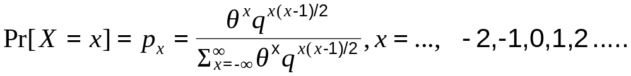
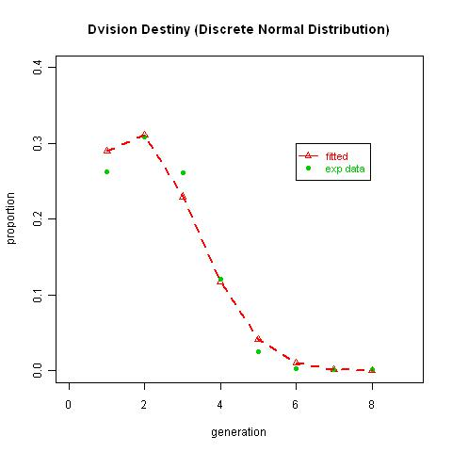
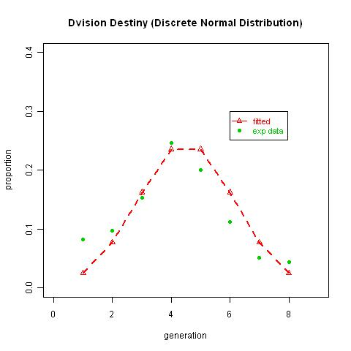
Modeling Division Destiny
Discrete Normal Distribution
Parameter estimation for division destiny
  MCMC and MH algorithm
Notes:
we need to keep in mind the growth data from Hawkins et al. (2009), which suggest that cell fate is determined at, or soon after, cell division. Or at least very early during the life cycle of the cell.
To summarize, if rm + rm−d is more than rhigh, then both siblings divide. If rm + rm−dis less than rlow, then both siblings die. If rm + rm−d is in between rlow and rhigh, then each cell has a stochastic outcome dependent on the value of r that it has associated with it. In this intermediate region, we propose that the probability of division increases linearly with rm + rm−d to effect a smooth transition.

Slide 15
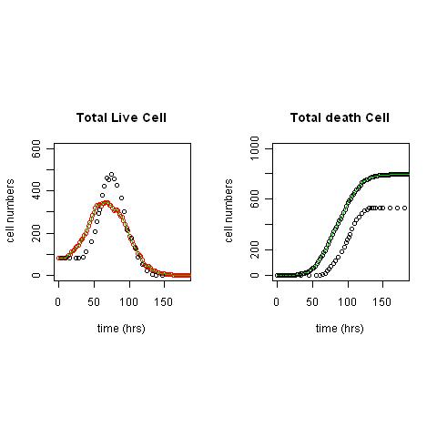
Simulation – Second Try
Bayesian Approach:MCMC and Metropolis-Hasting Algorithm
  Division, α,γ; cell death,β,ε
  Division destiny, θ and q for
Notes:
we need to keep in mind the growth data from Hawkins et al. (2009), which suggest that cell fate is determined at, or soon after, cell division. Or at least very early during the life cycle of the cell.
To summarize, if rm + rm−d is more than rhigh, then both siblings divide. If rm + rm−dis less than rlow, then both siblings die. If rm + rm−d is in between rlow and rhigh, then each cell has a stochastic outcome dependent on the value of r that it has associated with it. In this intermediate region, we propose that the probability of division increases linearly with rm + rm−d to effect a smooth transition.

Slide 16
Simulation
Notes:
we need to keep in mind the growth data from Hawkins et al. (2009), which suggest that cell fate is determined at, or soon after, cell division. Or at least very early during the life cycle of the cell.
To summarize, if rm + rm−d is more than rhigh, then both siblings divide. If rm + rm−dis less than rlow, then both siblings die. If rm + rm−d is in between rlow and rhigh, then each cell has a stochastic outcome dependent on the value of r that it has associated with it. In this intermediate region, we propose that the probability of division increases linearly with rm + rm−d to effect a smooth transition.

Slide 17
ODE Model with a Lag Phase
Lag, a phenomenon inherent to microbial kinetics
  “A delayed response of the microbial population to a sudden change in the environment”
  “An adjustment period during which bacterial cells modify themselves in order to initiate exponential growth
  (Swinnen, International J Food Microbiol,2004)

Slide 18
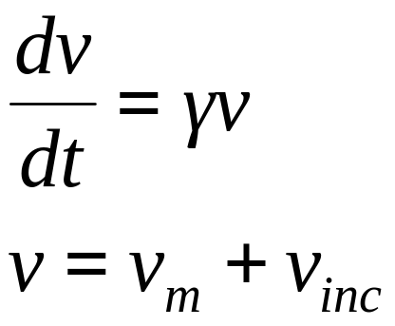
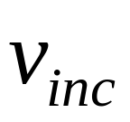

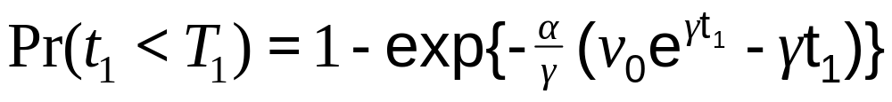
ODE Model with a Lag
  In state G
  For the transition, suppose that the transition is proportional to , instead of the total
  The time to the transition, T₁ , follows

Slide 19

Simulation – Third Try
Notes:
we need to keep in mind the growth data from Hawkins et al. (2009), which suggest that cell fate is determined at, or soon after, cell division. Or at least very early during the life cycle of the cell.
To summarize, if rm + rm−d is more than rhigh, then both siblings divide. If rm + rm−dis less than rlow, then both siblings die. If rm + rm−d is in between rlow and rhigh, then each cell has a stochastic outcome dependent on the value of r that it has associated with it. In this intermediate region, we propose that the probability of division increases linearly with rm + rm−d to effect a smooth transition.

Slide 20
What to do next………
Division destiny correlation between siblings
Division time correlation between siblings

Slide 21
Acknowledgement
Tom Kepler

