Slide 1
Image & Video Compression
Conferencing & Internet Video
Portland State University
Sharif University of Technology

Slide 2
Objectives
The student should be able to:
Describe the basic components of the H.263 video codec and how it differs from H.261.
Describe and understand the improvements of H.263+ over H.263.
Understand enough about Internet and WWW protocols to see how they affect video.
Understand the basics of streaming video over the Internet as well as error resiliency and concealment techniques.

Slide 3
Outline
Section 1: Conferencing Video
Section 2: Internet Review
Section 3: Internet Video

Slide 4
Section 1: Conferencing Video
Video Compression Review
Chronology of Video Standards
The Input Video Format
H.263 Overview
H.263+ Overview

Slide 5
Video Compression Review

Slide 6
Garden Variety Video Coder
Video Compression Review
Motion
Estimation
&
Compensation
Transform,
Quantization, Zig-
Zag Scan & Run-
Length Encoding
Symbol
Encoder
Frames of
Digital Video
Bit Stream
Video codecs have three
main functional blocks

Slide 7
Symbol Encoding
Video Compression Review
Motion
Estimation
&
Compensation
Transform,
Quantization, Zig-
Zag Scan & Run-
Length Encoding
Symbol
Encoder
Frames of
Digital Video
Bit Stream
The symbol encoder exploits the statistical properties of its input by using shorter code words for more common symbols.
Examples: Huffman & Arithmetic Coding

Slide 8
Symbol Encoding
Video Compression Review
Motion
Estimation
&
Compensation
Transform,
Quantization, Zig-
Zag Scan & Run-
Length Encoding
Symbol
Encoder
Frames of
Digital Video
Bit Stream
This block is the basis for most lossless image coders (in conjunction with DPCM, etc.)

Slide 9
Transform & Quantization
Video Compression Review
Motion
Estimation
&
Compensation
Transform,
Quantization, Zig-
Zag Scan & Run-
Length Encoding
Symbol
Encoder
Frames of
Digital Video
Bit Stream
A transform (usually DCT) is applied to the input data for better energy compaction which decreases the entropy and improves the performance of the symbol encoder.

Slide 10
Transform & Quantization
Video Compression Review
Motion
Estimation
&
Compensation
Transform,
Quantization, Zig-
Zag Scan & Run-
Length Encoding
Symbol
Encoder
Frames of
Digital Video
Bit Stream
The DCT also decomposes the input into its frequency components so that perceptual properties can be exploited. For example, we can throw away high frequency content first.

Slide 11
Transform & Quantization
Video Compression Review
Motion
Estimation
&
Compensation
Transform,
Quantization, Zig-
Zag Scan & Run-
Length Encoding
Symbol
Encoder
Frames of
Digital Video
Bit Stream
Quantization lets us reduce the representation size of each symbol, improving compression but at the expense of added errors. It’s the main tuning knob for controlling data rate.

Slide 12
Transform & Quantization
Video Compression Review
Motion
Estimation
&
Compensation
Transform,
Quantization, Zig-
Zag Scan & Run-
Length Encoding
Symbol
Encoder
Frames of
Digital Video
Bit Stream
Zig-zag scanning and run-length encoding orders the data into 1-D arrays and replaces long runs of zeros with run-length symbols.

Slide 13
Still Image Compression
Video Compression Review
Motion
Estimation
&
Compensation
Transform,
Quantization, Zig-
Zag Scan & Run-
Length Encoding
Symbol
Encoder
Frames of
Digital Video
Bit Stream
These two components form the basis for many still image compression algorithms such as JPEG, PhotoCD, M-JPEG and DV.

Slide 14
Motion Estimation/Compensation
Video Compression Review
Motion
Estimation
&
Compensation
Transform,
Quantization, Zig-
Zag Scan & Run-
Length Encoding
Symbol
Encoder
Frames of
Digital Video
Bit Stream
Finally, because video is a sequence of pictures with high temporal correlation, we add motion estimation/compensation to try to predict as much of the current frame as possible from the previous frame.

Slide 15
Motion Estimation/Compensation
Video Compression Review
Motion
Estimation
&
Compensation
Transform,
Quantization, Zig-
Zag Scan & Run-
Length Encoding
Symbol
Encoder
Frames of
Digital Video
Bit Stream
Most common method is to predict each block in the current frame by a (possibly translated) block of the previous frame.

Slide 16
Garden Variety Video Coder
Video Compression Review
Motion
Estimation
&
Compensation
Transform,
Quantization, Zig-
Zag Scan & Run-
Length Encoding
Symbol
Encoder
Frames of
Digital Video
Bit Stream
These three components form the basis for most of the standard video compression algorithms: MPEG-1, -2, & -4, H.261, H.263, H.263+.

Slide 17
Section 1: Conferencing Video
Video Compression Review
The Input Video Format
H.263 Overview
H.263+ Overview
Chronology of Video Standards

Slide 18
Chronology of Video Standards
H.261
H.263
H.263++
ITU-T
H.263+
H.263L
MPEG 1
MPEG 4
ISO
MPEG 2
MPEG 7
1990
1992
1994
1996
1998
2000
2002

Slide 19
Chronology of Video Standards
(1990) H.261, ITU-T
  Designed to work at multiples of 64 kb/s (px64).
  Operates on standard frame sizes CIF, QCIF.
(1992) MPEG-1, ISO “Storage & Retrieval of Audio & Video”
  Evolution of H.261.
  Main application is CD-ROM based video (~1.5 Mb/s).

Slide 20
Chronology continued
(1994-5) MPEG-2, ISO “Digital Television”
  Evolution of MPEG-1.
  Main application is video broadcast (DirecTV, DVD, HDTV).
  Typically operates at data rates of 2-3 Mb/s and above.

Slide 21
Chronology continued
(1996) H.263, ITU-T
  Evolution of all of the above.
  Supports more standard frame sizes (SQCIF, QCIF, CIF, 4CIF, 16CIF).
  Targeted low bit rate video <64 kb/s. Works well at high rates, too.
(1/98) H.263 Ver. 2 (H.263+), ITU-T
  Additional negotiable options for H.263.
  New features include: deblocking filter, scalability, slicing for network packetization and local decode, square pixel support, arbitrary frame size, chromakey transparency, etc…

Slide 22
Chronology continued
(1/99) MPEG-4, ISO “Multimedia Applications”
  MPEG4 video based on H.263, similar to H.263+
  Adds more sophisticated binary and multi-bit transparency support.
  Support for multi-layered, non-rectangular video display.
(2H/’00) H.263++ (H.263V3), ITU-T
  Tentative work item.
  Addition of features to H.263.
  Maintain backward compatibility with H.263 V.1.

Slide 23
Chronology continued
(2001) MPEG7, ISO “Content Representation for Info Search”
  Specify a standardized description of various types of multimedia information. This description shall be associated with the content itself, to allow fast and efficient searching for material that is of a user’s interest.
(2002) H.263L, ITU-T
  Call for Proposals, early ‘98.
  Proposals reviewed through 11/98, decision to proceed.
  Determined in 2001

Slide 24
Section 1: Conferencing Video
Video Compression Review
Chronology of Video Standards
H.263 Overview
H.263+ Overview
The Input Video Format

Slide 25
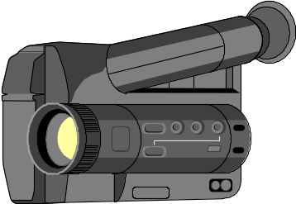
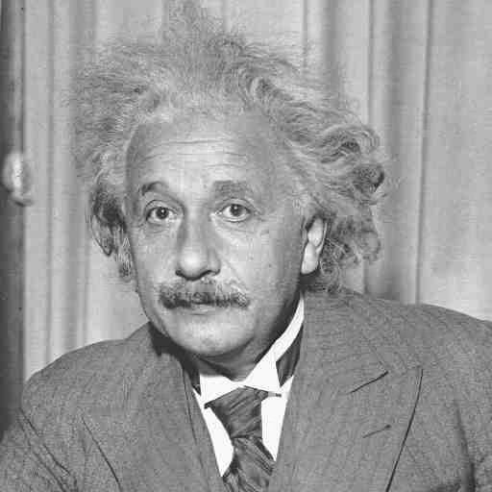
Video Format for Conferencing
Input Format
Input color format is YCbCr (a.k.a. YUV). Y is the luminance component, U & V are chrominance (color difference) components.
Chrominance is subsampled by two in each direction.
Input frame size is based on the Common Intermediate Format (CIF) which is 352x288 pixels for luminance and 176x144 for each of the chrominance components.
Y
=
Cr
Cb

Slide 26
YCbCr (YUV) Color Space
Input Format
Defined as input color space to H.263, H.263+, H.261, MPEG, etc.
It’s a 3x3 transformation from RGB.
Y
Cb
Cr
0.299 0.587 0.114
-0.169 -0.331 0.500
0.500 -0.419 -0.081
R
G
B
=
Y represents the luminance of a pixel.
Cr, Cb represents the color difference or chrominance of a pixel.

Slide 27

Subsampled Chrominance
Input Format
The human eye is more sensitive to spatial detail in luminance than in chrominance.
Hence, it doesn’t make sense to have as many pixels in the chrominance planes.

Slide 28
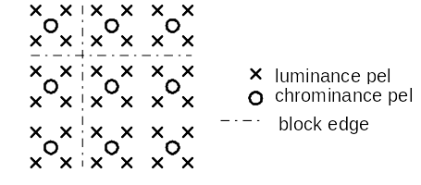
Spatial relation between luma and chroma pels for CIF 4:2:0
Input Format
Different than
MPEG-2 4:2:0

Slide 29
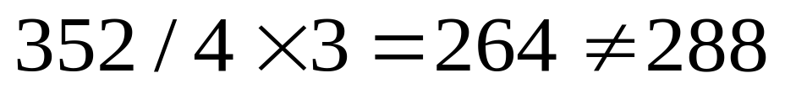
Common Intermediate Format
Input Format
The input video format is based on Common Intermediate Format or CIF.
It is called Common Intermediate Format because it is derivable from both 525 line/60 Hz (NTSC) and 625 line/50 Hz (PAL) video signals.
CIF is defined as 352 pels per line and 288 lines per frame.
The picture area for CIF is defined to have an aspect ratio of about 4:3 . However,

Slide 30
Picture & Pixel Aspect Ratios
Input Format
Pixels are not square in CIF.
288
Pixel
12:11
352
Picture
4:3

Slide 31
Picture & Pixel Aspect Ratios
Input Format
Hence on a square pixel display such as a computer screen, the video will look slightly compressed horizontally. The solution is to spatially resample the video frames to be
384 x 288 or 352 x 264
This corresponds to a 4:3 aspect ratio for the picture area on a square pixel display.

Slide 32
Blocks and Macroblocks
Input Format
The luma and chroma planes are divided into 8x8 pixel blocks. Every four luma blocks are associated with a corresponding Cb and Cr block to create a macroblock.
macroblock
Cb
Cr
Y
8x8 pixel blocks

Slide 33
Section 1: Conferencing Video
Video Compression Review
Chronology of Video Standards
The Input Video Format
H.263+ Overview
H.263 Overview

Slide 34
ITU-T Recommendation
H.263

Slide 35
ITU-T Recommendation H.263
H.263 targets low data rates (< 28 kb/s). For example it can compress QCIF video to 10-15 fps at 20 kb/s.
For the first time there is a standard video codec that can be used for video conferencing over normal phone lines (H.324).
H.263 is also used in ISDN-based VC (H.320) and network/Internet VC (H.323).

Slide 36
ITU-T Recommendation H.263
Composed of a baseline plus
four negotiable options
Baseline Codec
Unrestricted/Extended Motion Vector Mode
Advanced Prediction Mode
PB Frames Mode
Syntax-based Arithmetic
Coding Mode

Slide 37
Frame Formats
H.263 Baseline
Always 12:11 pixel aspect ratio.

Slide 38
Picture & Macroblock Types
H.263 Baseline
Two picture types:
  INTRA (I-frame) implies no temporal prediction is performed.
  INTER (P-frame) may employ temporal prediction.
Macroblock (MB) types:
  INTRA & INTER MB types (even in P-frames).
    INTER MBs have shorter symbols in P frames
    INTRA MBs have shorter symbols in I frames
  Not coded - MB data is copied from previous decoded frame.

Slide 39
Motion Vectors
H.263 Baseline
Motion vectors have 1/2 pixel granularity. Reference frames must be interpolated by two.
MV’s are not coded directly, but rather a median predictor is used.
The predictor residual is then coded using a VLC table.
B
C
A
X

Slide 40
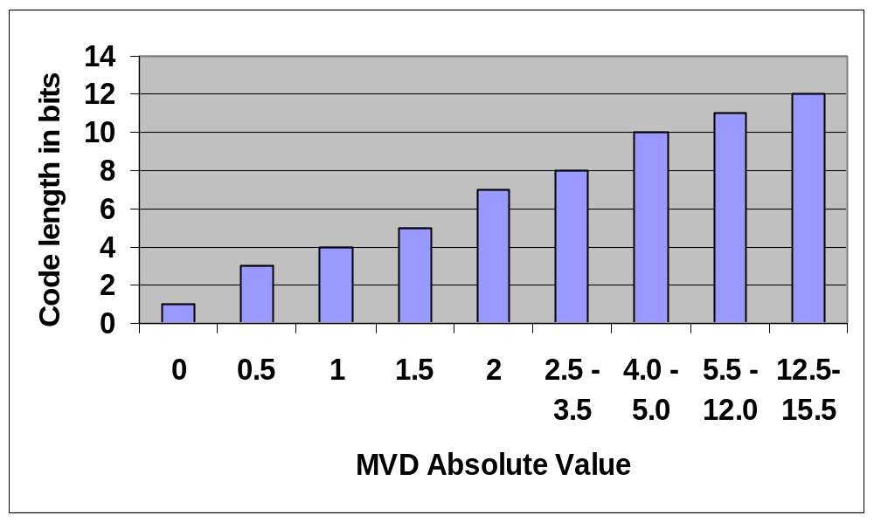
Motion Vector Delta (MVD) Symbol Lengths
H.263 Baseline

Slide 41
Transform Coefficient Coding
H.263 Baseline
Assign a variable length code according to three parameters (3-D VLC):
  - Length of the run of zeros preceding the current nonzero coefficient.
  - Amplitude of the current coefficient.
  - Indication of whether current coefficient is the last one in the block.
  - The most common are variable length coded (3-13 bits), the rest are coded with escape sequences (22 bits)

Slide 42
Quantization
H.263 Baseline
H.263 uses a scalar quantizer with center clipping.
Quantizer varies from 2 to 62, by 2’s.
Can be varied ±1, ±2 at macroblock boundaries (2 bits), or 2-62 at row and picture boundaries (5 bits).
out
2Q
Q
in
-Q
-2Q

Slide 43
Bit Stream Syntax
H.263 Baseline
Hierarchy of three layers.
Picture Layer
GOB* Layer
MB Layer
*A GOB is usually a row of macroblocks, except
for frame sizes greater than CIF.
...
Picture Hdr
GOB Hdr
MB
MB
...
GOB Hdr

Slide 44
Picture Layer Concepts
H.263 Baseline
Picture Start
Code
Temporal
Reference
Picture
Type
Picture
Quant
PSC - sequence of bits that can not be emulated anywhere else in the bit stream.
TR - 29.97 Hz counter indicating time reference for a picture.
PType - Denotes INTRA, INTER-coded, etc.
P-Quant - Indicates which quantizer (2…62) is used initially for the picture.

Slide 45
GOB Layer Concepts
GOB Headers are Optional
H.263 Baseline
GOB Start
Code
GOB
Number
GOB
Quant
GSC - Another unique start code (17 bits).
GOB Number - Indicates which GOB, counting vertically from the top (5 bits).
GOB Quant - Indicates which quantizer (2…62) is used for this GOB (5 bits).
GOB can be decoded independently from the
rest of the frame.

Slide 46
Macroblock Layer Concepts
H.263 Baseline
Coded
Flag
MB
Type
Code Block
Pattern
DQuant
MV
Deltas
Transform
Coefficients
COD - if set, indicates empty INTER MB.
MB Type - indicates INTER, INTRA, whether MV is present, etc.
CBP - indicates which blocks, if any, are empty.
DQuant - indicates a quantizer change by +/- 2, 4.
MV Deltas - are the MV prediction residuals.
Transform coefficients - are the 3-D VLC’s for the coefficients.

Slide 47
Unrestricted/Extended Motion Vector Mode
H.263 Options
Motion vectors are permitted to point outside the picture boundaries.
  non-existent pixels are created by replicating the edge pixels.
  improves compression when there is movement across the edge of a picture boundary or when there is camera panning.
Also possible to extend the range of the motion vectors from [-16,15.5] to [-31.5,31.5] with some restrictions. This better addresses high motion scenes.

Slide 48
Motion Vectors Over
Picture Boundaries
H.263 Options
Edge pixels
are repeated.
Reference Frame N-1
Target Frame N

Slide 49
Extended MV Range
H.263 Options
15.5
(31.5,31.5)
15.5
-16
15.5
Extended motion
vector range, [-16,15.5]
around MV predictor.
-16
-16
15.5
-16
Base motion vector range.

Slide 50
Advanced Prediction Mode
H.263 Options
Includes motion vectors across picture boundaries from the previous mode.
Option of using four motion vectors for 8x8 blocks instead of one motion vector for 16x16 blocks as in baseline.
Overlapped motion compensation to reduce blocking artifacts.

Slide 51
Overlapped Motion Compensation
H.263 Options
In normal motion compensation, the current block is composed of
  the predicted block from the previous frame (referenced by the motion vectors), plus
  the residual data transmitted in the bit stream for the current block.
In overlapped motion compensation, the prediction is a weighted sum of three predictions.

Slide 52
Overlapped Motion Compensation
H.263 Options
Let (m, n) be the column & row indices of an 8×8 pixel block in a frame.
Let (i, j) be the column & row indices of a pixel within an 8×8 block.
Let (x, y) be the column & row indices of a pixel within the entire frame so that:
  (x, y) = (m×8 + i, n×8 + j)

Slide 53
Overlapped Motion Comp.
H.263 Options
Let (MV⁰_{x},MV⁰_{y}) denote the motion vectors for the current block.
Let (MV¹_{x},MV¹_{y}) denote the motion vectors for the block above (below) if the current pixel is in the top (bottom) half of the current block.
Let (MV²_{x},MV²_{y}) denote the motion vectors for the block to the left (right) if the current pixel is in the left (right) half of the current block.
MV⁰
MV¹
MV¹
MV²
MV²

Slide 54
Overlapped Motion Comp.
H.263 Options
Then the summed, weighted prediction is denoted:
P(x,y) =
(q(x,y) H₀(i,j) + r(x,y) H₁(i,j) + s(x,y) H₂(i,j) +4)/8
Where,
q(x,y) = (x + MV⁰_{x}, y + MV⁰_{y}),
r(x,y) = (x + MV¹_{x}, y + MV¹_{y}),
s(x,y) = (x + MV²_{x}, y + MV²_{y})

Slide 55
Overlapped Motion Comp.
H.263 Options
H⁰(i, j) =

Slide 56
Overlapped Motion Comp.
H.263 Options
H¹(i, j) =
H²(i, j) = ( H¹(i, j) )^{T}

Slide 57
PB Frames Mode
H.263 Options
Permits two pictures to be coded as one unit: a P frame as in baseline, and a bi-directionally predicted frame or B frame.
B frames provide more efficient compression at times.
Can increase frame rate 2X with only about 30% increase in bit rate.
Restriction: the backward predictor cannot extend outside the current MB position of the future frame. See diagram.

Slide 58
PB Frames
H.263 Options
V 1/2
-V 1/2
Picture 1
P or I Frame
Picture 2
B Frame
Picture 3
P or I Frame
PB
2X frame rate for only 30% more bits.

Slide 59
Syntax based Arithmetic Coding Mode
H.263 Options
In this mode, all the variable length coding and decoding of baseline H.263 is replaced with arithmetic coding/decoding. This removes the restriction that each sumbol must be represented by an integer number of bits, thus improving compression efficiency.
Experiments indicate that compression can be improved by up to 10% over variable length coding/decoding.
Complexity of arithmetic coding is higher than variable length coding, however.

Slide 60
H.263 Improvements over H.261
H.261 only accepts QCIF and CIF format.
No 1/2 pel motion estimation in H.261, instead it uses a spatial loop filter.
H.261 does not use median predictors for motion vectors but simply uses the motion vector in the MB to the left as predictor.
H.261 does not use a 3-D VLC for transform coefficient coding.
GOB headers are mandatory in H.261.
Quantizer changes at MB granularity requires 5 bits in H.261 and only 2 bits in H.263.

Slide 61


Demo: QCIF, 8 fps @ 28 Kb/s
H.261
H.263

Slide 62
Video Conferencing
Demonstration

Slide 63
Section 1: Conferencing Video
H.263 Options
Video Compression Review
Chronology of Video Standards
The Input Video Format
H.263 Overview
H.263+ Overview

Slide 64
ITU-T Recommendation
H.263 Version 2
(H.263+)

Slide 65
H.263 Ver. 2 (H.263+)
H.263+
H.263+ was standardized in January, 1998.
H.263+ is the working name for H.263 Version 2.
Adds negotiable options and features while still retaining a backwards compatibility mode.

Slide 66
H.263: Overview
H.263+
H.263 “plus” more negotiable options
Arbitrary frame size, pixel aspect ratio (including square), and picture clock frequency
Advanced INTRA frame coding
Loop de-blocking filter
Slice structures
Supplemental enhancement information
Improved PB-frames

Slide 67
H.263: Overview
H.263 “plus” more negotiable options
Reference picture selection
Temporal, SNR, and Spatial Scalability Mode
Reference picture resampling
Reduced resolution update mode
Independently segmented decoding
Alternative INTER VLC
Modified quantization

Slide 68
Arbitrary Frame Size, Pixel Aspect Ratio, Clock Frequency
H.263+
In addition to the multiples of CIF, H.263+ permits any frame size from 4x4 to 2048x1152 pixels in increments of 4.
Besides the 12:11 pixel aspect ratio (PAR), H.263+ supports square (1:1), 525-line 4:3 picture (10:11), CIF for 16:9 picture (16:11), 525-line for 16:9 picture (40:33), and other arbitrary ratios.
In addition to picture clock frequencies of 29.97 Hz (NTSC), H.263+ supports 25 Hz (PAL), 30 Hz and other arbitrary frequencies.

Slide 69
Advanced INTRA Coding Mode
H.263+
In this mode, either the DC coefficient, 1st column, or 1st row of coefficients are predicted from neighboring blocks.
Prediction is determined on a MB-by-MB basis.
Essentially DPCM of INTRA DCT coefficients.
Can save up to 40% of the bits on INTRA frames.

Slide 70
Advanced INTRA Mode
H.263+
Row
Prediction
DCT Blocks
Column
Prediction

Slide 71
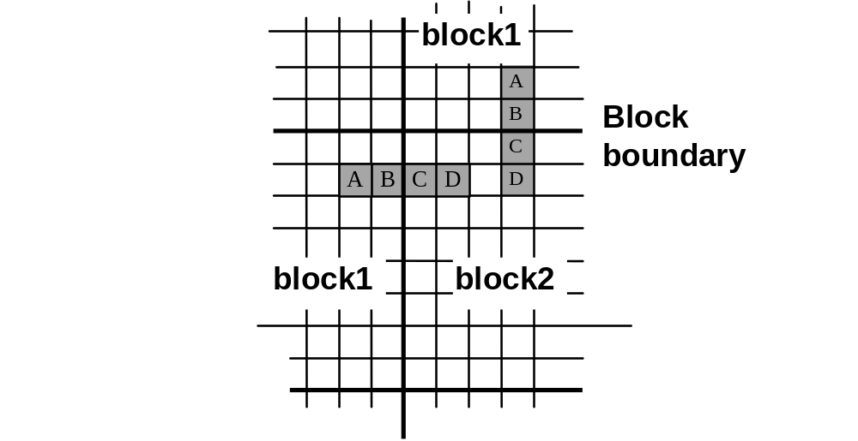
Deblocking Filter Mode
H.263+
Filter pixels along block boundaries while preserving edges in the image content.
Filter is in the coding loop which means it filters the decoded reference frame used for motion compensation.
Can be used in conjunction with a post-filter to further reduce coding artifacts.

Slide 72
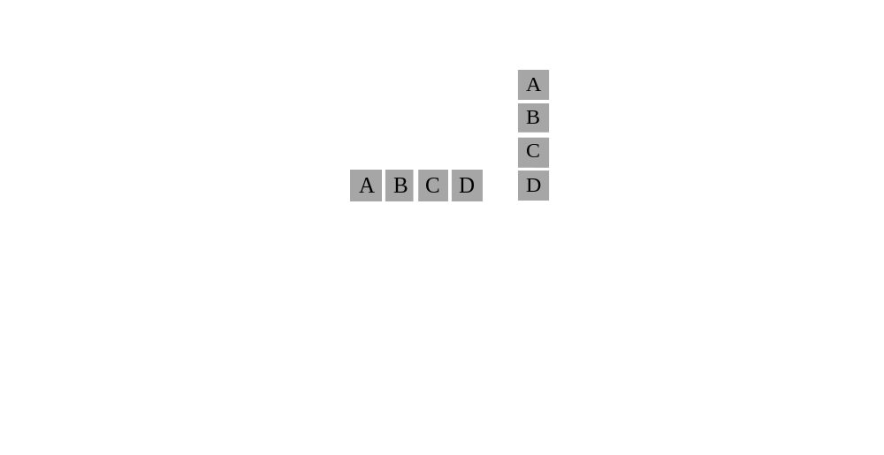
Deblocking Filter Mode
H.263+
Block
Boundary
Block
Boundary

Slide 73
Deblocking Filter Mode
H.263+
A, B, C and D are replaced by new values, A1, B1, C1, and D1 based on a set of non-linear equations.
The strength of the filter is proportional to the quantization strength.

Slide 74
Deblocking Filter Mode
H.263+
A,B,C,D are replaced by A1,B1,C1, D1:
  B1 = clip(B + d1)
  C1 = clip(C - d1)
  A1 = A - d2
  D1 = D + d2
  d2 = clipd1((A - D)/4, d1 / 3)
  d1 = Filter((A - 4B + 4C - D)/8, Strength(QUANT) )
  Filter(x, Strength) =
  SIGN(x) * (MAX(0, abs(x) - MAX(0, 2*( abs(x) - Strength))))

Slide 75
Post-Filter
H.263+
Filter the decoded frame first horizontally, then vertically, using a 1-D filter.
The post-filter strength is proportional to the quantization: Strength(QUANT)
D1 = D + Filter((A+B+C+E+F+G-6D)/8,Strength)

Slide 76
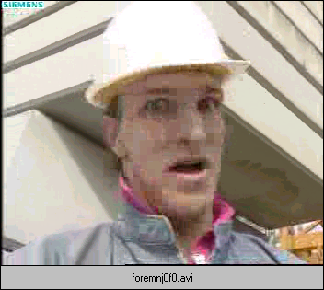

Deblocking Filter Demo
H.263+
No Filter
Deblocking
Loop Filter

Slide 77
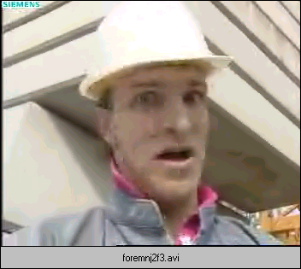
Deblocking Filter Demo
H.263+
No Filter
Loop &
Post Filter

Slide 78



Filter Demo Videos
No Filter
Loop Filter
Loop &
Post Filter

Slide 79
Slice Structured Mode
H.263+
Allows insertion of resynchronization markers at macroblock boundaries to improve network packetization and reduce overhead. More on this later.
Allows more flexible tiling of video frames into independently decodable areas to support “view ports”, a.k.a. “local decode.”
Improves error resiliency by reducing intra-frame dependence.
Permits out-of-order transmission to reduce latency.

Slide 80
Slice Structured Mode
H.263+
Slices start and end
on macroblock
boundaries.
Slice
Boundaries
No INTRA or MV
Prediction across
slice boundaries.

Slide 81
Slice Structured Mode
Independent Segments
H.263+
Slice sizes remain
fixed between INTRA
frames.
Slice
Boundaries
No INTRA or MV
Prediction across
slice boundaries.

Slide 82
Supplemental Enhancement
Information
H.263+
Backwards compatible with H.263 but permits indication of supplemental information for features such as:
  Partial and full picture freeze requests
  Partial and full picture snapshot tags
  Video segment start and end tags for off-line storage
  Progressive refinement segment start and end tags
  Chroma keying info for transparency

Slide 83
Reference Picture Resampling
H.263+
Allows frame size changes of a compressed video sequence without inserting an INTRA frame.
Permits the warping of the reference frame via affine transformations to address special effects such as zoom, rotation, translation.
Can be used for emergency rate control by dropping frame sizes adaptively when bit rate get too high.

Slide 84
Reference Picture Resampling with Warping
H.263+
Specify arbitrary
warping parameters
via displacement
vectors from corners.

Slide 85
Reference Picture Resampling
Factor of 4 Size Change
H.263+
P
P
P
P
P
No INTRA Frame Required when changing
video frame sizes

Slide 86
Scalability Mode
H.263+
Enhancement Layer 2
Enhancement Layer 1
Base Layer
A scalable bit stream consists of layers representing different levels of video quality.
Everything can be discarded except for the base layer and still have reasonable video.
If bandwidth permits, one or more enhancement layers can also be decoded which refines the base layer in one of three ways:
temporal, SNR, or spatial

Slide 87
Layered Video Bitstreams
H.263+
H.263+ Encoder
Enhancement Layer 4
Enhancement Layer 3
Enhancement Layer 2
320 kb/s
200 kb/s
Enh. Layer 1
90 kb/s
40 kb/s
Base Layer
20 kb/s

Slide 88



Scalability Mode
H.263+
Scalability is typically used when one bit stream must support several different transmission bandwidths simultaneously, or some process downstream needs to change the data rate unbeknownst to the encoder.
Example: Conferencing Multipoint Control Unit (we’ll see another example in Internet Video)

Slide 89
Layered Video Bit Streams in multipoint conferencing
H.263+
28.8 kb/s
128 kb/s
384 kb/s
384 kb/s

Slide 90
Temporal Enhancement
H.263+
Base Layer
+ B Frames
Higher
Frame Rate!

Slide 91
Temporal Scalability
H.263+
...
I or P
B
B
P
...
Temporal scalability means that two or more frame rates can be supported by the same bit stream. In other words, frames can be discarded (to lower the frame rate) and the bit stream remains usable.

Slide 92
Temporal Scalability
H.263+
The discarded frames are never used as prediction.
In the previous diagram the I and P frames form the base layer and the B frames from the temporal enhancement layer.
This is usually achieved using bidirectional predicted frames or B-frames.

Slide 93
B Frames
H.263+
-V 1/2
V 1/2
Picture 1
P or I Frame
Picture 2
B Frame
Picture 3
P or I Frame
2X frame rate for only 30% more bits

Slide 94
Temporal Scalability Demonstration
H.263+
layer 0, 3.25 fps, P-frames
layer 1, 15 fps, B-frames

Slide 95
SNR Enhancement
H.263+
Base Layer
+ SNR Layer
Better
Spatial
Quality!

Slide 96
SNR Scalability
H.263+
Base layer frames are coded just as they would be in a normal coding process.
The SNR enhancement layer then codes the difference between the decoded base layer frames and the originals.
The SNR enhancement MB’s may be predicted from the base layer or the previous frame in the enhancement layer, or both.
The process may be repeated by adding another SNR enhancement layer, and so on...

Slide 97
SNR Scalability
H.263+
EI
EP
EP
Legend:
I - Intracoded or Key Frame
P - Predicted Frame
EI - Enhancement layer key frame
EP - Enhancement layer predicted frame
Enhancement Layer
(40 kbit/s)
I
P
P
Base Layer
(15 kbit/s)

Slide 98
SNR Scalability Demonstration
H.263+
layer 0, 10 fps, 40 kbps
layer 1, 10 fps, 400 kbps

Slide 99
Spatial Enhancement
H.263+
Base Layer
+ Spatial Layer
More
Spatial
Resolution!!

Slide 100
Spatial Scalability
H.263+
For spatial scalability, the video is down-sampled by two horizontally and vertically prior to encoding as the base layer.
The enhancement layer is 2X the size of the base layer in each dimension.
The base layer is interpolated by 2X before predicting the spatial enhancement layer.

Slide 101
Spatial Scalability
H.263+
EI
EP
EP
Enhancement
Layer
Base
Layer
I
P
P

Slide 102
Spatial Scalability Demonstration
H.263+
layer 0, QCIF, 10 fps, 60 kbps
layer 1, CIF, 10 fps, 300 kbps

Slide 103
Hybrid Scalability
H.263+
It is possible to combine temporal, SNR and spatial scalability into a flexible layered framework with many levels of quality.

Slide 104
Hybrid Scalability
H.263+
EI
B
EI
EP
Enhancement
Layer 2
Enhancement
Layer 1
EI
EP
EP
EP
Base
Layer
I
P
P
P

Slide 105
Scalability Demonstration
H.263+
SNR/Spatial Scalability, 10 fps
  layer 0, 88x72, ~5 kbit/s
  layer 1, 176x144, ~15
  layer 2, 176x144, ~40
  layer 3, 352x288, ~80
  layer 4, 352x288, ~200

Slide 106
Other Miscellaneous Features
H.263+
Improved PB-frames
  Improves upon the previous PB-frame mode by permitting forward prediction of “B” frame with a new vector.
Reference picture selection (discussed later)
  A lower latency method for dealing with error prone environments by using some type of back-channel to indicate to an encoder when a frame has been received and can be used for motion estimation.
Reduced resolution update mode
  Used for bit rate control by reducing the size of the residual frame adaptively when bit rate gets too high.

Slide 107
Other Miscellaneous Features
H.263+
Independently decodable segments
  When signaled, it restricts the use of data outside of a current Group-of-Block segment or slice segment. Useful for error resiliency.
Alternate INTER VLC
  Permits use of an alternative VLC table that is better suited for INTRA coded blocks, or blocks with low quantization.

Slide 108
Other Miscellaneous Features
H.263+
Modified Quantization
  Allows more flexibility in adapting quantizers on a macroblock by macroblock basis by enabling large quantizer changes through the use of escape codes.
  Reduces quantizer step size for chrominance blocks, compared to luminance blocks.
  Modifies the allowable DCT coefficient range to avoid clipping, yet disallows illegal coefficient/quantizer combinations.

Slide 109
Outline
✓
Section 1: Conferencing Video
Section 2: Internet Review
Section 3: Internet Video

Slide 110
The Internet

Slide 111
Internet Basics
Internet Review
Phone lines are “circuit-switched”. A (virtual) circuit is established at call initiation and remains for the duration of the call.
Source
switch
switch
Dest.
switch

Slide 112
Internet Basics
Internet Review
Computer networks are “packet-switched”. Data is fragmented into packets, and each packet finds its way to the destination using different routes. Lots of implications...
Source
switch
switch
Dest.
X
switch

Slide 113

The Internet is heterogeneous [V. Cerf]
Dial-up IP
“SLIP”, “PPP”
Host
Corporate LAN
IP
INTERNET
(Global Public)
“SMTP”
E-mail
R
“SMTP”
IP
IP
IP
MCI Mail
E-mail
R
R
AOL
FR
Dial-up
X.25
GW
HyperStream
FR, SMDS, ATM
TYMNET
LAN Mail
“SLIP”
“PPP”
FR
FR
LAN
LAN

Slide 114
Layers in the Internet Protocol Architecture
Internet Review
Application Layer
consists of applications and processes
that use the network.
4
Host-to-Host Transport Layer
provides end-to-end data delivery
services.
3
Internet Layer
defines the datagram and handles the
routing of data.
2
Network Access Layer
consists of routines for accessing
physical networks
1

Slide 115
Data Encapsulation
Internet Review
Data Encapsulation
Application Layer
Data
Transport Layer
Header
Data
Internet Layer
Header
Header
Data
Network Access Layer
Header
Header
Header
Data

Slide 116
Internet Protocol Architecture
Internet Review
. . .
MIME
VIC/VAT
Utility/
Application
TELNET
FTP
SMTP
MBone
SNMP
DNS
RTP
Host-Host
Transport
TCP
UDP
I P
Internet
. . .
Network
Access
Layer
Ethernet
HDLC
X.25
FR
FDDI
Token Ring
SMDS
ATM

Slide 117
Specific Protocols for Multimedia
Internet Review
Specific Protocols for Multimedia
Data
Payload header
RTP
RTP
payload
TCP
UDP
UDP
RTP
payload
IP
IP
UDP
RTP
payload
Physical Network

Slide 118
The Internet Protocol (IP)
Internet Review
IP implements two basic functions
  addressing & fragmentation
IP treats each packet as an independent entity.
Internet routers choose the best path to send each packet based on its address. Each packet may take a different route.
Routers may fragment and reassemble packets when necessary for transmission on smaller packet networks.

Slide 119
The Internet Protocol (IP)
Internet Review
IP packets have a Time-to-Live, after which they are deleted by a router.
IP does not ensure secure transmission.
IP only error-checks headers, not payload.
Summary: no guarantee a packet will reach its destination, and no guarantee of when it will get there.

Slide 120
Transmission Control Protocol
(TCP)
Internet Review
Transmission Control Protocol (TCP)
TCP is connection-oriented, end-to-end reliable, in-order protocol.
TCP does not make any reliability assumptions of the underlying networks.
Acknowledgment is sent for each packet.
A transmitter places a copy of each packet sent in a timed buffer. If no “ack” is received before the time is out, the packet is re-transmitted.
TCP has inherently large latency - not well suited for streaming multimedia.

Slide 121
Universal Datagram Protocol
(UDP)
Internet Review
UDP is a simple protocol for transmitting packets over IP.
Smaller header than TCP, hence lower overhead.
Does not re-transmit packets. This is OK for multimedia since a late packet usually must be discarded anyway.
Performs check-sum of data.

Slide 122
Real time Transport Protocol
(RTP)
Internet Review
RTP carries data that has real time properties
Typically runs on UDP/IP
Does not ensure timely delivery or QoS.
Does not prevent out-of-order delivery.
Profiles and payload formats must be defined.
Profiles define extensions to the RTP header for a particular class of applications such as audio/video conferencing (IETF RFC 1890).

Slide 123
Real-time Transport Protocol
(RTP)
Internet Review
Payload formats define how a particular kind of payload, such as H.261 video, should be carried in RTP.
Used by Netscape LiveMedia, Microsoft NetMeeting®, Intel VideoPhone, ProShare® Video Conferencing applications and public domain conferencing tools such as VIC and VAT.

Slide 124
Real-time Transport Control
Protocol (RTCP)
Internet Review
RTCP is a companion protocol to RTP which monitors the quality of service and conveys information about the participants in an on-going session.
It allows participants to send transmission and reception statistics to other participants. It also sends information that allows participants to associate media types such as audio/video for lip-sync.

Slide 125
Real-time Transport Control Protocol (RTCP)
Internet Review
Sender reports allow senders to derive round trip propagation times.
Receiver reports include count of lost packets and inter-arrival jitter.
Scales to a large number of users since must reduce the rate of reports as the number of participants increases.
Most products today don’t use the information to avoid congestion, but that will change in the next year or two.

Slide 126
Multicast Backbone (Mbone)
Internet Review
Most IP-based communication is unicast. A packet is intended for a single destination. For multi-participant applications, streaming multimedia to each destination individually can waste network resources, since the same data may be travelling along sub-networks.
A multicast address is designed to enable the delivery of packets to a set of hosts that have been configured as members of a multicast group across various subnetworks.

Slide 127
Unicast Example
Streaming media to multi-participants
Internet Review
S1 sends duplicate
packets because there’s
two participants: D1, D2..
S1
D2
1
1
1
2
1
D1
S2
2
1
2
1
D2 sees excess
traffic on this
subnet.
1
D1
1

Slide 128
Multicast Example
Streaming media to multi-participants
Internet Review
S1 sends single set of
packets to a multicast
group.
S1
D2
1
2
1
D1
S2
2
1
2
1
D2 doesn’t see
any excess traffic
on this subnet.
D1
1
Both D1 receivers
subscribe to the
same multicast group.

Slide 129
Multicast Backbone (MBone)
Internet Review
Most routers sold in the last 2-3 years support multicast.
Not turned on yet in the Internet backbone.
Currently there is an MBone overlay which uses a combination of multicast (where supported) and tunneling.
Multicast at your local ISP may be 1-2 years away.

Slide 130
ReSerVation Protocol (RSVP)
Internet Draft
Internet Review
Used by hosts to obtain a certain QoS from underlying networks for a multimedia stream.
At each node, RSVP daemon attempts to make a resource reservation for the stream.
It communicates with two local modules: admission control and policy control.
Admission control determines whether the node has sufficient resources available. “The Internet Busy Signal”
Policy control determines whether the user has administrative permission to make the reservation.

Slide 131
Real-time Streaming Protocol
(RTSP) Internet Draft
Internet Review
A “network remote control” for multimedia servers.
Establishes and controls either a single or several time-synchronized streams of continuous media such as audio and video.
Supports the following operations:
  Requests a presentation from a media server.
  Invite a media server to join a conference and playback or record.
  Notify clients that additional media is available for an existing presentation.

Slide 132
Hyper-Text Transport Protocol
(HTTP)
Internet Review
HTTP generally runs on TCP/IP and is the protocol upon which World-Wide-Web data is transmitted.
Defines a “stateless” connection between receiver and sender.
Sends and receives MIME-like messages and handles caching, etc.
No provisions for latency or QoS guarantees.

Slide 133
Outline
✓
Section 1: Conferencing Video
Section 2: Internet Review
Section 3: Internet Video
✓

Slide 134
Internet Video

Slide 135
How do we stream video over the Internet?
Internet Video
How do we handle the special cases of unicasting? Multicasting?
What about packet-loss? Quality of service? Congestion?
We’ll look at some solutions...

Slide 136
HTTP Streaming
Internet Video
HTTP was not designed for streaming multimedia, nevertheless because of its widespread deployment via Web browsers, many applications stream via HTTP.
It uses a custom browser plug-in which can start decoding video as it arrives, rather than waiting for the whole file to download.
Operates on TCP so it doesn’t have to deal with errors, but the side effect is high latency and large inter-arrival jitter.

Slide 137
HTTP Streaming
Internet Video
Usually a receive buffer is employed which can buffer enough data (usually several seconds) to compensate for latency and jitter.
Not applicable to two-way communication!
Firewalls are not a problem with HTTP.

Slide 138
RTP Streaming
Internet Video
RTP was designed for streaming multimedia.
Does not resend lost packets since this would add latency and a late packet might as well be lost in streaming video.
Used by Intel Videophone, Microsoft NetMeeting, Netscape LiveMedia, RealNetworks, etc.
Forms the basis for network video conferencing systems (ITU-T H.323)

Slide 139
RTP Streaming
Internet Video
Subject to packet loss, and has no quality of service guarantees.
Can deal with network congestion via RTCP reports under some conditions:
  Should be encoding real time so video rate can be changed dynamically.
Needs a payload defined for each media it carries.

Slide 140
H.263 Payload for RTP
Internet Video
Payloads must be defined in the IETF for all media carried by RTP.
A payload has been defined for H.263 and is now an Internet RFC.
A payload has been defined for H.263+ as an ad-hoc group activity in the ITU and is now an Internet Draft.
An RTP packet typically consists of...
RTP Header
H.263 Payload Header
H.263 Payload (bit stream)

Slide 141
H.263 Payload for RTP
Internet Video
The H.263 payload header contains redundant information about the H.263 bit stream which can assist a payload handler and decoder in the event that related packets are lost.
Slice mode of H.263+ aids RTP packetization by allowing fragmentation on MB boundaries (instead of MB rows) and restricting data dependencies between slices.
But what do we do when packets are lost or arrive too late to use?

Slide 142
Internet Video
Error Resiliency:
Redundancy &
Concealment Techniques

Slide 143
Internet Packet Loss
Internet Video
Depends on network topology.
On the Mbone
  2-5% packet loss
  single packet loss most common
For end-to-end transmission, loss rates of 10% not uncommon.
For ISPs, loss rates may be even higher during high periods of congestion.

Slide 144
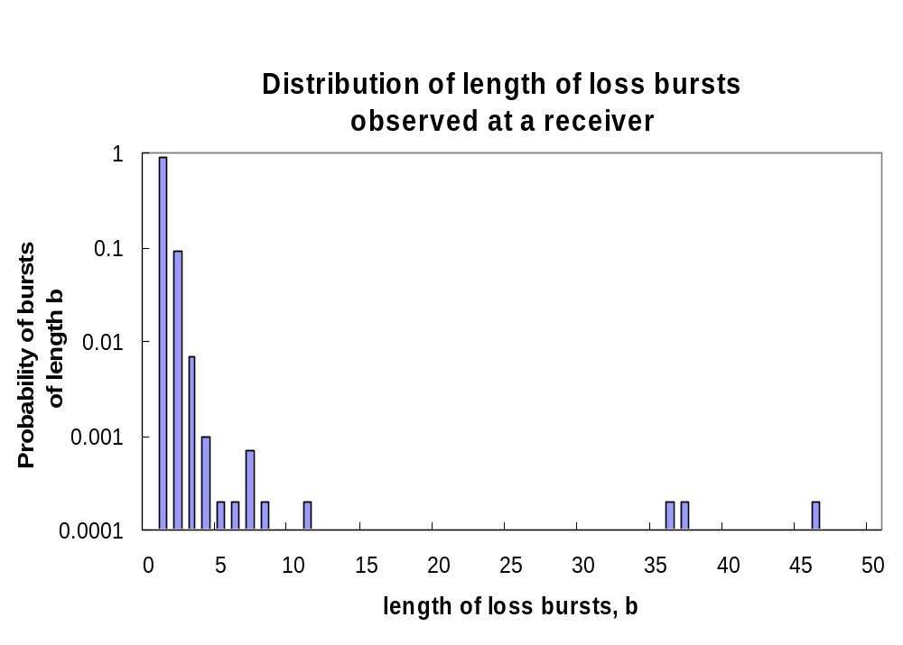
Packet Loss Burst Lengths
Internet Video

Slide 145
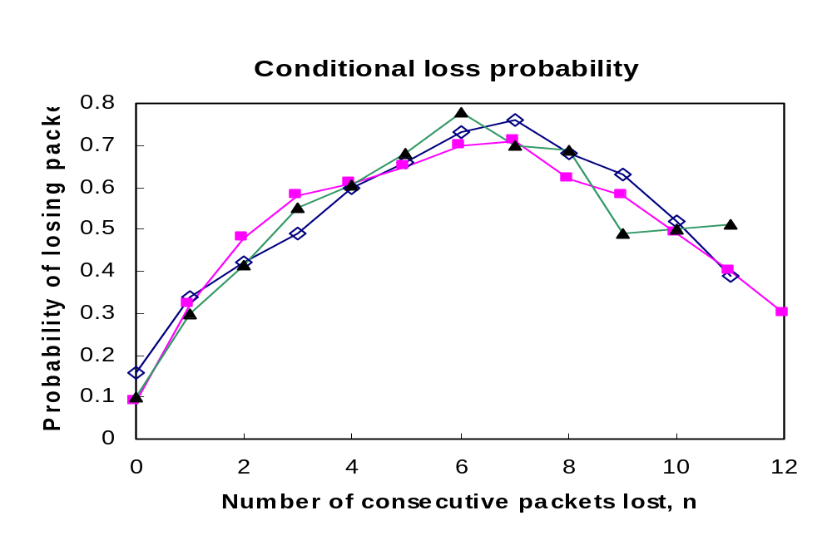
Internet Video

Slide 146
First Order Loss Model
2-Stage Gilbert Model
Internet Video
1 - p
q
1 - q
No
Loss
Loss
p
p = 0.083 q = 0.823

Slide 147
Internet Video
Error Resiliency
Error resiliency and compression have conflicting requirements.
Video compression attempts to remove as much redundancy out of a video sequence as possible.
Error resiliency techniques at some point must reconstruct data that has been lost and must rely on extrapolations from redundant data.
+
resiliency
REDUNDANCY
-
compression

Slide 148
Internet Video
Error Resiliency
Errors tend to propagate in video compression
because of its predictive nature.
I or P frame
P frame
One block is lost.
Error propagates to two
blocks in the next frame.

Slide 149
Internet Video
Error Resiliency
There are essentially two approaches to dealing with errors from packet loss:
  Error redundancy methods are preventative measures that add extra infromation at the encoder to make it easier to recover when data is lost. The extra overhead decreases compression efficiency but should improve overall quality in the presence of packet loss.
  Error concealment techniques are the methods that are used to hide errors that occur once packets are lost.
Usually both methods are employed.

Slide 150
Internet Video
Simple INTRA Coding & Skipped Blocks
Increasing the number of INTRA coded blocks that the encoder produces will reduce error propagation since INTRA blocks are not predicted.
Blocks that are lost at the decoder are simply treated as empty INTER coded blocks. The block is simply copied from the previous frame.
Very simple to implement.

Slide 151
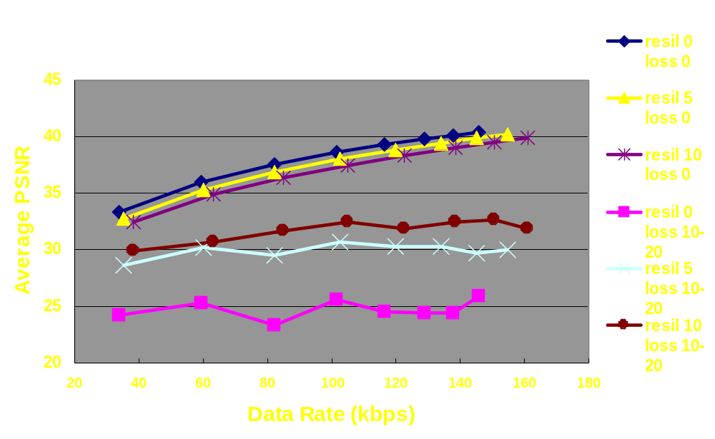
Intra Coding Resiliency
Internet Video

Slide 152
Internet Video
Reference Picture Selection
Mode of H.263+
I or P
frame
P
frame
P
frame
Last acknowledged
error-free frame.
No acknowledgment
received yet - not used for prediction.
In RPS Mode, a frame is not used for prediction in the encoder until it’s been acknowledged to be error free.

Slide 153
Internet Video
Reference Picture Selection
ACK-based: a picture is assumed to contain errors, and thus is not used for prediction unless an ACK is received, or…
NACK-based: a picture will be used for prediction unless a NACK is received, in which case the previous picture that didn’t receive a NACK will be used.

Slide 154
Internet Video
Multi-threaded Video
2
4
8
10
1
P
P
6
P
P
I
3
5
I
7
9
P
P
P
P
Reference pictures are interleaved to create two or more independently decodable threads.
If a frame is lost, the frame rate drops to 1/2 rate until a sync frame is reached.
Same syntax as Reference Picture Selection, but without ACK/NACK.
Adds some overhead since prediction is not based on most recent frame.

Slide 155
Internet Video
Conditional Replenishment
ME/MC
DCT, etc.
decoder
decoder
Encoder
A video encoder contains a decoder (called the loop decoder) to create decoded previous frames which are then used for motion estimation and compensation.
The loop decoder must stay in sync with the real decoder, otherwise errors propagate.

Slide 156
Internet Video
Conditional Replenishment
One solution is to discard the loop decoder.
Can do this if we restrict ourselves to just two macroblock types:
  INTRA coded and
  empty (just copy the same block from the previous frame)
The technique is to check if the current block has changed substantially since the previous frame and then code it as INTRA if it has changed. Otherwise mark it as empty.
A periodic refresh of INTRA coded blocks ensures all errors eventually disappear.

Slide 157
Internet Video
Error Tracking
Appendix II, H.263
Lost macroblocks are reported back to the encoder using a reliable back-channel.
The encoder catalogs spatial propagation of each macroblock over the last M frames.
When a macroblock is reported missing, the encoder calculates the accumulated error in each MB of the current frame.
If an error threshold is exceeded, the block is coded as INTRA.
Additionally, the erroneous macroblocks are not used as prediction for future frames in order to contain the error.

Slide 158
Internet Video
Prioritized Encoding
Some parts of a bit stream contribute more to image artifacts than others if lost.
The bit stream can be prioritized and more protection can be added for higher priority portions.
Picture Header
Motion Vectors
MB Information
Increasing
Error Protection
DC Coefficients
AC Coefficients

Slide 159
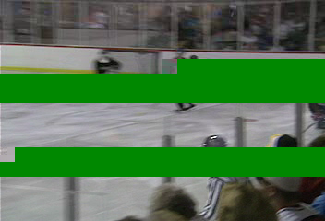
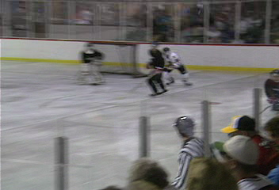
Prioritized Encoding Demo
Internet Video
Unprotected
Encoding
Prioritized
Encoding
(23% Overhead)
Videos used with permission of ICSI, UC Berkeley

Slide 160
Internet Video
Error Concealment by Interpolation
d₂
d₁
Lost block
Take the weighted average of
4 neighboring pixels.

Slide 161
Internet Video
Other Error Concealment Techniques
Error Concealment with Least Square Constraints
Error Concealment with Bayesian Estimators
Error Concealment with Polynomial Interpolation
Error Concealment with Edge-Based Interpolation
Error Concealment with Multi-directional Recursive Nonlinear Filter (MRNF)
See references for more information...

Slide 162

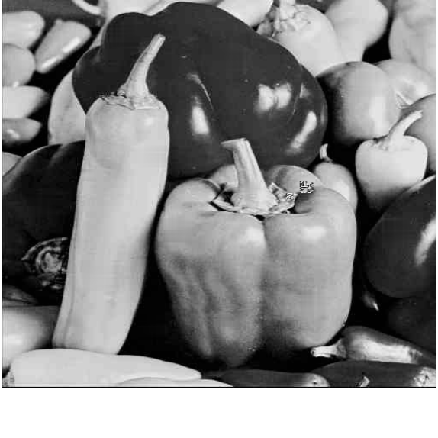
Internet Video
Example: MRNF Filtering

Slide 163
Internet Video
Network Congestion
Most multimedia applications place the burden of rate adaptivity on the source.
For mutlicasting over heterogeneous networks and receivers, it’s impossible to meet the conflicting requirements which forces the source to encode at a least-common denominator level.
The smallest network pipe dictates the quality for all the other participants of the multicast session.
If congestion occurs, the quality of service degrades as more packets are lost.

Slide 164
Internet Video
Receiver-driven Layered Multicast
If the responsibility of rate adaptation is moved to the receiver, heterogeneity is preserved.
One method of receiver based rate adaptivity is to combine a layered source with a layered transmission system.
Each bit stream layer belongs to a different multicast group.
In this way, a receiver can control the rate by subscribing to multicast groups and thus layers of the video bit stream.

Slide 165
Receiver-driven Layered Multicast
Internet Video
1
D1
2
D2
3
S
R
1
2
1
1
2
2
R
3
1
D3
Multicast groups are not transmitted
on networks that have no subscribers.

