Slide 1
What is H.264?
  Video compression standard
  Official name: Advanced Video Coding (AVC) for generic audiovisual services
    aka: MPEG-4/Part 10 or MPEG-4 AVC
  It's in your iPod
    Current generation standardized format
    Compression efficiency: H.264 >> XviD and DivX

Slide 2





How H.264 Compresses Video
Frame 1
Frame 2
Frame 3
Frame 4
Frame 5
Spatial
Redundancy
Temporal
Redundancy
<Source: Foreman, QCIF @ 25 fps>
  Three redundancy reduction principles:
    Spatial redundancy (Intra-frame prediction)
    Temporal redundancy (Inter-frame prediction)
    Entropy coding (Mapping more common symbols to shorter codes)

Slide 3
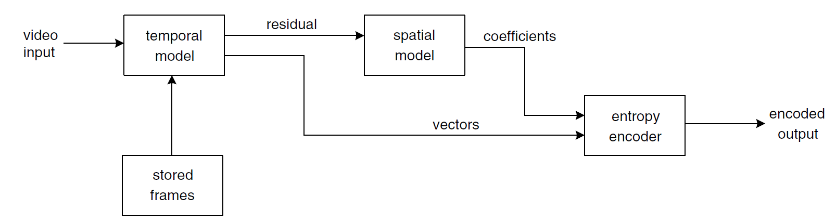
Simple Video Encoder

Slide 4
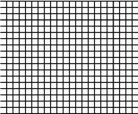
Intra-frame Prediction
  Prediction block is formed from previously encoded blocks in the same frame
  Use spatial similarities to compress each frame
    Use neighboring pixels to make a prediction on a block
    Transmit the difference between actual and predicted
    Tradeoff: prediction accuracy vs. # control bits
  Compression efficiency is relatively low in most areas of a typical scene
  Relatively low computation cost
Divide into 16x16 macroblocks (MBs)

Slide 5
Inter-frame Prediction
  Temporal locality
  Use previous frame as prediction for current frame
  Record movements
    "motion vectors" (MVs)

Slide 6
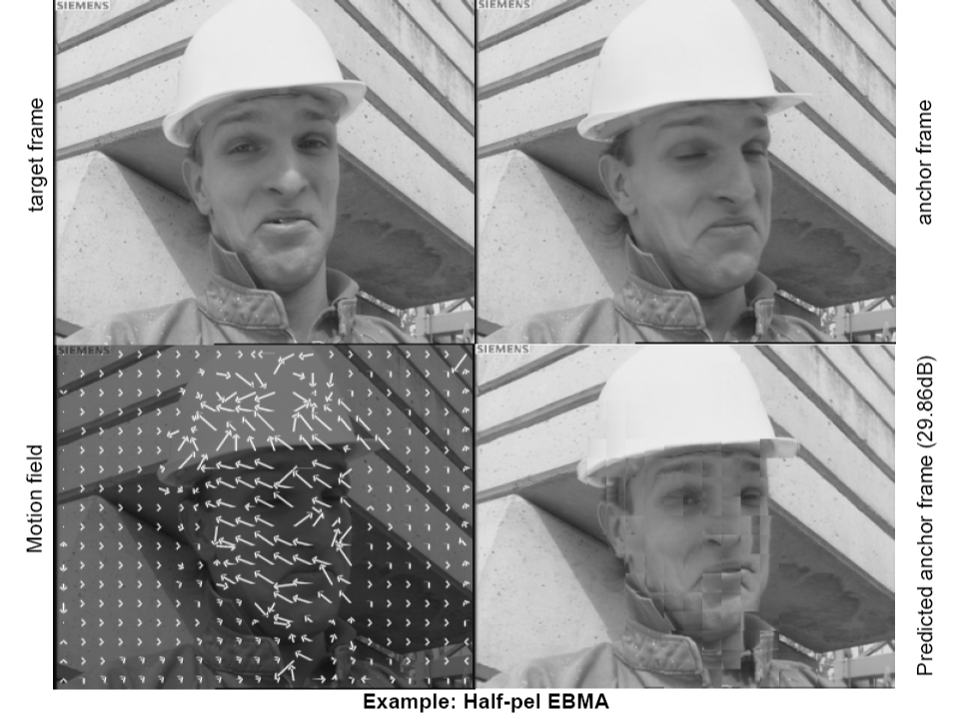
Motion Vectors

Slide 7
Motion Estimation Algorithms
  Block Matching
    16 pixel x 16 pixel macroblocks
    Estimate the movement of each macroblock
  Phase Correlation
    Perform the search in the frequency domain
    Only works well for translational motion
  Bayesian methods

Slide 8
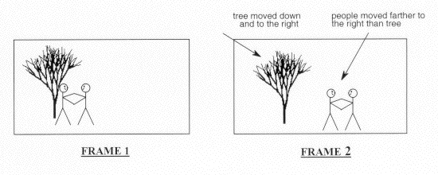
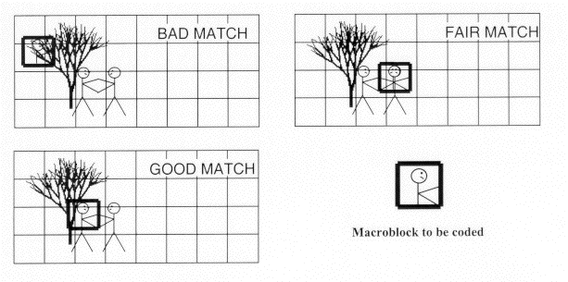
tree moved down
and to the right
people moved farther to the right than tree
Frame 1 (reference)
Frame 2 (current)
Macroblock to be coded

Slide 9




Big (Computational) Problem
  HD Video- 1080p (1920×1080) = 8,160 macroblocks
  Search window-how far we search for original block
    Normally 16 pixels; sometimes 32 pixels
    (2*16+1)*(2*16+1) = 1089 positions
ME block
Reference Frame
Current
Frame
Search Space

Slide 10
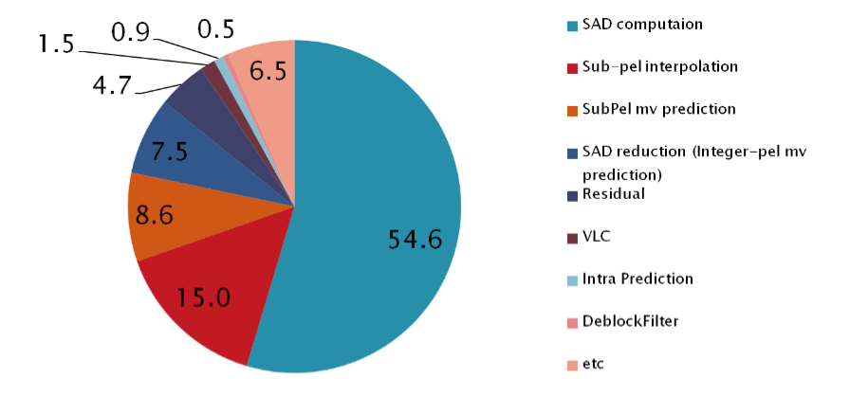
Profiling Results
  Motion estimation (ME) dominates the encoding time!
Results from JM H.264 Reference Code

Slide 11
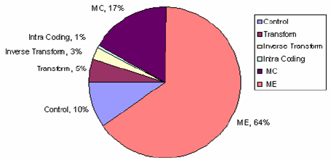
Amdahl's Law
  Limits the overall speedup
  Eventually, the speedup limited by unparallized portion of the code
    Optimized ME implementation (like x264) generally results in lower overall speedup

Slide 12

Previous Implementations
  x264
    CPU
    Open source
    C and hand-coded assembly
    VERY optimized
      MMX, SSE2, SSE3, SSE4
    Considered the fastest implementation of H.264
    Multithreaded (pthread support)
    Slow! Slower than last generation encoders.

Slide 13

In CUDA
  Several published articles which implemented H.264 encoder in CUDA.
  All of them target ME for parallelization
  An example*
    ME = 5 kernels
    Full-search (i.e., unoptimized ME)
    Sub-pel MV support
    Sub-partition support
* Wei-Nien Chen; Hsueh-Ming Hang, "H.264/AVC motion estimation implmentation on Compute Unified Device Architecture (CUDA)," Multimedia and Expo, 2008 IEEE International Conference on, pp.697-700, June 23 2008-April 26 2008.

Slide 14
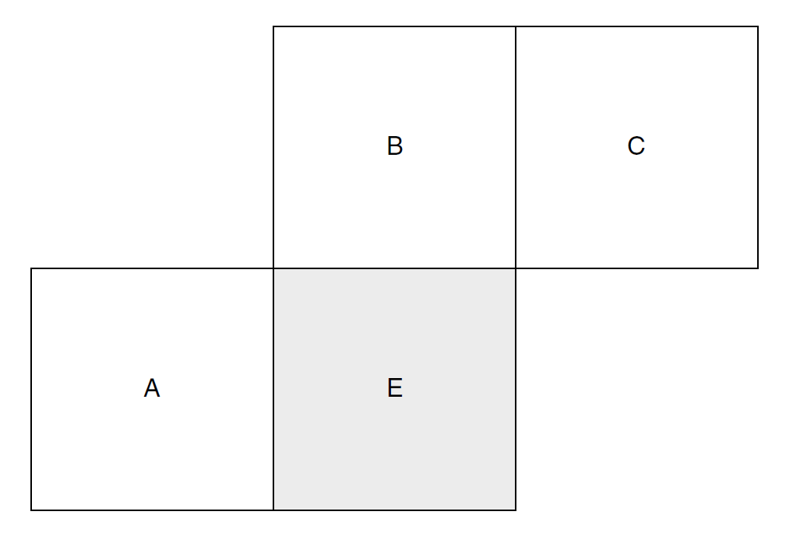
Problems with Previous Work
  Do not address inter-block dependencies
    Sacrifice quality for parallelizability (i.e. speed)
MVp Dependencies

Slide 15
Our Project
  H.264 specifies how the decoder will work
    Flexibility in encoder
      e.g. other CUDA implementations
  Solve motion estimation problem in parallel
    Deal with the dependency between blocks
    Best guess of MVp

Slide 16
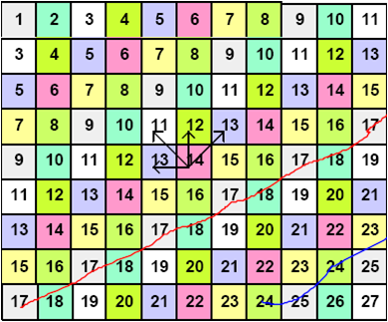
Direct Approach: Wavefront

Slide 17
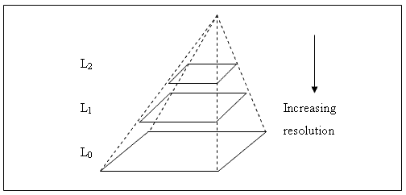
Our Approach: Pyramid ME
  Also known as "Hierarchical" ME
  Perform ME at a number of resolutions in increasing order
    Use the MV found at the higher level as an estimate of the MVp in the lower level

Slide 18


Motion Vector
Sub-sampled 16x

Slide 19
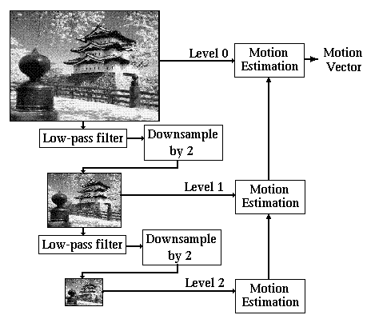
Using Pyramid ME to Solve MVp Problem

Slide 20
Our Prototyping Framework
  Originally MATLAB + nvmex
  Now pyCUDA + matplotlib
  Motivation
    Simplicity
    Flexibility (output images, graphs, etc.)
    pyCUDA == awesome
    Automatic tuning in the future

Slide 21
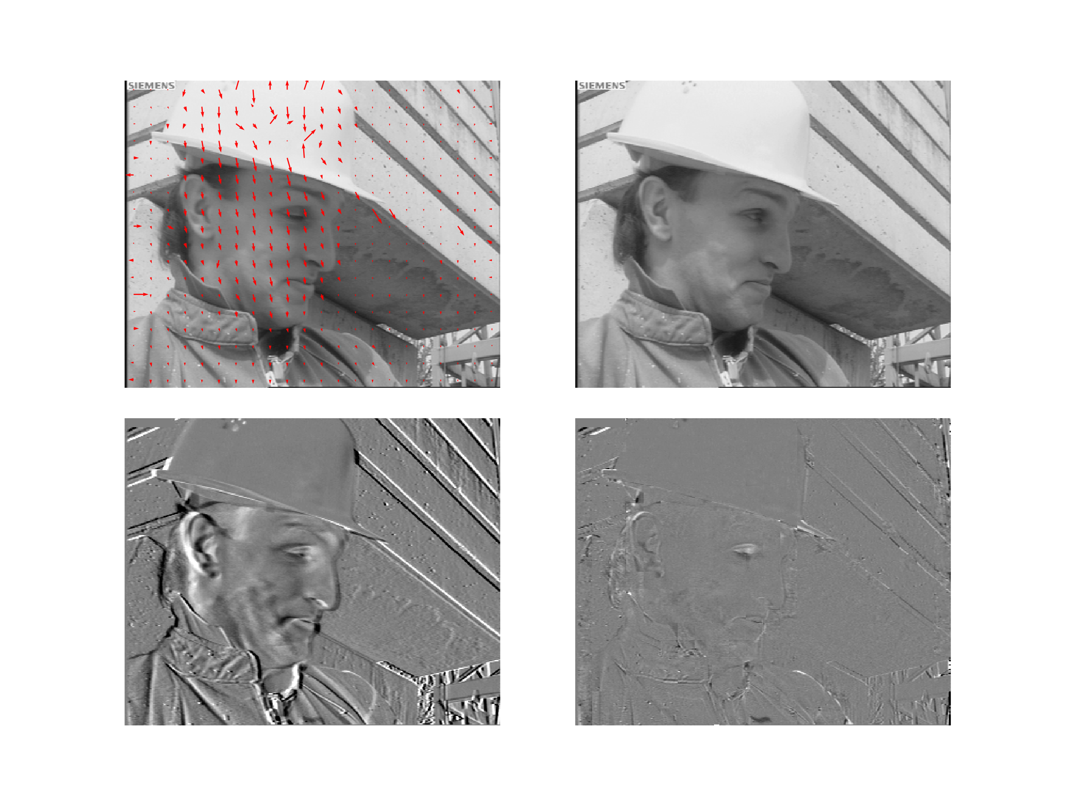
Our Prototyping Framework

Slide 22
Our CUDA Implementation
  CUDA + C
  One kernel / level of hierarchy
  One block per macroblock
  One thread per search position
    With 512 thread limit, search window size <= 11
    Can perform argmin reduction to find the best MV
  Texture memory for reference and current frame
    Allows for sub-pixel interpolation
    Handles border clamping

Slide 23
Results
Gold 203.3 msec
CUDA 3.6 msec
x264 11.6 msec
  Not appropriate to compare the CUDA time to the x264 time.
  The x264 is performing a more accurate search.
    The CUDA implementation will be made more accurate in the future.
    We implemented small subset of the ME features
Speedup = 56

Slide 24
Conclusions
  H.264 ME in CUDA is viable, but will not be easy
    Competing against very well written CPU code
  Full encoding process of H.264 is very complicated
    Complex control flow and data dependencies

Slide 25
Future Work
  Improve estimate for MVp
  Pipeline data transfers
  Downsample on GPU vs. CPU
    Data access concerns
  Process multiple frames together
    Improve occupancy
  More than ME in CUDA
    More dependency constraints

Slide 26


CUDA as a Development Framework
  Opened up GPU
    Took less than a month!
  Documentation is sparse
  Right way isn't always known
  Debugging is a pain
  Emulation mode is VERY slow
  CUDA servers can become locked and need rebooting

Slide 27
Acknowledgements
Dark_Shikari (x264 dev)
Various other people in #x264 channel @ Freenode.net

Slide 28









H.264 Encoder Block Diagram
Bitstream
Output
Video Input
+
Transform &
Quantization
Entropy
Coding
-
Inverse Quantization
& Inverse Transform
+
+
Intra/Inter Mode
Decision
Motion
Compensation
Intra
Prediction
Picture
Buffering
Deblocking
Filter
Motion
Estimation
Block prediction

Slide 29
References
E. G. Richardson, Iain (2003). H.264 and MPEG-4 Video Compression: Video Coding for Next-generation Multimedia. Chichester: John Wiley & Sons Ltd..
Wei-Nien Chen; Hsueh-Ming Hang, "H.264/AVC motion estimation implmentation on Compute Unified Device Architecture (CUDA)," Multimedia and Expo, 2008 IEEE International Conference on, pp.697-700, June 23 2008-April 26 2008.
S Ryoo, CI Rodrigues, SS Baghsorkhi, SS Stone, DB."Optimization Principles and Application Performance Evaluation of a Multithreaded GPU Using CUDA" 2008.
http://www.cs.cf.ac.uk/Dave/Multimedia/node256.html
http://homepages.inf.ed.ac.uk/rbf/CVonline/LOCAL_COPIES/AV0405/ZAMPOGLU/Hierarchicalestimation.html

