Slide 1
Introduction to
Video Transcoding
Of
MCLAB Seminar Series
By
Felix

Slide 2
Content
Introduction
MPEG Coding Basics
Transcoding Algorithms
Summary

Slide 3
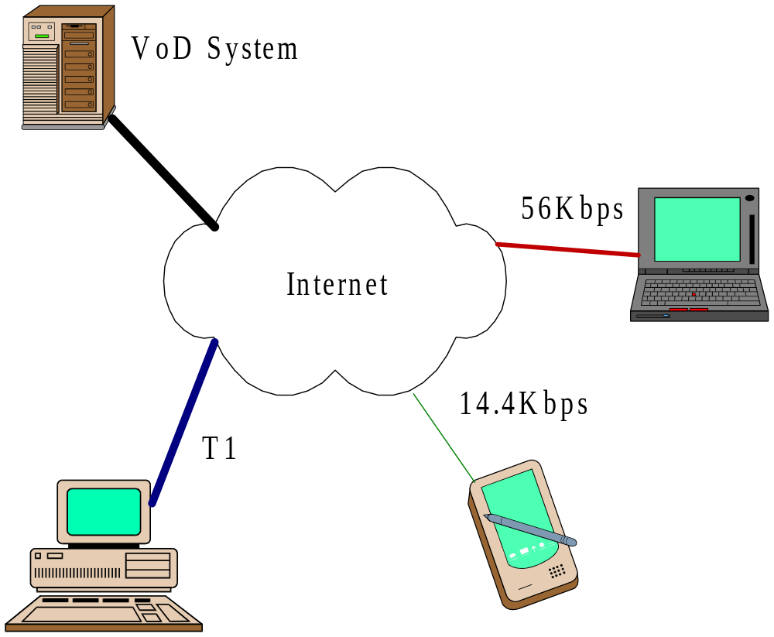
Introduction

Slide 4
Introduction
Heterogeneous Networks in VoD
  Different Network Bandwidths
Heterogeneous Client Configurations
  Different Screen Resolutions, CPU speed, etc.
  Different Decoders (eg. MPEG 1, 2, H.263, Quicktime… etc.)

Slide 5
Introduction
Solutions
  Multiple Copies
    Simple and Fast
    Waste Storage
  Re-encoding
    Only one high-quality video is stored
    Complex motion estimation is required

Slide 6
Introduction
Cont’
  Use video formats with bit-rate scalability (e.g. MPEG 4)
  Transcoding
    Convert a compressed video into another compressed video with lower bit rate or in other formats.

Slide 7
Introduction
Transcoding
  Only one high quality compressed video is stored
  No/Much less computations on motion estimation
  Can produce comparable video quality with direct encoding
Drop away data selectively
Input Movie
Output Movie
Partial Decode
Transcode
Partial Encode

Slide 8
MPEG Coding Basics
A MPEG stream consists of 3 types of frames
  I (Intra-coded)
  P (Predictive-coded)
  B (Bidirectional-predictive coded)

Slide 9
MPEG Coding Basics
I Frames
  The original picture represented can be reconstructed without reference to other frames
P Frames
  The original picture has to be reconstructed with reference to the past constructed I or P frames
B Frames
  The original picture has to be reconstructed with reference to the past and future constructed I or P frames

Slide 10
MPEG Coding Basics
Macroblocks
Frame
Macroblock
8
8
16
8
0
1
8
Y
2
3
=
8
16
Cr
4
8
Cb
5

Slide 11
MPEG Coding Basics
Coding of Macroblocks
  5 types of coding mode
    Intra-coded
    Forward Predictive-coded
    Backward Predictive-coded
    Bidirectional Predictive-coded
    Skipped

Slide 12
MPEG Coding Basics
  Types of macroblocks in I, P and B frames
 | Intra-coded | Forward Predictive-coded | Backward Predictive-coded | Bidirectional Predictive-coded | Skipped
I | X
P | X | X |  |  | X
B | X | X | X | X | X

Slide 13
MPEG Coding Basics
  Predictive-coding
Reference frame
Current frame
Motion Vector
Actual MB
Ref. MB
Prediction Residue
-
=

Slide 14
MPEG Coding Basics
  Encoding of a 8x8 block
DCT
Quantization
Run Length Coding
Huffman Coding

Slide 15
Transcoding Algorithms
Requantization
  Some DCT coefficients become zero after coarser quantization
  Open-loop Requantization
Input Stream
Output Stream
Q₁⁻¹
Q₂

Slide 16
Transcoding Algorithms
  Drifting effect of open-loop requantization
    Requantization error accumulates along the frames
    Eg.
Prediction Residue
Reference MB
Actual MB
Original:
+
=
After Requantization:
+
=

Slide 17
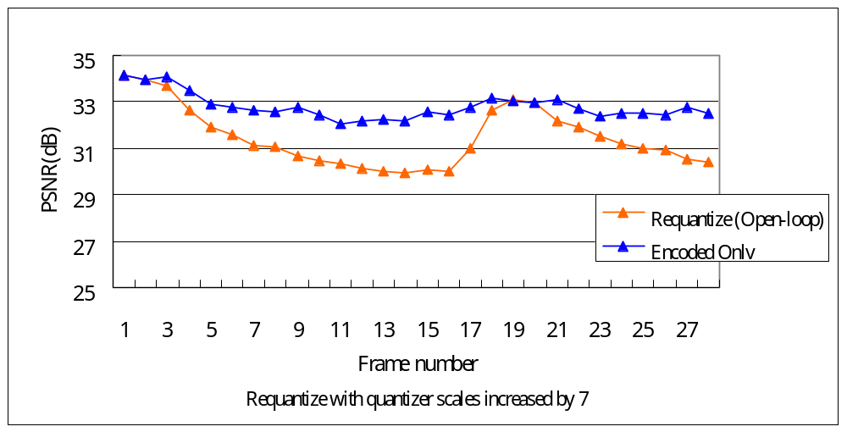
Transcoding Algorithms
  PSNR drops along the frames

Slide 18
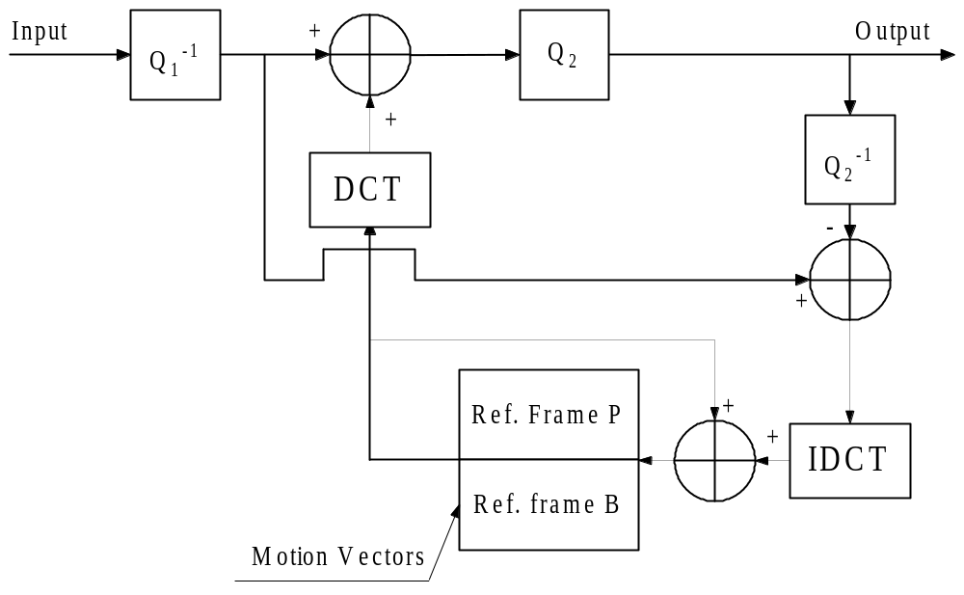
Transcoding Algorithms
  Spatial-domain drift-free Requantization
Extracted from: “A Frequency-Domain video Transcoder for Dynamic Bit-Rate Reduction of MPEG-2 Bit Streams”

Slide 19
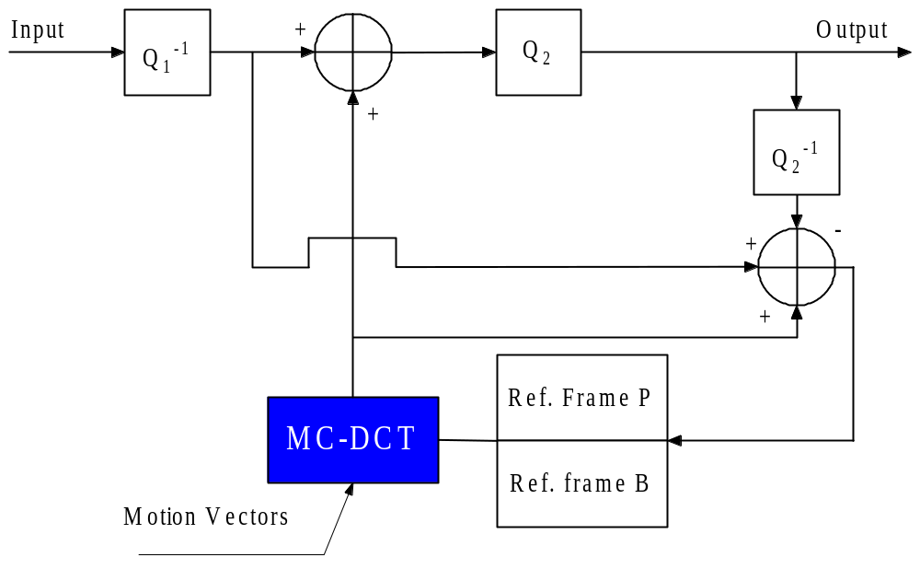
Transcoding Algorithms
Frequency-domain drift-free Requantization
Accumulated error
Accumulated error
Extracted from: “A Frequency-Domain video Transcoder for Dynamic Bit-Rate Reduction of MPEG-2 Bit Streams”

Slide 20
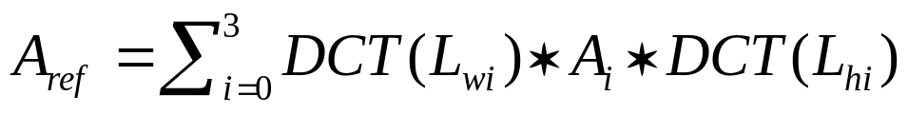
Transcoding Algorithms
MC-DCT (Motion Compensation in DCT)
A₀
h
8-h
A₁
w
Motion Vector
8-w
A_{ref}
Current Block
A₂
A₃
In the reference frame (DCT)
In the current frame (DCT)

Slide 21
Transcoding Algorithms
Limitations of requantization
  Limited bit rate reduction
  The clients may have lower screen resolution than the original video, thus the video bit rate can be further reduced by reducing the video resolution

Slide 22
Transcoding Algorithms
Spatial downscaling
  Compressed movie is downscaled spatially in a multiple of 2 in both horizontal and vertical directions
  Four macroblocks are combined and downscaled to the size of one macroblock
  Much more complicated than requantization

Slide 23
Transcoding Algorithms
General Block Diagram of Spatial Downscaling
Buffer
downscaled frame
Frames Reconstruction
Downscaling
Reconstruction of Motion Vectors
Reconstruction of macroblocks
Original frame
Reconstruction of Prediction Residual

Slide 24
Transcoding Algorithms
Problems to be solved in spatial downscaling
  Macroblock coding mode decision
  Motion vector reconstruction
  Downscaling

Slide 25
Transcoding Algorithms
Macroblock Coding Mode Decision
Intra
Coded
Forward
Predictive
Coded
?
+
Backward
Predictive
Coded
Bidirectional
Predictive
Coded

Slide 26
Transcoding Algorithms
Cont’
  Very few researches worked specifically on this problem
  Considerations
    Target bit rate
      Intra-coding mode requires more bits
    Speed
      Bidirectional predictive coding is the most computational expensive
      Intra coding is the least computational expensive
    Quality
      Intra coding introduces no drift

Slide 27
Transcoding Algorithms
Motion Vector Reconstruction

Slide 28
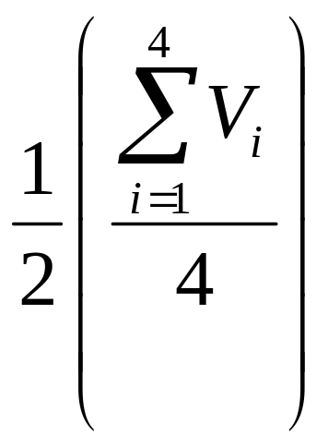
Transcoding Algorithms
Align To Average
  One common method is align-to-average(AAW)
  AAW gives poor results when the four motion vectors are not well-aligned

Slide 29
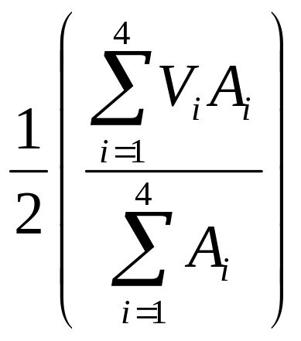
Transcoding Algorithms
Adaptive Motion Vector Resampling (AMVR)
  A_{i} is the weighting associated with motion vector V_{i}
Extracted from: “Adaptive Motion-Vector Resampling for Compressed Video Downscaling” By Bo Shen, Ishwar K. Sethi, and Bhaskaran Vasudev

Slide 30
Transcoding Algorithms
Cont’
  The resulting motion vector should skew closer to the motion vector that yielded poor prediction (larger A_{i}), this is so called align-to-worst (AWW)
  A_{i} is calculated as the number of nonzero AC coefficients (DCT coefficients at positions other then (0,0))

Slide 31
Transcoding Algorithms
Predictive Motion Estimation (PME)
  Similar to full-search motion estimation, however, it just compares the Mean Absolute Difference (MAD) obtained from 4 candidate motion vectors (V_{i}/2).
  If none of the MAD obtained is zero, then a new candidate motion vector is computed with the equation proposed by AMVR where A_{i}=1/MAD_{i}
Extracted from: “Predictive Motion Estimation for Reduced-Resolution Video from High-resolution Compressed Video” By Justy W.C. Wong, Oscar C. Au, Peter H. W. Wong and A. Tourapis

Slide 32
Transcoding Algorithms
Cont’
  Then choose the candidate vector with the minimum MAD value as the new motion vector
  PME produces higher quality than AMVR but requires much more computations

Slide 33
Transcoding Algorithms
Downscaling
  Given a picture in DCT domain, how to downscale the spatial resolution of it?
  Downscale in pixel domain
Averaging
Every 4
Neighboring
pixels
Original
DCT
Picture
Original
Pixel
Picture
IDCT
Downscaled
Pixel
Picture
Downscaled
DCT
Picture
DCT

Slide 34
Transcoding Algorithms
  Downscaling in DCT domain
A₁
A₂
S^{T}
S
T
X
X
A₃
A₄
T^{T}
A_{s}
0
0
0
Extracted from: “A fast approximate algorithm for scaling down digital images in the DCT domain” by B. Natarajan and V. Bhaskaran

Slide 35
Transcoding Algorithms
Temporal Downscaling
  In typical movies, the difference between consecutive pictures is usually small, so some frames can be safely skipped without any significant quality degradation
  The decoders have to repeat the previous non-skipped picture to maintain the same playback speed

Slide 36
Transcoding Algorithms
B frames can be skipped without affect other frames
Skipping P or I frames is much more complicated, as this affects the subsequent P and B frames

Slide 37
Transcoding Algorithms
Finding the new best-matched MB
?
F_{t-2}
F_{t-1} (Skipped)
F_{t}

Slide 38
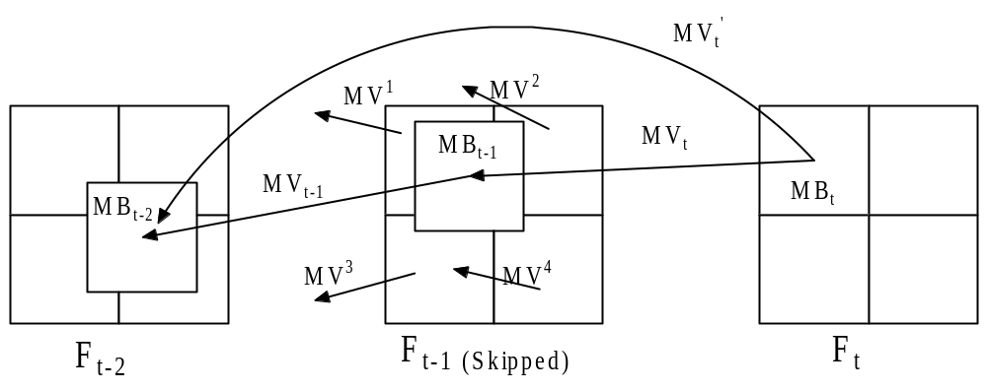
Transcoding Algorithms
Motion Vector Reconstruction for temporal downscaling
=?
=?
MV_{t}’ = MV_{t} + MV_{t-1}

Slide 39
Transcoding Algorithms
Cont’
  MV_{t-1} can computed by adopting the AMVR equation with A_{i} being the overlapping area of MB_{t-1} on MB^{i}
  After finding the MB_{t-2} , we can reconstruct the prediction residue of MB_{t}

Slide 40
Transcoding Algorithms
Which method is the best?
  No absolute answer because
    Image complexity and motion activity varies along the video streams
    Depends on target bit rate
Content-based hybrid transcoding
  Use different transcoding algorithms in different parts of a video stream according to the content

Slide 41
Summary
Video transcoding is a good solution to provide an adaptive VoD service in a heterogeneous environment because of its
  Low storage requirement
  Low computational complexity
  Comparable quality with direct encoding
Requantization, spatial and temporal downscaling are the most common transcoding algorithms
Content-based Hybrid Transcoding combines different algorithms to improve the overall transcoding performance

Slide 42
Thank You

