Slide 1
簡易加密貨幣網站

Slide 2
使用技術
Java
HTML
WebSocket
JQUERY
Javascript DOM
Css
Jsoup
Bootstrap

Slide 3
目錄
01
02
03
04
登入以及註冊頁面
市場行情
登入註冊頁面展示
顯示目前市場上即時的價格
交易功能
轉帳功能
提供買入以及賣出的功能，並可以即時知道盈虧
可以透過像是網路銀行一樣轉帳

Slide 4
01
登入以及註冊頁面

Slide 5
02
市場行情

Slide 6
03
交易功能

Slide 7
04
轉帳功能

Slide 8
Whoa!
This can be the part of the presentation where you can introduce yourself, write your email…

Slide 9
Introduction
It consists of the process of designing and building a computer program to achieve a computer result or to perform a task

Slide 10
—Someone Famous
“This is a quote, words full of wisdom that someone important said and can make the reader get inspired”

Slide 11
The slide title goes here!
Do you know what helps you make your point clear? Lists like this:
They’re simple
You can organize your ideas
You’ll never forget to buy milk!
And the audience won’t miss the point of your presentation

Slide 12
Student learning
Programming
Venus has a beautiful name and is the second planet from the Sun
Operating systems
Mercury is the smallest planet in the entire Solar System

Slide 13
Subjects
Software
Venus is the second planet from the Sun
Programming
Saturn is a gas giant and has several rings
Theory
Neptune is the farthest from the Sun

Slide 14
Operating systems

Slide 15
02
Concept
You can enter a subtitle here in case you need it

Slide 16

A picture
always reinforces
the concept
Images reveal large amounts of data, so remember: use an image instead of long texts

Slide 17
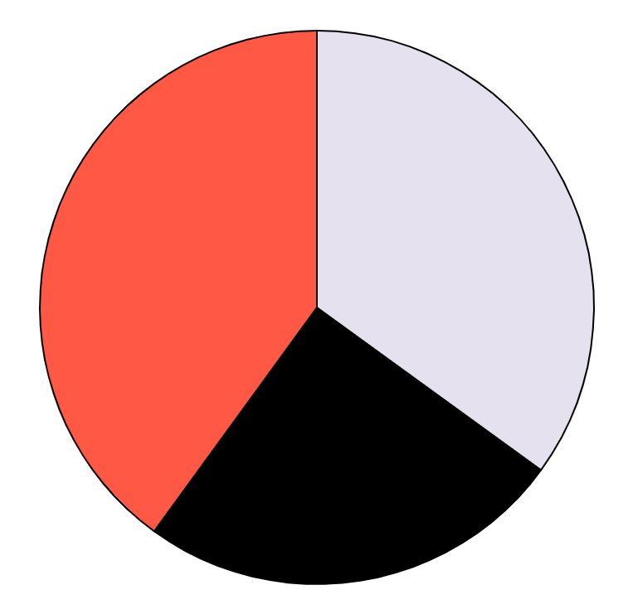
Our data
35%
Consultant
40%
Venus is the second planet from the Sun
Engineer
Saturn is a gas giant and has several rings
25%
Designer
Despite being red, Mars is a cold place
Follow the link in the graph to modify its data and then paste the new one here. For more info, click here

Slide 18
Common programming language
Html
Javascript
Java
Mercury is a really small planet
Venus is the second planet from the Sun
Despite being red, Mars is a cold place
Python
SQL
CSS
Saturn is a gas giant and has several rings
Jupiter is the biggest planet of them all
Neptune is the farthest from the Sun

Slide 19
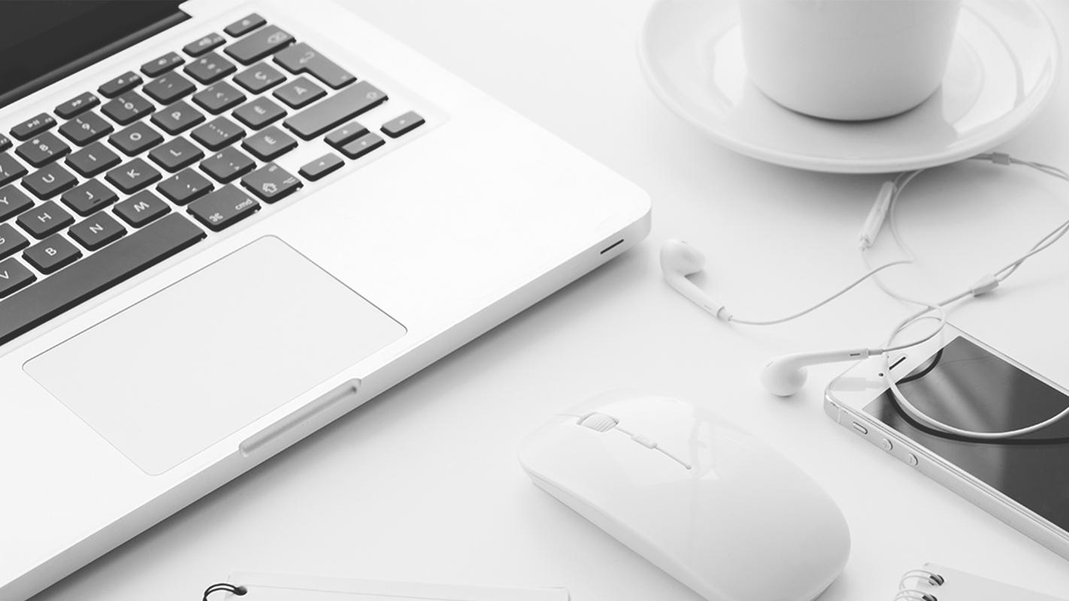
A picture is worth a thousand words

Slide 20
03
Conclusion
You can enter a subtitle here in case you need it

Slide 21
Programming languages
Input | Despite being red, Mars is a cold place
Output | Mercury is the closest planet to the Sun
Arithmetic | Venus is the second planet from the Sun
Repetition | Neptune is the farthest from the Sun

Slide 22
Universities
Columbia
Neptune is the farthest from the Sun
Stanford
Jupiter is the biggest planet of them all

