Slide 1
Introduction to Computer Systems
Lecture 5
Practical Skills in Computer Systems
Wei Xu
Note: Some slides and/or pictures in the following are adapted from materials from the online course https://missing.csail.mit.edu/.

Slide 2
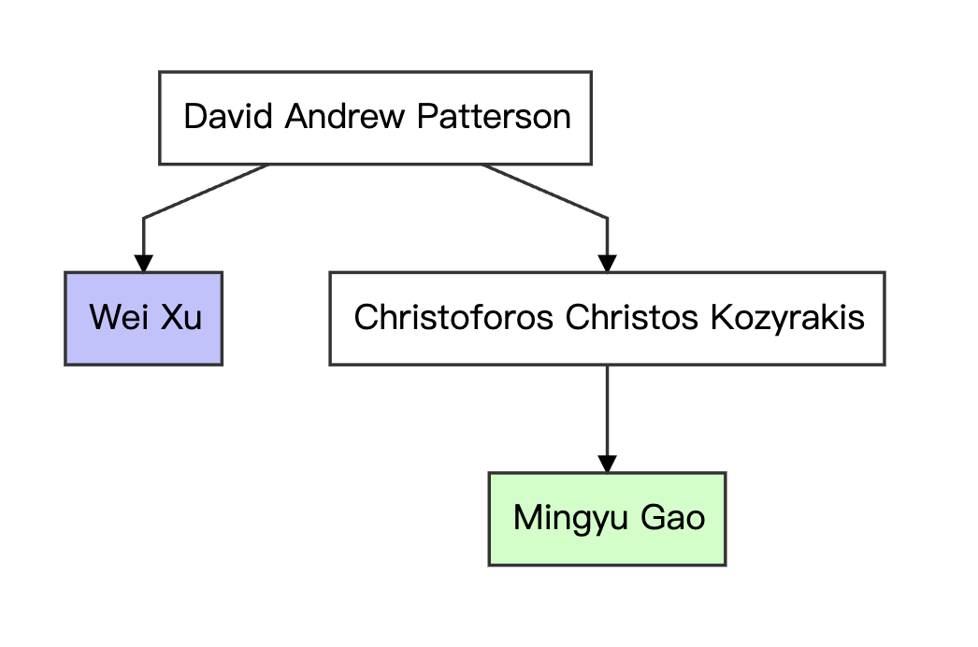
Who Am I?
Wei Xu 徐葳
  Professor @ IIIS
  Web: people.iiis.tsinghua.edu.cn/~weixu
Background:
  Tsinghua (1999) -> Univ. of Penn. (undergrad)
  UC Berkeley (Ph.d.)
    Adviser: David Patterson
  Software engineer at Google
  Teach at IIIS since 2013
  Research: Distributed systems + AI applications + AI safety
  I also teach distributed systems course
Industry Experience: I am an engineer, not a scientist
  Youdao, Google
  Startup and investment experiences

Slide 3
More about myself
Chat with me about
  Course content
  Engineering
  System security
  Fintech
  AI Applications
  出国读书/生活
  失恋/想不开
  Geek Stuff
  合作研究
  找工作/职业规划
  创业/融资
Do not ask me about
  NP Completeness / TCS
  Game Theory
  Computer Graphics
  考什么 （打死不说）
  不想交作业（找助教）
  改分 （只往低处改）
  撒狗粮 （免疫）
  鄙视/调戏我 （免疫）
  体育运动（无数据）
  娱乐明星（无数据）

Slide 4
This lecture
Introduce very useful tools for development
  Efficiency
  Understand the engineers’ talk
Know what they actually “look like” before dive into the principles behind them
Many have assumed that you know them, but …
  Took many people years to even know about them
  Many are very old-school tricks, but works
  You might be too young to know them
Do not hope to remember everything here
  Understand the principles
  Provide you with a start point to practice

Slide 5
Great design of the Unix shell
Building very basic tools
  Do one (or more) thing, and do it well
Connecting these tools into a powerful and customizable system
Need an programming language!
  Scripts
  Connects output of one command to the next
Idea
  Interpreted language
  Everything originally is a string + list, then interpret
    Command output etc.
  Naturally define inter-process communications
  The designer never thought of … It is perfect for AI !
The Bourne Again Shell (bash)

Slide 6
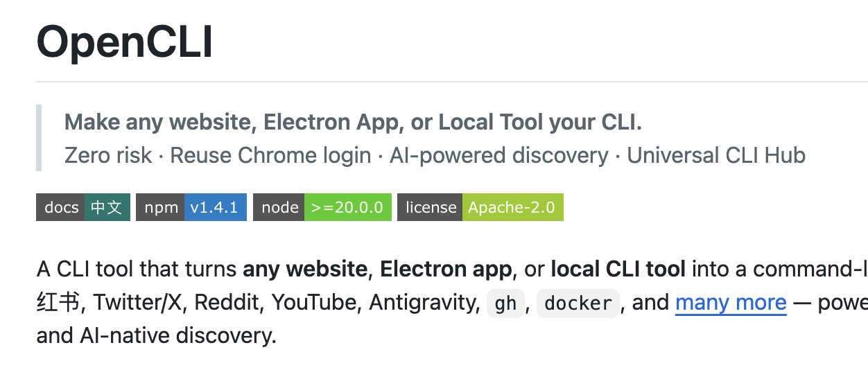
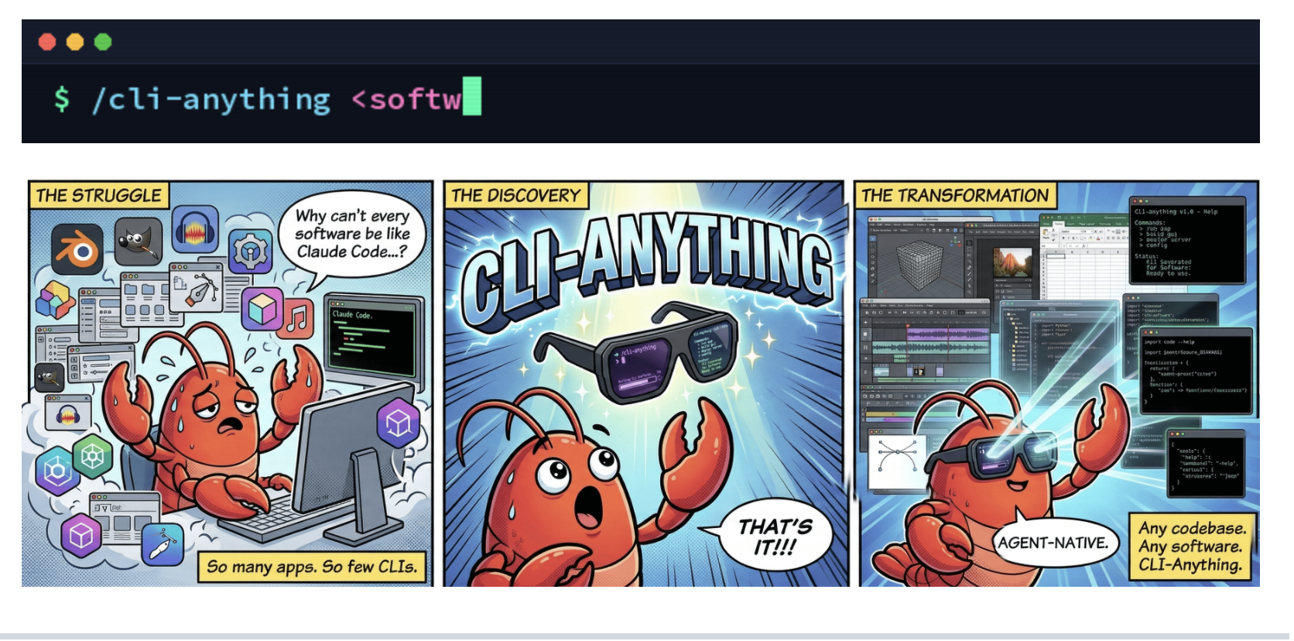

Slide 7
Jokes: If OSes are airlines …
Windows Air The terminal is pretty and colorful, with friendly stewards, easy baggage check and boarding, and a smooth take-off. After about 10 minutes in the air, the plane explodes with no warning whatsoever.
Mac Airlines All the stewards, captains, baggage handlers, and ticket agents look and act exactly the same. Every time you ask questions about details, you are gently but firmly told that you don't need to know, don't want to know, and everything will be done for you without your ever having to know, so just shut up.
UNIX Airways Everyone brings one piece of the plane along when they come to the airport. They all go out on the runway and put the plane together piece by piece, arguing non-stop about what kind of plane they are supposed to be building.

Slide 8

Jokes: If OSes are airlines … (cont’d)
Linux Air Employees build the planes, ticket counters, and pave the runways themselves. When you board the plane, you are given a seat, four bolts, a wrench, and a copy of the seat-HOWTO.html. Once settled, the fully adjustable seat is very comfortable, the plane leaves and arrives on time without a single problem. You try to tell customers of the other airlines about the great trip, but all they can say is, "You had to do what with the seat?"

Slide 9
Basic Shell Commands
date (print the date and time)
time (how long a command runs)
real 0m1.241s
user 0m0.238s
sys 0m0.476s
uptime
21:02:47 up 32 days, 5:40, 0 users, load average: 4.62, 4.48, 4.31
clear
Man
uname
whoami
Notes:
Load average:
The first value depicts the average load on the CPU for the last minute.
The second gives us the average load for the last 5-minute interval
The third value gives us the 15-minute average load

Slide 10
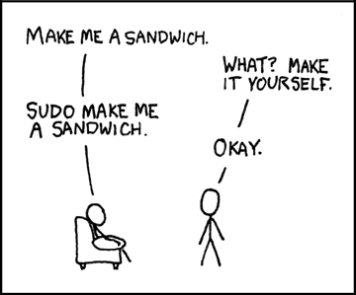
users / root and sudo
root is a special user
uid ==0 <=> root
The root user is special because it has complete, unrestricted access to all commands, files, and resources on a Linux system.
Execute command as root
sudo

Slide 11
The Shell basics: files

Slide 12
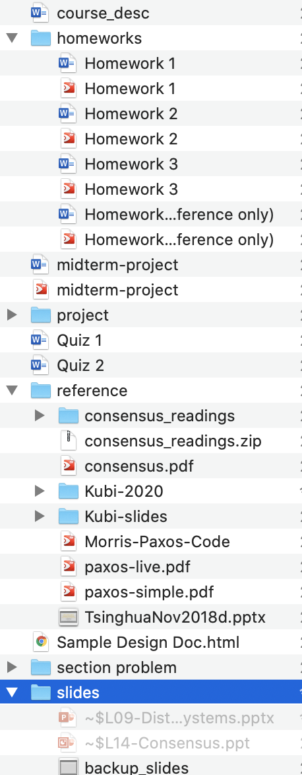
Basic file related commands
ls
cd
mkdir
pwd
cat
less / more
head
tail
tail –f
  tail –f /var/log/syslog
wc –l
df –kh
Special directories: ~ . .. $PWD , pwd
Directory: looks like a tree, but not

Slide 13
Run multiple commands
Checking the return value
  || (or)
  && (and)
  ; (no check)
Common use: only execute the second command if the first one is successful, we should use …
&&
ping -c 1 google.com && wget https://example.com/file.zip
||
make || echo "build failed”
(AI particularly like this )

Slide 14
Special Variables
$? - Return code of the previous command (argument to the exit() function in C)
$$ - Process identification number (PID) for the current script
!! – the entire previous command line
cat /etc/passwd
sudo !!

Slide 15
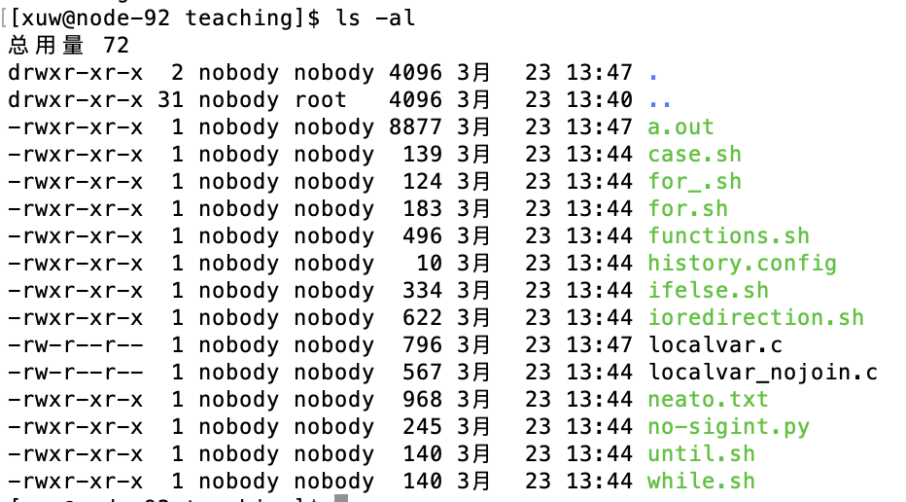
Basics about files
Owners
. and .. (special files)
Groups
Permissions

Slide 16
stdin, stdout and stderr
stdout
1
stdin
0
Process
stderr
2
C++ std::cerr << "This is an error message." << std::endl;
C fprintf(stderr, "This is an error message.\n");
Three open files on the start of the process
Default locations of the three files
  Recall: Shell fork()s itself to start processes
  Processes inherit all open files from their parents
  Thus, the same as the shell (keyboard + screen = terminal)
  “terminal emulator”

Slide 17
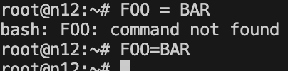
Also Inherited from parent procress: Environment Variables
Environment variables env
Prompt:
  xuwei-macbook-3:tmp xuw$
  Set it: environment variable $PS1
Where to find a command: $PATH, which
  Read it echo $PATH
  Set it: export PATH=$PATH:/home/ubuntu
  Config it: ~/.bashrc
No space
Why?
Why?

Slide 18
The Shell basics: processes and environment

Slide 19
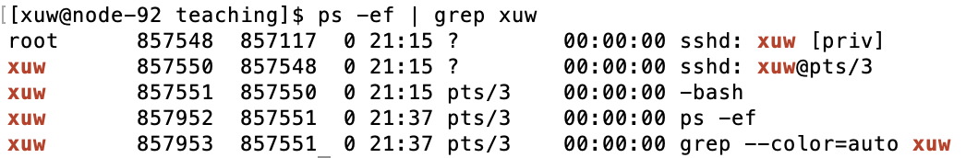
Processes
Process ID
Parent PID

Slide 20
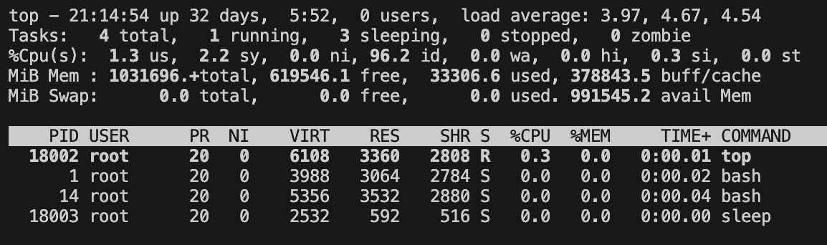
Process management commands
ps
ps -ef
top
  (Type q to quit)

Slide 21
I/O redirection and pipe
echo hello > hello.txt
cat < hello.txt
cat < hello.txt > hello2.txt
grep t > ./out 2> ./error
  # no space between 2 and >
2 is stderr

Slide 22
I/O redirection to other processes
equivalent to “tail -1”)
ls -l / | tail -n1
curl --head --silent baidu.com
| grep --ignore-case content-length
| cut --delimiter=' ' -f2

Slide 23
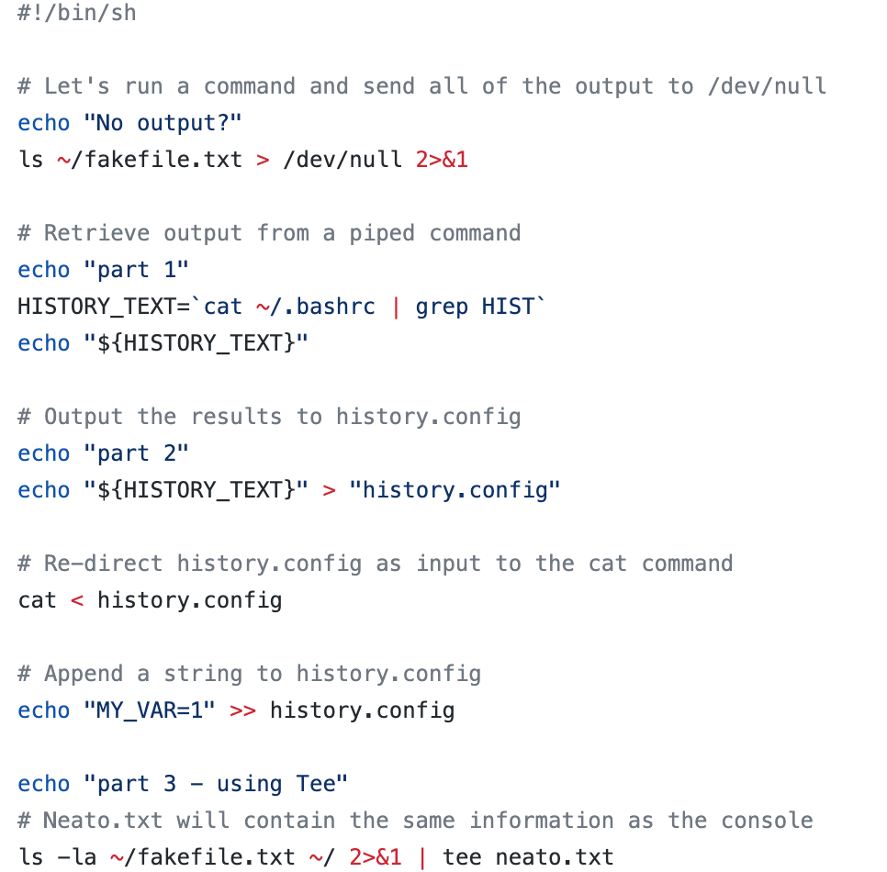
More examples of I/O redirection
Redirect stderr to stdout
` ` executes command
Appends
Send both to file and stdout

Slide 24
Useful terminal shortcut keys
<tab>
<ctrl-R>
<Ctrl-C> = SIGINT
<Ctrl-Z> = SIGSTP (background)
<Ctrl-D> = <EOF>
<Ctrl-A/E> = move to the beginning/end of line

Slide 25
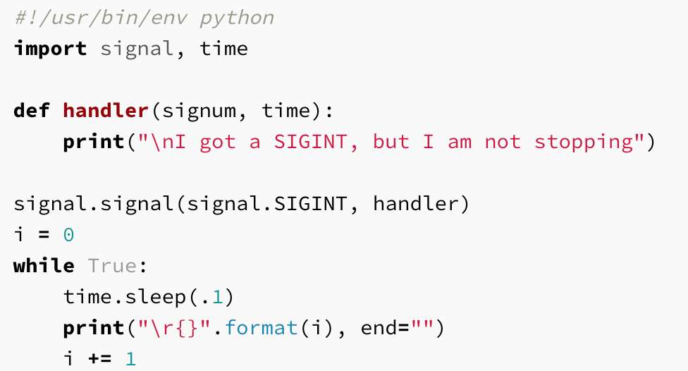
Job Control
Kill command
  Sending a signal
  Ctrl-C = SIGINT
  Ctrl-\ = SIGQUIT
  kill –TERM (default)
Stop and background
  Ctrl-Z = SIGSTOP
Background job
  Cannot output to terminal! (blocks when trying to write to terminal)
  Thus need to redirect

Slide 26
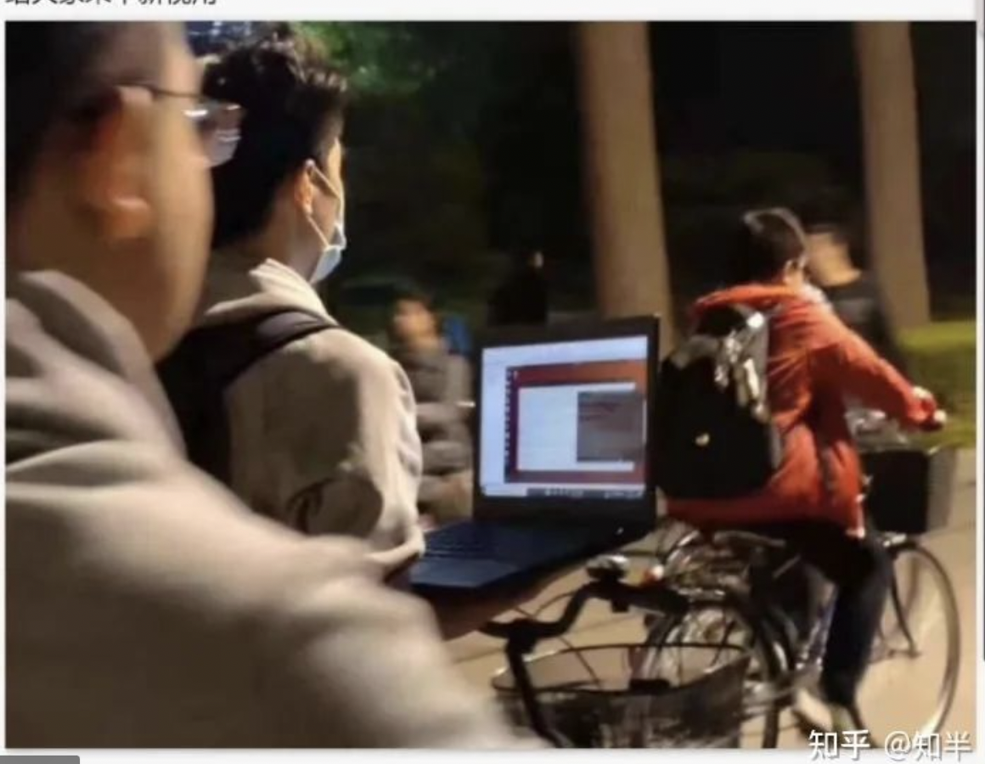
Job Control Demo
nohup keeps program running when you close the terminal
$ sleep 1000
^Z
[1] + 18653 suspended sleep 1000
$ nohup sleep 2000 &
[2] 18745
appending output to nohup.out
$ jobs
[1] + suspended sleep 1000
[2] - running nohup sleep 2000
$ bg %1
[1] - 18653 continued sleep 1000
$ jobs
[1] - running sleep 1000
[2] + running nohup sleep 2000
$ kill -STOP %1
[1] + 18653 suspended (signal) sleep 1000
$ jobs
[1] + suspended (signal) sleep 1000
[2] - running nohup sleep 2000
$ kill -SIGHUP %1
[1] + 18653 hangup sleep 1000
$ jobs
[2] + running nohup sleep 2000
$ kill -SIGHUP %2
$ jobs
[2] + running nohup sleep 2000
$ kill %2
[2] + 18745 terminated nohup sleep 2000
$ jobs

Slide 27
Multiple termals
screen
tmux – terminal multiplex (more advanced than screen)
https://github.com/tmux/tmux/wiki/Getting-Started
Or you can use multiple terminal windows
Also servers the purpose of nohup

Slide 28
Shell globbing
? and * - wild cards (different from regularexpressions)
{}
convert image.{png,jpg}
  # Will expand to convert image.png image.jpg
cp /path/to/project/{foo,bar,baz}.sh /newpath
  # Will expand to cp /path/to/project/foo.sh /path/to/project/bar.sh /path/to/project/baz.sh /newpath
mv *{.py,.sh} new_folder
  # Will move all *.py and *.sh files
mkdir foo bar && touch {foo,bar}/{a..h}
  # This creates files foo/a, foo/b, ... foo/h, bar/a, bar/b, ... bar/h

Slide 29
Places to look at when things goes wrong
tail /var/log
tail –f /var/log/syslog
  Often need command line tools above!
dmesg
ifconfig
route
top

Slide 30
Regular expressions

Slide 31
Regular expressions
. means “any single character” except newline
* zero or more of the preceding match
+ one or more of the preceding match
a{3} matches three a’s
[abc] any one character of a, b, and c
(RX1|RX2) either something that matches RX1 or RX2
^ the start of the line
$ the end of the line
Need a debugger?
https://regex101.com

Slide 32
Regular expression examples
gr(a|e)y
gr[ae]y
^dog
go+gle
\d{5}(-\d{4})?
[2-9]|[12]\d|3[0-6]
\d+(\.\d\d)?
((\d{3})(\.|-))?(\d{3})(\.|-)(\d{4})
Escape character

Slide 33
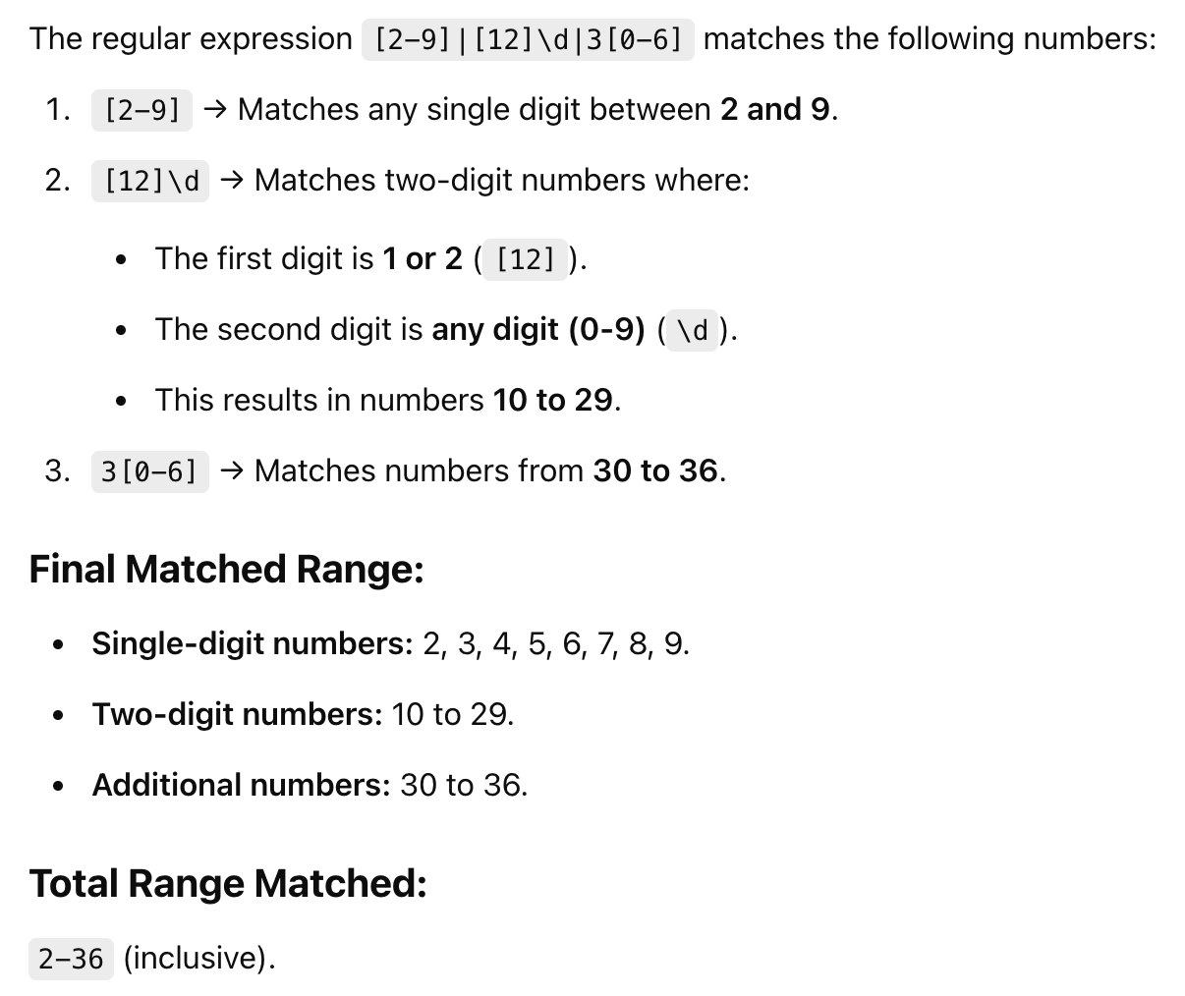
Puzzled? You can ask AI

Slide 34
Other Useful command line tools

Slide 35
Find
root@3a7ecb762a39:~/bash_tutorial# tldr find
find
Find files by extension:
find root_path -name '*.ext'
Find files matching multiple path/name patterns:
find root_path -path '**/path/**/*.ext' -or -name '*pattern*'
Find directories matching a given name, in case-insensitive mode:
find root_path -type d -iname '*lib*'

Slide 36
Find (cont’d)
Find files matching a given pattern, excluding specific paths:
find root_path -name '*.py' -not -path '*/site-packages/*'
Find files matching a given size range:
find root_path -size +500k -size -10M
Run a command for each file (use `{}` within the command to access the filename):
find root_path -name '*.ext' -exec wc -l {} \;
Find files modified in the last 7 days and delete them:
find root_path -daystart -mtime -7 -delete
Find empty (0 byte) files and delete them:
find root_path -type f -empty -delete

Slide 37
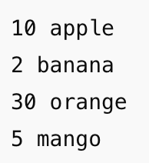
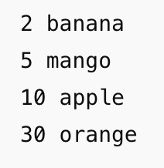
Other useful data manipulation tools
sort
  -n use numeric order
  -k start/stop of a column (1, 1)
  sort -nk1,1
uniq
  Works only on sorted data

Slide 38
Text Editing Commands (if you do not want to use Python)
Editing commands:
Sed
sed ’s/.*Disconnected from //’
sed -E 's/.*Disconnected from (invalid |authenticating )?user (.*) [^ ]+ port [0-9]+( \[preauth\])?$/\2/'
Second match
Mar 20 12:34:56 server sshd[12345]: Disconnected from user johndoe 192.168.1.100 port 22 [preauth]

Slide 39
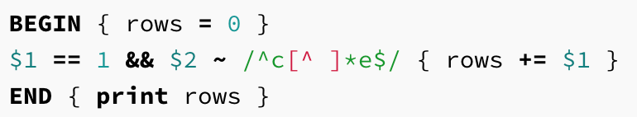
Text editing with awk
Awk
awk ‘$1 == 1 && $2 ~ /^c[^ ]*e$/ { print $2 }’
  Use -F Change separators
Match regex
Column 1
Column 2
Variables

Slide 40
How do I remember these?
Cheat sheets
Ask AI
Built-in cheat sheet
  tldr is an interesting tool
  TL;DR stands for "Too Long; Didn't Read”
  pip install tldr
  If does not work, run the following manually first:
  tldr --update-cache

Slide 41
You should really read the tldr for…
tldr will definitely help you on:
  tar (compress multiple files – can be used to copy lots of small files, esp. to another machine)
  grep (find lines matching a regular expression)
  apt-get (installing packages)
  pip (managing python packages)
tar -czf - /path/to/files | ssh user@host2
"cd /path/to/destination && tar -xzf -"

Slide 42
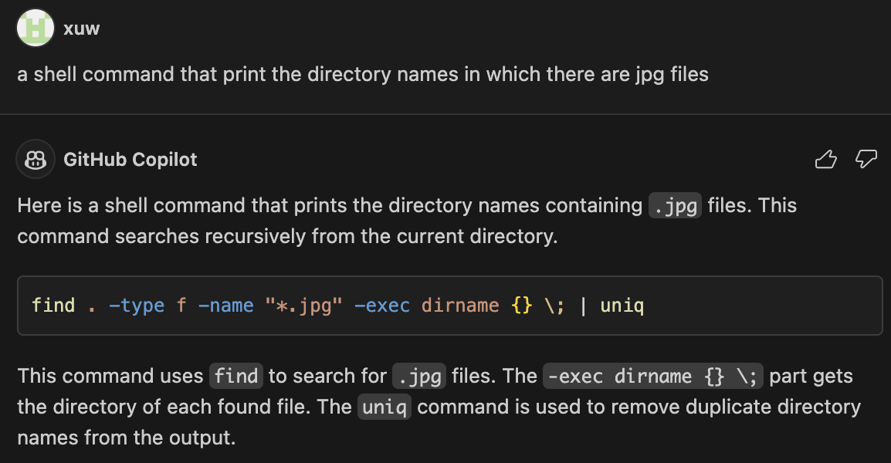
A modern way:
Use LLM / GitHub Copilot
Copilot is a great tool for writing code
  And free for students
Or you can use GPT/Claude Code/ openclaw etc.
Or just ask AI to write the code for you (but be careful)

Slide 43
Using SSH
ssh-keygen
  Generated keys in ~/.ssh/
Authorize for password-less login
  cat .ssh/id_ed25519.pub | ssh foobar@remote 'cat >> ~/.ssh/authorized_keys’
user@host
command

Slide 44
Using SSH to transfer files
cat localfile | ssh remote tee serverfile
scp
rsync (check tldr)
  Only copies files that have been changed
Unstable connections?
  Mosh https://mosh.org/#usage
sshfs https://github.com/libfuse/sshfs

Slide 45
Makefile

Slide 46
Building Software
Building is different from compiling
Compiler – focus on a single file
Building – describe the dependencies among many files
  Which one you should build first
Only build those files that has changed
Include a Makefile in your project directory

Slide 47
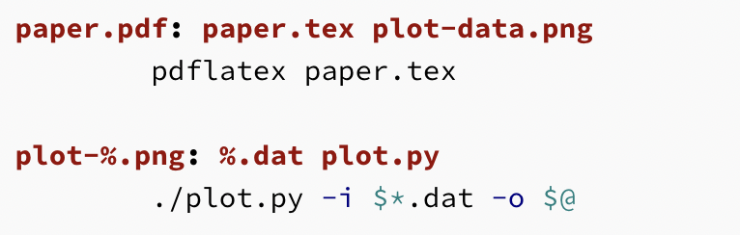
Make file example
It is a TAB !!
Target Name
(plot-%.png)
Stem of pattern
(plot-%)
Matches

Slide 48
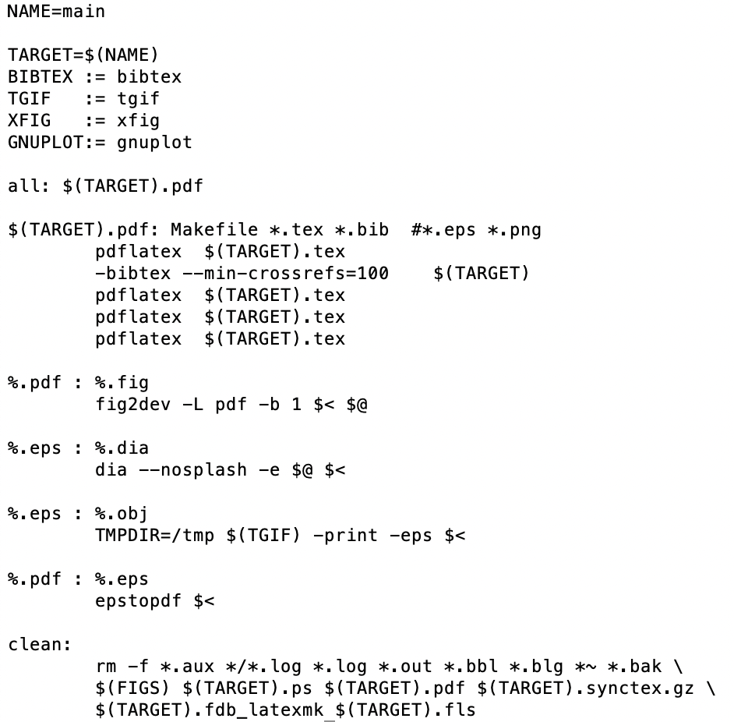
A more complete Makefile
Variable (should really use := instead of =)
:= assign only once
= assign each time it is called
Q: Why run it multiple times?
First requirement name %.obj
Good habit to provide the clean target
Line breaks

Slide 49
Bash scripting

Slide 50
Bash as a scripting language
Variables
  foo=bar #Note: no space
  Using a variable “this is ${foo}”
  Trap: Undeclared_variable == “”
Strings
  echo "$foo" # prints bar
  echo '$foo' # prints $foo
Integers (expression evaluation)
  $(( "50-34" ))

Slide 51
Special Variables
Special Variables
  $0 - Name of the script
  $1 to $9 - Arguments to the script. $1 is the first argument and so on.
  $@ - All the arguments
  $# - Number of arguments
  $? - Return code of the previous command (argument to the exit() function in C)
  $$ - Process identification number (PID) for the current script
  !! – the entire previous command line

Slide 52
Checking the return value
Return of a command
  STDOUT
  STDERR
  Return Code ( 0 = ok, otherwise error)
Command substitution
  $( CMD ) # equivalent to `CMD`
  <( CMD ) # write STDOUT into a temp file, and return the file name
    diff <(ls foo) <(ls bar)

Slide 53
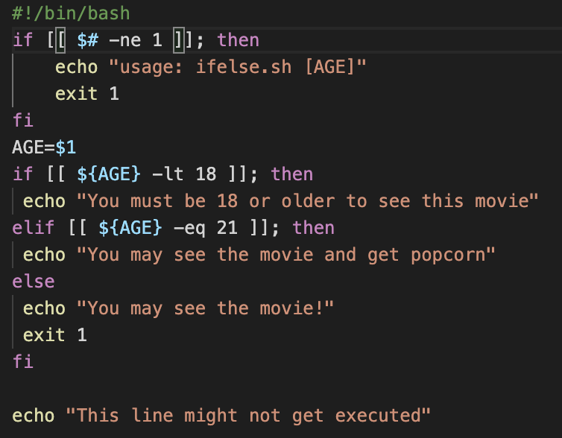
Comparisons and if else
Notes:
[[ is bash's improvement to the [ command. It has several enhancements that make it a better choice if you write scripts that target bash.
It is a syntactical feature of the shell, so it has some special behavior that [ doesn't have. You no longer have to quote variables like mad because [[ handles empty strings and strings with whitespace more intuitively. For example, with [ you have to write
if [ -f "$file" ] to correctly handle empty strings or file names with spaces in them. With [[ the quotes are unnecessary:
if [[ -f $file ]]
Because it is a syntactical feature, it lets you use && and || operators for boolean tests and < and > for string comparisons. [ cannot do this because it is a regular command and &&, ||, <, and > are not passed to regular commands as command-line arguments.
It has a wonderful =~ operator for doing regular expression matches. With [ you might write
if [ "$answer" = y -o "$answer" = yes ] With [[ you can write this as
if [[ $answer =~ ^y(es)?$ ]]
It even lets you access the captured groups which it stores in BASH_REMATCH. For instance, ${BASH_REMATCH[1]} would be "es" if you typed a full "yes" above.
You get pattern matching aka globbing for free. Maybe you're less strict about how to type yes. Maybe you're okay if the user types y-anything. Got you covered:
if [[ $ANSWER = y* ]]
Keep in mind that it is a bash extension, so if you are writing sh-compatible scripts then you need to stick with [. Make sure you have the #!/bin/bash shebang line for your script if you use double brackets.

Slide 54
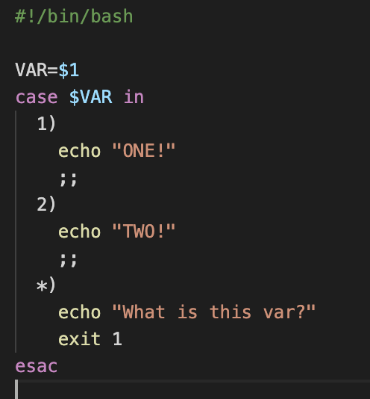
Switch-case

Slide 55
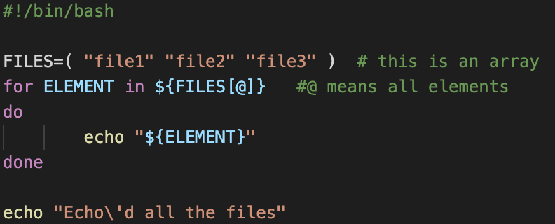
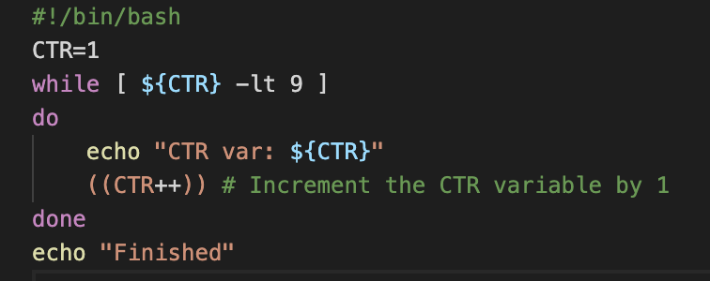
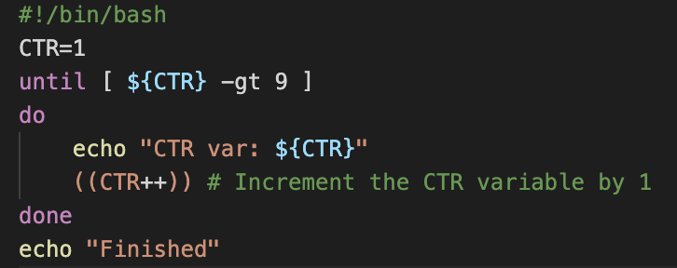
Loops

Slide 56
Array Type
arr=() Create an empty array
arr=(1 2 3) Initialize array
${arr[2]} Retrieve third element
${arr[@]} Retrieve all elements
${!arr[@]} Retrieve array indices
${#arr[@]} Calculate array size
arr[0]=3 Overwrite 1st element
arr+=(4) Append value(s)
str=$(ls) Save ls output as a string
arr=( $(ls) ) Save ls output as an array
${arr[@]:s:n} Retrieve n elements starting at index s

Slide 57
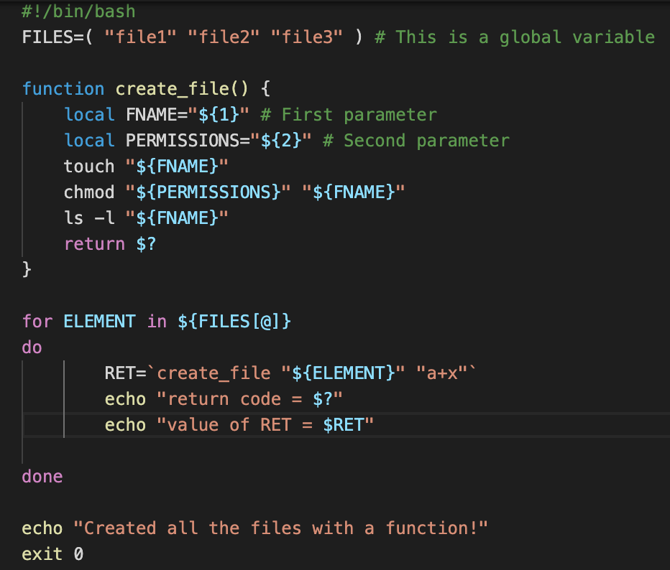
Functions

Slide 58
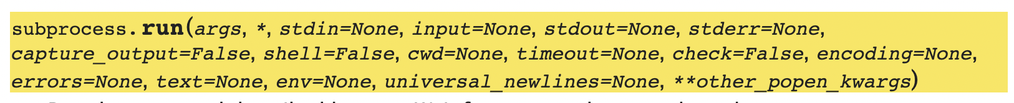
If you prefer Python: look at subprocess.run()
>>> import subprocess
>>> t = subprocess.run(["ls", "-l"], capture_output=True)
>>> print(t.stdout)
b'total 4\ndrwxr-xr-x 13 ubuntu ubuntu 416 Sep 12 2021 bash_tutorial\ndrwxr-xr-x 13 ubuntu ubuntu 416 Mar 21 15:24 fork_demo\n-rw------- 1 ubuntu ubuntu 0 Mar 22 10:09 nohup.out\n-rwx------ 1 ubuntu ubuntu 2 Mar 21 23:25 tt\n'

Slide 59
docker

Slide 60
Docker as a development environment
Package an application with all of its dependencies into a standardized unit for software development
Thinking it as a virtual machine, but much less heavy
Multiple versions of Python / Java
Different dependencies
Cross-compile toolchains
Don’t want to manually install lots of modules
  https://hub.docker.com/
Good integration with VSCode
  You can use the remote development environment (like the one you use with raspberry Pi) to access the docker
Then you can easily migrate to a server cluster

Slide 61
Sample commands
docker run -it --name course_demo -v "/Users/xuw/docker/course_demo/:/home/ubuntu" ubuntu20-dev
docker start course_demo
docker attach course_demo
docker commit course_demo course_demo
docker images

Slide 62
Summary: Challenge for system tools
Highly fragmented
  Basically we want one method to do a single thing
  Unfortunately, many different tools over the past years
Choose one tool, and stick with it
  Get familiar, and it will become a natural instinct
  Not necessarily the most clever way, but the way you like
NOT having to master all of them
  Know these tools exists, know the logics behind them
  Learn how read the documentation
  NEW: know if the command that AI writes is ok or not
  stackoverflow is a good place to check
  Or ask the AI!
Recommended reading
  https://missing.csail.mit.edu/

