Slide 1
Introduction to Computer Systems
Lecture 6
Concurrency and Synchronization (1)
Wei Xu
Note: Some slides and/or pictures in the following are adapted from slides ©2005 Silberschatz, Galvin, and Gagne. Slides courtesy of Anthony D. Joseph, John Kubiatowicz, AJ Shankar, George Necula, Alex Aiken, Eric Brewer, Ras Bodik, Ion Stoica, Doug Tygar, and David Wagner.

Slide 2
Run multiple commands
Checking the return value
  || (or)
  && (and)
  ; (no check)
Common use: only execute the second command if the first one is successful, we should use …
&&
ping -c 1 google.com && wget https://example.com/file.zip
||
make || echo "build failed”
(AI particularly like this )

Slide 3
Makefile

Slide 4
Building Software
Building is different from compiling
Compiler – focus on a single file
Building – describe the dependencies among many files
  Which one you should build first
Only build those files that has changed
Include a Makefile in your project directory

Slide 5
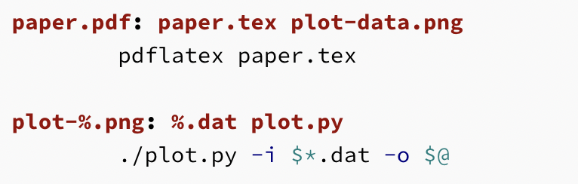
Make file example
It is a TAB !!
Target Name
(plot-%.png)
Stem of pattern
(plot-%)
Matches

Slide 6
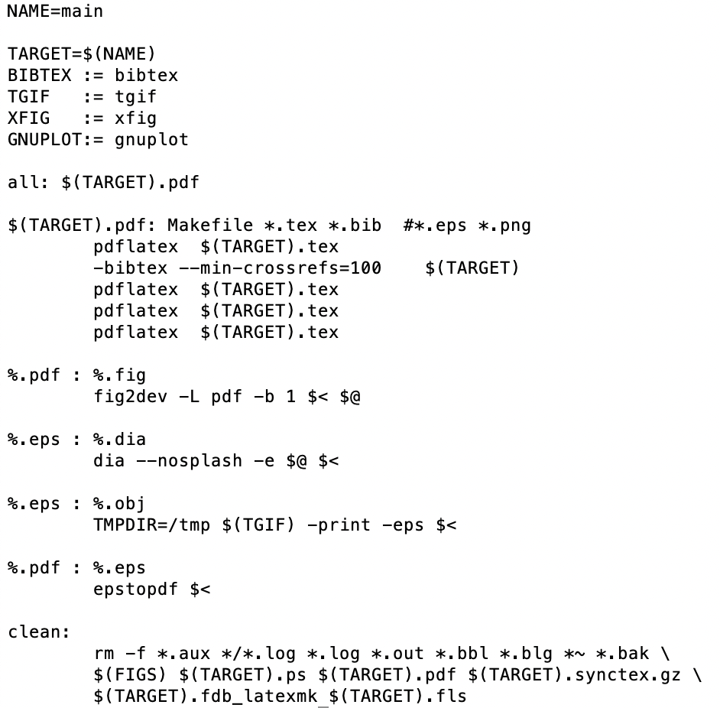
A more complete Makefile
Variable (should really use := instead of =)
:= assign only once
= assign each time it is called
Q: Why run it multiple times?
First requirement name %.obj
Good habit to provide the clean target
Line breaks

Slide 7
Recap: Multiprocessing: The Reality
Process executions are time-interleaved on the processor
Address spaces are all mapped to the memory
States (PC, registers, etc.) of non-executing processes are saved to memory
  Saved before descheduled
  Restored before continue
Multi-core supports concurrent execution
Memory
Stack
Stack
Stack
Heap
Heap
Heap
Data
Data
……
Data
Code
Code
Code
Saved States
Saved States
Saved States
Processor
Processor
PC
PC
Registers
Registers

Slide 8
Recap: Execution Context: Thread
A thread is a single unique execution context
  Including registers, PC, stack pointer, memory, …
A process can have one or multiple threads (multi-threading programs)
A thread can be executing, i.e., occupying a processor and running , or suspended, i.e., not executing
Context switch between threads involves swapping processor states (registers, PC, stack pointer, etc.), but data remain in memory
  Save those of the current executing thread to memory
  Restore those of the next executing thread from memory
Context switch is coordinated by OS

Slide 9
The key take away:
Threads are independently scheduled by the OS.
They can start / stop at any time.
Can we make the process less arbitrary? i.e. make threads cooperate?

Slide 10
Cooperating threads

Slide 11
Why allow cooperating threads?
People cooperate; computers help/enhance people’s lives, so computers must cooperate
Advantage 1: Share resources
  One computer, many users
  One bank balance, many ATMs
    What if ATMs were only updated at night?
  Embedded systems (robot control: coordinate arm & hand)
Advantage 2: Speedup
  Overlap I/O and computation
  Multiprocessors – chop up program into parallel pieces
Advantage 3: Modularity
  Chop large problem up into simpler pieces
    To compile, for instance, gcc calls cpp | cc1 | cc2 | as | ld
    Makes system easier to extend

Slide 12
Multiple Processes / Threads
Collaborate on a Task
Proc 1
Proc 2
Proc 3
Need Communication mechanism:
  Separate address spaces isolates processes
  Shared-Memory Mapping
    Accomplished by mapping addresses to common DRAM
    Read and Write through memory
  Message Passing
    send() and receive() messages
    Works across network
Notes:
Collaboration allows faults to propagate…

Slide 13
Thread Example: Web Server
Multithreaded version:
  serverLoop() {
  connection = AcceptCon();
  ThreadCreate(ServiceWebPage(),connection);
  }
Advantages of threaded version:
  Can share file caches kept in memory, results of CGI scripts, other things
  Threads are much cheaper to create than processes, so this has a lower per-request overhead
What if too many requests come in at once?
  throughput sinks

Slide 14
Thread Example:
Web server with Thread Pools
Problem with previous version: Unbounded Threads
Instead, allocate a bounded “pool” of threads, representing the maximum level of multiprogramming
Master
Thread
queue
Thread Pool
master() {
allocThreads(slave,queue);
while(TRUE) {
con=AcceptCon();
Enqueue(queue,con);
wakeUp(queue);
}
}
slave(queue) {
while(TRUE) {
con=Dequeue(queue);
if (con==null)
sleepOn(queue);
else
ServiceWebPage(con);
}
}

Slide 15
Accessing shared data: Problem is at the lowest level
Most of the time, threads are working on separate data, so cooperation is simple:
Thread A Thread B
x = 1; y = 2;
However, What about (Initially, y = 12):
Thread A Thread B
x = 1; y = 2;
x = y+1; y = y*2;
  What are the possible values of x?
Thread A Thread B
x = 1;
x = y+1;
    y = 2;
    y = y*2
x=13
Notes:
X could be (13, 5, 3)

Slide 16
Accessing shared data: Problem is at the lowest level
Most of the time, threads are working on separate data, so cooperation is simple:
Thread A Thread B
x = 1; y = 2;
However, What about (Initially, y = 12):
Thread A Thread B
x = 1; y = 2;
x = y+1; y = y*2;
  What are the possible values of x?
Thread A Thread B
y = 2;
y = y*2;
    x = 1;
    x = y+1;
x=5
Notes:
X could be (13, 5, 3)

Slide 17
Accessing shared data: Problem is at the lowest level
Most of the time, threads are working on separate data, so cooperation is simple:
Thread A Thread B
x = 1; y = 2;
However, What about (Initially, y = 12):
Thread A Thread B
x = 1; y = 2;
x = y+1; y = y*2;
  What are the possible values of x?
Thread A Thread B
y = 2;
x = 1;
    x = y+1;
    y= y*2;
x=3
Notes:
X could be (13, 5, 3)

Slide 18
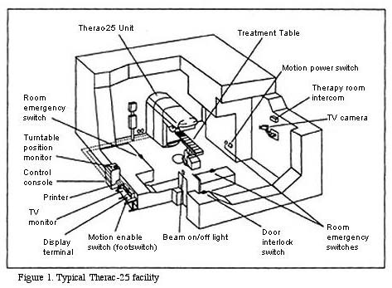
Correctness Problems
Threaded programs must work for all interleavings of thread instruction sequences
  Cooperating threads inherently non-deterministic and non-reproducible
  Really hard to debug unless carefully designed!
Example: Therac-25
  Machine for radiation therapy
    Software control of electron
    accelerator and electron beam/
    Xray production
    Software control of dosage
  Software errors caused
  overdoses and the death of
  several patients
    A series of race conditions on
    shared variables and poor
    software design
    “They determined that data entry speed during editing was the key factor in producing the error condition: If the prescription data was edited at a fast pace, the overdose occurred.”

Slide 19
Summary
Concurrent threads are a very useful abstraction
  Allow transparent overlapping of computation and I/O
  Allow use of parallel processing when available
Concurrent threads introduce problems when accessing shared data
  Programs must be insensitive to arbitrary interleavings
  Without careful design, shared variables can become completely inconsistent

Slide 20
Midterm Announcement
Apr 17 (the week after next), in-class midterm
Place TBD
Covers materials upto the end of the next lecture
For bash commands -> only covers what we discussed in the lecture
1 page A4-size cheat sheet allowed
  Must be readable with your bare eyes (and without destroying your eyes)
Non-programmable calculator allowed, but not necessary
  Following the normal definition of “calculator”

Slide 21
Problems

Slide 22

Motivation: “Too much milk”
Great thing about OS’s – analogy between problems in OS and problems in real life
  Help you understand real life problems better
  But, computers are much stupider than people
Example: People need to coordinate:
Time
Person A
Person B
3:00
Look in Fridge. Out of milk
3:05
Leave for store
3:10
Arrive at store
Look in Fridge. Out of milk
3:15
Buy milk
Leave for store
3:20
Arrive home, put milk away
Arrive at store
3:25
Buy milk
3:30
Arrive home, put milk away
Notes:
You’re sitting in class, hot day, milk does a body good. Go home, no milk, so go to store
Roommate leaves class late because prof is more long-winded than I am. Has same idea, but result is too much milk!
Problem: two cooperating threads, not cooperating properly

Slide 23
Atomic Operations
To understand a concurrent program, we need to know what the underlying atomic operations are!
Atomic Operation: an operation that always runs to completion or not at all
  It is indivisible: it cannot be stopped in the middle and state cannot be modified by someone else in the middle
  Fundamental building block – if no atomic operations, then have no way for threads to work together
On most machines, memory references and assignments (i.e. loads and stores) of a single word are atomic
  More than a word, usually need to be careful
    Double-precision floating point store often not atomic
    VAX and IBM 360 had an instruction to copy a whole array

Slide 24
Too Much Milk: Correctness Properties
Need to be careful about correctness of concurrent programs, since non-deterministic
  Always write down desired behavior first
  Impulse is to start coding first, then when it doesn’t work, pull hair out
  Instead, think first, then code
What are the correctness properties for the “Too much milk” problem?
  Never more than one person buys
  Someone buys if needed
Restrict ourselves to use only atomic load and store operations as building blocks

Slide 25
Definitions
Synchronization: using atomic operations to ensure cooperation between threads
  For now, only loads and stores are atomic
Critical Section: piece of code that only one thread can execute at once
Mutual Exclusion: ensuring that only one thread executes critical section
  One thread excludes the other while doing its task
Critical section and mutual exclusion are two ways of describing the same thing

Slide 26
Concurrency Challenges
Multiple computations (threads) executing in parallel
  Fine grain sharing:
    increase concurrency → better performance
    more complex
  Coarse grain sharing:
    Simpler to implement
    Lower performance
  Examples:
    Sharing CPU for 10ms vs. 1min
    Sharing a database at the row vs. table granularity

Slide 27



More Definitions
Lock: prevents someone from doing something
  Lock before entering critical section and
  before accessing shared data
  Unlock when leaving, after accessing shared data
  Wait if locked
    Important idea: all synchronization involves waiting
Example: fix the milk problem by putting a lock on refrigerator
  Lock it and take key if you are going to go buy milk
  Fixes too much (coarse granularity): roommate angry if only wants orange juice
  Of Course – We don’t know how to make a lock yet
#$@%@#$@

Slide 28

Too Much Milk: Solution #1
Use a note to avoid buying too much milk:
  Leave a note before buying (kind of “lock”)
  Remove note after buying (kind of “unlock”)
  Don’t buy if note (wait)
Suppose a computer tries this (remember, only memory read/write are atomic):
  if (noMilk) {
  if (noNote) {
  leave Note;
  buy milk;
  remove note;
  }
  }
Result?

Slide 29
Too Much Milk: Solution #1
Still too much milk but only occasionally!
Thread A Thread B
if (noMilk)
if (noNote) {
if (noMilk)
if (noNote) {
leave Note;
buy milk;
remove note;
}
}
leave Note;
buy milk;
…
Thread can get context switched after checking milk and note but before leaving note!
Solution makes problem worse since fails intermittently
  Makes it really hard to debug…
  Must work despite what the thread dispatcher does!

Slide 30

Too Much Milk: Solution #1½
Clearly the Note is not quite blocking enough
  Let’s try to fix this by placing note first
Another try at previous solution:
  leave Note;
  if (noMilk) {
  if (noNote) {
  buy milk;
  }
  }
  remove Note;
What happens here?
  Well, with human, probably nothing bad
  With computer: no one ever buys milk

Slide 31
Too Much Milk Solution #2
How about labeled notes?
  Now we can leave note before checking
Algorithm looks like this:
Thread A Thread B
leave note A; leave note B;
if (noNote B) { if (noNote A) {
if (noMilk) { if (noMilk) {
buy Milk; buy Milk;
} }
} }
remove note A; remove note B;
Does this work?

Slide 32
Too Much Milk Solution #2
Possible for neither thread to buy milk!
Thread A Thread B
leave note A;
leave note B;
if (noNote A) {
if (noMilk) {
buy Milk;
}
}
if (noNote B) {
if (noMilk) {
buy Milk;
…
remove note B;
Really insidious:
  Unlikely that this would happen, but will at worse possible time

Slide 33
Too Much Milk Solution #3
Here is a possible two-note solution:
Thread A Thread B
leave note A; leave note B;
while (note B) {\\X if (noNote A) {\\Y
do nothing; if (noMilk) {
} buy milk;
if (noMilk) { }
buy milk; }
} remove note B;
remove note A;
Does this work?
Yes. Both can guarantee that:
  It is safe to buy, or
  Other will buy, ok to quit
At line X:
  if no note B, safe for A to buy,
  otherwise wait to find out what will happen
At line Y:
  if no note A, safe for B to buy
  Otherwise, A is either buying or waiting for B to quit

Slide 34
Solution #3 discussion
Our solution protects a single “Critical-Section” piece of code for each thread:
if (noMilk) {
buy milk;
}
Solution #3 works, but it’s really unsatisfactory
  Really complex – even for this simple an example
    Hard to convince yourself that this really works
  A’s code is different from B’s – what if lots of threads?
    Code would have to be slightly different for each thread
  While A is waiting, it is consuming CPU time
    This is called “busy-waiting”
There’s a better way
  Have hardware provide better (higher-level) primitives than atomic load and store
  Build even higher-level programming abstractions on this new hardware support

Slide 35

Synchronization: High-Level Picture
The abstraction of threads is good:
  Maintains sequential execution model
  Allows simple parallelism to overlap I/O and computation
Unfortunately, still too complicated to access state shared between threads
  Consider “too much milk” example
  Implementing a concurrent program with only loads and stores would be tricky and error-prone
We’ll implement higher-level operations on top of atomic operations provided by hardware
  Develop a “synchronization toolbox”
  Explore some common programming paradigms

Slide 36
Too Much Milk: Solution #4
Suppose we have some sort of implementation of a lock (more in a moment)
  Lock.Acquire() – wait until lock is free, then grab
  Lock.Release() – unlock, waking up anyone waiting
  These must be atomic operations – if two threads are waiting for the lock, only one succeeds to grab the lock
Then, our milk problem is easy:
milklock.Acquire();
if (nomilk)
buy milk;
milklock.Release();
Once again, section of code between Acquire() and Release() called a “Critical Section”

Slide 37
The big picture of synchronization
Programs
Shared Programs
Higher-level
API
Locks Semaphores Monitors Send/Receive
Hardware
Load/Store Disable Ints Test&Set Comp&Swap
We are going to implement various higher-level synchronization primitives using atomic operations
  Everything is pretty painful if only atomic primitives are load and store
  Need to provide primitives useful at user-level

Slide 38
semaphores
Higher level synchronization primitives

Slide 39

Semaphores
Semaphores are a kind of generalized locks
  First defined by Dijkstra in late 60s
  Main synchronization primitive used in original UNIX
Definition: a Semaphore has a non-negative integer value and supports the following two operations:
  P(): an atomic operation that waits for semaphore to become positive, then decrements it by 1
  V(): an atomic operation that increments the semaphore by 1, waking up a waiting P, if any
  Note that P() stands for “proberen” (to test) and V() stands for “verhogen” (to increment) in Dutch

Slide 40

Semaphores Like Integers Except
Semaphores are like integers, except
  No negative values
  Only operations allowed are P and V – can’t read or write value, except to set it initially
  Operations must be atomic
    Two P’s together can’t decrement value below zero
    Similarly, thread going to sleep in P won’t miss wakeup from V – even if they both happen at same time
Semaphore from railway analogy
  Here is a semaphore initialized to 2 for resource control:
Value=2
Value=1
Value=0
Value=1
Value=0
Value=2

Slide 41
Use of semaphores (1)
Mutual Exclusion (initial value = 1)
  Also called “Binary Semaphore”.
  Can be used for mutual exclusion:
    semaphore.P();
    // Critical section goes here
    semaphore.V();
Difference from a lock?

Slide 42
Use of Semaphores (2)
Scheduling Constraints (initial value = 0)
  Allow thread 1 to wait for a signal from thread 2, i.e., thread 2 schedules thread 1 when a given constrained is satisfied
  Example: suppose you had to implement ThreadJoin which must wait for thread to terminate:
    Initial value of semaphore = 0
    ThreadJoin {
    semaphore.P();
    }
    ThreadFinish {
    semaphore.V();
    }

Slide 43

Producer-consumer with a bounded buffer
Producer
Consumer
Buffer
Problem Definition
  Producer puts things into a shared buffer
  Consumer takes them out
  Need synchronization to coordinate producer/consumer
Don’t want producer and consumer to have to work in lockstep, so put a fixed-size buffer between them
  Need to synchronize access to this buffer
  Producer needs to wait if buffer is full
  Consumer needs to wait if buffer is empty
Example 1: GCC compiler
  cpp | cc1 | cc2 | as | ld
Example 2: Coke machine
  Producer can put limited number of Cokes in machine
  Consumer can’t take Cokes out if machine is empty

Slide 44
Correctness constraints
Correctness Constraints:
  Consumer must wait for producer to fill slots, if empty (scheduling constraint)
  Producer must wait for consumer to make room in buffer, if all full (scheduling constraint)
  Only one thread can manipulate buffer queue at a time (mutual exclusion) -- necessary?
General rule of thumb:
Use a separate semaphore for each constraint
  Semaphore fullSlots; // consumer’s constraint
  Semaphore emptySlots;// producer’s constraint
  Semaphore mutex; // mutual exclusion

Slide 45
Full Solution to Bounded Buffer
Semaphore fullSlots = 0; // Initially, no coke
Semaphore emptySlots = bufSize;
// Initially, num empty slots
Semaphore mutex = 1; // No one using machine
Producer(item) {
emptySlots.P(); // Wait until space
mutex.P(); // Wait until machine free
Enqueue(item);
mutex.V();
fullSlots.V(); // Tell consumers there is
// more coke
}
Consumer() {
fullSlots.P(); // Check if there’s a coke
mutex.P(); // Wait until machine free
item = Dequeue();
mutex.V();
emptySlots.V(); // tell producer need more
return item;
}

Slide 46
Discussion about Solution
Producer(item) {
mutex.P();
emptySlots.P();
Enqueue(item);
mutex.V();
fullSlots.V();
}
Consumer() {
fullSlots.P();
mutex.P(); item = Dequeue();
mutex.V();
emptySlots.V();
return item;
}
Is order of P’s important?
  Yes! Can cause deadlock
Is order of V’s important?
  No, except that it might affect scheduling efficiency
What if we have 2 producers or 2 consumers?
  Do we need to change anything?
Notes:
????

Slide 47
Monitors and conditional variables
Higher level synchronization primitives

Slide 48
Motivation for Monitors and Condition Variables
Semaphores are a huge step up; just think of trying to do the bounded buffer with only loads and stores
Problem is that semaphores are dual purpose:
  They are used for both mutex and scheduling constraints
  You hold the lock (mutex) even if you block on scheduling constraints
  Example: the fact that flipping of P’s in bounded buffer gives deadlock is not immediately obvious. How do you prove correctness to someone?
Notes:
2 types of constraints:
Mutual exclusions
Scheduling constraints

Slide 49
Motivation for Monitors and Condition Variables
Cleaner idea: Use locks for mutual exclusion and condition variables for scheduling constraints
Monitor: a lock and zero or more condition variables for managing concurrent access to shared data
  Some languages like Java provide this natively
  Most others use actual locks and condition variables

Slide 50
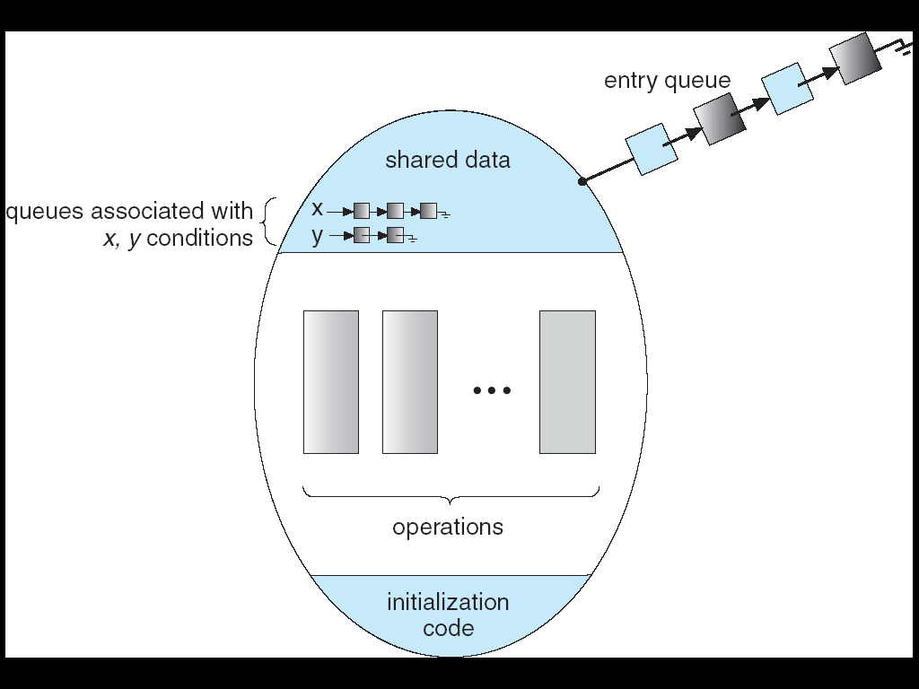
Monitor with Condition Variables
Lock: the lock provides mutual exclusion to shared data
  Always acquire before accessing shared data structure
  Always release after finishing with shared data
  Lock initially free
Condition Variable: a queue of threads waiting for something inside a critical section
  Key idea: make it possible to go to sleep inside critical section by atomically releasing lock at time we go to sleep

Slide 51
Simple Monitor Example
Here is an (infinite) synchronized queue
Lock lock;
Queue queue;
AddToQueue(item) {
lock.Acquire(); // Lock shared data
queue.enqueue(item); // Add item
lock.Release(); // Release Lock
}
RemoveFromQueue() {
lock.Acquire(); // Lock shared data
item = queue.dequeue();// Get next item or null
lock.Release(); // Release Lock
return(item); // Might return null
}
Not very interesting use of “Monitor”
  It only uses a lock with no condition variables
  Cannot put consumer to sleep if no work!

Slide 52
Condition Variables
Condition Variable: a queue of threads waiting for something inside a critical section
  Key idea: allow sleeping inside critical section by atomically releasing lock at time we go to sleep
  Contrast to semaphores: Can’t wait inside critical section
Operations:
  Wait(&lock): Atomically release lock and go to sleep. Re-acquire lock later, before returning.
  Signal(): Wake up one waiter, if any
  Broadcast(): Wake up all waiters
Rule: Must hold lock when doing condition variable ops!

Slide 53
Complete Monitor Example
(with condition variable)
Here is an (infinite) synchronized queue
Lock lock;
Condition dataready;
Queue queue;
AddToQueue(item) {
lock.Acquire(); // Get Lock
queue.enqueue(item); // Add item
dataready.signal(); // Signal any waiters
lock.Release(); // Release Lock
}
RemoveFromQueue() {
lock.Acquire(); // Get Lock
while (queue.isEmpty()) {
dataready.wait(&lock); // If nothing, sleep
}
item = queue.dequeue(); // Get next item
lock.Release(); // Release Lock
return(item);
}

Slide 54
Mesa vs. Hoare monitors
Need to be careful about precise definition of signal and wait. Consider a piece of our dequeue code:
while (queue.isEmpty()) {
dataready.wait(&lock); // If nothing, sleep
}
item = queue.dequeue(); // Get next item
  Why didn’t we do this?
if (queue.isEmpty()) {
dataready.wait(&lock); // If nothing, sleep
}
item = queue.dequeue(); // Get next item
Answer: depends on the type of scheduling
  Hoare-style
  Mesa-style

Slide 55
Hoare monitors
Signaler gives up lock and CPU to waiter; waiter runs immediately
Waiter gives up lock, processor back to signaler when it exits critical section or if it waits again
Most textbooks
…
lock.Acquire()
…
dataready.signal();
…
lock.Release();
Lock.Acquire()
…
if (queue.isEmpty()) {
dataready.wait(&lock);
}
…
lock.Release();
Lock, CPU
Lock, CPU

Slide 56
Mesa monitors
Signaler keeps lock and processor
Waiter placed on a local “e” queue for the monitor
Practically, need to check condition again after wait
Most real operating systems
Put waiting thread on ready queue
…
lock.Acquire()
…
dataready.signal();
…
lock.Release();
Lock.Acquire()
…
while (queue.isEmpty()) {
dataready.wait(&lock);
}
…
lock.Release();
schedule waiting thread

Slide 57
Mesa Monitor: Why “while()”?
Why do we use “while()” instead of “if() with Mesa monitors?
  Example illustrating what happens if we use “if()”, e.g.,
if (queue.isEmpty()) {
dataready.wait(&lock); // If nothing, sleep
}
We’ll use the synchronized (infinite) queue example
AddToQueue(item) {
lock.Acquire();
queue.enqueue(item);
dataready.signal();
lock.Release();
}
RemoveFromQueue() {
lock.Acquire();
if (queue.isEmpty()) {
dataready.wait(&lock);
}
item = queue.dequeue();
lock.Release();
return(item);
}
Hoare
Mesa: Replace “while” with “if”
Notes:
Hoare problem: priority inversion

Slide 58
Mesa Monitor: Why “while()”?
App. Shared State
Monitor
CPU State
queue
lock: FREE
Running: T1
Ready
queue → NULL
…
dataready
queue
NULL
T1 (Running)
RemoveFromQueue() {
lock.Acquire();
if (queue.isEmpty()) {
dataready.wait(&lock);
}
item = queue.dequeue();
lock.Release();
return(item);
}

Slide 59
Mesa Monitor: Why “while()”?
App. Shared State
Monitor
CPU State
queue
lock: BUSY (T1)
Running: T1
Ready
queue → NULL
…
dataready
queue
NULL
T1 (Running)
RemoveFromQueue() {
lock.Acquire();
if (queue.isEmpty()) {
dataready.wait(&lock);
}
item = queue.dequeue();
lock.Release();
return(item);
}

Slide 60
Mesa Monitor: Why “while()”?
App. Shared State
Monitor
CPU State
queue
lock: FREE
Running:
Ready
queue → NULL
…
dataready
queue
T1
wait(&lock) puts thread on dataready queue and releases lock
T1 (Waiting)
RemoveFromQueue() {
lock.Acquire();
if (queue.isEmpty()) {
dataready.wait(&lock);
}
item = queue.dequeue();
lock.Release();
return(item);
}

Slide 61
Mesa Monitor: Why “while()”?
App. Shared State
Monitor
CPU State
queue
lock: FREE
Running: T2
Ready
queue → NULL
…
dataready
queue
T1
T1 (Waiting)
T2 (Running)
RemoveFromQueue() {
lock.Acquire();
if (queue.isEmpty()) {
dataready.wait(&lock);
}
item = queue.dequeue();
lock.Release();
return(item);
}
AddToQueue(item) {
lock.Acquire();
queue.enqueue(item);
dataready.signal();
lock.Release();
}

Slide 62
Mesa Monitor: Why “while()”?
App. Shared State
Monitor
CPU State
queue
add
item
lock: BUSY (T2)
Running: T2
Ready
queue → NULL
…
dataready
queue
T1
T1 (Waiting)
T2 (Running)
RemoveFromQueue() {
lock.Acquire();
if (queue.isEmpty()) {
dataready.wait(&lock);
}
item = queue.dequeue();
lock.Release();
return(item);
}
AddToQueue(item) {
lock.Acquire();
queue.enqueue(item);
dataready.signal();
lock.Release();
}

Slide 63
Mesa Monitor: Why “while()”?
App. Shared State
Monitor
CPU State
queue
lock: BUSY (T2)
Running: T2
Ready
queue → T1
…
dataready
queue
NULL
T1 (Ready)
T2 (Running)
signal() wakes up T1 and moves it on ready queue
RemoveFromQueue() {
lock.Acquire();
if (queue.isEmpty()) {
dataready.wait(&lock);
}
item = queue.dequeue();
lock.Release();
return(item);
}
AddToQueue(item) {
lock.Acquire();
queue.enqueue(item);
dataready.signal();
lock.Release();
}

Slide 64
Mesa Monitor: Why “while()”?
App. Shared State
Monitor
CPU State
queue
lock: BUSY (T2)
Running: T2
Ready
queue → T1, T3
…
dataready
queue
NULL
T1 (Ready)
T2 (Running)
T3 (Ready)
RemoveFromQueue() {
lock.Acquire();
if (queue.isEmpty()) {
dataready.wait(&lock);
}
item = queue.dequeue();
lock.Release();
return(item);
}
AddToQueue(item) {
lock.Acquire();
queue.enqueue(item);
dataready.signal();
lock.Release();
}
RemoveFromQueue() {
lock.Acquire();
if (queue.isEmpty()) {
dataready.wait(&lock);
}
item = queue.dequeue();
lock.Release();
return(item);
}

Slide 65
Mesa Monitor: Why “while()”?
App. Shared State
Monitor
CPU State
queue
lock: FREE
Running:
Ready
queue → T1, T3
…
dataready
queue
NULL
T1 (Ready)
T2 (Terminate)
T3 (Ready)
RemoveFromQueue() {
lock.Acquire();
if (queue.isEmpty()) {
dataready.wait(&lock);
}
item = queue.dequeue();
lock.Release();
return(item);
}
AddToQueue(item) {
lock.Acquire();
queue.enqueue(item);
dataready.signal();
lock.Release();
}
RemoveFromQueue() {
lock.Acquire();
if (queue.isEmpty()) {
dataready.wait(&lock);
}
item = queue.dequeue();
lock.Release();
return(item);
}

Slide 66
Mesa Monitor: Why “while()”?
App. Shared State
Monitor
CPU State
queue
lock: FREE
Running: T3
Ready
queue → T1
…
dataready
queue
NULL
T3 scheduled first!
T1 (Ready)
T3 (Running)
RemoveFromQueue() {
lock.Acquire();
if (queue.isEmpty()) {
dataready.wait(&lock);
}
item = queue.dequeue();
lock.Release();
return(item);
}
RemoveFromQueue() {
lock.Acquire();
if (queue.isEmpty()) {
dataready.wait(&lock);
}
item = queue.dequeue();
lock.Release();
return(item);
}

Slide 67
Mesa Monitor: Why “while()”?
App. Shared State
Monitor
CPU State
queue
lock: BUSY (T3)
Running: T3
Ready
queue → T1
…
dataready
queue
NULL
T1 (Ready)
T3 (Running)
RemoveFromQueue() {
lock.Acquire();
if (queue.isEmpty()) {
dataready.wait(&lock);
}
item = queue.dequeue();
lock.Release();
return(item);
}
RemoveFromQueue() {
lock.Acquire();
if (queue.isEmpty()) {
dataready.wait(&lock);
}
item = queue.dequeue();
lock.Release();
return(item);
}

Slide 68
Mesa Monitor: Why “while()”?
App. Shared State
Monitor
CPU State
queue
remove
item
lock: BUSY (T3)
Running: T3
Ready
queue → T1
…
dataready
queue
NULL
T1 (Ready)
T3 (Running)
RemoveFromQueue() {
lock.Acquire();
if (queue.isEmpty()) {
dataready.wait(&lock);
}
item = queue.dequeue();
lock.Release();
return(item);
}
RemoveFromQueue() {
lock.Acquire();
if (queue.isEmpty()) {
dataready.wait(&lock);
}
item = queue.dequeue();
lock.Release();
return(item);
}

Slide 69
Mesa Monitor: Why “while()”?
App. Shared State
Monitor
CPU State
queue
lock: FREE
Running:
Ready
queue → T1
…
dataready
queue
NULL
T1 (Ready)
T3 (Finished)
RemoveFromQueue() {
lock.Acquire();
if (queue.isEmpty()) {
dataready.wait(&lock);
}
item = queue.dequeue();
lock.Release();
return(item);
}
RemoveFromQueue() {
lock.Acquire();
if (queue.isEmpty()) {
dataready.wait(&lock);
}
item = queue.dequeue();
lock.Release();
return(item);
}

Slide 70
Mesa Monitor: Why “while()”?
App. Shared State
Monitor
CPU State
queue
lock: BUSY (T1)
Running: T1
Ready
queue → NULL
…
dataready
queue
NULL
T1 (Running)
RemoveFromQueue() {
lock.Acquire();
if (queue.isEmpty()) {
dataready.wait(&lock);
}
item = queue.dequeue();
lock.Release();
return(item);
}

Slide 71
Mesa Monitor: Why “while()”?
App. Shared State
Monitor
CPU State
queue
lock: BUSY (T1)
Running: T1
Ready
queue → NULL
…
dataready
queue
NULL
T1 (Running)
RemoveFromQueue() {
lock.Acquire();
if (queue.isEmpty()) {
dataready.wait(&lock);
}
item = queue.dequeue();
lock.Release();
return(item);
}
ERROR: Nothing in the queue!

Slide 72
Mesa Monitor: Why “while()”?
App. Shared State
Monitor
CPU State
queue
lock: BUSY (T1)
Running: T1
Ready
queue → NULL
…
dataready
queue
NULL
T1 (Running)
RemoveFromQueue() {
lock.Acquire();
while (queue.isEmpty()) {
dataready.wait(&lock);
}
item = queue.dequeue();
lock.Release();
return(item);
}
Replace “if” with “while”

Slide 73
Mesa Monitor: Why “while()”?
App. Shared State
Monitor
CPU State
queue
lock: BUSY (T1)
Running: T1
Ready
queue → NULL
…
dataready
queue
NULL
T1 (Ready)
RemoveFromQueue() {
lock.Acquire();
while (queue.isEmpty()) {
dataready.wait(&lock);
}
item = queue.dequeue();
lock.Release();
return(item);
}
Check again if empty!

Slide 74
Mesa Monitor: Why “while()”?
App. Shared State
Monitor
CPU State
queue
lock: FREE
Running: T1
Ready
queue → NULL
…
dataready
queue
T1
T1 (Waiting)
RemoveFromQueue() {
lock.Acquire();
while (queue.isEmpty()) {
dataready.wait(&lock);
}
item = queue.dequeue();
lock.Release();
return(item);
}
http://research.microsoft.com/en-us/um/people/blampson/23-processesinmesa/Acrobat.pdf
Notes:
Potential Problem: Starvation

Slide 75

Tony Hoare (C A R Hoare)
Turing Award 1980
Quicksort (1960)
Hoare Logic (formal verification)
Communicating Sequential Processes (CSP)
Monitors
There are two ways of constructing a software design: One way is to make it so simple that there are obviously no deficiencies, and the other way is to make it so complicated that there are no obvious deficiencies. The first method is far more difficult.

Slide 76
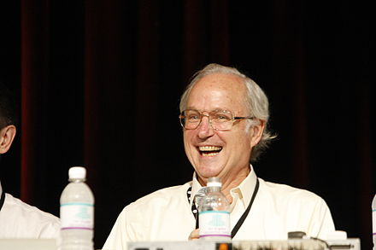
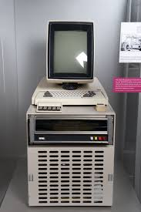
Butler Lampson
Turing Award, 1992
1970 – Xerox PARC
1973 Xerox Alto
Co-inventor of:
  laser printer
  two-phase commit protocols
  Bravo, the first WYSIWYG text formatting program;
  Ethernet

Slide 77
Summary
Semaphores
  Generalized locks
  Two operations: P(), V()
Monitors: A synchronous object plus one or more condition variables
  Always acquire lock before accessing shared data
  Use condition variables to wait inside critical section
    Three Operations: Wait(), Signal(), and Broadcast()

