Slide 1
Introduction to Computer Systems
Lecture 11
Networking
Wei Xu
Note: Some slides and/or pictures in the following are adapted from slides ©2005-2023 Silberschatz, Galvin, and Gagne. Slides courtesy of Anthony D. Joseph, John Kubiatowicz, AJ Shankar, George Necula, Alex Aiken, Eric Brewer, Ras Bodik, Ion Stoica, Doug Tygar, David Wagner, and John Canny .

Slide 2
Goals for Today
(Takes about 1.5 lectures)
Key ideas in computer networking
  Efficiently utilizing the wires: Multiplexing
  Finding the destinations: Addressing
  Getting data through: Reliability and Flow control
  Adapting to different applications: Layering
Interface to networking from software: Remote procedure calls

Slide 3
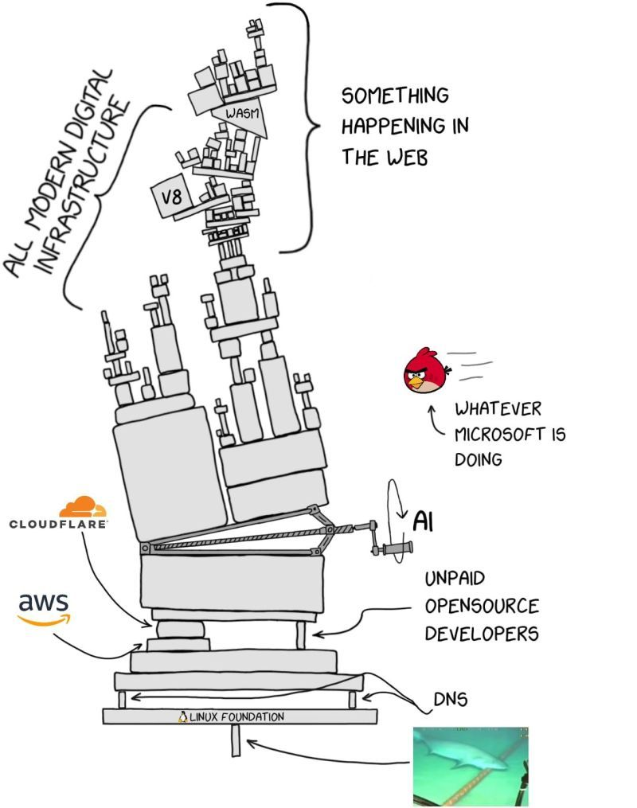
Why networking?
Why buy a computer / phone …
  Before you purchase …
  After you purchase …
When AI agents failed to work …
  Get get messy
Notes:
How is networking possible? It is made possible via the use of protocols.

Slide 4
Basic Network Functionalities
Delivery: deliver packets between to any two hosts in the Internet without a large number of physical wires
  E.g., deliver a packet from a host in Beijing to a host in LA?
Reliability: tolerate packet losses
  E.g., how do you ensure all bits of a file are delivered in the presence of packet loses?
Flow control and congestion control: avoid overflowing the receiver + avoid overflowing the routers
  E.g., how do you ensure that a server that can send at 10Gbps doesn’t overwhelm a LTE phone?
  Flow control is for your data transfer
  Congestion control is for the general good of the entire network
Notes:
Packet switching vs circuit switching. Efficiency vs. QoS
Lte: about 25MB/s
If we overflow the routers, they will drop packets. And we have to retransmit. Then get dropped. Bad circle. Nothing get through. So sending data as fast as you could actually hurts throughput.

Slide 5
multiplexing

Slide 6
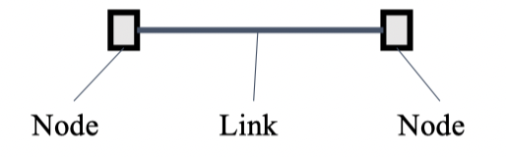
Basic Building Block: Links
Electrical questions
  Voltage, frequency, …
  Wired or wireless?
Link-layer issues: How to send data?
  When to talk — can either side talk at once?
  What to say — low-level format?

Slide 7
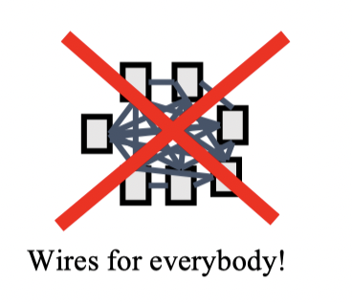
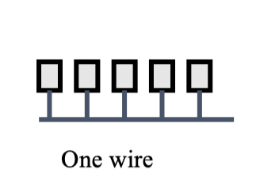
What if we want more hosts?
When to send?
Who should receive?
Scalability?

Slide 8
Multiplexing
Need to share network resources
Multiplexing is analogous to “time sharing” in OS
  Can share not only on time, but may on other things
How? Switched network
  Party “A” gets resources sometimes
  Party “B” gets them sometimes
Interior nodes act as “Switches”

Slide 9


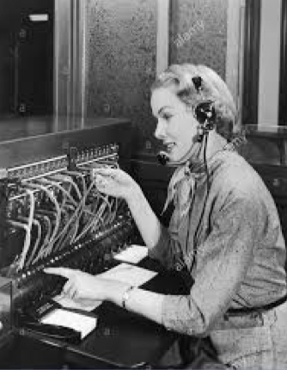


In the Old Days… Circuit Switching

Slide 10
Packet Switching
Source sends information as self-contained packets that have an address
  Source may have to break up single message into multiple
Each packet travels independently to the destination host
  Switches use the address in the packet to detmerine how to forward the packets
  Store and forward
Analogy: a letter in surface mail.

Slide 11




Packet Switching — Statistical Multiplexing
Packets
Swtiches arbitrate between inputs
Can send from any input that’s ready
  Links never idle when there is traffic to send
  Efficiency

Slide 12
addresses

Slide 13
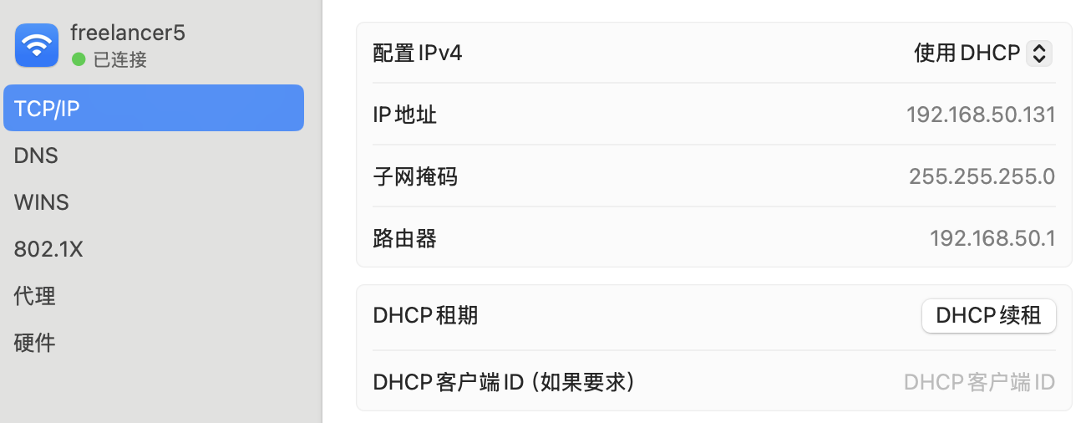
IP addresses and gaetway

Slide 14
IP Addresses vs. MAC Addresses
Why not use MAC addresses for routing?
  Doesn’t scale
Analogy
  MAC address → Cell phone number
  IP address → (unreadable) home address / landline number
MAC address: uniquely associated to the device for the entire lifetime of the device
IP address: changes as the device location changes
  Your notebook IP address at school is different from home
Notes:
Switches operate at datalink layer. Routers operate at network layer.
Ip addresses are another example of another level of indirection.

Slide 15
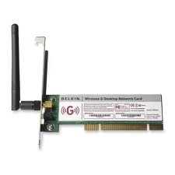
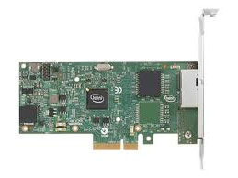
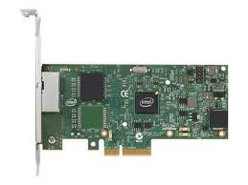
Network interface cards (NICs)
Network (interface) card/controller (NIC): hardware that physically connects a computer to the network
A computer can have more than one networking cards
  E.g., one card for wired network, and one for wireless network
Process
A
Process
B
OS
OS
Network cards

Slide 16
Addressing to a NIC
MAC address: 48-bit unique identifier assigned by card vendor
IP Address: 32-bit (or 128-bit for IPv6) address assigned by network administrator or dynamically when computer connects to network
Process
A
Process
B
IP Addr2
MAC Addr2
IP Addr3
MAC Addr3
OS
OS
IP Addr1
MAC Addr1
Network cards
Notes:
When should we use a fixed ip? – server

Slide 17
Addressing into a process: ports
Connection: communication channel between two processes
Each endpoint is identified by a port number
  Port number: 16-bit identifier assigned by app or OS
  Globally, an endpoint is identified by (IP address, port number)
Process
A
Process
B
Connection
PortA
PortB
IP Addr2
MAC Addr2
IP Addr3
MAC Addr3
OS
OS
IP Addr1
MAC Addr1
Network cards
Notes:
A connection is on the software level and is something that you can write code to manipulate. It is between two processes on two machines.

Slide 18
Common Port Numbers
Application | Port number
Wake-on-LAN | 9
FTP data | 20
FTP control | 21
SSH | 22
Telnet | 23
DNS | 53
HTTP | 80
SNMP | 161
… | …

Slide 19
Addressing: finding the right target

Slide 20
Addressing on a local area network (LANs)
How does one find the MAC of a IP host?
  Broadcast
ARP
  Broadcast search for IP address
    E.g., “who-has 128.2.184.45 tell 128.2.206.138” sent to Ethernet broadcast (all FF address)
  Destination responds (only to requester using unicast) with appropriate 48-bit Ethernet address
    E.g, “reply 128.2.184.45 is-at 0:d0:bc:f2:18:58” sent to 0:c0:4f:d:ed:c6

Slide 21



LANs: Hubs
All hosts in a LAN can share the same physical communication media (wire)
“Hubs” forward from one wire to all the others
  If a host is not the intended recipient, it drops the frame
Congestions on the wire?
  Ethernet: Detect and retransmit
MAC Addr: A
MAC Addr: B
MAC Addr: C
B
B
Notes:
LAN shares the same datalink layer

Slide 22
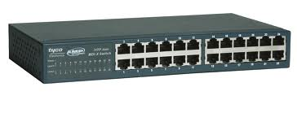

LANs: Switches
Hosts in same LAN can be also connected by switches
A switch forwards frames only to intended recipients
  “Learning switch”: remembers which MAC is connected to which port
  Far more efficient than broadcast channel
MAC Addr: B
MAC Addr: D
Switch
MAC Addr: C
MAC Addr: A
B
Notes:
More efficient. In a broadcast network, if one is transmitting, no one else can transmit. It is also safer. You don’t see other’s traffic. So your roommate can’t see what movies you are watching, if your lan is switched. Now most ethernets are switched.

Slide 23
Wide Area Network (WAN)
Wide Area Network (WAN): network that covers a broad area (e.g., city, state, country, entire world)
  E.g., Internet is a WAN
WAN connects multiple datalink layer networks (LANs)
Datalink layer networks are connected by routers
  Different LANs can use different communication technologies (e.g., wireless, cellular, optics, wired)
Host A
(IP A)
R4
Host B
(IP B)
R2
R3
R1

Slide 24
WANs: Routers
Forward each packet received on an incoming link to an outgoing link based on packet’s destination IP address (towards its destination)
Store & forward: packets are buffered before being forwarded
Forwarding table: mapping between IP address and the output link
incoming links
Router
outgoing links
Memory

Slide 25
Packet Forwarding
Upon receiving a packet, a router
  read the IP destination address of the packet
  consults its forwarding table → output port
  forwards packet to corresponding output port
Host A
(IP A)
R4
Host B
(IP B)
IP B
R2
R3
R1

Slide 26
Naming -> addressing

Slide 27
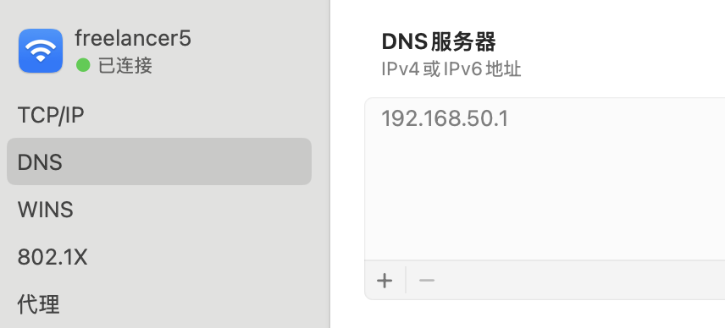
DNS
Domain name
To IP address
Not just easier to remember
  A level of indirection
  E.g. find the closest server
  E.g. avoid attacks

Slide 28
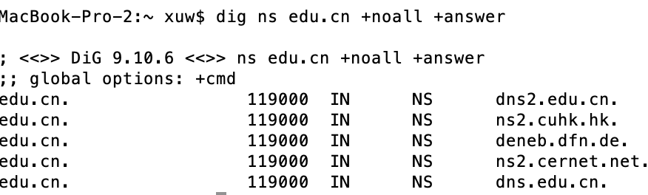
Typical Resolution
iiis.tsinghua.edu.cn
iiis.tsinghua.edu.cn
Root & .cn
DNS Server
NS
edu.cn
Client
Local DNS Server

Slide 29
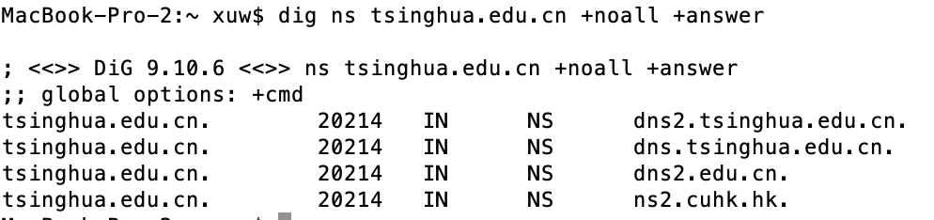
Typical Resolution
iiis.tsinghua.edu.cn
iiis.tsinghua.edu.cn
Root & .cn
DNS Server
NS
edu.cn
Client
Local DNS Server
NS
tsinghua.edu.cn
edu.cn DNS

Slide 30
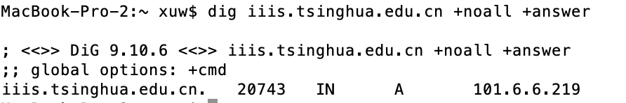
Typical Resolution
iiis.tsinghua.edu.cn
iiis.tsinghua.edu.cn
Root & .cn
DNS Server
NS
edu.cn
Client
Local DNS Server
NS
tsinghua.edu.cn
A
Iiis.tsinghua.edu.cn
edu.cn DNS
Tsinghua.edu.cn DNS

Slide 31
Why is DNS important?
Overloaded for many many things
Load balancing
Geo-locality
Fault tolerance
Security
Censorship
Everything running on 1980’s design

Slide 32
Reliability and flow control

Slide 33
Parameters of a communication channel
Latency – how long does it take for the first bit to reach destination
Capacity — how many bits/sec can we push through? (often termed “bandwidth”)
Jitter — how much variation in latency?
Loss / reliability — can the channel drop packets?
Packet reordering

Slide 34

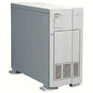
Data may get Lost
Problem: Lost Data
GET index.html
Internet
Solution: Timeout and Retransmit
GET index.html
GET index.html
Internet
GET index.html
Key problem: You never distinguish the data is lost b/c of
1) a link problem or 2) because of overflow / congestion
Nor can can you distinguish if it is
1) delayed for very long, or 2) really lost

Slide 35
Data may get Corrupted
Problem: Data Corruption
GET index.html
GET inrex.html
Internet
Solution: Add a checksum
X
0,9
9
6,7,8
21
4,5
7
1,2,3
6

Slide 36
Data may be delivered Out of Order
Problem: Out of Order
ml
inde
x.ht
GET
GET x.htindeml
Solution: Add Sequence Numbers
ml
4
inde
2
x.ht
3
GET
1
GET index.html

Slide 37
What If Network is Overloaded?
Problem: Network Overload
Solution: Buffering and Congestion Control
Short bursts: buffer (reduces jitter) – queuing
What if buffer overflows?
  Packets dropped
What can we do?
  Avoid: make sure that the network is not congested
  Recover: Sender adjusts rate until not overloaded

Slide 38
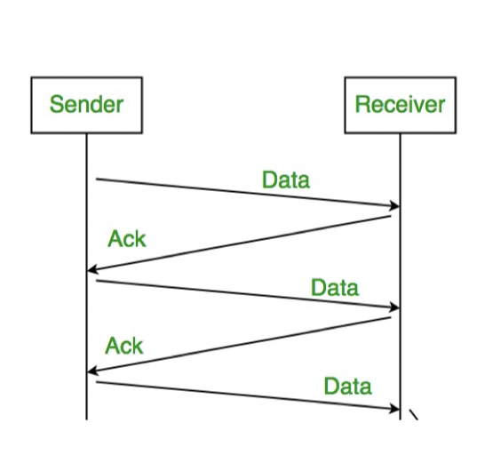
Avoid overflowing the receiver:
Polite Networks: Stop & Wait Protocol
A kind of reliable delivery.
Accomplished by using acknowledgements (ACK) and timeouts
Receipt of ACK indicates to sender of original frame that it was successfully delivered
If sender doesn’t receive ACK after a reasonable timeout, it retransmits frame.

Slide 39
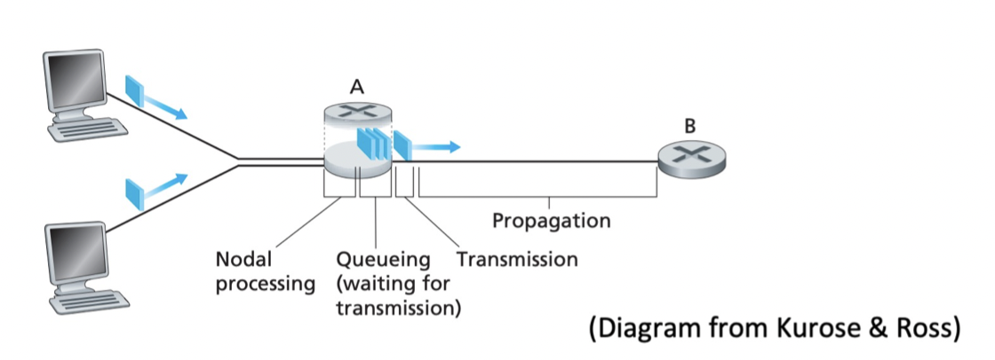
Packet Delay
Sum of a number of different delay components:
Propagation delay on each link.
  Proportional to the length of the link
Transmission delay on each link.
  Proportional to the packet size and 1/(link speed)
Processing delay on each router.
  Depends on the speed of the router
Queuing delay on each router.
  Depends on the traffic load and queue size

Slide 40
Packet Delay
(xmit = transmission delay)
Prop + xmit
2*(Prop + xmit)
2*prop + xmit
Store & Forward
Cut-through
When does cut-through matter?
Next: back-of-the-envelope calculations
(What’s the xmit? Which protocol are we using?)

Slide 41
Back-of-the-Envelope Bandwidth Calculation
Cross country latency
  Distance/speed = 5 * 10^6m / 2x10^8m/s = 25 * 10^-3 s = 25ms
  50ms round-trip-time (RTT) for one bit
Link speed (capacity) 100Mbps
Packet size = 1250 bytes = 10 kbits
  Packet size on networks usually = 1500bytes across wide area or 9000bytes in local area
Propagation delay
Transmission delay
Processing delay
Queuing delay
1 packet takes
  10k/100M = .1 ms to transmit
  25ms to reach there
  ACKs are small → so 0ms to transmit
  25ms to get back
Effective bandwidth = 10kbits/50.1ms = 200kbits/sec ☹

Slide 42
Think about this…
What if we sent two packets before waiting for an ACK
  What if we sent N packets?
  How many packets do we need to send before we use up the capacity of the link?

Slide 43
How does it work in reality? (TCP)
This is a very incomplete view. :)
Source
Destination
Data pkt
ACKnowledgement
Time
  What TCP does:
  1) Allow W packets before requiring an ACK
  2) Need to figure out W
  3) Also need to figure out which packets got lost

Slide 44
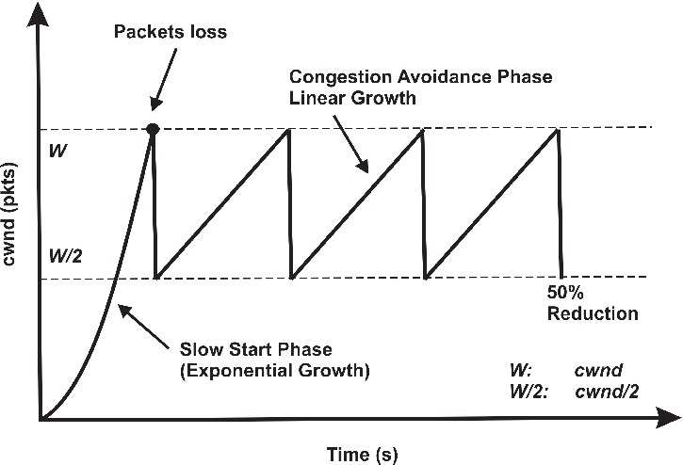
Intuitive TCP flow control
Retransmit lost packets
  Keep a sequence number on each packet
Figuring out the rate
  Slow start
    Start with very small sending rate, increase fast
    Until detect overflow (how?)
  Slowdown quickly, then increase slowly until overflow again
  AIMD = additive increment multiplicative decrement
Congestion control
Many details + optimizations
in networking course

Slide 45
layering

Slide 46
The Problem (cont’d)
Application
Skype
SSH
NFS
HTTP
Transmission
Media
Coaxial
cable
Fiber
optic
Packet
Radio
Re-implement every application for every technology?
No! But how does the Internet design avoid this?

Slide 47
Solution: Intermediate Layers
Introduce intermediate layers that provide set of abstractions for various network functionality & technologies
  A new app/media implemented only once
  Variation on “add another level of indirection”
Application
Skype
SSH
NFS
HTTP
Intermediate
layers
Transmission
Media
Coaxial
cable
Fiber
optic
Packet
radio
Notes:
Adding another level of indirection turns an nxm problem into an n+m one.

Slide 48
Software System Modularity
Partition system into modules & abstractions:
Well-defined interfaces give flexibility
  Hides implementation - thus, it can be freely changed
  Extend functionality of system by adding new modules
E.g., libraries encapsulating set of functionality
E.g., programming language + compiler abstracts away not only how the particular CPU works …
  … but also the basic computational model
Well-defined interfaces hide information
  Present high-level abstractions
  But can impair performance

Slide 49
Layering: A Modular Approach in Networking
Like software modularity, but:
  Implementation distributed across many machines (routers and hosts)
Partition the system
  Each layer solely relies on services from layer below
  Each layer solely exports services to layer above
Interface between layers defines interaction
  Hides implementation details
  Layers can change without disturbing other layers
Notes:
Each layer should provide complete end to end communication.

Slide 50
Properties of Layers
Service: what a layer does (functionality)
Service interface: how to access the service
  Interface for layer above
Protocol: how peers communicate to use the service
  Set of rules and formats that specify the communication between network elements
  Does not specify the implementation on a single machine, but how the layer is implemented between machines

Slide 51
Protocol Standardization
Ensure communicating hosts speak the same protocol
  Standardization to enable multiple implementations
  Or, the same folks have to write all the software
Standardization: Internet Engineering Task Force
  Based on working groups that focus on specific issues
  Produces “Request For Comments” (RFCs)
    Promoted to standards via rough consensus and running code
  IETF Web site is http://www.ietf.org/
  RFCs archived at http://www.rfc-editor.org/
De facto standards: same folks writing the code
  P2P file sharing, Skype, <your protocol here>…
Notes:
Protocols are conventions. They need to have commonly agreed means. When I say chilema? I didn’t mean to take you to dinner. It is kind of a greeting. Who assign meanings to messages and signals that are commonly understood across the global? We need some standardization.
There are also some de facto standards. De facto means, it just happened, I wrote an application and it became pupolar and the convention I choose became standard.

Slide 52
OSI Layering Model
Open Systems Interconnection (OSI) model
  Developed by International Organization for Standardization (ISO) in 1984
  Seven layers
Internet Protocol (IP)
  Only five layers
  The functionalities of the missing layers (i.e., Presentation and Session) are provided by the Application layer
Application
Presentation
Session
Transport
Network
Datalink
Physical
Notes:
There are basically two competing models. Osi model defined by ISO. ISO standardizes everything, from food quality to how you build your factory. One of them won,

Slide 53

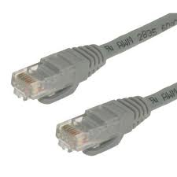
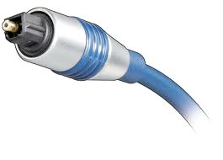
Physical Layer (1)
Application
Present.
Session
Service: move information between two systems connected by a physical link
Interface: specifies how to send and receive bits
Protocol: coding scheme used to represent a bit, voltage levels, duration of a bit
Examples: coaxial cable, optical fiber links; transmitters, receivers
Transport
Network
Datalink
Physical
Datalink
layer
Datalink
layer
Transmission
medium
Physical Layer
Physical Layer
101010100110101110
101010100110101110
Notes:
Protocol: specifies how to encode the information using signals, duration, wavelength, voltages, etc

Slide 54
Datalink Layer (2)
Application
Present.
Session
Transport
Network
Datalink
Service:
  Enable end hosts to exchange frames (atomic messages) on the same physical line or wireless link
  Possible other services:
    Arbitrate access to common physical media
    May provide reliable transmission, flow control (not common)
Interface: send frames to other end hosts; receive frames addressed to end host
Protocols:
  Addressing: ARP
  Media Access Control (MAC): e.g., CSMA/CD - Carrier Sense Multiple Access / Collision Detection
Physical
Notes:
Physical layer deals with transmitting bits, datalink deals with transmitting frames. And the hosts must be on the same physical line or wireless link.

Slide 55
Datalink Layer (2)
Application
Present.
Session
Each frame has a header which contains a source and a destination MAC address
ARP to address (using broadcast)
Can have flow control or not
Transport
Network
Datalink
Physical
MAC Dest. Address
MAC Src. Address
…
Network
Layer
Network
Layer
Datalink Layer
Frame
Hdr.
Frame Payload
Frame
Hdr.
Frame Payload
Datalink Layer
Physical Layer
Physical Layer
101010100110101110
101010100110101110

Slide 56
(Inter) Network Layer (3)
Application
Present.
Session
Transport
Service:
  Deliver packets to specified network (IP) addresses across multiple datalink layer networks
  Possible other services:
    Packet scheduling/priority
    Buffer management
Interface: send packets to specified network address destination; receive packets destined for end host
Protocols: define network addresses (globally unique); construct forwarding tables; packet forwarding
Network
Datalink
Physical

Slide 57
(Inter) Network Layer (3)
Application
Present.
Session
IP address: source + destination
Transport
Network
Datalink
Physical
Transport
Layer
IP Dest. Address
IP Src. Address
…
Transport
Layer
Network Layer
Net.
Hdr.
Net. Payload
Net.
Hdr.
Net. Payload
Network Layer
Frame Payload
Datalink Layer
Frame
Hdr.
Net.
Hdr.
Net. Payload
Frame
Hdr.
Net.
Hdr.
Net. Payload
Datalink Layer
Physical Layer
Physical Layer
101010100110101110
101010100110101110

Slide 58



The Internet Protocol (IP)
Application
Present.
Session
Transport
Internet Protocol: Internet’s network layer
Service it provides: “Best-Effort” Packet Delivery
  Tries it’s “best” to deliver packet to its destination
  Packets may be lost / corrupted / out of order
Network
Datalink
Physical
source
destination
IP network

Slide 59
Transport Layer (4)
Application
Present.
Session
Service:
  Port: end-to-end communication between processes
  Demultiplexing of communication between hosts: Multiple processes on the same hosts communicating simultaneously
  Optional other services:
    Reliability in the presence of errors
    Timing properties
    Rate adaption (flow-control, congestion control)
Interface: send message to specific process at given destination; local process receives messages sent to it
Protocol: port numbers, perhaps implement reliability, flow control, packetization of large messages, framing
Examples: TCP and UDP
Transport
Network
Datalink
Physical
Notes:
Ip is end-to-end communication between hosts

Slide 60
Port Numbers
Application
Present.
Port number: 16-bit number identifying a process on destination host
Session
Transport
Network
Datalink
Physical
Transport Layer
Trans.
Hdr.
Data
Trans.
Hdr.
Data
Transport Layer
Network Layer
Net.
Hdr.
Trans.
Hdr.
Data
Net.
Hdr.
Trans.
Hdr.
Data
Network Layer
Datalink Layer
Frame
Hdr.
Net.
Hdr.
Trans.
Hdr.
Data
Frame
Hdr.
Net.
Hdr.
Trans.
Hdr.
Data
Datalink Layer
Physical Layer
Physical Layer
101010100110101110
101010100110101110
Notes:
Port number identifies a process. Can be assigned by the os or requested by the application.

Slide 61
Internet Transport Protocols
Application
Present.
Session
Transport
Datagram service (UDP)
  No-frills extension of “best-effort” IP
  Multiplexing/Demultiplexing among processes
Reliable, in-order delivery (TCP)
  Connection set-up & tear-down
  Discarding corrupted packets (segments)
  Retransmission of lost packets (segments)
  Flow control
  Congestion control
Services not available
  Delay and/or bandwidth guarantees
  Sessions that survive change-of-IP-address
Network
Datalink
Physical
Notes:
Udp is basically IP between processes. It does multiplexing/demultiplexing.
Mobile ip protocol supports change of ip addresses. But it is not used very widely.

Slide 62
Application Layer (7 - not 5!)
Application
Present.
Session
Transport
Service: any service provided to the end user
Interface: depends on the application
Protocol: depends on the application
Examples: Skype, SMTP (email), HTTP (Web), BitTorrent …
What happened to layers 5 & 6?
  “Session” and “Presentation” layers
  Part of OSI architecture, but not Internet architecture
  Their functionality is provided by application layer
Network
Datalink
Physical

Slide 63
The entire stack
Application Layer
Application Layer
Data
Data
Transport Layer
Trans.
Hdr.
Data
Trans.
Hdr.
Data
Transport Layer
Network Layer
Net.
Hdr.
Trans.
Hdr.
Data
Net.
Hdr.
Trans.
Hdr.
Data
Network Layer
Datalink Layer
Frame
Hdr.
Net.
Hdr.
Trans.
Hdr.
Data
Frame
Hdr.
Net.
Hdr.
Trans.
Hdr.
Data
Datalink Layer
Physical Layer
Physical Layer
101010100110101110
101010100110101110

Slide 64
Five Layers Summary
Lower three layers implemented everywhere
Ideally, top two layers implemented only at hosts
  But there are “smart” network devices nowadays too
Application
Application
Transport
Transport
Network
Network
Network
Datalink
Datalink
Datalink
Physical
Physical
Physical
Host A
Router
Host B
Communication goes down to physical network
Then from network peer to peer
Then up to relevant layer

Slide 65
The Internet Hourglass
SMTP
HTTP
DNS
NTP
Applications
TCP
UDP
Transport
Waist
IP
Data Link
Ethernet
SONET
802.11
Physical
Copper
Fiber
Radio
The Hourglass Model
There is just one network-layer protocol, IP
The “narrow waist” facilitates interoperability
Notes:
It’s like everyone speaks the same language.

Slide 66
Implications of Hourglass
Single Internet-layer module (IP):
Allows arbitrary networks to interoperate
  Any network technology that supports IP can exchange packets
Allows applications to function on all networks
  Applications that can run on IP can use any network
Supports simultaneous innovations above and below IP
  But changing IP itself, i.e., IPv6 is very complicated and slow
Notes:
Downside: if you need to change the waist, it is really hard. You need to change everything.

Slide 67
Drawbacks of Layering
Layering can hurt performance
  E.g., hiding details about what is really going on
Headers start to get really big
  Sometimes header bytes >> actual content
Layer N may duplicate layer N-1 functionality
  E.g., error recovery to retransmit lost data
  Modern model training software build on IB, a layer-2 directly
Layers may need same information
  E.g., timestamps, maximum transmission unit size
Notes:
Video: compressed using codec which often supports error recovery. If we are using a network that drops corrupted packets, you will never have a chance to do this recovery.
Question: can you think of a better solution than layering? With systems, you need to make tradeoffs. It is impossible to have everything,
Internet spans multiple entities, there may not be a better way,

Slide 68
End-to-End Argument / Reasoning
Deals with where to place functionality
  Inside the network (in switching elements)
  At the edges
Argument
  If you have to implement a function end-to-end anyway, don’t implement it inside the communication system
  True or False: if network provide perfect delivery, we do not need to handle network I/O errors in the software
  Unless there’s a compelling performance enhancement
Key motivation for split of functionality between TCP,UPD and IP
“End-to-End Arguments in System Design.” Saltzer, Reed, and Clark.

Slide 69
Remote procedure calls

Slide 70
Inter-process communication (IPC)
Recall: Process is a “virtual machine”, cannot see each other
Recall: inter-process communication mechanisms we learned so far..
fork() – return values
Signal
File
  including stdin / stdout
Pipes
Shared memory segments
Networking - Socket

Slide 71
Raw network from software:
Socket API
Client
Server
socket
socket
bind
open_listenfd
open_clientfd
listen
Connection
request
connect
accept
Client / Server
Session
write
read
read
write
close
EOF
read
close
You can wrap the socket API into an RPC as the underlying communication mechanism.

Slide 72

Communication mode 1:
Clients and Servers
Client program
  Running on end host
  Requests service
  E.g., Web browser
Server program
  Running on end host
  Provides service
  E.g., Web server
GET /index.html
“Site under construction”

Slide 73
Communication mode 2:
Peer-to-Peer Communication
Each host is both server and client
No always-on server at the center of it all
  Hosts can come and go, and change addresses
  Hosts may have a different address each time
Example: peer-to-peer file sharing (e.g., BitTorrent)
  Any host can request files, send files, query to find where a file is located, respond to queries, and forward queries
  Scalability by harnessing millions of peers
  Each peer acting as both a client and server

Slide 74
Protocols
A protocol is an agreement on how to communicate
Includes
  Syntax: how a communication is specified & structured
    Format, order messages are sent and received
  Semantics: what a communication means
    Actions taken when transmitting, receiving, or when a timer expires
Notes:
How is networking possible? It is made possible via the use of protocols.

Slide 75
Remote Procedure Call
IPC mechanisms share raw bytes
  Raw messaging is a bit too low-level for programming
  Part of high-level programming language is to provide data types!
  What is a data type?
    Size + meaning of each bit
    “Protocol”
Another option: Remote Procedure Call (RPC)
  Looks like a local procedure call on client:
  file.read(1024);
  Translated automatically into a procedure call on remote machine (server)
Implementation:
  Uses request/response message passing “under the covers”

Slide 76

RPC Information Flow
marshall
args
Client
(caller)
call
Client
Stub
send
Packet
Handler
return
receive
unmarshall
ret vals
Machine A
Network
Network
Machine B
marshall
return vals
Server
(callee)
return
Server
Stub
send
Packet
Handler
call
receive
unmarshall
args

Slide 77
RPC Details: Marshalling Arguments
Marshalling involves converting values to a canonical form, serializing objects, copying arguments passed by reference, etc.
  Needs to account for cross-language and cross-platform issues
  Can encode as JSON (very general), but need to tradeoff efficiency
Client and server use “stubs” to glue pieces together
  Also called “serialize” / “de-serialize”
Technique: compiler generated stubs
  Input: interface definition language (IDL)
    Contains, among other things, types of arguments/return
  Output: stub code in the appropriate source language

Slide 78
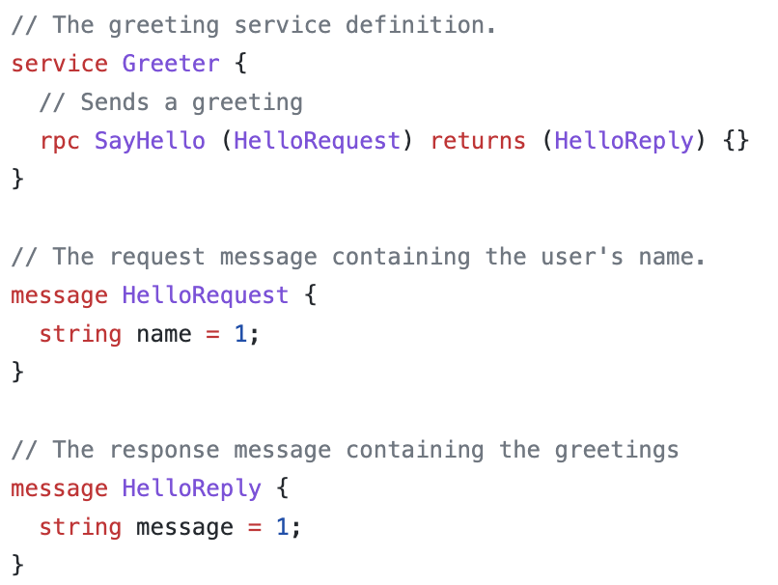
GRPC
GRPC is a cross-platform, cross-language RPC system developed at Google
Uses its own IDL (.proto files)

Slide 79
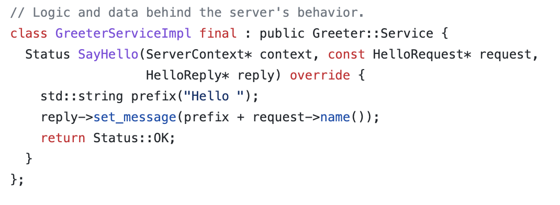
Server and Client Template
IDL compiles to the RPC stub code (.pb.h/.pb.cc code)
As well as a GreeterServiceImpl template

Slide 80
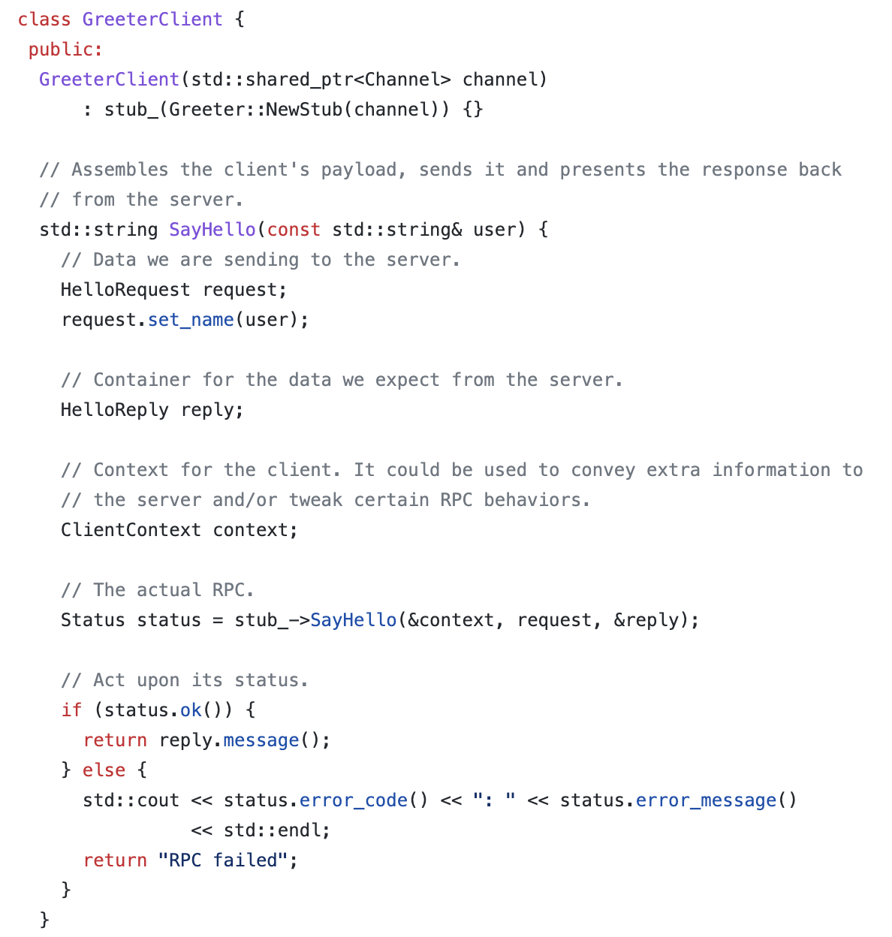
Client Code

Slide 81
Is RPC the same as local call?
  Different failure modes
  Without RPC a failure within a procedure call usually meant whole application would crash/die
  With RPC a failure within a procedure call means remote machine crashed, but local one could continue working
  Answer? Distributed transactions can help
Performance
  Cost of Procedure call << same-machine RPC << network RPC
  Means programmers must be aware they are using RPC
    No transparency in performance
    Caching can help, but may make failure handling even more complex

Slide 82
Call Semantics
Exactly once (same as local IPC)
At most once
At least once
How about if a RPC times out?

