Slide 1
Introduction to Computer Systems
Lecture 12
Transactions
Wei Xu
Note: Some slides and/or pictures in the following are adapted from slides ©2005 Silberschatz, Galvin, and Gagne. Slides courtesy of Anthony D. Joseph, John Kubiatowicz, AJ Shankar, George Necula, Alex Aiken, Eric Brewer, Ras Bodik, Ion Stoica, Doug Tygar, David Wagner, and John Canny .

Slide 2
Announcement
Final Exam (updated)
  Jun 16th (Tuesday) 19:00-21:00
  技科楼-3311,技科楼-3417
Covering the entire semester, with a focus on the second half
HW 4 will be released next week
  (no need to submit, review only)
Final review the week after next

Slide 3
Agenda
From file systems to database
  Structured data and schema
  Query execution
  Concept of a transaction
How to achieve atomic writes on disks
Implementing isolation in transactions (locks)

Slide 4
Databases and queries

Slide 5
Why do we talk about DB?
Very important software
Revisit concepts we learned for the OS, with extensions
  Atomic memory access -> atomic disk access
  Lock in memory -> lock + I/O
  Revisit of reader-writer locks
What is the different from OS file system?
  Structured data (“data model”)
    Why?
  So provide more reliability

Slide 6
Key Concept: Structured Data
A data model is a collection of entities and their relationships
A schema is an instance of a data model
  E.g., describes the fields in the database; how the database is organized
A relational data model is the most used data model
  Relation, a table with rows and columns
  Every relation has a schema which describes the fields in the columns
Notes:
Data models: relational, also Document Model (encoded as XML)

Slide 7
Example: Course Database
Conceptual schema:
  Students(sid: string, name: string, email: string, age: integer,
  gpa:real)
  Courses(cid: string, cname:string, credits:integer)
  Enrolled(sid:string, cid:string, grade:string)
  FOREIGN KEY sid REFERENCES Students
  FOREIGN KEY cid REFERENCES Courses
Notes:
7

Slide 8
What is a Database System?
A Database Management System (DBMS) is a software system designed to store, manage, and facilitate access to databases.
A DBMS provides:
  Data Definition Language (DDL)
    Define relations, schema
  Data Manipulation Language (DML)
    Queries – to retrieve, analyze and modify data.
  Guarantees about durability, concurrency, semantics, etc

Slide 9
Key Concepts: Queries, Query Plans, and Operators
Pick columns:(sid, name, gpa)
  SELECT sid, name, gpa
  FROM Students S
  WHERE S.gpa > 3
Projection
Select all students with GPA>3
Select
Students
System handles query plan generation & optimization; ensures correct execution.
Students
Courses
Enrolled
Select all students with GPA > 3.0

Slide 10
Key Concepts: Queries, Query Plans, and Operators
Count distinct sids
  SELECT
  COUNT DISTINCT (E.sid)
  FROM Enrolled E, Courses C
  WHERE E.cid = C.cid
  AND C.credits = 4
Count distinct
Select rows with credits=4
Select
Columns:
(sid,cid,
credits,…)
Join
Enrolled
Courses
System handles query plan generation & optimization; ensures correct execution.
Columns:
(sid,cid,…)
Columns:
(cid,credits,…)
Students
Courses
Enrolled
Number of students who take a 4 credit class

Slide 11
A general way to reliability: transactions

Slide 12
Key concept: Transaction
An atomic sequence of database actions (reads/writes)
Takes DB from one consistent state to another
transaction
consistent state 1
consistent state 2

Slide 13
“Consistency”
checking: $200
savings: $1000
transaction
checking: $300
savings: $900
Here, consistency is based on our knowledge of banking “semantics”
In general, up to writer of transaction to ensure transaction preserves consistency
DBMS provides (limited) automatic enforcement, via integrity constraints (IC)
  e.g., balances must be >= 0
Notes:
“check” constraints are only evaluated on each row

Slide 14
The ACID properties of Transactions
Atomicity: all actions in the transaction happen, or none happen
Consistency: transactions maintain data integrity, e.g.,
  Balance cannot be negative
  Cannot reschedule meeting on February 30
Isolation: execution of one transaction is isolated from that of all others; no problems from concurrency
Durability: if a transaction commits, its effects persist despite crashes

Slide 15
Database functionality: group any sequences as a transaction
BEGIN; --BEGIN TRANSACTION
UPDATE accounts SET balance = balance - 100.00 WHERE name = 'Alice';
UPDATE branches SET balance = balance - 100.00 WHERE name = (SELECT branch_name FROM accounts WHERE name = 'Alice');
UPDATE accounts SET balance = balance + 100.00 WHERE name = 'Bob';
UPDATE branches SET balance = balance + 100.00 WHERE name = (SELECT branch_name FROM accounts WHERE name = 'Bob');
COMMIT; --COMMIT WORK
Transfer $100 from Alice’s account to Bob’s account

Slide 16
Implementing transactions: atomic writes to disk

Slide 17
Operations on persistent storage are not atomic !
Recall: in-memory operations
  Load / Store on a single word is atomic
  Basic operations are atomic
Atomicity on persistent storage
  Even writing a single block is not atomic
  Many operations involves many reads/writes
  If broken, cannot recovery from a single reboot
E.g. File system update
  Some operations in progress may complete
  Some operations in progress may be lost
  Overwrite of a block may only partially complete

Slide 18
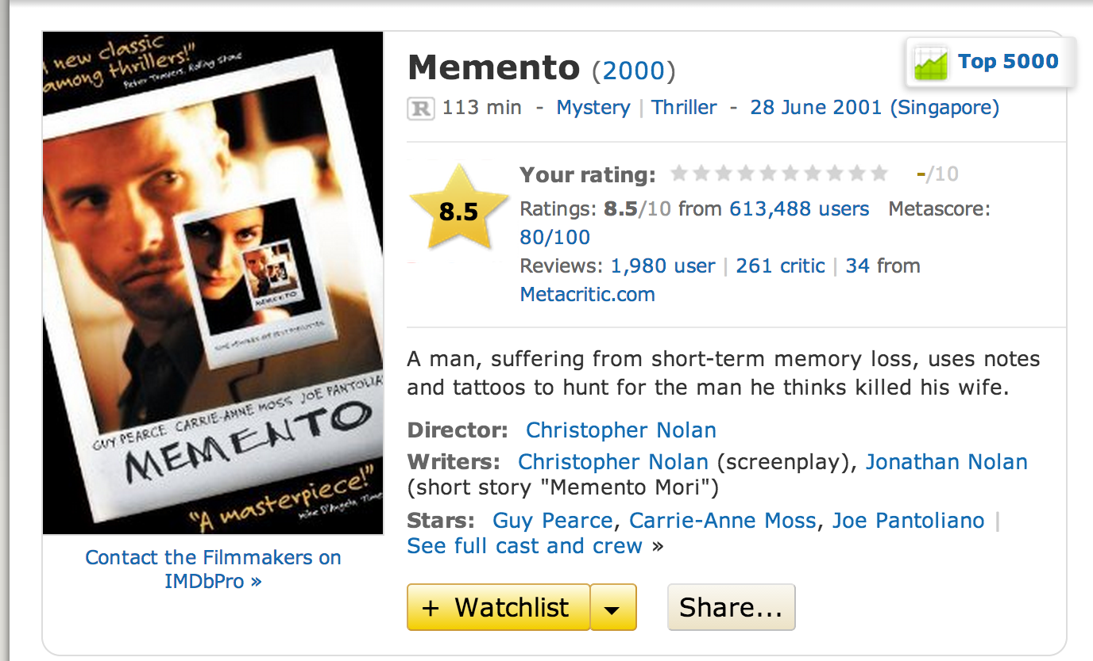

Slide 19
File Systems: Create a File
Normal operation:
Allocate data block
Write data block
Allocate inode
Write inode block
Update bitmap of free blocks and inodes
Update directory with file name → inode number
Update modify time for directory
Recovery:
Scan inode table
If any unlinked files (not in any directory), delete or put in lost & found dir
Compare free block bitmap against inode trees
Scan directories for missing update/access times
Time proportional to disk size

Slide 20
Concept of a log
One simple action is atomic – write/append a basic item
Use that to seal the commitment to a whole series of actions
Commit Tran N
Start Tran N
Get 10$ from account A
Get 7$ from account B
Get 13$ from account C
Put 15$ into account X
Put 15$ into account Y

Slide 21
Example: Creating a File
Find free data block(s)
Find free inode entry
Find dirent insertion point
-----------------------------------------
Write map (i.e., mark used)
Write inode entry to point to block(s)
Write dirent to point to inode
Free space map
Data blocks
…
Inode table
Directory
entries

Slide 22
Ex: Creating a file (as a transaction)
Find free data block(s)
Find free inode entry
Find dirent insertion point
---------------------------------------------------------
[log] Write map (used)
[log] Write inode entry to point to block(s)
[log] Write dirent to point to inode
Free space map
Data blocks
…
Inode table
Directory
entries
tail
head
done
pending
start
commit
Log: in non-volatile storage (Flash or on Disk)

Slide 23
“Redo Log “ – Replay Transactions
After Commit
All access to file system first looks in log
Eventually copy changes to disk
Free space map
Data blocks
…
Inode table
Directory
entries
tail
tail
tail
tail
tail
head
done
start
commit
pending
Log: in non-volatile storage (Flash or Disk)

Slide 24
Crash During Logging – Recover
Upon recovery scan the log
Detect transaction start with no commit
Discard log entries
Disk remains unchanged
Free space map
Data blocks
…
Inode table
Directory
entries
tail
head
done
pending
start
Log: in non-volatile storage (Flash or on Disk)

Slide 25
Recovery After Commit
Scan log, find start
Find matching commit
Redo it as usual
  Or just let it happen later
Free space map
Data blocks
…
Inode table
Directory
entries
tail
head
done
pending
start
commit
Log: in non-volatile storage (Flash or on Disk)

Slide 26
“Journaling file system”
Why go through all this trouble?
Updates atomic, even if we crash:
  Update either gets fully applied or discarded
  All physical operations treated as a logical unit
Isn't this expensive?
Yes! We're now writing all data twice (once to log, once to actual data blocks in target file)
Modern file systems offer an option to journal metadata updates only
  Record modifications to file system data structures
  But apply updates to a file's contents directly

Slide 27
Implementing transactions:
Locks

Slide 28
From Multiprogramming to Transactions
Transactions are atomic
  But we do not run them one by one
  Concurrent execution essential for good performance
    Disk slow, so need to keep the CPU busy by working on several user programs concurrently
DBMS only concerned about what data is read/written from/to the database
  i.e. DBMS’s abstract view of a user program, i.e., a sequence of reads and writes.

Slide 29
Example
Consider two transactions:
  T1: moves $100 from account A to account B
  T2: moves $50 from account B to account A
Each operation consists of (1) a read, (2) an addition/subtraction, and (3) a write
Example: A = A-100
T1:A := A-100; B := B+100;
T2:A := A+50; B := B-50;
Read(A); // R(A)
A := A – 100;
Write(A); // W(A)

Slide 30
Database Locks
A “lock” in a DB is a higher-level construct than in an OS.
Think of it as a Readers-Writers Monitor. Why?
Locks are handled by a lock manager process, and involve updates to a lock table accessible to all clients.
Setting and releasing locks is a relatively expensive process.

Slide 31
Locking Granularity
Database
What granularity to lock?
  Database
  Tables
  Rows
Fine granularity (e.g., row) → high concurrency
  Multiple users can update the database and same table simultaneously
Coarse granularity (e.g., database, table) → simple, but low concurrency
Provide the same semantics as clients were running one at a time
Table 1
Table 3
Row
Table 2
Table 4

Slide 32
Goals of Transaction Scheduling
Maximize system utilization, i.e., concurrency
  Interleave operations from different transactions
Preserve transaction semantics
  Semantically equivalent to a serial schedule, i.e., one transaction runs at a time
T1: R, W, R, W
T2: R, W, R, R, W
Serial schedule (T1, then T2):
Serial schedule (T2, then T1):
R, W, R, W, R, W, R, R, W
R, W, R, R, W, R, W, R, W

Slide 33
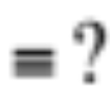
Two Key Questions
Is a given schedule equivalent to a serial execution of transactions?
How do you come up with a schedule equivalent to a serial schedule?
Schedule:
R, R, W, W, R, R, R, W, W
Serial schedule (T1, then T2):
:
Serial schedule (T2, then T1):
R, W, R, W, R, W, R, R, W
R, W, R, R, W, R, W, R, W

Slide 34
Anomalies with Interleaved Execution
May violate transaction semantics, e.g., some data read by the transaction changes before committing
Inconsistent database state, e.g., some updates are lost
Anomalies always involves a “write”; Why?

Slide 35
Anomalies with Interleaved Execution
Write-write conflict (overwriting uncommitted data)
Get T1’s update of B and T2’s update of A
Violates transaction serializability
Obviously incorrect
If transactions were serial, you’d get either:
  T1’s updates of A and B
  T2’s updates of A and B
T1:W(A), W(B)
T2: W(A),W(B)

Slide 36
Anomalies with Interleaved Execution
Read-Write conflict (Unrepeatable reads)
Violates transaction semantics
Example: Mary and John want to buy a TV set on jd.com on 618, but there is only one left in stock
  (T1) John logs in first, but waits…
  (T2) Mary logs in second and buys the TV set right away
  (T1) John decides to buy, but it is too late…
T1:R(A), R(A),W(A)
T2: R(A),W(A)

Slide 37
Anomalies with Interleaved Execution
Write-read conflict (reading uncommitted data)
Example:
  (T1) A user updates value of A in two steps
  (T2) Another user reads the intermediate value of A, which can be inconsistent
  Violates transaction semantics since T2 is not supposed to see intermediate state of T1
T1:R(A),W(A), W(A)
T2: R(A), …

Slide 38
Transaction Scheduling
Serial schedule: A schedule that does not interleave the operations of different transactions
  Transactions run serially (one at a time)
Equivalent schedules: For any storage/database state, the effect (on storage/database) and output of executing the first schedule is identical to the effect of executing the second schedule
Serializable schedule: A schedule that is equivalent to some serial execution of the transactions
  Intuitively: with a serializable schedule you only see things that could happen in situations where you were running transactions one-at-a-time

Slide 39
Conflict Serializable Schedules
Two operations conflict if they
  Belong to different transactions
  Are on the same data
  At least one of them is a write
Two schedules are conflict equivalent iff:
  Involve same operations of same transactions
  Every pair of conflicting operations is ordered the same way
Schedule S is conflict serializable if S is conflict equivalent to some serial schedule
Conflict serializable => serializable

Slide 40
Conflict Equivalence – Intuition
If you can transform an interleaved schedule by swapping consecutive non-conflicting operations of different transactions into a serial schedule, then the original schedule is conflict serializable
Example:
T1:R(A),W(A), R(B),W(B)
T2: R(A),W(A), R(B),W(B)
T1:R(A),W(A), R(B), W(B)
T2: R(A), W(A), R(B),W(B)
T1:R(A),W(A),R(B), W(B)
T2: R(A),W(A), R(B),W(B)

Slide 41
Conflict Equivalence – Intuition (cont’d)
If you can transform an interleaved schedule by swapping consecutive non-conflicting operations of different transactions into a serial schedule, then the original schedule is conflict serializable
Example:
T1:R(A),W(A),R(B), W(B)
T2: R(A),W(A), R(B),W(B)
T1:R(A),W(A),R(B), W(B)
T2: R(A), W(A),R(B),W(B)
T1:R(A),W(A),R(B),W(B)
T2: R(A),W(A),R(B),W(B)

Slide 42
Conflict Equivalence – Intuition (cont’d)
If you can transform an interleaved schedule by swapping consecutive non-conflicting operations of different transactions into a serial schedule, then the original schedule is conflict serializable
Is this schedule conflict serializable?
T1:R(A), W(A)
T2: R(A),W(A),

Slide 43
Dependency Graph
Dependency graph:
  Transactions represented as nodes
  Edge from Ti to Tj:
    an operation of Ti conflicts with an operation of Tj
    Ti appears earlier than Tj in the schedule
Theorem: Schedule is conflict serializable if and only if its dependency graph is acyclic

Slide 44
Example
Conflict serializable schedule:
No cycle!
T1:R(A),W(A), R(B),W(B)
T2: R(A),W(A), R(B),W(B)
A
B
T1
T2
Dependency graph

Slide 45
Example
Conflict that is not serializable:
Cycle: The output of T1 depends on T2, and vice-versa
T1:R(A),W(A), R(B),W(B)
T2: R(A),W(A),R(B),W(B)
A
T1
T2
Dependency graph
B

Slide 46
Example
T1:R(A), W(A)
T2: R(A),W(A),
A
T1
T2
Dependency graph
B

Slide 47
Notes on Conflict Serializability
Conflict Serializability doesn’t allow all schedules that you would consider correct
  This is because it is strictly syntactic - it doesn’t consider the meanings of the operations or the data
In practice, Conflict Serializability is what gets used, because it can be done efficiently
  Note: in order to allow more concurrency, some special cases do get implemented, such as for travel reservations, …
Notes:
Maybe the operations are commutative (add 1)

Slide 48
Serializability ≠> Conflict Serializability
Following schedule is not conflict serializable
However, the schedule is serializable since its output is equivalent with the following serial schedule
Note: deciding whether a schedule is serializable (not conflict-serializable) is NP-complete
Dependency graph
T1:R(A), W(A),
T2: W(A),
T3: W(A)
A
A
T1
T2
A
A
T3
T1:R(A),W(A),
T2: W(A),
T3: W(A)

Slide 49
Locks
“Locks” to control access to data
Two types of locks:
  shared (S) lock – multiple concurrent transactions allowed to operate on data
  exclusive (X) lock – only one transaction can operate on data at a time
 | S | X
S | √ | –
X | – | –
Lock
Compatibility
Matrix

Slide 50
Two-Phase Locking (2PL)
1) Each transaction must obtain:
  S (shared) or X (exclusive) lock on data before reading,
  X (exclusive) lock on data before writing
2) A transaction can not request additional locks once it releases any locks
Thus, each transaction has a “growing phase” followed by a “shrinking phase”
Lock Point!
Growing
Phase
Shrinking
Phase

Slide 51
Two-Phase Locking (2PL)
2PL guarantees that the dependency graph of a schedule is acyclic. => Conflict Serializable
Why?
  Assume there is a cycle between Tj and Tj
  Edge from Ti -> Tj : Ti acquires lock first, Tj waits
  Edge from Tj -> Ti : Tj acquires lock first, Ti waits
  Thus, Both Ti and Tj waits (for each other), and no one releases the lock
  Deadlocked => cannot proceed, so contradiction.
Therefore 2PL-compatible schedules are conflict serializable.

Slide 52
Summary
Transaction: a sequence of storage operations
ACID:
  Atomicity: all operations in a transaction happen, or none happens
  Consistency: if database/storage starts consistent, it ends up consistent
  Isolation: execution of one transaction is isolated from another
  Durability: the results of a transaction persists
Correctness criterion for transactions is “Serializability”
  In practice, we use “Conflict Serializability”, which is somewhat more restrictive but easy to enforce
  2PL is an algorithm to implement conflict serializability
Atomicity and Durability if there are failures
  Redo Logging
Notes:
Sp13 finished 20 mins early

