Slide 1
Introduction to Computer Systems
Lecture 13
Distributed Systems
Wei Xu
Note: Some slides and/or pictures in the following are adapted from slides ©2005 Silberschatz, Galvin, and Gagne. Slides courtesy of Anthony D. Joseph, John Kubiatowicz, AJ Shankar, George Necula, Alex Aiken, Eric Brewer, Ras Bodik, Ion Stoica, Doug Tygar, David Wagner, and John Canny .

Slide 2
Agenda
What is an distributed system?
Communication building blocks (RPCs)
Challenges in distributed systems
Using distributed file systems as examples

Slide 3
Distributed systems overview

Slide 4
Why distributed systems?
Recall on a single machine (OS) – Multi-core and parallelism …
  Couldn’t increase GHz much more without CPU temperatures reaching solar levels
  But we can still stuff more transistors (Moore’s Law)
  Result: Multi-core and GPUs
    Your computer has became a parallel / distributed system
And the whole Internet …
  My iPhone syncs its calendar with Apple, which I can get on my desktop
    And connectivity hugely changes
  Most things are distributed, and more each day

Slide 5
Why do we want distributed systems?
Cheaper and easier to build lots of simple computers
Easier to add power incrementally
Administrative domain: users can have complete control over some components
Collaboration: Much easier for users to collaborate through network resources

Slide 6
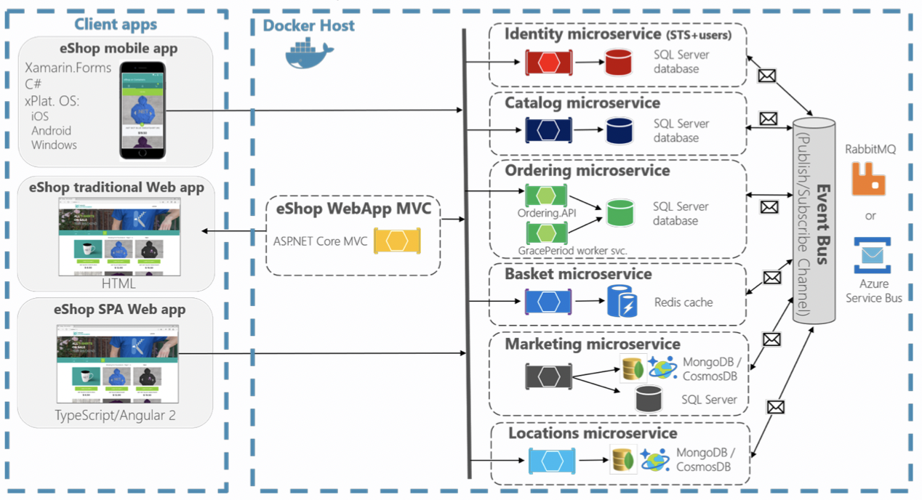
Examples of distributed systems

Slide 7
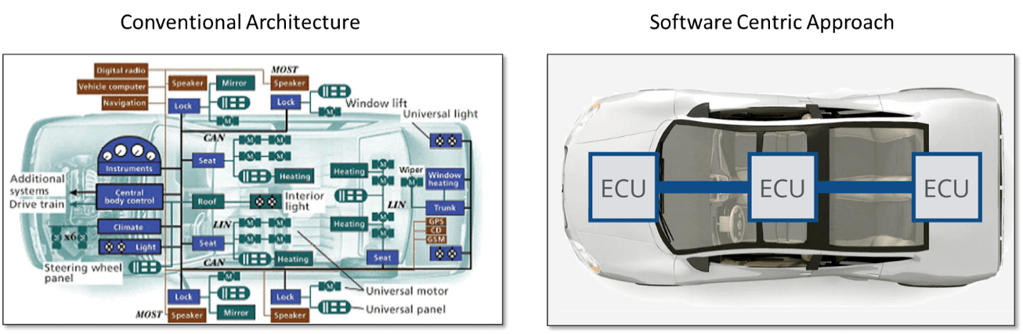
A Single Car is a Distributed System!

Slide 8
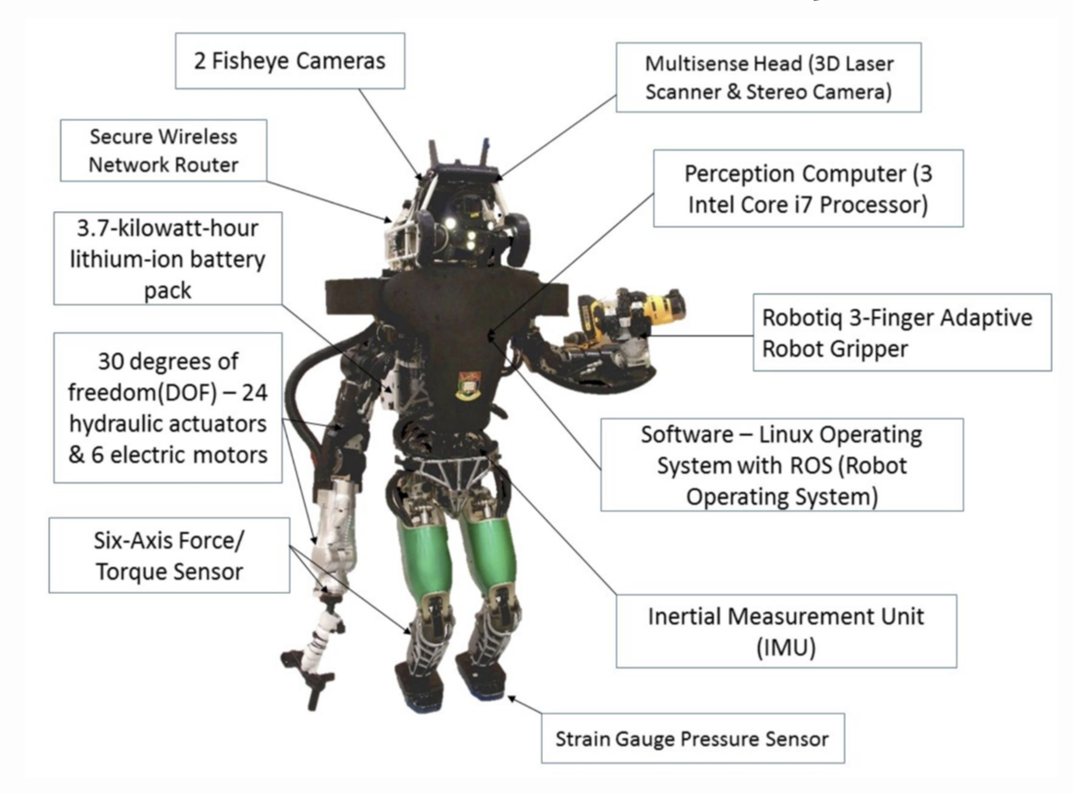
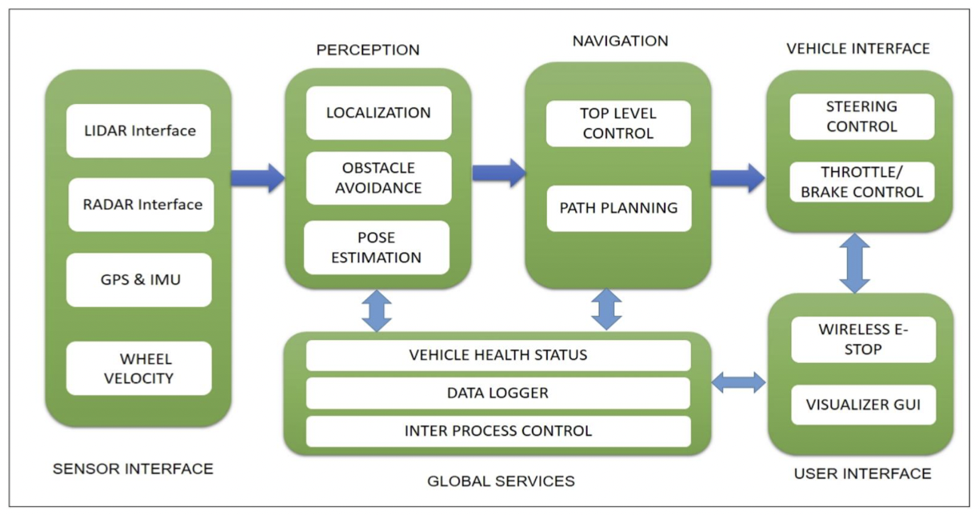
Other examples of distributed systems

Slide 9
What Is A Distributed System?
A collection of independent computers that appears to its users as a single coherent system.
  “shared nothing architecture”
Features:
  No shared memory — message-based communcation
  Each runs its own local OS
  Heterogeneity
Ideal: to present a single-system image:
  The distributed system “looks like” a single computer rather than a colelction of separate computers.

Slide 10
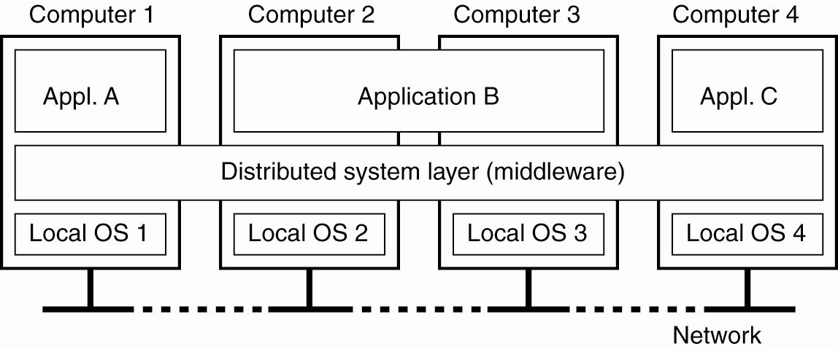
Distributed System Layer
A distributed system organized as middleware. The middleware layer runs on all machines, and offers a uniform interface to the system.

Slide 11
The Reality of (most) Distributed Systems
Worse availability: depend on every machine being up
  Lamport: “a distributed system is one where I can’t do work because some machine I’ve never heard of isn’t working!”
Worse reliability: can lose data if any machine crashes
Worse security: anyone in the world can break into system
Coordination is more difficult
  Must coordinate multiple copies of shared state information (using only a network)
  What would be easy in a centralized system becomes a lot more difficult

Slide 12
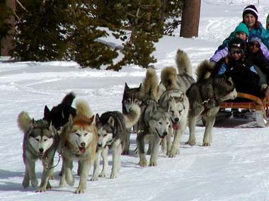
Key challenge: How to make them run in the same direction?
In a more technical term: How to keep them consistent?

Slide 13
network file system (NFS) and Andrew file system (afs)

Slide 14
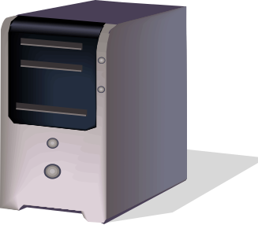


Distributed File Systems
Read File
Network
Data
Client
Server
Distributed File System:
  Transparent access to files stored on a remote disk

Slide 15
Simple Distributed File System
Read (RPC)
Return (Data)
Client
Write (RPC)
Server
ACK
Client
EVERY read and write gets forwarded to server
Advantage: Server provides completely consistent view of file system to multiple clients
Problems? Performance!
  Going over network is slower than going to local memory
  Server can be a bottleneck

Slide 16
Use Caching to Reduce Network Load
read(f1)
→V1
cache
Read (RPC)
read(f1)→V1
read(f1)→V1
F1:V1
Return (Data)
read(f1)→V1
Client
Write (RPC)
Server
cache
F1:V1
F1:V2
ACK
cache
write(f1)
→OK
F1:V2
read(f1)→V2
Client
Advantage: if open/read/write/close can be done locally, don’t need to do any network traffic…fast!
Problems:
  Cache consistency!
    Client caches not consistent with server/each other
    Who cached what?
  Failure:
    Client caches have data not committed at server

Slide 17
NFS Caching
Write-through caching: Modified data committed to server’s disk before results are returned to the client
  Lose some of the advantages of caching
  Time to perform write() can be long
  Need some mechanism for readers to eventually notice changes!

Slide 18
NFS Cache consistency
NFS protocol: weak consistency
  Client polls server periodically to check for changes
    Polls server if data hasn’t been checked in last 3-30 seconds (exact timeout is tunable parameter).
    Thus, when file is changed on one client, server is notified, but other clients use old version of file until timeout.
  What if multiple clients write to same file?
    In NFS, can get either version (or parts of both)
    Completely arbitrary!
cache
F1 still ok?
F1:V2
F1:V1
No: (F1:V2)
Client
Write (RPC)
Server
cache
F1:V2
ACK
cache
F1:V2
Client

Slide 19
NFS Pros and Cons
NFS Pros:
  Simple, Highly portable
NFS Cons:
  Sometimes inconsistent!
  Doesn’t scale to large # clients
    Must keep checking to see if caches out of date
    Server becomes bottleneck due to polling traffic
    Probably does not handle scale (* - you can buy huge NFS appliances today that will, but they’re $$$-y).
    Is very sensitive to network latency

Slide 20
Andrew File System
Developed at CMU in the late 1980s
Global distributed file system
  “One AFS”, like “one Internet”
    Why would you want more than one?
LARGE numbers of clients, servers
  1000 machines could cache a single file,
  Most local, some (very) remote
Goal: Minimize / eliminate work per client operation
  O(1) work per client may just be too expensive!
Notes:
Goal:

Slide 21
AFS Assumptions
Client machines have disks(!!)
  Can cache whole files over long periods
Write/write and write/read sharing are rare
  Most files updated by one user, on one machine
Access from local disk is faster and cheaper than from LANs
  (Not so true now…)
Notes:
Question: What about Read/Read sharing? Why does AFS not have any assumptions about that? Because it does not matter and that does not cause consistency problems and files are cached locally anyways.

Slide 22
AFS Caching
More aggressive caching (AFS caches on disk in addition to just in memory)
  Cache the whole file
Prefetching (on open, AFS gets entire file from server, making later ops local & fast).
  Remember: with traditional hard drives, large sequential reads are much faster than small random writes.
  So easier to support (client A: read whole file; client B: read whole file) than having them alternate.
  Improves scalability, particularly if client is going to read whole file anyway eventually.

Slide 23
Client Caching in AFS
Callbacks!
  Clients register with server that they have a copy of file;
  Server tells them: “Invalidate!” if the file changes
  This trades state for improved consistency
Notes:
Another way that AFS improves performace (AFSv2) is to allow CallBacks to invalidate clients that have files cached. Think of “CallBacks” like promises by a AFS server that it will notify the clients in case the file changes (due to a write), which essentially invalidates their callback and that way the client knows that it needs to read the file again the next time since content has changed. The nice part, its event driven rather than the clients having to constantly check with the server if the file changed and their cached copy is invalid.

Slide 24
File access consistency

Slide 25
File Access Consistency
In UNIX local file system, concurrent file reads and writes have “sequential” consistency semantics
  Each file read/write from user-level app is an atomic operation
    The kernel locks the file vnode
  Each file write is immediately visible to all file readers
Ideal: One Copy Semantics
Neither NFS nor AFS provides such concurrency control
  NFS: “sometime within 30 seconds”
  AFS: session semantics for consistency

Slide 26
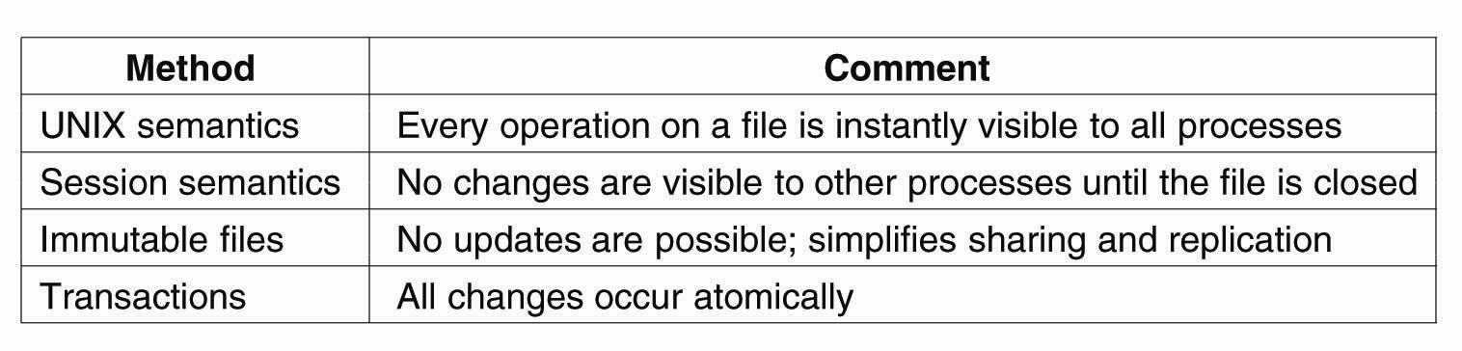
Popular Semantics of File Sharing

Slide 27
Session Semantics in AFS
What it means:
  A file write is visible to processes on the same box immediately, but not visible to processes on other machines until the file is closed
  When a file is closed, changes are visible to new opens, but are not visible to “old” opens
  Last writer (i.e. the last close()) wins
Implementation
  Dirty data are buffered at the client machine until file close, then flushed back to server, which leads the server to send “break callback” to other clients
Notes:
Chunk-based I/O
No real consistency guarantees
close() failures surprising to many Unix programs
...and to early Linux kernels!

Slide 28
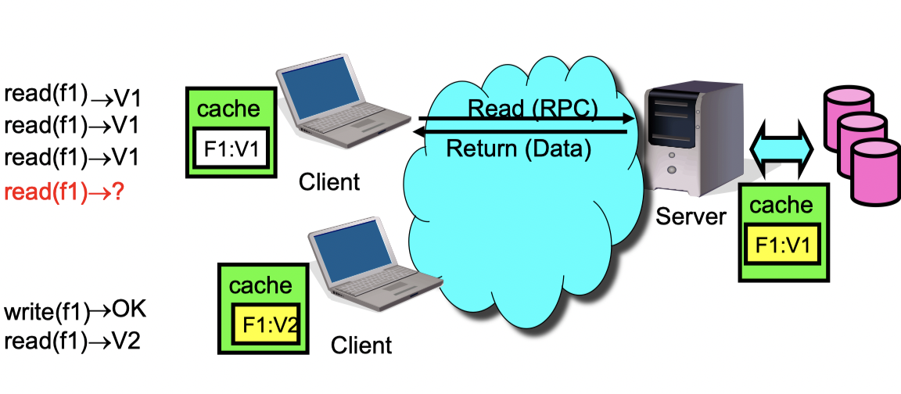
Session Semantics

Slide 29
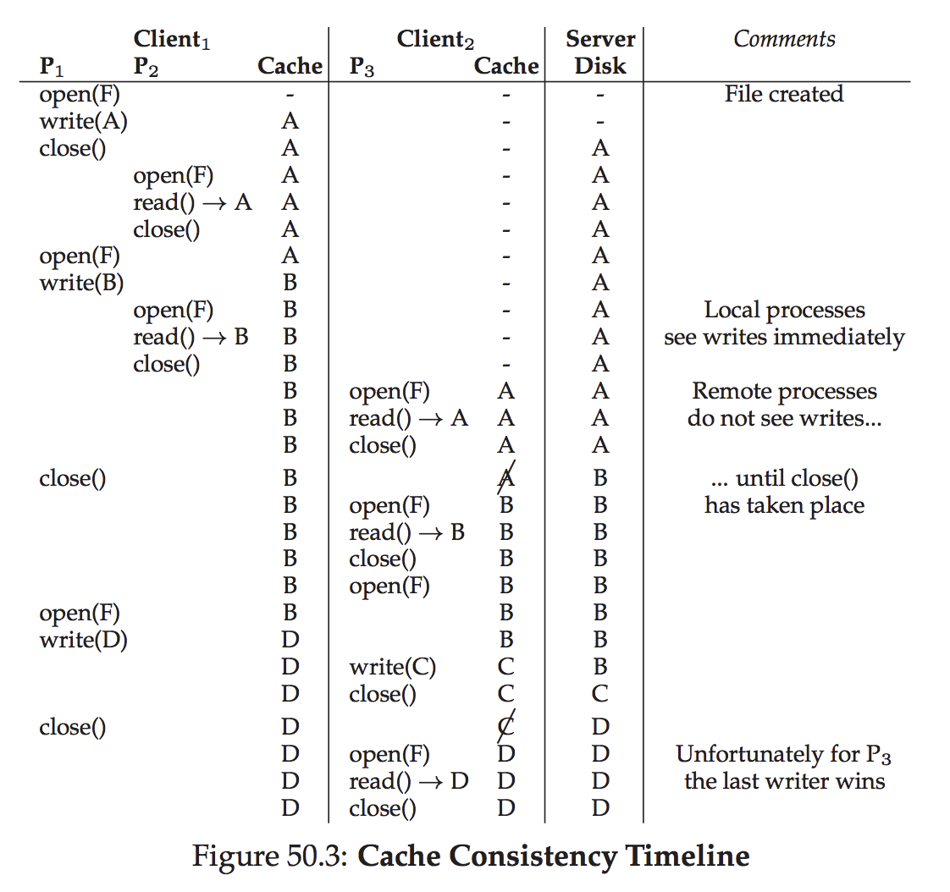
AFS: Cache Consistency Timeline
Source:
Remzi, OS Book, “AFS”

Slide 30
AFS Write Policy
Writeback cache
  Opposite of NFS “every write is sacred”
  Store chunk back to server
    When cache overflows
    On close()
  ...or don't (if client machine crashes)
Is writeback crazy?
  Write conflicts “assumed rare”
  Who wants to see a half-written file?
    Matters for collaborative editing apps
AFS also operates on a file granularity, so the last writer wins
Notes:
AFS also operates on a file granularity, so the last writer wins. Again, remember these assumptions come from the user model and workloads that AFS was designed for. Thought question: would this work for something like a collaborative document editing system like GoogleDocs?

Slide 31
Failure handling

Slide 32
NFS Failures Handling: Issues
What if server crashes?
  Can client wait until server comes back up and continue as before?
  Any data in server memory but not on disk can be lost
What if server crashes after seek? Then, when client does “read”, it will fail
Message retries: recall “rm foo” case.
What if client crashes?
  Might lose modified data in client cache

Slide 33
NFS Server Design Choices
NFS servers are stateless; each request provides all arguments require for execution
  E.g. reads include information for entire operation, such as ReadAt(inumber,position), not Read(openfile)
  No need to perform network open() or close() on file – each operation stands on its own
  Server keeps no state about client, except as hints to help improve performance (e.g. a cache)
Idempotent: Performing requests multiple times has same effect as performing it exactly once
  Example: Server crashes between disk I/O and message send, client resend read, server does operation again
  Example: Read and write file blocks: just re-read or re-write file block – no side effects
  Example: What about “remove”? NFS does operation twice and second time returns an advisory error

Slide 34
NFS Failure handling
Stateless + Idempotent:
  If server crashes and restarted, requests can continue where left off (in many cases)
Failure Model: Transparent to client system
  Is this a good idea? What if you are in the middle of reading a file and server crashes?
  Options (NFS Provides both):
    Hang until server comes back up (next week?)
    Return an error. (Of course, most applications don’t know they are talking over network)

Slide 35
AFS Failure Handling
What if server crashes? Lose all callback state!
  Reconstruct callback information from client: go ask everyone “who has which files cached?”
  “Soft state”
What if client crashes?
  Must revalidate any cached content it uses since it may have missed callback

Slide 36
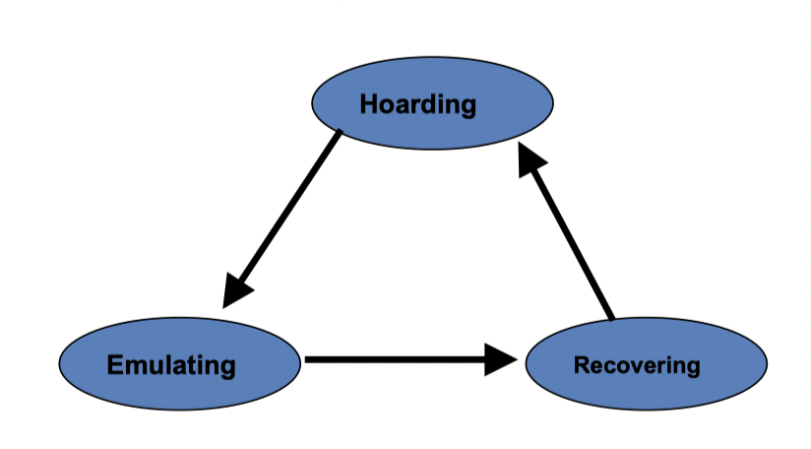
A more extreme case of AFS failure handing: disconnected operation (Coda)
“Optimistic Replica Control”
1. Hoarding:
  Normal (connected) operation mode
2. Emulating:
  Disconnected operation mode
3. Reintegrating (Recovery):
  Propagates changes and detects inconsistencies

Slide 37
Hoarding
Hoard useful data for disconnection
Balance the needs of connected and disconnected operation
  Cache size is limited
  Unpredictable disconnections
Uses user specified preferences + usage patterns to decide on files to keep in hoard

Slide 38
Emulation
In emulation mode:
  Attempts to access files that are not in the client caches appear as failures to application
  All changes are written in a persistent log, the client modification log
  Coda removes from log all obsolete entries like those pertaining to files that have been deleted

Slide 39
Reintegration
When workstation gets reconnected, Coda initiates a reintegration process
  Performed one volume at a time
  Ships replay log to all volumes
  Each volume performs a log replay algorithm
Only care about write/write conflict
  Conflict resolution succeeds?
    Yes. Free logs, keep going…
    No. Save logs to a tar. Ask for help
In practice:
  No Conflict at all! Why?
  Over 99% modification by the same person
  Two users modify the same object within a day: <0.75%

Slide 40
Summary: Distributed System Challenges
Multiple processes
Multiple copies of data
  Cache to reduce traffic
  Replication to improve availability
Consistency issues
  Am I reading / writing stale data?
Especially: Partial failures
Distributed System Theory: Full of Impossibility Results!
In practice: how to make it “mostly” possible

