Slide 1
Linear Algebra
Instructor: Yifan Song

Slide 2
Self Introduction
宋一凡
Yifan Song
Assistant Professor
Office: C1901-8, TusPark
Wechat: syf553605540
Email: yfsong@mail.tsinghua.edu.cn
Office Hour: Tuesday 10am – 11am
Education
2013 – 2017 Yao Class, Tsinghua University
2017 – 2022 Carnegie Mellon University
2022.12 Join IIIS
Research Area
Cryptography

Slide 3
Teaching Assistant
李君儒
Junru Li
杜宗航
Zonghang Du
jr-li24@mails.tsinghua.edu.cn
duzh23@mails.tsinghua.edu.cn

Slide 4
Grading
20% Homework
27% Midterm Exam
3% Attendance （三次随机课上考勤）
50% Final Exam

Slide 5
Grading
Homework (20%; Once per Week)
Return in 1 week (Friday night by default).
Show clearly how you derive your answer in English.
Hand in your solutions via Web Learning（网络学堂）in pdf electronic form.
Make sure your solutions can be easily recognized (especially for hand-writing)
No Argument Accept if TAs cannot decode them
Late submission is not accepted in general. Please try to not submit your homework in the last minute.
Your score * 50% within one day after the deadline and 0 after that.

Slide 6
Grading
Exams (27% + 50%)
Exams will be held together with the other parallel class
Midterm exam is scheduled in class (Friday, 11/13/2026)
Some problems will be directly from the homework or the lecture

Slide 7
Recitals（习题课）
The recitals will be held together with the other parallel class.
Once per week, to be scheduled.
Please finish the questionnaire if you haven’t.

Slide 8
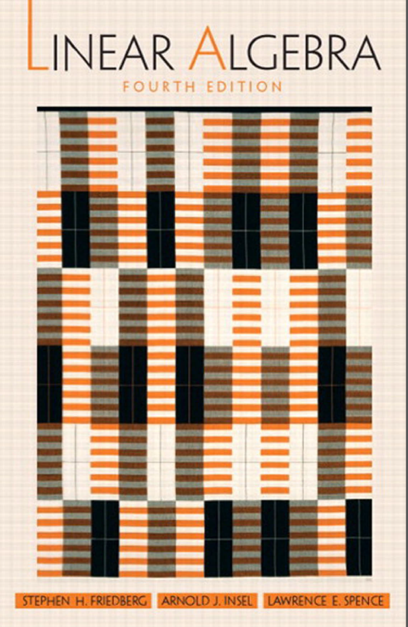
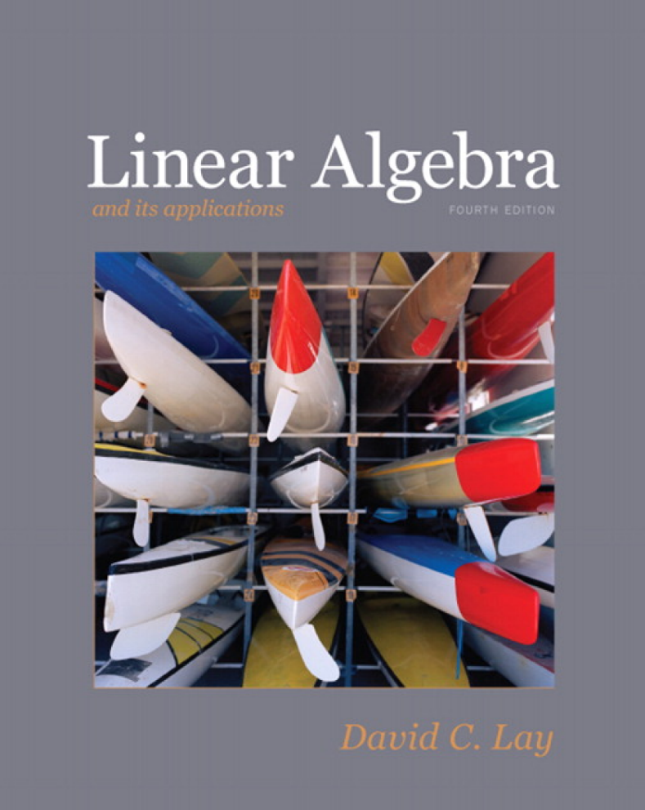
Textbooks
Linear Algebra – Fourth Edition
Linear Algebra and its applications – Fourth Edition

Slide 9
Tentative Syllabus
Lectures | Materials to be Covered
1 | Systems of Linear Equations, Row Reduction and Echelon Form, Vector Equations and Matrix Equations.
2 | Field, Vector Space, Subspace and Linear Independence, Bases and Dimension.
3 | Linear Transformation, Null Space and Range, the Matrix Representation of a Linear Transformation.
4 | Composition of Linear Transformation and Matrix Multiplication, Invertibility and Isomorphism.
5 | The Changes of Coordinate Matrix and Dual Space, the Rank of a Matrix.
6 | Partitioned Matrices, LU Decompositions and Matrix Inverses.
7 | Determinants of Order 2 and Order n, Cofactor Expansion.
8 | Midterm Exam

Slide 10
Tentative Syllabus
Lectures | Materials to be Covered
9 | Properties of Determinants, Diagonalization: Eigenvectors and Eigenvalues, Diagonalizability, Test for Diagonalizability.
10 | Differential Equation, Direct Sum, Invariant Subspace, the Cayley-Hamilton Theorem.
11 | Inner Product Space, The Gram-Schmidt Orthogonalization, Process, Orthogonal Complements, The Adjoint of a Linear Operator.
12 | Least Squares Approximation, Minimum Solutions to Systems of Linear Equations, Normal and Self-adjoint Operators.
13 | Unitary and Orthogonal Operators and their Matrices, Orthogonal Projections and the Spectral Theorem.
14 | Bilinear Forms, Diagonalization of Symmetric Matrices, Quadratic Forms, Singular Value Decomposition.
- | Final Exam

Slide 11
Importance of Linear Algebra
Prerequisite for almost all classes: abstract algebra, information physics, quantum mechanics, statistical physics, graphics, data compression, game theory, cryptography, …
Useful Math Tools
Reveal Connections of Many Objects from Different Areas

Slide 12
Question?
Notes:
Any question before we move on?

