Slide 1
 | Gerber Files | Specctra Files
Output Files | Several output files that each contain information on specific elements of the PCB. Includes a control file with file locations and functions | One file containing all the information from the PCB.
File Format | Similar to modular programming, the control file is easier to read and understand. However, the syntax in the more complex files are not as “human friendly” | File contain labels that are organized in hierarchical order, with labels of higher precedence like structure, placement, library, networks and wiring
File Size | 19 KB | 21 KB
Compatible with FreeRouter (autowiring) | No | Yes
Backward compatible with KiCad | No | No

Slide 2
Specctra Files Notes
Higher Precedence Labels:
Structure: Changes the geometrical and properties boundaries of the PCB
Placement: Placement and orientation of components within structure
Library: Data in components and their footprint on the circuit
Networks: Pins and nets
Wiring: Information in wiring between the pins of different components Used FreeRouting to automatically generate the route connections

Slide 3
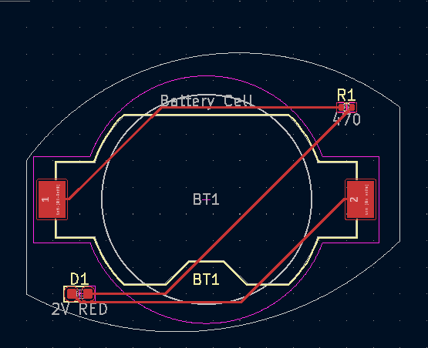
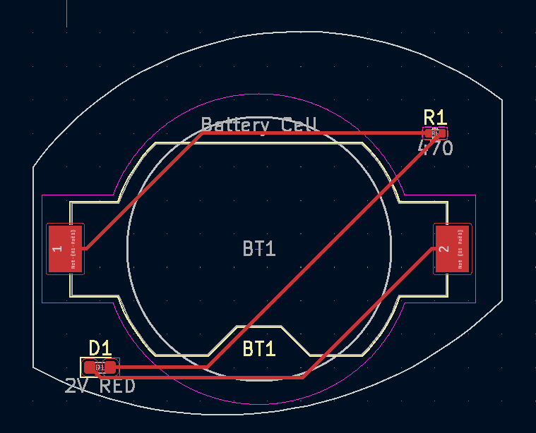
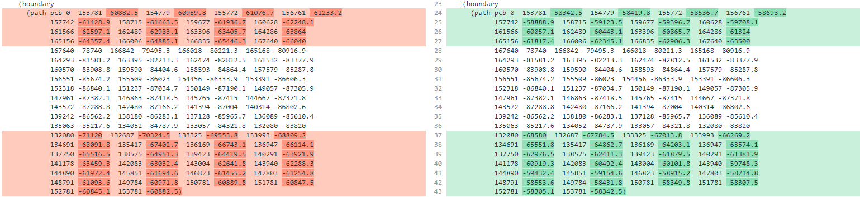
PCB Boundaries on Specctra Files
Original PCB
PCB with side edges dragged 1 unit upwards

Slide 4
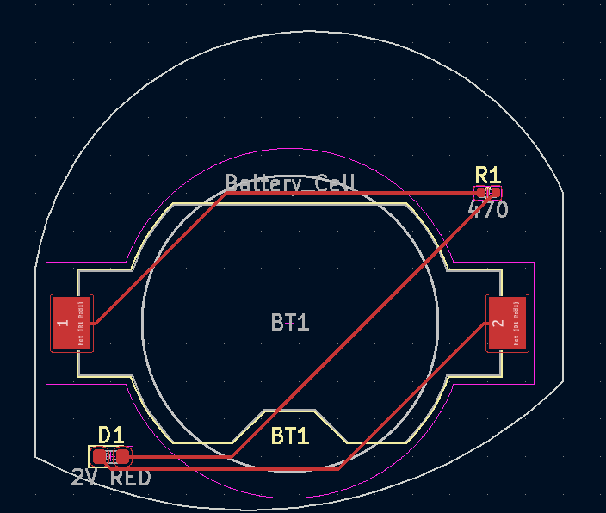
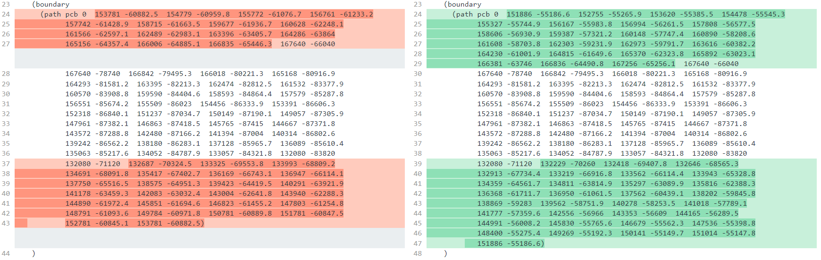
PCB Boundaries on Specctra Files
Original PCB
PCB with upper arc dragged upwards

Slide 5
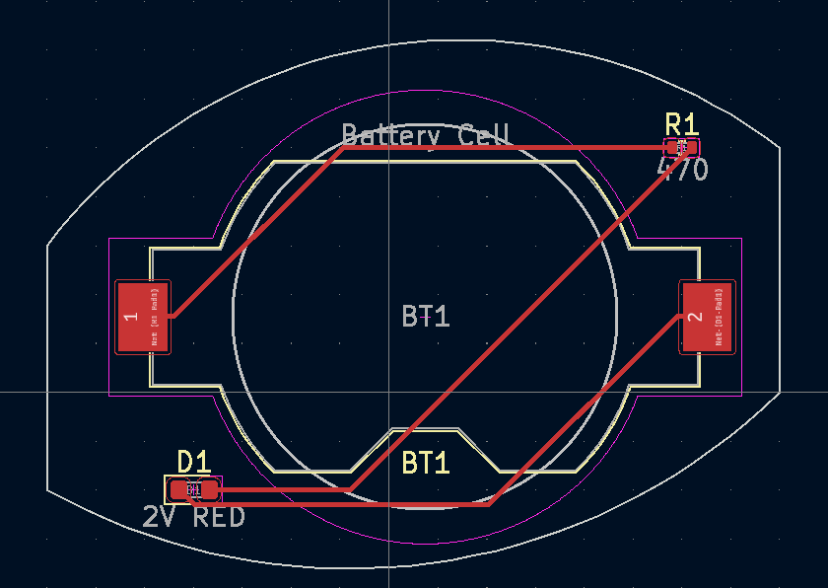
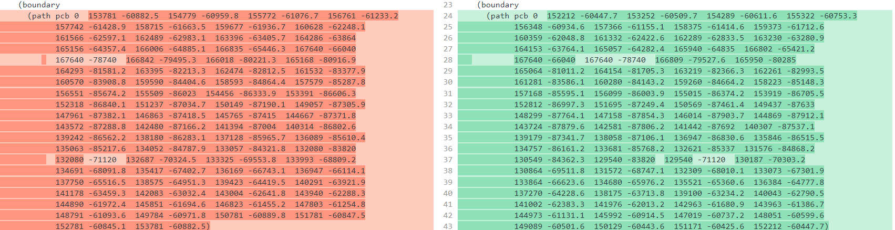
PCB Boundaries on Specctra Files
Original PCB
PCB with left side dragged 1 unit to the left

