Slide 1
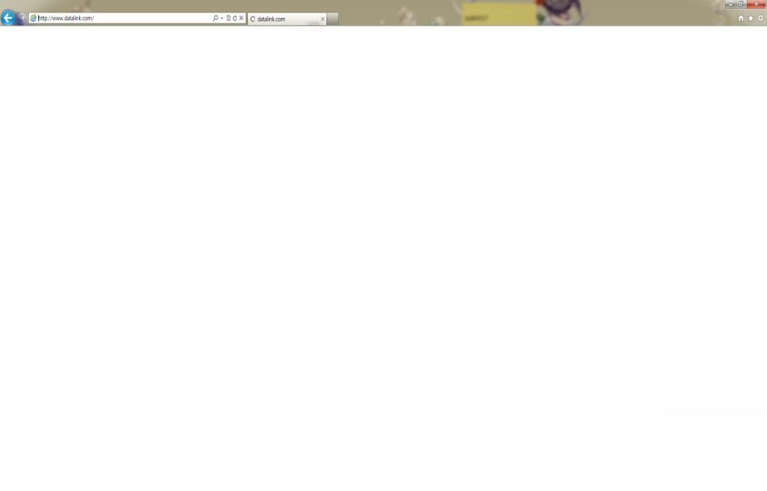



Login API
Login
API-users()
Parameter
id-Username
pwd-Password
email-Email
name-Your Name
Username
Password
API-Login()
Parameter
mail-Username
pwd-Password
Notes:
Ex)http://210.118.69.65/mangosteen_rest/mangosteen_rest/rest/users

Slide 2



Add Friend API
API-requestFriend()
Parameter
id – Username
friend - FriendID
Add Friend
API-serchFriend()
Parameter
id - FriendID
Add Friend
API- removeFriend()
Parameter
id – Username
friend - FriendID
Friend ID
API- accptedRequestFriend()
Parameter
id – Username(accptedFriend)
friend – FriendID(Send Request user)
API-rejectRequestFriend ()
Parameter
id – Username(accptedFriend)
friend – FriendID(Send Request user)

Slide 3



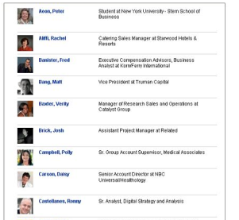
View API
API- viewMyFriendList()
Parameter
id – Username
API- viewMyFriendListAll()
Parameter
id – Username
Friends List
Friends List
API-viewMyFriendMessage()
Parameter
id – Username
friend - FriendID
API- insertMessage ()
Parameter
id – Username
msg- Message
API- viewMyList ()
Parameter
id – Username
API- viewAllMyList()
Parameter
id – Username

Slide 4
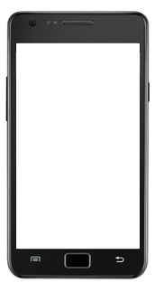






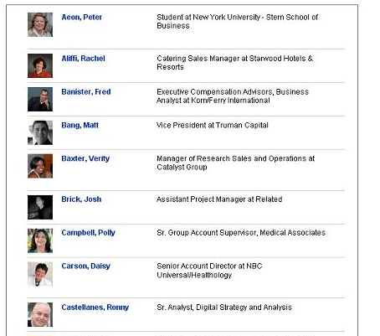





Scenario - Client
Access Server Request
Friends List
Request Access
Please wait…
Request Access
Please wait…
Friends List
Request Access
Please wait…

Slide 5

Scenario
Access Server Accept
Friends List
Friends List
Accept Access
http://210.118.69.65
Accept Access
http://210.118.69.65

Slide 6







Data Access Layer
DB Connection Pool
Store Procedure Execution
Android
Web Client
Http Relay Server
Jetty-Base
Web Server
Application
Http Relay Service
File Explore
Mobile Information Viewer
Mjpeg Live Streaming
Bridge Server
Image Viewer
Http Live Streaming
Web Application
Movie Viewer
Android communicator
NAT Check
Relay Bridge

Slide 7
Bridge Server
Web Application
Data Access Layer
Android communicator
DB Connection Pool
NAT Check
Store Procedure Execution
Relay Bridge

Slide 8
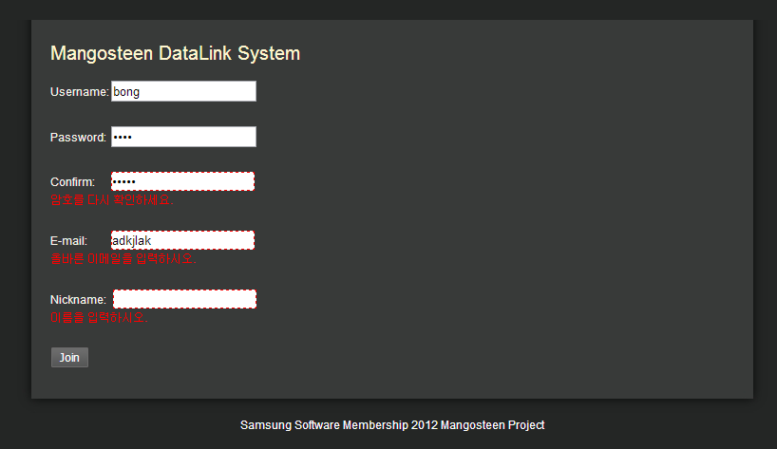
DB
User Information

Slide 9
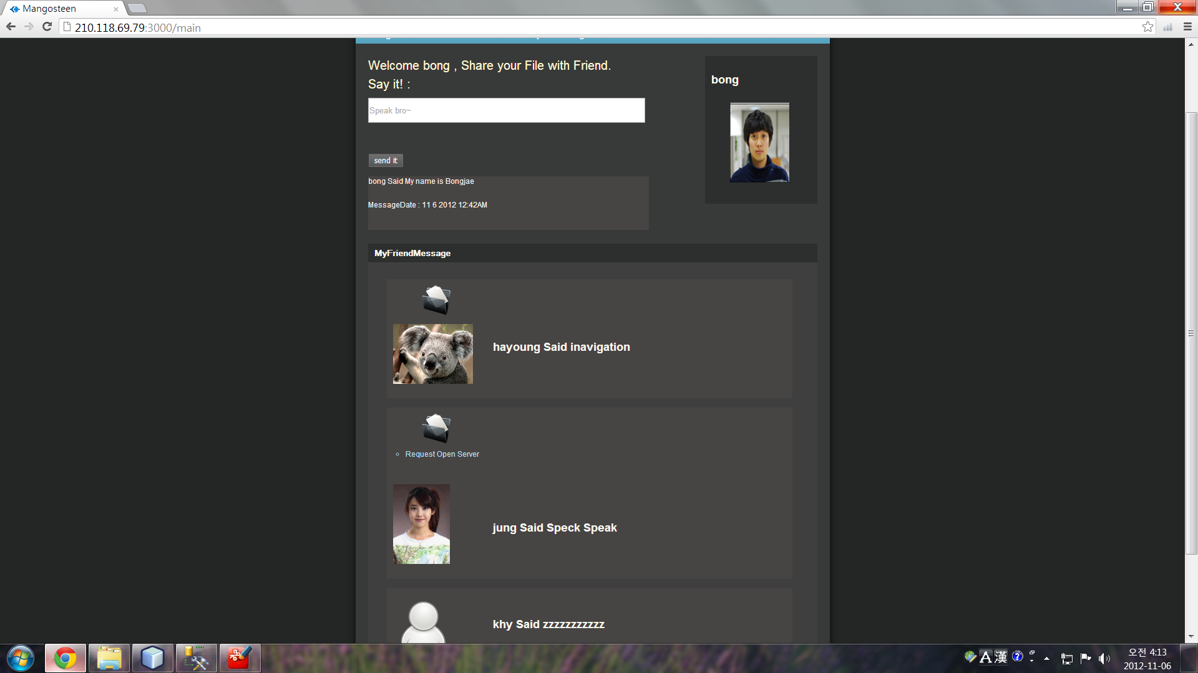
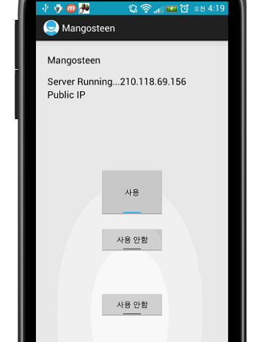
Bridge Server

Slide 10
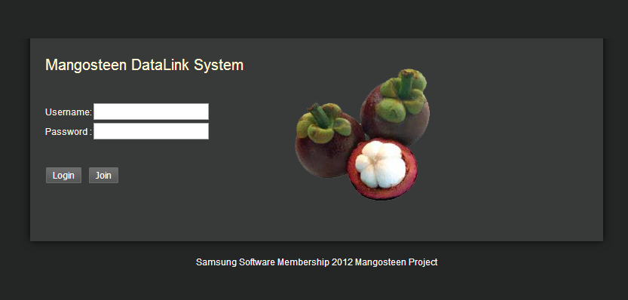

Slide 11
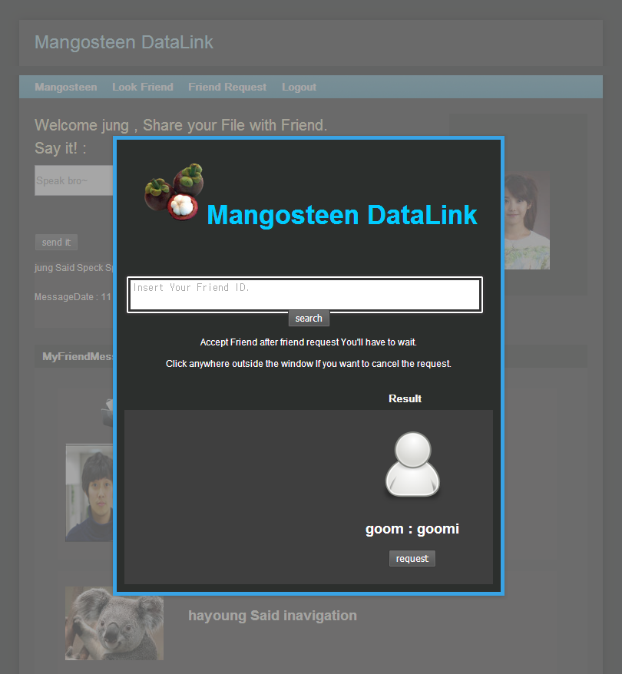

Slide 12
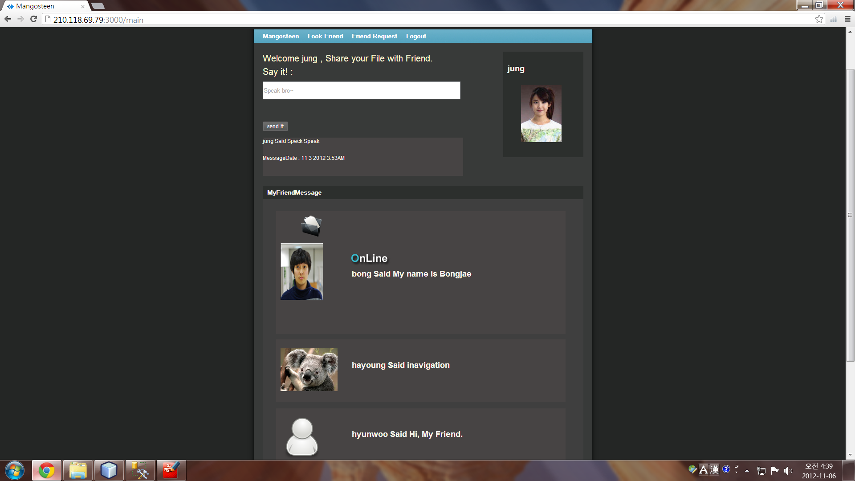

Slide 13
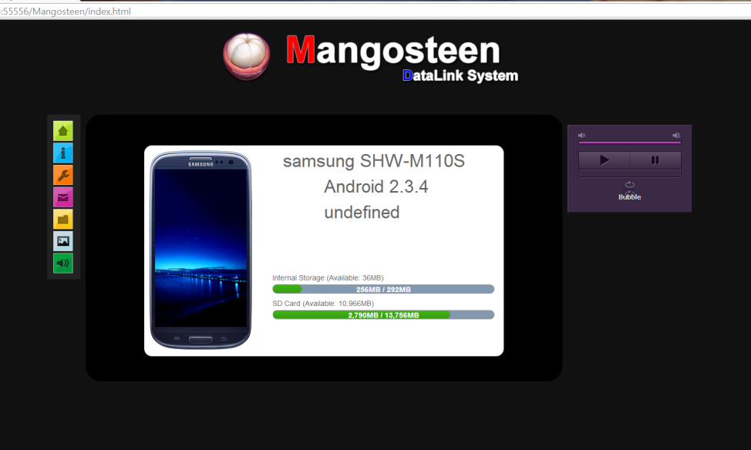

Slide 14
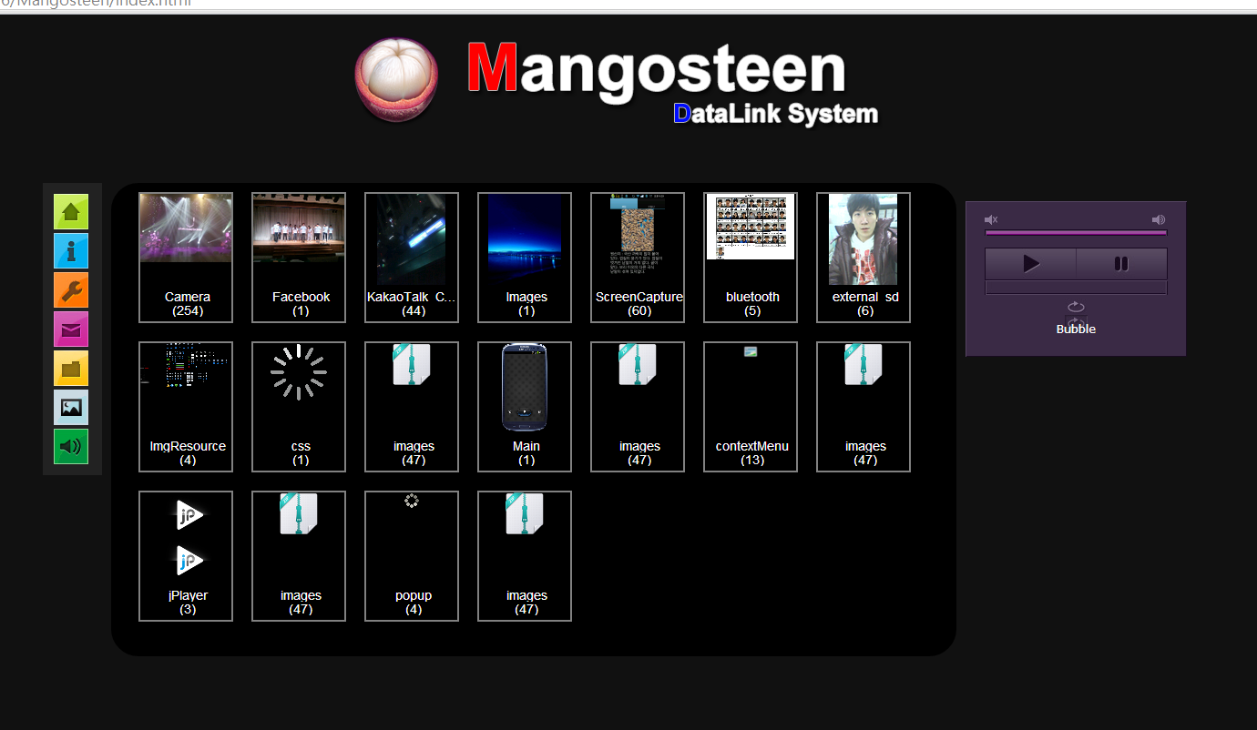

Slide 15
