Slide 1

ISM 001 Introduction to Programming
Searching
Florence Fok
Lingnan University CC

Slide 2
Searching
Searching → determine of a value (search key) present in the data → find value’s location
1) Linear search
  Searches each element sequentially → inefficient
  If search key is not present
    Tests each element
    When algorithm reaches end of array, informs user search key is not present
  If search key is present
    Return the location

Slide 3
import javax.swing.*;
public class LinearSearch {
public static void main(String argv[]) {
int test[]=new int[5];
System.out.println("Please enter " + test.length + " marks");
for(int i=0; i<test.length; i++) {
String strNum = JOptionPane.showInputDialog("Enter the number ");
test[i]=Integer.parseInt(strNum);
}
int total = 0;
// add each element's value to total
for ( int i = 0; i < test.length; i++ )
total += test[ i ];
System.out.println("The total mark is " +total );
System.out.println( "Average mark is: " +total/test.length );

Slide 4
String strKey = JOptionPane.showInputDialog("Enter the key ");
int sKey=Integer.parseInt(strKey);
int position=linearSearch(test, sKey);
if(position == -1)
System.out.println("No key found");
else
System.out.println("We find the key in position "+ position);
}//end main
public static int linearSearch ( int a[], int key ) {
for (int n=0; n < a.length; n++) {
if ( a[n] == key )
return n;
}//end for
return -1;
}//end method
}

Slide 5
Searching
1) Binary search
More efficient
Require the array to be sorted
Tests the middle element in an array
  If it is the search key, algorithm returns
  Otherwise, if the search key is smaller, eliminates larger half of array
  If the search key is larger, eliminates smaller half of array
Each iteration eliminates half of the remaining elements

Slide 6
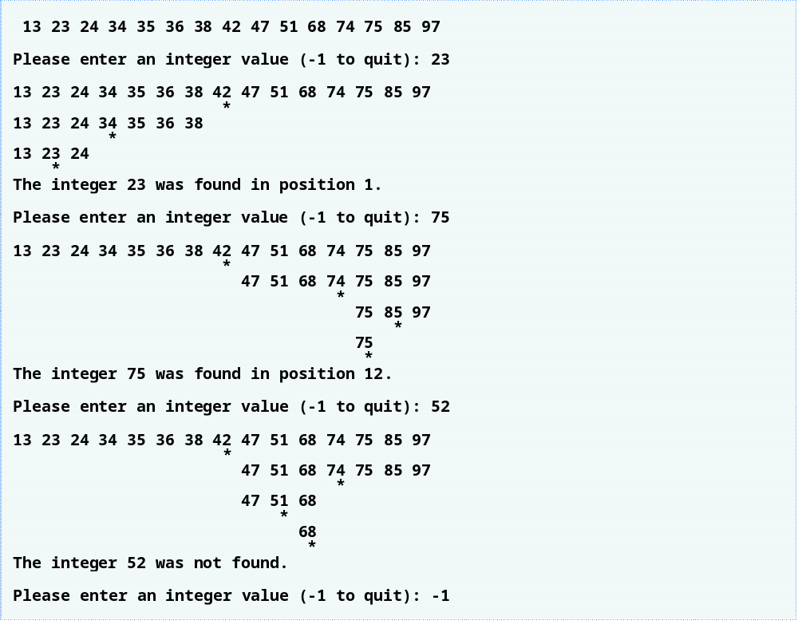

Slide 7
public static int binarySearch( int array[], int key ){
int low = 0; // low subscript
int high = array.length - 1; // high subscript
int middle; // middle subscript
while ( low <= high ) {
middle = ( low + high ) / 2;
if ( key == array[ middle ] ) // match
return middle;
else if ( key < array[ middle ] )
high = middle - 1; // search low end of array
else
low = middle + 1; // search high end of array
}
return -1;
}//end binary search

Slide 8
Try
Try to use binary search method to search a key with an array of data with 15 elements (such as the one in Slide 6)

