Slide 1

ISM 001 Introduction to Programming
Methods: A deeper look
Florence Fok
Lingnan University CC

Slide 2

Methods
Methods
  Called functions or procedures in other languages
  Modularize programs by separating its tasks into self-contained units
  Enable a divide-and-conquer approach
    Construct a large program from smaller pieces (or modules)
  Can reuse and prevent repeating code

Slide 3
Software Reusability
To promote software reusability, every method should be limited to performing a single, well-defined task, and the name of the method should express that task effectively.
Such methods make programs easier to write, debug, maintain and modify.

Slide 4
Software Reusability
Modularization using classes and methods allows us to reuse our programs.
If we write methods carefully, it is possible that the methods that we write can be reused in other programs.
In Java programming, we often use methods written by other Java programmers. Many of these methods are found in the Java Application Programming Interface (Java API) packages.

Slide 5
static Methods, static Fields and Class Math
static method (or class method)
  Applies to the class as a whole instead of a specific object of the class
  Call a static method by using the method call:
  ClassName.methodName( arguments )
  All methods of the Math class are static
    example: Math.sqrt( 900.0 )
  Class Math is part of the java.lang package, which is implicitly imported by the compiler, so it is not necessary to import class Math to use its methods.

Slide 6
static Methods, static Fields and Class Math
Method main
  main is declared static so it can be invoked without creating an object of the class containing main
  Any class can contain a main method
    The JVM invokes the main method belonging to the class specified by the first command-line argument to the java command

Slide 7
Notes on Declaring and Using Methods
Three ways to call a method:
  Use a method name by itself to call another method of the same class
  Use a variable containing a reference to an object, followed by a dot (.) and the method name to call a method of the referenced object
  Use the class name and a dot (.) to call a static method of a class
static methods cannot call non-static methods of the same class directly

Slide 8
Notes on Declaring and Using Methods
Three ways to return control to the calling statement:
  If method does not return a result:
    Program flow reaches the method-ending right brace or
    Program executes the statement return;
  If method does return a result:
    Program executes the statement return expression;
      expression is first evaluated and then its value is returned to the caller

Slide 9
A Reusable Method
// Program to output the squared value of 0-10
public class Squared {
public static void main (String args[]) {
int sq_i;
System.out.println("\ti\ti sq.");
System.out.println("\t-\t-----");
for (int i = 1; i <= 10; i++) {
sq_i = square(i);
System.out.println("\t" + i + "\t" + sq_i);
}
}
//Method to calculate the square of an integer
public static int square(int y) {
return(y * y);
}
}

Slide 10
Reusing a Method
// Program to reuse the squared.square method.
public class Reuse {
public static void main (String args[] ) {
int x = 5;
System.out.println("The value of x is " + x);
System.out.println("The square of x is " +
Squared.square(x) );
}
}
Sample output of reuse.java:
>java reuse
The value of x is 5
The square of x is 25

Slide 11
Reusing a Method
When we reuse a method written in another Java class, we should call the method by its class name.
In other words, we should use
  class_name.method_name(parameter_list)
The class name is required because the Java virtual machine (JVM) needs to know where to find the method.

Slide 12
Reusing a Method
For example, in Reuse.java, we call the square method by writing:
  Squared.square(x)
where Squared is the name of the class (Squared.java) and square(x) is the name of the method we want to call in Squared.java.

Slide 13
Java API and Math class

Slide 14
The Java API
The Java Application Programming Interface (API) defines a collection of common reusable classes in Java.
In the Java API, classes are grouped together in packages.

Slide 15
Common Packages in the Java API
java.applet - Defines the Applet class.
java.awt - Provides classes for GUI.
java.io - Provides classes for input and output of data.
java.lang - Provides basic classes needed by most Java programs.
java.net - Provides classes for networking.
java.sql - Provides classes for database connection.
java.text - Provides classes for text handling.
java.util - Provides miscellaneous utilities.

Slide 16
The java.lang Package
The package that is used the most often is the java.lang package.
The iava.lang package contains the most useful and basic classes in Java.
Because of its importance, java.lang is automatically available to every Java program (you don’t need to import java.lang).
You may see a complete list of classes in the java.lang package in the Java API online documentation.

Slide 17
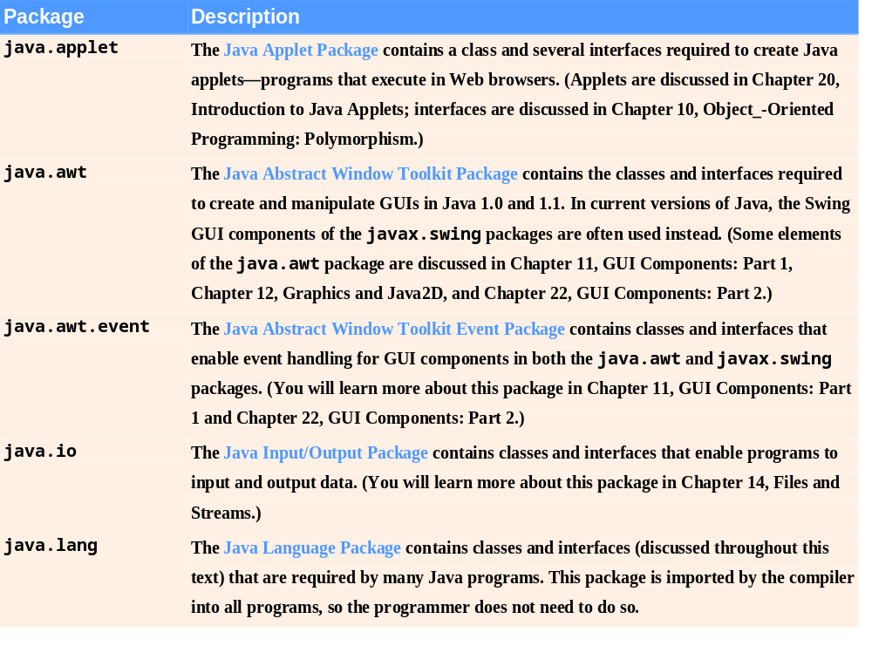
Fig. 6.6 | Java API packages (a subset). (Part 1 of 2)

Slide 18
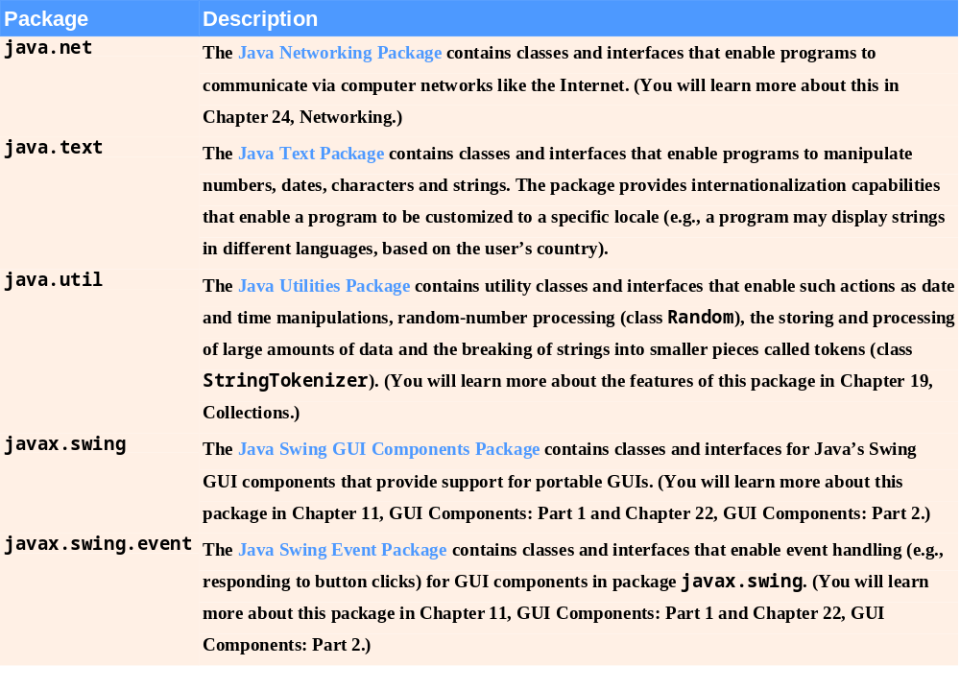
Fig. 6.6 | Java API packages (a subset). (Part 2 of 2)

Slide 19
The java.lang.Math Class
The Math class in the java.lang package contains useful methods and constants for mathematics.
The natural log constant e and the geometrical constant PI are defined in the Math class. The following Java program will print the value of PI.
// Program to print PI.
public class PI {
public static void main (String args[] ) {
System.out.println("PI = " + Math.PI);
}
}

Slide 20
The Math.random() Method
The Math.random() method is used to generate a random number.
The value of a random number is determined by chance.
The definition of the random method is:
public static double random()
  Returns a random number greater than or equal to 0.0 and less than 1.0. Returned values are chosen pseudorandomly with (approximately) uniform distribution from that range.

Slide 21
The Math.random() Method
The following program will print several random values ranging from 0.0 up to, but not including, 1.
This program will print a list of different values every time it is run.

Slide 22
The Math.random() Method
// Program to print random numbers
public class randNums {
public static void main (String args[]) {
System.out.println("\t" + Math.random() );
System.out.println("\t" + Math.random() );
System.out.println("\t" + Math.random() );
}
}

Slide 23
Random Numbers Scaling
The range of 0.0 to 1 returned by Math.random() may not suit our needs sometimes.
For example, to simulate a dice, we need random numbers from 1 to 6.
We may use the scaling technique to scale the results of Math.random() to the range of values we want

Slide 24
Random Numbers Scaling
To scale the results of Math.random() to the range of 1 to 6 inclusive, we first multiply the random number by 6:
  Math.random() * 6
This will give us the range of 0.0 to 5.9999
Then we cast the result to integer by using the cast operator(int):
  (int) (Math.random() * 6)
This will drop the floating points and give us the range of 0 to 5 inclusive.

Slide 25
Random Numbers Scaling
Finally, we add 1 to the result, which then gives us the range of 1 to 6 inclusive:
  1 + (int) (Math.random() * 6)
The following example will simulate a dice game. The user will input a guess, then the program will use the technique we just described to randomly generate a value of 1 to 6. Then the random result is compared to the user's input to determine if he/she has won.

Slide 26
The Game of Dice
import java.util.*;
public class RollDice {
public static void main (String args[]){
Scanner input=new Scanner(System.in);
int dice;
System.out.print("What is your guess? Press ENTER");
int number1=input.nextInt();
dice = 1 + (int) (Math.random() * 6);
if (number1==dice)
System.out.println("You won!");
else {
System.out.println("The dice says " + dice);
System.out.println("You lose!");
}
}
}

Slide 27
Scope of the variables

Slide 28
Automatic Variables in a Method
The parameters and variables declared within a method are called automatic variables.
They are called automatic variables because they are created automatically when the program passes control to the method.
Automatic variables exist in the computer's memory only when the method is being executed.

Slide 29
Scope of Automatic Variables
Automatic variables are visible only locally, I.e. within the method in which they are declared.
Therefore, automatic variables are also called local variables.
In the following example, it is illegal for the caller (main) to reference pay directly because pay is a local variable of the wagePayment method.
Likewise, the main method cannot reference the parameters of wagePayment, namely hours and rate.

Slide 30
Scope of Automatic Variables
public class calc_wage {
public static void main (String args[]) {
int h,r;
h = 40; r = 12;
System.out.println("Pay=" + pay); // Wrong!!
System.out.println("Pay=" + wagePayment(h, r)); // Correct
}
public static double wagePayment( int hours, double rate) {
double pay; // pay is visible only in wagePayment
if ( hours > 40 )
pay = ( 40 * rate ) + (hours - 40) * rate * 1.5;
else
pay = hours * rate;
return (pay);
}
}

Slide 31
Instance and Static Variables
Variables can also be declared within a class (I.e. inside of the { and } of the class) but outside of any methods.
If the keyword static is used in the declaration, it is called a static variable.
Otherwise, it is called an instance variable.
public class myVariables {
static int x, y; // static variables
int a, b; // instance variables
}

Slide 32
Scope of Instance and Static Variables
Static and instance variables have class scope, in other words, they are visible to all methods within that class.
We also use the term "global" to describe this visibility.
However, there is an exception to this rule: static methods can access the static variables of a class, but not the instance variables. The reason for this will be explained later.

Slide 33
Local v.s. Global Variables
In the case when a local or automatic variable has the same name as an instance or static variable that has class scope, the local variable will take precedence over the global variable.
In other words, the instance or static variable will be temporarily "hidden". Any reference to the variable name within the method is made to the local variable.

Slide 34
A Scoping Example
// A scoping example
public class static_Scoping {
static int x = 1; // static variable
public static void main (String args[]) { //static method
int x = 5; // local (automatic) variable
System.out.println("Local x in main is " + x);
a(); // a has automatic local x
b(); // b uses static variable x
a(); // a reset automatic local x
b(); // static variable x retains its value
System.out.println("\nLocal x in main is " + x);
}

Slide 35
static void a() { // static method
int x = 25; // initialized each time a is called
System.out.println("\nLocal x in a is " + x +
" after entering a");
++x;
System.out.println("Local x in a is " + x +
" before exiting a");
}
static void b() { // static method
System.out.println("\nGlobal variable x is " + x +
" on entering b");
x *= 10;
System.out.println("Global variable x is " + x +
" on entering b");
}
}

Slide 36
Output from static_Scoping.java
>java static_Scoping
Local x in main is 5
Local x in a is 25 after entering a
Local x in a is 26 before exiting a
Global variable x is 1 on entering b
Global variable x is 10 on entering b
Local x in a is 25 after entering a
Local x in a is 26 before exiting a
Global variable x is 10 on entering b
Global variable x is 100 on entering b
Local x in main is 5

Slide 37
The Block Scope
Variables may be declared within a program block (for examples, within the block of a selection or repetition structure).
This type of local variables are visible from the point that they are declared to the right brace (}) of the block.

Slide 38
Block Scope Example
public class block_scope {
public static void main (String args[] ) {
System.out.println("x is " + x); // Wrong!!
for (int x = 1; x <= 10; x++)
System.out.print(x); // OK
if (true) {
int y = 8;
System.out.println("\n" + y); // OK
}
System.out.println("x is " + x); // Wrong!!
System.out.println("y is " + y); // Wrong!!
}
}

Slide 39
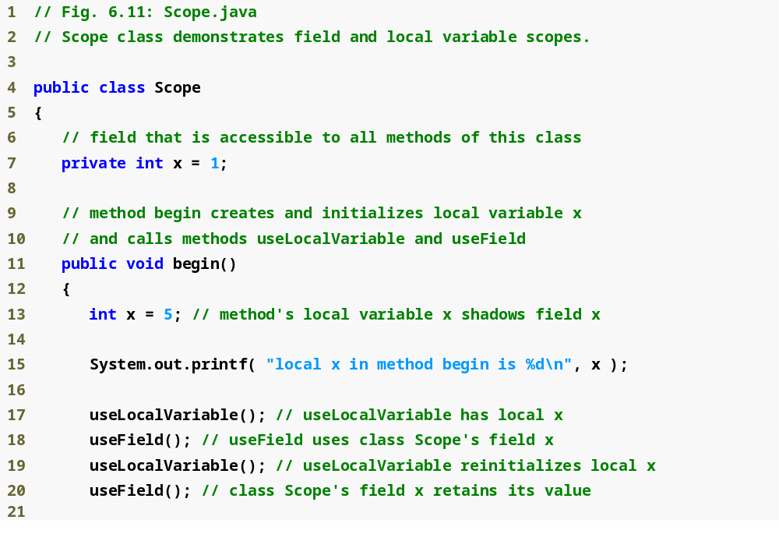
Outline
Scope.java
Shadows field x
Display value of local variable x

Slide 40
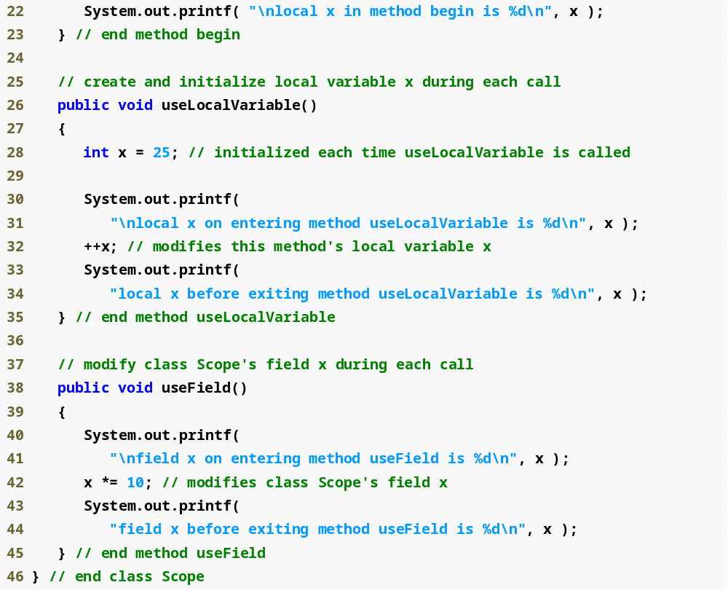
Outline
Scope.java
Shadows field x
Display value of local variable x
Display value of field x

Slide 41
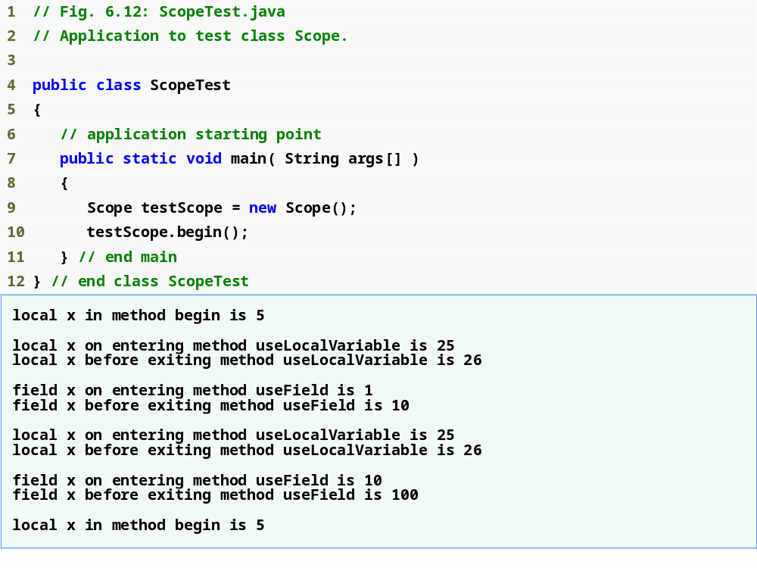
Outline
ScopeTest.java

Slide 42
Method Overloading

Slide 43
Method Overloading
Java allows two methods to have the same name as long as the two methods have different parameters.
This is called method overloading.
The parameters of two methods are different if the number of parameters are different, if the order of parameters are different, or if the types of the parameters are different.

Slide 44
Method Overloading
Compiler decides which method is being called by matching the method call’s argument list to one of the overloaded methods’ parameter lists
  A method’s name and number, type and order of its parameters form its signature
Differences in return type are irrelevant in method overloading
  Overloaded methods can have different return types
  Methods with different return types but the same signature cause a compilation error

Slide 45
Method Overloading
The following method definitions are considered different by Java. Therefore, it is legal to have them both in the same class:

Slide 46
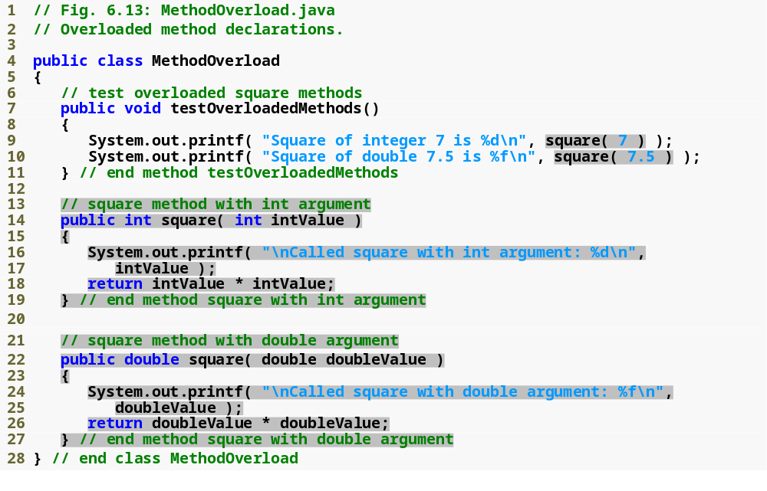
Outline
Correctly calls the “square of int” method
MethodOverload.java
Correctly calls the “square of double” method
Declaring the “square of int” method
Declaring the “square of double” method

Slide 47
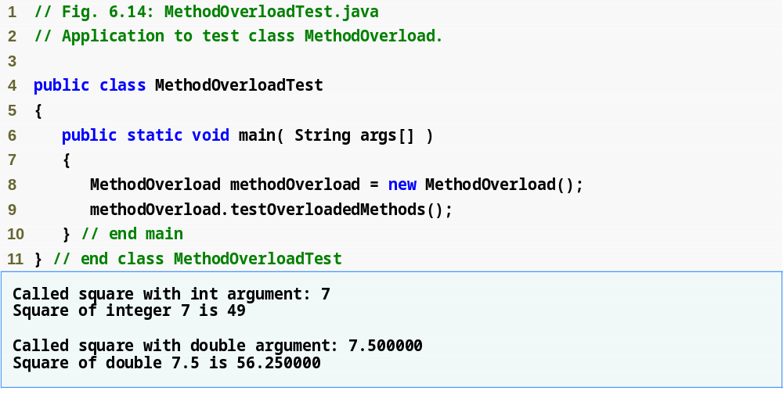
Outline
MethodOverloadTest.java

Slide 48
Method Overloading
Methods are distinguished by their signature.
A method’s signature is the combination of the method name and the parameter list.
Therefore in the previous example, the two square methods have different signatures:
  square (int x)
    Signature = “square+int”
  square (double x)
    Signature = “square+double”
Notice that the names of parameters are not important in a method’s signature.

Slide 49
Method Overloading
Further examples of overloaded methods:
  void foo (int a, float b)
    Signature = “foo+int+float”
  void foo (float a, int b)
    Signature = “foo+float+int”
Since the signatures are different, these two methods are treated as two different methods in Java.

Slide 50
Method Overloading
The return type of a method is not a part of the method signature.
Therefore it is not allowed to have the following methods in the same class:
  int foo (int a, float b)
  float foo (int a, float b)

Slide 51
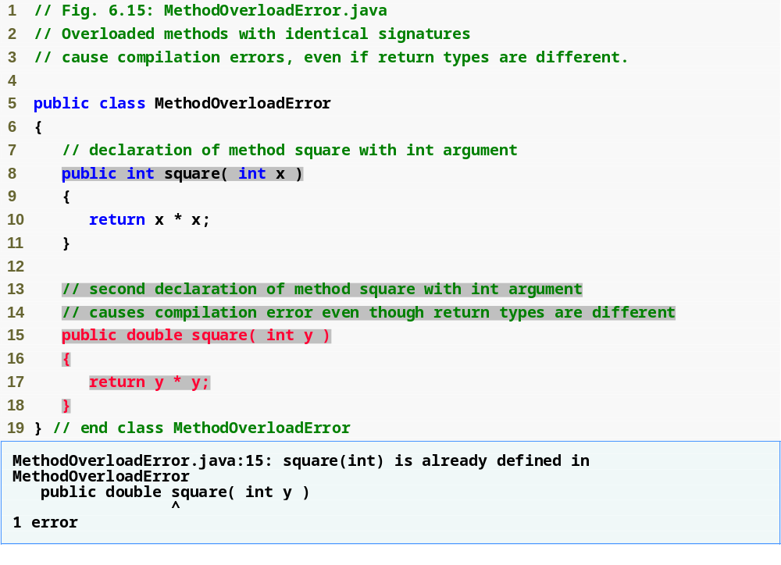
Outline
MethodOverloadError.java
Same method signature
Compilation error
Declaring overloaded methods with identical parameter lists is a compilation error regardless of whether the return types are different.

Slide 52
Why Method Overloading?
Method overloading is useful when we have two or more versions of the same method that perform similar function on different parameters.
Java will automatically choose the correct method to use, based on the type of the parameter.

