Slide 1

ISM 001 Introduction to Programming
Array
Florence Fok
Lingnan University CC

Slide 2

Variables v.s. Arrays
We have been using variables to capture a single instance of data.
If we want to process student grade, two separate spaces are created for the variables in memory:
In the above example, the program can only store one student's grade at a time.
What if we need to process 10 students' grades at the same time?
int
float
SID
grade

Slide 3
Variables v.s. Arrays
One possible solution is to create 10 sets of the SID and grade variables in the program:
  // Student Ids
  int SID0, SID1, SID2, SID3, SID4,
  SID5, SID6, SID7, SID8, SID9;
  // average grades
  float grade0, grade1, grade2, grade3, grade4,
  grade5, grade6, grade7, grade8, grade9;

Slide 4
Variables v.s. Arrays
SID0
int
grade0
float
SID1
int
grade1
float
SID2
int
grade2
float
SID3
int
grade3
float
SID4
int
grade4
float
SID5
int
grade5
float
.
.
.
.
.
.
SID9
int
grade9
float

Slide 5
Variables v.s. Arrays
Using many sets of variables with different names may have solved the storage problem.
However, there is still a programming problem to be solved.
Consider the following portion of Java program that stores and prints the grades for 10 students:

Slide 6
public class grades_var {
// Student Ids
static int SID0, SID1, SID2, SID3, SID4,
SID5, SID6, SID7, SID8, SID9;
// Student grades
static float grade0, grade1, grade2, grade3, grade4,
grade5, grade6, grade7, grade8, grade9;
public static void main (String args[]) {
// Use scanner to get user input
// Input storage
// Now print the grades for verification
System.out.println("\nThese are the grades you entered:");
System.out.println("Student ID: "+SID0+"\tgrade: "+grade0);
System.out.println("Student ID: "+SID1+"\tgrade: "+grade1);
System.out.println("Student ID: "+SID2+"\tgrade: "+grade2);
System.out.println("Student ID: "+SID3+"\tgrade: "+grade3);
System.out.println("Student ID: "+SID4+"\tgrade: "+grade4);
System.out.println("Student ID: "+SID5+"\tgrade: "+grade5);
System.out.println("Student ID: "+SID6+"\tgrade: "+grade6);
System.out.println("Student ID: "+SID7+"\tgrade: "+grade7);
System.out.println("Student ID: "+SID8+"\tgrade: "+grade8);
System.out.println("Student ID: "+SID9+"\tgrade: "+grade9);
} // end main
} // end class

Slide 7
Variables v.s. Arrays
Although the logic is simple, the program is very clumsy because we have to declare variables for each instance of data, and refer to them by their distinct names.
Therefore, array is used to solve the problem, it can store not just one value, but a list of values of the same type and have the same meaning

Slide 8
What is an Array?
An array is a block of continuous memory space in the computer that stores the same type of data and accessed by the same name.
For example, this is how the array SID[] might look like in the computer's memory:
SID[0]
SID[1]
SID[3]
SID[4]
SID[5]
SID[6]
SID[7]
SID[8]
SID[2]
SID[9]
SID[ ]
int
int
int
int
int
int
int
int
int
int

Slide 9
Declaring Arrays
Arrays are declared using this general format:
  element_data_type array_name[];
  (e.g int a[])
The element_data_type can be any of the primitive data types, or it can be a non-primitive data type, such as a class name or String.
The array_name is an identifier that the programmer chooses.
The [] (square brackets) indicates that this is an array.

Slide 10
Allocation of Memory for an Array
The memory space for an array is not allocated after the declaration.
After the declaration, we use the new command to allocate memory space for a new array:
  int SID[]; //declare array variables
  SID = new int[10]; //create array
The above example allocates an array with 10 elements, each element is an integer.
Length of array

Slide 11
Allocation of Memory for an Array
Declaration and allocation of an array can be combined into one step:
int SID[] = new int [ 10 ];
SID[0]
SID[1]
SID[3]
SID[4]
SID[5]
SID[6]
SID[7]
SID[8]
SID[2]
SID[9]
SID[ ]
int
int
int
int
int
int
int
int
int
int

Slide 12
Automatic Initialisation of Arrays
When an array is allocated, the elements are automatically initialized.
If the element data type is one of the numeric primitive data types (I.e. byte, short, int, long, float, double), the elements are initialized with zero.
If the element data type is boolean, the elements are initialized with false.
For char arrays, elements are initialised to the null character (ASCII code 0).
For all other non-primitive types, the elements are initialised with null (nothing).

Slide 13
An Array Example
public class grades_array {
static int SID[] = new int[10];
static float grades[] = new float[10];
public static void main (String args[]) {
// Now print the grades for verification
System.out.println("\nThese are the grades you entered:");
for (int i=0; i<10; i++) {
System.out.println("Student ID: "+SID[i]+"\tgrade: "+grades[i]);
} // end for
} // end main
} // end class

Slide 14
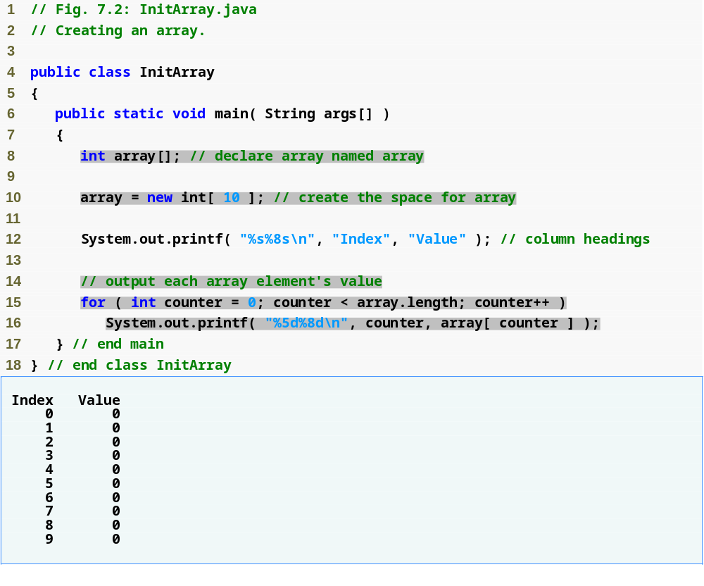
Outline
Create 10 ints for array; each int is initialized to 0 by default
Declare array as an array of ints
InitArray.java
Line 8
Declare array as an array of ints
Line 10
Create 10 ints for array; each int is initialized to 0 by default
Line 15
array.length returns length of array
Line 16
array[counter] returns int associated with index in array
array.length returns length of array
Each int is initialized to 0 by default
array[counter] returns int associated with index in array

Slide 15
Manual Initialisation of Arrays
You may also initialize an array manually. There are two methods to do it.
The first method is to use a comma-separated list of initializers in the array declaration:
  int n[] = {1, 2, 3, 4, 5};
Items enclosed in braces ({}), do not need new keyword.
n[0]
n[1]
n[3]
n[2]
n[4]
n[ ]
1
2
3
4
5

Slide 16
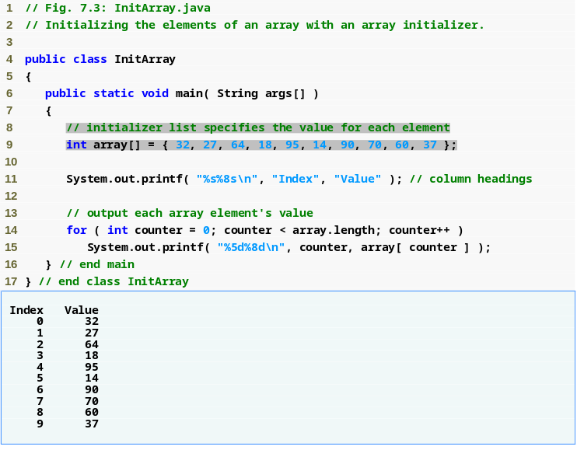
Outline
Declare array as an array of ints
Compiler uses initializer list to allocate array
InitArray.java

Slide 17
Manual Initialisation of Arrays
The second method is more traditional. It uses a for repetition structure to initialize the array elements one by one:
float n[] = new float[ 5 ];
for (int I=0; I<5; I++)
n[I] = I + 1;
n[0]
n[1]
n[3]
n[2]
n[4]
n[ ]
1
2
3
4
5

Slide 18
Accessing Elements of an Array
Elements in an array are accessed by the following format:
  array_name [ subscript ]
The subscript* is any integer expression that falls within the range:
0 <= subscript < length of array.
*subscript is also called index.First element has index zero

Slide 19
Accessing Elements of an Array
The elements in an array are numbered from zero to (length_of_array - 1).
I.e. for an array with 5 elements, the valid subscripts are from 0 to 4.
When a program attempts to access an element outside the array bounds, an ArrayIndexOutOfBoundsException occurs.
float hours[] = new float[5];
hours[0] = 40.0; // Correct
hours[4] = 40.0; // Correct
hours[-1]= 40.0; // Out of range!
hours[5] = 40.0; // Out of range!

Slide 20
The length Property and Constant
Each array has a length property which can be used to retrieve the length of the array.
The data type of length is int.
Constant variables also are called named constants or read-only variables. Such variables often make programs more readable e.g. a constant such as ARRAY_LENGTH clearly indicates this purpose.

Slide 21
Using Arrays to sum up values
Arrays are normally used by accessing their elements individually.
Each array element can be used like a simple variable.
Each element can be assigned a value, or referenced in an expression.
  E.g. c[0]=100; c[1]=c[0];
Array elements can represent a series of values
  We can sum these values

Slide 22
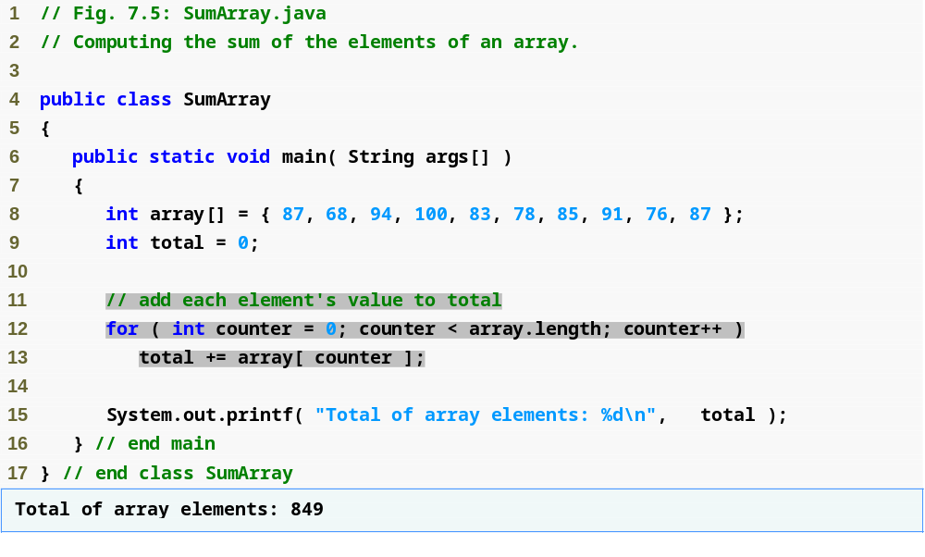
Outline
Declare array with initializer list
Sum all array values
SumArray.java

Slide 23
Passing Arrays to Methods
When we pass an array as a parameter to a method, we are actually passing the reference of the array.
This means that when we change the content of an array in the called method, the changes will be visible by the caller as well.
We call this behaviour call-by-reference.
The original copy of parameters of primitive data types are protected from changes by the called method. This is called call-by-value.

Slide 24
Passing Arrays to Methods
To pass array argument to a method, specify array name without brackets
    Array hourlyTemperatures is declared as
    int hourlyTemperatures[] = new int[ 24 ];
    The method call
    modifyArray( hourlyTemperatures );
    Passes array hourlyTemperatures to method modifyArray
    Parameter list: void modifyArray(int[] a) {…}
No square bracket

Slide 25
Passing Arrays to Methods
When an argument to a method is an entire array (e.g. hourlyTemperatures), the called method will receive copy of reference
When an argument to a method is an individual array element (e.g. hourlyTemperatures[0]), the called method will receive copy of element’s value
The following example illustrates the difference between call-by-reference and call-by-value.
Notice how the elements of the array parameter are permanently changed by the method call.

Slide 26
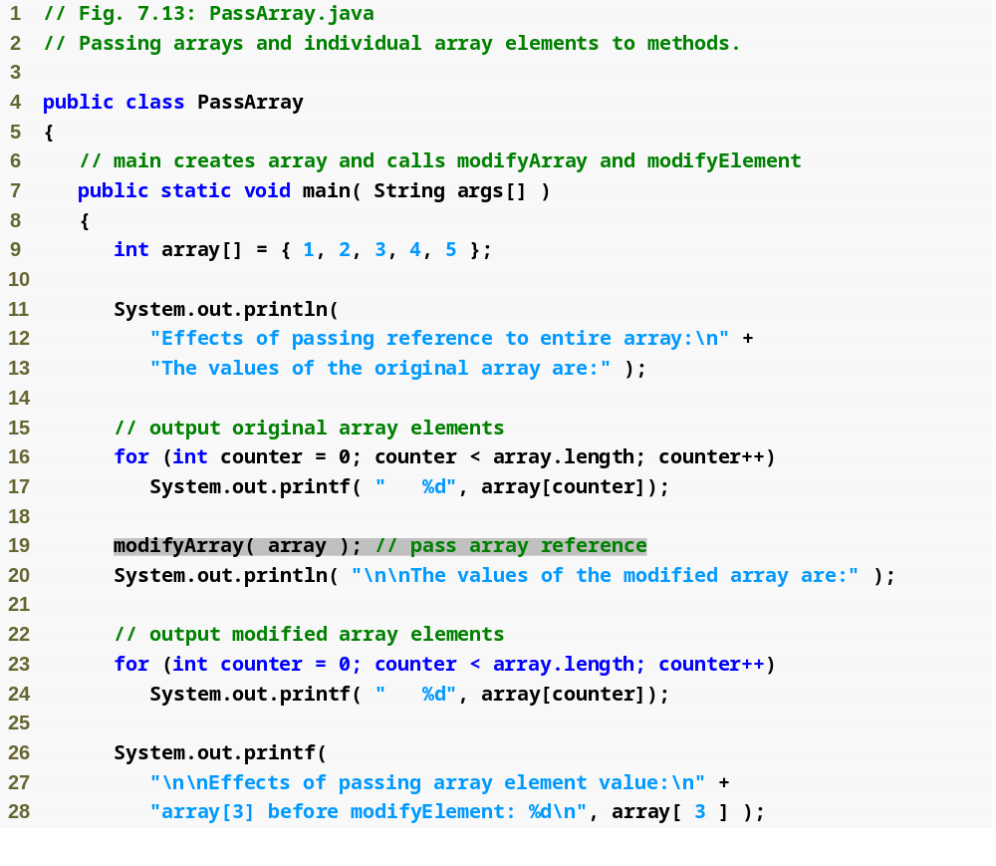
Outline
Declare 5-int array with initializer list
PassArray.java
Pass entire array to method modifyArray

Slide 27
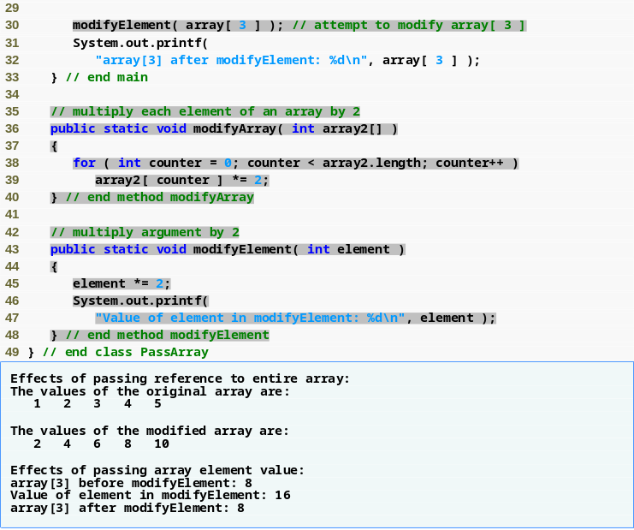
Outline
Pass array element array[3] to method modifyElement
Method modifyArray manipulates the array directly
Method modifyElement manipulates a primitive’s copy
PassArray.java

Slide 28
Passing Arrays to Methods
Notes on passing arguments to methods
  Two ways to pass arguments to methods
    Pass-by-value (or call-by-value)
      Copy of argument’s value is passed to called method
      Does not affect original variable values in the caller
      primitive type is pass-by-value?
    Pass-by-reference (or call-by-reference)
      Caller gives called method direct access to caller’s data
      Both parameter in called method and argument in calling method refer to same object in memory
      Called method can manipulate the object directly
      Improved performance over pass-by-value
      In Java, every object is pass-by-reference
        In Java, arrays are objects
        Therefore, arrays are passed to methods by reference

Slide 29
Searching an Array
Sometimes it is necessary to search an array in order to determine if a particular value exists in the array.
The following method searches an integer array for a particular value. If the value is found, the index of the element is returned. Otherwise, the method returns -1.

Slide 30
Searching an Array
public int linearSearch ( int a[], int key ) {
for (int n=0; n < a.length; n++) {
if ( a[n] == key )
return n;
}
return -1;
}//end for
}//end method

Slide 31
Searching an Array
Notice that the objective of the search is to locate the element that contains the target value. Therefore the method should return the index or subscript of the element that contains the value, not the value itself.
If the caller receives -1 from linearSearch, then the search is not successful.
The sentinel of -1 is usable for searching an array

Slide 32
Multidimensional Arrays
Arrays with one subscript is one-dimensional.
Arrays with two subscripts are said to be two-dimensional.
  int b[][]; //Declares a two-dimensional array
By custom, we call the first subscript the row, and the second subscript the column.

Slide 33
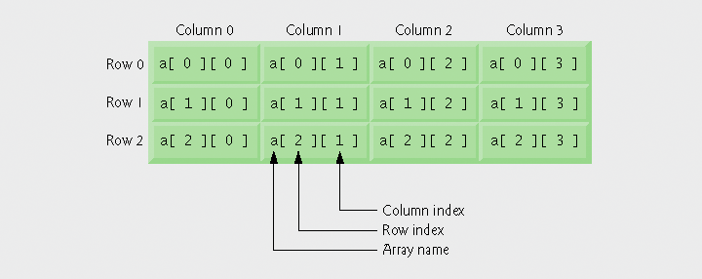
Multidimensional Arrays

Slide 34
Multidimensional Arrays
Arrays of one-dimensional array
  Declaring two-dimensional array b[2][2]
    int b[][] = { { 1, 2 }, { 3, 4 } };
      1 and 2 initialize b[0][0] and b[0][1]
      3 and 4 initialize b[1][0] and b[1][1]
    int b[][] = { { 1, 2 }, { 3, 4, 5 } };
      row 0 contains elements 1 and 2
      row 1 contains elements 3, 4 and 5

Slide 35
Multidimensional Arrays
Two-dimensional arrays with rows of different lengths
  Lengths of rows in array are not required to be the same
    E.g., int b[][] = { { 1, 2 }, { 3, 4, 5 } };

Slide 36
Multidimensional Arrays
Creating two-dimensional arrays with array-creation expressions
  Can be created dynamically
    3-by-4 array
    int b[][];
    b = new int[ 3 ][ 4 ];
    Rows can have different number of columns
    int b[][];
    b = new int[ 2 ][ ]; // create 2 rows
    b[ 0 ] = new int[ 5 ]; // create 5 columns for row 0
    b[ 1 ] = new int[ 3 ]; // create 3 columns for row 1
!!!! Again, it is not necessary for rows and columns
to have same length in a multi-dimensional array

Slide 37
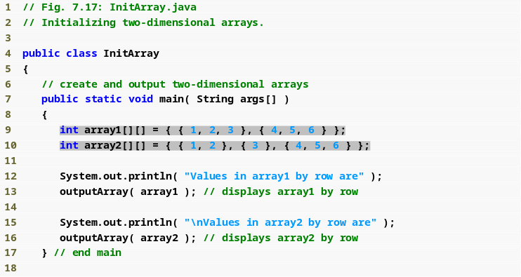
Outline
Use nested array initializers to initialize array1
Use nested array initializers of different lengths to initialize array2

Slide 38
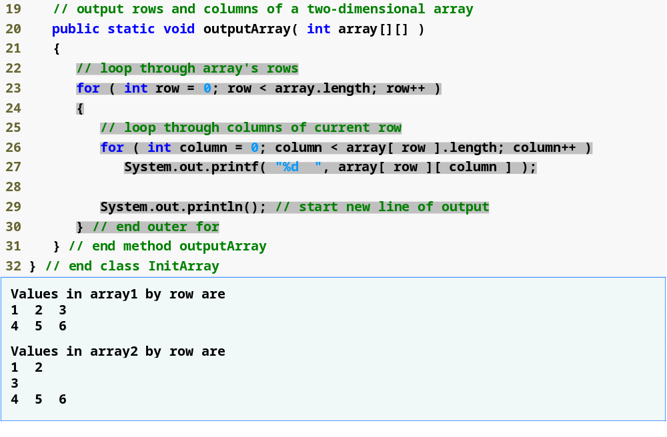
Outline
array[row].length returns number of columns associated with row subscript
Use double-bracket notation to access two-dimensional array values

Slide 39
Allocating Multidimensional Arrays
Multiple-subscripted arrays can be allocated dynamically using initializers or the new keyword.
The following example allocates a char array of two rows and three columns using initializers:
char c[][] = { {'A','B','C'}, {'a','b','c'} };

Slide 40
Allocating Multidimensional Arrays
Column 0
Column 1
Column 2
C[0][0]
'A'
C[0][1]
'B'
C[0][2]
'C'
Row 0
Row 1
C[1][0]
'a'
C[1][1]
'b'
C[1][2]
'c'

Slide 41
Allocating Multidimensional Arrays
The same array can be allocated and initialised manually by using the following statements:
// Allocating multi-dimensional arrays
public class array3by2 {
public static void main (String args[]) {
char c[][];
c = new char[2][3];
c[0][0] = 'A'; c[0][1] = 'B'; c[0][2] = 'C';
c[1][0] = 'a'; c[1][1] = 'b'; c[1][2] = 'c';
}
}

Slide 42
Using command line argument
It is possible to pass arguments from command line
An array of String in the parameter list of main(), the parameter name is args
E.g. java myClass peter 24 passes two parameter to main method of myClass
The arguments peter & 24 are separated by space, not comma

Slide 43
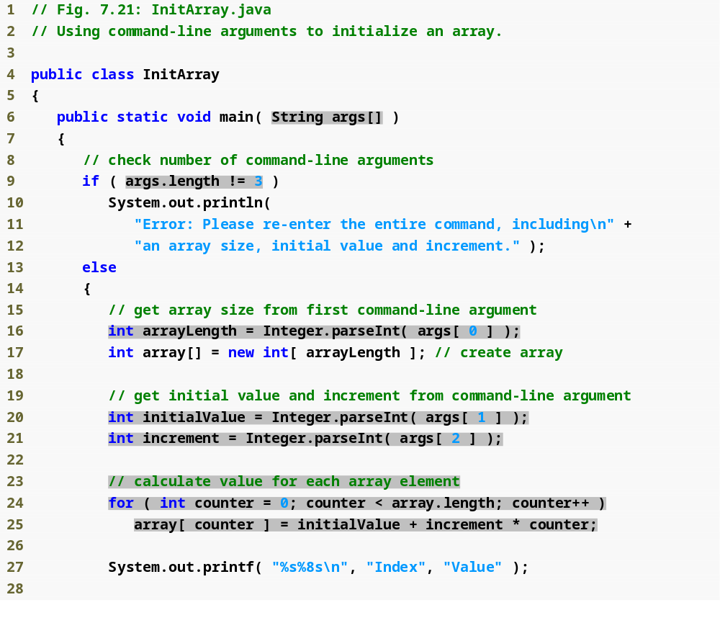
Outline
Array args stores command-line arguments
Check number of arguments passed in from the command line
Obtain first command-line argument
Obtain second and third command-line arguments
Calculate the value for each array element based on command-line arguments

Slide 44
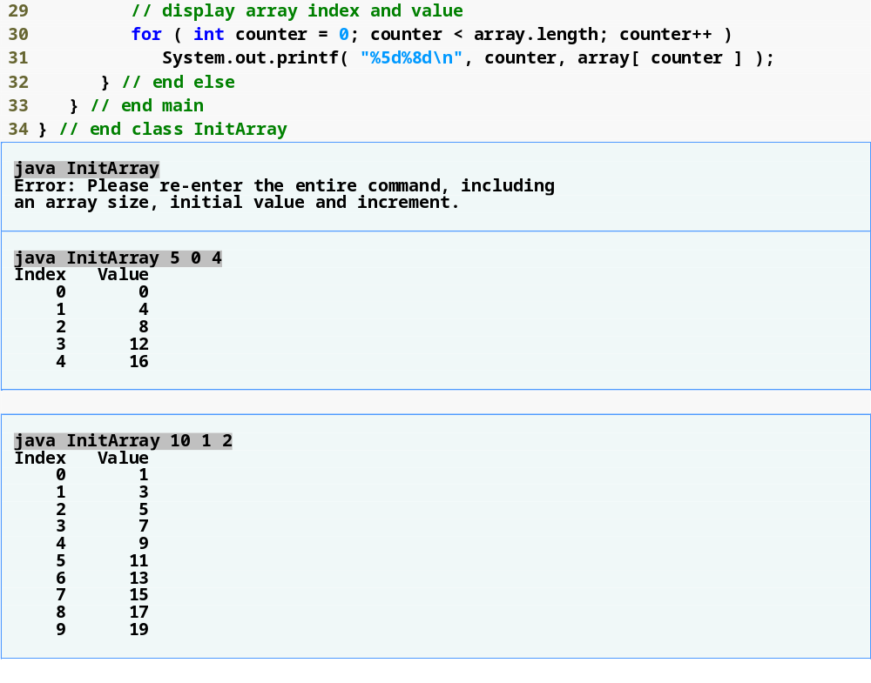
Outline
Missing command-line arguments
Three command-line arguments are 5, 0 and 4
Three command-line arguments are 10, 1 and 2

