Slide 1

ISM 001 Introduction to Programming
Florence Fok
Lingnan University CC

Slide 2

Computer Programming
A computer program is a series of instructions that directs a computer to perform tasks.
Computers do everything by running computer programs
  The hardware is the body, the software is the soul
Programmer writes and modifies program
To write a computer program, programmer often use a programming language.
A programming language is a set of words, symbols, and codes that enable programmer to communicate instructions to a computer.
Different programming lang. uses different kinds of syntax

Slide 3
Computer Programming
Programmer uses a variety of programming language to write code
Coding means actually writing the programs (Programming-process)
Application programs vs System Program

Slide 4
Computer Organisation
Hardware
Computer Network
A Computer
Application Programs
O/S
Word
Excel
Java VM

Slide 5
Programming Languages
Programmers write computer programs by using programming languages
First computer program written by a woman - Ada Byron, Countess of Lovelace in 1842
Hundreds of programming languages are in use today

Slide 6
Programming Languages
Three main types:
  Machine Languages
  Assembly Languages
  High-level Languages

Slide 7
Machine Language
Machine languages
  Directly understandable by the computer
  Hardware dependent
  In binary code (strings of 0s and 1s)
  The fastest and most efficient to execute
  Very difficult to write
  Programmers must learn a new language for a new type of computer

Slide 8
Machine Languages
The following example is from a payroll program. It adds overtime pay to basic pay and stores the result to gross pay:
+1300042774
+1400593419
+1200274027
Write
Execute

Slide 9
Assembly Languages
Use English-like abbreviations to replace binary instructions
A separate program, called the assembler is used to translate the abbreviations to machine language
  LOAD BASEPAY
  ADD OVERPAY
  STORE GROSSPAY
Write
Translate
Execute

Slide 10
High-level Languages
To make writing programs even faster
Use instructions that look almost like common English and use common symbols:
  grossPay = basePay + overTimePay
Greatly improve programming efficiency

Slide 11
High-level Languages
A compiler is used to translate English-like instructions to machine language
Fortran, COBOL, Pascal, C, C++, and Java are examples of High-level languages
Write
Compile
Execute

Slide 12
What is Java?
A High-level programming language that is
Simple
Object-oriented
Cross-platform – write once, run anywhere (Platform Independent)
Use a building-block approach to create programs. Avoid reinventing the wheel—use existing pieces wherever possible. Called software reuse, this practice is central to object-oriented programming.

Slide 13
History of Java
Java
  The development of Java started in 1991 and it was led by James Gosling.
  Originally name for a new language was Oak
  Originally for intelligent consumer-electronic devices
  Then used for creating Web pages with dynamic content
  Now also used to:
    Develop large-scale enterprise applications
    Enhance WWW server functionality
    Provide applications for consumer devices (cell phones, etc.)

Slide 14
What is Object-oriented?
( Oh Oh ??)
Object: model the real world objects, including person, event, place
Class: a blueprint of objects
Instance : an object is an instance of a class

Slide 15
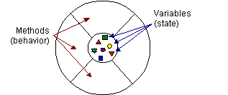
What are Classes & Objects?
Real world objects e.g. your car, my cat, your PC, peter, john
Objects have two characteristics: state and behavior
Objects can change its state by using methods.
A class is a blueprint or prototype that defines the variables and the methods common to all objects of a certain kind
An Object

Slide 16
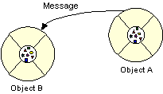
What Are Messages?
Objects interact and communicate with each other using messages

Slide 17
Can you differentiate
Classes and Objects
this course
Mammal
Human beings
Cats
My cat
A circle
My Computer
Account
Florence
Students
You
The monitor in front of you
Shape
Dog
Mary’s Account

Slide 18
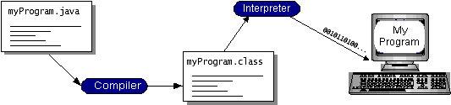
Compilation and Interpretation
Java Program
(Source code)
Java Virtual Machine
Machine code being run
Java Bytecodes

Slide 19

Write Once Run Anywhere
Java Virtual Machine
(Java VM)

Slide 20
Create a Java Source File
How to create source file?
  Notepad, PC Editor, Specialised integrated development environments (IDE) -UltraEditor, MS J++, Symantec Visual Café, Borland JBuilder
Create a file named HelloWorld.java with the Java code shown below:
/**
* The HelloWorld class implements an application that
* simply displays "Hello World!" to the standard output.
*/
class HelloWorld {
public static void main(String[] args) {
System.out.println("Hello World!"); //Display the string.
}
}
void means main method returns no information
Comment

Slide 21
Compile the Source File
Compiling a Java Source File Using the JDK (J2SE Development Kit)
How to download the JDK?
How to compile?
javac HelloWorld.java
Produces .class files that contain java bytecodes
Java Tutorial?

Slide 22
Run the application
Performed by the java virtual machine (JVM)
Java programs can be run independently
  using the JVM in the JDK
  How to run the program using Java Interpreter?
>java HelloWorld

Slide 23
Comments in Java Code
/**
* The HelloWorld class implements an application that
* simply displays "Hello World!" to the standard output.
*/
class HelloWorld {
public static void main(String[] args) {
System.out.println("Hello World!"); //Display the string.
}
}

Slide 24
Modifying Our First Java Program
Escape characters
  Backslash ( \ )
  Indicates special characters be output
Newline characters (\n)
  Interpreted as “special characters” by methods System.out.print and System.out.println
  Indicates cursor should be at the beginning of the next line
  Line breaks at \n

Slide 25
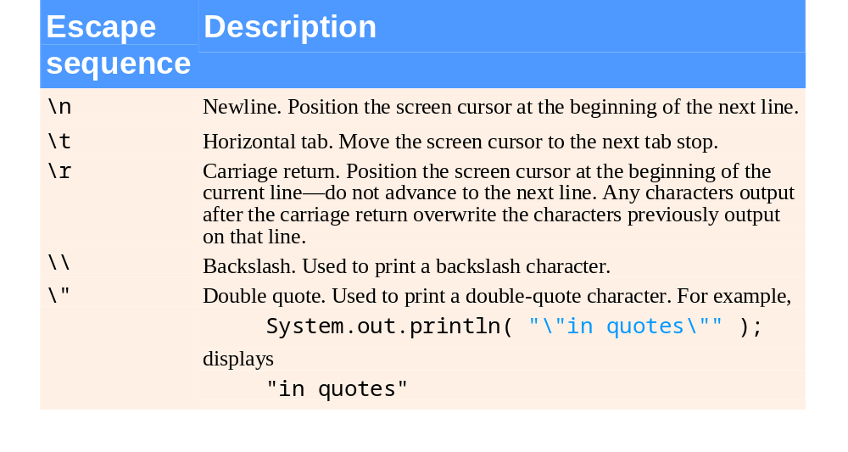
Some common escape sequences

Slide 26
Java Class Libraries
Java programs are composed of little pieces called classes
Any software written in Java is simply a collection of classes working together
Classes that are related to a common purpose is often stored together in a package
Classes
  Include methods that perform tasks
    Return information after task completion
  Used to build Java programs
Java provides class libraries
  Known as Java APIs (Application Programming Interfaces)

Slide 27
Java Class Libraries
Three types of packages (class libraries)
  Those written by yourself as a programmer
  Those written by other programmers
  Those written and distributed by Sun Microsystems as part of the standard Java language (known as Java APIs - Application Programming Interface)
Learn the Java API packages
  Classes, interfaces

Slide 28
Typical Java Development Environment
Java programs normally undergo five phases
  Edit
    Programmer writes program (and stores program on disk)
  Compile
    Compiler creates bytecodes from program
  Load
    Class loader stores bytecodes in memory
  Verify
    Bytecode Verifier confirms bytecodes do not violate security restrictions
  Execute
    JVM translates bytecodes into machine language

Slide 29
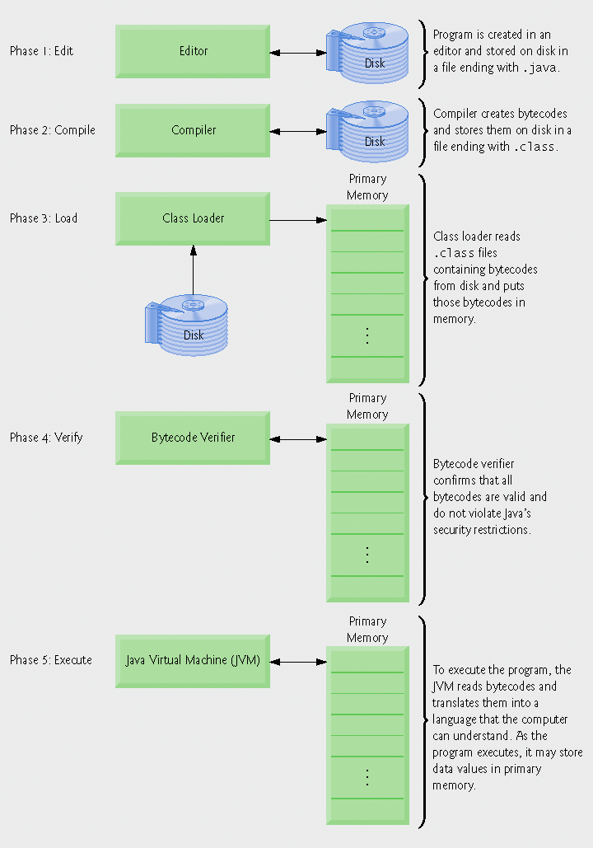
Typical Java development environment

Slide 30
Java Applet

Slide 31
First Java Applet Program Welcome.java
// A first Java applet
import java.applet.Applet; // import Applet class
import java.awt.Graphics; // import Graphics class
public class Welcome extends Applet {
public void paint( Graphics g )
{
g.drawString( "Welcome to Java Programming!", 25, 25 );
}
}
Open the command prompt, go to the directory which contains the .java file
>javac Welcome.java

Slide 32
Welcome.html
<HTML>
<HEAD>
<TITLE> A Simple Program </TITLE>
</HEAD>
<BODY>
Here is the output of my program:
<APPLET CODE=“Welcome.class" WIDTH=275 HEIGHT=55>
</APPLET>
</BODY>
</HTML>
** Put the html file and the applet within the same directory
Size of the applet

Slide 33
Importing Classes and Packages
import java.applet.Applet;
import java.awt.Graphics;
public class Welcome extends Applet {
public void paint( Graphics g ) {
g.drawString( "Welcome to Java Programming!", 25, 25 );
}
}
Applet class is contained in the package java.applet.
Drawing area
(x,y) position
of text

Slide 34
Using Appletviewer
Viewing an Applet Using the JDK:
appletviewer Welcome.html

Slide 35
1) Loading the Applet
When an applet is loaded,
An instance of the applet's controlling class (an Applet subclass) is created.
The applet initializes itself.
The applet starts running.

Slide 36
2) Leaving and Returning to the Applet's Page
When the user leaves the page -- for example, to go to another page -- the applet has the option of stopping itself.
When the user returns to the page, the applet can start itself again.

Slide 37
3) Reloading the Applet
Some browsers let the user reload applets, which consists of unloading the applet and then loading it again.
Before an applet is unloaded, it's given the chance to stop itself and then to perform a final cleanup, so that the applet can release any resources it holds. After that, the applet is unloaded and then loaded again.

Slide 38
4) Quitting the Browser
When the user quits the browser (or whatever application is displaying the applet), the applet has the chance to stop itself and do final cleanup before the browser exits.

Slide 39
Methods for Milestones
init()
  To initialize the applet each time it's loaded (or reloaded).
start()
  To start the applet's execution, such as when the applet's loaded or when the user revisits a page that contains the applet.
stop()
  To stop the applet's execution, such as when the user leaves the applet's page or quits the browser.
destroy()
  To perform a final cleanup in preparation for unloading.

Slide 40
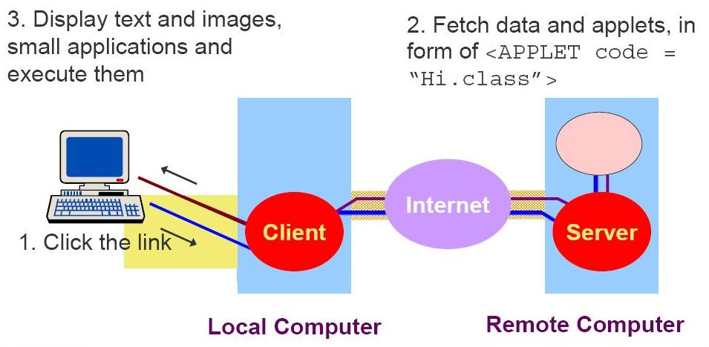
WWW and Applets

Slide 41
WWW and Applets
When a browser user visits an HTML page that contains an applet, here's what happens:
1.The browser finds the class file for the applet's Applet subclass. The location of the class file (which contains Java bytecodes) is specified with the CODE attributes of the <APPLET> tag.
2.The browser retrieves the bytecodes over the network .
3.The browser creates an instance of the Applet subclass.
4.The browser calls the applet's init method which performs any one-time initialization that is required.
5.The browser calls the applet's start method.

Slide 42
Applications and Applets
An executable Java program is either an Applet or a Console Application. And they are written differently
Applications
    Java applications are similar to application programs developed in other languages (run from the command line).
    No browser is needed
    No built-in downloading mechanism.
    An application requires the Java platform, Java Virtual Machine (JVM), to run, or using the JRE

Slide 43
Applications and Applets
Applets
  These programs require a supporting environment, such as a browser, like IE and Netscape to run. They can not run independently.
  When a WWW page containing an applet is accessed by a Java enabled browser, the browser automatically downloads the applet code from the code base specified in the tag and runs it in the local machine.
  An applet does not have access to system services and system resources, while an application has full access to all of these.
  An application has to be used when access to the local file system is required.

Slide 44
Applications vs. Applets
Welcome.java
// An applet in Java
import java.applet.Applet;
import java.awt.Graphics;
public class Welcome extends Applet {
public void paint( Graphics g )
{
g.drawString( "Welcome to Java Programming!", 25, 25 );
}
}
Console_Welcome.java
// A console application in Java
import java.io.*;
public class Console_Welcome {
public static void main (String args[])
{
System.out.print
( "Welcome to Java Programming!");
}
}

Slide 45
Appet restrictions
It cannot ordinarily read or write files on the host that is executing it.
It cannot make network connections except to the host that it came from.
It cannot start any program on the host that is executing it.
It cannot read certain system properties.
Notes:
For security reason, applets downloaded from network cannot access (read or write) the files on the host that is executing them. This prevents computer files being disclosed or modified unintentionally.
Applets cannot make network connections except to the host that they came from. This prevents applets sending information to unintended network.
Applets cannot start any program on the computer it is running. This prevents the applet start any harmful program (e.g. format the hard disk).

Slide 46
Applets Online
Home of Java Applets:
http://java.sun.com/applets
Java Tutorial:
http://java.sun.com/docs/books/tutorial/index.html
Applet Tutorial:
http://java.sun.com/docs/books/tutorial/applet/index.html
Notes:
The http://java.sun.com web site provides most of the Java information and documentation. You can download many Java related materials, including development tools, source program, from there. The web page http://java.sun.com/applets is delegated to Java applets. You can find introduction, free applets, demo codes from there.
Sun Microsystem provides many tutorial on her web site. You may buy the book from book store or download it from the Web Site. One of the chapter in the tutorial is for Java Applets. You may read it online.

Slide 47
Applets Online (2)
Free Applets:
http://www.ericharshbarger.org/java/
http://www.vandaveer.com/tank/index.htm
http://lectureonline.cl.msu.edu/~mmp/applist/applets.htm
Notes:
There are many free applets available from Internet. You will find lots of them using a search engine to search for ‘Applet’. The above three links are extracted from the search results.

