Slide 1

ISM 001 Introduction to Programming
Classes, Objects and Methods (1)
Florence Fok
Lingnan University CC

Slide 2

Memory Concepts
Variables in a Java program actually point to locations in the computer’s RAM (Random Access Memory)
The RAM is like a series of empty spaces for storage of data
  Think of the mail boxes in the lobby of an apartment building
Each empty space (mail box) is assigned a physical address (a sequence number)

Slide 3
Memory Concepts
The smallest unit in a computer’s storage space is called a bit.
Connect eight bits together, you have a byte.
Collect 1024 bytes together, you have a kilobyte.
Collect 1024 kilobytes together, you have a megabyte.
Etc…

Slide 4
Memory Concepts
To declare two variables:
  int number; // variable that stores input value
  int sum; // variable that stores sum of integers
We can imagine two blocks of empty spaces are being reserved in the RAM for these variables:
number
sum

Slide 5
Memory Concepts
The statement:
  sum = 0;
Puts the value 0 into the space reserved for sum:
number
sum
0

Slide 6
Memory Concepts
The statement:
  sum = sum + number;
adds the value in number to the value in sum, then store the result in sum.
For example: If number = 45, sum = 0, then after the operation:
45
45
number
number
0
sum
45
sum
Before
After

Slide 7
Variables Declaration
Java is a strongly typed language. Every variable must be declared.
  Format: [modifiers] type identifier;
  Modifiers: public, private, protected, static, final.
  Type: int, double, float, char, byte, long, short, boolean
Sample variable declarations:
  int i, j, k;
  private float numberOne, numberTwo;
  public double bigNumber;
  byte n; char c;

Slide 8
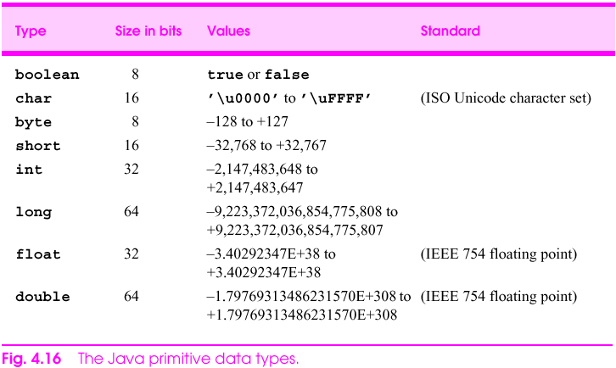
Primitive Data Types

Slide 9
Java identifier
  Java identifier
    Series of characters consisting of letters, digits,
    underscores ( _ ) and dollar signs ( $ )
    Does not begin with a digit, has no spaces
    Examples: Welcome1, $value, _value, button7
      7button is invalid
    Java is case sensitive (capitalization matters)
      a1 and A1 are different

Slide 10
Assignment Operators
The assignment operator is represented by a single ‘equals’ sign =.
It assigns the value on the right to the variable on the left
  X = Y;
  X = 5;
  X = 3 + Y;
  X = X + Y;
X

Slide 11
Assignment Operators
The assignment statement:
  c = c + 3
Can be abbreviated as:
  c += 3
The two statements above are the same.
The “shorthand” forms are used for efficiency.

Slide 12
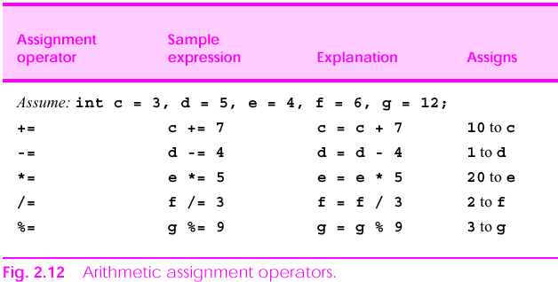
Assignment Operators

Slide 13
Increment and Decrement Operators
The increment operator (++) and decrement operator(- -) are used to add and subtract 1 from a variable respectively.
I.e.
  i++ will add 1 to the variable i
  i-- will subtract 1 from the variable i
Increment and decrement operators can be placed at the front or after a variable
  It is called preincrement or predecrement if it is placed at the front. Eg. --i, ++c, ++count
  It is called postincrement or postdecrement if it is placed behind. Eg. i--, c--, count--

Slide 14
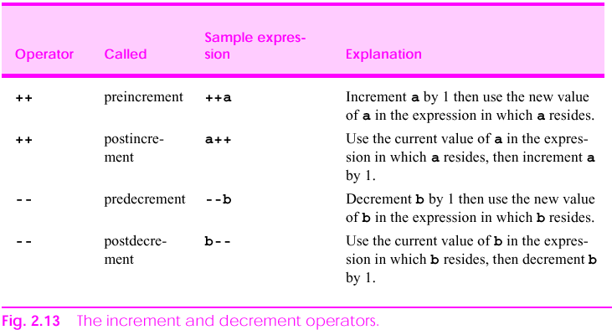
Increment and Decrement Operators

Slide 15
Increment and Decrement Operators
When the increment and decrement operators are used, usually the variable is being referenced.
Exercise:
  counter = 5;
  System.out.println(“The counter is “ + counter++);
  System.out.println(“Now it is “ + counter);
What will be printed?
  The counter is 5
  Now it is 6

Slide 16
Increment and Decrement Operators
Another examples:
  counter = 5;
  System.out.println(“The counter is “ + ++counter);
  System.out.println(“Now it is “ + counter--);
  System.out.println(“Now it is “ + counter);
What will be printed?
  The counter is 6
  Now it is 6
  Now it is 5

Slide 17
Increment and Decrement Operators
If the increment or decrement operator is used alone in a statement, pre- or post- make no difference.
  I.e. the statement:
    counter++;
  Is the same as:
    ++counter;
There should be no space between the increment and decrement operators and the variable itself.
I.e. Write ++i, but not ++ i.

Slide 18
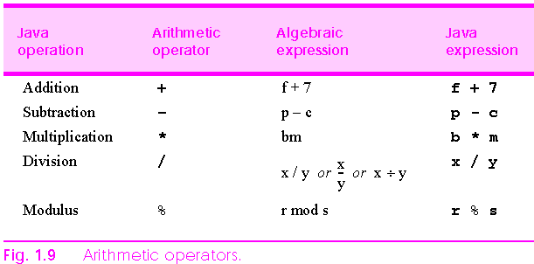
Arithmetic Operators

Slide 19
Arithmetic Expressions
Arithmetic expressions in Java are written in a straight line
    is written as a / b
a
b

Slide 20
Arithmetic Operators
About integer division:
  Dividing two integers gives an integer quotient
    e.g. 7 / 4 evaluates to 1
    The remainder is dropped, there is no rounding
  To force Java to return fractional quotient, cast one of the operators to a floating point value
    e.g. 3.0 / 2 evaluates to 1.5
About the modulus operator (%):
  The modulus operator returns the remainder of a division
    e.g. 7 % 4 evaluates to 3 (because 7 - 4 = 3)
    e.g. 8 % 4 evaluates to 0 (because 8 - 8 = 0)
  The modulus operator only operates on integers

Slide 21
Operator Precedence
Expressions in parentheses() are evaluated first
  Nested parentheses are evaluated from inside out
Multiplication (*), division (/), and modulus (%) operators are evaluated next.
Addition (+) and subtraction (-) operators are evaluated last.
Operators on the same level of precedence is evaluated from left to right.

Slide 22
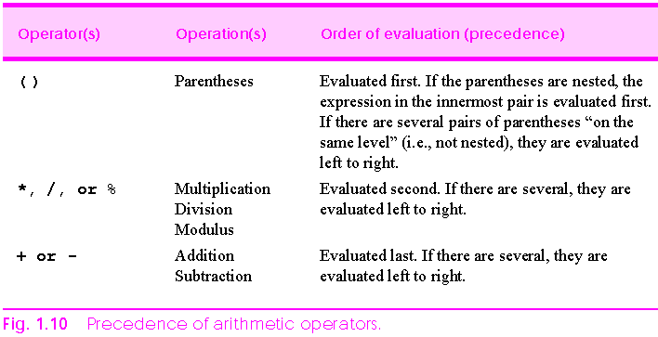
Operator Precedence

Slide 23
Operator Precedence
Operator precedence
  Some arithmetic operators act before others (i.e., multiplication before addition)
    Use parenthesis when needed e.g. a * (b + c)
  Example: Find the average of three variables a, b and c
    Do not use: a + b + c / 3
    Use: ( a + b + c ) / 3

Slide 24
Equality and Relational Operators
Equality and relational operators are also called logical operators
Equality and relational operators always evaluates to either true or false
Equality and relational operators are very useful. They allow a Java program to choose different actions based on a condition
An example of a decision making control structure in Java is the if structure

Slide 25
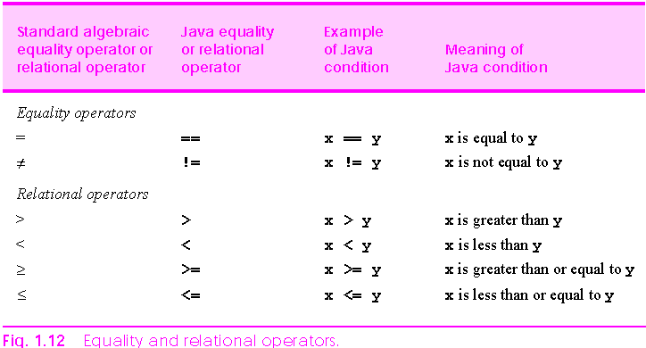
Equality and Relational Operators
Note: It is an error to put a space in the operators

Slide 26
Equality and Relational Operators
True or false?
  4 == 5
  12 != 12
  6 > 8
  8 < 12
  3400 >= 3400
  128 <= 130

Slide 27
Equality and Relational Operators
  int X;
  int Y;
  X = 14;
  Y = 84 / 3;
True or false?
  X <= Y
  Y >= X
  Y != Y * 2

Slide 28
Equality and Relational Operators
Equality and relational operators evaluate to a logical condition
A logical condition is either true or false
The if statement is used to decide whether to execute certain action based on a logical condition:
  if condition_is_true
  execute_this_statement ;
  if A > B
  B = A;

Slide 29
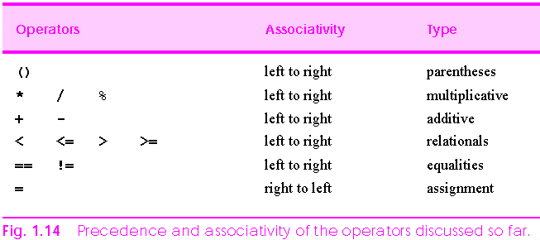
Precedence and Associativity of Operators

Slide 30
Declaring a Class with a Method and Instantiating an Object
Each class declaration that begins with keyword public must be stored in a file that has the same name as the class and ends with the .java file-name extension.

Slide 31
Class GradeBook
keyword public is an access modifier
Class declarations include:
  Access modifier
  Keyword class
  The ClassName (the first character is in capital letter)
  Pair of left and right braces

Slide 32
Class GradeBook
Method declarations
  Keyword public indicates method is available to public
  Keyword void indicates no return type
  Access modifier, return type, name of method and parentheses comprise method header

Slide 33
Common Programming Error
Declaring more than one public class in the same file is a compilation error.

Slide 34
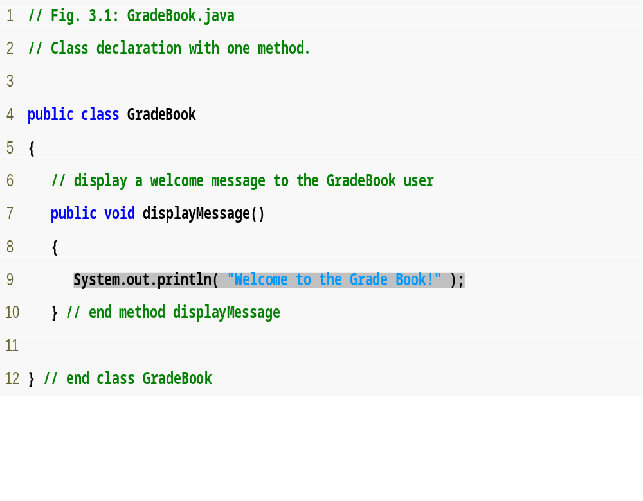
Outline
Print line of text to output
GradeBook.java

Slide 35
Class GradeBookTest
Java is extensible
  Programmers can create new classes
Class instance creation expression
  Keyword new
  Then name of class to create and parentheses
Calling a method
  Object name, then dot separator (.)
  Then method name and parentheses

Slide 36
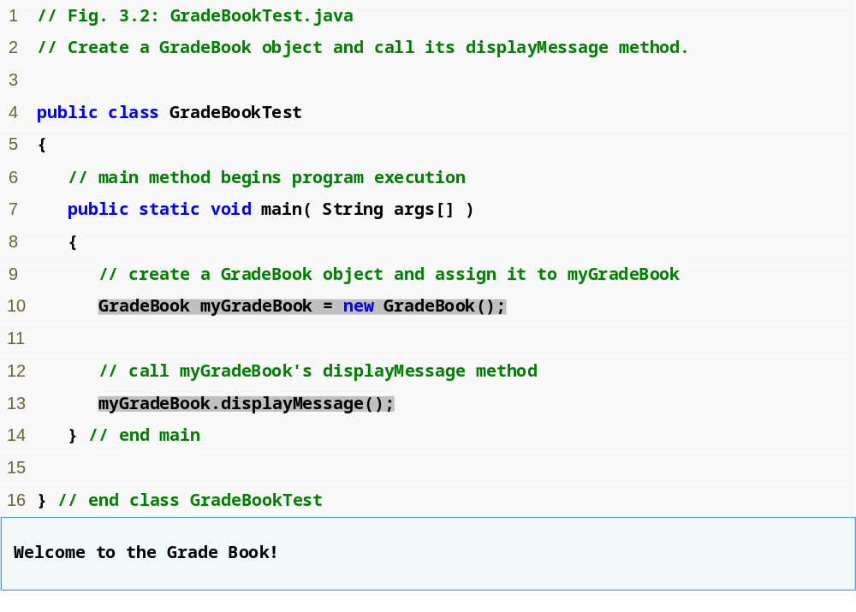
Outline
GradeBookTest.java
Use class instance creation expression to create object of class GradeBook
Call method displayMessage using GradeBook object

Slide 37
Modify GradeBook.java
public class GradeBook1{
private String courseName;
public void displayMessage() {
System.out.println( "Welcome to the Grade Book!" );
}
public void setCourseName(String name) {
courseName = name;
}
public GradeBook1( String name ){
courseName = name; // initializes courseName
}
public String getCourseName() {
return courseName;
}
}

Slide 38
Modify GradeBookTest.java
public class GradeBookTest1
{
public static void main( String args[] )
{
GradeBook1 myGradeBook = new GradeBook1("Java-How to Program");
myGradeBook.displayMessage();
System.out.println();
System.out.println(myGradeBook.getCourseName());
}
}

Slide 39
Further modification
Make some modification by using setCourseName(“Internet and WWW”);
Combined two files into one

Slide 40
Methods in Java
Methods are small functional units within a class
Class A
public class A {
.
.
public static void method m1 {
.
.
}
public static void method m2 {
.
.
}
}
Method m1
Method m2

Slide 41
Methods that are familiar to you:
You have seen some of the common methods in Java.
For example, when you write a Java application, you would use the main method:
  public class MyClass {
  public static void main (String args[]) {
  .
  .
  }
  }
This is a method!

Slide 42
Methods in Java?
In Java, everything is done by methods.
Different classes contain different methods.
  For examples:
    The “Applet” class contains the following methods
      public void init();
      public void paint(Graphics g);
When you write programs in Java, You will either write your own methods or use methods written by others.

Slide 43
Calling a Method
A method is called (or invoked) by other methods.
The method that calls another method is the caller.

Slide 44
A Class with Simple Methods
// Program to greet audience
public class SimpleMethods {
public static void main (String args[]) {
sayHello();
sayName();
sayGoodbye();
}
public static void sayHello() {
System.out.println("Hello!");
}
public static void sayName() {
System.out.println("My name is ET.");
}
public static void sayGoodbye() {
System.out.println("Goodbye.");
}
}
Caller
Methods called by main
Method definitions

Slide 45
Output from simpleMethods.java
D:\>java SimpleMethods
Hello!
My name is ET.
Goodbye.

Slide 46
Exercise
Create a Car class with attributes licenseNumber (String) and gas (double)
Create another class called CarTest and create an object called peterCar
peterCar has initial setting: licenseNumber=“BK8866” and gas=400.9
Use methods to print car information
Please submit your exercise to webCT

