Slide 1

ISM 001 Introduction to Programming
Classes, Objects and Methods (2)
Florence Fok
Lingnan University CC

Slide 2

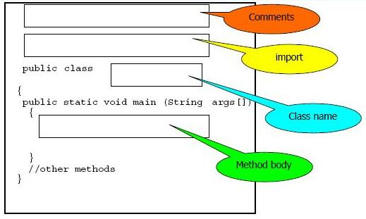
Application Template

Slide 3
Primitive Data Types
The primitive data types in Java are the building blocks for more complex data types.
Java is strongly typed, meaning that variables must be declared for a data type before they are used. Also, there are straight rules governing the assignment compatibility between variables of different types.
Usually, only variables of the same type can be assigned to each other.

Slide 4
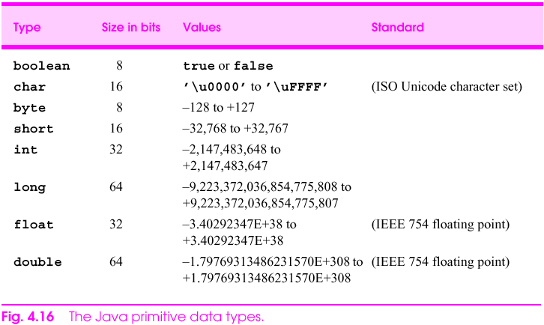
Primitive Data Types

Slide 5
How to declare and initialize?
int a=4;
double b= 6.94;
char c = 'A';
byte d = 36;
long e = 50;
short f = 35;
float g = 345.3466f;
boolean h= false;

Slide 6
Primitive Types vs. Reference Types
Java data types are portable, meaning that they are the same across all computers that support Java.
Types in Java:
  1) Primitive
    boolean, byte, char, short, int, long, float, double
    String is NOT Primitive Types
  2) Reference (sometimes called nonprimitive types)
    Objects
    Default value of null
    Used to invoke an object’s methods
    E.g. String, Car, GradeBook

Slide 7
Object Declaration
Every object used must be declared.
  Format: <ClassName> <objectName>;
  <ClassName> is the name of a class to which the object belongs to; must be defined elsewhere
<objectName> a sequence of object names separated by commas
Naming Convention:
  Uppercase for first letter for class names
  Lowercase for first letter for object names
Advice: Strictly follow this standard naming convention in writing your Java programs to make them easier to read

Slide 8
Constants
We can change the value of a variable. If we want the value to remain the same, we use a constant:
final int MONTH_IN_YEAR = 12;
final double PI = 3.14159;
final: the variable is assigned exact once, and must be in the declaration
Cannot be changed after initialization

Slide 9
Object creation using Constructor
**NO** objects are actually created by the declaration
Create an object can only created by new command.
Java will provide a default no-argument constructor if none is provided
Syntax:
<ClassName> <objectName>= new <ClassName>(<arguments>);
<arguments> is a sequence of values passed to the method.
e.g. GradeBook myGradeBook=new GradeBook(“Java”);
Constructor

Slide 10
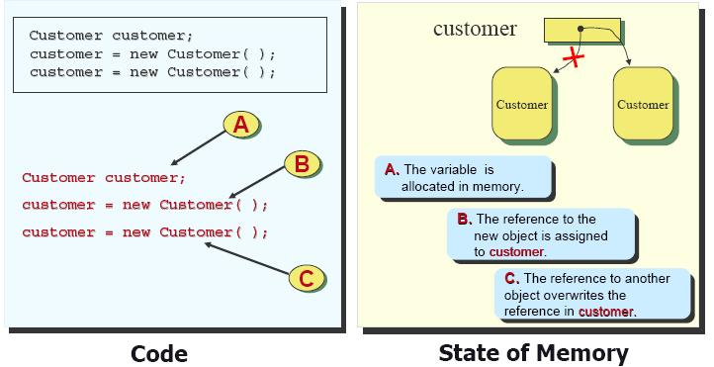
Assigning Objects

Slide 11
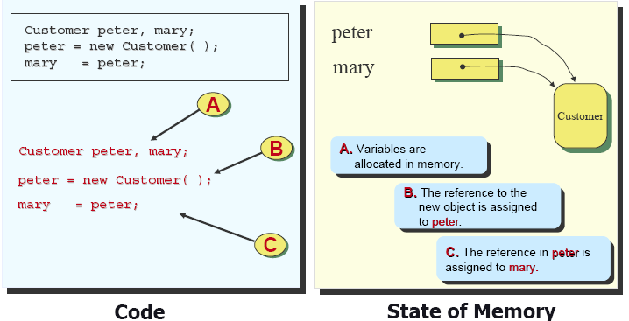
Two references to a single object

Slide 12
Method Definition
The format of a method definition is:
return_value_type method_name (parameters_list) {
  declarations and statements
  }
  e.g. public String getCourseName(){….return xx;}
  public void setCourseName(String name){…..}

Slide 13
A Simple Method
public means this method can be called by other classes
The return data type
The method name
The parameter list (empty)
public static void sayName() {
System.out.println("My name is ET.");
}
Class method

Slide 14
Why do we need methods?
Modularization means to group program statements that perform specific functions together to form functional modules.
Each method in a Java class should perform one specific function.
Modularization makes software development more manageable.
  We can write one method at a time
It also makes our program more powerful. By using parameters, we can use a method on different data.
The following example changed the sayName() method in simpleMethods.java to make the program say a different name everytime it is run.

Slide 15
Method with Parameters
// Program to greet audience
public class sayNameParam {
public static void main (String args[]) {
String myName = args[0];
sayHello();
sayName(myName);
sayGoodbye();
}
public static void sayHello() {
System.out.println("Hello!");
}
public static void sayName(String aName) {
System.out.println("My name is " + aName + ".");
}
public static void sayGoodbye() {
System.out.println("Goodbye.");
}
}

Slide 16
Outputs from sayNameParam.java
D:\>java sayNameParam Ultraman
Hello!
My name is Ultraman.
Goodbye.
D:\>java sayNameParam HelloKitty
Hello!
My name is HelloKitty.
Goodbye.

Slide 17
Method Parameters
Parameters are copies of data passed by the caller to the method.
A method may take any number of parameters.
The parameters passed to a method must be declared in the parameter list of the method definition.

Slide 18
Method Parameters
The format of the parameter list is:
  method_name (data_type parameter_name, data_type parameter_name, ..)
Each pair of data_type parameter_name identifies one parameter.
The parameter name is an identifier that you choose to name the parameter.

Slide 19
Method Parameters
An example of a method with no parameter:
  public static void sayHello() {..}
An example of a method with one parameter:
  public static void sayName(String aName) {..}
An example of a method with multiple parameters:
  public static void sayNameAndAge(String aName, int age) {..}

Slide 20
Calling a Method with Parameters
When a caller calls a method with parameters, it must supply the right number of parameters in the right order.

Slide 21
Calling a Method with Parameters
Within a method, we must use the parameter names in the parameter list to refer to the parameters.
However, the caller is not restricted by the parameter names.
The caller may use any expression to supply a parameter, as long as the expression evaluates to a data type that is compatible with the parameter in the method definition.

Slide 22
Calling a Method with Parameters
public class sayNameAndAge {
public static void main (String args[]) {
String s;
Short i;
s = args[0];
i = Short.parseShort(args[1]);
sayNameAndAge(s, i); //i is promoted to integer
}
public static void sayNameAndAge(String name, int age) {
System.out.println("My name is " + name);
System.out.println("I am " + age + " years old.");
}
}

Slide 23
Output from sayNameAndAge.java
D:\>java sayNameAndAge William 25
My name is William
I am 25 years old.

Slide 24
Automatic Promotion of Parameters
For certain data types, Java will automatically promote a more restrictive type to a less restrictive type.
For example, byte, short, int, and long are all integer data types in Java. When passing a short integer to a int parameter, Java will automatically promote (upgrade) the value passed to an int.
The range of values of each primitive type determines the possible automatic promotions.

Slide 25
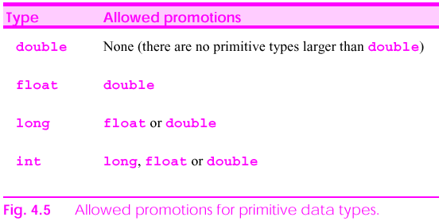
Automatic Promotion of Parameters

Slide 26
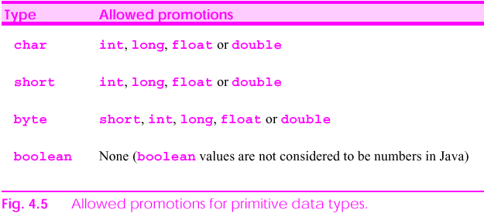
Automatic Promotion of Parameters

Slide 27
The following statements are valid?
int c=4;
double b=c+10; //automatic promotion without loss
System.out.println(b);
double x = 3 + 5; //auto promotion
System.out.println(x);
c= (int) 10.3 * x //casting
int i, j;
float x,y;
double u;
i = x; (not allowed)
x = u+y; (not allowed)
Notice that it is a promotion. Demotion is not allowed.
  E.g. int x= 3.5; (NOT ALLOWED!!!!)

Slide 28
Return Value from a Method
A method may return a value to its caller.
If a method does not need to return a value, we should use the void keyword as the return data type in the method definition:
  public static void sayHello() {
  System.out.println(“Hello.”);
  }
A method may return a value (primitive type/reference type):
public static boolean isEvenNumber(int I) {
  return ( (I % 2) == 0 );
  }

Slide 29
Return Value from a Method
A method returns a value by using the return statement.
If used without an expression, the return statement causes the method to exit immediately and returns program control to the caller.
If used with an expression, then the expression is evaluated and the result is passed back to the caller.

Slide 30
Examples of Methods with Return Value
  public static boolean isEvenNumber(int I) {
  return ( (I % 2) == 0 );
  }
  public static int sum(int x, int y) {
  return ( x + y );
  }
  public static double wagePayment( int hours, double rate) {
  double pay;
  if ( hours > 40 )
  pay = ( 40 * rate ) + (hours - 40) * rate * 1.5;
  else
  pay = hours * rate;
  return (pay);
  }

Slide 31
Get Input
From User in Java Application

Slide 32
Java Application: Adding Integers
Use Scanner to read two integers from user
Use printf to display sum of the two values

Slide 33
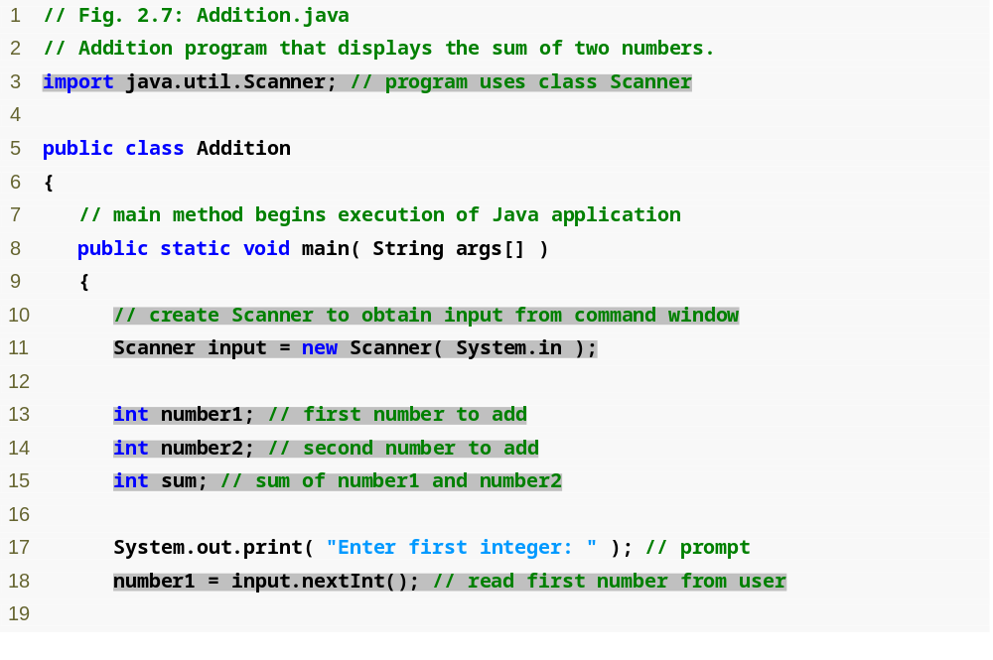
Outline
import declaration imports class Scanner from package java.util.
Declare and initialize variable input, which is a Scanner.
Declare variables number1, number2 and sum.
Read an integer from the user and assign it to number1.
Addition.java

Slide 34
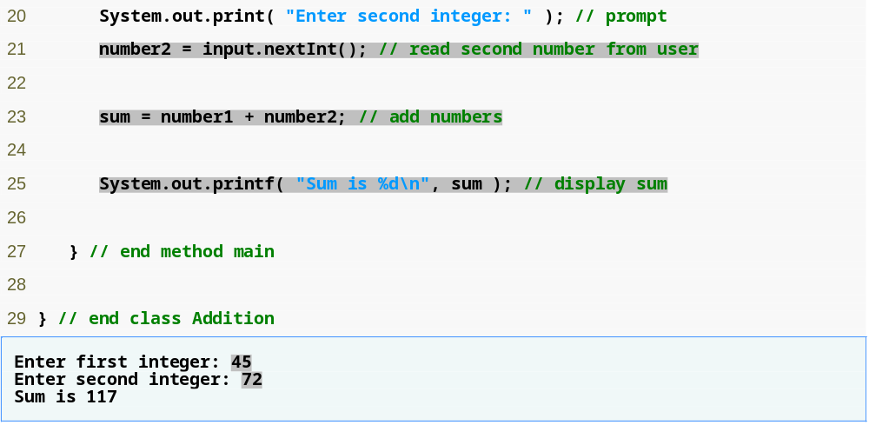
Outline
Read an integer from the user and assign it to number2.
Calculate the sum of the variables number1 and number2, assign result to sum.
Display the sum using formatted output.
Two integers entered by the user.

Slide 35
Java Application: Adding Integers
3 import java.util.Scanner; // program uses class Scanner
  import declarations
    Used by compiler to identify and locate classes used in Java programs
    Tells compiler to load class Scanner from java.util package (J2SDK 1.5.0)
  Begins with public class Addition
    Recall that file name must be Addition.java
  Lines 8-9: begins main
5 public class Addition

Slide 36
Java Application: Adding Integers
10 // create Scanner to obtain input from command window
11 Scanner input = new Scanner( System.in );
Variable Declaration Statement
  Variables
    Location in memory that stores a value
      Declare with name and type before use
    input is of type Scanner
      Enables a program to read data for use
  Initialize variable in its declaration
    Standard input object
      System.in
Format specifier
  Placeholder for integer: %d
  Placeholder for String: %s
  Placeholder for float: %f, %.2f(Used to output floating-point numbers)

Slide 37
Modify the Addition Program
Modify int number1 to double number1
Use number1 = input.nextDouble(); to read the double value
Modify sum to double
Use appropriate format specifier to print the results
Try to insert double value in number2
Try to run the program:
  >java Addition2
  Enter first integer: 3.552
  Enter second integer: 25
  Sum is ?

Slide 38
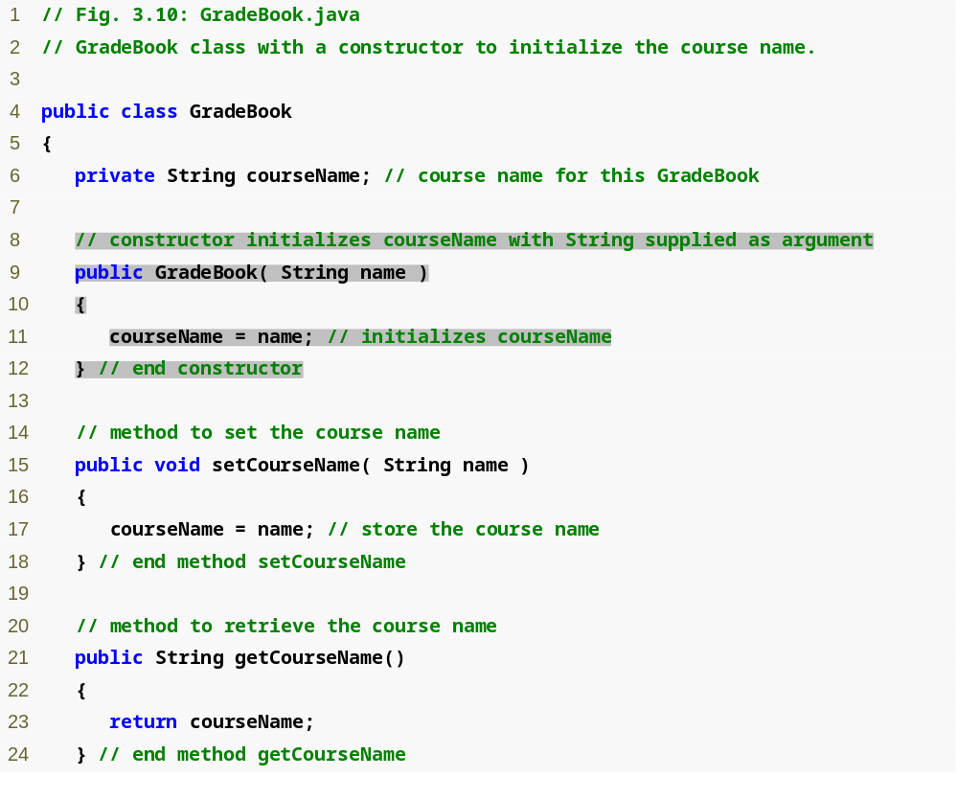
Outline
Constructor to initialize courseName variable
GradeBook.java

Slide 39
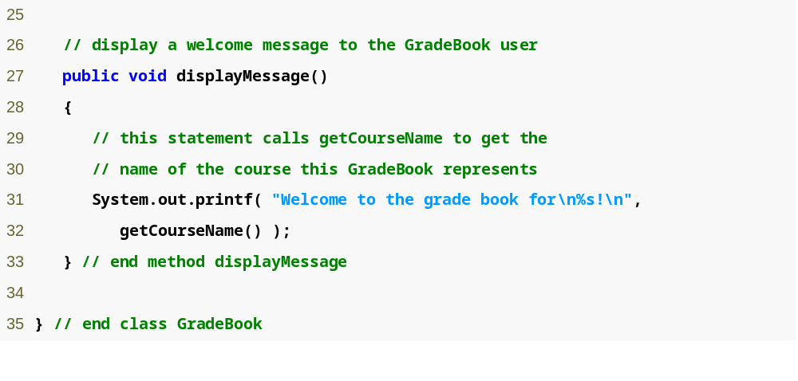
Outline
GradeBook.java

Slide 40
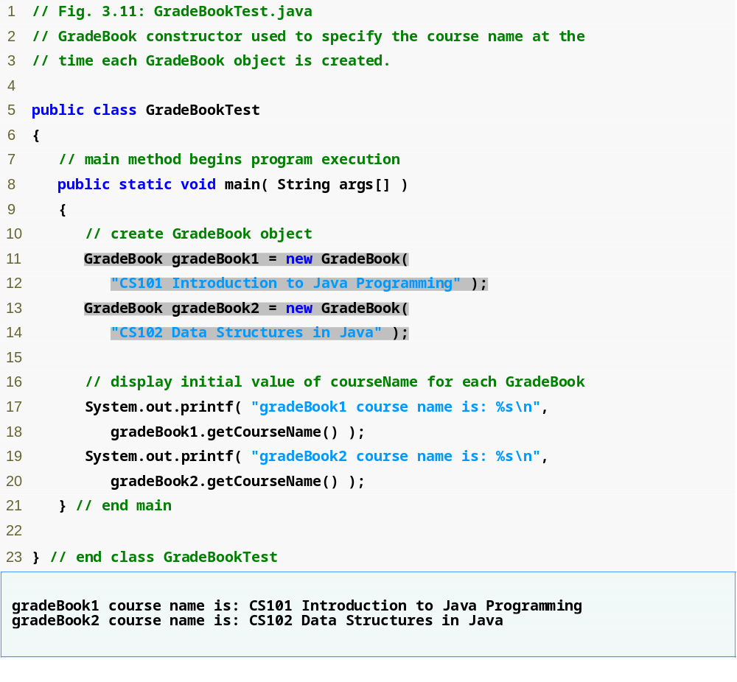
Outline
GradeBookTest.java
Call constructor to create first grade book object
Create second grade book object

Slide 41
Displaying Text in a Dialog Box
Windows and dialog boxes
  Many Java applications use these to display output
  JOptionPane provides prepackaged dialog boxes called message dialogs

Slide 42
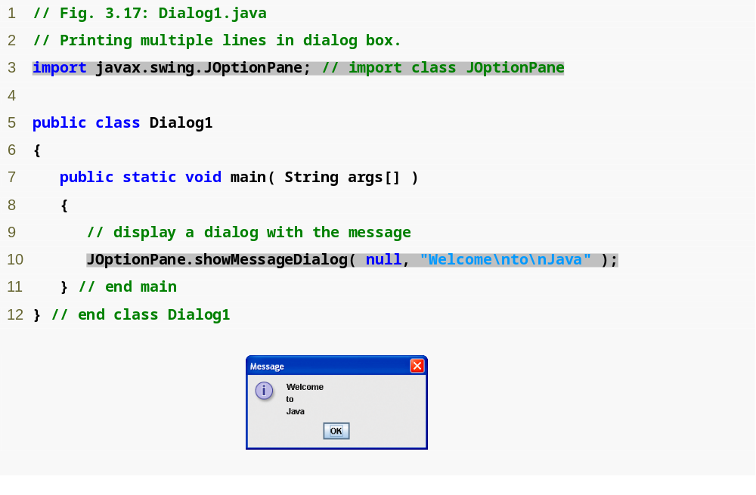
Outline
Dialog1.java
Import class JOptionPane
Show a message dialog with text

Slide 43
Displaying Text in a Dialog Box
Package javax.swing
  Contains classes to help create graphical user interfaces (GUIs)
  Contains class JOptionPane
    Declares static method showMessageDialog for displaying a message dialog
Try different message Type!!

Slide 44
Entering Text in a Dialog Box
Input dialog
  Allows user to input information
  Created using method showInputDialog from class JOptionPane

Slide 45
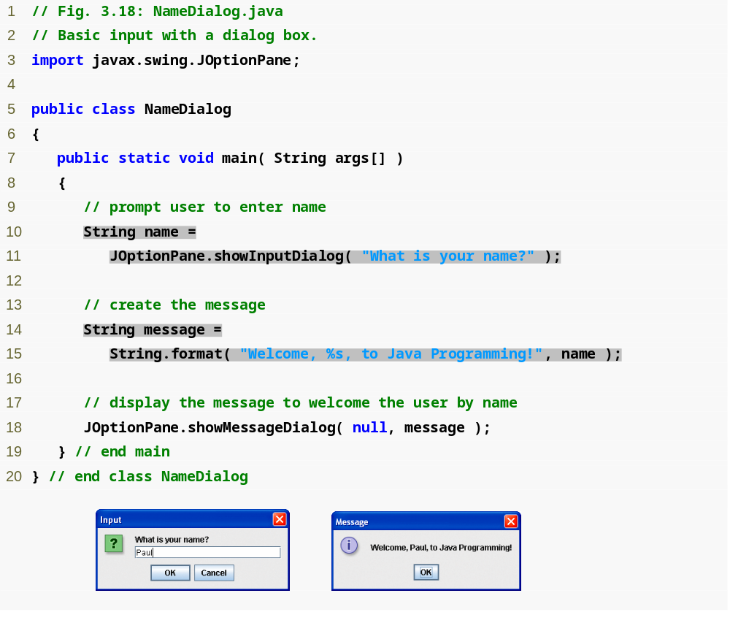
Outline
NameDialog.java
Show input dialog
Format a String to output to user

Slide 46
/* structure is Clear
1) declare and initalize
2) read in number
3) convert String to int
4) Sum up
5) print result
*/
import javax.swing.JOptionPane;
public class Addition3 {
public static void main(String args[]){
String firstNumber, //first string entered by user
secondNumber; //second string entered by user
int number1, // first number to add
number2, // second number to add
sum; // sum of number1 and number2

Slide 47
// read in first number from user as a string
firstNumber = JOptionPane.showInputDialog("Enter first integer" );
// read in second number from user as a string
secondNumber =JOptionPane.showInputDialog("Enter second integer" );
// convert numbers from type String to type int
number1 = Integer.parseInt( firstNumber );
number2 = Integer.parseInt( secondNumber );
// add the numbers
sum = number1 + number2;
// display the results
JOptionPane.showMessageDialog(null, "The sum is " + sum, "Results",JOptionPane.PLAIN_MESSAGE );
System.exit( 0 ); // terminate the program
}
}

Slide 48
Modify the program
Modify the program so that number1, number2 and sum are of type “double”
Use Double.parseDouble to convert the String to double
Calculate the sum (in double)

Slide 49
Other Calculation with Math()
The Math class in the java.lang package contains useful methods and constants for mathematics.
The natural log constant e and the geometrical constant PI are defined in the Math class.
Math.PI and Math.E are final static fields of the Math class
The following Java program will print the value of PI.
  System.out.println("PI = " + Math.PI);
System.out.println("The square root of 9 = " + Math.sqrt(9.0));

Slide 50
Other Calculation with Math()
Modify Addition and print the result as follows:
  result=Math.max(number1,number2);
  result=Math.min(number1,number2);
  result=Math.pow(number1,number2);

Slide 51
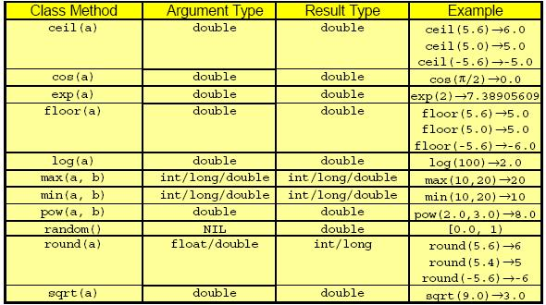
Some Math() class methods

Slide 52
Round up to 2 d.p.
All Math methods are static class methods and therefore they are invoked through the class name.
E.g. rounding to two decimal places, e.g., 75.19999
Step 1: Multiply the number by 100, giving 7519.99
Step 2: Add 0.5 to the number giving 7520.49
Step 3: Drop the fraction part giving 7520
Step 4: Divide the result by 100, giving 75.20
R = Math.floor(R*100.0+0.5)/100.0;

Slide 53
Package

Slide 54
Putting Classes in Packages
Create a folder (directory) and name this folder using the package name.
  Suppose you want to call your package myclass, then name the folder myclass.
Insert the declaration
  package <package-name> ;
  at the beginning of the classes you want to add to the package.
  If the package is myclass, then the declaration is
  package myclass ;
Compile the source files and place the bytecode files in the package folder.
Except the package java.lang, all other packages must be imported before use. (java.lang package is imported by default)

Slide 55
Exercise for package
// Exercise for package
/*
Your name: Chan Tai Man, Joe
Sid: 123456
*/
package testing;
class Hello {
public static void main(String args[]) {
System.out.println("Welcome \nto \nProgramming");
System.out.println("My name is Chan Tai Man!");
}
}
Then, compile it, set classpath and run!

