Slide 1

ISM 001 Introduction to Programming
Controls (1)
Florence Fok
Lingnan University CC

Slide 2

Structured Programming
Structured programming is a term used to describe an approach to solving programming problems
The basic strategy in structured programming is divide and conquer
The process used is called stepwise refinement
The tools used for drafting and expressing ideas are called algorithms and Pseudocode

Slide 3
Structured Programming
The use of structured programming is not restricted to Java. It is a general concept applied to any other programming languages

Slide 4
Algorithms
Any computing problem can be solved by executing a series of actions in a specific order.
An algorithm for solving a programming problem consists of:
  the Actions to be executed, and
  the order in which these actions are to be executed

Slide 5
Algorithms
The algorithm(演算法) for getting out of bed and going to work (or school):
  1. Get out of bed
  2. Take off pajamas
  3. Take a shower
  4. Get dressed
  5. Eat breakfast
  6. Take a bus to work (or school)
The order of execution is important!

Slide 6
Pseudocode
Pseudocode is an artificial and informal language the helps programmers develop algorithms
  “Pseudo” means pretended, not real
  “code” refers to computer programs
Pseudocode is similar to everyday English
It is easy to understand by humans
It cannot be executed by computers (not a programming language)
Pseudocode only expresses the actions or commands to be executed
Should contain input, output and calculation actions
Should not contain variable declarations

Slide 7
Control Structures
Sequential execution - The execution of program statements in straight sequential order
  OT_Pay = OT_Hours * Hourly_Rate
  Base_Pay = Base_Hours * Hourly_Rate
  Total_Pay = Base_Pay + OT_Pay
Sometimes, we need to invoke other method to perform the task for us, we can say there is a transfer of control
Transfer of control means the order of execution is changed
Order of execution

Slide 8
Control Structures
All programs can be written using three types of control structures:
  Sequence structures
  Selection structures
    if, if/else, switch
  Repetition structures
    while, do/while, for
Control structures can be illustrated by flowcharts

Slide 9
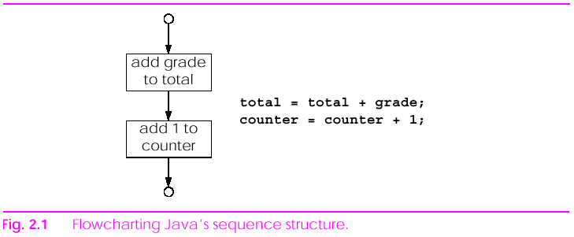
Flowcharts
A flowchart is a graphical representation of a control structure

Slide 10
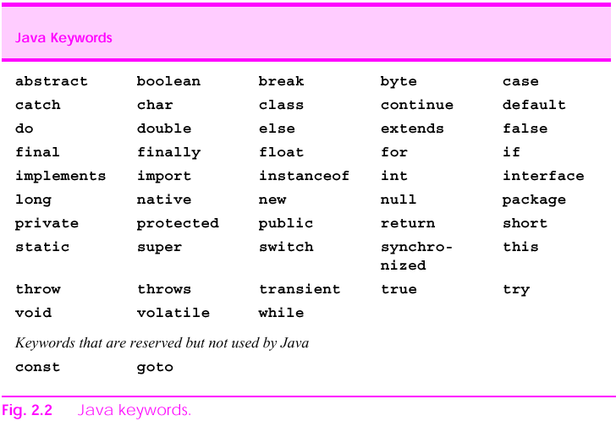
Java Keywords
Keywords are reserved words in Java

Slide 11
Java Keywords
Java keywords may not be used as identifiers such as variable names or class names.
Using a keyword as an identifier/class name is a syntax error.

Slide 12
The if Selection Structure
Consider this pseudocode statement:
  If student’s grade is greater than or equal to 60
  Print “Passed”
In the above statement, the word “Passed” will be printed if the student’s grade is 60 or higher.
Whether the grade is 60 or higher is called a condition in the program.
If the condition is satisfied, then do the following statement (Print). Otherwise, ignore the statement.

Slide 13
The if Selection Structure
The pseudocode:
  If student’s grade is greater than or equal to 60
  Print “Passed”
can be translated into Java as:
  if (grade >= 60)
  System.out.println(“Passed”);

Slide 14
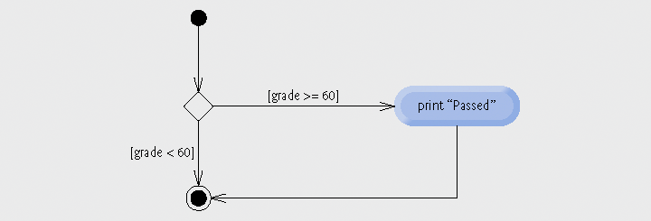
The if Selection Structure
The flowchart of the if selection structure uses a diamond symbol to represent a decision.

Slide 15
The if Selection Structure
In Java, a decision (the diamond) is made on any expression that evaluates to a boolean value.
A boolean value is a value that has only two possibilities: true or false.

Slide 16
The if/else Selection Structure
The following pseudocode statement:
  If student’s grade is greater than or equal to 60
  Print “Passed”
  else
  Print “Failed”
Is translated into Java as:
  if (grade >= 60)
  System.out.println(“Passed”);
  else
  System.out.println(“Failed”);

Slide 17
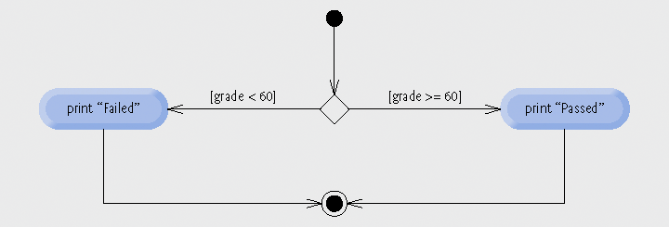
The if/else Selection Structure

Slide 18
Matching if-else
Suppose x == 3 and y == 6, what will the following statement print?
  If ( x > 5 )
  if ( y > 5 )
  System.out.println( “x and y are greater than 5”);
  else
  System.out.println( “x is <= 5” );
Suppose x == 6 and y == 3, what will it print?
Indentation can’t force the compiler to understand what you expect !!
else always refer to the if statement immediately above it.
Suggestion: Using brace {}

Slide 19
Matching if-else
To correct the previous example, it should be written as:
  If ( x > 5 ) {
  if ( y > 5 )
  System.out.println( “x and y are greater than 5”);
  }
  else
  System.out.println( “x is <= 5” );
The braces ({}) are used to enclose the body of the first if statement, so the compiler knows that the else statement doe not apply to the second if.
Blocks
  Braces { } associate statements into blocks

Slide 20
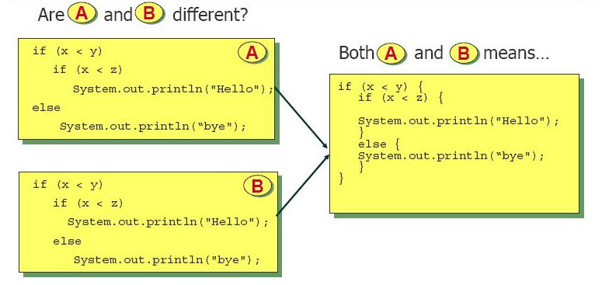
Matching if-else

Slide 21
The Conditional Operator
In Java, the conditional operator (?:) sometimes can be used to replace an if/else control structure:
  if (grade >= 60)
  System.out.println(“Passed”);
  else
  System.out.println(“Failed”);
  Can be written as:
  System.out.println(grade >= 60 ? “Passed” : “Failed” );

Slide 22
Nested if/else Structures
Consider this complex pseudocode statement:
  If student’s grade is greater than or equal to 90
  Print “A”
  else
  If student’s grade is greater than or equal to 80
  Print “B”
  else
  If student’s grade is greater than or equal to 70
  Print “C”
  else
  If student’s grade is greater than or equal to 60
  Print “D”
  else
  Print “F”

Slide 23
Nested if/else Structures
This pseudocode may be written in Java as:
  if ( grade >= 90 )
  System.out.println(“A”);
  else
  if (grade >= 80 )
  System.out.println(“B”);
  else
  if ( grade >= 70 )
  System.out.println(“C”);
  else
  if ( grade >= 60 )
  System.out.println(“D”);
  else
  System.out.println(“F”);

Slide 24
Nested if/else Structures
The previous Java example can be written as:
  if ( grade >= 90 )
  System.out.println("A");
  else if (grade >= 80 )
  System.out.println("B");
  else if ( grade >= 70 )
  System.out.println("C");
  else if ( grade >= 60 )
  System.out.println("D");
  else
  System.out.println("F");
  It looks neat because there are less indentations.

Slide 25
Nested if/else Structures
Statements enclosed within a pair of braces ({}) are called a compound statement
  if (grade >= 60 )
  System.out.println( “Passed” );
  else {
  System.out.println( “Failed” );
  System.out.println( “Re-take the course again.” );
  }

Slide 26
Nested if/else Structures
What will happen if the previous example is written like this?
  if (grade >= 60 )
  System.out.println( “Passed” );
  else
  System.out.println( “Failed” );
  System.out.println( “Re-take the course again.” );

Slide 27
ifelse Double-Selection Statement
Logic errors
  Fatal logic errors cause a program to fail and terminate prematurely
  Nonfatal logic errors cause a program to produce incorrect results
Empty statements
  Represented by placing a semicolon ( ; ) where a statement would normally be
  Can be used as an if body

Slide 28
The while Repetition Structure
The while structure is used to tell the computer to repeat certain actions while a certain condition is true.
Consider this pseudocode:
  While there are more items on my shopping list
  Buy next item and cross it off my list

Slide 29
The while Repetition Structure
When the following program segment stops, what is the value of the variable product?
  int product = 2;
  while ( product <= 1000)
  product = 2 * product;

Slide 30
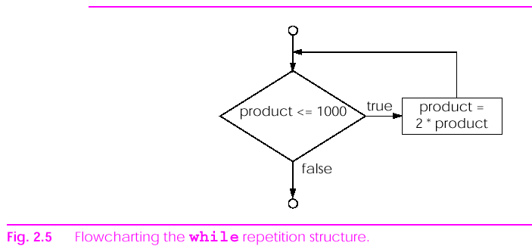
The while Repetition Structure
The flowchart of the Java while structure:

Slide 31
The while Repetition Structure
When the while structure is entered, product is 2
Each repetition of the loop will multiply product by 2
Therefore product will take the values 2, 4, 8, 16, 32, 64, 128, 256, 512, and 1024.
When product is 1024, the while structure terminates (because product is now greater than 1000)

Slide 32
Formulating Algorithms:
Case Study 1
The user requirements:
  Input 10 students’ marks
  Calculate the total mark
  Calculate the average point for the class
  Output the result (total and average)

Slide 33
Formulating Algorithms:
Case Study 1
1 Set total to zero
2 Set grade counter to one
3
4 While grade counter is less than or equal to ten
5 Prompt the user to enter the next grade
6 Input the next grade
7 Add the grade into the total
8 Add one to the grade counter
9
10 Set the class average to the total divided by ten
11 Print the class average
Pseudocode algorithm that uses counter-controlled repetition to solve the class-average problem

Slide 34
Formulating Algorithms:
Case Study 1
Since there are 10 students, we can use a counter to control the input.
In the beginning of the program, we set the counter to one. This is called initialization.
After we input the grade of one student, we add one to the counter. This is called an increment to the counter.
When the counter is greater than 10, we stop the input process.

Slide 35
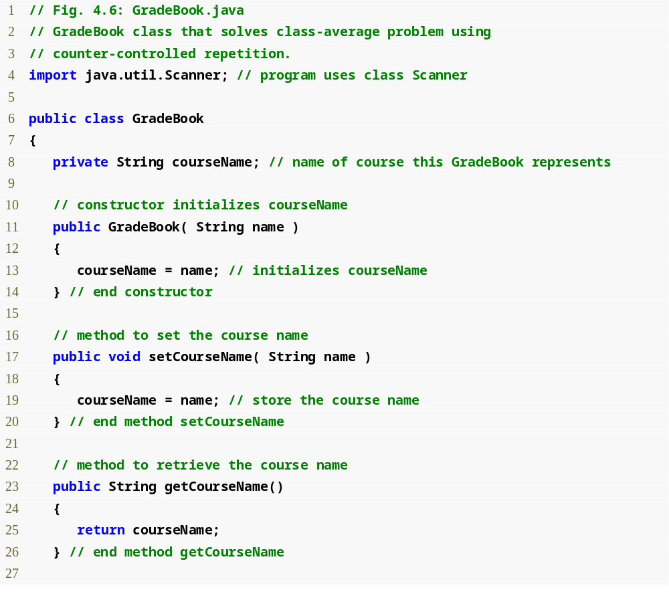
Outline
GradeBook.java
Assign a value to instance variable courseName
Declare method setCourseName
Declare method getCourseName

Slide 36
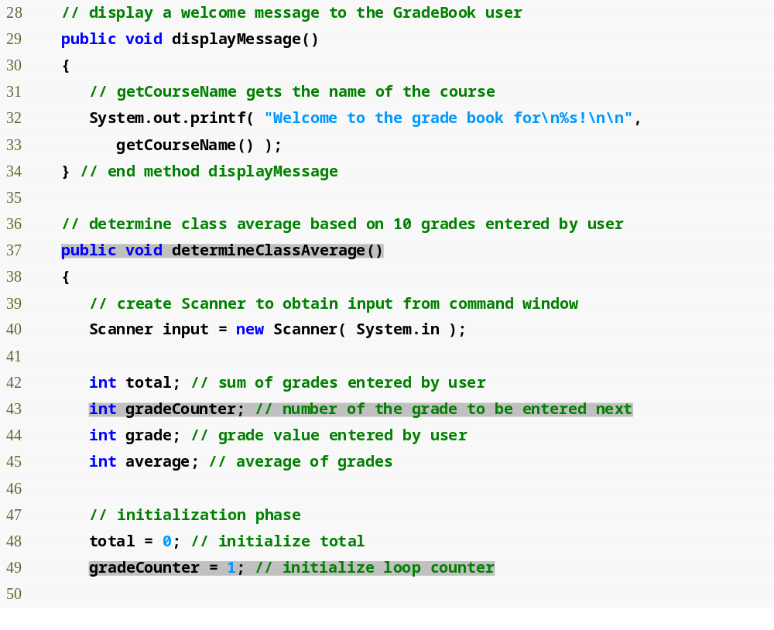
Outline
Declare method displayMessage
GradeBook.java
Declare method determineClassAverage
Declare and initialize Scanner variable input
Declare local int variables total, gradeCounter, grade and average

Slide 37
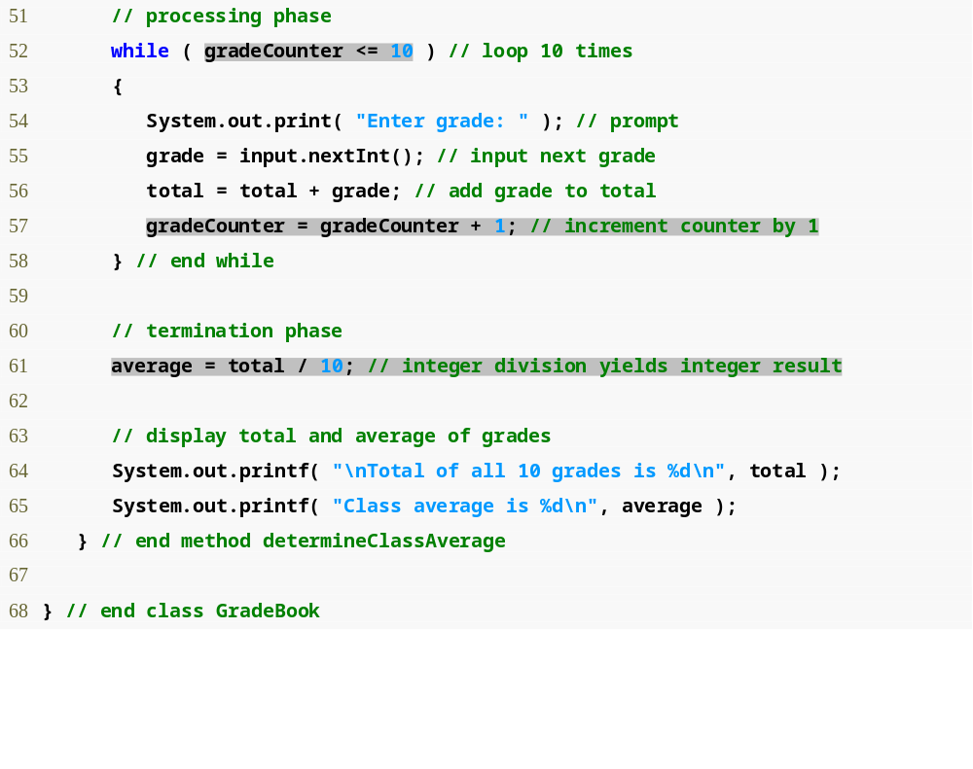
Outline
while loop iterates as long as gradeCounter <= 10
GradeBook.java
Increment the counter variable gradeCounter
Calculate average grade
Display results

Slide 38
GradeBookTest.java
public class GradeBookTest
{
public static void main( String args[] )
{
// create GradeBook object myGradeBook and
// pass course name to constructor
GradeBook myGradeBook = new GradeBook(
"CS101 Introduction to Java Programming" );
myGradeBook.displayMessage(); // display welcome message
myGradeBook.determineClassAverage(); // find average of grades
} // end main
} // end class GradeBookTest

Slide 39
Class Exercise 2
Convert the GradeBook exercise by using JOptionPane class to input 10 marks, calculate the total and average and output the results in Dialog box.

Slide 40
Logical Operator
AND OR NOT

Slide 41
The && (Logical AND) Operator
The format of the && operator:
  (boolean expression1) && (boolean expression 2)
The above expression will be true only when both boolean expressions are true.

Slide 42
The && (Logical AND) Operator
What will be printed?
  int x = 0;
  int y = 5;
  if ((x == 0) && (y == 5))
  System.out.println(“Expression is true!”);
  else
  System.out.println(“Expression is false!”);

Slide 43
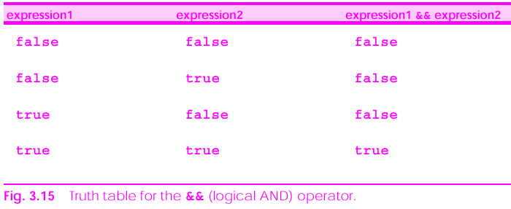
The && (Logical AND) Operator

Slide 44
The || (Logical OR) Operator
The format of the || operator:
  (boolean expression1) || (boolean expression 2)
The above expression will be true when both or one of the boolean expressions is true.

Slide 45
The || (Logical OR) Operator
What will be printed?
  int x = 0;
  int y = 5;
  if ((x == 0) || (y > 5))
  System.out.println(“Expression is true!”);
  else
  System.out.println(“Expression is false!”);

Slide 46
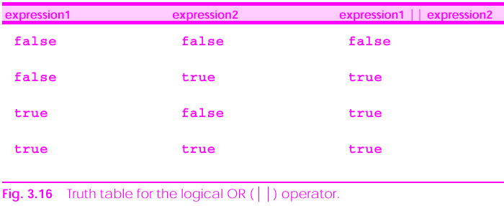
The || (Logical OR) Operator

Slide 47
Summary: Truth Tables
Since && and || each have two operands, there are four possible combinations of true and false
a
true
true
false
false
b
true
false
true
false
a && b
true
false
false
false
a || b
true
true
true
false

Slide 48
Short-Circuit Evaluation of && and || Operators
Both the && and || operators will be evaluated until a conclusion can be reached.
Sometimes, only the first half of the logical operation is evaluated by the computer because the computer can determine the result after looking at just the first half of the operation.

Slide 49
Short-Circuit Evaluation of && and || Operators
In the following code, the Boolean expression on the right of || (I.e. (y > 5)) will not be evaluated because the result can be determined after evaluating the expression on the left:
  int x = 0;
  int y = 5;
  if ((x == 0) || (y > 5))
  System.out.println(“Expression is true!”);
  else
  System.out.println(“Expression is false!”);

Slide 50
Short-Circuit Evaluation of && and || Operators
Likewise, in the following expression, only the first half of the && operation is evaluated by the computer:
  int x = 0;
  int y = 5;
  if ((x > 0) && (y == 5))
  System.out.println(“Expression is true!”);
  else
  System.out.println(“Expression is false!”);

Slide 51
Short-Circuit Evaluation of && and || Operators
When using &&, place the expression that is likely to be false on the left.
When using ||, place the expression that is likely to be true on the left.
Your program will run faster if you follow these rules.

Slide 52
The Boolean Logical AND (&) and
Boolean Logical OR (|) Operators
The & operator works the same as && except that there is no short-circuit operation.
The | operator works the same as || except that there is no short-circuit operation.
In other words, both sides of the | and & operation will be fully evaluated by the computer.

Slide 53
The Logical NOT (!) Operator
Placing the logical negation (!) operator in front of any boolean expression will reverse the value of the expression
I.e. true will be negated to false, or vice versa.
if ( ! (sex == ‘M’) )
System.out.println(“It is a girl!”);

Slide 54
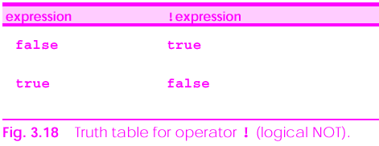
The Logical NOT (!) Operator

Slide 55
Summary of Relational and Logical Operators
We have learned six relational operators before:
  == (equal)
  != (not equal)
  > (greater than)
  < (less than)
  >= (greater than or equal)
  <= (less than or equal)
In this lecture, we have learned five logical operators:
  ||, | (logical OR and boolean logical OR)
  &&, & (logical AND and boolean logical AND)
  ! (logical NOT)

Slide 56
Summary of Relational and Logical Operators
All the relational and logical operations evaluate to a boolean expression, I.e. true / false.
The use of relational and logical operations is a basic skill in computer programming.
You need to memorise these operators and become very familiar with how they are used.

Slide 57
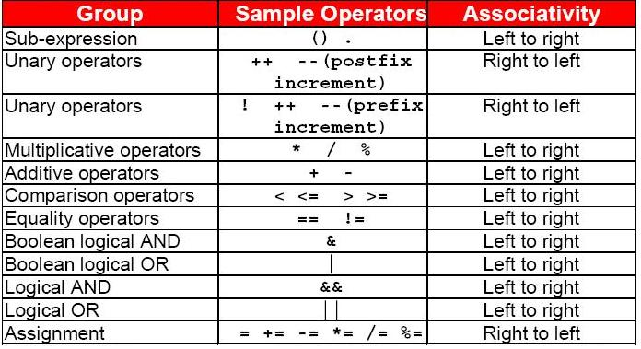
Summary of Operator Precedence

