Slide 1

ISM 001 Introduction to Programming
Controls (2)
Florence Fok
Lingnan University CC

Slide 2

Top-Down Design and Stepwise Refinement
Consider this new requirement:
  Develop a class-averaging program that will process an arbitrary number of grade value each time the program is run.

Slide 3
Top-Down Design and Stepwise Refinement
We don’t know how many grades will be entered. (There are different number of students in each class)
Q. How can the computer program know that all grades have been entered?
A. The user must tell the program when the input is finished.

Slide 4
Sentinel-Controlled Repetition
When the user enters a special value, called a sentinel, (also known as a signal, dummy or flag value), the program knows that input is finished.
Values that are outside the range of acceptable data can be used as sentinels
  For examples:
    for letter grades ‘A’, ‘B’, ‘C’, ‘D’, and ‘F’, any other letter can be used as the sentinel (e.g. ‘Z’ can be a sentinel as there is no ‘Z’ grade)
    for human age, zero or -1 can be used as the sentinel value
Choosing a sentinel value that is also a legitimate data value results in a logic error.

Slide 5
Top-Down Design and Stepwise Refinement
Using a top-down design approach, we begin by writing the top-level, most important objective of the program in one pseudocode statement:
  Determine the class average for the exam
This statement summarizes the overall function of the program. We call it the top-level definition of the program.

Slide 6
Top-Down Design and Stepwise Refinement
Therefore we use a stepwise refinement process to add detail to the program one step at a time.
We divide the top-level function into a series of smaller tasks and list the smaller tasks in order of their execution:
  Initialize variables
  Input, sum up, and count the exam grades
  Calculate and print the class average
Most programs are divided into the initialization stage, the processing stage, and the termination stage.

Slide 7
Top-Down Design and Stepwise Refinement
The next step of refinement is to add further detail to each of the three stages.
In the first stage, initialize variables, we need to determine how many variables are needed.
Since the objective of the program is to calculate the average, therefore we will need at least two variables: total and counter (Why?)
becomes
Initialize total to zero
Initialize counter to zero
Initialize variables

Slide 8
Top-Down Design and Stepwise Refinement
The second stage:
  Input, sum up, and count the exam grades
will be represented using a repetition structure (i.e. a loop):

Slide 9
Class-average problem pseudocode algorithm with sentinel-controlled repetition.
1 Initialize total to zero
2 Initialize counter to zero
3
4 Prompt the user to enter the first grade
5 Input the first grade (possibly the sentinel)
6
7 While the user has not yet entered the sentinel
8 Add this grade into the running total
9 Add one to the grade counter
10 Prompt the user to enter the next grade
11 Input the next grade (possibly the sentinel)
12
13 If the counter is not equal to zero
14 Set the average to the total divided by the counter
15 Print the average
16 else
17 Print “No grades were entered”

Slide 10
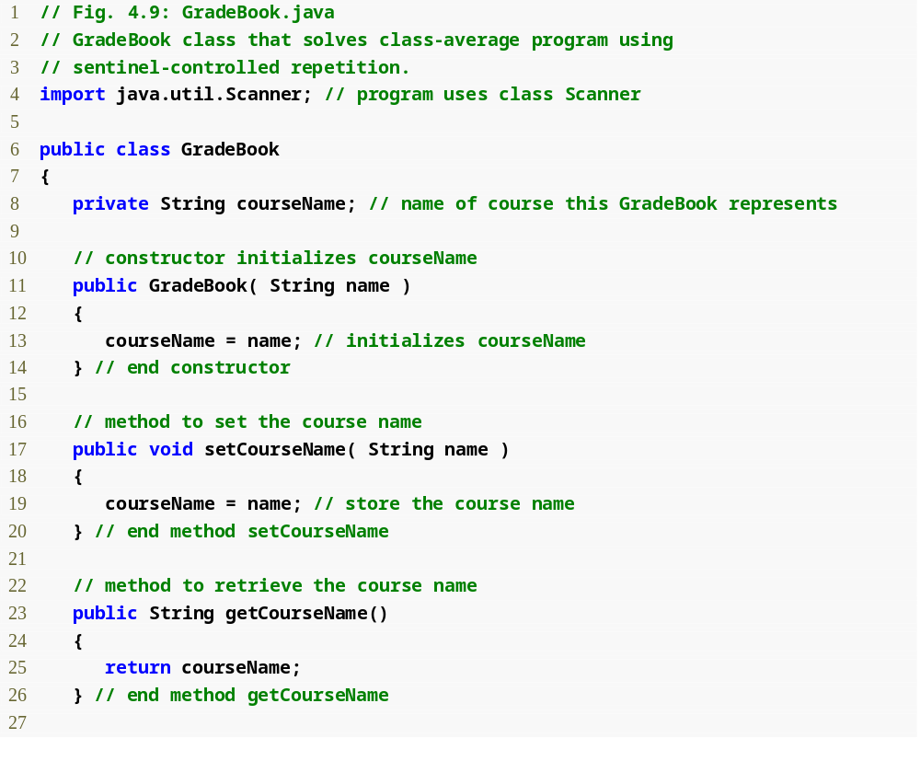
Outline
GradeBook.java
(1 of 3)
Assign a value to instance variable courseName
Declare method setCourseName
Declare method getCourseName

Slide 11
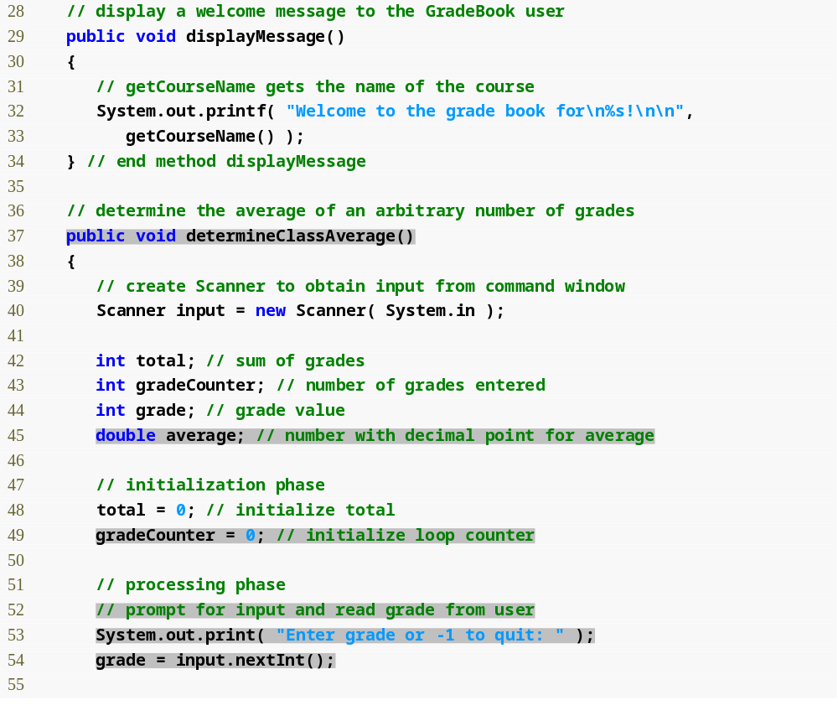
Outline
Declare method displayMessage
GradeBook.java
(2 of 3)
Declare method determineClassAverage
Declare and initialize Scanner variable input
Declare local int variables total, gradeCounter and grade and double variable average

Slide 12
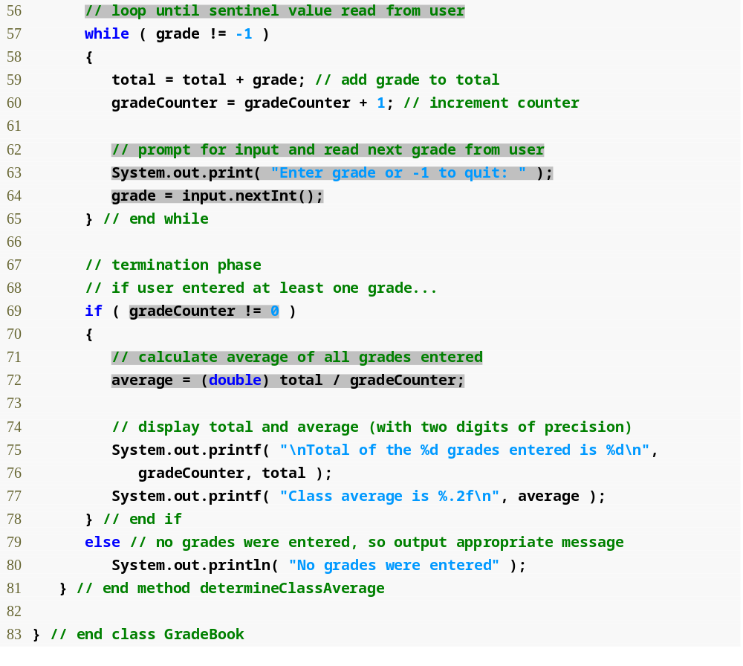
Outline
while loop iterates as long as grade != the sentinel value, -1
GradeBook.java
(3 of 3)
Calculate average grade using (double) to perform explicit conversion
Display average grade
Display “No grades were entered” message

Slide 13
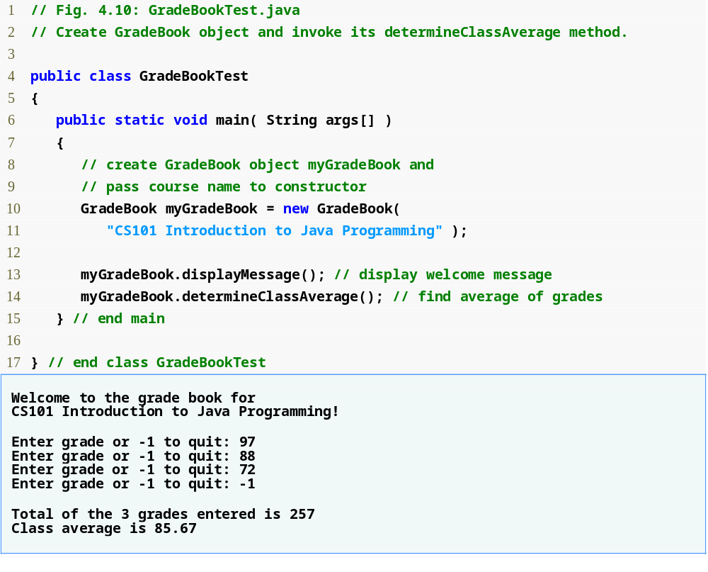
Outline
Create a new GradeBook object
Pass the course’s name to the GradeBook constructor as a string
Call GradeBook’s determineClassAverage method
GradeBookTest.java

Slide 14
About the program
In a sentinel-controlled loop, the prompts requesting data entry should explicitly remind the user of the sentinel value
Calculate average grade using (double) to perform explicit conversion [Unary cast operator]
Converting a value (e.g. int) to another data type (e.g. double) to perform a calculation [Implicit conversion or Promotion]

Slide 15
Nested Control Structures
Lets look at another programming problem:
Write a program to summarize the exam results of 10 students. A list of results are given to you with a ‘1’ written by the students who have passed and ‘2’ by the students who have failed.
The program should count the number of passes and failures. It should recommend a tuition raise if more than 8 students passed the exam.

Slide 16
Nested Control Structures
Observations about the problem:
  The program must process test results for 10 students. A counter-controlled loop will be used.
  Each test result is a number - either a ‘1’ or a ‘2’.
  Two counters are used to keep track of the exam results - one to count the number of 1’s (passes), and the other to count the number of 2’s (failures).
  After the program has processed 10 results, it must decide if more than 8 students passed the exam.

Slide 17
Nested Control Structures
The top-level definition of the program can be written like this:
Analyze exam results and decide if tuition should be raised

Slide 18
Nested Control Structures
The first refinement yields the following steps:
  Initialize the variables
  Input the ten results and count passes and failures
  Print a summary of the results and decide if tuition should be raised

Slide 19
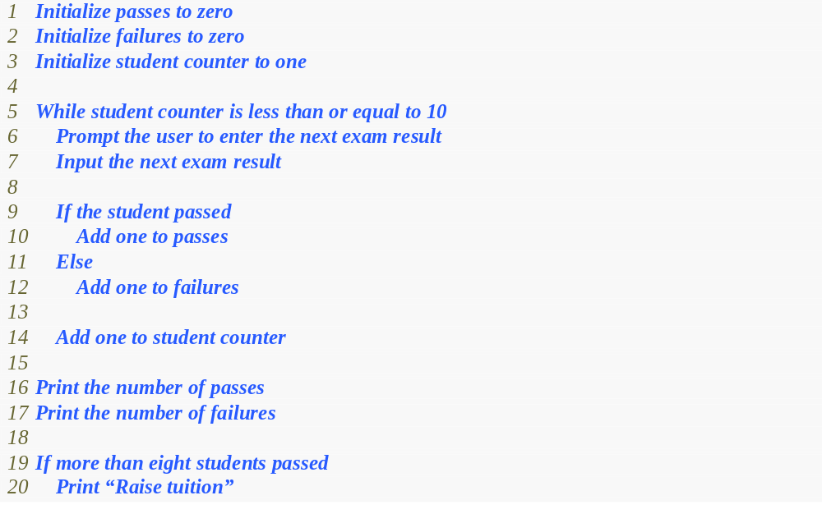
Nested Control Structures
The second refinement:

Slide 20
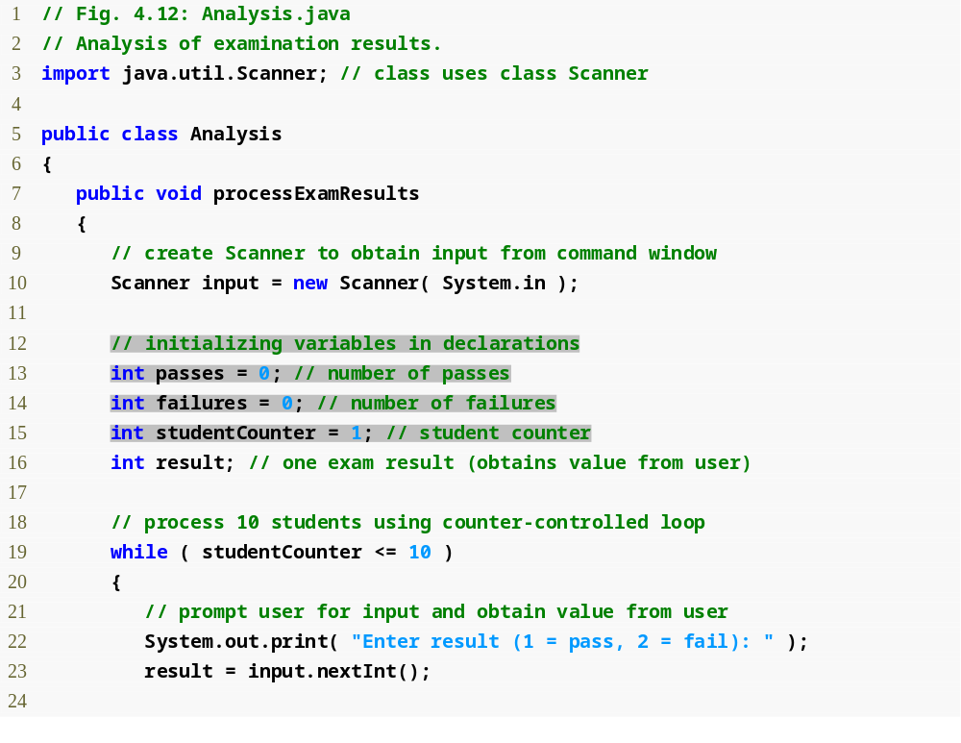
Outline
Declare processExamResults’ local variables
Analysis.java
(1 of 2)
while loop iterates as long as studentCounter <= 10

Slide 21
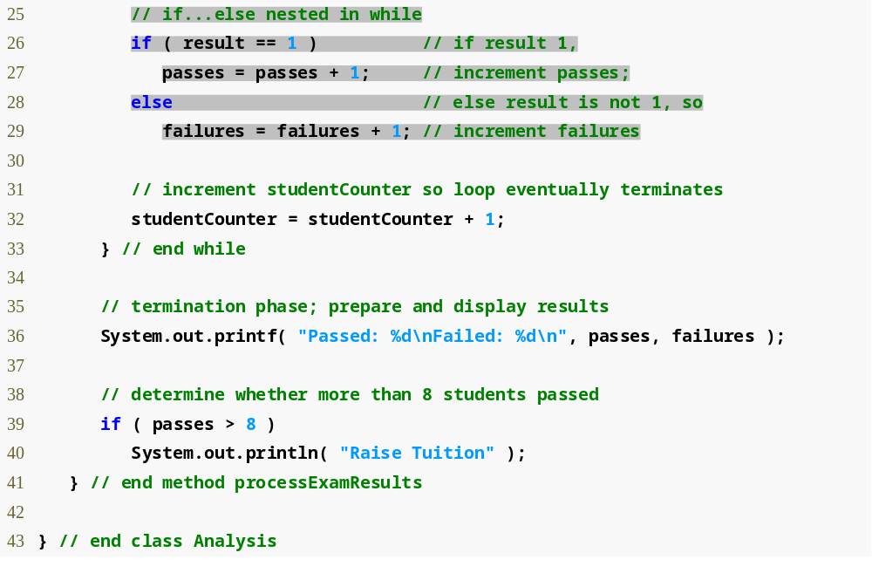
Outline
Determine whether this student passed or failed and increment the appropriate variable
Analysis.java
(2 of 2)
Determine whether more than eight students passed the exam

Slide 22
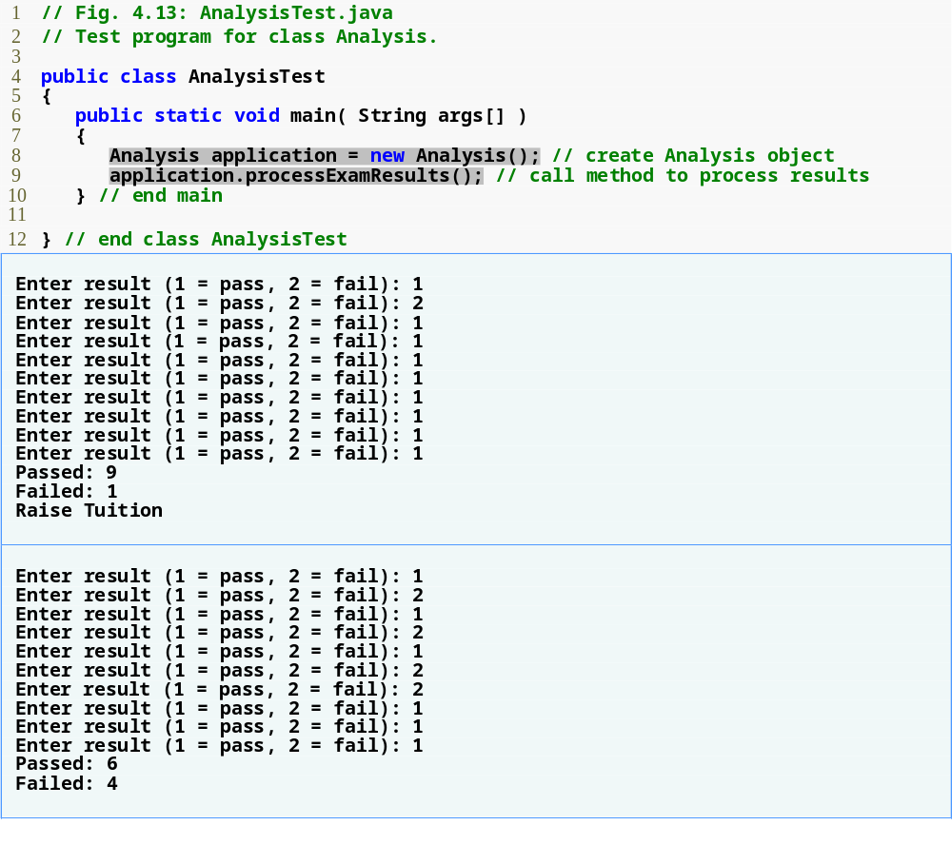
Outline
Create an Analysis object
AnalysisTest.java
More than 8 students passed the exam

Slide 23
Good Programming Practices
Initializing variables when they are declared helps the programmer avoid compiler messages warning of uninitialized data.
The most difficult part of solving a problem on a computer is developing the algorithm for the solution. Once a correct algorithm has been specified, the process of producing a working Java program is straightforward.
Developing programs without careful planning and design may lead to serious errors on complex projects.

Slide 24
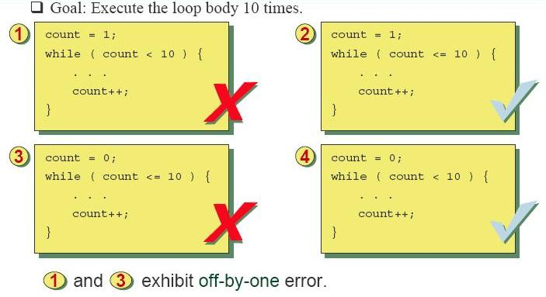
Good Programming Practices

Slide 25
Other Java’s remaining control structures
    for
    do…while
    switch

Slide 26
Essentials of Counter-Controlled Repetition
Counter-controlled repetition requires:
  Control variable (loop counter)
  Initial value of the control variable
  Increment/decrement of control variable through each loop
  Loop-continuation condition that tests for the final value of the control variable

Slide 27
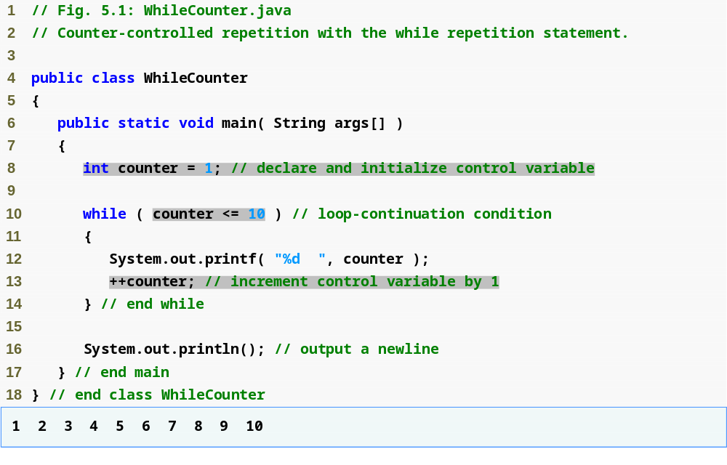
Outline
WhileCounter.java
Control-variable name is counter
Control-variable initial value is 1
Condition tests for counter’s final value
Increment for counter

Slide 28
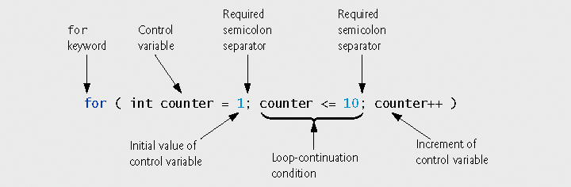
for Repetition Statement
Handles counter-controlled-repetition details
Using commas instead of the two required semicolons in a for header is a syntax error.

Slide 29
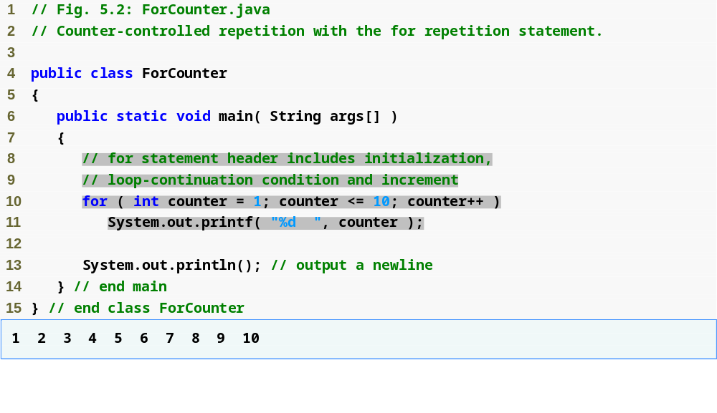
Outline
Control-variable name is counter
Control-variable initial value is 1
Increment for counter
Condition tests for counter’s final value
ForCounter.java
Line 10
int counter = 1;
Line 10
counter <= 10;
Line 10
counter++;

Slide 30
for Repetition Statement
for ( initialization; loopContinuationCondition; increment )
statement;
can usually be rewritten as:
initialization;
while ( loopContinuationCondition )
{
statement;
increment;
}
P.S. Using commas instead of the two required semicolons in a for header is a syntax error.

Slide 31
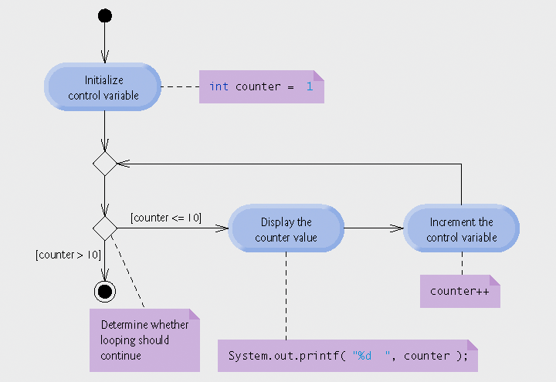
for Repetition Statement

Slide 32
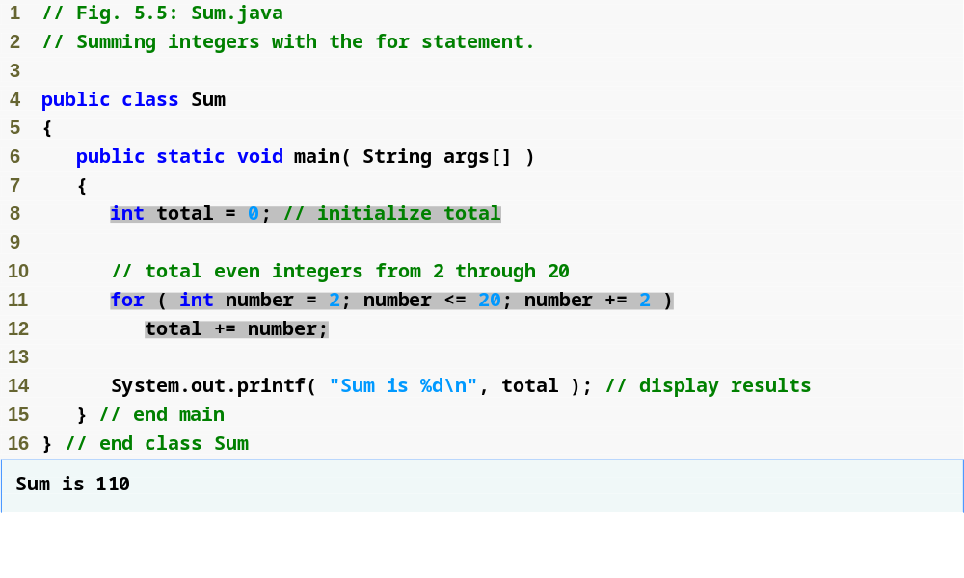
Outline
Sum.java
Line 11
increment number by 2 each iteration

Slide 33
Examples Using the for Statement
Initialization and increment expression can be comma-separated lists of expressions
  E.g., lines 11-12 can be rewritten as
  for ( int number = 2; number <= 20; total += number, number += 2 )
  ; // empty statement

Slide 34
Examples Using the for Statement
  Vary control variable over the sequence: 2, 5, 8, 11, 14, 17, 20
    for ( int i = 2; i <= 20; i += 3 )
  Vary control variable over the sequence: 99, 88, 77, 66, 55, 44, 33, 22, 11, 0
    for ( int i = 99; i >= 0; i -= 11 )

Slide 35
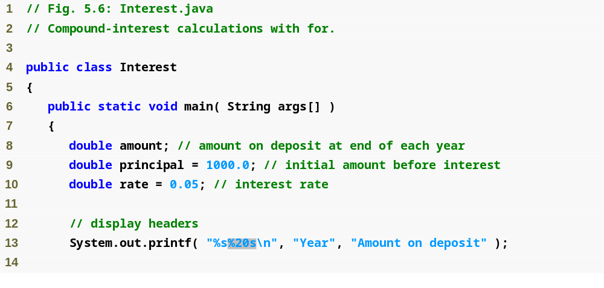
Outline
Java treats floating-points as type double
Second string is right justified and displayed with a field width of 20
Interest.java

Slide 36
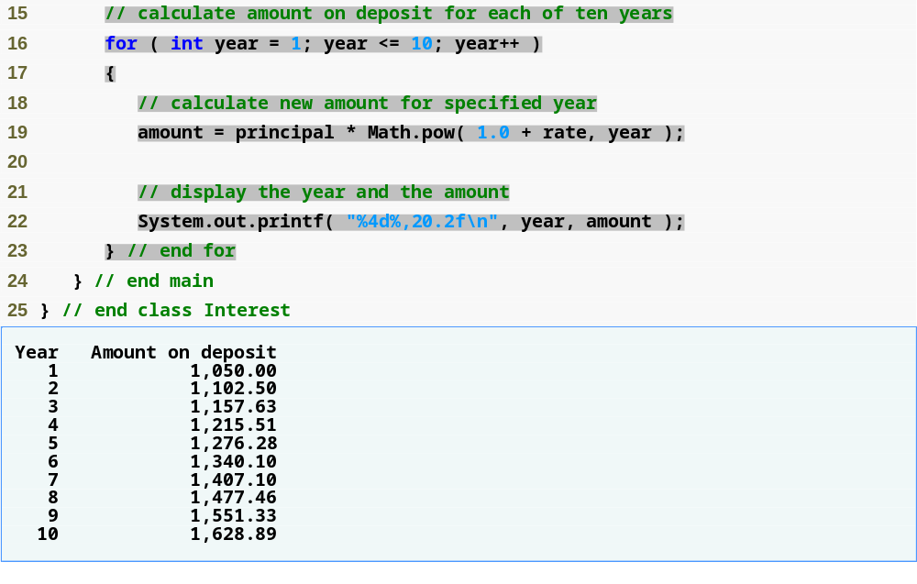
Outline
Calculate amount with for statement
Use the comma (,) formatting flag to display the amount with a thousands separator
Interest.java

Slide 37
do…while Repetition Statement
do…while structure
  Similar to while structure
  Tests loop-continuation after performing body of loop
    i.e., loop body always executes at least once

Slide 38
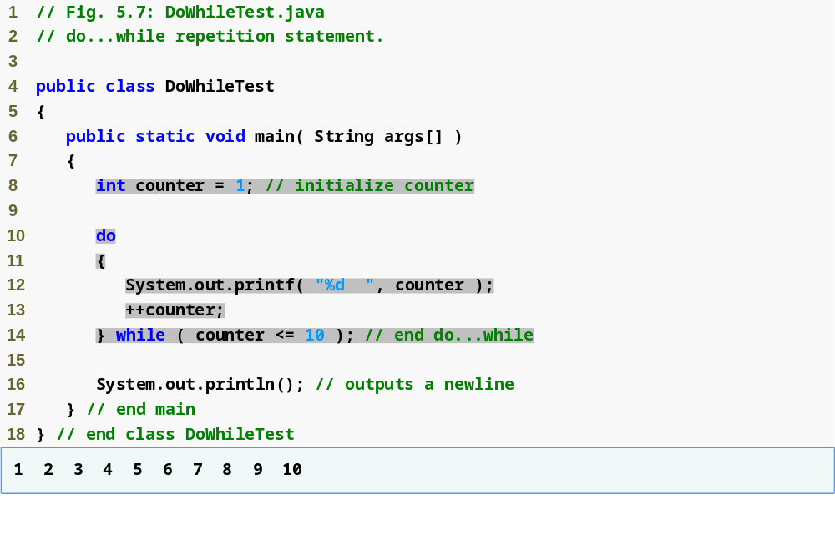
Outline
Declares and initializes control variable counter
Variable counter’s value is displayed before testing counter’s final value
DoWhileTest.java

Slide 39
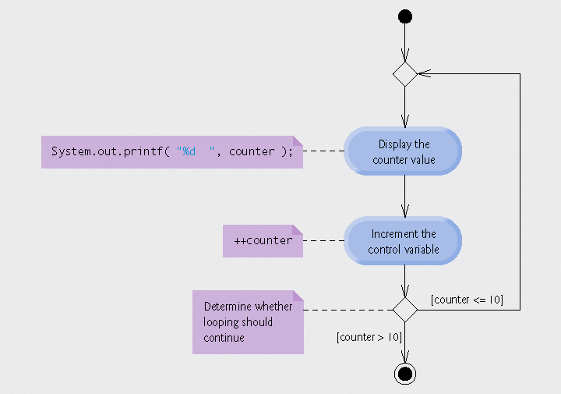
do...while repetition statement

Slide 40
do/while Repetition Structure
The format of the do/while structure:
  do {
  statement
  }
  while (condition);

Slide 41
do/while Repetition Structure
What will be printed by the following?
int i = 1;
  do {
  System.out.println(“*”);
  i += 1;
  }
  while ( i <= 10);

Slide 42
switch Multiple-Selection Structure
The switch structure is used for multiple selection
It is used to select an action based on each of the possible values of the control variable.
The default statement at the end is to catch any conditions not handled by the case labels.

Slide 43
switch Multiple-Selection Structure
The general format of a switch structure is:
  switch (expression) {
  case value1 :
  statement1;
  break;
  case value2 :
  statement2;
  break;
  ……
  default : default statement;
  }

Slide 44
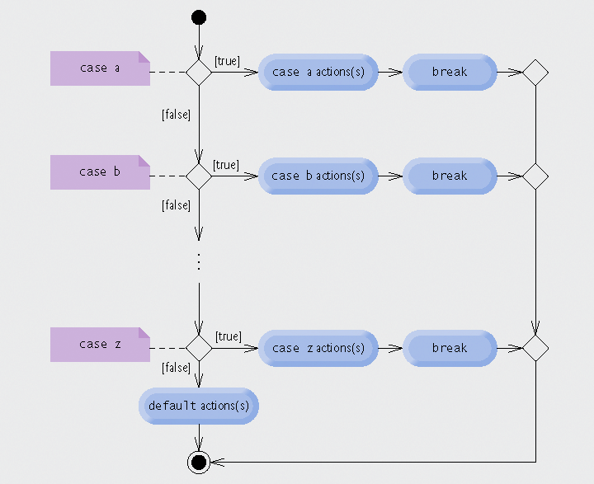
switch Multiple-Selection Structure

Slide 45
switch Multiple-Selection Structure - An Example
int month;
. . .
switch (month) {
case 1: System.out.println("January"); break;
case 2: System.out.println("February"); break;
case 3: System.out.println("March"); break;
case 4: System.out.println("April"); break;
case 5: System.out.println("May"); break;
case 6: System.out.println("June"); break;
case 7: System.out.println("July"); break;
case 8: System.out.println("August"); break;
case 9: System.out.println("September"); break;
case 10: System.out.println("October"); break;
case 11: System.out.println("November"); break;
case 12: System.out.println("December"); break;
default: System.out.println("Hey, that's not a valid month!");
break;
}

Slide 46
Difference between if and switch
The if statement makes a decision based on a boolean (true and false) expression.
  E.g.
  if (grade > 40)
  System.out.println(“Passed”);
  else System.out.println(“Failed”);
Therefore, in an if structure we can choose at most two different courses of actions.
However, in a switch structure, the number of choices is limited only by the number of different values the control variable may assume.

Slide 47
The switch Multiple-Selection Structure
The expression in switch (expression) must be a constant integral expression.
  ‘a’ … ‘z’
  ‘A’ … ‘Z’
  All other valid single characters e.g. !@#$%^&*()
  Any integer

Slide 48
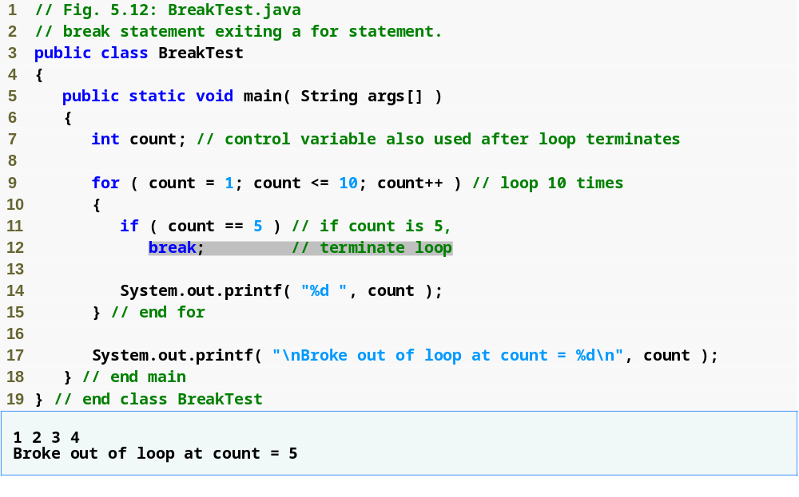
The break Statement
BreakTest.java
Loop 10 times
Exit for statement (break) when count equals 5

Slide 49
The break Statement
The break statement causes immediate exit from a while, for, do/while, or switch structure.
It alters the flow of control
Forgetting a break statement when one is needed in a switch is a logic error.

Slide 50
The continue Statement
The continue statement will skip the remaining statements in the body of a repetition structure, and begin a new iteration in a for, while, or do/while repetition structure.
It can also alter the flow of control
What will be printed by the following code?

Slide 51
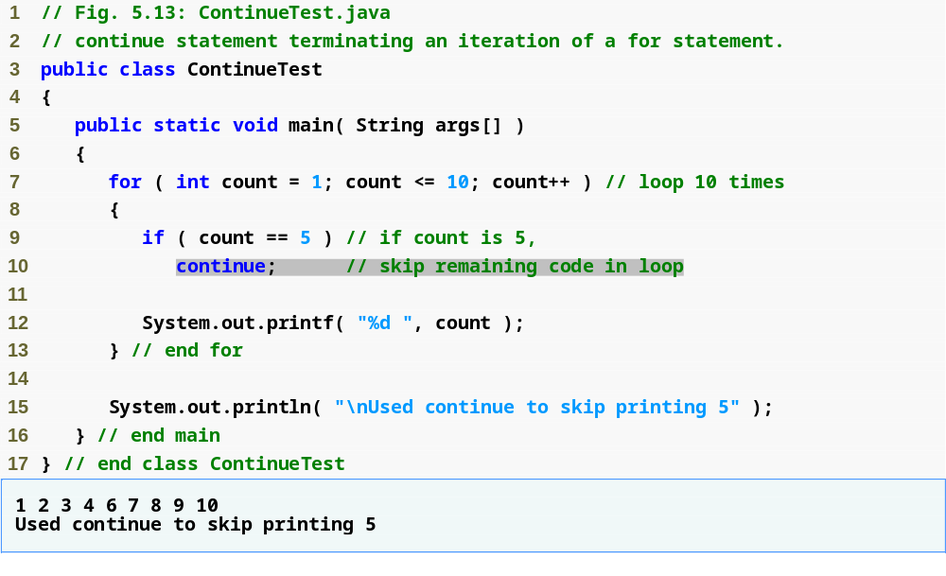
Outline
Loop 10 times
Skip line 12 and proceed to line 7 when count equals 5
ContinueTest.java

Slide 52
The labeled break statement
break statements can be used together with labels.
The format of a labeled block:
  label_name: {
  statements
  }
The labeled break statement will exit from any repetition structure and goes directly to the end of the labeled block:
  break label_name;

Slide 53
The labeled break statement
Normally, without label, it only breaks innermost block.
With label, it breaks the layer indicated by the label (but must be enclosing break itself).
  outside: for (int i=0; i<5; i++) {
  inside: for (int j=i; j< 5; j++) {
  System.out.println("In inside loop");
  if (i+2==j){
  System.out.println("Here");
  break outside; //breaks the outer loop.
  }
  }
  System.out.println("In outside loop");
  }
  System.out.println("Outside of outside");

Slide 54
The labeled break statement
What will be printed by the following code?
  //nested_for.java
  for (int x = 1; x <= 5; x++)
  for (int y = 1; y <= 5; y++)
  System.out.println(“x == “ + x + “, y == “ + y);
Edit nested_for.java

Slide 55
The labeled break statement
What will be printed after adding this break statement?
  //labeled_break1.java
  for (int x = 1; x <= 5; x++)
  for (int y = 1; y <= 5; y++) {
  if ( x > 3 ) break;
  System.out.println(“x == “ + x + “, y == “ + y);
  } //for y

Slide 56
The labeled break statement
What will be printed after adding this labeled break statement?
  //labeled_break.java
  Top: {
  for (int x = 1; x <= 5; x++)
  for (int y = 1; y <= 5; y++) {
  if ( x > 3 ) break Top;
  System.out.println(“x == “ + x + “, y == “ + y);
  } //for y
  } //Top

Slide 57
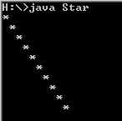
How to create the following?

