Slide 1

ISM 001 Introduction to Programming
Exception
Florence Fok
Lingnan University CC

Slide 2
What is Exception?
An exception (異常) occurs when any semantic constraints of the Java language is violated.
Exception is a representation of an error condition or any situation that is not the expected result of a method.
When an exception occurs, the JVM run-time environment throws the object exception to the processor who looks for a handler, or a way to handle the problem.
Unless the programmer codes a way to catch the exception, the program will terminate prematurely and display an exception error message.

Slide 3
Exception
The act of detecting an abnormal condition and generating an exception is called throwing (拋 出) an exception.
An exception is said to be thrown and caught.
When our program calls a statement that can throw an exception, we must write a code to either
  handle it by the try-catch block statement, or
  Propagate error back to caller using the thrown exception

Slide 4
Exception
Exception handling means to take care of errors and exceptions that may happen in a Java application.
A try block is a Java programming language construct that encloses one or more Java statements.
Use the try-catch statement to include the exception handling routines.
Exceptions are thrown by throw statements.
You enable exception handling by placing throw statements inside try blocks.
If no exception is thrown, the compilers runs the statements in the try block as usual and ignores the catch clauses

Slide 5
Syntax
try {
// statements that are monitored for exceptions
[throw exception;
// statements that throw exceptions]
// statements that are monitored for exceptions
}
[catch (exception_class object_reference) {
//blocks that handle exceptions }
]
[finally {
//statements always executed at the end of the
try block }
]

Slide 6
Exception.java
import javax.swing.*;
public class Exception{
public static void main(String args []) {
String num1String = JOptionPane.showInputDialog
("Give me the first number" );
int num1 = Integer.parseInt ( num1String );
String num2String = JOptionPane.showInputDialog
("Give me the second number" );
int num2 = Integer.parseInt( num2String );
int n3 = num1 / num2;
System.out.println(num1 + " / " + num2 + " = " + n3);
System.exit(0);
}
}

Slide 7
Exception.java
Exception.java asks for two integers from the user, then divide the first one by the second one.
The program can function correctly if we enter 12 as the first number and 4 as the second number.
However, if the user enters something wrong e.g. entering some characters (“abcd”) in the input dialog box, there will be NumberFormatException
Similarly, if we enter 0 as the second number, there will be ArithmeticException: / by zero

Slide 8
Exception Handling
In both cases when an error occurs, an exception is thrown.
Since Exception.java lacks the capability to handle the exceptions, the application terminates with a message that is not easy to be understood by the user.
In order to improve the user-friendliness and robutness, we may include some exception handling code in the program.
  A user-friendly program is easy to use and easy to understand.
  A robust program is strong. That means it can tolerate and recover from most errors. A robust program is also stable and reliable.

Slide 9
Exception Handling
import javax.swing.*;
public class Exception1{
public static void main(String args []) {
try {
String num1String = JOptionPane.showInputDialog
("Give me the first number" );
int num1 = Integer.parseInt ( num1String );
String num2String = JOptionPane.showInputDialog
("Give me the second number" );
int num2 = Integer.parseInt( num2String );
int n3 = num1 / num2;
System.out.println(num1 + " / " + num2 + " = " + n3);
}

Slide 10
Exception Handling
catch (NumberFormatException e) {
JOptionPane.showMessageDialog(null ,"Please input a valid integer", "Number Format Error", JOptionPane.ERROR_MESSAGE );
}
catch (ArithmeticException e) {
JOptionPane.showMessageDialog(null , "Attempted to Divide by Zero", "Arithmetic Error", JOptionPane.ERROR_MESSAGE );
}
System.exit(0);
}
}

Slide 11
Steps of Exception Handling
In Exception1.java, the Integer.parseInt method may find an error when trying to convert a String into an integer.
E.g. when the user enters “abcd", it cannot convert to an integer.
Therefore, Integer.parseInt will construct an instance of NumberFormatException.
Then, Integer.parseInt will throw the new NumberFormatException instance.
The exception will be caught by the catch block.

Slide 12
Dissection of the try-catch
try block includes any catch clauses that follow the block of statement, and an optional finally clauses.
You can have zero, one, or more catch clauses. Each clauses catches one specific type of exception object, and is never executed unless it catches an exception.
The compiler can execute at most one catch clause each time when the try block is run.
The compiler always executes the statements inside a finally clause at the end of the try block, regardless of whether an exception is thrown and caught or the entire try block runs without an exception.

Slide 13
The try {...} catch {...} Blocks
Exception handling routines in Java are provided by a series of try {...} catch {...} blocks.
The general format of try {...} catch {...} blocks is:
  try {
  statements
  }
  catch ( Exception_class_name1 e ) {
  exception handling statements
  }
  catch ( Exception_class_name2 e ) {
  exception handling statements
  }
  ...

Slide 14
Propagation Approach
Instead of handling the exception directly, in this approach, the exception is propagated back to its caller.
However, if the thrown exception is not handled by an method in the propagation chain, the Java interpreter will eventually handle it.
Add the phrase throws <Exception> to the declaration for a method that includes a call to a statement that can throw exceptions.
Replace <Exception> with the actual exception class, such as NumberFormatException and so forth.

Slide 15
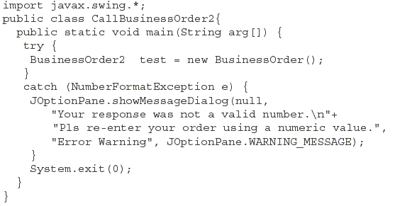
A Complete Example (1)

Slide 16
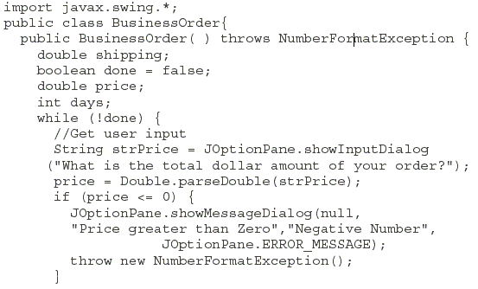
A Complete Example (2)

Slide 17
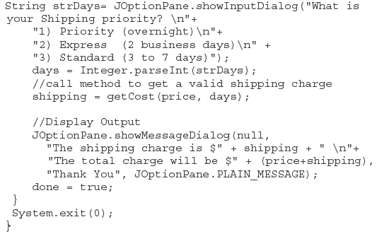
A Complete Example (3)

Slide 18
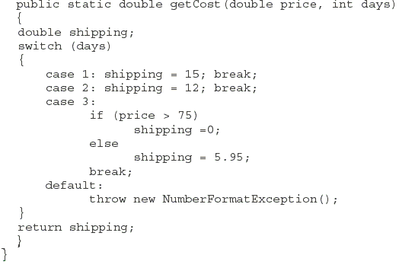
A Complete Example (4)

Slide 19
The throws Clause
Java requires that a method must either provide the exception handler for the exceptions it throws, or declare that it may throw an exception to its caller.
➔ forces Java programmers to either
  1) take care of the exceptions or
  2) defer the exception handling task

Slide 20
The throws Clause
The general format of the throws clause is:
Public return_type method_name (parameter_list) throws exception_class1, exception_class2, ....{
  //if condition match
  //throw new Exception1
  };
The throws clause should include all the possible exception classes that the method may throw, separated by commas.

