Slide 1

ISM 001 Introduction to Programming
Objects: A deeper look
Florence Fok
Lingnan University CC

Slide 2

More about Objects
Objects are the most important building blocks in Java programming.
Like variables and arrays, objects exist in the computer's memory.
Objects can store both data and methods.
Objects are created from classes.

Slide 3
Students.java
// Students.java
// Class definition for students
public class Students {
public int id;
public float grade;
public boolean promoteToNextYear() {
return ((grade >= 40) ? true : false);
}
}
It is only a class definition. No objects are created yet.
To test the Students class, we need a testing program which creates an object from the class definition.

Slide 4
Testing the Students Class
public class Test_Students {
public static void main (String args[] ) {
Students s; // reference to an object
s = new Students(); // creates an object
s.id = 12345; // sets the id property
s.grade = 99.5f; // sets the grade property
System.out.print("Student " + s.id);
if (s.promoteToNextYear())
System.out.println(" will be promoted.");
else
System.out.println(" will repeat.");
}
}

Slide 5
Data Encapsulation
In Test_Students.java, we create a new object of the Students class by using the new keyword:
  s = new Students();
Once the object is created, it automatically allows us to use the id and grade properties.
Besides, the new object "knows" how to determine the promotion status of the student.
The properties and methods are encapsulated in the class definition of Students. That means the data and procedures are hidden inside the objects (information hiding).

Slide 6
Members of a Class
Properties and methods are collectively known as members of a class.
// Students.java
// Class definition for students
public class Students {
public int id;
public float grade;
public boolean promoteToNextYear() {
return ((grade >= 40) ? true : false);
}
}
Properties
Method

Slide 7
Properties
Properties are variables declared within a class definition, but outside of methods:
  public class Students {
  public int id; //instance variable id
  public float grade; //instance variable grade
  //method 1
  //method 2
  }
Properties are also called instance variables or attributes.
The place of their declaration gives them class scope.

Slide 8
Class Scope
Within a class definition, class members are immediately accessible by all of the class's methods.
Members are referenced simply by their names within their own class definition.
public class students_1 {
public int id;
public float grade;
...
public boolean promoteToNextYear() {
return ((grade >= 40) ? true : false);
}

Slide 9
Creating an Object from a Class Definition
Once the class is defined, we can create an object from the class definition using the new keyword, followed by a constructor:
  object_reference = new class_name();
The object_reference is any valid identifier chosen by the programmer.
The class_name() represents a constructor for the class. Constructors always have the same name as the class.
constructor

Slide 10
Creating an Object from a Class Definition
This is how we created a new Students object in the previous example:
Students s; // declares a reference
s = new Students(); // creates an instance
The newly created object, referenced by s, is also called an instance of the class Students.
This is called instantiation of a class.

Slide 11
Accessing Members of an Object
Members of an object (I.e. properties and methods) are accessed by the following format:
  object_reference.member_name;
  e.g. peterCar.licenseNumber;
If the member is a method, the member_name should include the parenthesis with parameters.
  object_reference.method_name(parameter_list);
  e.g. peterCar.getLicenseNumber();

Slide 12
Accessing Members of an Object
In Test_Students.java, we access properties of Students through the following statements:
s.grade = 99.5f; // sets the grade property
System.out.print("Student " + s.id);
(As long as “id” is public in class Students”)
And we access a method of Students through the following statement:
if (s.promoteToNextYear())
System.out.println(" will be promoted.");

Slide 13
The “this” keyword, access modifier, get() and set()

Slide 14
The “this” keyword
Every object can access to itself with keyword this
Non-static methods implicitly use this when referring to the object’s instance variables and other methods
This is useful when a class member is “hidden” by an automatic (local) variable due to name conflict.

Slide 15
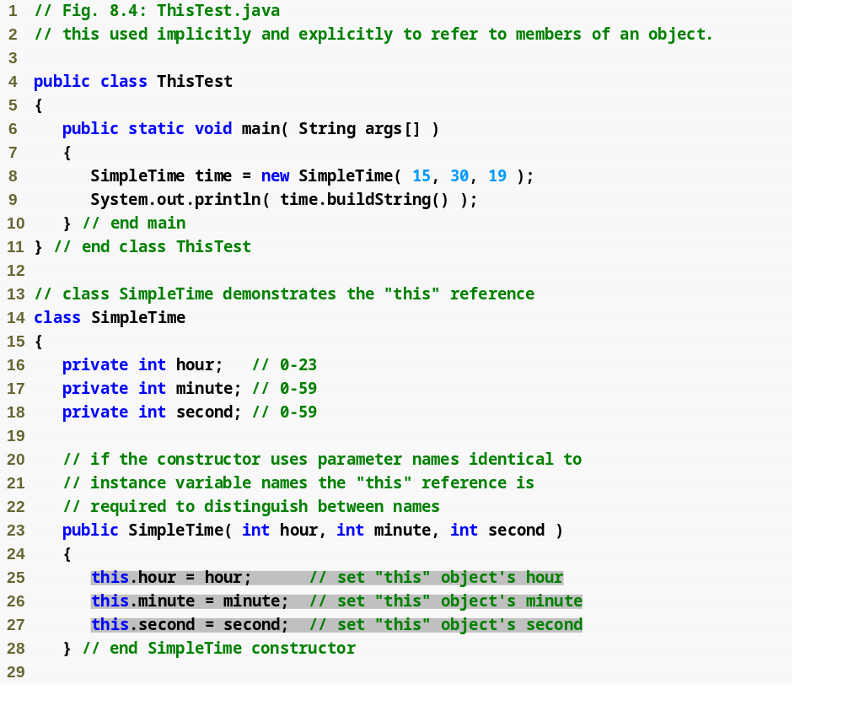
Outline
Create new SimpleTime object
Declare instance variables
Method parameters shadow instance variables
Using this to access the object’s instance variables

Slide 16
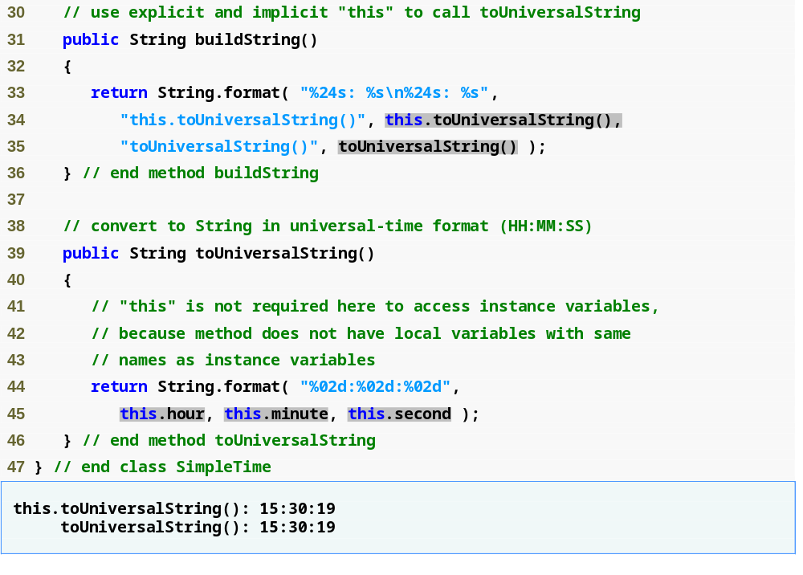
Outline
Using this explicitly and implicitly to call toUniversalString
Use of this not necessary here
Can use this reference to refer to the shadowed field explicitly.

Slide 17
Example of Using this
In Students1, the method setId() has a parameter called id, which is in conflict with the id property of the class.
If we want to refer to the id property instead of the id parameter, we must use the this keyword:
public class Students1 {
private int id;
private float grade;
public void setId(int id) {
this.id = id;
}
...
}

Slide 18
Member Access Modifiers
We can control the accessibility of class members by using the access modifiers: public, private, and protected.
Members that are available to all other classes are called public.
Members that are restricted access to methods within the class definition are called private.
Protected will be explained later.

Slide 19
Using the private Access Modifier
Sometimes we want to protect a property from direct access by other classes because:
  We don’t want others to know “how we did it”.
  We want to enforce some security or validity checks before changing the values of the properties.

Slide 20
Using private properties
public class Students1 {
private int id;
private float grade;
...
public void setGrade(float grade) {
if (grade >= 0)
this.grade = grade;
}
...
}

Slide 21
Using private properties
In the setGrade method, we check the incoming parameter value to make sure that it is valid (I.e. grade > 0) before we modify the grade property.
The users of Students1 do not know know grades are stored in Students1 .
Also, it is not possible for users to enter an invalid grade because of the checking.

Slide 22
Using get and set methods
Once we have marked properties with the private keyword, they are no longer visible from the outside.
In order to provide a way for users to read and write the properties, we use a pair of access methods for each private property.
By custom, these methods are called getXXXX and setXXXX (to read and write)
getXXXX and setXXXX must be public.

Slide 23
General Format of getXXXX
getXXXX methods are used to read a property value. Therefore it must return a value of the same type as the private property.
Can control the format of the data it returns
public class Students1 {
private int id;
private float grade;
...
public float getGrade() {
return grade;
}
...
}

Slide 24
General Format of setXXXX
setXXXX methods are used for writing a property. Therefore it should take a parameter of the same type as the private property.
Can change the value of instance variables
public class Students1 {
private int id;
private float grade;
...
public void setGrade(float grade) {
if (grade >= 0)
this.grade = grade;
}
...
}

Slide 25
Testing the Students1 Class
// Accessing properties through GET / SET methods
public class Test_Students1 {
public static void main (String args[] ) {
Students1 s; // reference to an object
s = new Students1(); // creates an instance by calling constructor
s.setId( 12345 ); // sets the id property
s.setGrade( 99.5f ); // sets the grade property
System.out.print("Student " + s.getId() );
if (s.promoteToNextYear())
System.out.println(" will be promoted.");
else
System.out.println(" will repeat.");
}
}

Slide 26
Multiple Instances of a Class
Within a Java program, many independent instances may be created from one class definition.
The following example creates 3 instances for Students1 class:

Slide 27
Students_1 s1, s2, s3; // declare references
s1 = new Students_1(); // creates first instance
s2 = new Students_1(); // creates second instance
s3 = new Students_1(); // creates third instance
s1.id = 10001; // sets the id property
s1.grade = 99.5f; // sets the grade property
s2.id = 10002; // sets the id property
s2.grade = 49.5f; / sets the grade property
s3.id = 10003; // sets the id property
s3.grade = 35.5f; // sets the grade property
System.out.println("Student " + s1.id +
(s1.promoteToNextYear()?" will be promoted.":" will repeat.") );
System.out.println("Student " + s2.id +
(s2.promoteToNextYear()?" will be promoted.":" will repeat.") );
System.out.println("Student " + s3.id +
(s3.promoteToNextYear()?" will be promoted.":" will repeat.") );

Slide 28
Instance Properties
Each instance has its own allocated space in the memory of the computer.
Therefore each instance has its own copies of properties that are independent from those of the other instances:
S1
S2
S3
id
10001
id
10001
id
10003
grade
99.5f
grade
49.5f
grade
35.5f

Slide 29
Instance Methods
Instance methods are shared by all the instances of the class.
And instance methods will use the respective copies of instance properties for processing.

Slide 30
Instance Methods
public class Multi_students {...
System.out.println(...s1.promoteToNextYear()...);
System.out.println(...s2.promoteToNextYear()...);
System.out.println(...s3.promoteToNextYear()...);...}
public class Students_1 {...
public boolean promoteToNextYear() {
return ((grade >= 40) ? true : false);
}
S1
S2
S3
id
10001
id
10001
id
10003
grade
99.5f
grade
49.5f
grade
35.5f

Slide 31
Constructor

Slide 32
Default and No-Argument Constructors
Every class must have at least one constructor
  If no constructors are declared, the compiler will create a default constructor that takes no arguments and initializes instance variables to their initial values
    Default values are zero for primitive numeric types, false for boolean values and null for references
  If constructors are declared, the default initialization for objects of the class will be performed by a no-argument constructor (if one is declared)

Slide 33
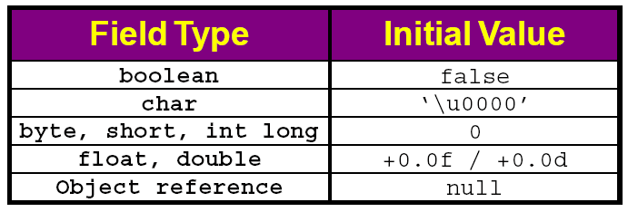
Default values of instance variables

Slide 34
Defining a Constructor
Constructors are define in a way similar to methods:
  public class_name(parameter_list);
However, there is no return type specified in a constructor definition.

Slide 35
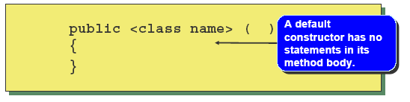
Default Constructor
If there is no constructors in a class definition, then Java will create a default constructor automatically.
The format of the default constructor is:
Notice that there is no parameters in the default constructor.
If you write a constructor in the class, Java will not create a default constructor.

Slide 36
Constructors Overloading
We may create many constructors in the same class definition.
  If the class name is Car, then the constructor is public Car() {……}
There can be > 1 constructors, each of them must have a different list of parameters. That means there are overloaded constructors.

Slide 37
Example of Overloaded Constructors
// Class definition with overloaded constructors
public class student_4 {
public int id; public String name;
public char certgrades[];
public student_4 () {
name = "unknown";
certgrades = new char[5];
}
public student_4 (String newName) {
name = newName;
certgrades = new char[5];
}
Constructor with no parameters
Constructor with one parameters

Slide 38
Example of Overloaded Constructors
public student_4 (int newId,
String newName) {
id = newId;
name = newName;
certgrades = new char[5];
}
public student_4 (int newId,
String newName,
int gradesCount) {
id = newId;
name = newName;
certgrades = new char[gradesCount];
}
}
Constructor with two parameters
Constructor with three parameters

Slide 39
Testing student_4
public class tst_student_4 {
public static void main (String args[]) {
student_4 s[] = new student_4[4];
s[0] = new student_4();
s[1] = new student_4("Mary Ma");
s[2] = new student_4(1002, "Larry Lau");
s[3] = new student_4(1003,"Johnny Jiu", 12);
for (int i=0; i<=3; i++) {
System.out.println("Student " + (i+1) + ":");
System.out.println("Id =\t" + s[i].id);
System.out.println("Name =\t" + s[i].name);
System.out.println("No. of grades = " +
s[i].certgrades.length);
}
}
}

Slide 40
Output of tst_student_4.java
>java tst_student_4
Student 1:
Id = 0
Name = unknown
No. of grades = 5
Student 2:
Id = 0
Name = Mary Ma
No. of grades = 5
Student 3:
Id = 1002
Name = Larry Lau
No. of grades = 5
Student 4:
Id = 1003
Name = Johnny Jiu
No. of grades = 12

Slide 41
Composition
Composition
  A class can have references to objects of other classes as members
  Sometimes referred to as a has-a relationship

Slide 42
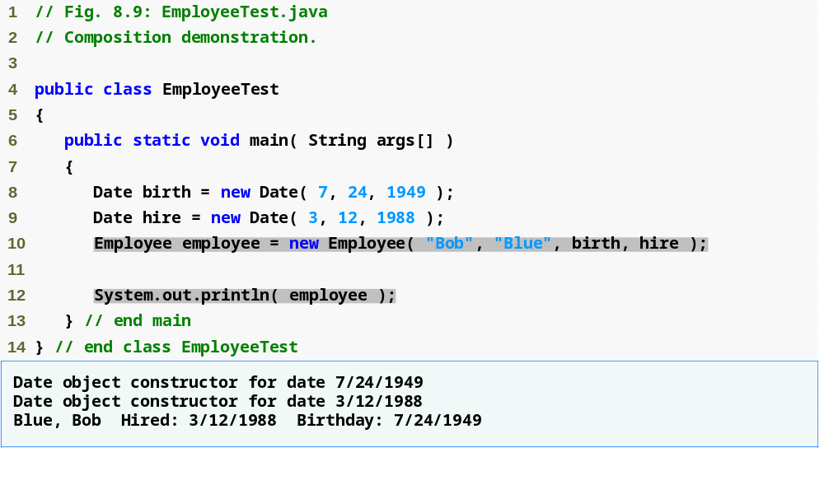
Outline
EmployeeTest.java
Create an Employee object
Display the Employee object

Slide 43
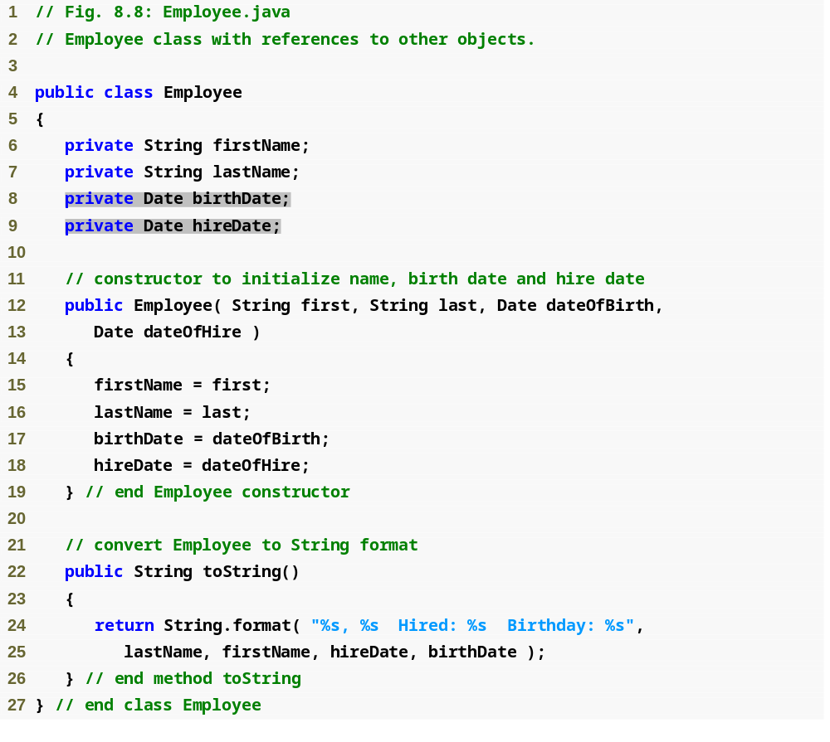
Outline
Employee contains references to two Date objects
Implicit calls to hireDate and birthDate’s toString methods

Slide 44
Static Class Members

Slide 45
static Class Members
static fields
  Also known as class variables
  Represents class-wide information
Use a static variable when all objects of a class must use the same copy of the variable.
Static class variables and methods can be used, even if no objects of that class exist
  e.g. Math.PI
Invoked with the class name or an object name and a dot (.) e.g. Math.pow(), JOptionPane.showMessageDialog(“Enter sth”);
Must be initialized in their declarations, or else the compiler will initialize it with a default value

Slide 46
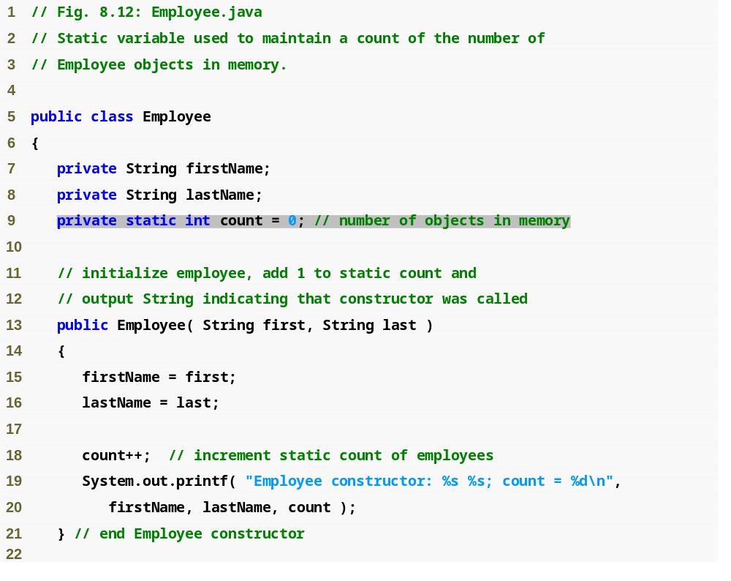
Outline
Declare a static field
Employee.java
Increment static field

Slide 47
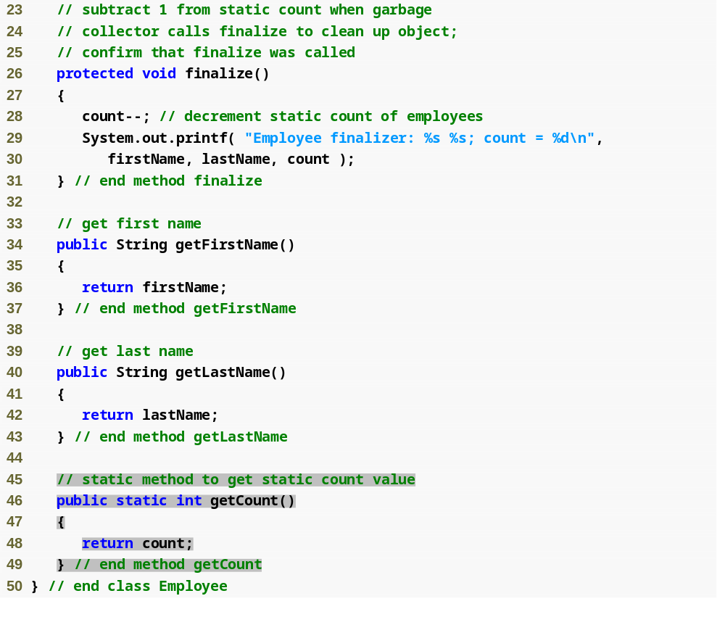
Outline
Declare method finalize
Employee.java
Declare static method getCount to get static field count

Slide 48
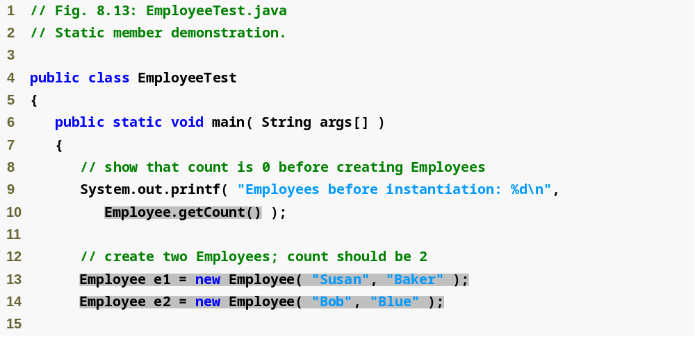
Outline
Call static method getCount using class name Employee
Create new Employee objects
EmployeeTest.java

Slide 49
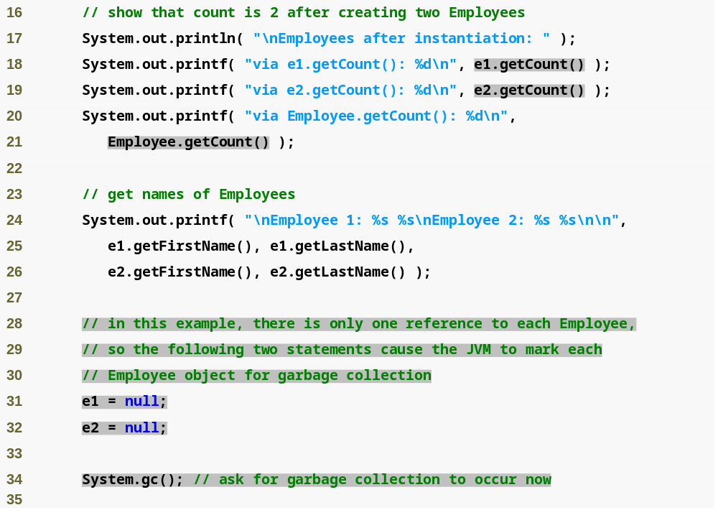
Outline
Call static method getCount outside objects
Call static method getCount inside objects
EmployeeTest.java
Remove references to objects, JVM will mark them for garbage collection
Call static method gc of class System to indicate that garbage collection should be attempted

Slide 50
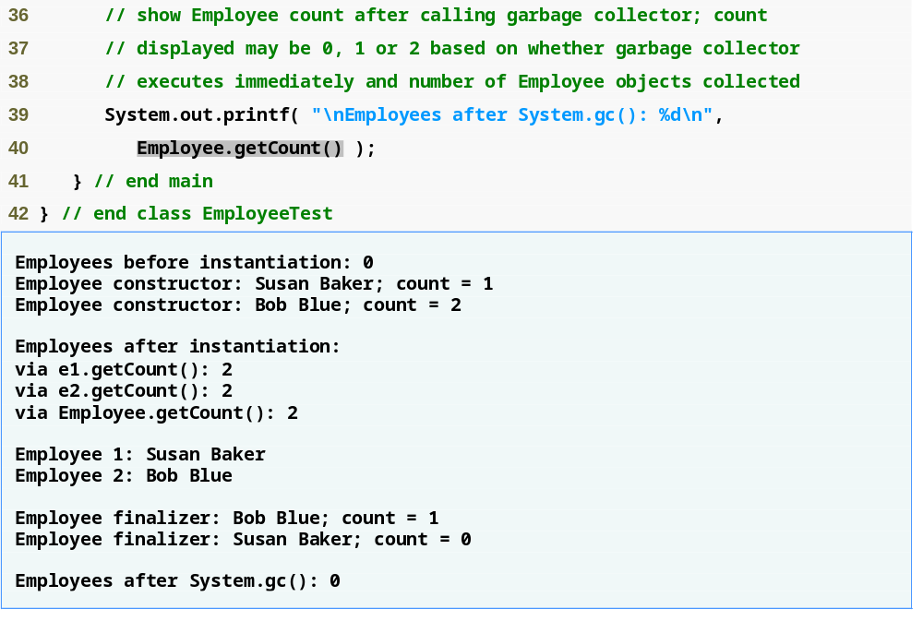
Outline
EmployeeTest.java
Call static method getCount

Slide 51
About the program
e1=null; and e2=null;
  means they no longer refer to any objects. This marks the objects for Garbage Collection (which means an object instance is erased from memory when it is no longer needed in a program)
static method gc of class System
  Indicates that the garbage collection occurs
  garbage collection is used to reclaim the memory occupied by memory that are no longer use.
  Give resources back to system and avoid “resource leaks”

Slide 52
Garbage Collection and Method finalize
Garbage collection
  JVM marks an object for garbage collection when there are no more references to that object
  JVM’s garbage collector will retrieve those objects memory so it can be used for other objects

Slide 53
The finalize() Method
Finalize() is called by the garbage collector gc();
finalize() takes no parameters and must have return type void
The finalize() method is usually defined as follows:
protected void finalize() {
  ...
  }

Slide 54
The finalize() Method
In Employee.java, we use the finalize() method to decrease the value of count by 1 every time when an instance of Employee is removed from memory.
protected void finalize() {
--count; // decrement static count of employees
...
}

Slide 55
Final instance variables

Slide 56
final Instance Variables
final instance variables
  Keyword final
    Specifies that a variable is not modifiable (is a constant)
    e.g. private final int INCREMENT;
  final instance variables can be initialized at their declaration
    If they are not initialized in their declarations, they must be initialized in all constructors

Slide 57
final Instance Variables
A final field should also be declared static if it is initialized in its declaration.
Once a final field is initialized in its declaration, its value can never change.
Making the field static enables all objects of the class to share the final field.

Slide 58
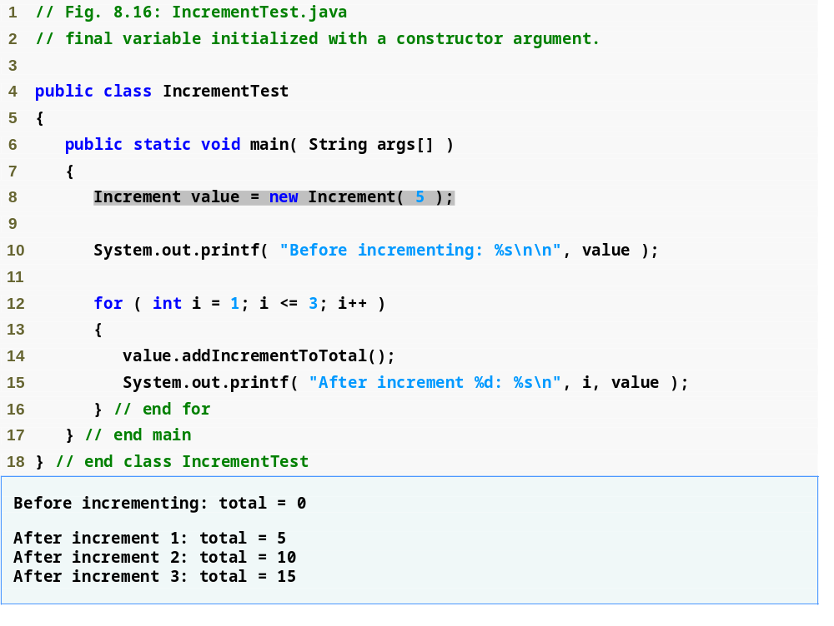
Outline
Create an Increment object
Call method addIncrementToTotal

Slide 59
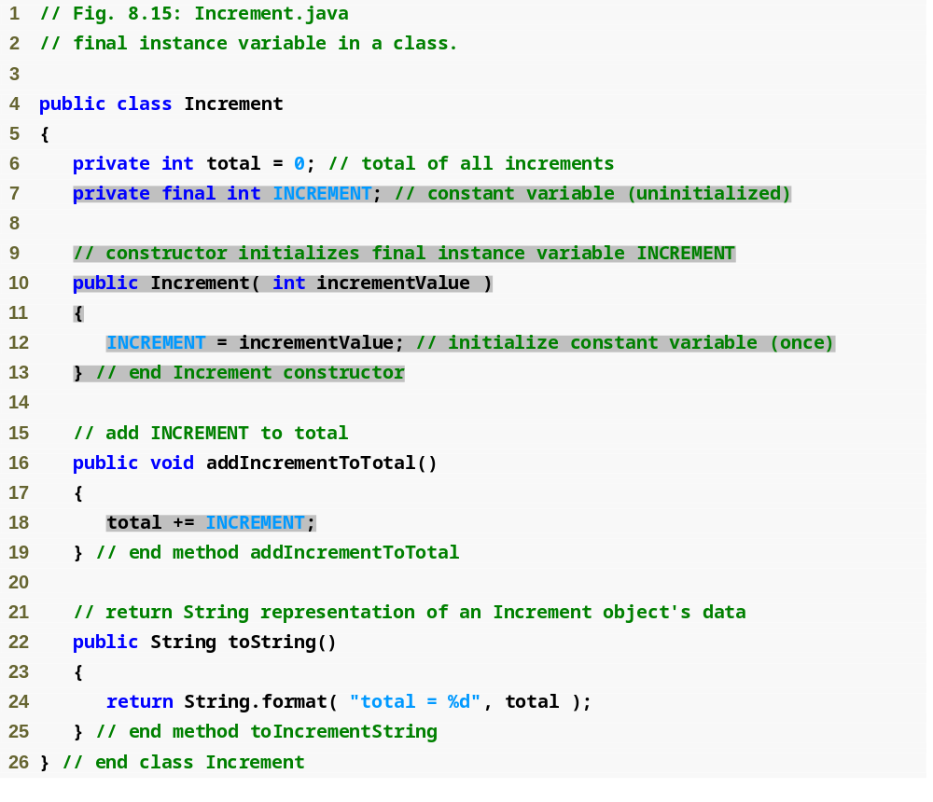
Outline
Declare final instance variable
Initialize final instance variable inside a constructor

