Slide 1

ISM 001 Introduction to Programming
Inheritance, Abstract Class, Polymorphism
Florence Fok
Lingnan University CC

Slide 2

Inheritance
Inheritance enables us to create a class that is similar to a previously defined class, but one that still has some of its own properties. Here, subclass is inherited from superclass or superclass extends to subclass
Superclass
Subclass

Slide 3
Inheritance
Inheritance is one of the cornerstones of OOP. The other two are: encapsulation and polymorphism.
It allows the creation of hierarchical classification.
Using inheritance, we can create a general class that defines traits common to a set of related items.
This class can then be inherited by other.

Slide 4
Inheritance
If two objects are expected to share common behaviors and data, it is better to design their classes using inheritance.
Using unrelated classes in such an instance will result in duplicating code common to both classes.

Slide 5
Inheritance
Employee class:
  name, salary, hireDay;
  getName, raiseSalary(), getHireDay().
Manager is-a Employee, has all above, and
  Has a bonus
  getsalary() computed differently
Instead of defining Manager class from scratch, one can derive it from the Employee class. Work saved.

Slide 6
Inheritance
Inheritance allows one to factor out common functionality by moving it to a superclass, results in better program.
Checking
method A
method B1
superclass
Account
method A
Saving
method A
method B2
Checking
method B1
Saving
method B2
subclass

Slide 8
Using super
A subclass can call a constructor method defined by its superclass.
  Super(parameter-list)
Here, parameter-list specifies any parameters needed by the constructor in the superclass.
Super() must always be the first statement executed inside a subclass’constructor.

Slide 9
Super.member
The second from of super acts somewhat like this, except that it always refers to the superclass of the subclass in which it is used. This usage has the following general form:
  super.member

Slide 11
Abstract Classes
Sometimes, we want to define a superclass that declares the structure of a abstraction with a complete implementation of every method.
That is, we want to create a superclass that only defines a generalised form that will be shared by all of its subclasses.

Slide 12
More about Abstract Classes
The main purpose of an abstract class is to define a common interface for it's subclasses to which some or all implementation is deferred.
Abstract classes may be used in designing a family of related subclasses. The general form is:
abstract type name (parameter-list)

Slide 13
Final
Final with inheritance has three uses.
First, it can be used to create the equivalent of a named constant
Secondly, to apply final to prevent overriding
Thirdly, to use final to prevent inheritance

Slide 14
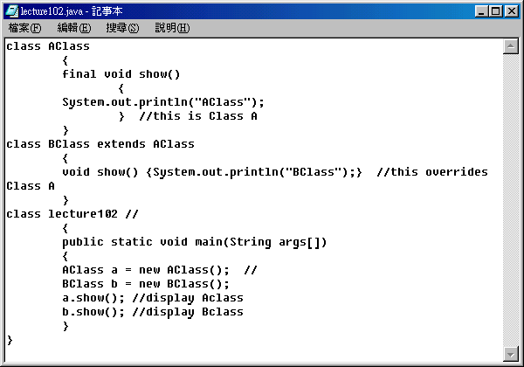
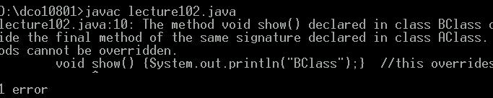
Example – with a compilation error
Because show() is declared as final, it cannot be overridden.
error

Slide 16
Inheritance
Object-oriented programming is powerful because we can create new classes from existing classes.
In the world, there are many similar things that share a common root, or things that are modified from a common sample.
  Absorb existing class’s data and behaviors
  Enhance with new capabilities
Subclass (子類別) extends superclass (父類別)
  Subclass
    More specialized group of objects
    Behaviors inherited from superclass

Slide 17
Superclasses and subclasses
Superclasses and subclasses
  Object of one class “is an” object of another class
    Example: Rectangle is quadrilateral.
      Class Rectangle inherits from class Quadrilateral
      Quadrilateral: superclass
      Rectangle: subclass
  Superclass typically represents larger set of objects than subclasses
    Example:
      superclass: Vehicle
        Car, Truck, Boats, Bicycle, …
      subclass: Car
        Smaller, more-specific subset of vehicles

Slide 18
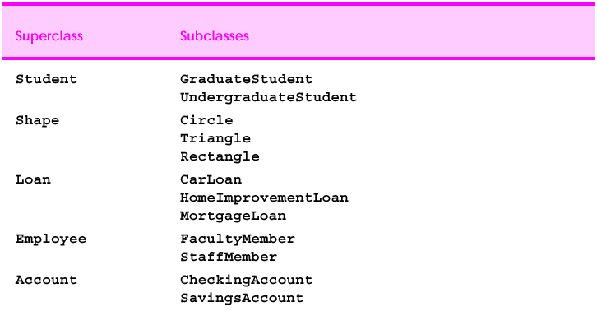
Class Inheritance Examples

Slide 19
Inheritance
Class hierarchy
  Direct superclass
    Inherited explicitly (one level up hierarchy)
  Indirect superclass
    Inherited two or more levels up hierarchy
  Single inheritance
    Inherits from one superclass
  Multiple inheritance
    Inherits from multiple superclasses
      Java does not support multiple inheritance

Slide 20
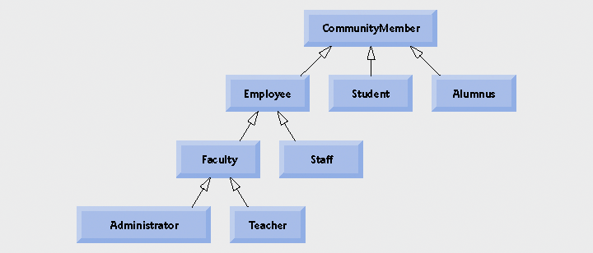
Generalization and Specialization
General
Specialize
A subclass must be conceptually a type of the superclass, but has more refined details.

Slide 21
An Inheritance Example
In Lingnan CC, there are two classes of Students in the BA Dept. – CIT Students and Logistics Students.
CIT and Logistics Students share many common characteristics because they belong to the general category of objects called Students.
  id, name, grade
Assume the only difference between CIT and Logistics Students is that one has CIT grade and one has Logistics grade
Therefore, we can summarize the properties of different Students as the following:
Student (id, name, grade, courseName)
  CIT_Student (id, name, grade, courseName, CIT_grade)
  LOGISTICS_Student (id, name, grade, courseName, Logistics_grade)

Slide 22
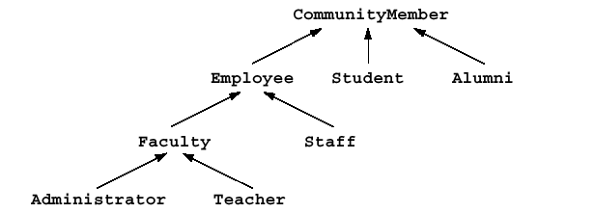
Generalization and Specialization
General
Specialize
CIT Student
Logistics Student

Slide 23
Generalization and Specialization
Student is more general.
CIT_Student and Logistics_Student are specific types of objects derived from Student.
Student is the superclass
CIT_Student and Logistics_Student are subclasses.
CIT_Student and Logistics_Student inherits from Student. They will inherit the attributes (properties) and methods (behavior) from the superclass

Slide 24
Inheritance of Class Members
A subclass inherits all the non-private members from its superclass.
Therefore, both CIT_Student and Logistics_Student inherit all the members from Student.
In addition to the inherited members, both CIT_Student and Logistics_Student have their own specialized properties and methods.

Slide 25
Student.java
public class Student {
int id; String name; int year;
protected String courseName = null;
public Student (int id, String name) {
this.id = id;
this.name = name;
}
public int getId () { return id; }
public String getName () { return name; }
public void setYear (int newValue) {
year = newValue;}
public int getYear () { return year; }
}

Slide 26
The extends Keyword
In Java, we specify that a class is an extension of another class by using the extends keyword:
  class subclass_name extends superclass_name

Slide 27
An Inheritance Example: CIT_Student.java
public class CIT_Student extends Student {
public float CIT_grade;
public CIT_Student (int id, String name) {
super(id, name); // superclass constructor
courseName = "Java"; // protected member
}
public void setCIT_grade (float newValue)
{ CIT_grade = newValue;}
public float getCIT_grade ()
{ return CIT_grade; }
}

Slide 28
An Inheritance Example: Logistics_Student.java
public class Logistics_Student extends Student {
public float Logistics_grade;
public Logistics_Student (int id, String name) {
super(id, name); // superclass constructor
courseName = "Logistics and Transport";
}
public void setLOG_grade (float newValue)
{ Logistics_grade = newValue;}
public float getLOG_grade ()
{ return Logistics_grade ; }
}

Slide 29
Testing Inherited Class Members
public class Test_1 {
public static void main(String args[]) {
CIT_Student cit = new CIT_Student(1001,
"Chan Tai Man");
cit.setCIT_grade(99.9f); // subclass member
cit.setYear(2); // inherited method
System.out.println("CIT Student info: ");
System.out.println("id: \t"+ cit.getId());
System.out.println("name: \t"+ cit.getName());
System.out.println("year: \t"+ cit.getYear());
System.out.println("CIT: \t"+ cit.getCIT_grade());
}
}

Slide 30
Object and Inheritance in Java
In Java, every class is a direct or indirect subclass of the class Object.
When you write a class without the extends keyword, then the class will automatically extends Object.
In our example, the Student class implicitly extends Object because no extends keyword is used in Student.java.
The inheritance hierarchy:
Object
  Student
    CIT_Student
    Logistics_Student

Slide 31
The Object Class
Some of the methods from the Object class are commonly used or overridden.
E.g. equals() method when we talked about Strings. It compares two objects for equality and return true if they are equal. E.g.
object1.equals(objects2)
The CIT_Student and Logistics_Student classes also inherit the methods of Object indirectly through Student.

Slide 32
Package Access
We have studied two Access Modifiers for class members: private and public.
There is a third type of access scope for class members: package access.
When we define class members (i.e. variables and methods) without an access modifier, we are specifying package access for the members.
Package access means that these class members are accessible to classes within the same package, but not to classes outside of the package.

Slide 33
The protected Access Modifier
The protected access modifier is an intermediate level of protection between public and private access modifiers.
Protected members of a superclass may be accessed by methods of its subclasses, and by methods of other classes in the same package.
In our example, the constructors of CIT_Student and Logistics_Student access a protected member of the superclass: Student.courseName.

Slide 34
Summary of Access Rules for Class Members
Methods of a subclass may access:
  All public members of the superclass
  All protected members of the superclass
  All package access members of the superclass, if the subclass is in the same package as the superclass.
Methods of a subclass cannot access private members of the superclass.

Slide 35
Constructors and Inheritance
Constructors are not inherited.
This is simply because constructors are named after the class (i.e. the constructors of Student are also called Student), but subclasses cannot be named the same as the superclass.
CIT_Student and Logistics_Student have their own constructors.

Slide 36
Calling Constructors of the Superclass Using the super Keyword
In CIT_Student constructor, we call the constructor of Student by using the super keyword.
This is necessary because the constructor of Student helps us to set the values of some properties.
The super keyword is provided for accessing the members of the superclass from a subclass.

Slide 37
Calling Constructors of the Superclass
public class CIT_Student extends Student {
float CIT_grade;
public CIT_Student (int id, String name) {
super(id, name); // explicitly call superclass
courseName = "CIT"; // protected member
}
.
.
.
}

Slide 38
Calling Constructors of the Superclass
public class Student {
// The following properties allow package access
int id; String name; int year;
protected String courseName = null;
public Student (int id, String name) { this.id = id;
this.name = name;
}
public int getId () { return id; }
public String getName () { return name; }
public void setYear (int newValue) {
year = newValue;}
public int getYear () { return year; }
}

Slide 39
Constructors and Inheritance
If we do not call one of the superclass's constructors explicitly, then Java will automatically calls the default constructor of the superclass for us, before it executes the constructor of the subclass.
  This is an error if the superclass does not have a default constructor with no parameters.
The constructor of the superclass is always executed before the constructor of the subclass.
Calling the superclass's constructor should be the first statement in the subclass's constructor.

Slide 40
Modify the program
Change protected to private (A compilation error occurs)
Add the following method to CIT_Student.java
public void displayMessage(){
System.out.println("The course Name is "+ courseName);
}
The problems when using protected before:
  can change superclass variables directly, and the subclass can assign illegal value without validity checking
  visible to all classes in same package
  if superclass variable names change, subclass variables also change , e.g. courseName in Student changes to course. Any solution?????

Slide 41
Modify the program
Add the following codes to Test_1.java
Logistics_Student log_s=new Logistics_Student(1000,"Chan Siu Ming");
log_s.setLOG_grade(90.9f); // subclass member
log_s.setYear(1); // inherited method
System.out.println("LOG Student info: ");
System.out.println("id: \t"+ log_s.getId());
System.out.println("name: \t"+ log_s.getName());
System.out.println("year: \t"+ log_s.getYear());
System.out.println("CIT: \t"+ log_s.getLOG_grade());
log_s.displayMessage();

Slide 42
Overriding Methods
An overriding method must have the same signature (name and parameter list) as the original method. Otherwise, it is simply a new method:
  Original Method in Employee:
  public double getSalary( ){…}
  public void raiseSalary(double byPercent){…}
  New rather than overriding methods in Manager:
  public void raiseSalary(int byPercent){…}
  public void raiseWage(double byPercent){…}

Slide 43
Overriding Methods
An overriding method must have the same return type as the original method:
An overriding method must be at least as visible as the superclass method.
private methods cannot be overridden, but others (public, protected, default-access methods) can.

Slide 44
Inheritance Hierarchies
Inheritance hierarchy: inheritance relationships among a collection of classes
Employee
Manager
Secretary
Programmer
Executive

Slide 45
Abstract Class

Slide 46
Abstract Superclass
From our discussion of generalization and specialization, we know that Student is a superclass created to capture the most general properties and methods of a Student object.
More specialized versions of Student are implemented by the subclasses CIT_Student and Logistics_Student.
We should never construct Student objects directly, but should construct objects of CIT_Student and Logistics_Student instead

Slide 47
Abstract Class
In order to prevent the construction of objects from the Student class, we can declare Student as an abstract class.
To declare an abstract class, we use the abstract keyword:
  abstract class class_name {}

Slide 48
Abstract Class
public abstract class Student{
int id; String name; int year;
protected String courseName = null;
public Student (int id, String name) {
this.id = id;
this.name = name;
}
public int getId () { return id; }
public String getName () { return name; }
public void setYear (int newValue) {
year = newValue;}
public int getYear () { return year; }
}

Slide 49
Abstract Class
An abstract class cannot be instantiated into objects.
Since Student is now an abstract class, we can no longer construct an object from it directly. The following program would result in a compiler error:
public class Test_1 {
public static void main (String args[]) {
//The following statement is wrong!
Student s = new Student(1003, "Peter Pan");
}
}

Slide 50
Abstract Class
When we try to compileTest_1.java, the following error message will show:
G:\Testing>javac Test_1.java
Test_1.java:27: Student is abstract; cannot be instantiated
Student s=new Student(1003,“Peter Chan");

Slide 51
Implementation of Methods in Abstract Superclasses
Although abstract superclasses cannot be instantiated, they may contain definitions for methods and properties that will be inherited by their subclasses.
An abstract superclass may also declare and define constructors which will be called implicitly by Java when instantiating it subclasses or explicitly by its subclass constructors.
In Student, we have declared and defined a few methods which will be inherited by its subclasses

Slide 52
Concrete Subclasses
The opposite of abstract is concrete.
A subclass of an abstract superclass maybe either abstract or concrete.
Concrete class can provide implementation for every method that abstract class declared
If we want to do something with the classes, we must instantiate the concrete subclasses

Slide 53
Instantiating Subclass Objects of an Abstract Superclass
public class Test_1 {
public static void main(String args[]) {
CIT_Student cit = new CIT_Student(1001,
"Chan Tai Man");
cit.setCIT_grade(99.9f); // subclass member
cit.setYear(2); // inherited method
System.out.println("CIT Student info: ");
System.out.println("id: \t"+ cit.getId());
System.out.println("name: \t"+ cit.getName());
System.out.println("year: \t"+ cit.getYear());
System.out.println("CIT: \t"+ cit.getCIT_grade());
System.out.println("The course Name is "+ cit.getCourseName());
}
}

Slide 54
Output of Test_1.java
>java Test_1
CIT Student info:
id: 1001
name: Chan Tai Man
year: 2
CIT: 99.9
The course Name is Java

Slide 55
Abstract Methods
Abstract methods do not provide implementations
A class contains any abstract methods must be declared as an abstract class
An abstract class normally contains one or more abstract methods.
Each concrete subclass must provide concrete implementations to override abstract methods from superclass.
Constructors and static methods cannot be declared as abstract
For example, in Student, we declare several abstract methods:
public abstract float getSubjGrade();
public abstract void setSubjGrade(float newValue);

Slide 56
Abstract Methods
The most important characteristic about abstract methods is that while there is a clear definition of their signatures, there is no implementation logic.
Referring to the examples in Student, you may notice that none of those abstract methods have an implementation block ({...}) after the declaration.

Slide 57
Implementation of Abstract Methods in Subclasses
A subclass that extends Student (such as CIT_Student) cannot inherit the abstract methods.
Each concrete subclass must provide the actual implementation of all of the abstract methods of its superclass.
If the subclass only implements some, but not all, of the abstract methods of its superclass, then the subclass must also be declared abstract.
By placing these abstract methods in Student, it is guaranteed that eventually, all the concrete subclasses of Student will implement all of these methods.

Slide 58
CIT_Student.java (Revised)
public final class CIT_Student extends Student{
float CIT_grade; // package access
public CIT_Student(int id, String name) {
super(id, name); // superclass constructor
courseName = "Java";
}
//public String getSubjName() { return "Java";}
public float getSubjGrade() { return CIT_grade;}
public void setSubjGrade(float newValue) {
CIT_grade = newValue;
}
}

Slide 59
Logistics_Student.java (Revised)
public final class Logistics_Student extends Student{
float Logistics_grade;
public Logistics_Student (int id, String name) {
super(id, name); // superclass constructor
courseName = "Logistics and Transportation";
}
//public String getSubjName() { return "Logistics";}
public float getSubjGrade() { return Logistics_grade;}
public void setSubjGrade(float newValue) {
Logistics_grade = newValue;
}
}

Slide 60
Overriding Superclass Members in a Subclass
A subclass may override the properties and methods of the superclass.
Most of the time, a subclass only overrides the methods of its superclass.
To override a method, we write a method in the subclass that has the same signature as one of the methods inherited from the superclass.
E.g. add the following code to Student class and create same method for CIT_Student and Logistics_Student classes (see Revised version):
public String getSubjName() { return "None";}

Slide 61
Overriding Superclass Members in a Subclass
Since getSubjName has been overridden, when a program calls getSubjName through an instance of CIT_Student and Logistics_Student, the version of getSubjName defined in CIT_Student.java will be used.
This is called method overriding.
Add System.out.println("Get subject Name\t"+ cit.getSubjName()); to Test_1.java and compile again.

Slide 62
Overriding Superclass Members in a Subclass
If you intend to override a superclass method, you must make sure that the signatures of the subclass method and the superclass method must be the same. Otherwise, you are overloading the method, not overridding it.
If the superclass method has been declared final, it is not allowed to be overridden. (try!)
That means a class declared final cannot be a superclass

Slide 63
Polymorphism

Slide 64
Polymorphism
Polymorphism
  Enables us “programming in the general” rather than program in specific
  can produce “many forms” of results

Slide 65
Polymorphism Example
public class Morph1 {
public static void main(String args[]) {
Student[] s= new Student[2];
s[0] = new CIT_Student(1001, "Chan Tai Man");
s[1] = new Logistics_Student(1002, "Wong Tai Mui");
for (int x=0; x<s.length; x++) {
System.out.print("Subject name of Student " +
s[x].getId());
System.out.println(" = \t"+ s[x].getSubjName());
}
}
}

Slide 66
Polymorphism Example
s[] is an array of Student, the superclass.
Therefore, each element in the array is a reference to a Student object.
However, we initialize each element with a reference to a subclass object of Student:
s[0] = new CIT_Student(1001, "Chan Tai Man");
s[1] = new Logistics_Student(1002, "Wong Tai Mui");
This is necessary because as Student is an abstract superclass, we cannot directly create instances for it.

Slide 67
Polymorphism Example
The method getSubjName is called
System.out.println(" = \t"+
s[x].getSubjName());
As each element in s[] is a reference to Student, we expect that s[x].getSubjName() should refer to the getSubjName() method in the Student class:
>java Morph1
Subject name of Student 1001 = Java
Subject name of Student 1002 = Logistics

Slide 68
Polymorphism Example
Although s[x] is declared a reference to Student, when we call s[x].getSubjName() the overridden versions of getSubjName are called instead of the original version in Student.
Furthermore, Java is automatically making decision on which version of getSubjName to call, based on the actual subclass object referenced in s[x].
This phenomenon is called polymorphism.
poly=multiple, morph=form

Slide 69
Interface

Slide 70
Interface
Special pure abstract class
A class can be made pure abstract by making all its methods abstract
Java does not support multiple inheritance, a pure abstract class without fields is called Interface
An Interface declaration begins with the keyword interface
To use the interface, a concrete class must specify that it implements the interface

Slide 71
Interface
All interface members must be public and interface may not specify the implementation details.
Can declare constants and abstract methods
  All methods are implicitly public abstract methods
e.g. public interface Payable{ double getPayment(); }
// must be public and abstract, no need to declare this.
  All constants are implicitly public, static and final
e.g. public interface Payable{ int ONE=1; int TWO=2; }
Classes can implement interfaces
  The class must declare all the methods of the interface , otherwise, the class must be declared abstract
  Like: I will declare all the methods specified by the interface or I will declare my class abstract

Slide 72
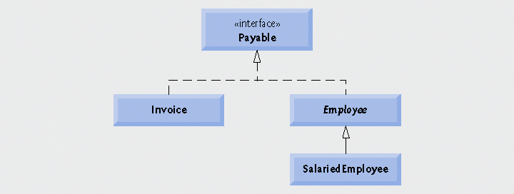
Interface

Slide 73
Interface Example
public interface Payable{
double getPayment(); }
public class Invoice implements Payable {
//….overriding getPayment() method
}
public abstract class Employee implements Payable {
//….does not override getPayment()method so
//Employee is abstract class
}
public class SalariedEmployee extends Employee {
//….overriding getPayment() method
}

Slide 74
Reference
More about Abstract class

Slide 75
Abstract Classes
Consider two classes: Employee and Student
Common methods:
  getName
  getDescription: returns
    Employee: “an employee with salary $50,000”
    Student: “a student majoring in Computer Science”
To write better code, introduce a superclass Person with those two methods
Person
Student
Employee

Slide 76
Abstract Classes
class Person
    { public Person(String n) { name = n;}
    public String getName()
    { return name;}
    public String getDescription();
    // but how to write this?
    private String name;
    }
The Person class knows nothing about the person except for the name. We don’t know how to implement the method in the Person class although we know it must be there.

Slide 77
Abstract Classes
Solution: leave the getDescription method abstract
  Hence leave the Person class abstract
abstract class Person
    { public Person(String n)
    { name = n;}
    public abstract String getDescription();
    public String getName()
    { return name;}
    private String name;
    }

Slide 78
Abstract Classes
An abstract method is a method that
  Cannot be specified in the current class (C++: pure virtual function).
  Must be implemented in non-abstract subclasses.
An abstract class is a class that may contain one or more abstract methods
Notes:
  An abstract class does not necessarily have abstract method
  Subclass of a non-abstract class can be abstract.

Slide 79
Abstract Classes
Cannot create objects of an abstract class:
    New Person(“Micky Mouse”) // illegal
An abstract class must be extended before use.
    class Student extends Person
    { public Student(String n, String m)
    { super(n); major = m;}
    public String getDescription()
    { return "a student majoring in " + major; }
    private String major;
    }

Slide 80
Abstract Classes
    class Employee extends Person
    { …
    public String getDescription()
    {
    NumberFormat formatter
    = NumberFormat.getCurrencyInstance();
    return "an employee with a salary of "
    + formatter.format(salary);
    }
    …
    private double salary;
    }

Slide 81
Abstract Classes
  Person[] people = new Person[2];
  people[0]= new Employee("Harry Hacker", 50000, 1989,10,1);
  people[1]= new Student("Maria Morris", "computer science");
  for (int i = 0; i < people.length; i++)
  { Person p = people[i];
  System.out.println(p.getName() + ", "
  + p.getDescription());
  } //PersonTest.java
This would not compile if we don’t have getDescription in Person.

