Slide 1
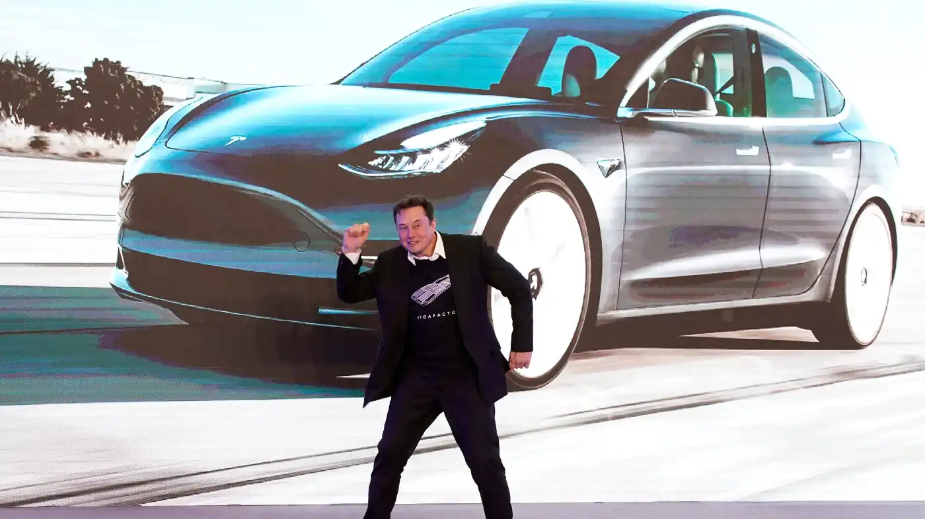
Tesla stock evaluation
Forrest Fallon
IST 652 – Scripting for Data Analysis

Slide 2
Data Sources
Tesla dataset – Kaggle: https://www.kaggle.com/timoboz/tesla-stock-data-from-2010-to-2020
Nasdaq 100 – Yahoo finance: https://finance.yahoo.com/quote/%5ENDX/history?period1=1277683200&period2=1638316800&interval=1d&filter=history&frequency=1d&includeAdjustedClose=true
Tweets: snscrape package

Slide 3
Questions and goals
Did Tesla and Nasdaq 100 follow similar trends?
Are Elon Musk’s tweets actually impact the Tesla stock price overall?
What are the largest losses over time for the Tesla stock?
Can this be visualized meaningfully?

Slide 4
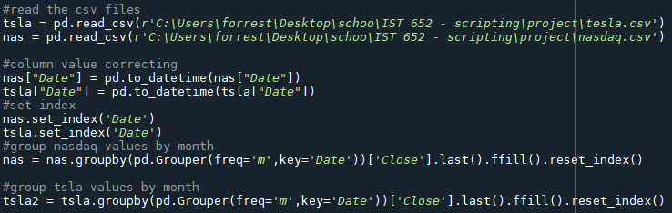
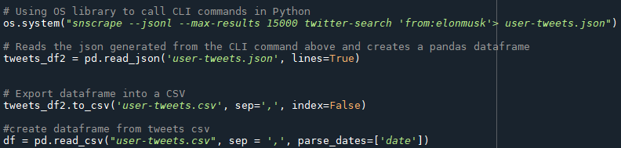
Import data Clean/set indexes Groupby Run snscrape Export to csv Read csv

Slide 5
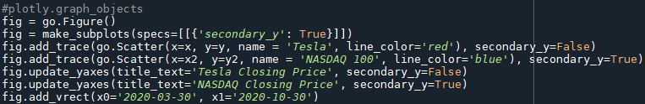
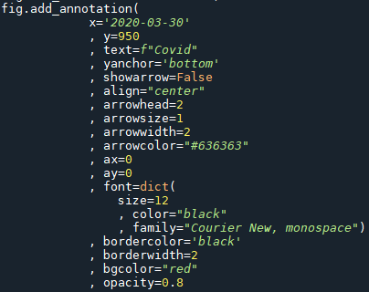

Plotly graph setup Annotation setup Dynamic Plot (browser graph)

Slide 6
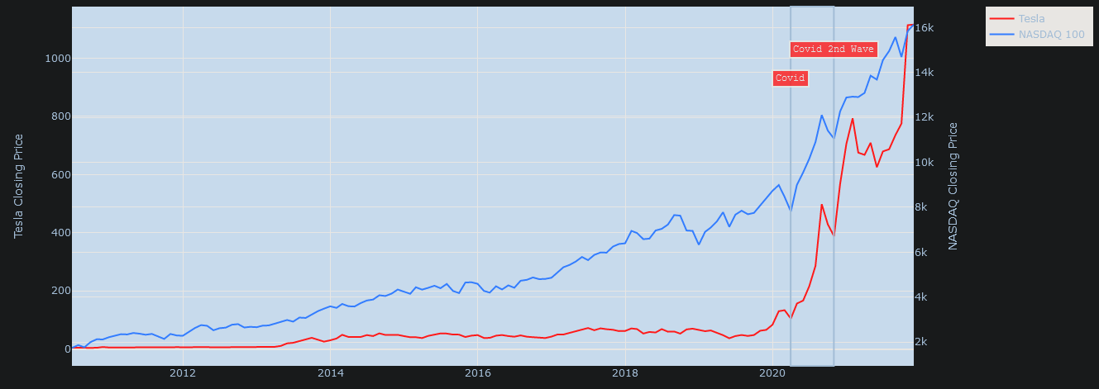
Tesla vs. Nasdaq closing price (monthly) to 2021

Slide 7

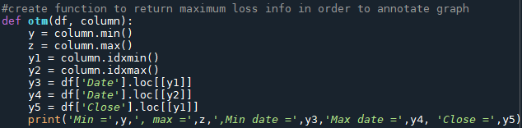

Create diff columns Function to return respective info Output

Slide 8
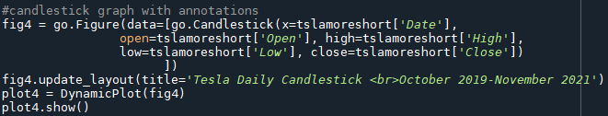
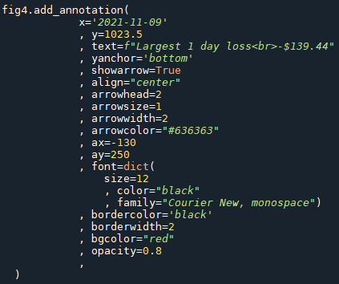
Create tesla candlestick chart Luckily, this was an option within plotly already; the main differences being the need to set an open, high, low, and close value.

Slide 9
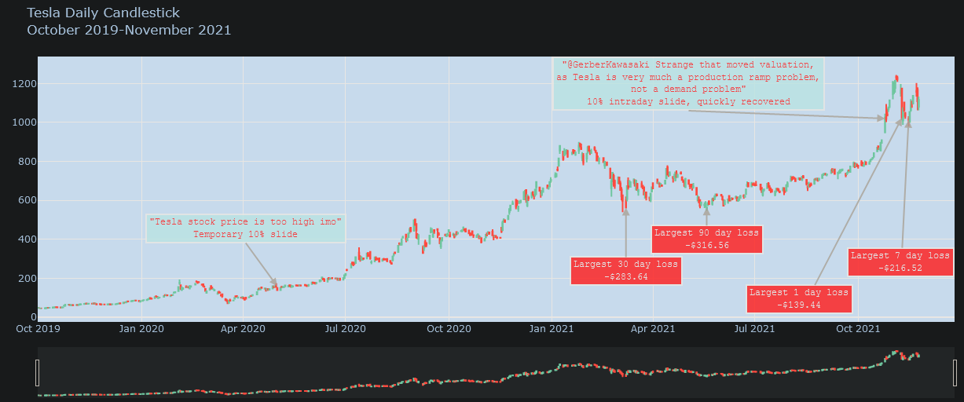
Tesla daily chart with highlight tweets and differences

