Slide 1


Slide 2

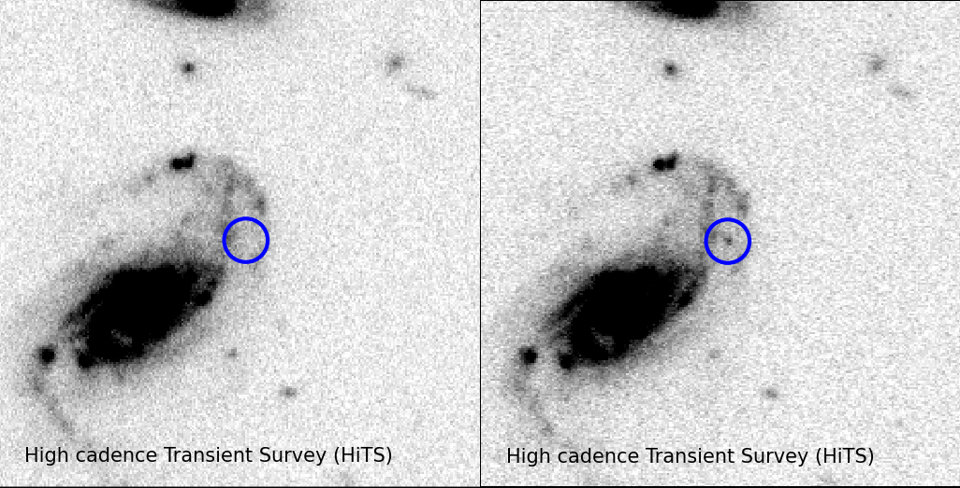
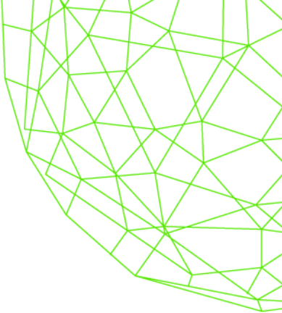




HITS: The High cadence Transient Survey
F. Förster, J.C. Maureira, J. San Martín, M. Hamuy, P. Estévez, R.C. Smith, K. Vivas, P. Huijse, G. Cabrera, S. Flores, J. Littín, J. Anderson, F. Bufano, Ll. Galbany, Th. de Jaeger, S. González-Gaitán, G. Pignata, J. Martínez, G. Medina, R. Muñoz, E. Vera, C. Pérez

Slide 3
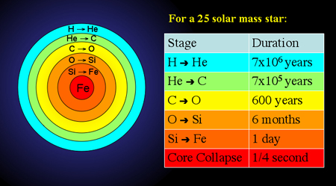
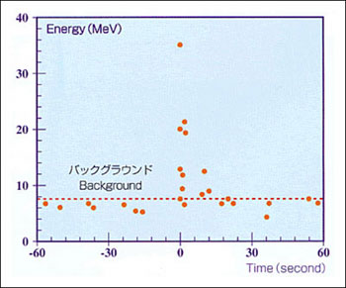
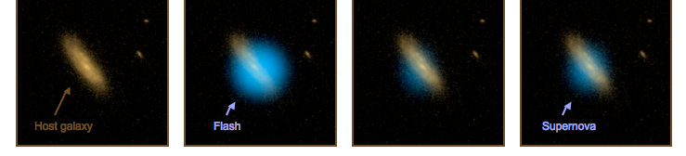
Life and death of a massive star
Formation of a neutron star and shock formation (~sec)
Shock acceleration down density slope and emergence (~hrs)
Star disruption and free expansion (~day)
Fast expanding (~0.1 c), glowing ejecta (~weeks, months)
Remnant diffusion into the interstellar medium (kyr)
Supernova shock breakout
Main supernova light curve

Slide 4
Shock breakout
Τ
Stellar surface
τ_{shock}
v_{shock}
τ
τ~1

Slide 5
Shock breakout
Τ
Stellar surface
τ_{shock}
v_{shock}
τ_{shock}
τ
τ~1

Slide 6
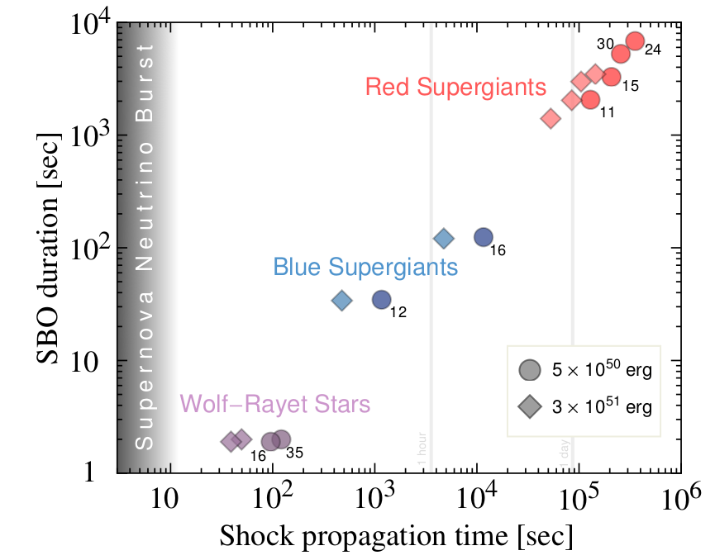
Supernova shock breakout (SBO) timescales
500-1000 R_{sun}
25-50 R_{sun}
5-10 R_{sun}
Kistler, Haxton & Yüksel 2014

Slide 7
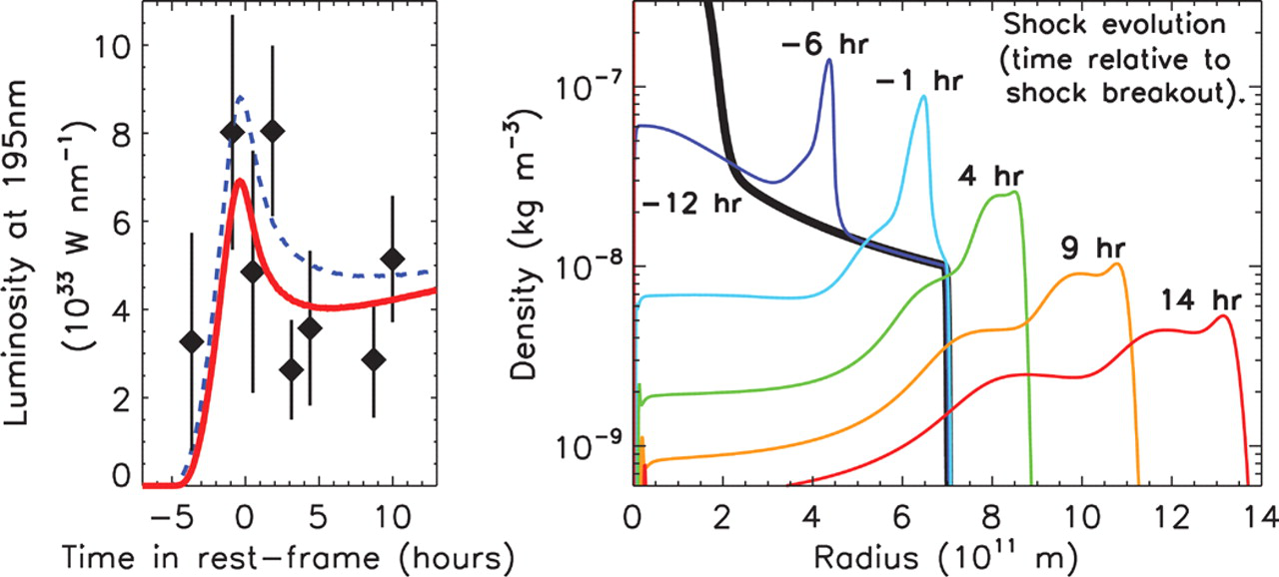
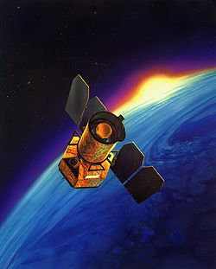
Red supergiant SBO
Schawinski et al. 2008 (Science)
High energy (10⁴⁸ erg) – Low temperature (~ 10 eV) burst → extended progenitor
Light curve and spectra consistent with SN IIP
Long duration (~ hr) consistent with red supergiant star

Slide 8
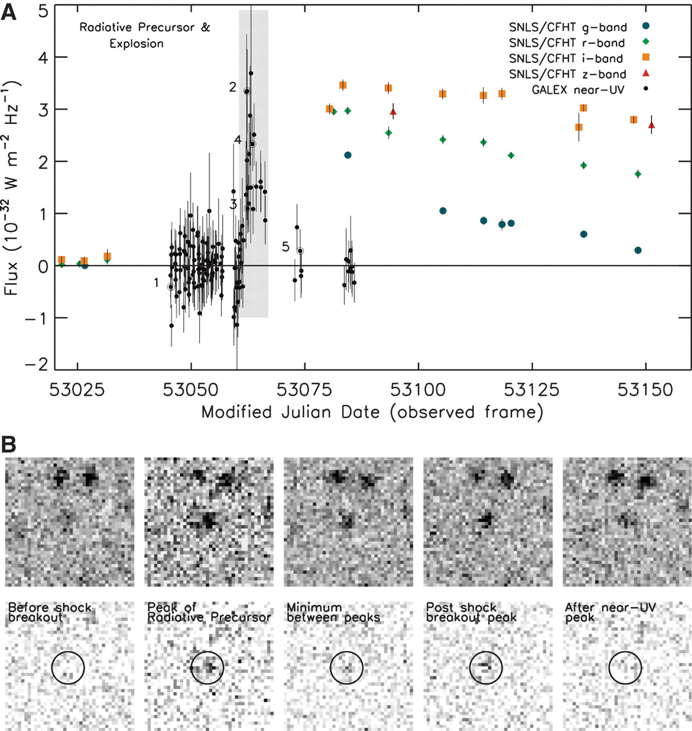
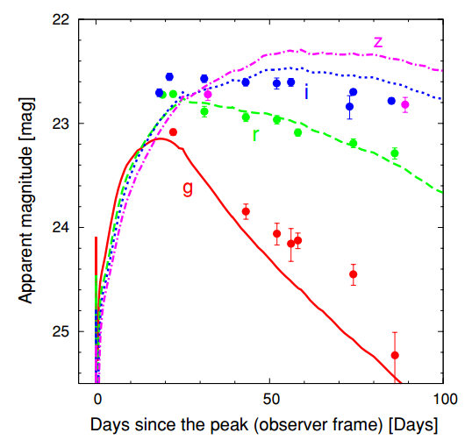
Red supergiant SBO
Schawinski et al. 2008, Science
Gezari et al. 2008, ApJ
Tominaga et al. 2009, ApJ
M_{ZAMS} = 20 M_{Sun}, M_{preSN} = 18.4 M_{Sun}, and R_{preSN} = 800 R_{Sun}, E = 1.2×10⁵¹ erg.

Slide 9
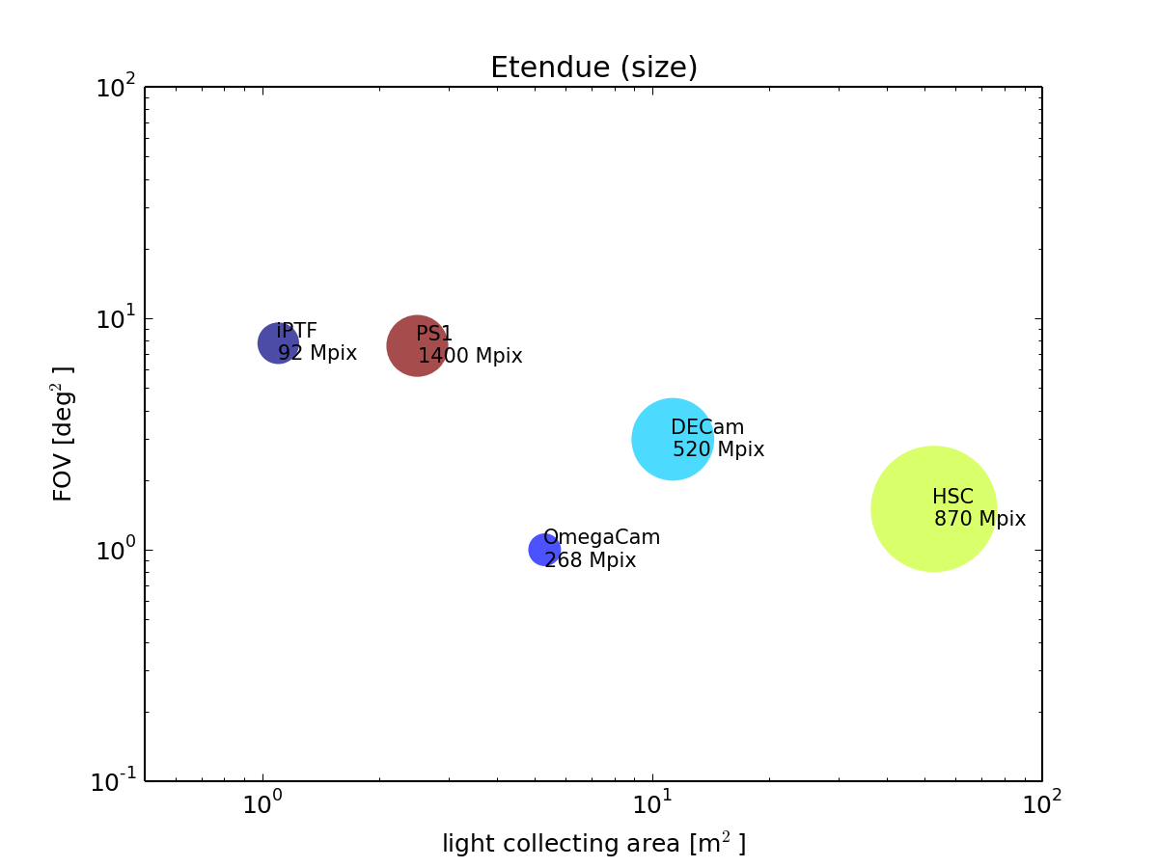
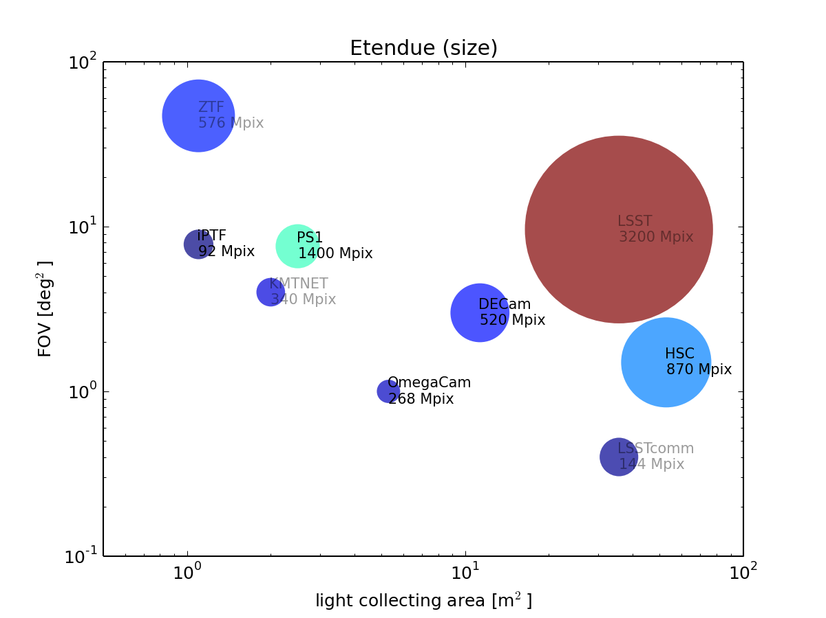
Etendue and number of pixels

Slide 10
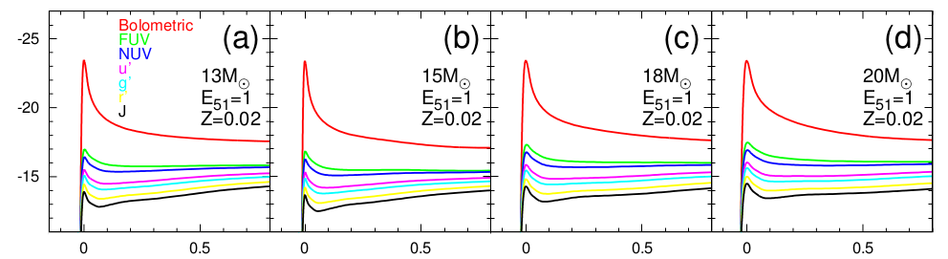
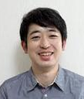
SBO multicolor light curves
Tominaga et al. 2011, ApJ

Slide 11
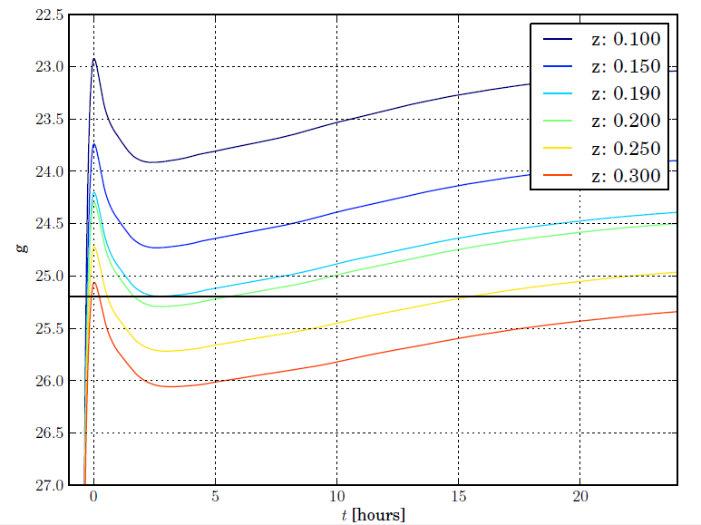
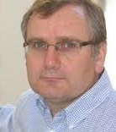
Supernova shock breakouts with DECam
M = 13 M_{Sun}, M_{preSN} = 12.7 M_{Sun}, R_{preSN} = 564 R_{Sun}
N. Tominaga
M. Hamuy

Slide 12
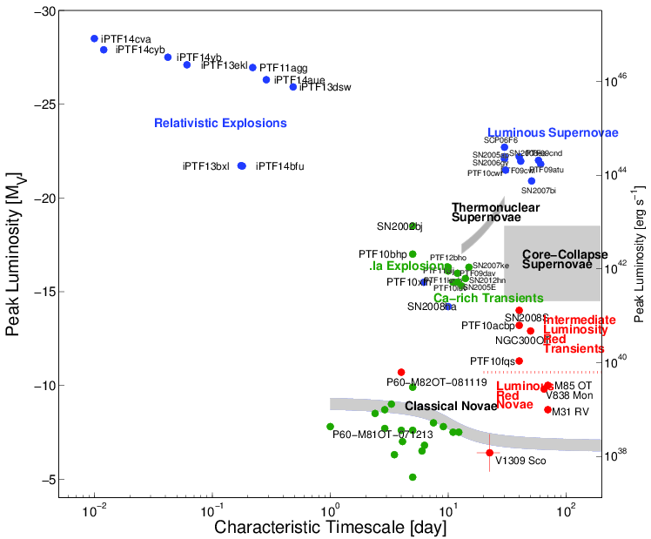
Optical transient sky
HITS
(@ z < ~0.2)
Red supergiant
supernova shock
breakouts?
Credit: Mansi Kasliwal

Slide 13
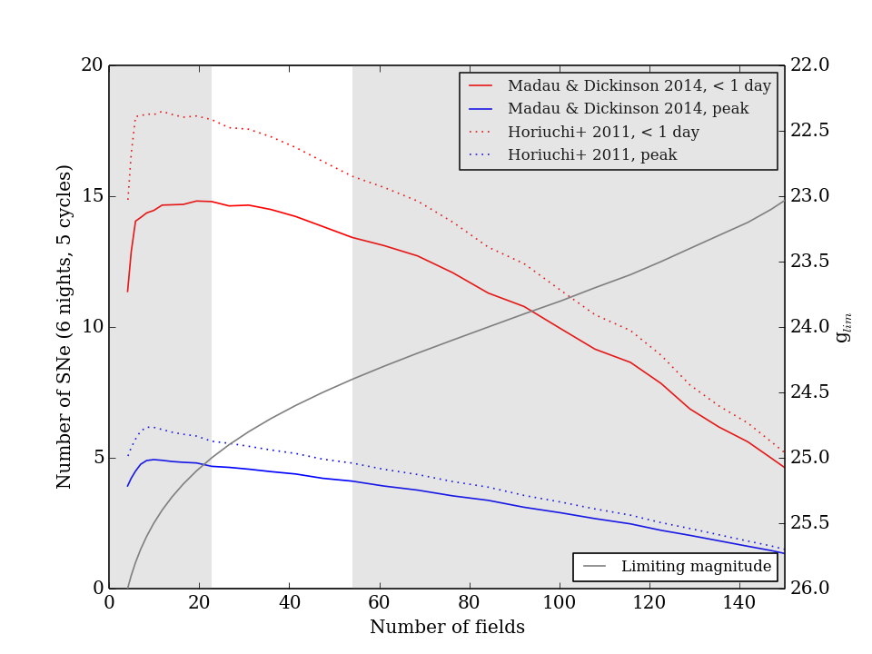
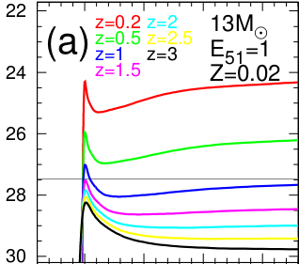
Expected number of young supernovae (SNR ~ 8)
0 0.5 1 t [days]
Tominaga et al. 2011
Using ETC v5!
More difficult to follow up
Faster file transfer/pipeline required
larger overhead fraction

Slide 14
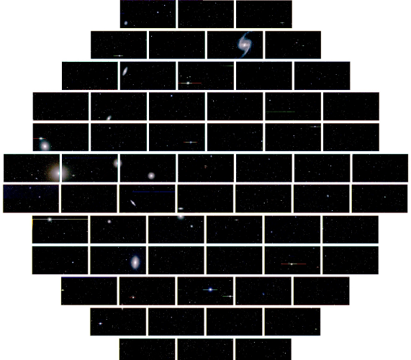
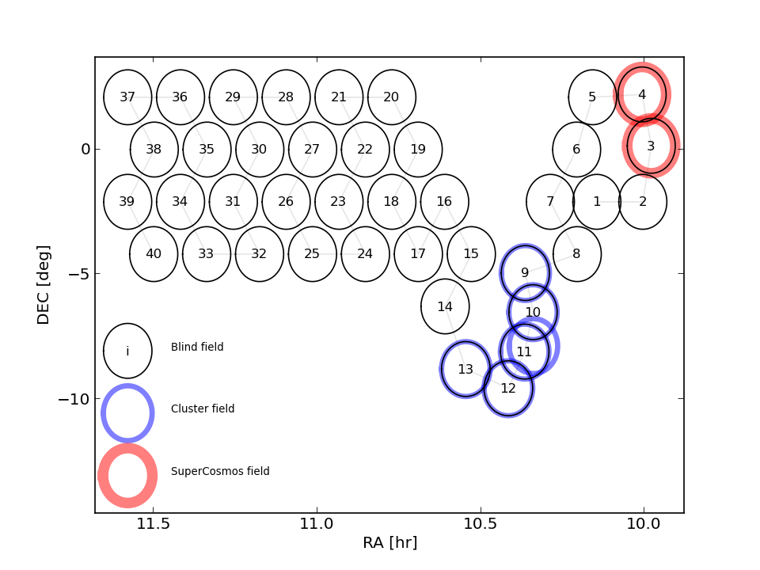
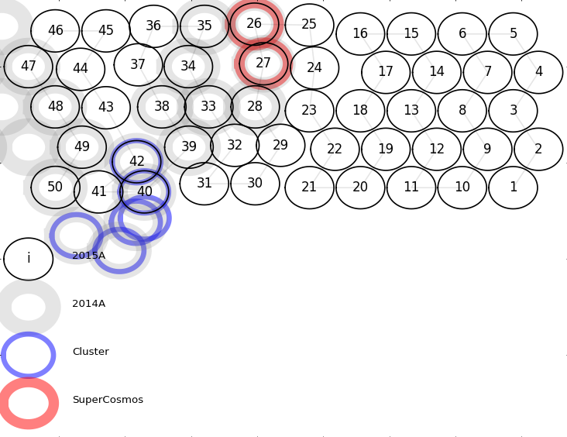
HITS challenges (2014A/2015A)
2014A
120 sq.deg.
2 hours cadence
160 s exp. time
2015A
150 sq.deg.
1.6 hr cadence
87 s exp. time
Observe 40/50 DECam fields every 2/1.6 hr for 5/6 consecutive nights (Done)
CTIO → La Serena → CMM file transfer faster than one exposure time (Done)
Run preprocessing pipeline in 60 CCDs in less than one exposure time (Done)
Run image subtraction pipeline in 60 CCDs in less than one exposure time (Done)
Filter false positives keeping efficiency high in real-time (Done)
Trigger follow up observations in real time (1 day/3.2 hr reaction possible)

Slide 15
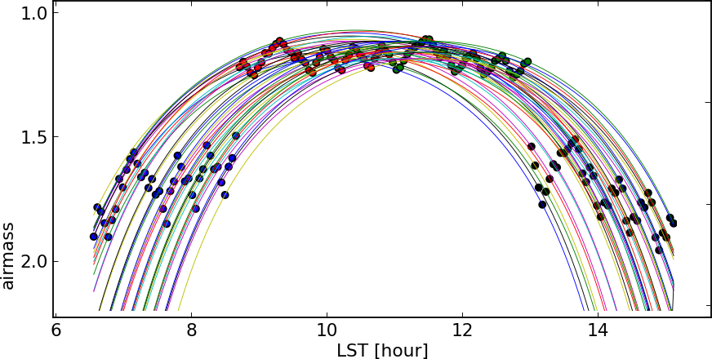
Observing strategy
RA chosen to guarantee full night visibility
DEC chosen to minimize combined atmospheric + galactic extinction
2 x 40 x 5 = 400 triplets with a cadence of 2 hours
3 x 50 x 6(4) = 900(600) triplets with a cadence of 1.6 hours

Slide 16
Pipeline flow outline
Slew
30 sec
Exposure
86 sec
Readout
17 sec
CTIO-La Serena
transfer
~120 sec
La Serena-Santiago
Transfer
~10 sec
DECam
Comm Pipeline
~80 sec
CRBlaster
~20 sec
Image diff
Pipeline
(own code)
~60 sec
Visual inspection
< 116 sec
~5-6 min lag
50 fields x 5 epochs = 250 times per night
6 + 3 x 0.5 nights

Slide 17
Pipeline flow outline
DECam
observations
~130 sec
Raw
Data
~80 sec
Reduced
data
~5 sec
Data &
Catalogue
Data &
Astrometry
~10 sec
Projected
data
~30 sec
Matched
data
~7 sec
Difference/
Optimal
photometry
Transient
candidates
~10 sec
Selected
candidates
minutes
Transient &
Light curve
Follow up

Slide 18
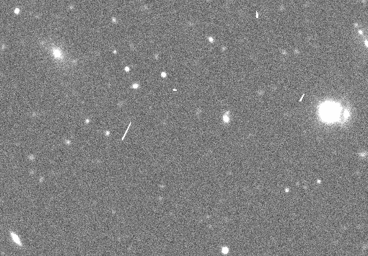
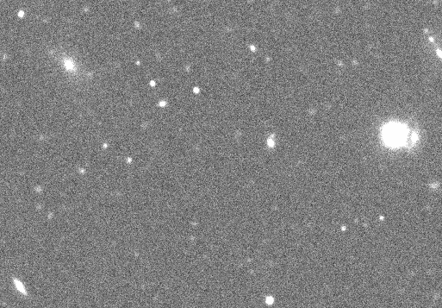
Preprocessing
Bias correction + flat fielding + bad pixel mask using own code (2014) and DECam community pipeline (2015)
Cosmic ray removal using CRBLASTER (Mighell 2010), based on the Laplacian cosmic ray identification routine LA-cosmic (van Dokkum 2001)
After CRBLASTER
(cosmic rays replaced via interpolation)
Before CRBLASTER
CRBLASTER uses OpenMP and runs in ~20 sec with 4 cores per image.

Slide 19
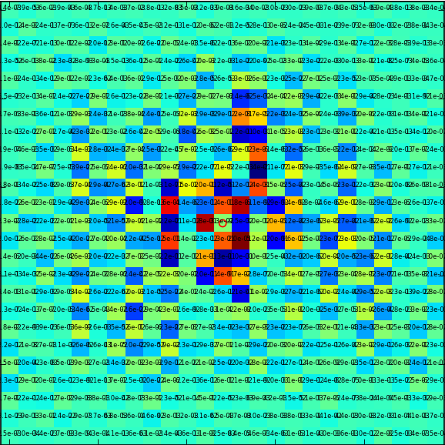
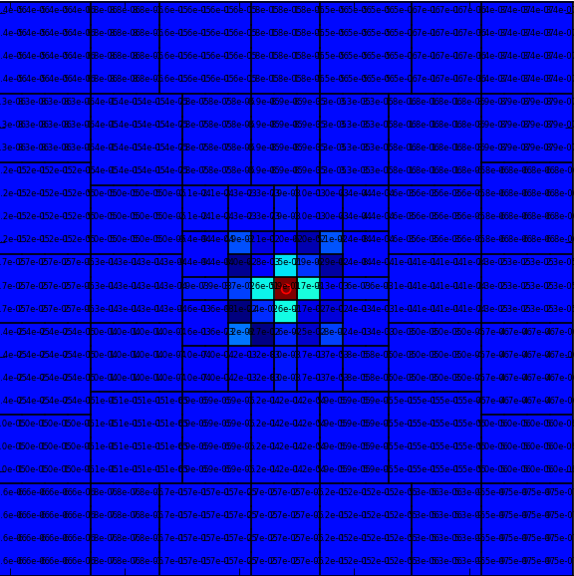
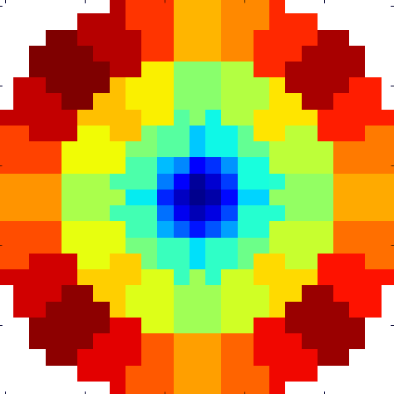
PSF matching: convolution kernel
Fixed size kernel pixels: over-fitting produces oscillations between pixels
Variable size kernel pixels: no oscillations → fewer artifacts
Final kernel model
25 x 25 pixels,
81 free parameters (regulatization), circular shape
(Fortran 95 + OpenMP + F2PY)

Slide 20
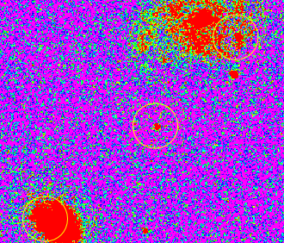
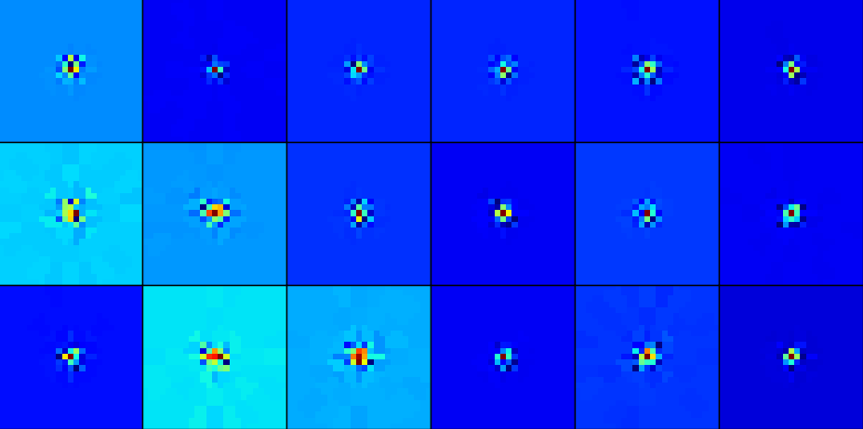
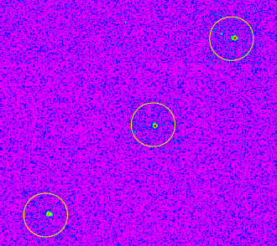
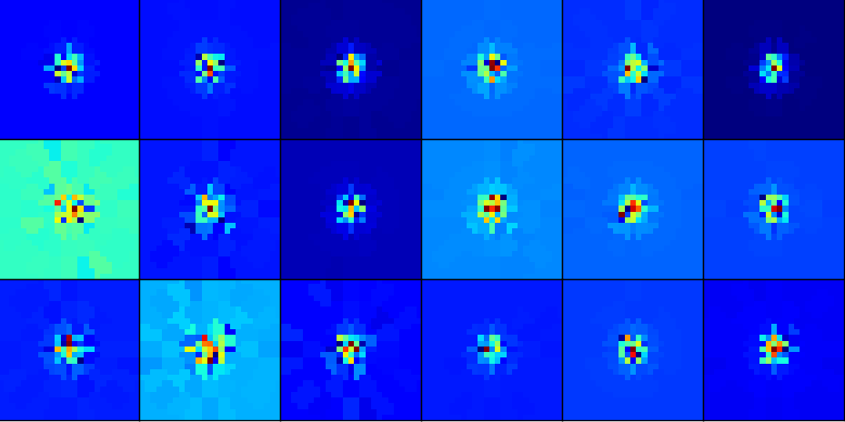
PSF matching: convolution kernel
FWHM ~ FWHM_{ref}
FWHM ~ 2 x FWHM_{ref}

Slide 21
Optimal photometry
We perform optimal photometry (Naylor 1998) centered in every pixel of the difference images (Fortran 95 + OpenMP + F2PY)
Pixel counts
Sky counts at
given pixel
Flux
Empirical PSF
at given pixel
Variance at
given pixel
Flux variance

Slide 22
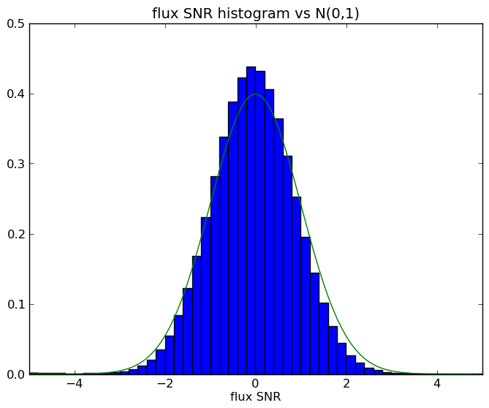
Optimal photometry SNR distribution
Optimal photometry signal to noise ratio histogram consistent with modeled errors

Slide 23
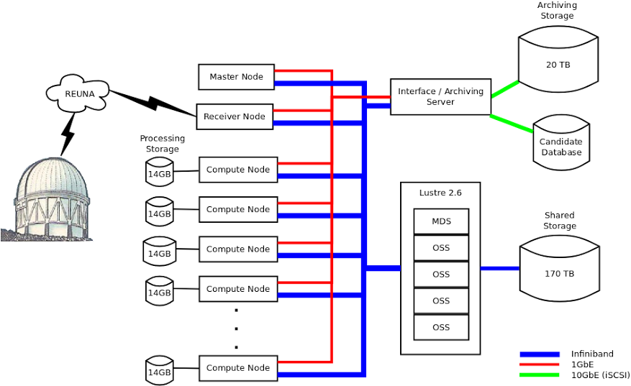

High performance computing - storage
~300 cores, astro toolchain
Most important bottle necks:
2014: slow to fast storage file transfer
2015: CTIO → La Serena transfer
J.C. Maureira

Slide 24
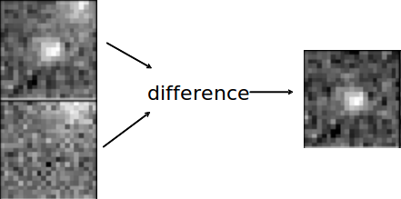
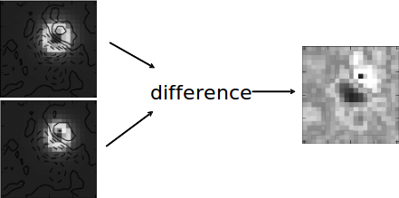
Machine learning

Slide 25
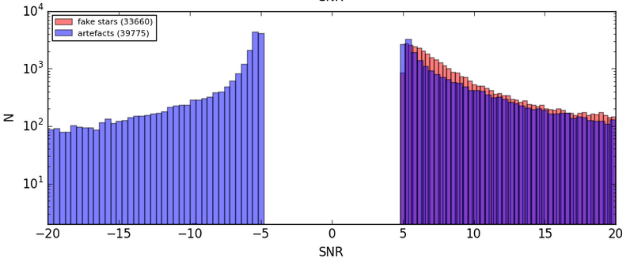
Training sample
We insert observed stars into predefined positions, scaled down to force a given SNR distribution resembling the artefact SNR distribution.

Slide 26
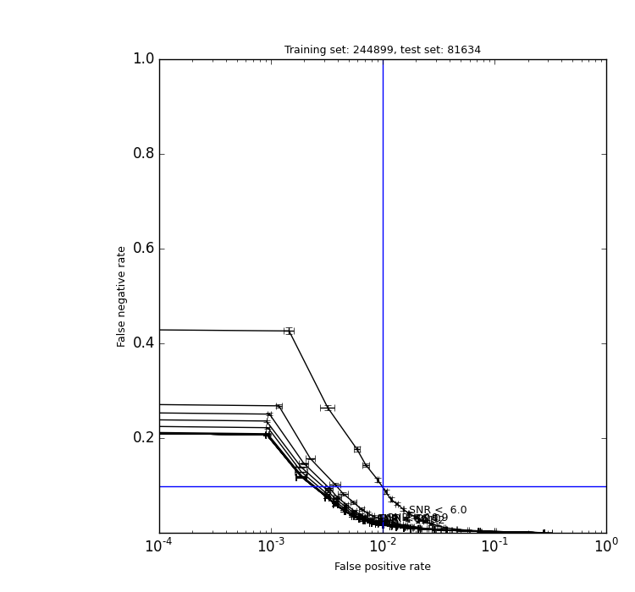
Random forest efficiency and purity
ROC curves depend strongly on the test (and training) candidate SNR distribution!
SNR < 6
False positive rate
False negative rate
SNR < 10
SNR < inf
False positive rate

Slide 27
Candidate selection
1. SNR of integrated flux difference > 5
+ not too close to flagged pixels
+ difference between pre and post CRBlaster in reference smaller than a threshold
+ candidate density around the candidate smaller than a threshold
2. Classified as real based on selected features with probability > 0.5
+ repeated at least once in the same location
+ positive difference with respect to the reference.

Slide 28
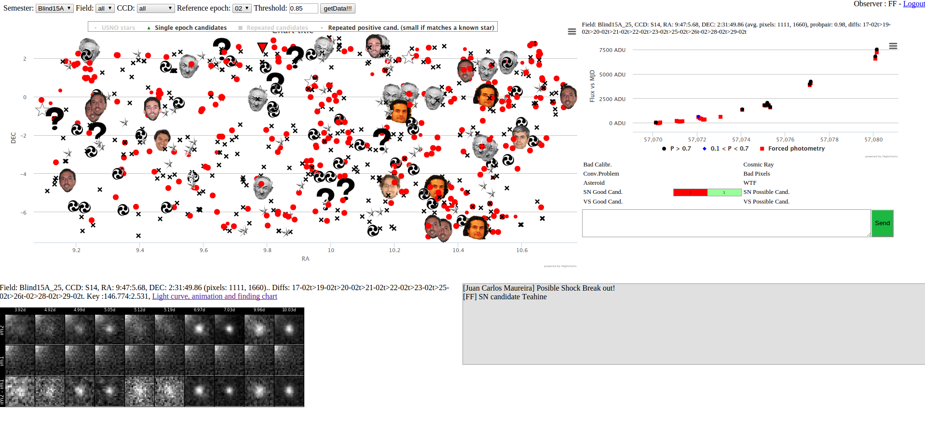
Interactive web: how to visualize 1 Tpix

Slide 29
RESULTS

Slide 30
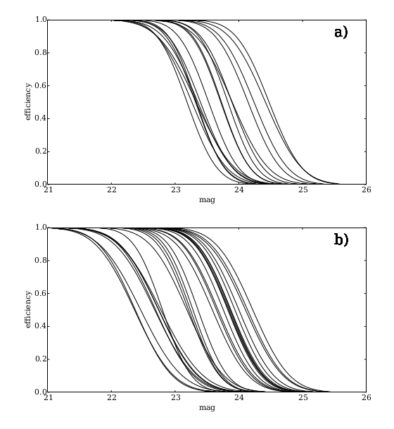
Survey depth
160 sec, g
87 sec, g

Slide 31
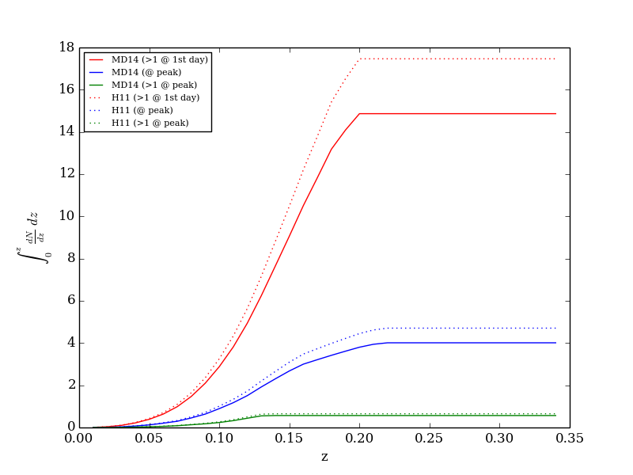
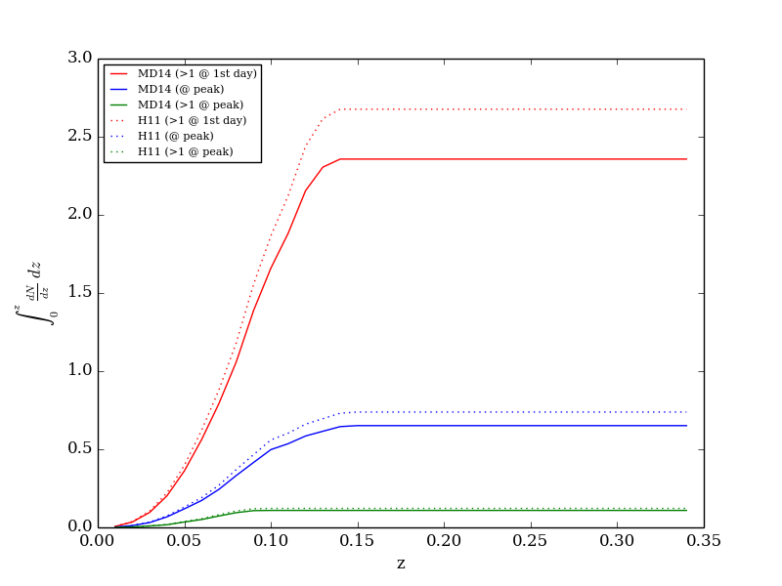
Simulated number of events in expected vs actual obs.
2+ detections within first day after SBO
N
N
One detection during the initial peak (SBO)
2+ detections during the initial peak (SBO)
Simulated using ETC v5, SNR=8
Simulated using actual limiting magnitude

Slide 32
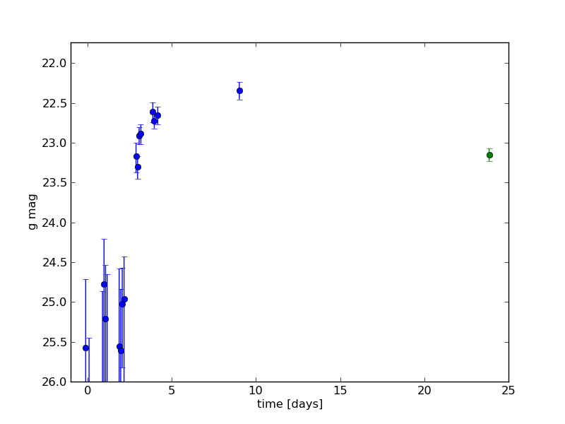
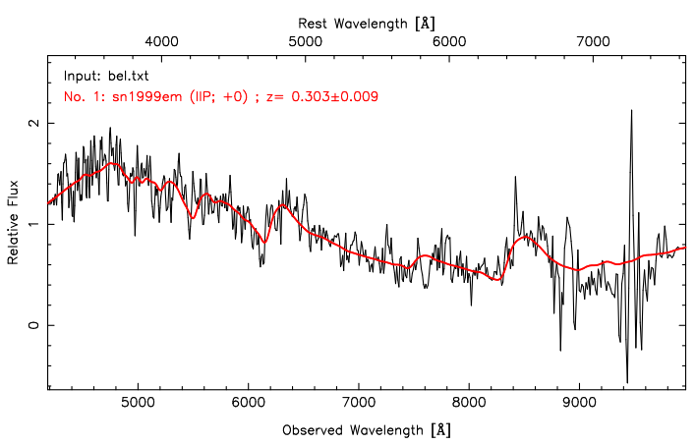
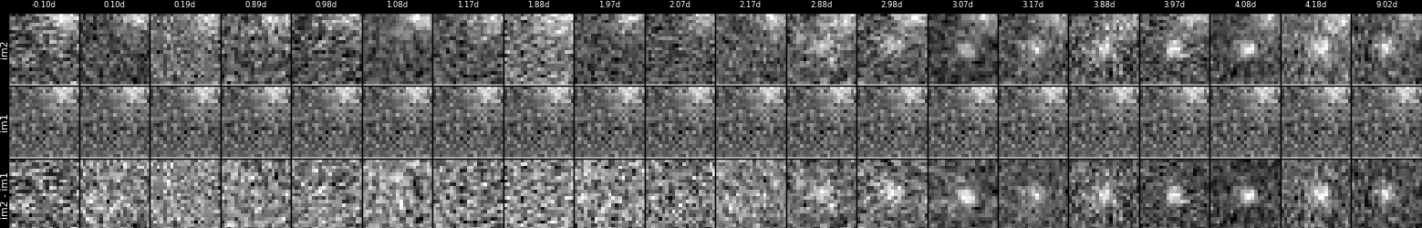
Very fast rise in SNe IIP, no SBO observed
VLT
DECam
SOAR
Cannot reconcile high luminosity + fast evolution + low expansion velocities (CSM interaction?)

Slide 33
Light curve modelling
Takashi Moriya

Slide 34
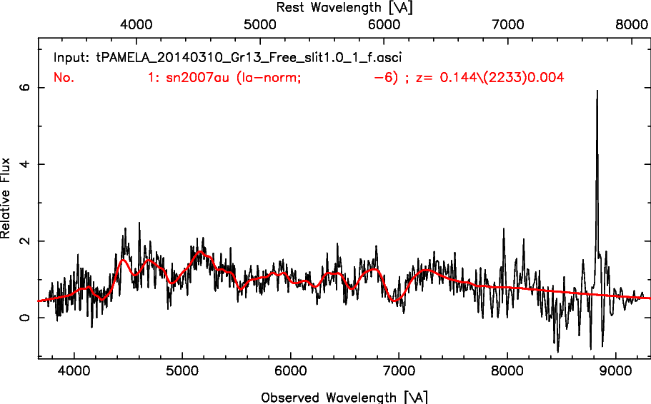
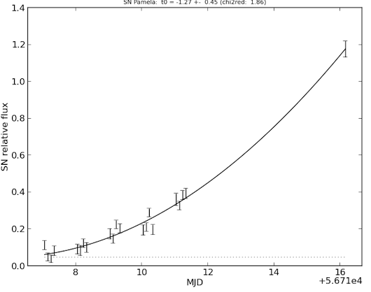
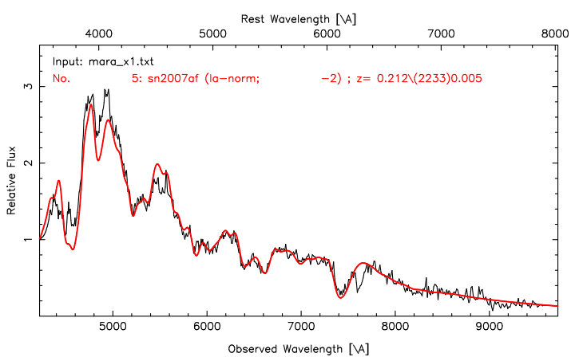
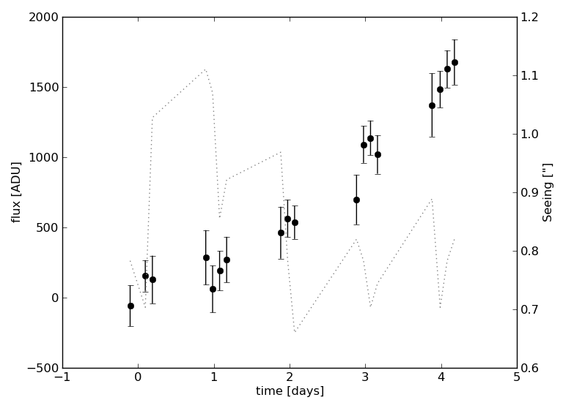
~t² rise in SNe Ia, no obvious interaction (?)
NTT
VLT
K. Vivas

Slide 35
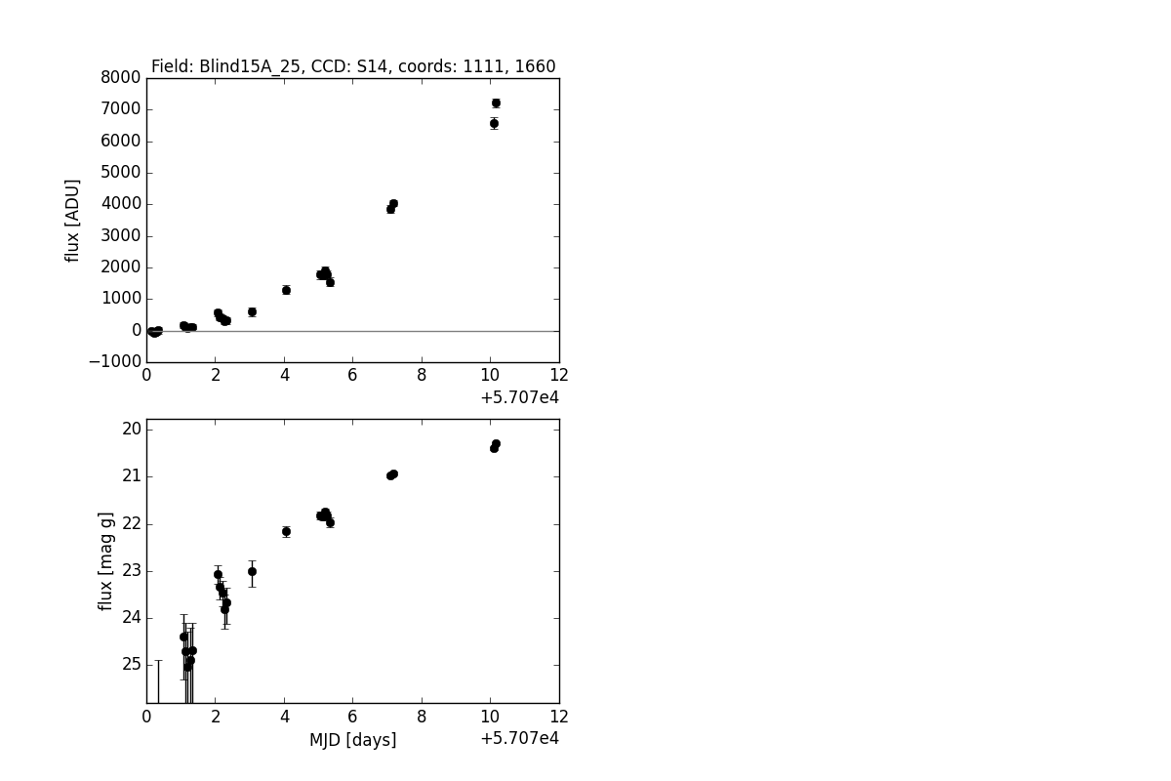



PRELIMINARY
?
ATELs 7099, 7108, 7115, 7122, 7131, 7146, 7148, 7149

Slide 36




SNHiTS15B: fast transient (2 day rise + 8 day decline)
Drout+14 (4-7% of the CC rate)

Slide 37





~10² SNe, ~10³ asteroids, ~10² of RR Lyrae, ? eclipsing stars
ATELs 5949, 5956

Slide 38




Collaboration with Kepler Extragalactic Survey
Olling et al.

Slide 39

Sample of very early IIP light curves

Slide 40
Summary
First real time DECam data reduction achieved (~0.4 Tpix processed in real-time in 2014, ~1 Tpix processed in 2015, ~5 TB raw data, ~40 TB processed data!).
Rapid reaction after explosion possible (<1 day in 2014, <3.2 hours in 2015)
32 young SN candidates discovered in 2014A, 90 young SN candidates in 2015A (with spectra: 7 Ia + 3 II). Candidates made public the same night of discovery.
SBO detection in the optical difficult with observed DECam limiting magnitudes.
New sample of very young SNe (< 1 day) shows very fast early evolution of core collapse SNe in the optical (consistent with Olling et al.)
Other science: >10² new distant RR Lyrae stars, >10³ new asteroids, dozens of unknown objects (flares? Other?). Public catalogue of light curves under construction (PhD student J. Martínez).
Interdisciplinary collaboration crucial for Big Data astronomy (LSST)

Slide 41
Thanks!
This project used data obtained with the Dark Energy Camera (DECam), which was constructed by the Dark Energy Survey (DES) collaborating institutions - See more at: http://www.ctio.noao.edu/noao/content/Acknowledgment-DECam#sthash.Z7MCPHs3.dpuf

Slide 42
Comparison of LSST and HiTS pipelines (preliminary)

Slide 43

Diff [ADU] Diff [ADU]

Slide 44

Diff [ADU] Diff [ADU]

Slide 45

Diff [ADU] Diff [ADU]

Slide 46


Slide 47


Slide 48


Slide 49

Previous results assume no covariance, which underestimates our integrated flux errors

Slide 50

With local variance approximation, integrated flux errors look OK

Slide 51

But we overestimate difference errors...

Slide 52


Slide 53


