Slide 1
AI IN PRACTICE · DAY 1
✕
Magic
It is not magic.
Where AI comes from and how it thinks
✕
A brain
It is not a brain.
Prediction
very good guesses from data
Today: where AI comes from, how it
works, and why it only seems intelligent.
Notes:
• Welcome everyone. Six days, all hands-on: every session ends with something you made.
• Before we start: quick positioning quiz (Wooclap or Google Forms, 5 min). We repeat it on Day 6 to measure progress.
• Click by click: AI is not magic, not a brain. It is prediction. That one idea runs through the whole day.
Click 1: It is not magic.
Click 2: It is not a brain.
Click 3: Prediction
Click 4: Today: where AI comes from, how it works, and why it only seems intelligent.

Slide 2
Today's journey
01
Who we are me, you, and what AI leaders say
02
AI is already in your life and a short history
03
What AI is how people use it
04
How machines learn classification, regression, vision
05
Tokens and prediction why it is not intelligence
06
First steps in prompting good prompts and the chat tools
Notes:
• The plan for today, in six parts. Morning: parts 1 to 3. Afternoon: parts 4 to 6.
• Each part has a short exercise. Breaks around 10:30 and 15:00.
Click 1: Who we are — me, you, and what AI leaders say
Click 2: AI is already in your life — and a short history
Click 3: What AI is — how people use it
Click 4: How machines learn — classification, regression, vision
Click 5: Tokens and prediction — why it is not intelligence
Click 6: First steps in prompting — good prompts and the chat tools

Slide 3
Who I am and what I do
Fadi Fouladgar
AI integration and growth trainer
I train students, job seekers and entrepreneurs to use AI for real results.
Growth marketing and digital transformation consultant.
I teach in English, French and Arabic.
25+
years in marketing, sales and training
15+
countries: Europe, Middle East, Asia, USA
1,000+
professionals trained
50+
people in the teams I have led
DIPLOMAS
Bachelor, Digital Marketing · Oreegami Academy with Google France (2023)
Business Computing · C&E American University Institute (1995)
Notes:
• Click 1, the ID card: today I train people to use AI: Simplon, Rocket School, France Travail, and here at Université Côte d'Azur.
• My background is marketing: Marketing Director at Total Media Cast (media group, MENA and Europe), 14 years Marketing Manager at Dar El Marefah (publishing, 14 countries), and before that Hospitality Marketing Concepts in California (luxury hotels, Le Méridien).
• Tiles: 25+ years, 15+ countries, more than 1,000 people trained, teams of up to 52 people.
• Why it matters for you: I use AI every day for real work, not in theory. Everything I show you, I use.
• Keep it to 2 minutes. Then move to them: this course is about you.
Click 1: Fadi Fouladgar
Click 2: 25+ years in marketing, sales and training
Click 3: 15+ countries: Europe, Middle East, Asia, USA
Click 4: 1,000+ professionals trained
Click 5: 50+ people in the teams I have led
Click 6: Diplomas

Slide 4









Who I have worked with
France Travail
Rocket School
Choueiri Group
TRAINING · MEDIA · HOSPITALITY · PUBLISHING
Notes:
• Row 1, training: Simplon, Université Côte d'Azur, France Travail, Rocket School. AI workshops for students, job seekers and entrepreneurs.
• Row 2, media (Total Media Cast): Google, Ipsos and DMS Choueiri Group were key accounts; France 24, Fox News, Al Jazeera and Al Arabiya were partnerships.
• Row 3: Le Méridien, where I set up marketing departments with Hospitality Marketing Concepts.
• Say exactly what each relationship was: client, partner or employer. Students respect precision.
Click 1: Simplon, Université Côte d'Azur, France Travail, Rocket School
Click 2: Google, Ipsos, France 24, Al Jazeera
Click 3: Al Arabiya, Fox News, Le Méridien, Choueiri Group
Click 4: Training · media · hospitality · publishing

Slide 5
Now, present yourself
01
Your name
02
Your major what you study
03
The job you are aiming for
04
Your goal in this course
05
What you expect from it
06
AI tools you have tried and how often you use them
07
What you want to learn about AI
Notes:
• One minute each, maximum. Go around the room; I take notes.
• Listen for: their majors and target jobs (use them as examples all week), their level with AI, and their fears.
• Write the tools they name on the board. Come back to it on Day 6: who tried something new?
• If the group is big: pairs present each other in 30 seconds.
Click 1: Your name
Click 2: Your major — what you study
Click 3: The job you are aiming for
Click 4: Your goal in this course
Click 5: What you expect from it
Click 6: AI tools you have tried — and how often you use them
Click 7: What you want to learn about AI

Slide 6




What AI leaders say
+
+
!
“AI is one of the most important things humanity is working on. It is more profound than… electricity or fire.”
“10 times bigger than the Industrial Revolution, and maybe 10 times faster.”
“You're not going to lose your job to an AI, but you're going to lose your job to someone who uses AI.”
Sundar Pichai
CEO, Google · 2018
Demis Hassabis
CEO, Google DeepMind · 2025
Jensen Huang
CEO, Nvidia · 2025
!
!
?
AI could wipe out half of all entry-level white-collar jobs within five years.
“If this technology goes wrong, it can go quite wrong.”
“The whole AGI rhetoric is about creating God. I don't believe in God.”
Dario Amodei
CEO, Anthropic · 2025 (Axios)
Sam Altman
CEO, OpenAI · US Senate, 2023
Arthur Mensch
CEO, Mistral AI · 2024
Notes:
• Read each quote aloud as it lands. Green + = enthusiast, red ! = warning, ? = sceptic.
• Pichai (Recode/MSNBC town hall, 2018). Hassabis (The Guardian, Aug 2025). Huang (Milken conference, May 2025).
• Amodei is a paraphrase, not a word-for-word quote: in Axios (May 2025) he warned half of entry-level white-collar jobs could go within 1–5 years, unemployment 10–20%. It is one CEO's forecast, not a fact.
• Altman said it at the US Senate hearing, 16 May 2023, asking for regulation.
• Mensch (New York Times, April 2024): the French voice. He thinks AGI talk is almost religious.
• Point to make: the people who build AI disagree with each other. Also: Geoffrey Hinton (Nobel 2024) gives 10–20% odds of AI causing extinction within 30 years; Yann LeCun (Meta) says a house cat has more common sense than any LLM.
Click 1: Sundar Pichai: “AI is one of the most important things humanity is working on. It is more profound than… electricity or fire.”
Click 2: Demis Hassabis: “10 times bigger than the Industrial Revolution, and maybe 10 times faster.”
Click 3: Jensen Huang: “You're not going to lose your job to an AI, but you're going to lose your job to someone who uses AI.”
Click 4: Dario Amodei: AI could wipe out half of all entry-level white-collar jobs within five years.
Click 5: Sam Altman: “If this technology goes wrong, it can go quite wrong.”
Click 6: Arthur Mensch: “The whole AGI rhetoric is about creating God. I don't believe in God.”

Slide 7
Your turn: hopes and fears
QUESTION 1
Hopes
what excites you about AI?
QUESTION 2
Fears
jobs, cheating, privacy…?
QUESTION 3
Your vote
which quote do you agree with?
NO WRONG ANSWERS
Notes:
• Quick round: 1 hope and 1 fear each, on sticky notes or in Wooclap (word cloud works well).
• Group the fears on the board: jobs, cheating at school, fake news, privacy, losing skills. Keep the board: we answer these fears during the week.
• Vote by show of hands on the quotes: enthusiast, warning or sceptic.
• Don't argue with fears. Acknowledge them; the course gives them tools, and tools reduce fear.
Click 1: Hopes what excites you about AI?
Click 2: Fears jobs, cheating, privacy…?
Click 3: Your vote which quote do you agree with?
Click 4: No wrong answers

Slide 8
AI in one sentence
Nobody writes the rules:
it finds them in the data.
THE SIMPLEST VERSION
It learns, then guesses.
It learns patterns from examples, then predicts.
Notes:
• Left: the short version to remember. AI learns from examples, then makes guesses.
• Line: classic software follows rules a person wrote. AI finds its own rules in the data.
• Right: predict what? The next word (ChatGPT), the right label (spam or not), the best move (chess), the price (house).
• Everything today comes back to this sentence.
Click 1: It learns, then guesses.
Click 2: Nobody writes the rules: it finds them in the data.
Click 3: It learns patterns from examples, then predicts.

Slide 9
Is that really intelligence?
YOUR OPINION
Smart, or just very good at guessing?
Notes:
• Ask them to vote: smart, or very good at guessing? Then let 2–3 people defend their answer.
• Don't give the answer yet. We come back to it in Part 5, after tokens: "It only predicts the next word."
Click 1: really
Click 2: Your opinion
Click 3: Smart, or just very good at guessing?

Slide 10
You have already used AI today.
BEFORE 10 A.M.
How many times did AI touch your morning?
Notes:
• Let them guess a number. Most say 0 or 1. The real answer is usually 10 or more.
• Hint: your alarm, your phone unlock, your music, your feed, your route to campus.
Click 1: already
Click 2: Before 10 a.m.
Click 3: How many times did AI touch your morning?

Slide 11
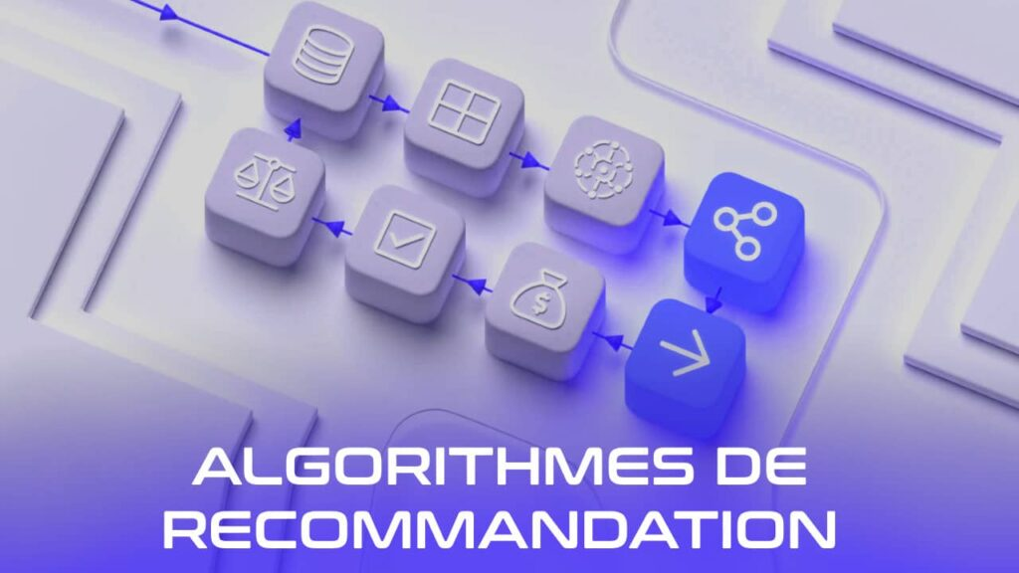

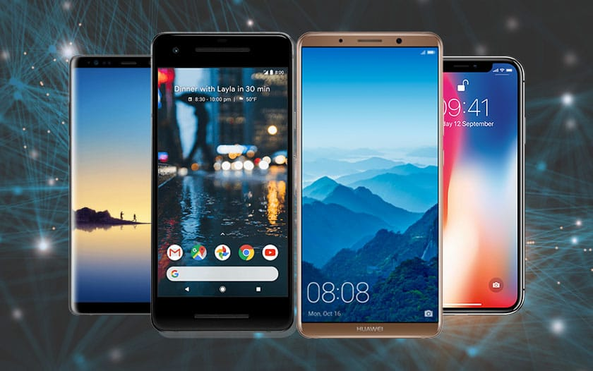
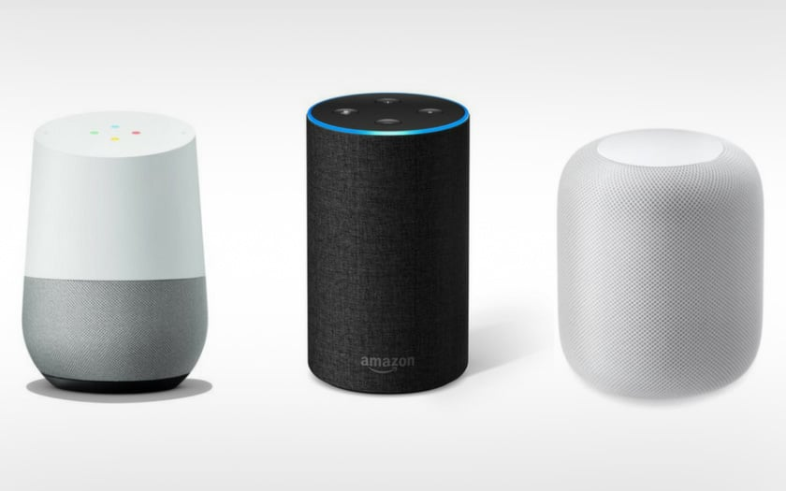
AI is already everywhere
Recommendations
Netflix, YouTube, Spotify
Driving help
GPS, lane assist
Your phone
face unlock, photos, keyboard
Voice assistants
Siri, Alexa, Google
NONE OF THESE IS CHATGPT
Notes:
• Recommendations: they learn what you watch and suggest more. Driving: GPS predicts traffic. Phone: face unlock, photo sorting, the keyboard guessing your next word. Voice: turning speech into text.
• Footer: AI existed long before ChatGPT. It was just invisible.
Click 1: Recommendations Netflix, YouTube, Spotify
Click 2: Driving help GPS, lane assist
Click 3: Your phone face unlock, photos, keyboard
Click 4: Voice assistants Siri, Alexa, Google
Click 5: None of these is ChatGPT

Slide 12
Exercise: the AI hunt
01
List every AI you used before 10 a.m.
apps, devices, services
02
Compare in pairs
who found more?
03
Share the most surprising one
Notes:
• 10 minutes. Phones allowed: check the apps you opened this morning.
• Surprising answers to look for: bank fraud checks, spam filter, photo enhancement, Uber prices, Instagram filters.
Click 1: List every AI you used before 10 a.m. — apps, devices, services
Click 2: Compare in pairs — who found more?
Click 3: Share the most surprising one

Slide 13
PART 1
A short history
Notes:
• 75 years in 3 minutes. The goal: AI did not appear in 2022.
Click 1: A short history

Slide 14
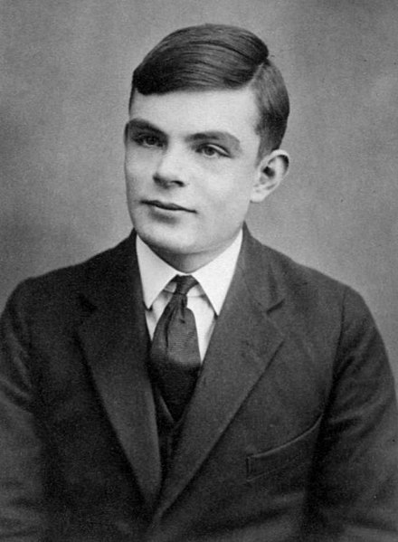

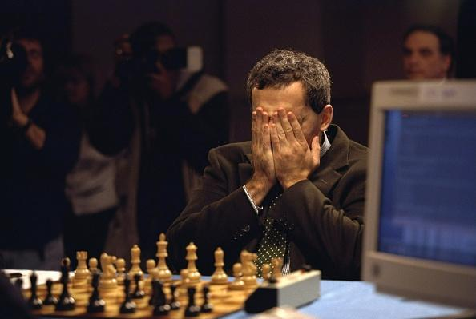
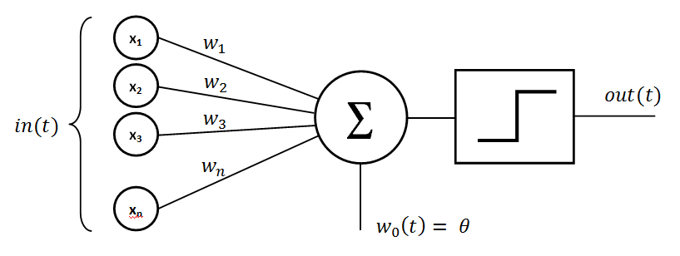
From an idea to a field
1950
Alan Turing
"Can machines think?"
1958
The perceptron
a first artificial neuron
1970s–80s
AI winters
big promises, weak computers
1997
Deep Blue
beats Kasparov at chess
Notes:
• 1950, Turing asks "Can machines think?" and proposes a test: can a machine pass for a human in a conversation?
• 1956: the Dartmouth workshop gives the field its name, "artificial intelligence".
• 1958, the perceptron: the first machine that learns, one artificial neuron (we see it in Part 2).
• AI winters: researchers promised human-level AI in 20 years. Computers were far too slow and data too scarce, so results disappointed and the funding was cut. Twice: in the 1970s and late 1980s. "Winter" = no money, no interest.
• 1997: IBM's Deep Blue beats world chess champion Garry Kasparov. But by brute force, calculating millions of moves, not by learning.
Click 1: 1950 Alan Turing "Can machines think?"
Click 2: 1958 The perceptron a first artificial neuron
Click 3: 1970s–80s AI winters big promises, weak computers
Click 4: 1997 Deep Blue beats Kasparov at chess

Slide 15
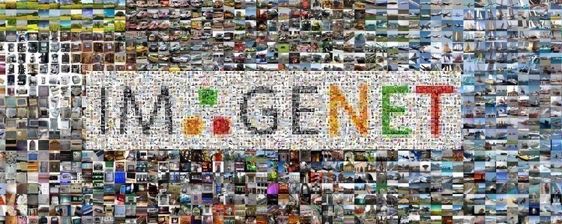
From learning to talking
2017
2024+
2012
Deep learning
wins at recognising images
Transformers
AI reads whole sentences at once: the T in GPT
2022
ChatGPT
AI reaches everyone
Reasoning and agents
AI that checks and acts
Notes:
• 2012: a deep learning network wins the ImageNet image-recognition contest by a huge margin. Thanks to GPUs (graphics cards) and big data, the winters are over.
• 2017, Transformers: Google researchers publish "Attention Is All You Need". Before, AI read a sentence word by word and forgot the start. The transformer looks at all the words at once and works out which ones matter for each other ("attention"). GPT = Generative Pre-trained Transformer.
• 2022: ChatGPT reaches 100 million users in two months. AI becomes visible to everyone.
• 2024 and after: models that reason before answering, and agents that take actions (browse, book, write code).
• Also: 2016, AlphaGo beats Lee Sedol at Go.
Click 1: 2012 Deep learning wins at recognising images
Click 2: 2017 Transformers AI reads whole sentences at once: the T in GPT
Click 3: 2022 ChatGPT AI reaches everyone
Click 4: 2024+ Reasoning and agents AI that checks and acts

Slide 16
AI did not arrive in 2022.
It became visible.
Notes:
• The one sentence to remember from the history. 70 years of research; 2022 is when it got a chat window.
Click 1: AI did not arrive in 2022.
Click 2: It became visible.

Slide 17
PART 2
What AI is
and how we use it
Notes:
• Now: what is inside, and what people actually do with it.
Click 1: What AI is
Click 2: and how we use it

Slide 18
Technologies inside each other
Artificial intelligence
ARTIFICIAL INTELLIGENCE
A classic chatbot: rules written by people
Machine learning
MACHINE LEARNING
Netflix learns what you like
Deep learning
DEEP LEARNING
Recognising faces and objects in images
Generative AI
GENERATIVE AI
ChatGPT writes, Midjourney draws
Notes:
• Like Russian dolls: each circle sits inside the one before.
• AI: any machine that imitates a human decision, even with rules written by hand ("if the client types 1, show prices").
• Machine learning: no hand-written rules; it learns them from examples.
• Deep learning: machine learning with many layers of artificial neurons. Good with images, sound and text.
• Generative AI: deep learning that creates new content: text, images, music, video.
• Keep this slide in mind: the sorting exercise uses these four circles.
Click 1: Artificial intelligence: A classic chatbot: rules written by people
Click 2: Machine learning: Netflix learns what you like
Click 3: Deep learning: Recognising faces and objects in images
Click 4: Generative AI: ChatGPT writes, Midjourney draws

Slide 19
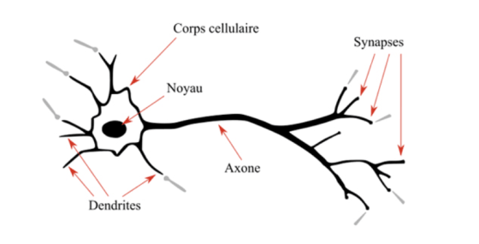
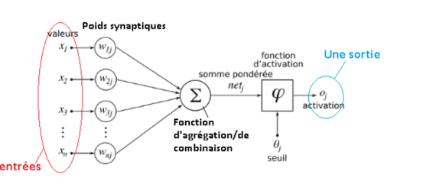
Inspired by the brain
BIOLOGICAL
A neuron
dendrites in, axon out, synapses connect
ARTIFICIAL
A perceptron
inputs × weights → sum → output
Notes:
• Click 1, the biological neuron: dendrites receive signals, the cell body adds them up, the axon sends a signal on. Synapses are the connections between neurons; they get stronger as we learn.
• Click 2, the artificial neuron: numbers come in (inputs), each is multiplied by a weight (how important it is), they are added up, and an activation function decides the output.
• Learning = adjusting the weights. Exactly like synapses getting stronger or weaker.
• Deep learning stacks thousands of these in layers. Inspired by the brain, but far simpler. (Labels in the images are in French.)
Click 1: BIOLOGICAL A neuron dendrites in, axon out, synapses connect
Click 2: ARTIFICIAL A perceptron inputs × weights → sum → output

Slide 20
How many connections?
GUESS
1 mm³ of brain: how many synapses?
Notes:
• 1 mm³ is a grain of sand. Let them shout numbers. Write the guesses on the board.
Click 1: connections
Click 2: Guess
Click 3: 1 mm³ of brain: how many synapses?

Slide 21
1 MM³ OF HUMAN BRAIN · 2024 STUDY
150M
synapses in 1 mm³ of brain
Notes:
• 150 million connections in a grain of sand of brain, plus about 57,000 cells.
• Source: Harvard and Google mapped 1 mm³ of human cortex (journal Science, May 2024). It took 1.4 petabytes of data to store that one cube.
Click 1: 150M
Click 2: synapses in 1 mm³ of brain

Slide 22
Brain vs AI: how big?
1 MM³ BRAIN
synapses
150M
WHOLE BRAIN
synapses
100T
GPT-3
≈ 1.2 cm³ brain
175B
DEEPSEEK-V3
≈ 4.5 cm³ brain
671B
A BIG AI ≈ A SUGAR CUBE OF BRAIN
Notes:
• In AI, the equivalent of a synapse is a parameter: one connection weight. Roughly comparable, but a real synapse is far more complex.
• Whole brain: about 86 billion neurons and around 100 trillion synapses (estimates range 100 to 1,000 trillion). It runs on 20 watts, like a light bulb.
• GPT-3: 175 billion parameters = the synapses in about 1.2 cm³ of brain (175B ÷ 150M per mm³ ≈ 1,170 mm³).
• DeepSeek-V3: 671 billion parameters ≈ 4.5 cm³, about a sugar cube. GPT-4, Claude and Gemini sizes are secret; estimates of 1–2 trillion would still be under 15 cm³.
• Message: the biggest AIs are a sugar cube of brain, and they need data centres, not 20 watts.
Click 1: synapses 150M
Click 2: synapses 100T
Click 3: ≈ 1.2 cm³ brain 175B
Click 4: ≈ 4.5 cm³ brain 671B
Click 5: A big AI ≈ a sugar cube of brain

Slide 23
How people use generative AI
The Teacher
Learn
The Partner
Brainstorm
The Creative
Co-create
The Expert
Delegate
Explains
Analyses data
Watches trends
Corrects, translates, summarises
Coaches
Identifies options
Brainstorms
Writes: emails, texts, speeches, files, reports, tenders, articles
Advises
Evaluates decisions
Inspires
Teaches new practices
Challenges your choices
Generates ideas
Gives methods
Asks questions
Innovates
Reproduces
Offers an outside view
Builds strategies
Links ideas, analogies
Improves
Constructive criticism
Stimulates, provokes
Plans
Notes:
• Four roles you can give the AI. Each header lands, then its uses one by one.
• Teacher: you learn with it. "Explain this concept like I'm 15", "Quiz me", "Criticise my essay".
• Partner: you think with it. "Give me 3 options and their risks", "Challenge my plan".
• Creative: you create with it. "Give me 20 ideas", "Find an analogy from sport".
• Expert: you hand work over. "Summarise", "Translate", "Draft the email", "Plan my week".
• Ask: which role do you use most? Most students only use the Expert. The best results come from the Teacher and the Partner.
Click 1: The Teacher (Learn)
Click 2: Explains
Click 3: Coaches
Click 4: Advises
Click 5: Teaches new practices
Click 6: Gives methods
Click 7: Offers an outside view
Click 8: Constructive criticism
Click 9: The Partner (Brainstorm)
Click 10: Analyses data
Click 11: Identifies options
Click 12: Evaluates decisions
Click 13: Challenges your choices
Click 14: Asks questions
Click 15: Builds strategies
Click 16: The Creative (Co-create)
Click 17: Watches trends
Click 18: Brainstorms
Click 19: Inspires
Click 20: Generates ideas
Click 21: Innovates
Click 22: Links ideas, analogies
Click 23: Stimulates, provokes
Click 24: The Expert (Delegate)
Click 25: Corrects, translates, summarises
Click 26: Writes: emails, texts, speeches, files, reports, tenders, articles
Click 27: Reproduces
Click 28: Improves
Click 29: Plans

Slide 24
Four families of use
Content
Make
Documents
Understand
Conversation
Real time
Action
Automate · new
Text
Summaries
Chatbots and callbots
Agents that do tasks
Image
Analysis
Talking to your documents
Workflows (n8n, Make)
Video
Translation
Sound
Classification
Using a computer
Formulas
Scheduled tasks
Code
Notes:
• Content production: text, images, video, sound, Excel formulas, code.
• Document intelligence: summarise a 50-page report, analyse a contract, translate, sort emails by topic.
• Real-time interaction: chatbots and callbots (phone), and chatting with your own documents (NotebookLM, Day 4).
• The 4th family is new and growing: action. Agents that do tasks for you: browse, fill forms, send emails, run on a schedule. We build one on Day 5.
• My original slides had three families; I added Action because agents became mainstream in 2025.
Click 1: Content (Make)
Click 2: Text
Click 3: Image
Click 4: Video
Click 5: Sound
Click 6: Formulas
Click 7: Code
Click 8: Documents (Understand)
Click 9: Summaries
Click 10: Analysis
Click 11: Translation
Click 12: Classification
Click 13: Conversation (Real time)
Click 14: Chatbots and callbots
Click 15: Talking to your documents
Click 16: Action (Automate · new)
Click 17: Agents that do tasks
Click 18: Workflows (n8n, Make)
Click 19: Using a computer
Click 20: Scheduled tasks

Slide 25
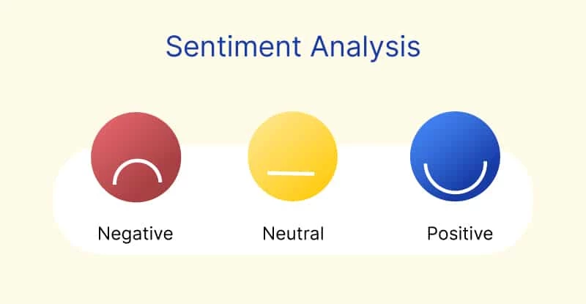
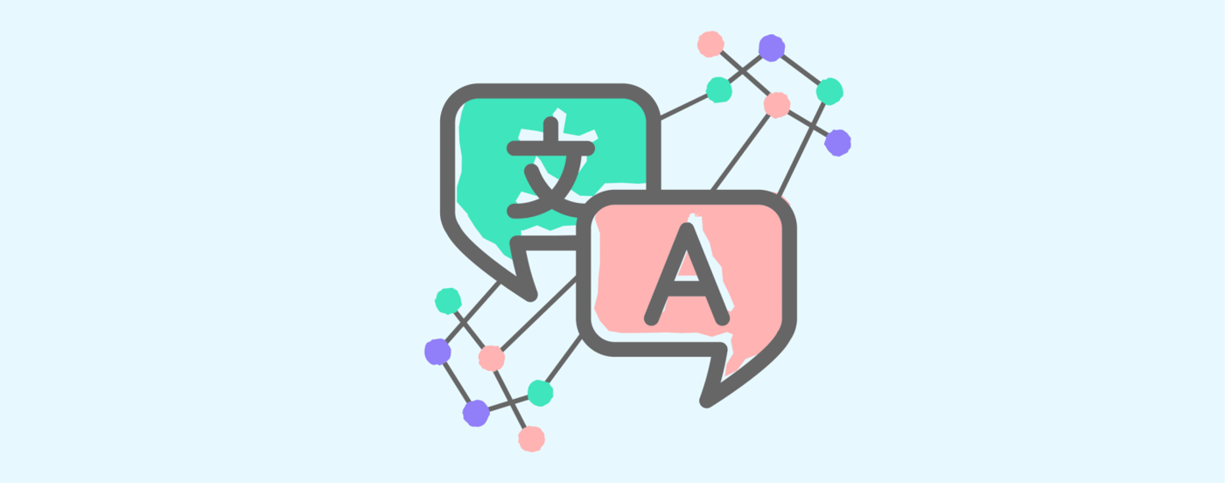
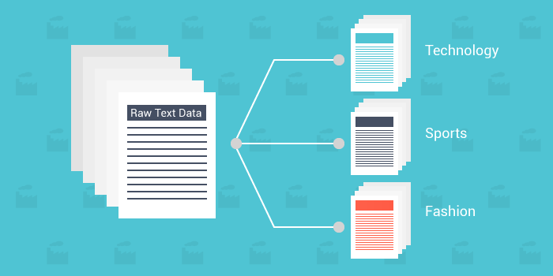

AI before ChatGPT: everyday tasks
Sentiment
is this review happy or angry?
Translation
Chatbots
Sorting texts
sport, tech, fashion…
Notes:
• These tasks existed before ChatGPT, with smaller specialised models.
• Sentiment: brands read thousands of reviews and tweets automatically. Translation: Google Translate since 2006, neural since 2016. Chatbots: the bank or airline bot. Sorting: news by topic, emails into folders.
• Today one model like ChatGPT does all four.
Click 1: Sentiment is this review happy or angry?
Click 2: Translation
Click 3: Chatbots
Click 4: Sorting texts sport, tech, fashion…

Slide 26
Exercise: sort the examples
01
Work in groups of three
one writes, one speaks, one checks
02
Read the 12 examples
on the next slide
03
Place each one in a circle
rules-based AI, machine learning, deep learning or generative AI
04
Name its family of use
content, documents, conversation or action
05
Defend one choice
then we reveal the answers together
Notes:
• 15 minutes. Leave the next slide (the 12 examples) on screen while they work.
• Circles = slide "Technologies inside each other". Families = slide "Four families of use".
• Debrief: each group defends one example. Then click to reveal the answers.
Click 1: Work in groups of three — one writes, one speaks, one checks
Click 2: Read the 12 examples — on the next slide
Click 3: Place each one in a circle — rules-based AI, machine learning, deep learning or generative AI
Click 4: Name its family of use — content, documents, conversation or action
Click 5: Defend one choice — then we reveal the answers together

Slide 27
12 examples: which circle?
Machine learning
Machine learning
Deep learning
Deep learning
Gmail spam filter
Netflix suggestions
Face ID unlocks your phone
Google Translate
1
2
3
4
Generative AI
Deep learning
Machine learning
Machine learning
ChatGPT writes an essay
Siri understands your voice
Google Maps arrival time
Bank fraud alert by SMS
5
6
7
8
Generative AI
Rules-based AI
Machine learning
Deep learning
Midjourney draws a poster
Website bot with a fixed menu
Your Instagram feed
Reading an X-ray scan
9
10
11
12
Notes:
• Three clicks show the examples, row by row. Leave them up during the exercise. The last click reveals the answers.
• Machine learning (learns from data, predicts or recommends): spam filter, Netflix, Maps arrival time, fraud alert, Instagram feed.
• Deep learning (images, sound, language): Face ID, Google Translate (neural since 2016), Siri, X-ray reading.
• Generative AI (creates something new): ChatGPT essay, Midjourney poster.
• Rules-based AI: the website bot with a fixed menu. A person wrote every rule.
• Accept good arguments: the circles are nested, so deep learning is also machine learning, and Netflix uses deep learning too. The point is to reason, not to memorise.
Click 1: Gmail spam filter, Netflix suggestions, Face ID unlocks your phone, Google Translate
Click 2: ChatGPT writes an essay, Siri understands your voice, Google Maps arrival time, Bank fraud alert by SMS
Click 3: Midjourney draws a poster, Website bot with a fixed menu, Your Instagram feed, Reading an X-ray scan
Click 4: answers

Slide 28
PART 3
How machines learn
Notes:
• Two basic jobs a machine learns: predict a number, or pick a group.
Click 1: How machines learn

Slide 29


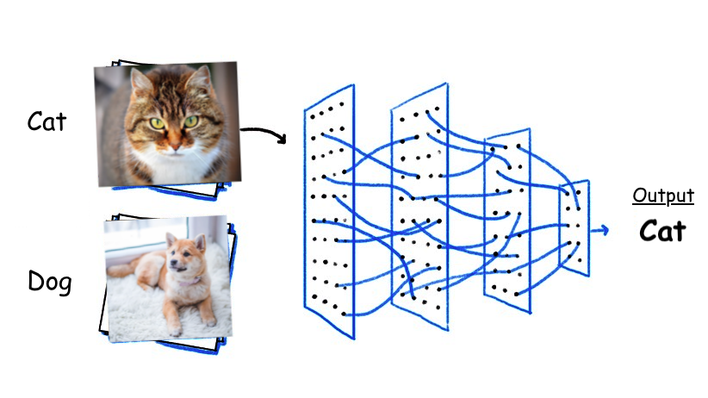

Two ways to predict
REGRESSION
A number
tomorrow's stock price
REGRESSION
A number
the price of a house
CLASSIFICATION
A group
loan: yes or no?
CLASSIFICATION
A group
cat or dog?
REGRESSION PREDICTS A NUMBER, CLASSIFICATION A GROUP
Notes:
• Regression = the answer is a number on a scale: a price, a temperature, a time.
• Classification = the answer is one box among a fixed list: yes/no, cat/dog, spam/not spam.
• House price: the model learned from thousands of past sales (size, area, rooms → price).
• Loan: learned from past clients who did or did not repay.
Click 1: REGRESSION A number tomorrow's stock price
Click 2: REGRESSION A number the price of a house
Click 3: CLASSIFICATION A group loan: yes or no?
Click 4: CLASSIFICATION A group cat or dog?
Click 5: Regression predicts a number, classification a group

Slide 30


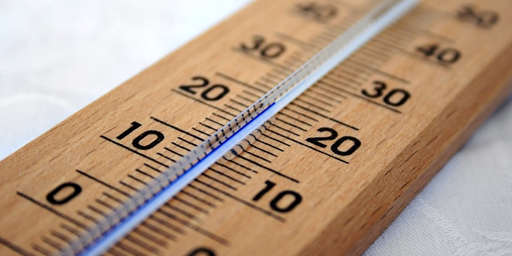
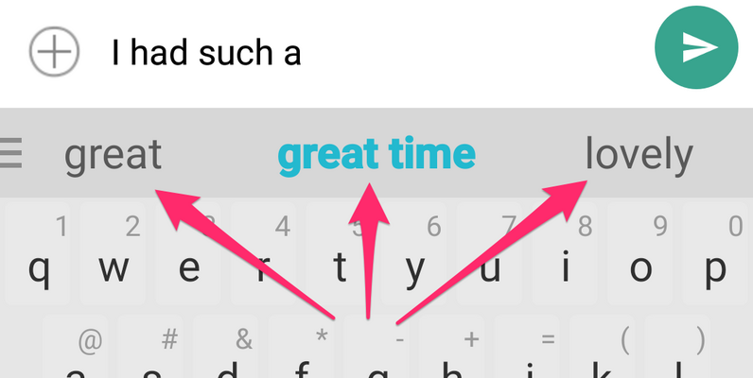
Quiz: regression or classification?
Regression
Classification
Regression
Classification
Exam grade
number or group?
Diploma: yes or no
number or group?
Room temperature
number or group?
The next word
number or group?
CHATGPT PICKS THE NEXT WORD FROM A LIST
Notes:
• Show each picture and ask the room: classification or regression? Let them vote with hands. Don't confirm yet.
• Once all four are answered, one click reveals all the answers.
• Exam grade: a number (12/20) → regression. Diploma: pass or fail → classification. Temperature: a number → regression.
• The surprise: the next word is classification. ChatGPT chooses one word out of its whole vocabulary (about 100,000 tokens), like picking one box among 100,000.
Click 1: Exam grade number or group?
Click 2: Diploma: yes or no number or group?
Click 3: Room temperature number or group?
Click 4: The next word number or group?
Click 5: answers
Click 6: ChatGPT picks the next word from a list

Slide 31
How a machine learns
Training: examples
Garbage in, garbage out.
✓
It finds the pattern
✓
Prediction: new cases
✓
Notes:
• Training: we show it thousands of examples with the right answer (photos labelled cat or dog).
• It adjusts its weights until it finds the pattern that links examples to answers.
• Prediction: we show it something new; it applies the pattern.
• Garbage in, garbage out: bad or biased examples give bad or biased predictions. Example: a hiring AI trained on past CVs that were mostly men learned to prefer men (Amazon, 2018).
Click 1: Training: examples
Click 2: It finds the pattern
Click 3: Prediction: new cases
Click 4: Garbage in, garbage out.

Slide 32
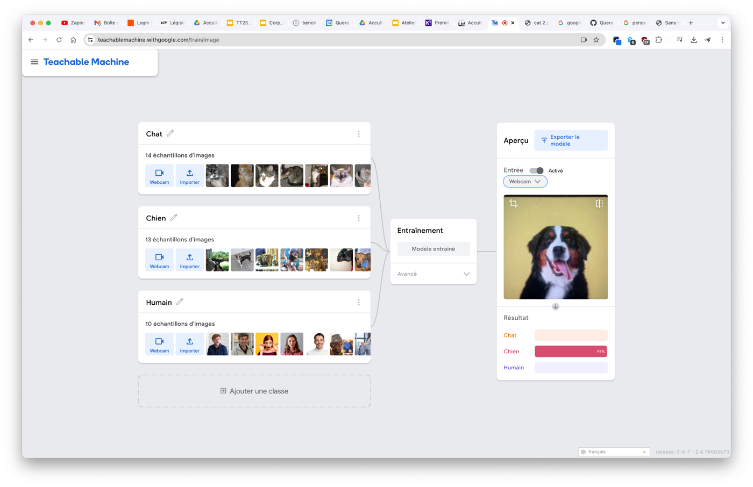
Exercise: Teachable Machine
Train an image classifier
Test it on new images
Break it with bad data
Notes:
• teachablemachine.withgoogle.com (free, no account). 20 minutes.
• Two classes, e.g. "thumbs up" and "thumbs down", 30 webcam photos each. Train, then test.
• Then break it: train one class only in dark light, or with a hat. Watch it fail. That's "garbage in, garbage out" live.
Click 1: picture
Click 2: Train an image classifier
Click 3: Test it on new images
Click 4: Break it with bad data

Slide 33
PART 4
AI that sees
Notes:
• Computer vision: the same classification, applied to images.
Click 1: AI that sees

Slide 34
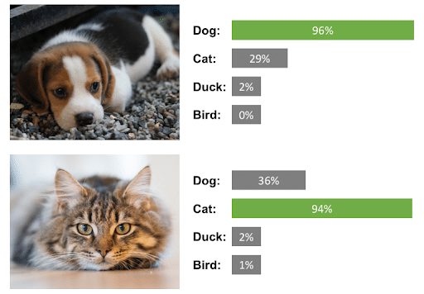
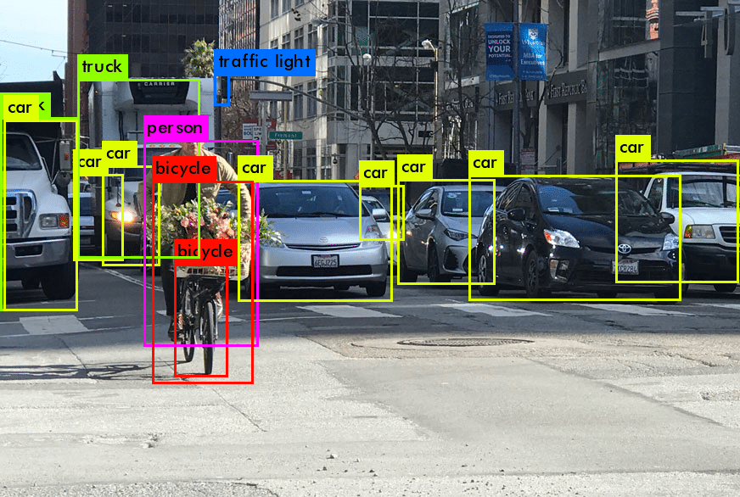
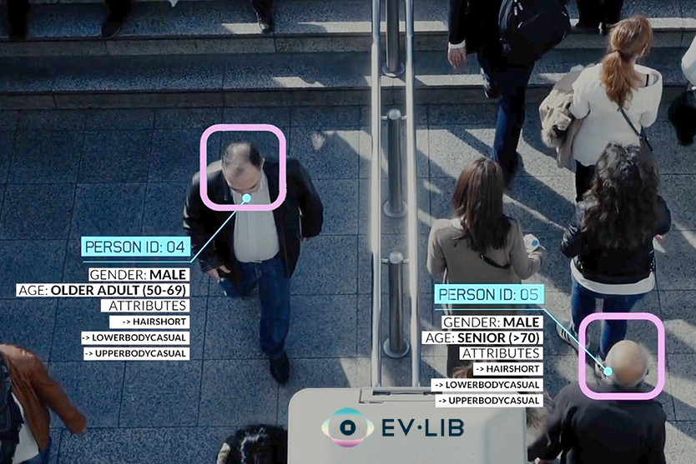
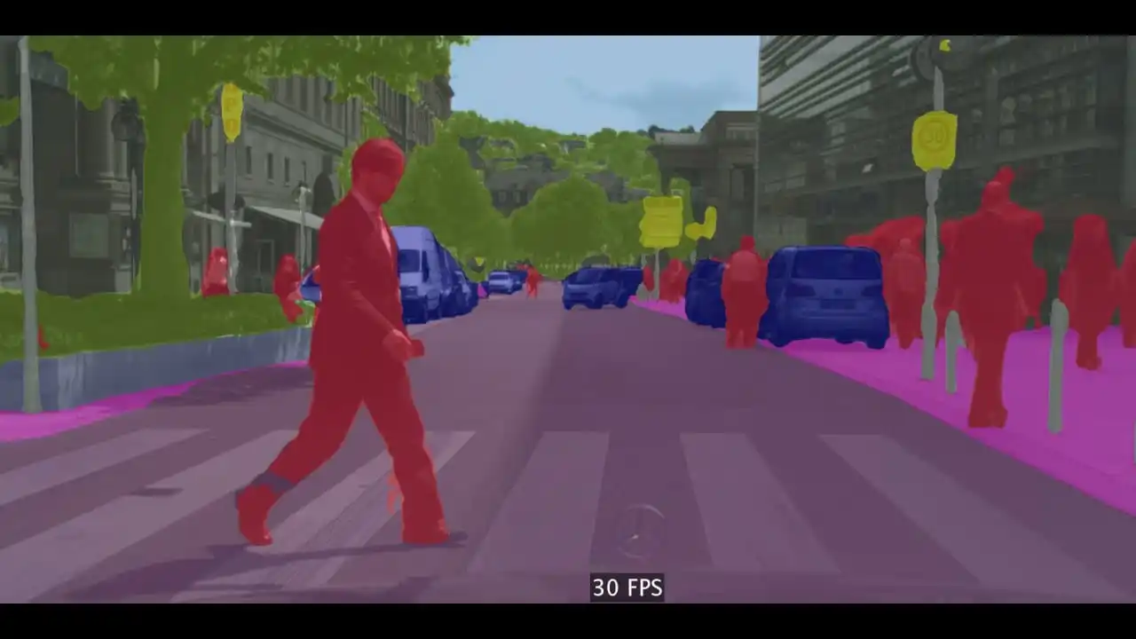
What AI vision does
Classify
what is in the image?
Detect
where is each object?
Identify
who or which one?
Segment
outline every pixel
Notes:
• Classify: one label for the whole image ("a dog").
• Detect: a box around each object ("3 dogs, 1 ball, here").
• Identify: which one exactly (this face is Marie; this car plate is AB-123).
• Segment: the exact outline, pixel by pixel. Used by self-driving cars and photo apps (remove background).
Click 1: Classify what is in the image?
Click 2: Detect where is each object?
Click 3: Identify who or which one?
Click 4: Segment outline every pixel

Slide 35
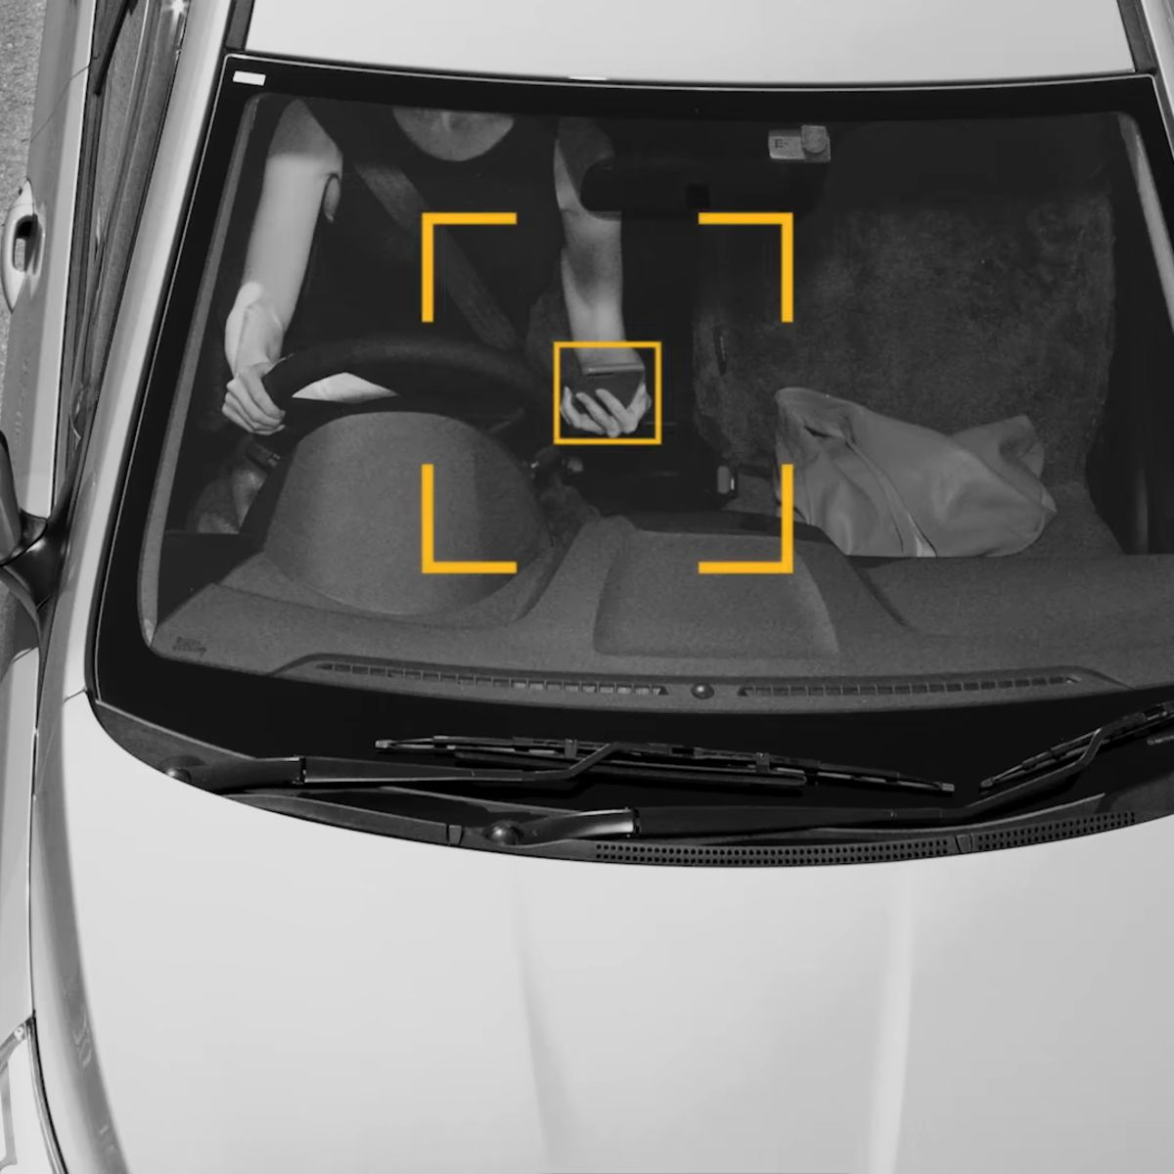
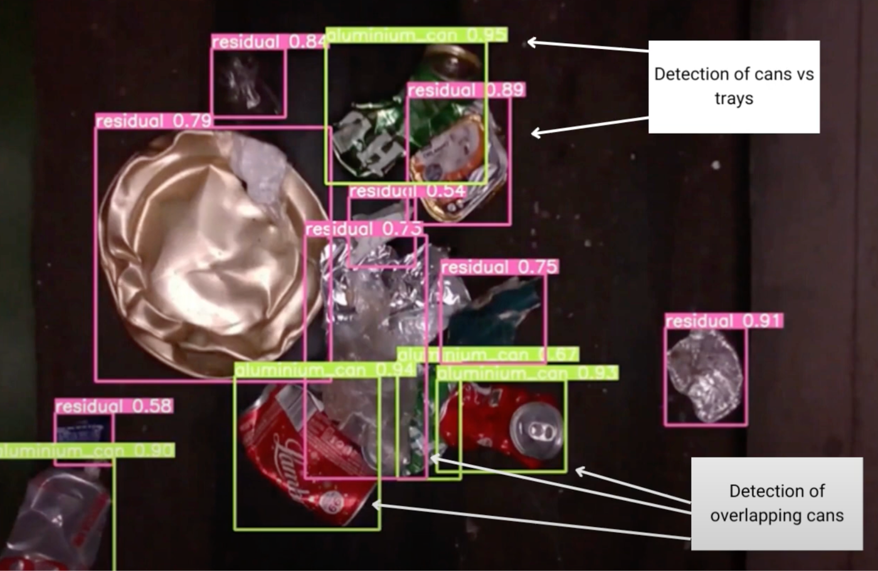
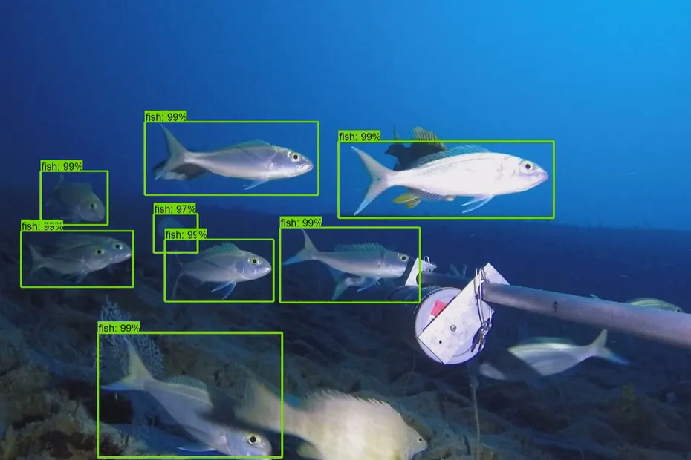
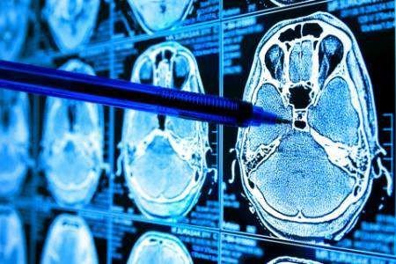
AI vision at work
Recycling
sorting waste on a belt
Road safety
phone at the wheel
Nature
counting fish species
Health
reading medical scans
Notes:
• Recycling: cameras spot plastic, metal and paper; robot arms sort them.
• Road safety: cameras detect drivers holding a phone (used in Australia).
• Nature: counting fish species from underwater video, instead of divers counting by hand.
• Health: spotting tumours on scans. It helps the doctor; it doesn't replace them.
Click 1: Recycling sorting waste on a belt
Click 2: Road safety phone at the wheel
Click 3: Nature counting fish species
Click 4: Health reading medical scans

Slide 36

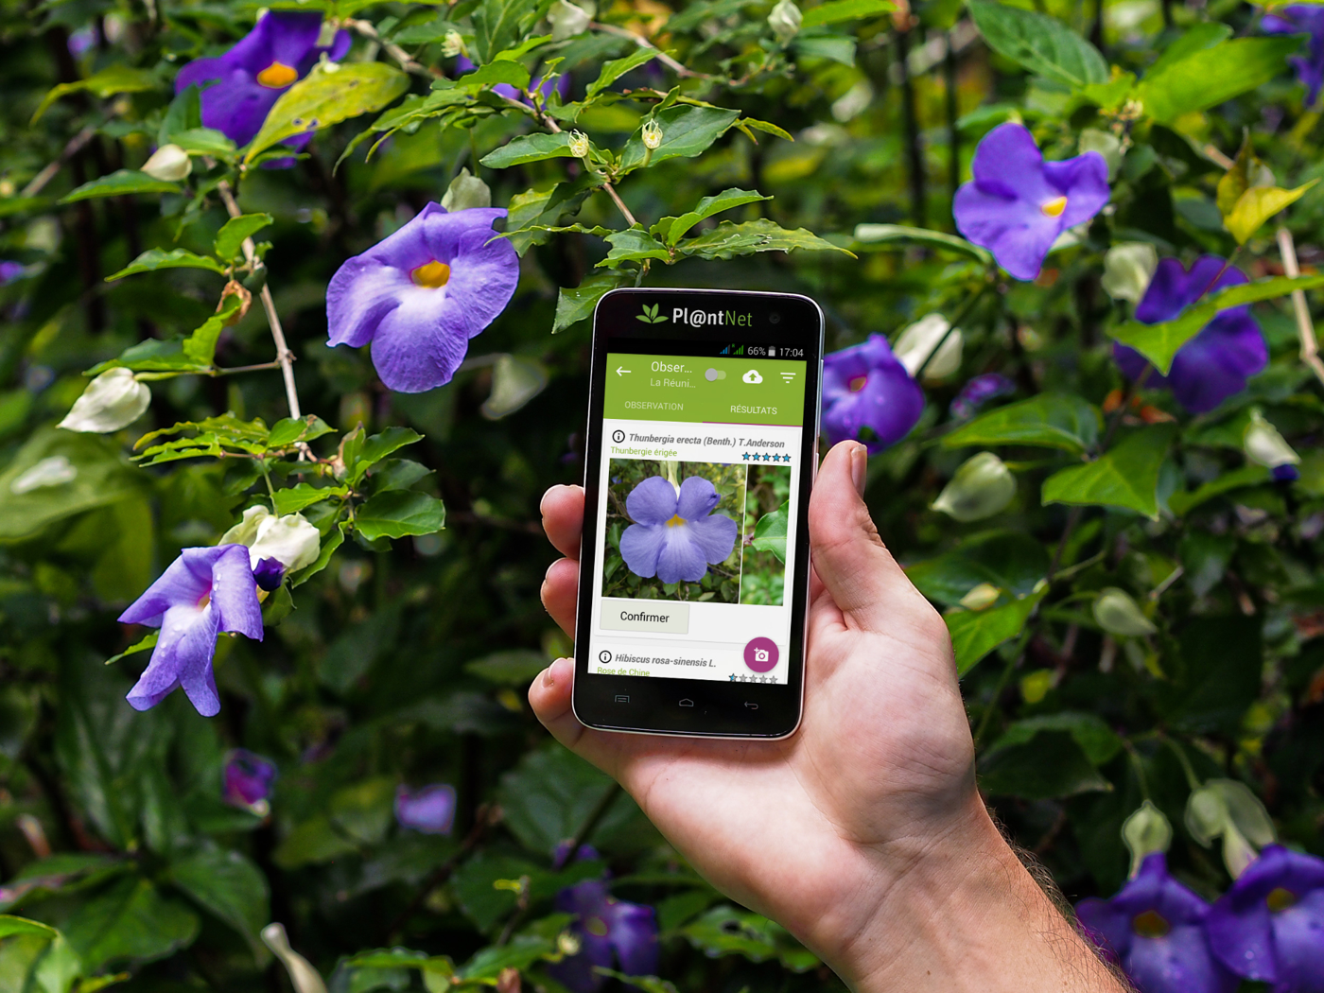
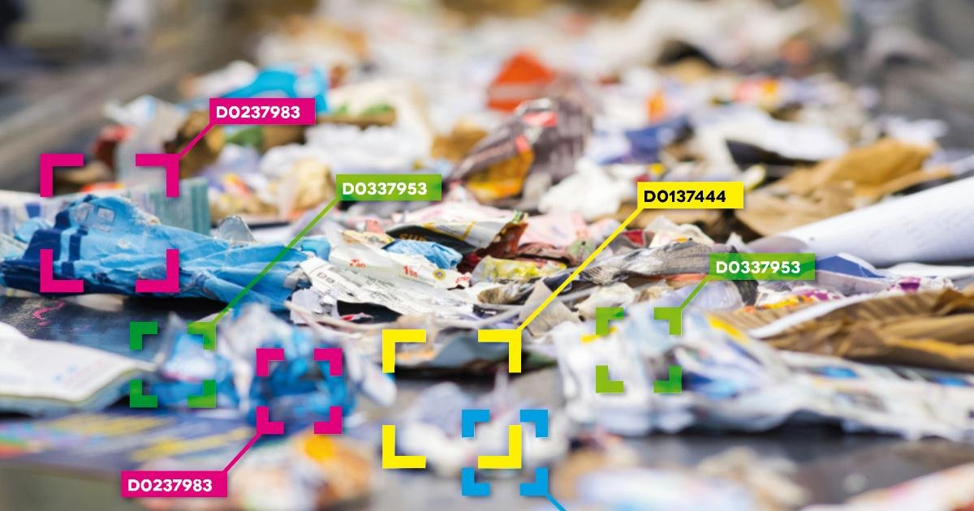
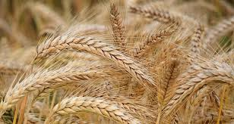
Case studies: AI for good
Plastic in the ocean
Surfrider maps waste from photos
Waste sorting
recognises materials
Crop yield
predicted from satellite images
Plant ID
name a plant from a photo
Notes:
• Surfrider: volunteers photograph beach waste; AI recognises and counts it to map pollution.
• Crop yield: satellite images + weather → predicted harvest (regression!).
• Plant ID: apps like PlantNet (French, from Montpellier) identify a plant from one photo (classification).
Click 1: Plastic in the ocean Surfrider maps waste from photos
Click 2: Waste sorting recognises materials
Click 3: Crop yield predicted from satellite images
Click 4: Plant ID name a plant from a photo

Slide 37
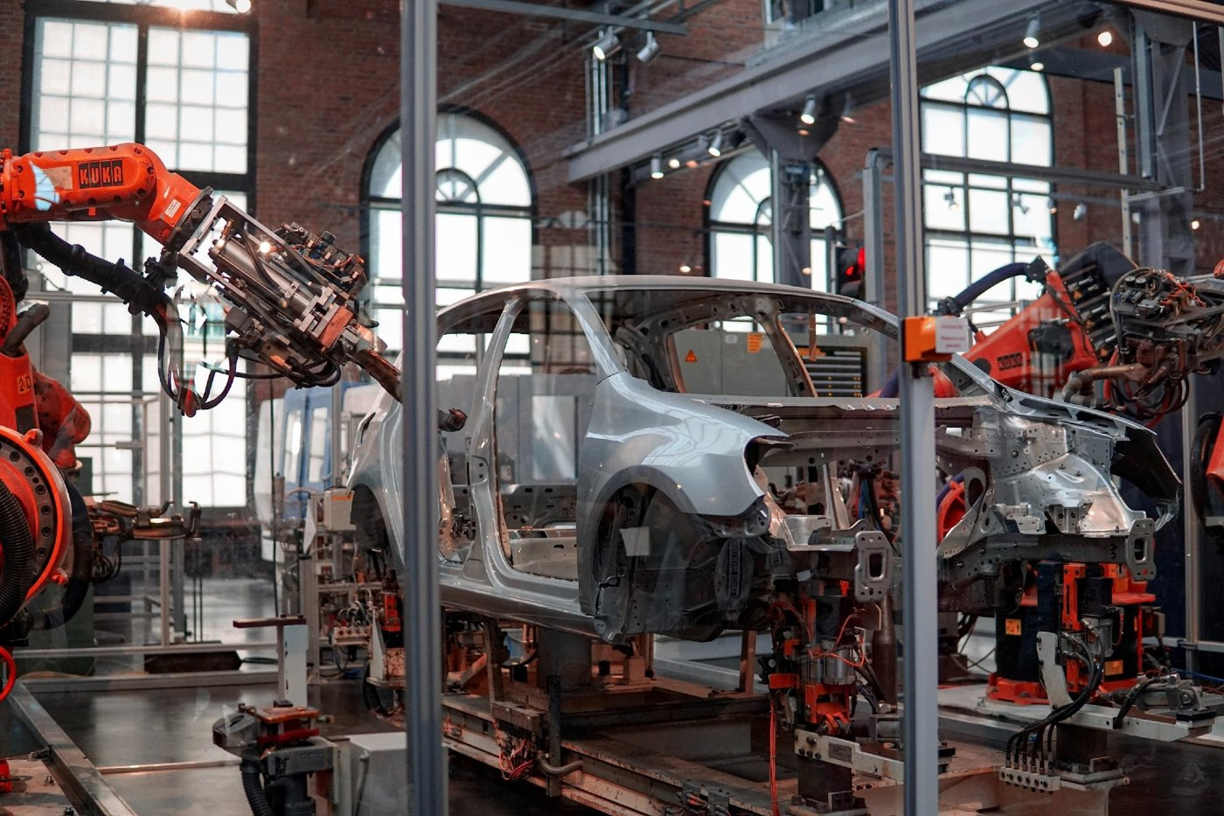
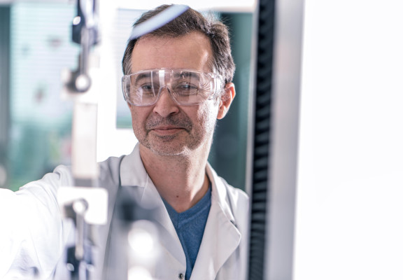
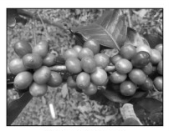
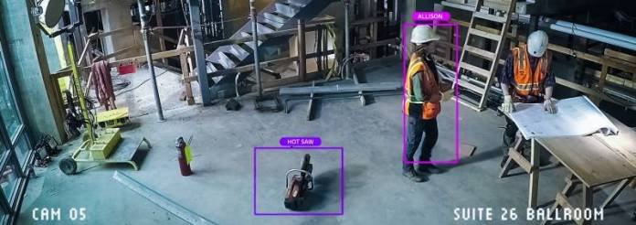
Case studies: AI at work
Factories
spotting defects
Maintenance
fix before it breaks
Safety
detecting danger on site
Farming
counting coffee cherries
Notes:
• Factories: cameras check every product on the line and reject defects.
• Predictive maintenance: sensors predict when a machine will break, so it's repaired before.
• Safety: detect workers without a helmet, or someone entering a danger zone.
• Farming: counting ripe coffee cherries from photos to plan the harvest.
Click 1: Factories spotting defects
Click 2: Maintenance fix before it breaks
Click 3: Safety detecting danger on site
Click 4: Farming counting coffee cherries

Slide 38
Exercise: pick one case
Plastic in the ocean
Waste sorting
Crop yield
Plant ID
Factory defects
Maintenance
Site safety
Coffee harvest
Notes:
• The 8 cases they can pick from. Each pair picks one; no two pairs on the same case if possible.
• Leave this slide up while they choose, then show the questions on the next slide.
Click 1: Plastic in the ocean, Waste sorting, Crop yield, Plant ID
Click 2: Factory defects, Maintenance, Site safety, Coffee harvest

Slide 39
Dissect your case
01
What problem does it solve?
for whom?
02
What data does it learn from?
photos, numbers, sensors, text…
03
Classification, regression, or vision?
04
What could go wrong?
bad data, bias, privacy
Notes:
• 15 minutes in pairs, then 1 minute per pair to present.
• This is the seed of Day 2's ODS framework: Objective (the problem), Data (what it learns from), Skill (what it does).
Click 1: What problem does it solve? — for whom?
Click 2: What data does it learn from? — photos, numbers, sensors, text…
Click 3: Classification, regression, or vision?
Click 4: What could go wrong? — bad data, bias, privacy

Slide 40
PART 5
Tokens and prediction
Notes:
• How a chatbot reads your text, and what it really does with it.
Click 1: Tokens and prediction

Slide 41
AI reads tokens, not words
LOWERCASE
4 tokens 19 chars
ici c'est Marseille
ONE CAPITAL LETTER
5 tokens 19 chars
Ici c'est Marseille
ENGLISH
6 tokens 19 chars
Hello, how are you?
Try it: platform.openai.com/tokenizer
Notes:
• A token is a piece of text: a word, part of a word, or punctuation. Each colour = one token.
• Row 1: "ici c'est Marseille" = 19 characters, 4 tokens.
• Row 2: the same sentence with a capital I = 5 tokens. One capital letter changes how it is cut. The AI doesn't see words; it sees pieces.
• Row 3: "Hello, how are you?" also 19 characters, 6 tokens (every word and punctuation mark is one token in English). Check it live before class: tokenizers change with models.
• Why it matters: you pay and you are limited in tokens, not words. Roughly 1 token ≈ 4 characters in English; French usually needs more tokens.
• Last click: the link. Open it live (it's clickable in slide show) and type a student's name.
Click 1: lowercase: 4 tokens, 19 characters
Click 2: one capital letter: 5 tokens, 19 characters
Click 3: English: 6 tokens, 19 characters
Click 4: link: https://platform.openai.com/tokenizer

Slide 42
From words to numbers
“The dog eats its kibble”
1 · WORDS BECOME TOKENS
The
dog
eats
its
kibble
2 · TOKENS BECOME VECTORS (LISTS OF NUMBERS)
The
→ [67, -78, -56, 1, 0, 6]
dog
→ [-79, 8, 56, 8, 20, 5]
eats
→ [47, 78, 12, -89, 2, 7]
its
→ [87, 13, -85, -17, 7, 6]
kibble
→ [-34, 4, 6, 46, -21, 5]
Notes:
• Step 1: the sentence is cut into tokens.
• Step 2: each token becomes a vector, a list of numbers that places it on a map of meaning.
• These numbers are made up for the example. Real vectors have thousands of numbers.
• Words with close meanings get close numbers: "dog" sits near "puppy" and "cat", far from "invoice".
• From here on, the AI only calculates with numbers. It never "reads" like we do.
Click 1: the sentence: The dog eats its kibble
Click 2: 1. words become tokens: The, dog, eats, its, kibble
Click 3: 2. tokens become vectors
Click 4: The → [67, -78, -56, 1, 0, 6]
Click 5: dog → [-79, 8, 56, 8, 20, 5]
Click 6: eats → [47, 78, 12, -89, 2, 7]
Click 7: its → [87, 13, -85, -17, 7, 6]
Click 8: kibble → [-34, 4, 6, 46, -21, 5]

Slide 43
It only predicts the next word.
FINISH THE SENTENCE
The cat sat on the…
Notes:
• Let the room finish the sentence. Everyone says "mat" or "sofa". That's exactly what the AI does: it picks the most likely next word, then the next, then the next.
Click 1: next
Click 2: Finish the sentence
Click 3: The cat sat on the…

Slide 44
Every next word is a bet
VERY LIKELY
mat
LIKELY
sofa
POSSIBLE
floor
UNLIKELY
moon
YOUR CONTEXT CHANGES THE ODDS
Notes:
• The model gives every possible next word a probability, then picks one, usually among the most likely.
• That's why the same question can give different answers: a bit of chance is built in (called "temperature").
• Footer: if the sentence started with "In the rocket, the cat sat on the…", "moon" becomes likely. Context changes the odds.
Click 1: mat
Click 2: sofa
Click 3: floor
Click 4: moon
Click 5: Your context changes the odds

Slide 45
Context steers the answer
A river nearby, or money talk?
SAME WORD
"bank"
Your context picks the river bank or the money bank.
Notes:
• "I sat on the bank and watched the water" vs "I need to call my bank about my card".
• The transformer's "attention" looks at the other words to decide which meaning applies.
• Lesson for prompting: the more context you give, the better it guesses what you mean.
Click 1: "bank"
Click 2: A river nearby, or money talk?
Click 3: Your context picks the river bank or the money bank.

Slide 46
Is it intelligent?
✕
No
it predicts
WHAT IT LOOKS LIKE
It understands me.
WHAT REALLY HAPPENS
It calculates the most likely next word.
Notes:
• Back to the morning question: smart, or very good at guessing?
• It sounds like it understands because it learned from billions of human texts.
• But it has no intention, no experience, no idea if it's true. That's why it can invent facts with confidence ("hallucinations").
Click 1: No it predicts
Click 2: It understands me.
Click 3: not that
Click 4: It calculates the most likely next word.

Slide 47
A classic model answers at once
STEP 1
You ask
your prompt
STEP 2
Word by word
each word is a new bet
STEP 3
No going back
it can't rewrite a word
FAST, BUT IT NEVER RECONSIDERS
Notes:
• A classic chat model (like the first ChatGPT) starts answering immediately.
• It writes one word at a time, each word a bet based on the words before.
• Once a word is written, it can't go back. If it starts down a wrong path, it keeps going and justifies it.
• Example: ask a tricky maths or logic question; a classic model often answers fast and wrong.
Click 1: You ask your prompt
Click 2: Word by word each word is a new bet
Click 3: No going back it can't rewrite a word
Click 4: Fast, but it never reconsiders

Slide 48
A reasoning model thinks first
First, a hidden draft:
Still prediction. Just more of it.
Breaks it into steps
✓
Tries, then checks
✓
Fixes, then answers
✓
Notes:
• Newer "reasoning" models (OpenAI o-series and GPT-5 Thinking, Claude with extended thinking, Gemini Thinking, DeepSeek-R1) write a draft you usually don't see before answering.
• In that draft they split the problem into steps, try an answer, check it, and correct their mistakes.
• You can see it: "Thought for 12 seconds", with a summary of the reasoning.
• Side card: it is still next-word prediction, just a lot more of it. It is slower and costs more, but it's much better at maths, code and planning.
• Tip: use reasoning mode for hard problems, the fast mode for simple writing.
Click 1: First, a hidden draft:
Click 2: Breaks it into steps
Click 3: Tries, then checks
Click 4: Fixes, then answers
Click 5: Still prediction. Just more of it.

Slide 49



The main chat tools
ChatGPT
OpenAI
Claude
Anthropic
Gemini
Google
Copilot
Microsoft
ALL HAVE A FREE VERSION
Notes:
• ChatGPT: the most used, good all-rounder. Claude: strong at writing, long documents and code. Gemini: built into Google (Docs, Gmail, Drive). Copilot: built into Microsoft (Word, Excel, Teams); students often have it free with their university account.
• All four have a free version. We use several during the week and compare.
Click 1: ChatGPT OpenAI
Click 2: Claude Anthropic
Click 3: Gemini Google
Click 4: Copilot Microsoft
Click 5: All have a free version

Slide 50




Also worth knowing
Le Chat
Mistral AI, French
Grok
xAI, built into X
Perplexity
search with sources
DeepSeek
China, open models
Qwen
Alibaba, open models
MIND WHERE YOUR DATA GOES
Notes:
• Le Chat by Mistral AI: the French champion, based in Paris, fast and GDPR-friendly.
• Grok by xAI (Elon Musk): built into X, with access to live posts. A major player; also the most controversial on content moderation.
• Perplexity: an AI search engine that cites its sources. Good for research.
• DeepSeek and Qwen: Chinese models, very strong and open (anyone can download them). Data from their apps is stored in China.
• Footer: never paste personal or confidential data (yours, your employer's, your classmates') into a free tool. GDPR applies.
Click 1: Le Chat Mistral AI, French
Click 2: Grok xAI, built into X
Click 3: Perplexity search with sources
Click 4: DeepSeek China, open models
Click 5: Qwen Alibaba, open models
Click 6: Mind where your data goes

Slide 51
PART 6
First steps in
prompting
Notes:
• Prompt engineering = the art of writing instructions for an AI. It's the skill we build all week.
Click 1: First steps in
Click 2: prompting

Slide 52
Good prompt, bad prompt
✕
?
Which one works?
BAD PROMPT
Write a post about our tapenade.
GOOD PROMPT
Food marketer: 3 Instagram posts launching our organic tapenade. 100 words, friendly.
Notes:
• Before showing anything, ask: what makes a prompt good or bad? Collect 3–4 answers.
• Bad prompt: no role, no audience, no goal, no format. The AI fills the gaps with the most average answer.
• Good prompt: a role, a precise task, a number, a format and a tone. Same AI, much better result.
• Optional: run both live in ChatGPT and compare.
Click 1: ? Which one works?
Click 2: Write a post about our tapenade.
Click 3: not that
Click 4: Food marketer: 3 Instagram posts launching our organic tapenade. 100 words, friendly.

Slide 53
Three essentials
1 · CLARITY
Clear, precise
Why: vague in, vague out
2 · CONTEXT
Give context
Why: it knows nothing about you
3 · INSTRUCTIONS
Say it plainly
Why: it can't read your mind
Notes:
• Clarity and precision: simple sentences, no ambiguity, be specific. A vague request gets a vague, generic answer.
• Context: the subject, the tone you want, the audience. The AI starts from zero every time; it doesn't know you, your class or your project.
• Explicit instructions: say exactly what you expect (length, format, steps). It won't guess what you didn't write.
Click 1: Clear, precise Why: vague in, vague out
Click 2: Give context Why: it knows nothing about you
Click 3: Say it plainly Why: it can't read your mind

Slide 54
Five steps to a good prompt
01
Define your objectives
what for? what result? which format, style, language?
02
Give context
who you are, what you want, for whom, for what use
03
Analyse and check
think critically: verify the facts, rephrase if it's off
04
Refine and discuss
guide it, add examples, go back, split into steps
05
Make it yours
it's never perfect: add your value, then put it to use
Notes:
• 1. Objectives: what will you use it for? Do you know what you want at the end? Any format, style or language requirements?
• 2. Context: the more context, the more precise the answer. Who are you, what do you want, for whom, why, at what level?
• 3. Analyse and check: you need to know enough about the topic to judge the answer, or check other sources. Rephrase if it's far off; dig deeper if it's good.
• 4. Refine and discuss: talk to it like an assistant who needs material and feedback. Add details, give examples, go back, validate, split into steps.
• 5. Make it yours: the result is never perfect. Add your own value and be creative in how you use it.
Click 1: Define your objectives — what for? what result? which format, style, language?
Click 2: Give context — who you are, what you want, for whom, for what use
Click 3: Analyse and check — think critically: verify the facts, rephrase if it's off
Click 4: Refine and discuss — guide it, add examples, go back, split into steps
Click 5: Make it yours — it's never perfect: add your value, then put it to use

Slide 55
A good prompt, piece by piece
Role
You are an expert in marketing and communication.
Context
You work for a company that makes gourmet products, including a wide range of tapenades.
Objective
Write one post for each social network to launch our new organic green olive and almond tapenade.
Expected result
The goal is to turn readers into customers.
Constraints
Each post must mention the ingredients, their Provençal origin and the artisanal process.
Format
100 to 150 words per post, in a friendly tone.
Notes:
• Read each part aloud as it appears. After each, ask: what would the answer look like without this part?
• Role: sets the expertise and vocabulary. Context: who we are. Objective: the task. Expected result: why we do it. Constraints: what must be in it. Format: length and tone.
Click 1: Role: You are an expert in marketing and communication.
Click 2: Context: You work for a company that makes gourmet products, including a wide range of tapenades.
Click 3: Objective: Write one post for each social network to launch our new organic green olive and almond tapenade.
Click 4: Expected result: The goal is to turn readers into customers.
Click 5: Constraints: Each post must mention the ingredients, their Provençal origin and the artisanal process.
Click 6: Format: 100 to 150 words per post, in a friendly tone.

Slide 56
The same prompt, assembled
You are an expert in marketing and communication. You work for a company that makes gourmet products, including a wide range of tapenades. Write one post for each social network to launch our new organic green olive and almond tapenade. The goal is to turn readers into customers. Each post must mention the ingredients, their Provençal origin and the artisanal process. 100 to 150 words per post, in a friendly tone.
Role
Context
Objective
Expected result
Constraints
Format
Notes:
• The same six parts written as one normal paragraph. A good prompt reads like a clear brief to a colleague.
• The colours are a checklist: before you send a prompt, can you find each colour in it?
Click 1: the full prompt
Click 2: Role
Click 3: Context
Click 4: Objective
Click 5: Expected result
Click 6: Constraints
Click 7: Format

Slide 57
Prompt structures to remember
SIMPLE
RTF
Role, Task, Format
PRECISE
RTCE
Role, Task, Constraints, Examples
COMPLETE
CO-STAR
Context, Objective, Style, Tone, Audience, Response
Notes:
• Three ready-made structures, from quick to complete.
• RTF for everyday requests. RTCE when you need precision; examples are the most powerful part. CO-STAR for anything public-facing.
• They all contain the same colours as our tapenade prompt. Pick one; the structure matters more than which one.
Click 1: RTF Role, Task, Format
Click 2: RTCE Role, Task, Constraints, Examples
Click 3: CO-STAR Context, Objective, Style, Tone, Audience, Response

Slide 58
Exercise: improve your last prompt
01
Open the last prompt you wrote
in any chat tool
02
Rebuild it with a structure
the 6 colours, RTF, RTCE or CO-STAR
03
Make it better
add context, constraints and a format
04
Test it
same tool, in a new chat
05
Tell us what changed
in the answer, and in how it reasoned
Notes:
• 20 minutes, alone, then share in pairs.
• No old prompt? Use: "Help me prepare for a job interview."
• New chat matters: the AI remembers the conversation, so a fresh chat gives a fair comparison.
• Debrief: 3 volunteers read before and after. Ask: what changed in the output? In the reasoning (did it ask questions, plan, check)?
Click 1: Open the last prompt you wrote — in any chat tool
Click 2: Rebuild it with a structure — the 6 colours, RTF, RTCE or CO-STAR
Click 3: Make it better — add context, constraints and a format
Click 4: Test it — same tool, in a new chat
Click 5: Tell us what changed — in the answer, and in how it reasoned

Slide 59
Exercise: prompt generators
01
Try an online generator
feedough.com/ai-prompt-generator
02
Or ask the chatbot to write the prompt
"Write me the best prompt to…"
03
Compare with your improved prompt
which answer is better, and why?
Notes:
• 15 minutes. The link is clickable in slide show.
• Second option: ask ChatGPT "Ask me questions, then write the best prompt to…". The AI is good at writing prompts for itself.
• Compare: generator vs their own improved prompt. Usually the best is a mix: the generator's structure plus their own context.
Click 1: Try an online generator — feedough.com/ai-prompt-generator
Click 2: Or ask the chatbot to write the prompt — "Write me the best prompt to…"
Click 3: Compare with your improved prompt — which answer is better, and why?

Slide 60
Tomorrow: the prompting funnel
1 · WHO
Find the best
at what I need to do
2 · HOW
Their method
ask the AI to describe it
3 · SPLIT
Break it down
step by step
4 · USE
Apply it to me
"Do the same for…"
EXAMPLE: PITCH LIKE STEVE JOBS
Notes:
• A teaser for Day 2: my funnel technique. Instead of asking the AI directly, you borrow the method of the best.
• Example: you need a 2-minute pitch for an internship.
• 1. "Who is the best at product presentations?" → Steve Jobs. 2. "What was his method?" → one big idea, rule of three, a demo, "one more thing".
• 3. "Break it into steps I can follow." 4. "Use this method to write my 2-minute internship pitch. Here is my CV."
• Tomorrow we do it properly, then turn it into a master prompt.
Click 1: Find the best at what I need to do
Click 2: Their method ask the AI to describe it
Click 3: Break it down step by step
Click 4: Apply it to me "Do the same for…"
Click 5: Example: pitch like Steve Jobs

Slide 61
Inside a mega prompt
Expert role
You are a recruitment and ATS expert (Taleez, Flatchr, Recruitee…) who knows their keyword logic.
Mission
Optimise the Experience section of a CV for one job ad, so it passes ATS filters.
Inputs first
First ask for the current CV and the full job ad.
Numbered steps
Find the ad's 30 key words, find the CV's gaps, then rewrite.
Measurable rules
6 lines per job, 85–90 characters each, one keyword per line, 40 lines max.
Deliverables
The new section, the 30 keywords and a 5-line explanation.
Notes:
• This is the recruiting mega prompt (the ATS CV prompt from the Simplon job-search course), summarised in English.
• ATS = Applicant Tracking System: software that filters CVs by keywords before a human reads them.
• What makes it "mega": an expert role with precise knowledge, inputs requested first, numbered steps, rules you can measure (characters, lines, numbers) and a clear list of deliverables.
• Reverse engineering: if we keep the shape and remove the CV topic, we get a recipe for any mega prompt. Next slide.
Click 1: Expert role: You are a recruitment and ATS expert (Taleez, Flatchr, Recruitee…) who knows their keyword logic.
Click 2: Mission: Optimise the Experience section of a CV for one job ad, so it passes ATS filters.
Click 3: Inputs first: First ask for the current CV and the full job ad.
Click 4: Numbered steps: Find the ad's 30 key words, find the CV's gaps, then rewrite.
Click 5: Measurable rules: 6 lines per job, 85–90 characters each, one keyword per line, 40 lines max.
Click 6: Deliverables: The new section, the 30 keywords and a 5-line explanation.

Slide 62
The master prompt generator
Role
You are an expert prompt engineer who builds reusable master prompts.
Mission
Write a master prompt for the task I describe, one I can reuse every time.
Ask first
First ask me 5 questions: task, audience, inputs, result, limits.
Structure
Include: role, mission, inputs, numbered steps, rules, deliverables.
Measurable
Turn every rule into numbers or checklists. End with a self-check step.
Format
One copy-ready block, then 3 lines on why it works.
Notes:
• The same anatomy, turned into a machine that writes mega prompts for any task.
• Demo: paste it into ChatGPT or Claude, answer its 5 questions for "prepare me for a job interview at L'Oréal", and show the master prompt it produces.
• The full text is in the file master_prompt_generator.md; share it with the students at the end of the day.
• We use it on Day 2 to build everyone's personal master prompt.
Click 1: Role: You are an expert prompt engineer who builds reusable master prompts.
Click 2: Mission: Write a master prompt for the task I describe, one I can reuse every time.
Click 3: Ask first: First ask me 5 questions: task, audience, inputs, result, limits.
Click 4: Structure: Include: role, mission, inputs, numbered steps, rules, deliverables.
Click 5: Measurable: Turn every rule into numbers or checklists. End with a self-check step.
Click 6: Format: One copy-ready block, then 3 lines on why it works.

Slide 63
Today: AI predicts.
Remember
Data decides
Context steers
Prompts guide
Next: the funnel
Notes:
• Data decides: an AI is only as good as what it learned from.
• Context steers: the same question with more context gets a better answer.
• Prompts guide: structure your prompts with the six colours.
• Tomorrow: personalising your AI, the ODS framework (Objective, Data, Skill), the funnel and the master prompt.
• Homework: write down 3 tasks in your studies or job search you'd like AI to help with.
Click 1: Remember
Click 2: Data decides
Click 3: Context steers
Click 4: Prompts guide
Click 5: Next: the funnel

