Slide 1
Visual Literacy
The ability to recognize and understand ideas conveyed through visible actions or images.
(Merriam Webster’s Collegiate Dictionary)
Visual Literacy relates to the ability to understand and use images.

Slide 2
What is graphic representation?
Representation and Communication
Illustration
Pictures
Icons
Symbols
Figures
Diagrams
Animated visuals
Instruction Strategies
Orientation/anticipatory organization
Information Chunking
9935266960
99 35 266 960

Slide 3
To question the assumptions made usually on the tradition (1400 to 1900) of European Painting.. The way we see them today in the second half of 20th C. and the first half of 21st C. in reference to the situation that we are living.
The process of seeing a visual is less spontaneous than we tend to believe.
The large part of seeing depends on habit and convention.
All visuals from convention have used the convention of perspective.
Perspective centers everything to the eye of the beholder. The message that travels in. The appearance is called reality in art.
PERSPECTIVE MAKES THE EYE THE CENTRE OF THE VISIBLE WORLD.
But human eye can only be at one place at a time.
It takes the visible world with it as it walks.
With the invention of camera appearance just got travelled across the world. It was no longer so easy to think appearance is always travelling to single centre.

Slide 4
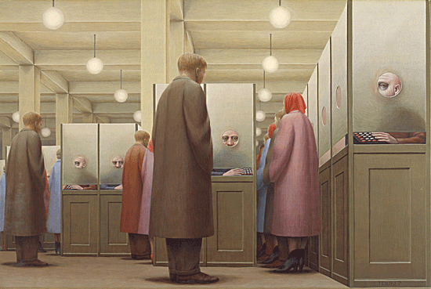
Illusion of space
Devices to show depth
Size
In this painting by George Tooker, we see the differences in size of the various figures. This immediately establishes a sense of pictorial space. We know the smaller figures are not tiny but are simply farther away.

Slide 5

Even in abstract or semiabstract patterns, the spatial effect is more pronounced if the same shape is repeated in various sizes. The device works less well with different shapes.
Artists in the past often ignored size as a way to show spatial location. Size was often used to denote some conceptual importance and not to indicate how close or far away the figures was spatially. This is called Hieratic Scaling. Thus deities, angels, and rulers might be shown in the arbitrary large size to indicate their thematic importance.

Slide 6
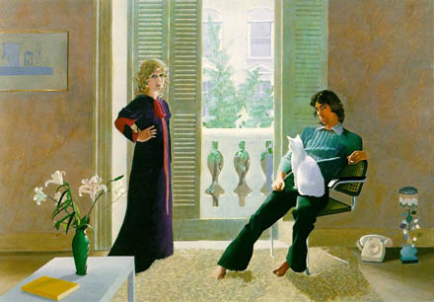
Overlapping
David Hockney
Mr and Mrs Clark and Percy
1970–1

Slide 7
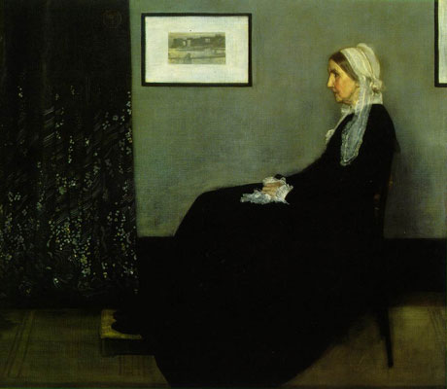
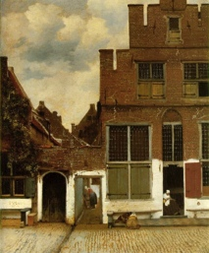
The Little Street (1657–58)
Johannes Vermeer
Whistler: ritratto della madre

Slide 8
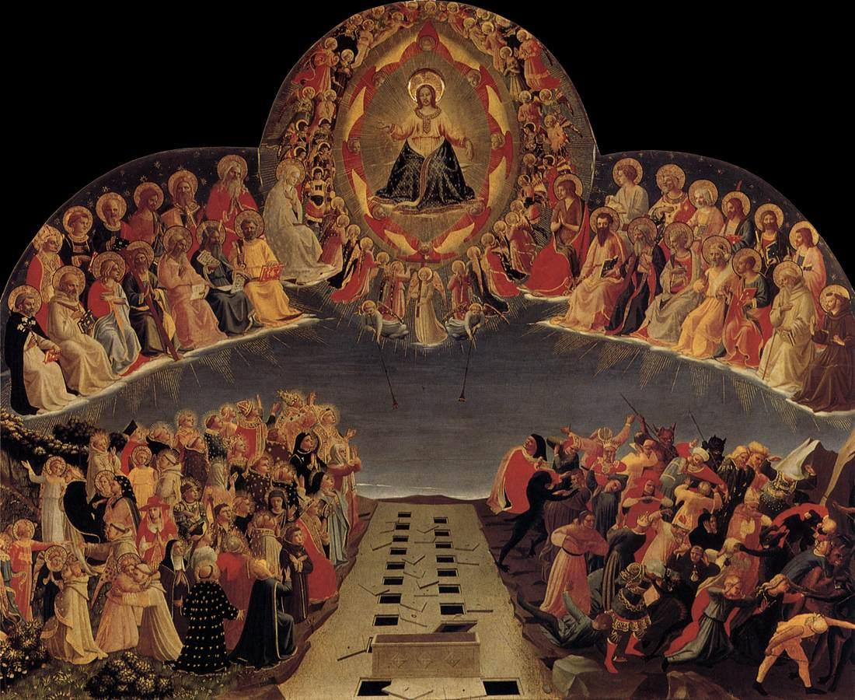
Overlapping is another simple device. A good feel of space can be created by it even without making much scale difference in different pictorial elements.

Slide 9
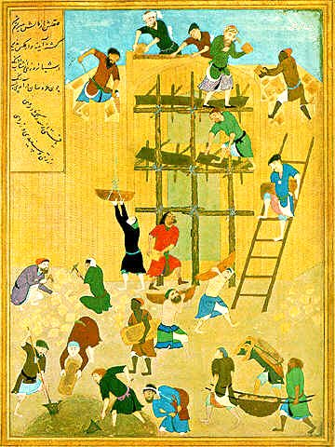
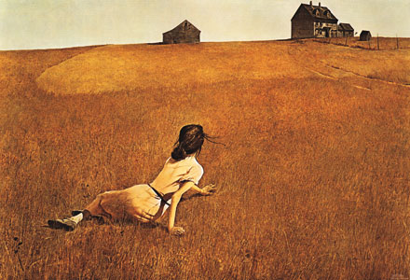
Vertical Location
The higher an object, the farther back it is assumed to be.

Slide 10


Arial Perspective
Arial or atmospheric perspective means the use of light/dark to show depth.
The value contrast between distant objects gradually lessens, and contours become less distinct.
Faraway objects appear hazy.
A feeling of spatial recession can be achieved simply by reducing the size of objects as they apparently fade into the distance.
Spatial recession can be made even more effective if the receding object blend more and more with the background.

Slide 11
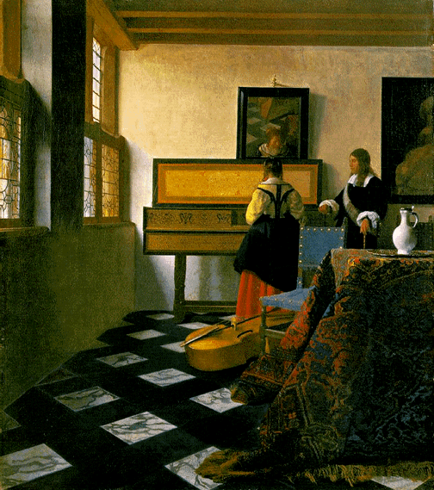
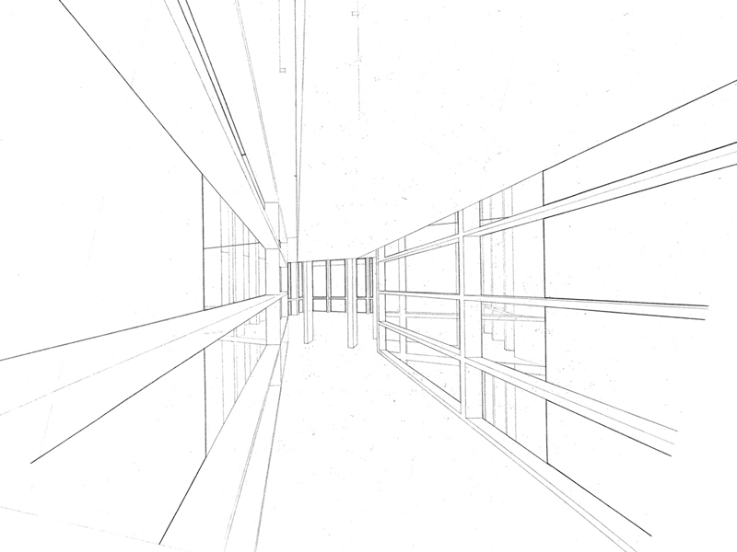
Linear Perspective
Jan Vermeer's The Music Lesson
(painted in 1662-1665)
As parallel lines recede, they appear to converge and meet at some point.
One/two/multiple point perspectives are the way outs to create a great sense of depth with due perfection.

Slide 12
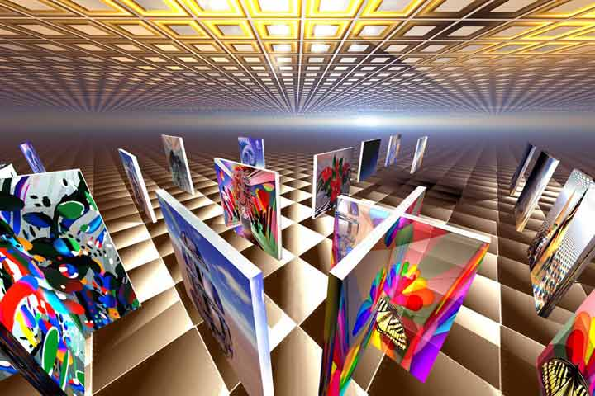
Multiple point perspective
Perspective acts as a unifying factor, with all lines receding to a common point, it automatically organizes these many trapezoidal shapes into a coherent pattern.
Most importantly, linear perspective is a tool to employ when appropriate and to ignore when wished for the sake of both expression and aesthetics.

Slide 13

Amplified Perspective
Jamrs Montgomary Flagg.World War 1 recruiting poster.

Slide 14
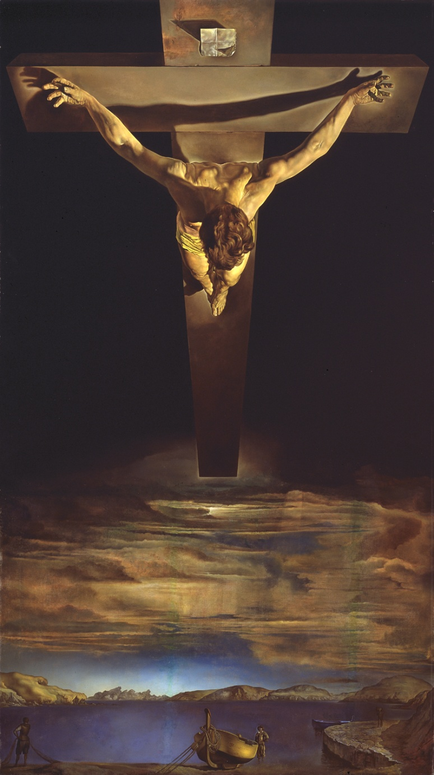
Salvador Dali.Christ of St. Jhon of the Cross.

Slide 15
In order to introduce a dramatic dynamic quality, many artists have introduced Amplified perspective in their visual.
This effect is mostly created by foreshortening.
This unusual or uncommon view creates the excitement of watching the visual.
With this very device, the spatial quality becomes the most eye catching element.
Viewer enjoys the dynamic pull devoid of a static, frozen quality.

Slide 16
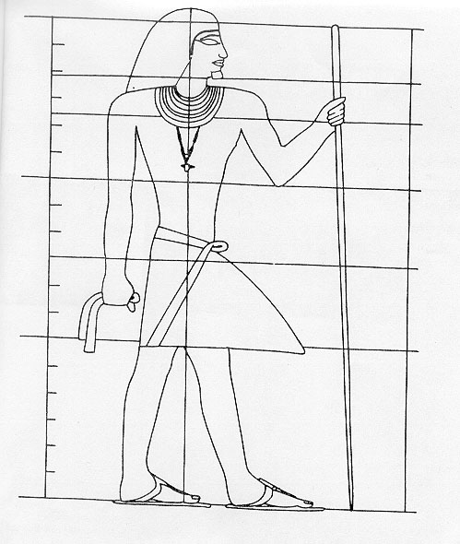
Multiple Perspectives
Another interesting device, where the aim is not necessarily to reproduce the visual image, but to give a composite image combining the most descriptive or characteristic view of each part.
A profile (side view) with a front viewed eye for example, a front view torso, with a side view of the legs and so forth.

Slide 17
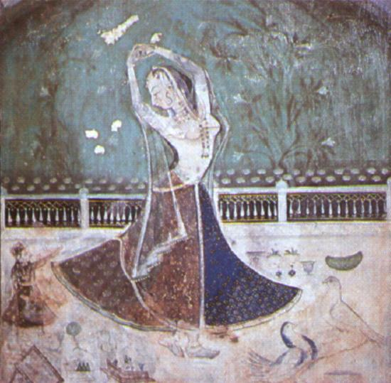
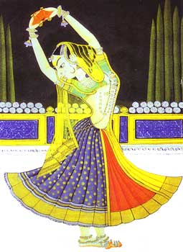
This devise has a lot of significance in a way, that, it is so much different from the photographic reality.

Slide 18
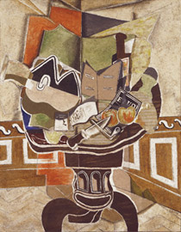
Braque, The round table, The items on the table top are simplified into basic shapes, are shown from different angles to give us the most descriptive view, or views, of each individual items. It shows the table’s top view as well as the table stand in one frame, unrealistically, but effectively, with a fresh approach.
The cubist artist clearly employed multiple perspectives in his still life.
This aspect has been meant to give a more subjective, conceptual view of forms.

Slide 19
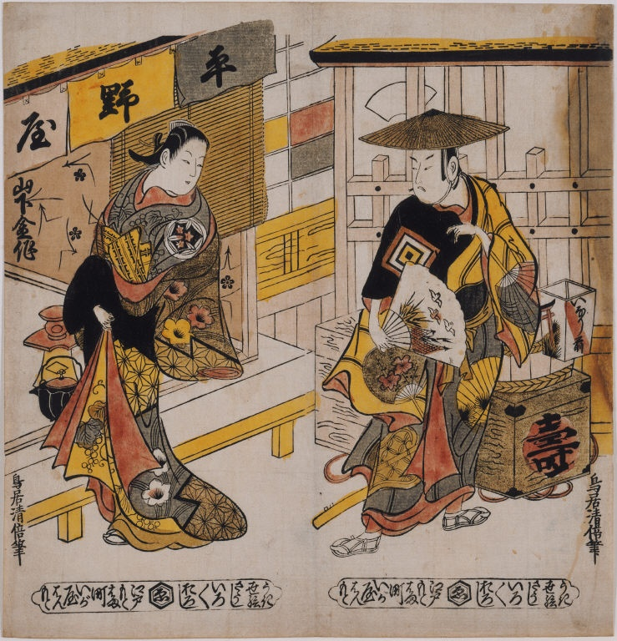
Oriental Space
Isometric projection
Traditionally, oriental artists did not make wide use of linear perspective, the lines, instead of drawing closer together, remain parallel.
It helps to show a greater amount of space in the given frame.
Torii Kivomasu.

Slide 20
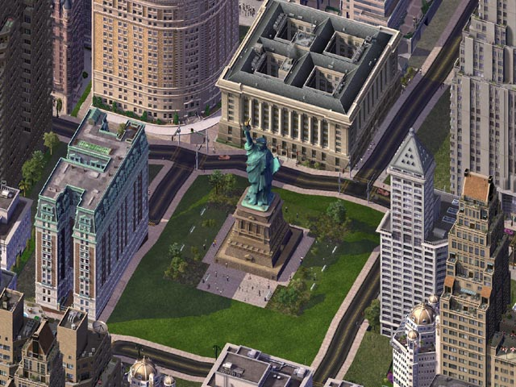
Isometric projection

Slide 21
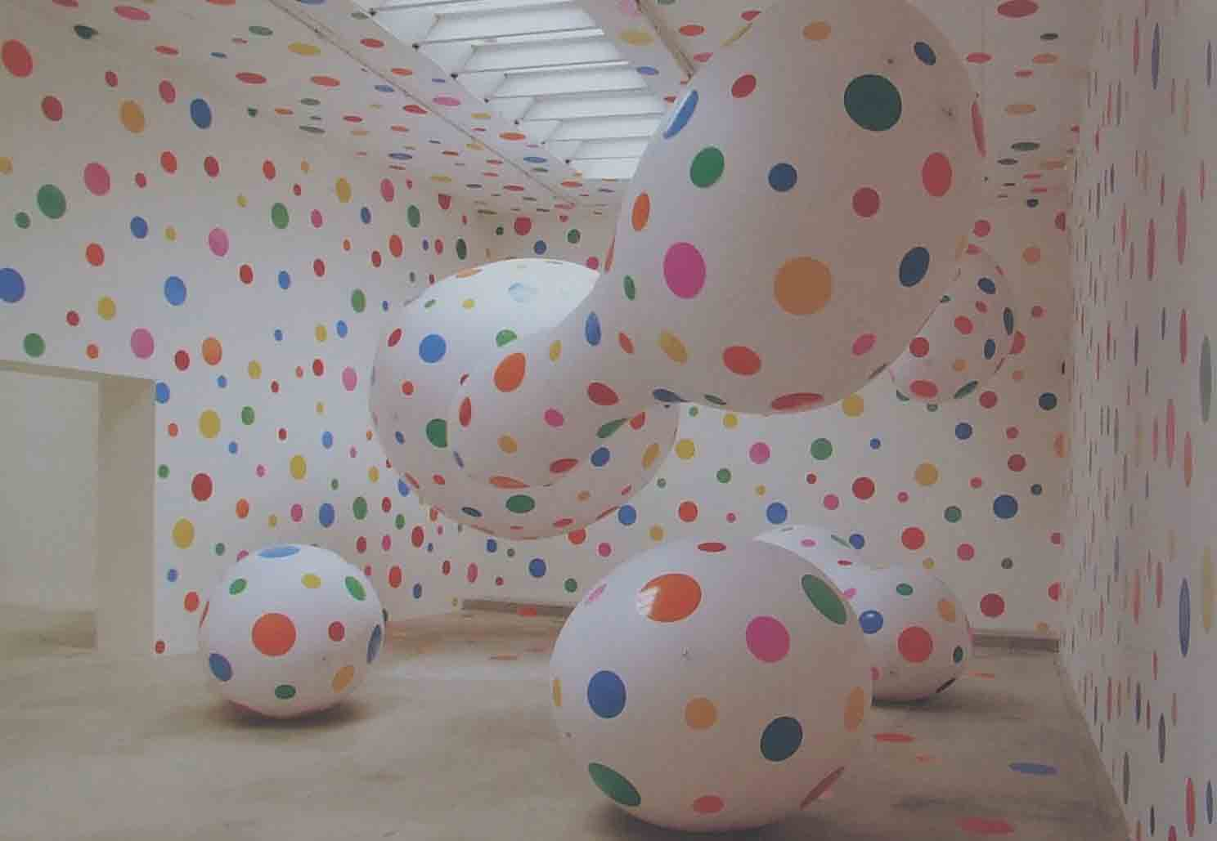
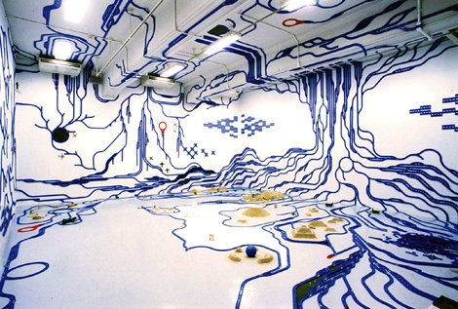
Frame restriction; open/close form
We may or may not restrict our visual in close frames.
Closed forms are formal, structured in appearance, while, open forms being not so common gives a casual at the same time special, momentary feeling.

Slide 22
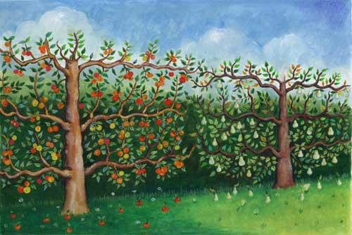
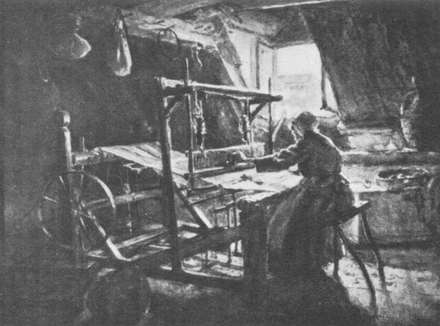
Plane/Diagonal Recession
Showing recession diagonally create more drama in the visual space.

Slide 23
Spatial Puzzles
Distorting image to confuse viewer for a change, to add some humor.
Creating ambiguity in space
Creating a space far from visual reality, may be surreal in nature, without any detection of mistake in the technicalities.

Slide 24
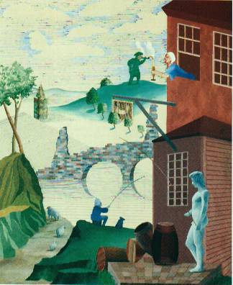
David Hockney1975

Slide 25
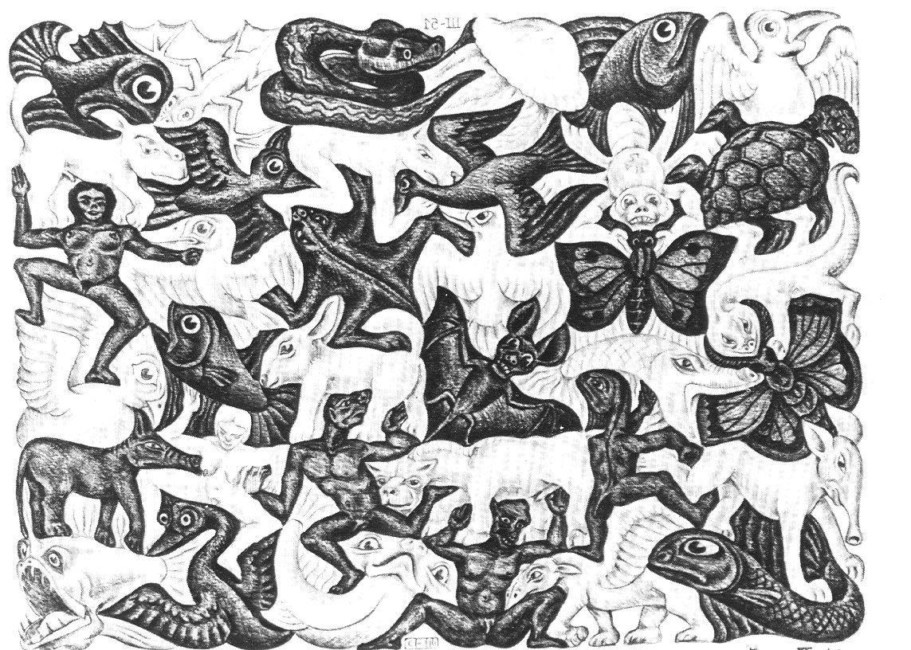
M.C.Eschar

Slide 26
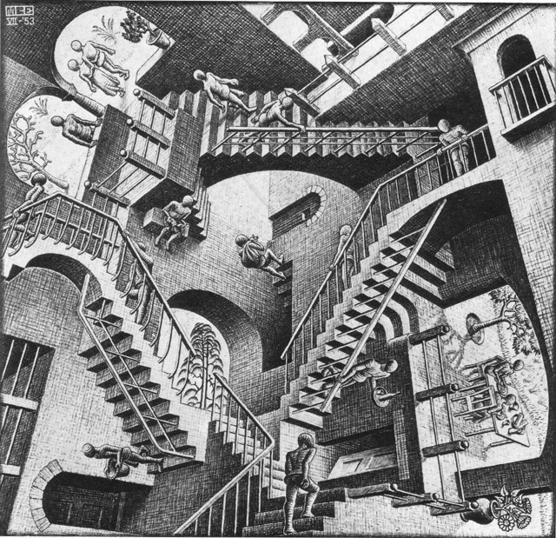
M.C.Eschar

Slide 27
