Slide 1
Scale/Proportion
Scale and proportions are similar terms with a slightly different emphasis.
Big or small remains meaningless unless we have some standard of reference.
Proportion refers to relative size, size measured against other elements or against some mental norm or standard.

Slide 2
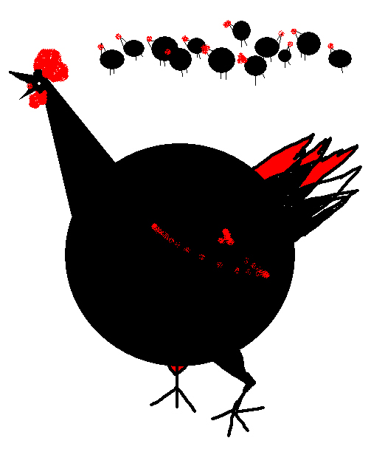
Here the large black circle would certainly be called large scale. It is a large element and occupies much space, given the overall dimensions of the design. It could also be described as out of proportion, compared to others, tiny elements. But an out of scale element in art is not always a fault depending on the purpose, such an element could communicate a theme, however visually disturbing.

Slide 3
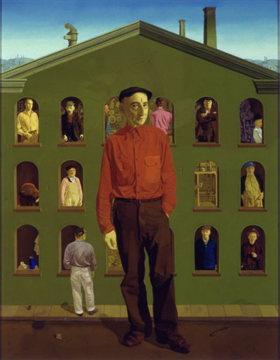
The eye goes naturally to the large scale figure first, the artist,Honore Sharrer, has created a focal point that dominates the other smaller figures.

Slide 4
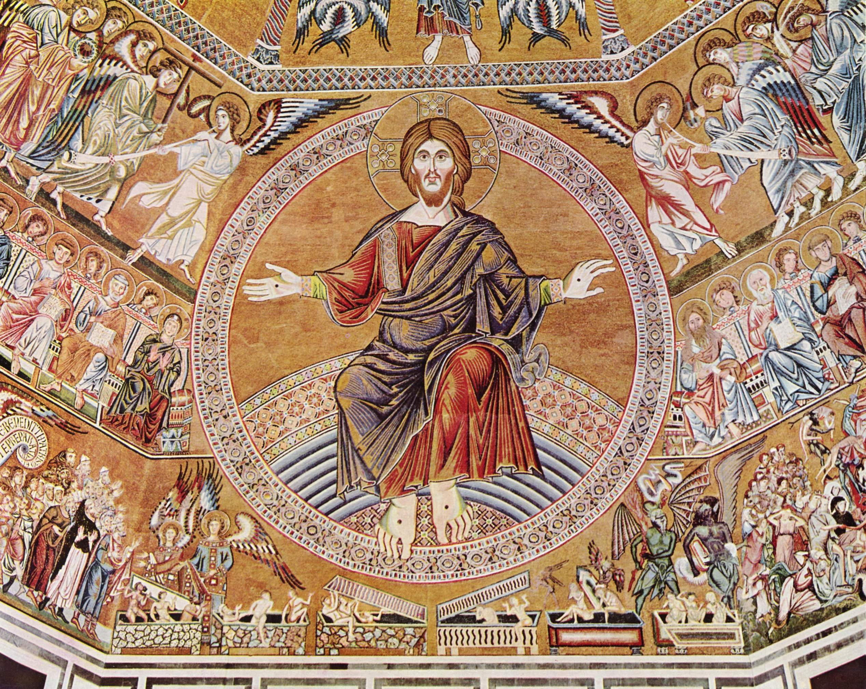
This is an example of HIEATIC SCALEING. By making a figure unnaturally large, the artist immediately established not only an obvious visual focal point but also indicated the angel’s conceptual importance.

Slide 5
Scale of Art
Considering the scale of the work itself--- its size in relation to other art, in relation to its surroundings, or in relation to human size.
When we are confronted by the frescos such as Sistine Chapel ceiling, our first reaction is simply awe at the enormous scope of the work. Later, we study and admire details, but first we are overwhelmed by the sheer magnitude.

Slide 6
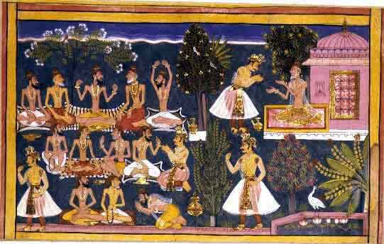
It may also come as shock when we see an original for it is tiny, barely similar to its reproduction here.

Slide 7
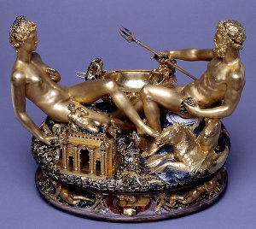
The detailed golden saltcellar graced a regal dining table.Benvenuto Cellini.

Slide 8
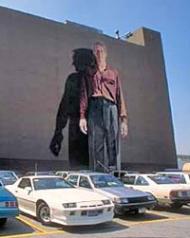
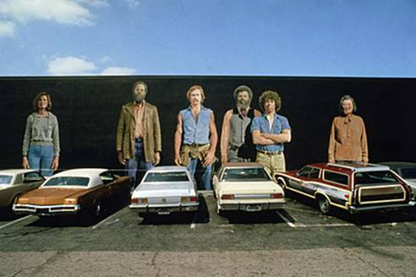
Kent Twitchell. Acrylic oil painting,1977 The naturalistic images blown up to such monumental scale cannot be ignored, and they alter the urban environment.

Slide 9
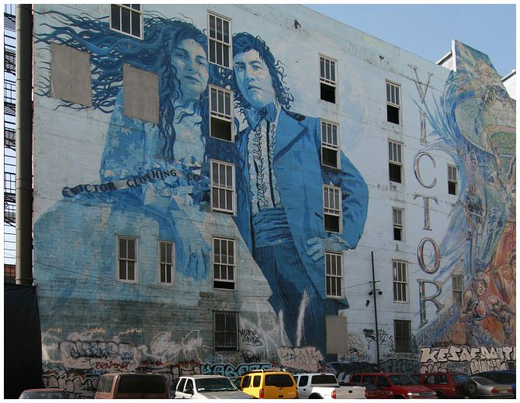
Kent Twitchell. Acrylic oil painting

Slide 10
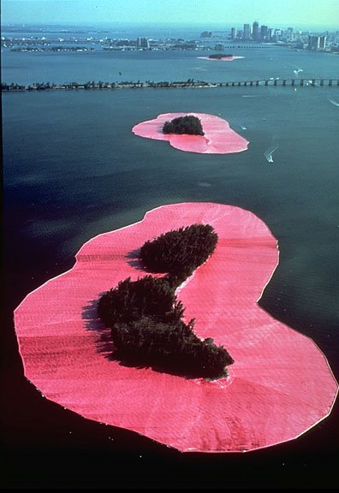
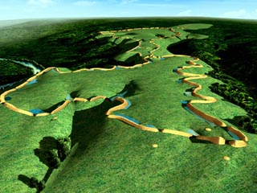
a computerized reconstruction of the site as it may have appeared 1,900 years ago
Chirsto has convinced and constructed unique landscape projects those are gigantic in scale. Earth shows as an unrestricted canvas/workspace, with the traditional link to the past in the huge earthworks constructed in many countries by ancient people.

Slide 11
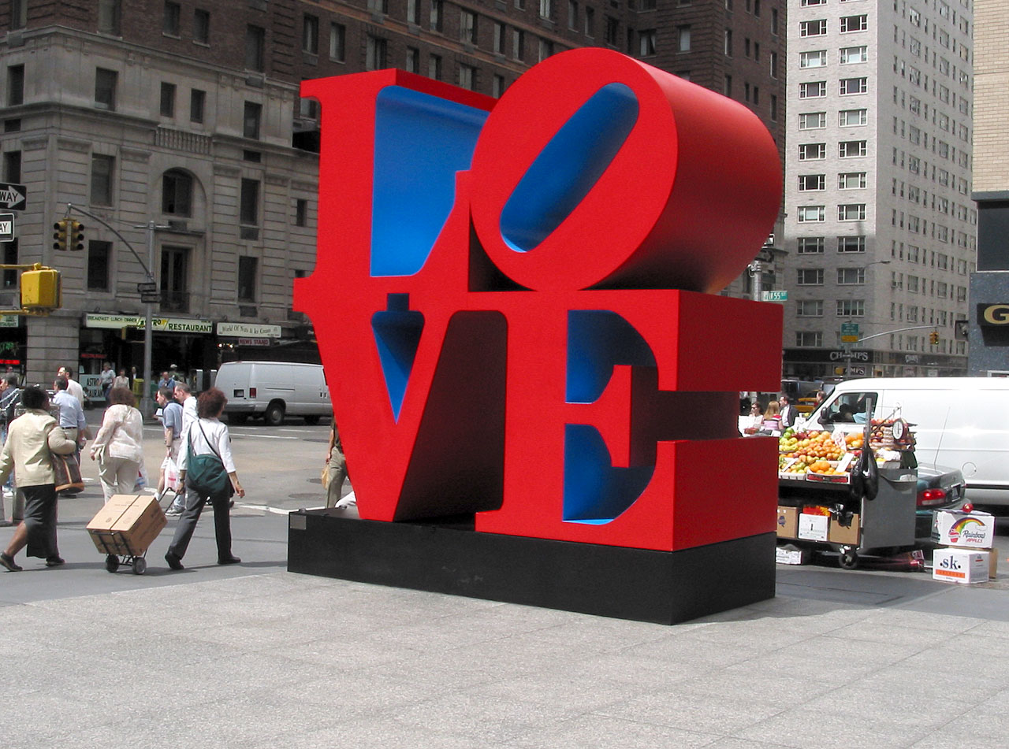
Probably no motif from contemporary art has been reproduced so many times for so many different purposes as Robert Indiana’s LOVE. The image has been used on T-shirts, coffee mugs, match box covers, wall posters, bracelet charms, postage stamps, cocktail napkins and myriad other things. In each medium it has changing scale; but each time it remained graphically appealing to a large audience.
We call this quality as Monumentality in art.

Slide 12
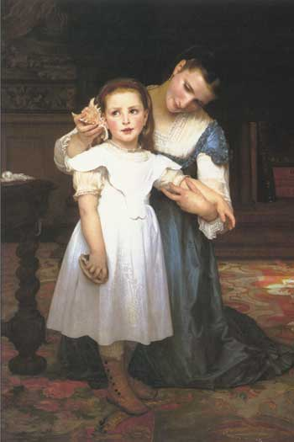
French Salon artist of the 19th.century often painted their illustrative anecdotes in enormous scale in order to stand out among the hundreds of works shown in the yearly exhibits.
Be sure you know in your mind why your design should be overlarge or very tiny.

Slide 13
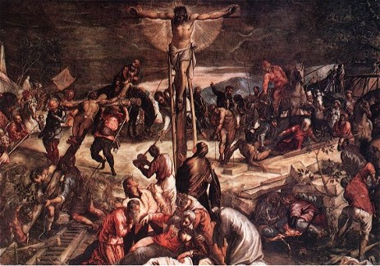
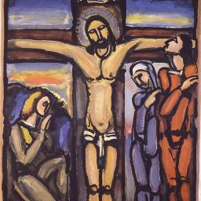
Scale within Art
Jacopo Tintoretto, 1565 Georges Rouault, 1932
Both have themes dealing with the sufferings of Christ.
The main difference in the two images is the use of scale within the picture.
In contrast to Tintoretto, Rouault’s figure of Christ being mocked by the soldiers is large scale.
The two background figures of Roman soldiers give a suggestion of the larger story, but we concentrate on the personal agony of Christ, we forget all other elements and focus on his sorrowful attitude.
Both are emotional images, but the scale of the elements results in contrasting impressions.

Slide 14
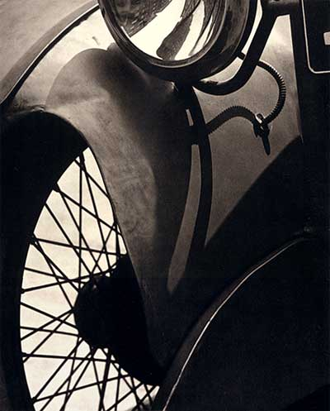
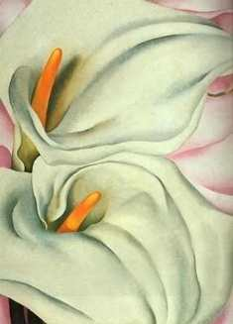
A detail of a flower becomes a monumental image of four feet in Georgia O’Keefe ‘s paintings, may create such dramatic image out of perhaps mundane subject matter.

Slide 15
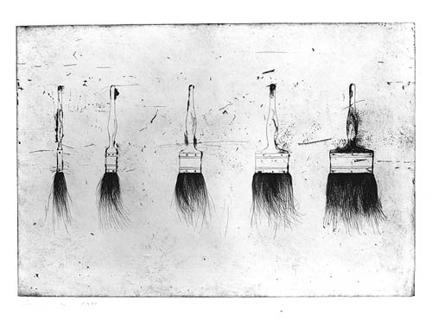
Painter Jim Dine took the opposite approach to scale. Now the detailed small scale provides the interest.
Both techniques of unexpectedly large and unusually a small image are often used by designers of advertising. The change from the usual, or expected, scale can attract the casual reader’s attention.

Slide 16
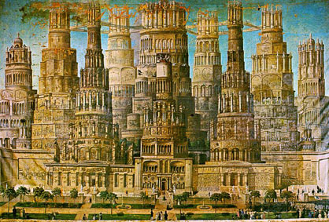
Scale Confusion
In this particular work American artist Estus Field, created a mysterious impact by the image of this impossibly enormous building. The many tall towers, the almost countless colonnades, the statuary-all in a veritable maze of architectural details.
The artist has painted a vision, an image totally outside our experience.
Surrealism is an art form based on paradox, on images that can not be explained.
The artists who work in this manner present the irrational world of the dream or nightmare-recognizable elements in impossible situations.

Slide 17
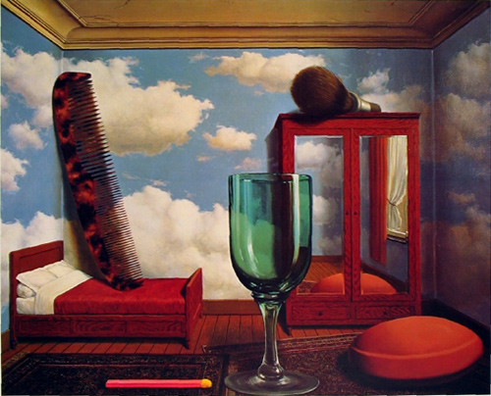
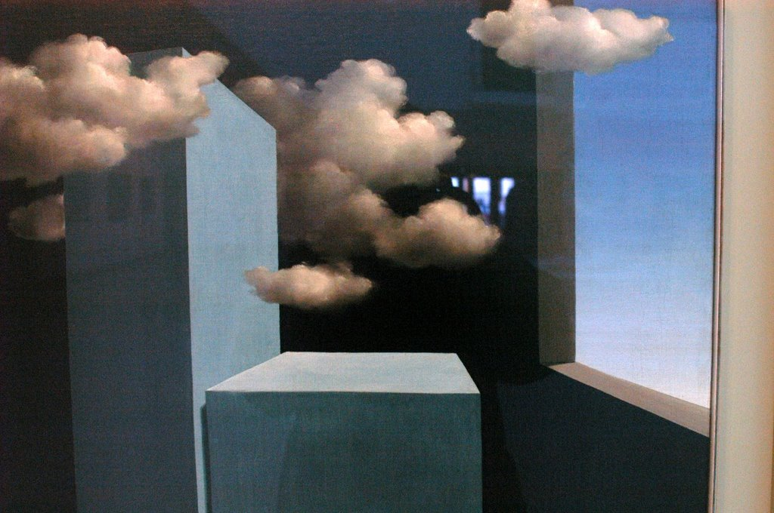
The painting by Magritte shows one such enigma. Confusion of scale. The comb etc. are either having an abnormal size or a normal one in an abnormally small room, neither explanation makes a rational sense.

Slide 18
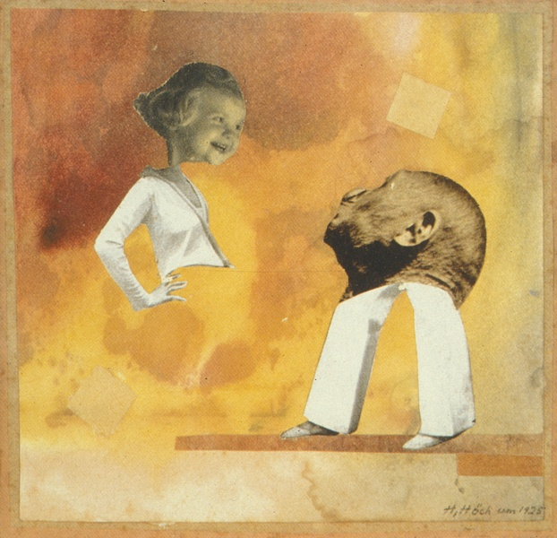
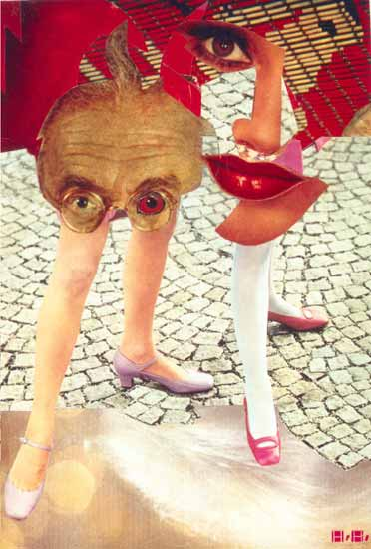
The Dada artist also used the irrational imageries, the photomontage by Hannah Hoch, again employs scale differences to produce a totally incongruous design.
The extreme shifts in size on various parts of the two figures startle and intrigue the viewer.

