Slide 1
“ Hands and machines are equal. Each works in its own way, each has its own beauty. The designer must find the right balance of human touch and mechanical structures.”
Reiko Sudo

Slide 2
Line
Other than making a mark made by a pointed tool, line is a form that has length and width.
Geometry defines a line as an infinite numbers of points.
In art we may call line a moving dot.
A line is created by movement, therefore it inherits a rapid and dynamic quality, which expresses the theme of the drawing.
A line is a minimum statement, capable of infinite variety.

Slide 3
Line and Shape
Line describes shapes, acts as edges.
There are no lines exists in nature but objects which are linear in feeling.
No line runs around objects. Line is an element to describe and identify shape and guide to understand the image.
Line as a design element is mighty self sufficient.

Slide 4
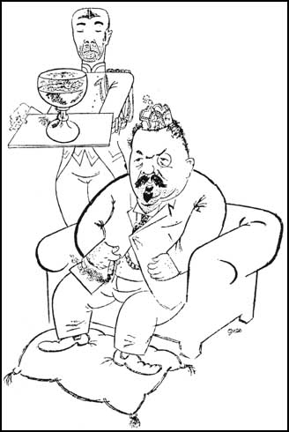
George Grosz, Friedrich Ebert:
Life of a Socialist (1919)

Slide 5
Types of lines
An implied line is created by positioning a series of points so that the eyes tend automatically to connect them.
A psychic line is no real/physical line, but a mental connection between the two elements. This occurs when something points in a certain direction, the eye invariably follow, and the psychic line results.

Slide 6
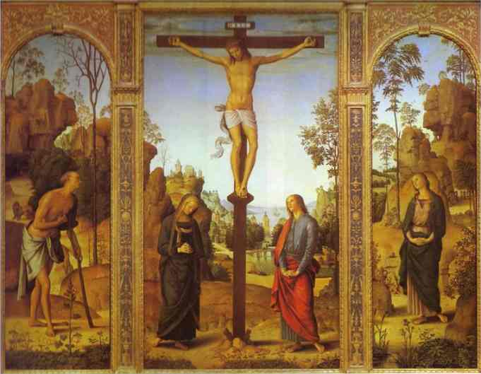
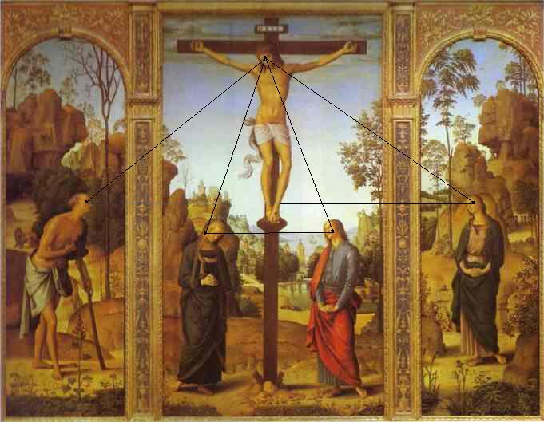
Pietro Perugino. The Crucifixion with the Virgin, St. John, St. Jerome and St. Mary Magdalene. c.1485. Oil on canvas.
In this work actual lines are formed for all edges.
An implied line is created at the bottom, where the virgin’s feet, the base of the cross, and St.John’s feet are points that connect into a horizontal line. This particular line is also picked up in the horizontal shadows of the side panels.
Physic lines occur as our eyes follow the direction in which each figure is looking at.
The purpose of these lines is to unify or visually tie together the various elements.

Slide 7
Line direction
A horizontal line implies quiet, repose.
A vertical line such as a standing body has more potential for activity.
But a diagonal line suggests motion, indicating movements.
The horizontal and vertical lines within a design are called stabilizers, elements that reduce any feeling of movement.

Slide 8
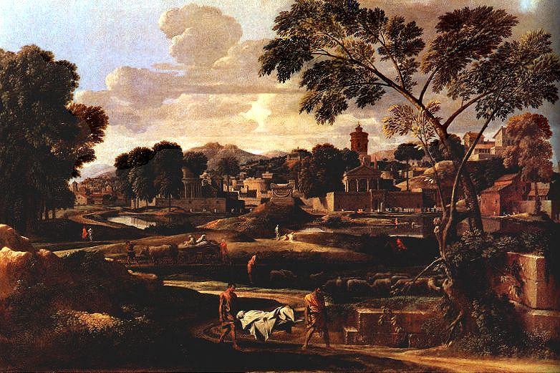
Nicholas Poussin The Funeral of Phocion, 1648
Poussin’s work contains predominantly horizontal and vertical lines, with the diagonal road being the major exception.
The emphasis, extending even to the clouds, is not just chance. The artist planned it.
This painting often is called a classical work, a term that implies a static, serene, unchanging image
The emphasis on horizontal and vertical is a major factor in classicism.

Slide 9
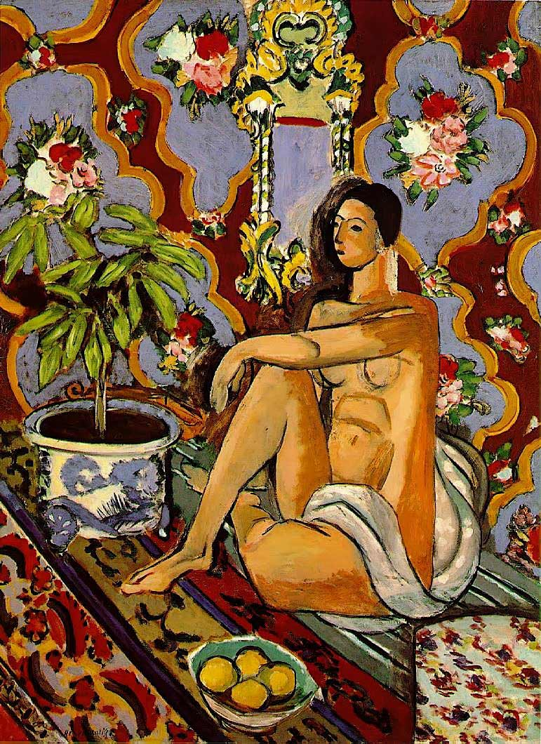
Matisse, Henri Decorative Figure on an Ornamental Ground
We are accustomed to seeing pictures with figures in action posed against static backgrounds. Matisse has reversed his norm. The figure is highly linear, with many horizontal and vertical outlines and therefore immobile. The background floats with diagonal lines, and curves form diagonal patterns on the walls and floor.

Slide 10
Contour and Gesture
Regardless of the chosen medium, when line is the main element of an image, the result is called a drawing.
There are two general types of drawings:
Contour
Gesture
When line is used to follow the edges of forms, to describe their accurately observed outlines, the result is called a contour drawing. This is probably the most common use of line in visual design.
Lines are often executed with tonal gradations to emphasize certain areas as well as details are often ignored.
In gesture drawing describing shapes is less important than showing the action taking place. Line does not essentially stay at the edges, but moves freely within forms.

Slide 11
Contour Drawing may have a sketchy quality about it. These are often spontaneous in manner as the artist feels less obligated in recording exact details.
Gesture Drawings are almost always created quickly and spontaneously. It captures the momentary aspects of subject, rather than recording nuance of the very form. Gesture drawing are not drawings of objects as much as drawings of movement.
While quite different approaches to drawing, these two categories of lines are not mutually exclusive. Many drawings combine elements of both.

Slide 12
Line Quality
A line done with a brush and ink is heavy and bold, with variation of thickness.
A dry brush may reinforce the spontaneous effect to express the feel of a rapid scribble like movement .
The linear technique one chooses can produce emotional or expressive qualities in the final pattern. Solid and bold, quiet and flowing, delicate and dainty, jagged and nervous, or countless other possibilities will influence the effect on the viewer of the design or drawing.
Once the theme is conceived, a suitable linear technique is to be chosen to fit to it.

Slide 13
Line as Value
A single line can show the shape of objects. But an outline shape is essentially flat, it does not suggest the volume of the original subject.
The artist can, by placing a series of lines close together, create visual areas of grey.
By varying the numbers of lines and their proximity an almost limitless numbers of mid tones (grays) can be created.
These resulting areas of dark and light or areas of value, can begin to give the three dimensional quality lacking in a pure contour line.
Quality of line may vary among different artists.

Slide 14
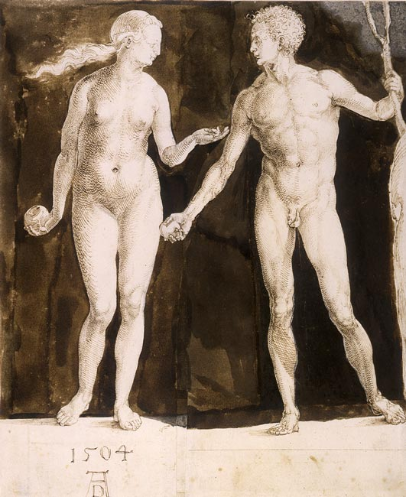
In this drawing Durer added a series of parallel lines in a criss-cross pattern or cross hatches to create the gray tone or middle tone.
Mid tone causes the figure to have some roundness or naturalistic volume.

Slide 15
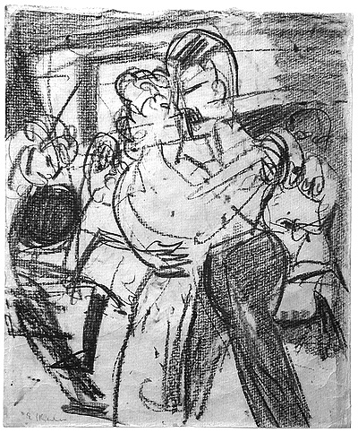
In this drawing of Kirchner the technique is rather lose, more spontaneous, and even scribbled quickly in places. Charcoal as a medium gives a linear effect that is softer, more indistinct, and smudgy.
Moreover the very approach leads towards expression rather than a record of the visual image.

Slide 16
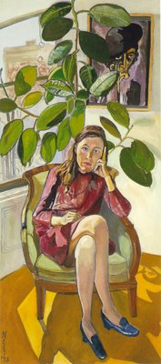
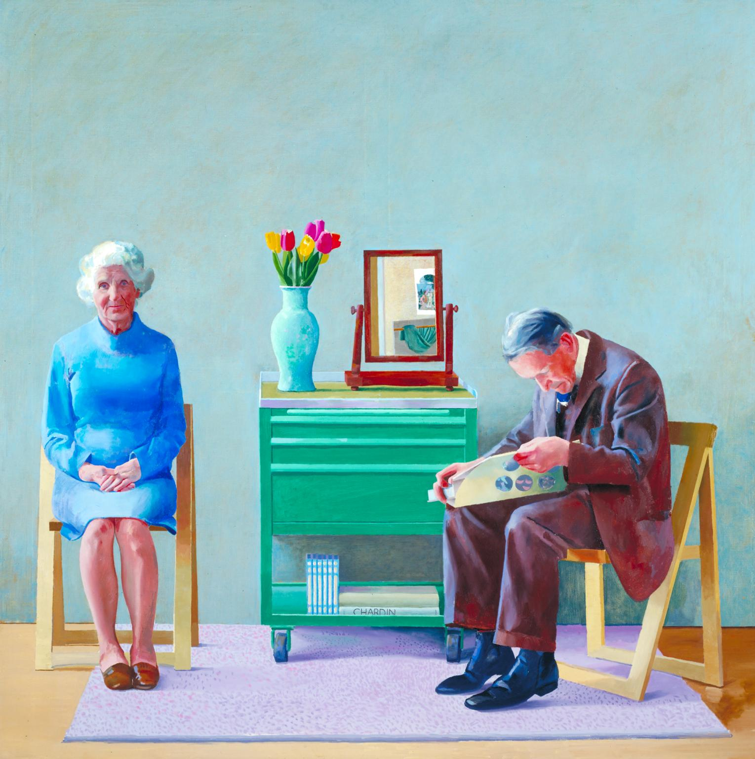
Line in Paintings
Line becomes important to paintings if the artist deliberately or purposely
choose to outline forms.
In this work by Alice Neel we can see such obvious lines

Slide 17
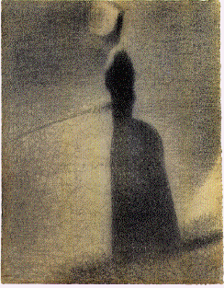
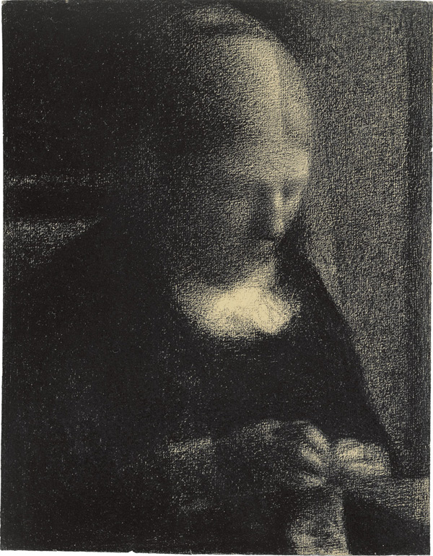
In this drawing of Seurat, the line is almost totally confined to the background. The figures are silhouetted against areas of soft, vertical, linear strokes of conte crayon.
Only a few lines within the body suggest the characters. The effect is soft, delicate understated. Contour is vague and indefinite, with only a faint line here and there actually defining an edge, giving the drawing an abstract quality and a great contrast to the precise exactitude found in.

Slide 18
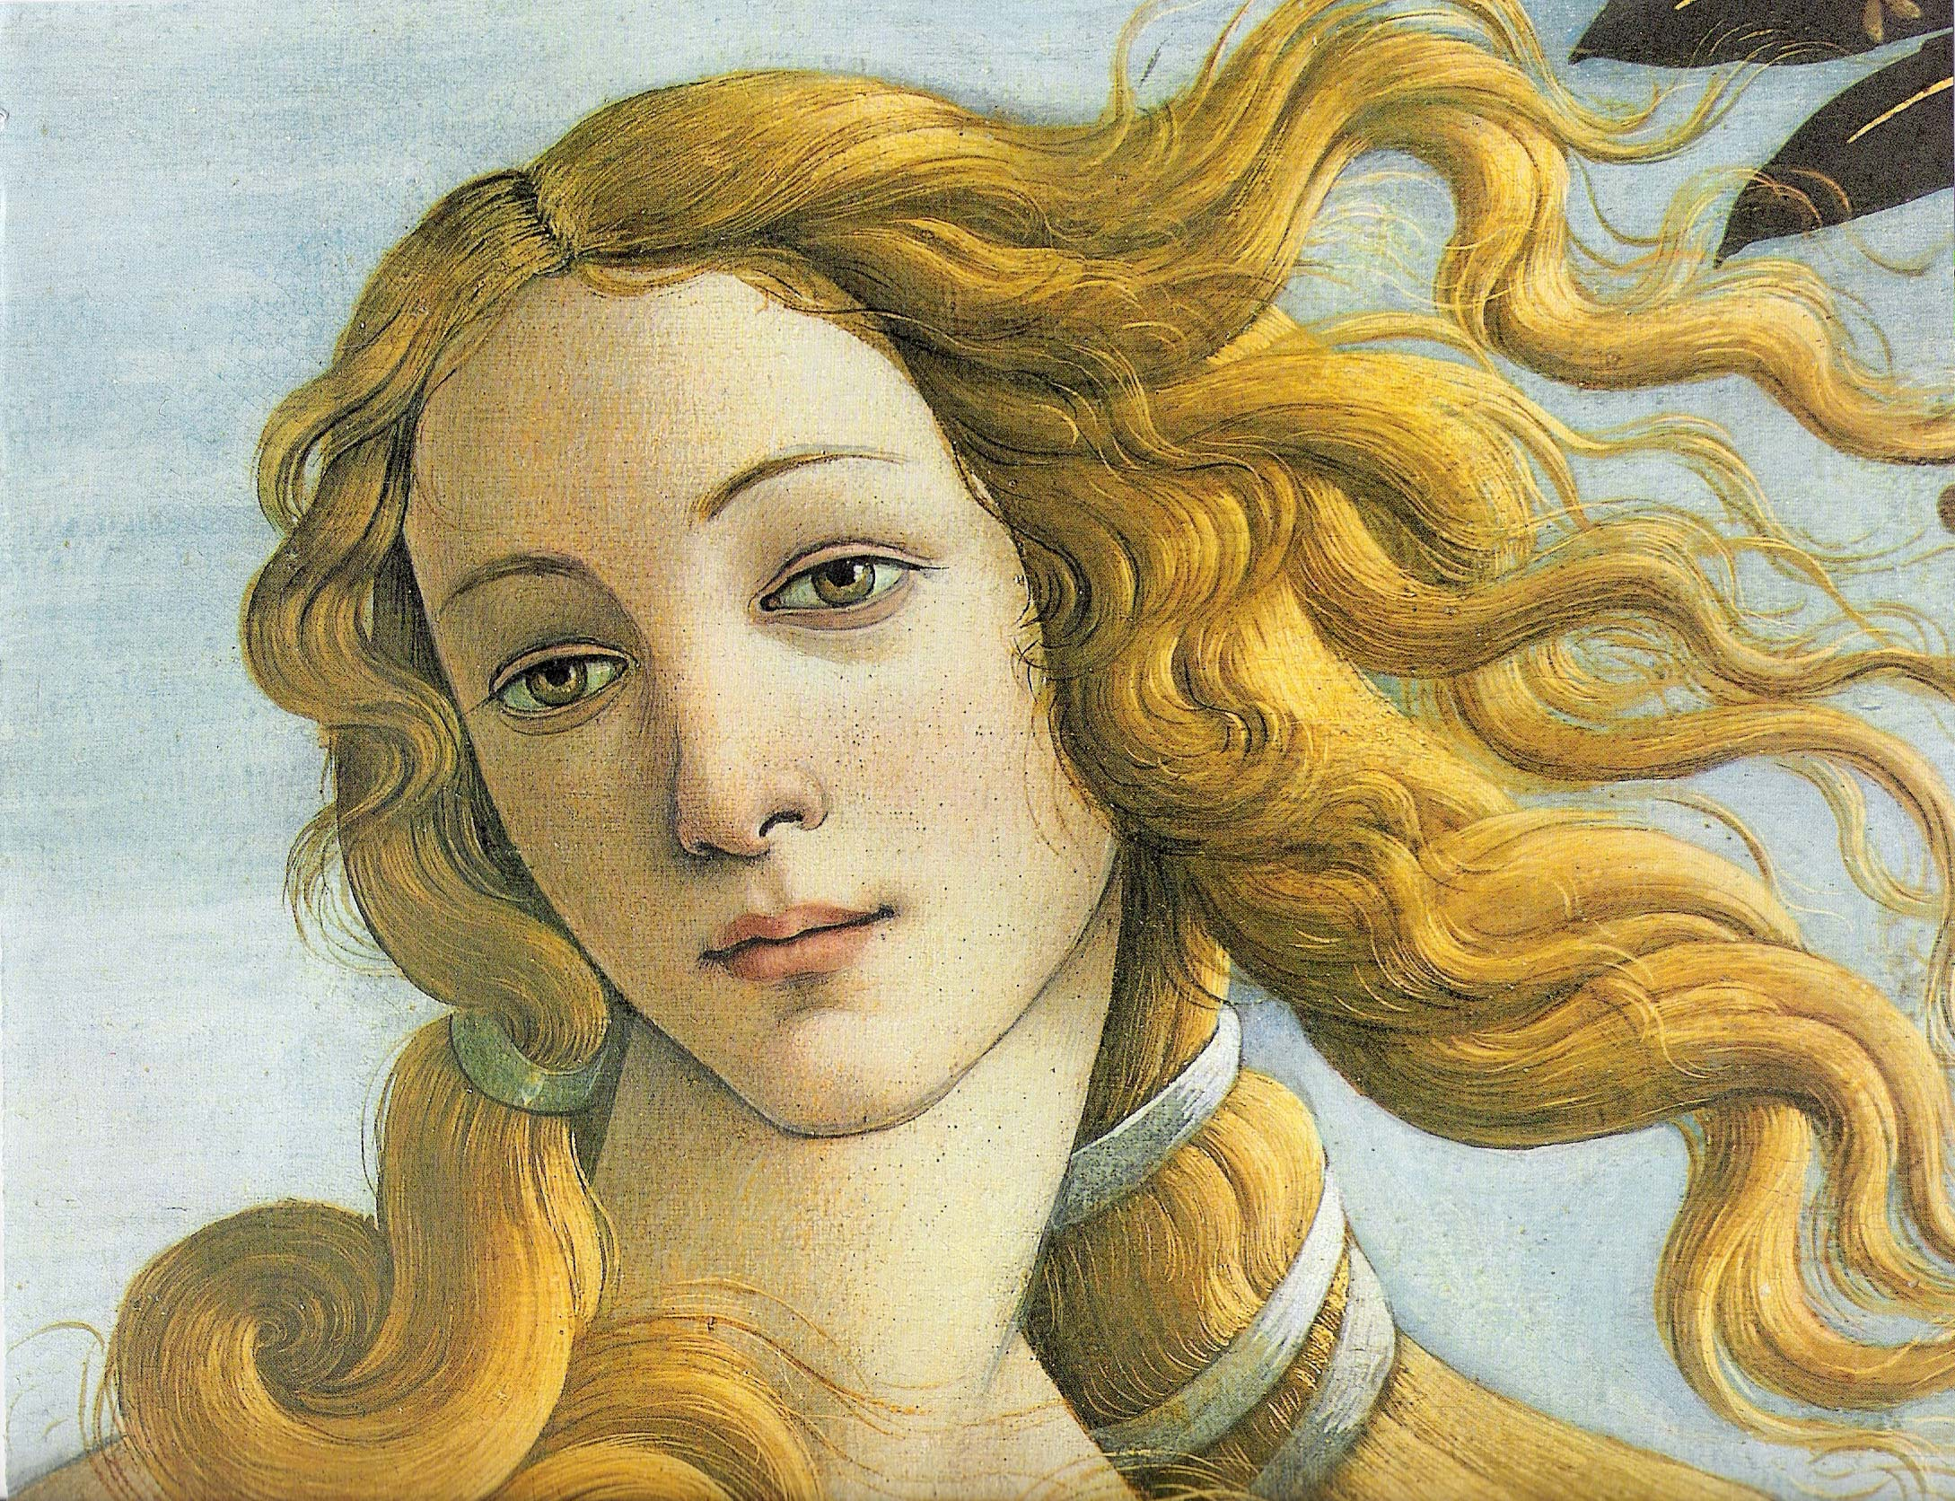
There are prominent swirling lines in the detail of Botticelli’s Venus.
There is a distinct value difference in the jaw line and the neck line.
Various delicate and sharp lines are seen to be skillfully arranged to bring about a lively quality allover.

Slide 19
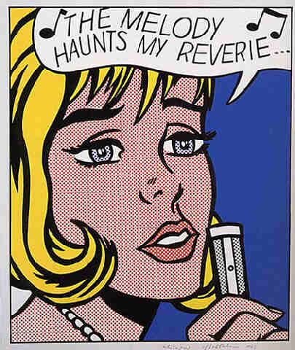
Roy Lichtenstein , a famous pop artist employs an extremely bold line- almost a crude line reminiscent of the drawing in comic books.
If we compare the earlier plate of Venus with this one, this is for sure that the respective artists has adapted their techniques to the theme.
Venus is portrayed as the embodiment of all grace and beauty, and Lichtenstein's character in contrast a singer suggests a dull contemporary culture with a blatantly commercial image.

Slide 20
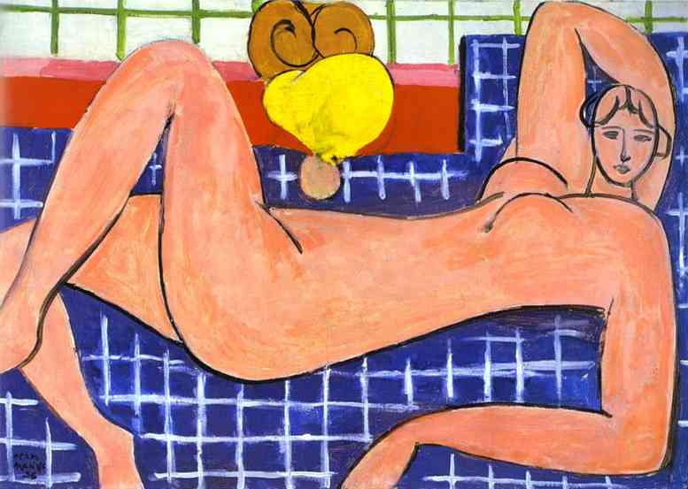
The use of a black or dark line in a design is often belittled as a “crutch”.
There is no doubt that a dark linear structure can often lend desirable emphasis when the initial colour or value pattern seems to provide little excitement.
Many artists both past and present, have purposely chosen to exploit the decorative quality of dark line to enhance their work.

Slide 21
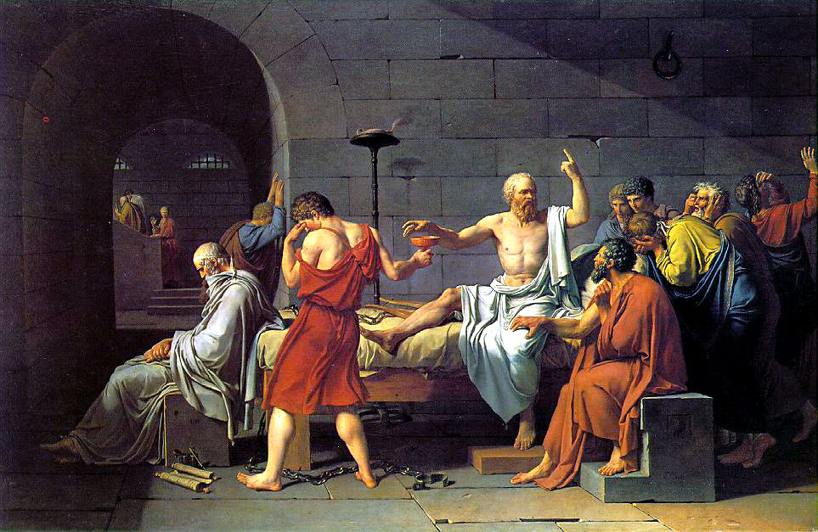
Jacques Louis David’s painting The Death of Socrates contains no actual outlines, as such. The contour edges of the figures are quite sharply defined.
The colour adds interest to the whole scene but the viewer remains absolutely aware of the essential drawing underneath.
Despite the absence of actual lines the work holds the classification of a linear painting.

Slide 22
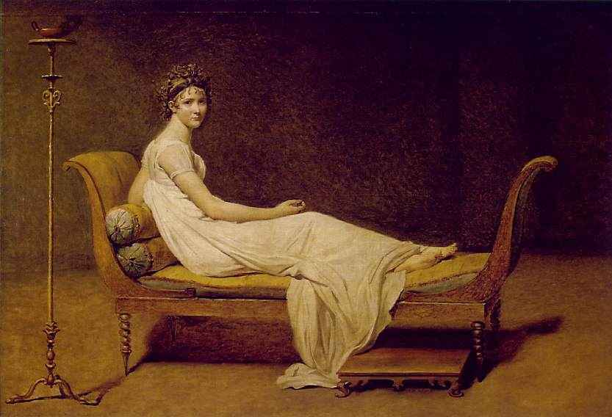
Jacques Louis David

Slide 23
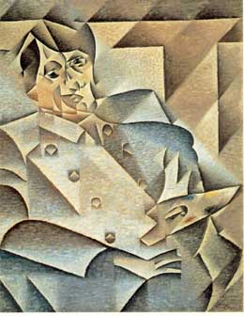
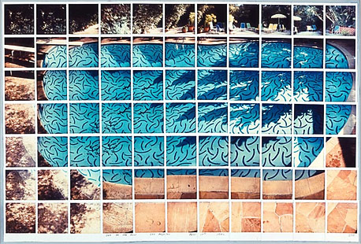
A linear painting is distinguished by its clarity. The emphasis on edges, with the resulting separation of forms, makes a clear, definite statement.
An abstract painting which otherwise simplifies form and ignores minute details, often presents this effect.

Slide 24
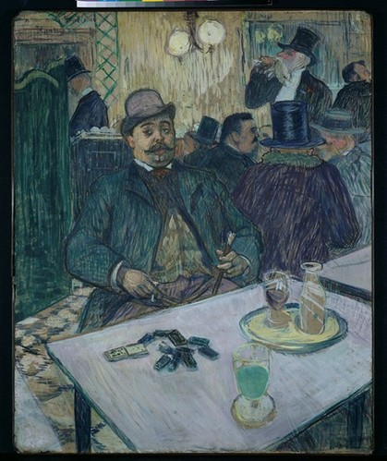
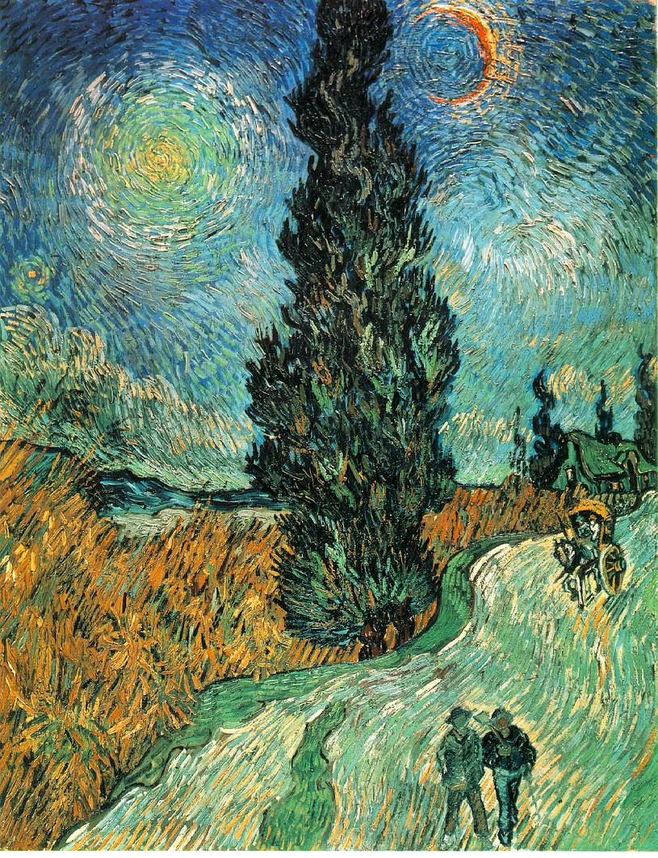
Linear techniques can be used in applying colours.The coloured areas are built up by repeated linear strokes of the brush, which are not smoothed over.
Toulouse Lautrec’s café scene shows that the artist actually drew with the brush; almost every area is constructed of variously coloured linear strokes.
The line direction varies to describe the different shapes.
Van Gogh used similar technique in a more agitated and dynamic way. Short linear strokes swirl around the painting.
In both Lautrec’s and Gogh’s work multicolored lines give an interesting textural effect to the various areas and provide another element of visual unity.

Slide 25
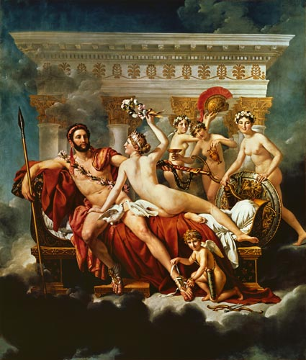
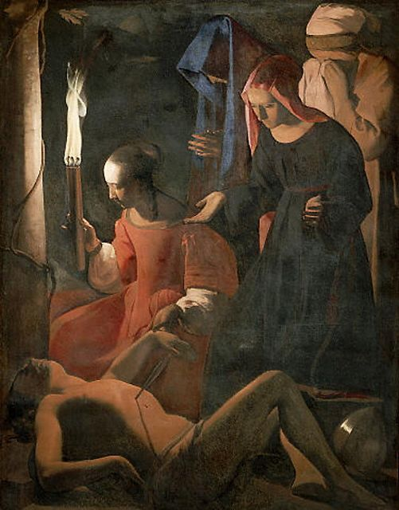
Lost and Found Contour
The above painting by David has again no actual lines.
The colour and value variations of the painting impart interest, but the line version is perfectly understandable.
The effect is different in this painting by de la Tour.
He puts more emphasis on colour and value than on line. In each of the figures, only part of the body is revealed by a sharp contour, but the edge then disappears into a mysterious darkness.

Slide 26
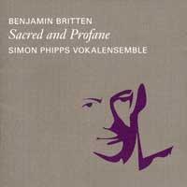
The artist gives us a few clues and we fill in the rest.
Lost and found contour provides the viewer with relative clarity, for many forms are not fully described.
The exiting effect of strong highlights and edges lost in darkness is of course, not confined to painting. Artists in all mediums may use it.
In photography the right selection of light by the photographer often exploits the emotional effects of lost and found contour.

