Slide 1
Fundamentals of Testing
Software Testing
ISTQB / ISEB Foundation Exam Practice
1. Fundamentals
2. Testing in SDLC
3. Static Testing
4. Test
Techniques
5. Test
Management
6. Tools
Chapter 1

Slide 2
CONTENT
What is testing?
Why testing is necessary
Testing principles
Fundamental test process
Psychology of testing
Code of Ethics

Slide 3
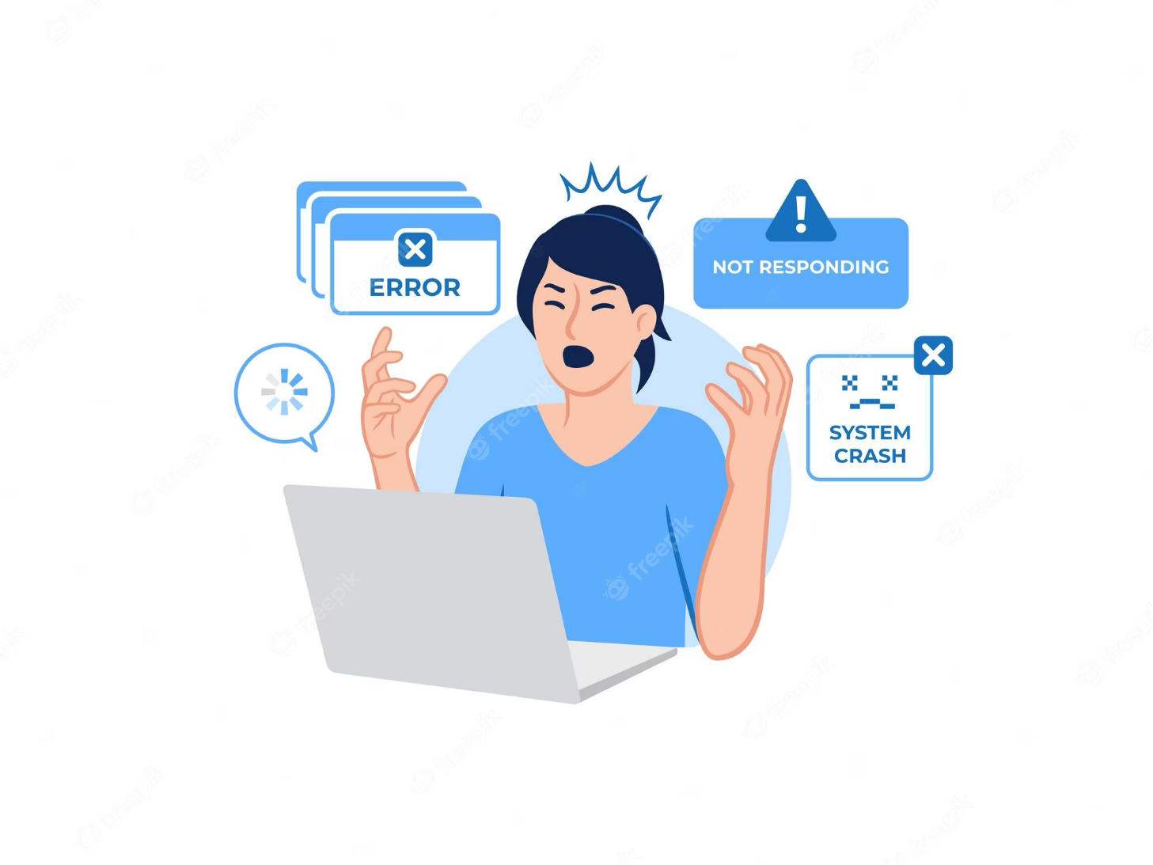
What is Testing?: Background
Most people have had an experience with software that did not work as expected
Software that does not work correctly can lead to many problems, including:
  loss of money, time, or business reputation
  injury or death (can you think of an example?)
Notes:
How can a software cause injury or death? – Can you think of an example?
There are many scenarios
If you’re driving a car, your car contains around 50 microcontroller, 50 small computers: one for the brakes, one for your seat, one for the gears, and so on. If there is a problem, for example, in the software that is attached to the brakes, you might have an accident. OR, supposed that you are not concentrating and you’re driving your car; then the navigation application told you to turn right and this is a one-way street.
Alzheimer patient and there’s an application that reminds him of his pill’s timing. If there is a problem with the application & it rings at a wrong time, the patient’s health might be in great danger.
Airplanes

Slide 4
What is Testing?: Cost of Software Faults
Huge sums
  Ariane 5 ($7billion)
  The Explosion of the Ariane 5 (umn.edu)
  Mariner space probe to Venus ($250m)
  Mariner 1 destroyed due to code error, July 22, 1962 – EDN
  American Airlines ($50m)
Very little or nothing at all
  minor inconvenience
  no visible or physical detrimental impact
Software is not “linear”:
  small input may have very large effect

Slide 5
What is Testing?: Safety-critical systems
Software faults can cause death or injury
  radiation treatment kills patients (Therac-25)
  train driver killed
  aircraft crashes (Airbus & Korean Airlines)
  bank system overdraft letters cause suicide
  Debt lad’s suicide note …on letter from bank – The Sun

Slide 6
What is Testing?
No generally accepted set of testing definitions used world-wide
New testing standard BS 7925-1
  Glossary of testing terms (emphasis on component testing)
  most recent
  developed by a working party of the BCS SIGIST
  adopted by the ISEB / ISTQB
  Working Draft of BS 7925-1 (testingstandards.co.uk)

Slide 7
What is Testing?
The process consisting of all lifecycle activities, both static and dynamic, concerned with planning, preparation and evaluation of a component or system and related work products to determine that they satisfy specified requirements, to demonstrate that they are fit for purpose and to detect defects.
Source: ISTBQ glossary
Software testing is a way to:
  assess the quality of the software
  reduce the risk of software failure in operation

Slide 8
Question
Which of the following is a main goal of software testing?
Assess the quality of the software
Increase the quality of the software

Slide 9
Question
If you find a defect while you are testing the software early in the lifecycle, what will be impacted by this action?
Risk of finding this defect in operation will increase
Risk of finding this defect in operation will not be impacted
Risk of finding this defect in operation will be reduced

Slide 10
Question
What is the main role of the tester in software projects?
resolve defects
develop applications
find defects

Slide 11
Question
Software testing is a way to …
Increase the quality of the software
Reduce the risk of software failure in operation

Slide 12
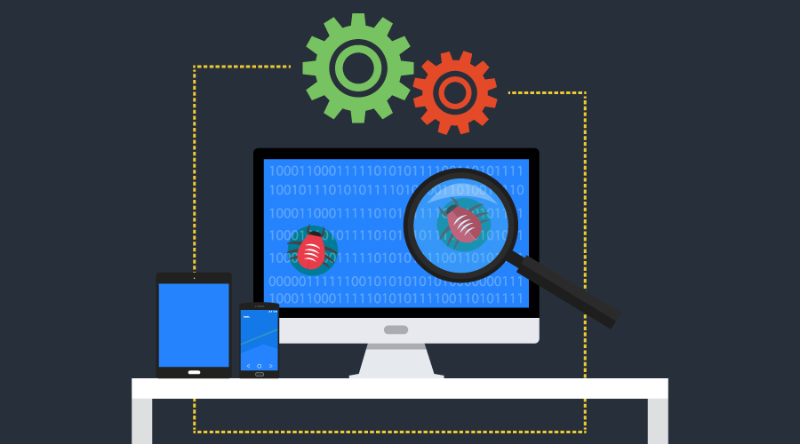

What is Testing?: Misperceptions
Software testing $≠$ Test execution
  Software testing is a process which includes many different activities
  Execution is only one of these activities

Slide 13
What is Testing?: Misperceptions
Static Testing
Software Testing
Dynamic Testing

Slide 14
What is Testing?: Misperceptions
Software Testing
Validation
Verification

Slide 15

What is Testing?: Misperceptions
VERIFICATION
2 sleeves?
Is it size L?
Is it blue?
Are any button missing?
VALIDATION
Does it fit?
Will my crush like it?
Can I afford it?
Does it feel comfortable to wear?
Does the colour match my eyes?

Slide 16
Question
Software testing is not the same as test execution, because software testing is a process and test execution is just one step in this process. The test process consists of 7 steps, do you remember the order of test execution in them?
4
5
6
7

Slide 17
Question
If you get a code from the developer and your task is to test whether the developer added proper commenting to his code or not, which type of testing is this?
Dynamic Testing
Static Testing

Slide 18
Question
Building the right product and building the product right, which one of them is validation and which is verification?
Building the right product is validation and building the product right is verification.
Building the right product is verification and building the product right is validation

Slide 19
Question
If a developer runs his code and finds a defect in it, this is called............
static testing
dynamic testing
system testing

Slide 20
What is Testing?: Objectives of Testing
Work Product Evaluation
Requirement Fulfilment
Building Confidence
Providing Information to Stakeholders
Preventing Defects
Finding Defects
Reducing Risks
Compliance with Law
Objectives may vary

Slide 21
Question
Which of the following can be considered as one main objective of software testing?
Market our product to potential customers
Give the client good knowledge about the status of the project
Evaluate other team members and make a decision about their eligibility to get a bonus

Slide 22
Question
If the tester reviewed the requirements and found a contradiction between two requirements, which objective of testing can be obtained using this activity?
Building confidence
Compliance with laws
Preventing defects

Slide 23
Question
Component (unit) testing is a test level that focuses on individual hardware or software components, and it always happens early in the software lifecycle.
Depending on this definition, what testing objective can be obtained using component testing?
Reduce risk
Give information to stakeholders
Compliance with laws

Slide 24
Question
Which of the following is not an objective of software testing?
requirements fulfilment
building confidence in components
Preventing defects
reducing project duration

Slide 25
Question
When test cases are designed early in the lifecycle, verifying the test basis via the test design, which common test objective is being achieved?
Gaining confidence
Finding defects
Preventing defects
Providing information for decision making

Slide 26
Question
If you are making sure that what you have built is the same as what the client wants, which test objective is mostly met by this activity?
reducing risks
finding defects
requirements fulfilment

Slide 27
What is Testing?: Testing & Debugging
The process of finding, analysing & removing the causes of failures in software
The activity to ensure that the fix does resolve the failure
Testing
Debugging
Confirmation Testing
Tester’s job
Dev’s job
Tester’s job
In Agile development and in some other lifecycles, testers may be involved in debugging and component testing.

Slide 28
Question
Which of the following is a correct definition to debugging?
Testing/checking whether the software performs correctly
Checking that no unintended consequence have occurred as a result of a fix
Identifying the cause of a defect, repairing the code & checking if the fix is correct
Checking that previously reported defect has been corrected

Slide 29
Question
In which lifecycle may testers be involved in debugging and component testing?
Waterfall Model
Agile Development
V-Model

Slide 30
Question
Which of the following is an example of debugging?
A tester finds a defect & reports it
A tester retests a fix from the developer & finds a regression
A developer finds & fixes a defect
A developer performs unit testing

Slide 31
Question
Which of the following statements BEST describes the difference between testing & debugging?
Testing pinpoints the defects. Debugging analyses the faults & proposes prevention activities.
Dynamic testing shows failures caused by defects. Debugging finds, analyses, and removes the causes of failures in the software.
Testing removes faults. Debugging identifies the causes of failures.
Dynamic testing prevents causes of failures. Debugging removes the failures.

Slide 32
CONTENT
What is testing?
Why testing is necessary
Testing principles
Fundamental test process
Psychology of testing
Code of Ethics

Slide 33
Why is Testing Necessary?
Rigorous testing reduces the risk of failures occurring during operation.
When defects are fixed, quality increases.
Testing verifies that a system is correctly built & validates that it will meet user’s and stakeholders’ needs.
Software testing may also be required to meet contractual or legal requirements or industry-specific standards

Slide 34

Testing’s Contributions to Success
Having testers involved in requirements reviews or user story refinement could detect defects in these work products.
Identifying & removing defects at this stage reduces the risks of the wrong software (incorrect or untestable) being developed.

Slide 35

Testing’s Contributions to Success
Having testers work closely with system designers while the system is being designed can increase each party’s understanding of the design and how to test it.
Better understanding at this stage can reduce the risk of fundamental design defects & enable tests to be identified at an early stage.

Slide 36

Testing’s Contributions to Success
Having testers work closely with developers while the code is under development can increase each party’s understanding of the code and how to test it.
This increased understanding can reduce the risk of defects within the code and the tests.

Slide 37

Testing’s Contributions to Success
Having testers verify and validate the software prior to release can detect failures that might otherwise have been missed, and support the process of removing the defects that caused the failures (i.e., debugging).
This increases the likelihood that the software meets stakeholder needs & satisfies requirements.

Slide 38
Quality Assurance & Testing
Quality management refers to all activities that direct and control an organization with regard to quality in all aspects.
  Quality affects not only software development but also HR procedures, delivery processes & so on.
Quality assurance, part of quality management, is typically focused on adherence to proper processes.
  Proper processes → Work products higher quality
Quality control is concerned with the quality of the products rather than processes.
  Testing is a quality control activity rather than a quality assurance activity.

Slide 39
Errors - Defects - Failures
Error (mistake): a human action that produces an incorrect result
Defect (fault/bug): a manifestation of an error in software
  if executed, a fault may cause a failure
Failure: an event in which a component or system does not perform a required function within specified limits
  found defect
Failure is an event; defect is a state of the software, caused by an error.

Slide 40

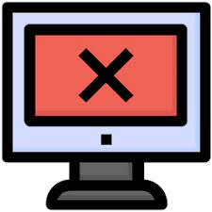
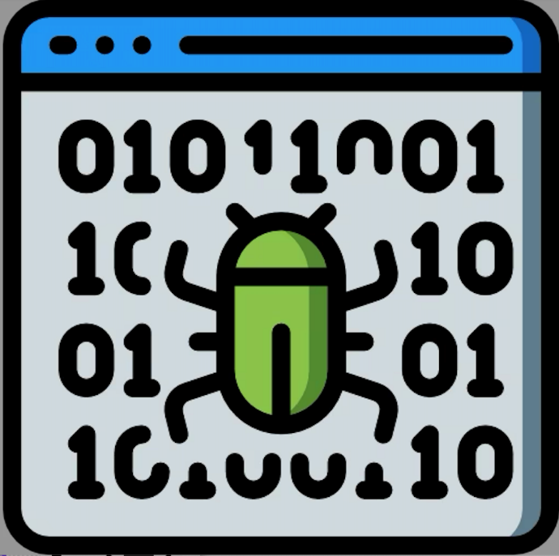
Errors - Defects - Failures
A person makes
an error ...
… that creates a
defect in the
software ...
… that can cause
a failure
in operation

Slide 41
Errors - Defects - Failures
Common thought: failures = result of "bug in the code"
20% of defects in requirements, 25% in design

Slide 42
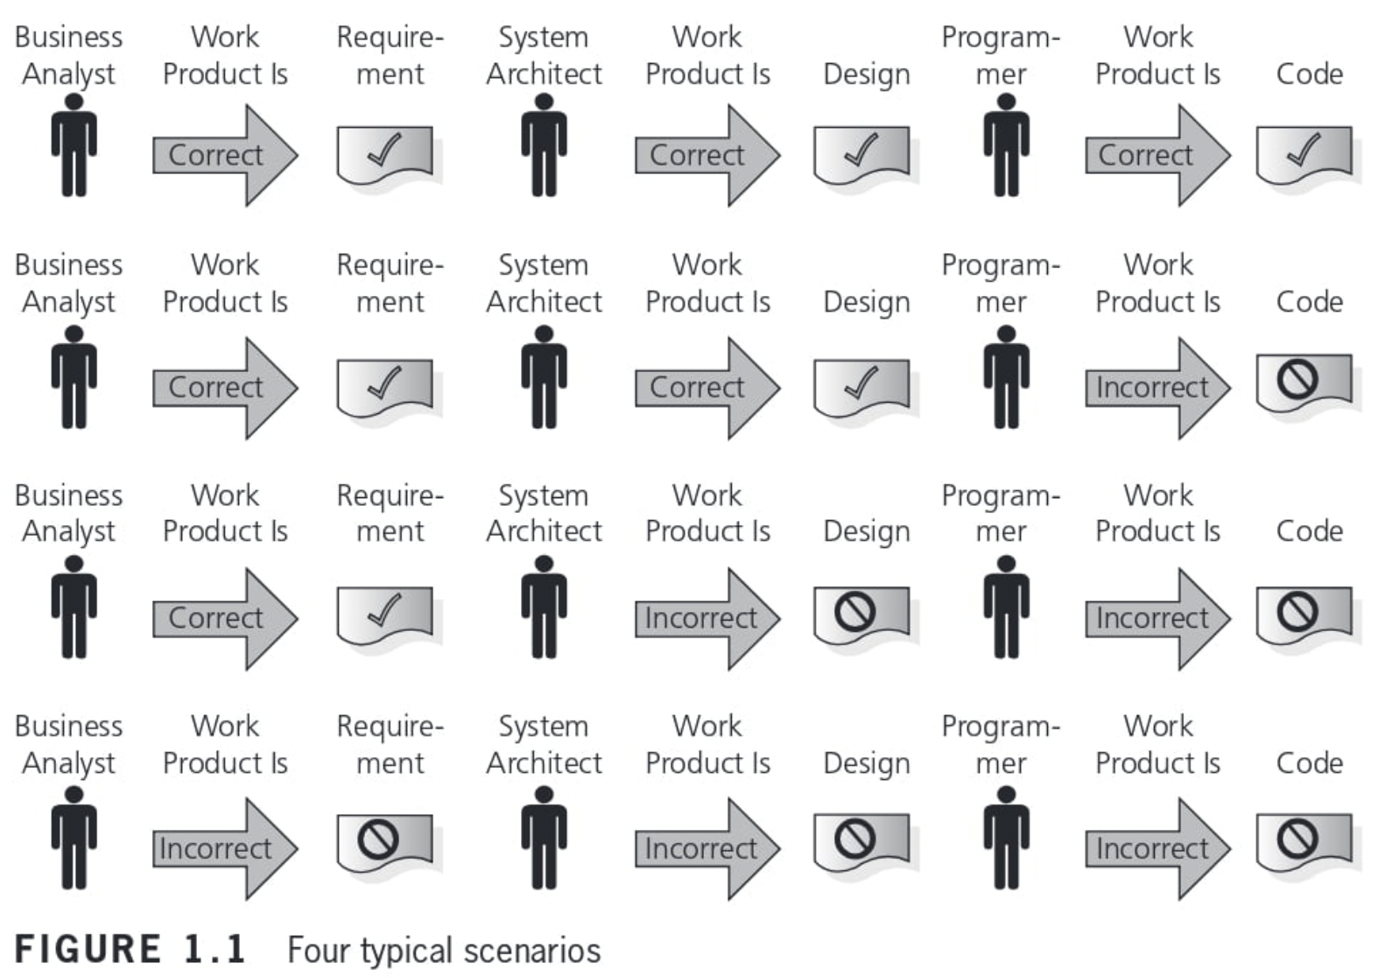
Errors - Defects - Failures

Slide 43
Errors - Defects - Failures
Failure
Error
Defect
No Failure

Slide 44
Reliability vs. Faults
Reliability: the probability that software will not cause the failure of the system for a specified time under specified conditions.
Can a system be fault-free? (zero faults, right first time)
Can a software system be reliable but still have faults?
Is a “fault-free” software application always reliable?

Slide 45
Why do errors happen?
Software is written by human beings
  who know something, but not everything
  who have skills, but aren’t perfect
  who do make mistakes (errors)
Under increasing pressure to deliver to strict deadlines
  no time to check but assumptions may be wrong
  systems may be incomplete
if you have ever written software ...

Slide 46
Why do errors happen?
Time pressure
Human fallibility
Lack of experience
Miscommunication
Complexity of work products
System interactions
New technologies
Environmental conditions

Slide 47
What do software faults cost?
Cost to Repair
16X
8X
4X
1X
2X

Slide 48
So why is testing necessary?
because software is likely to have faults
to learn about the reliability of the software
to fill the time between delivery of the software and the release date
to prove that the software has no faults
because testing is included in the project plan
because failures can be very expensive
to avoid being sued by customers
to stay in business

Slide 49
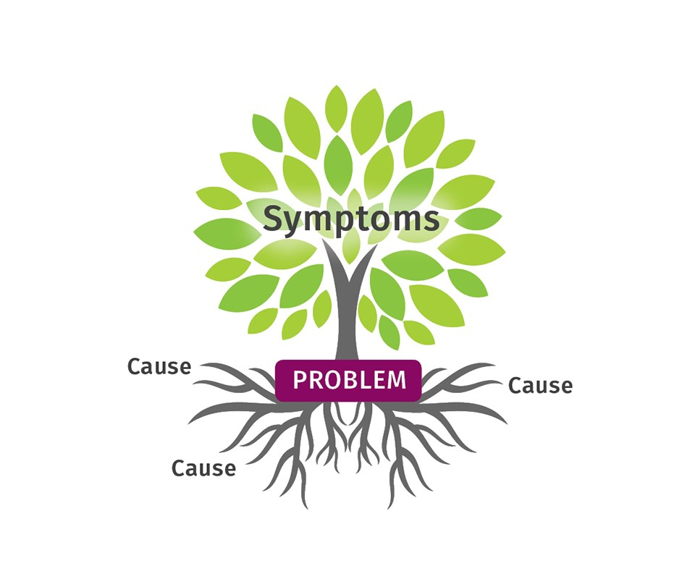
Defects – Root Causes – Effects
Root cause: a source of a defect such that if it is removed, the occurrence of the defect type is decreased or removed.
Root cause analysis can lead to process improvements that prevent a significant number of future defects from being introduced.

Slide 50
Defects – Root Causes - Effects
For example, suppose incorrect interest payments, due to a single line of incorrect code, result in customer complaints
The defective code was written for a user story which was ambiguous, due to the product owner’s misunderstanding of how to calculate interest.
Failure: incorrect calculations for customers
Defect: the wrong calculation in the code
Root cause: the product owner’s lack of knowledge on interest calculation
Effect: customer complaints

Slide 51
Question
Which one of the statements below describes a failure discovered during testing or in production?
The product crashed when the user selected an option in a dialog box
The wrong version of one source code file was included in the build
The computation algorithm used the wrong input variables
The developer misinterpreted the requirement for the algorithm

Slide 52
Question
From your comprehension of Root cause analysis, choose the correct answer:
Root cause analysis can be applied in software environment only
Root causes of defects are the earliest actions that contributed to creating the defect but it will destroy the process
Root cause analysis can be applied in all life cycle steps and can prevent a significant number of future defects from being introduced

Slide 53
Question
Which of the following is a correct statement?
A developer makes an error which results in a failure that may be seen as a fault when the software is executed
A developer has a failure which results in a defect that may be seen as a mistake during dynamic testing
A developer makes a mistake which causes a defect that may be seen as a failure during dynamic testing
A developer makes a mistake which causes a bug that may be seen as a defect when the software is executed

Slide 54
Question
Which of the following statements are TRUE?
1 – Software testing may be required to meet legal or contractual requirements
2 – Software testing is mainly needed to improve the quality of the developer’s work
3 – Rigorous testing & fixing of defects found can help reduce the risk of problems occurring in an operational environment
4 – Rigorous testing is sometimes used to prove that all failures have been found
2 & 3 are true, 1 & 4 are false
1 & 4 are true, 2 & 3 are false
1 & 3 are true, 2 & 4 are false
3 & 4 are true, 1 & 2 are false

Slide 55
CONTENT
What is testing?
Why testing is necessary
Testing principles
Fundamental test process
Psychology of testing
Code of Ethics

Slide 56
Seven Testing Principles
1. Testing shows the presence of defects
Testing can show that defects are present but cannot prove that there are no defects.
Testing reduces the probability of undiscovered defects remaining in the software but, even if no defects are found, it is not a proof of correctness.

Slide 57
Seven Testing Principles
2. Exhaustive testing is impossible
Testing everything (all combinations of inputs and preconditions) is not feasible except for trivial cases.

Slide 58
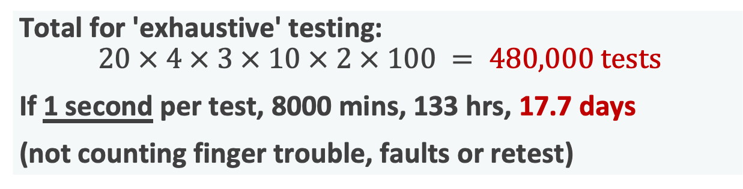
Why not just "test everything"?
Avr. 4 menus
3 options / menu
20 screens
Average: 10 fields / screen
2 types input / field
(date as Jan 3 or 3/1)
(number as integer or decimal)
Around 100 possible values
Total for 'exhaustive' testing:
  $$20 × 4 × 3 × 10 × 2 × 100 = 480,000 tests$$
If 1 second per test, 8000 mins, 133 hrs, 17.7 days
(not counting finger trouble, faults or retest)

Slide 59
Exhaustive testing?
What is exhaustive testing?
  when all the testers are exhausted
  when all the planned tests have been executed
  exercising all combinations of inputs and preconditions
How much time will exhaustive testing take?
  infinite time
  not much time
  impractical amount of time

Slide 60
How much testing is enough?
It's never enough
When you have done what you planned
When your customer/user is happy
When you have proved that the system works correctly
When you are confident that the system works correctly
It depends on the risks for your system

Slide 61
How much testing?
It depends on RISK
Risk of missing important faults
Risk of incurring failure costs
Risk of releasing untested or under-tested software
Risk of losing credibility and market share
Risk of missing a market window
Risk of over-testing, ineffective testing

Slide 62
So little time, so much to test ..
Test time will always be limited
Use RISK to determine:
  what to test first
  what to test most
  how thoroughly to test each item
  what not to test (this time)
}
i.e. where to
place emphasis
Use RISK to
  allocate the time available for testing by prioritising testing ...

Slide 63
Most important principle
Prioritise tests so that, whenever you stop testing, you have done the best testing in the time available.

Slide 64
Testing and quality
Testing measures software quality
Testing can find faults; when they are removed, software quality (and possibly reliability) is improved.
What does testing test?
  system function, correctness of operation
  non-functional qualities: reliability, usability, maintainability, reusability, testability, etc.

Slide 65
Other factors that influence testing
Contractual requirements
Legal requirements
Industry-specific requirements
  e.g. pharmaceutical industry (FDA), compiler standard tests, safety-critical or safety-related such as railroad switching, air traffic control
It is difficult to determine how much testing is enough, but it is not impossible.

Slide 66
Seven Testing Principles
3. Early testing
Testing activities (both static & dynamic) should start as early as possible in the software/system development life cycle and should be focused on defined objectives.
Early testing is sometimes referred to as "shift left". Testing early in the SDLC helps reduce or eliminate costly changes.

Slide 67
Seven Testing Principles
4. Defect clustering
A small number of modules contain most of the defects discovered during pre-release testing, or they are responsible for most of operational failures.
Predicted defect clusters, and the actual observed defect clusters in test or operation, are an important input into a risk analysis used to focus the test effort.

Slide 68
Seven Testing Principles
5. Pesticide paradox
If the same tests are repeated over and over again, eventually these tests no longer find any new defects.
To detect new defects, existing tests & test data are changed, and new tests need to be written.

Slide 69
Seven Testing Principles
6. Testing is context dependent
Testing is done differently in different dependent contexts. E.g., safety-critical software is tested differently from an e-commerce site.

Slide 70
Seven Testing Principles
7. Absence-of-errors fallacy
Finding and fixing defects does not help if fallacy the system built is unusable and does not fulfill the users' needs and expectations.

Slide 71
Question
Which of the following statements CORRECTLY describes one of the seven key principles of software testing?
By using automated testing it is possible to test everything
With sufficient effort and tool support, exhaustive testing is feasible for all software
It is normally impossible to test all input/output combinations for a software system
The purpose of testing is to prove the absence of defects

Slide 72
Question
Why is it important to avoid the pesticide paradox?
Dynamic testing is less reliable in finding bugs
Pesticides mixed with static testing can allow bugs to escape detection
Tests should not be context dependent
Running the same tests over & over will reduce the chance of finding new defects

Slide 73
Question
Which of the following is a true statement about exhaustive testing?
It is a form of stress testing
It is not feasible except in the case of trivial software
It is commonly done with test automation
It is normally the responsibility of the developer during unit testing

Slide 74
Question
A test team consistently finds between 90% and 95% of the defect present in the the system under test. While the test manager understands that this is a good defect detection percentage for her test team and industry, senior management and executes remain disappointed in the test group, saying that the test team misses too many bugs. Given that the users are generally happy with the system and that the failures which have occurred have generally been low impact, which of the following testing principles is most likely to help the test manager explain to these managers and executives why some defects are likely to be missed?
Pesticide paradox
Defect clustering
Exhaustive testing is impossible
Absence of error fallacy

Slide 75
Question
A programmer is working on code which is very complex. Which of the following is a general testing principle that may affect his work?
Pesticide paradox
Defect clustering
Absence of error fallacy
Exhaustive testing is impossible

Slide 76
CONTENT
Why testing is necessary
What is testing
Testing principles
Test process
Psychology of testing
Code of Ethics

Slide 77
Test Process
There is no 'one size fits all' test process
But testing needs to include common set of activities w/o which testing will be less likely to achieve its established objectives

Slide 78
Test Process in Context
Test basis is the body of knowledge used as the basis for test analysis and design.
  it is whatever the tests are being derived from (user requirement, user story, design, or code)
It is useful if the test basis has measurable coverage criteria defined.
Coverage: the degree to which specified coverage items have been determined to have been exercised by a test suite, expressed as a percentage.

Slide 79
Test Process in Context
For example, for a mobile application, the test basis may include a list of requirements and a list of supported mobile devices.
  Each requirement is an element of the test basis. Each supported device is also an element of the test basis.
The coverage criteria may require at least one test case for each element of the test basis.
Once executed, the results of these tests tell stakeholders whether specified requirements are fulfilled and whether failures were observed on supported devices.

Slide 80
Test Process Activities
Test Planning
Test Analysis
Test Completion
Test Monitoring & Control
Test Design
Text Execution
Test Implementation
Test Planning
Test Implementation
Test Completion
Test Monitoring & Control

Slide 81
Test Process Activities
Although these activities appear logically sequential, they may overlap or take place concurrently or iteratively.
Each group of activities consist of many individual tasks; these will vary for different projects or releases.

Slide 82
Step 1. Test Planning
Test planning involves defining objectives of testing & the approaches for meeting those objectives within project constraints and contexts.
This includes deciding on suitable test techniques to use, what tasks need to be done, formulating a test schedule, etc.

Slide 83
Step 2. Test Monitoring and Control
Test monitoring. On-going comparison of actual progress against the test plan using any test monitoring metrics defined in the test plan
Test control. Taking actions necessary to meet the objectives of the test plan
Supported by exit criteria or DoD (Definition of Done)
Test progress against the plan is communicated to stakeholders in test progress reports

Slide 84
Step 3. Test Analysis
Test condition. An aspect of the test basis that is relevant in order to achieve specific test objectives.
Test analysis. The activity that identifies test conditions by analysing the test basis (i.e., reqs. specs., design, code, risk analysis report).
Test analysis answers the question – "What to test?"
Capturing bi-directional traceability
Test conditions can be used as objectives in Test Charters

Slide 85
Step 4. Test Design
Answer the question "How to Test"
Design and prioritize test cases
Identify test data
Design test environment

Slide 86
A good test case
Finds faults
Effective
Exemplary
Evolvable
Economic
Represents others
Easy to maintain
Cheap to use

Slide 87
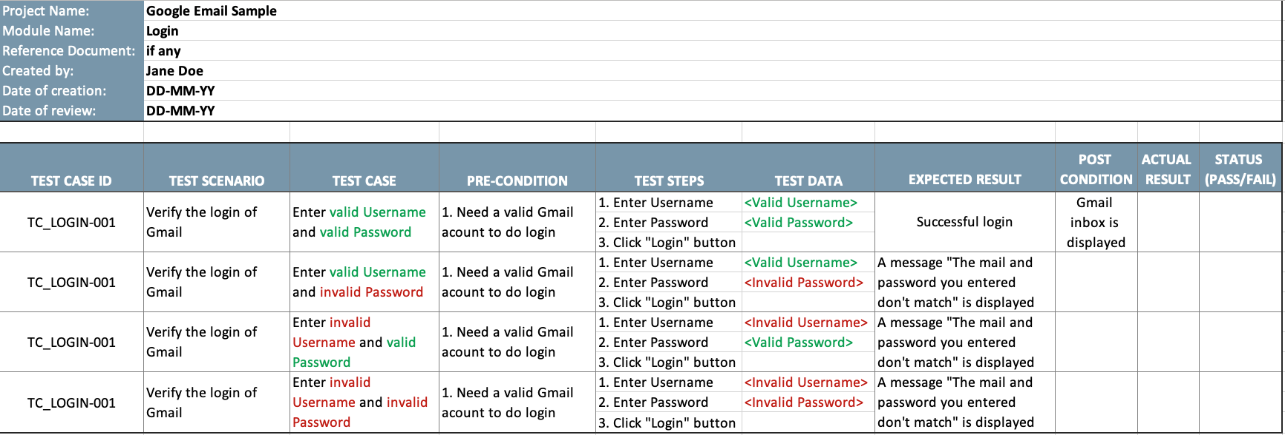
Step 4. Test Design (cont.)

Slide 88
Step 5. Test Implementation
Answer the question "Do we now have everything in place to run the tests?"
Develop and prioritize test procedures
Create test suites, arrange them in test execution schedule
Build test environment

Slide 89
Step 6. Test Execution
Test suites are run according to the test execution schedule
Compare actual result with expected result
  Differences are referred as anomalies
  Analyse anomalies to identify their causes (defects in code, false-positives, or test defects)
Report defects based on failures observed
Confirmation and/or Regression Testing

Slide 90
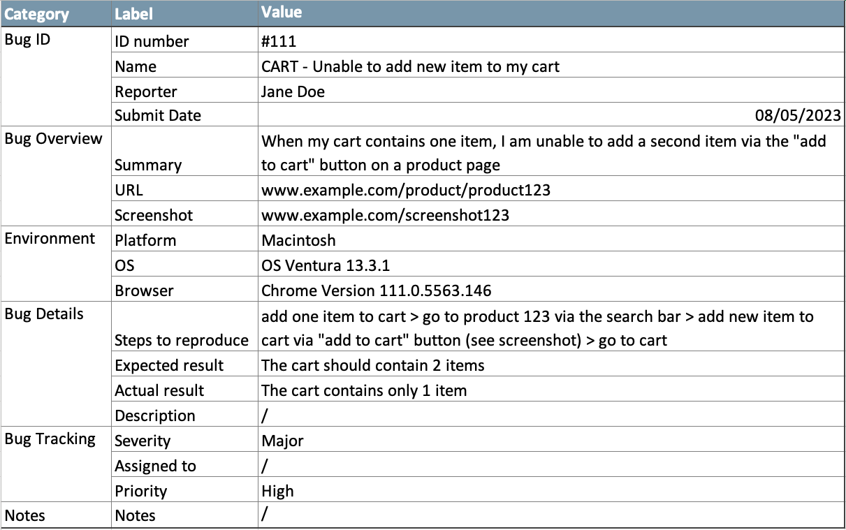
Step 6. Test Execution (cont.)
Notes:
ANOMALY / DEFECT REPORT SAMPLE
Severity is a term that denotes how severely a defect can affect the functionality of the software.
Priority is a term that defines how fast we need to fix a defect.

Slide 91
Step 7. Test Completion
Collect data from completed test activities
Occurs at project milestones
Check Defect Reports
Create Test Summary Report
Hand over the testware (Why?)
Notes:
So now we begin to collect information based on the execution status that happened.
How many test cases did we run?
How many defects did we find?
How many defects are solved?
What is the priority and severity of each defect?
Why do we do this? in order to give the stakeholders a chance to make a decision.
Are we ready to deliver the software?
Are we ready to move on to the next step of testing or not?
Test completion doesn't happen only one time in the project.
So test summary report is a work product that happens in monitoring and control and also at test completion.
But test progress report only happens in test monitoring and control.

Slide 92
Test Work Products
Activity | Work Products
Test Planning | Test Plans
Test Monitoring & Control | Test Progress/Summary Reports
Test Analysis | Test Conditions – Test Charters
Test Design | Test Cases – Test Data
Test Implementation | Test Procedures – Test Suites – Test Execution Schedule
Test Execution | Status of Test Cases – Defect Reports
Test Completion | Test Summary Reports – Change Requests

Slide 93
Comparison of tasks
Governs the
quality of tests
Planning
Intellectual
one-off
activity
Specification
activity
repeated
many times
Good to
automate
Execute
Recording
Clerical

Slide 94
Question
When following the fundamental test process, when should the test control activity take place?
During the planning activities
During the implementation and execution activities
During the monitoring activities
During all the activities

Slide 95
Question
Which of the following is the activity that compares the planned test progress to the actual test progress?
Test monitoring
Test planning
Test closure
Test control

Slide 96
Question
Designing and prioritizing test cases occurs during which activity in the fundamental test process?
Test Planning
Test Analysis
Test Design
Test Completion

Slide 97
Question
Designing and prioritizing test conditions based on analysis of the test basis occurs during which activity in the fundamental test process?
Test Planning
Test Analysis
Test Design
Test Completion

Slide 98
Question
Checking whether all defect reports are closed occurs during which activity in the fundamental process?
Test Planning
Test Analysis
Test Design
Test Completion

Slide 99
Question
Comparing actual results with expected results occurs during which activity in the fundamental process?
Test Monitoring & Control
Test Analysis
Test Implementation
Test Execution

Slide 100
Question
Developing and prioritizing test procedures occurs during which activity in the fundamental process?
Test Monitoring & Control
Test Analysis
Test Implementation
Test Execution

Slide 101
Question
Checking test results and test logs against specified coverage criteria occurs during which activity in the fundamental process?
Test Monitoring & Control
Test Analysis
Test Implementation
Test Execution

Slide 102
CONTENT
Why testing is necessary
What is testing
Testing principles
Fundamental test process
Psychology of testing
Code of Ethics

Slide 103
Why test?
build confidence
prove that the software is correct
demonstrate conformance to requirements
find faults
reduce costs
show system meets user needs
assess the software quality

Slide 104
Assessing software quality
You think
you are here
High
Few
Faults
Many
Faults
Few
Faults
Low
High
Software Quality
Few
Faults
Test
Quality
Few
Faults
You may
be here
Low
Notes:
DEVELOPERS’ PERSPECTIVE - CONFIRMATION BIAS

Slide 105
Independence
Test one’s own work?
Find 30% - 50% of your own faults
Same assumptions and thought processes
See what one meant or wants to see, not what is there
Emotional attachment
  Don’t want to find faults
  Actively want NOT to find faults

Slide 106
Levels of independence
None: tests designed by the person who wrote the software
Tests designed by a different person w/I the dev team
Tests designed by someone from a different department or team (e.g. test team)
Tests designed by someone from a different organisation (e.g. agency)
Tests generated by a tool (low quality tests?)

Slide 107
Human Psychology & Testing
Identifying defects may be perceived as criticism of the product and of its author.
Confirmation bias can make it difficult to accept information that disagree with currently held beliefs,
Cognitive biases may make it difficult for people to understand or accept information produced by testing.
It is a common human trait to blame the bearer of bad news.
Some people may perceive testing as a destructive activity
Try to reduce these perceptions by having the right attitudes, and communicating in a constructive way.
Notes:
Confirmation bias, also called reinforcement bias, is the tendency to analyse information in such a way that it confirms your prior beliefs while ignoring information that conflicts with it.
It is particularly strong when they believe is important to you.
Confirmation bias influences how people seek out information. They will seek out sources that confirm their beliefs and ignore sources that challenge their opinions.
Confirmation bias also causes people to interpret information in a way that confirms their beliefs.
Confirmation bias also leads to biased recall of information.
Why might confirmation bias exist? It is essentially a shortcut to conserve mental energy.
A cognitive bias is a systemic error in thinking that affects the decisions and judgments that people make when they are processing information about the world around them.

Slide 108
Attitudes & Communications
Start with collaboration rather than battles. Remind everyone of the common goal of better quality systems.
Emphasize the benefits of testing.
  for the authors, defect information can help them improve their work products and their skills.
  for the organization, defects found and fixed during testing will save time and money and reduce overall risk to product quality
Communicate test results and other findings in a neutral, fact-focused way without criticizing the person who created the defective item.
Write objective and factual defect reports and review findings
Try to understand how the other person feels and the reasons they may react negatively to the information.
Confirm that the other person has understood what has been said and vice versa.

Slide 109
A traditional testing approach
Show that the system:
  does what it should
  doesn't do what it shouldn't
Goal: show working
Success: system works
Fastest achievement: easy test cases
Result: faults left in

Slide 110
A better testing approach
Show that the system:
  does what it shouldn't
  doesn't do what it should
Goal: find faults
Success: system fails
Fastest achievement: difficult test cases
Result: fewer faults left in

Slide 111
The testing paradox
Finding faults destroys confidence
Purpose of testing: to find faults
Purpose of testing: destroy confidence
Purpose of testing: build confidence
The best way to build confidence
is to try to destroy it

Slide 112
Who wants to be a tester?
A destructive process
Bring bad news (“your baby is ugly”)
Under worst time pressure (at the end)
Need to take a different view, a different mindset (“What if it isn’t?”, “What could go wrong?”)
How should fault information be communicated (to authors and managers?)

Slide 113
Testers have the right to:
  Accurate information about progress and changes
  Insight from developers about areas of the software
  Delivered code tested to an agreed standard
  Be regarded as a professional (no abuse!)
  Find faults!
  Challenge specifications and test plans
  Have reported faults taken seriously (non-reproducible)
  Take predictions about future fault levels
  Improve your own testing process

Slide 114
Testers have responsibility to:
  Follow the test plans, scripts etc. as documented
  Report faults objectively and factually (no abuse!)
  Check tests are correct before reporting s/w faults
  Remember it is the software, not the programmer, that is being tested
  Assess risk objectively
  Prioritise what are reported
  Communicate the truth

Slide 115
CONTENT
Why testing is necessary
What is testing
Testing principles
Fundamental test process
Psychology of testing
Code of Ethics

Slide 116
Code of Ethics
ISTQB Code of Ethics:
Public – Certified software testers shall act consistently with the public interest.
Client & Employer – Certified software testers shall act in a manner that is in the best interests of their client and employer, consistent with the public interest.
Product – Certified software testers shall ensure that the deliverables they provide (on the products and systems they test) meet the highest professional standards possible.
Judgment – Certified software testers shall maintain integrity and independence in their professional judgment.

Slide 117
Code of Ethics
Management – Certified software test managers and leaders shall subscribe to and promote an ethical approach to the management of software testing.
Profession – Certified software testers shall advance the integrity and reputation of the profession consistent with the public interest.
Colleagues – Certified software testers shall be fair to and supportive of their colleagues; and promote cooperation with software developers.
Self – Certified software testers shall participate in lifelong learning regarding the practice of their profession and shall promote an ethical approach to the practice of the profession.

Slide 118
CHAPTER REVIEW
Section 1.1: bug, defect, error, failure, fault, mistake, quality, risk, software, testing and exhaustive testing
From Section 1.2: what testing is? common objectives of testing? fundamental principles of testing?
Section 1.3: code, debugging, development of software, requirement, review, test basis, test case, testing and test objective.
From Section 1.4: confirmation testing, exit criteria, incident, regression testing, test basis, test condition, test coverage, test data, test execution, test log, test plan, test strategy, test summary report and test-ware.
Section 1.5, you now should be able to explain the psychology of testing and how people influence testing success
1
2
3
Principles
ISTQB / ISEB Foundation Exam Practice
4
5
6

