Slide 1

EchoMood: The Journey
From localhost to legend 🌍
Words, slides and design by Mr G. P. T.
Memes and Music by Pierce

Slide 2
The Spark 💡
What if... your mood made your playlist?

Slide 3
The Grind Begins 🔧
Me learning Spotipy: 'It do be confusing tho'

Slide 4
localhost:8501
When it works locally but breaks in front of your teacher 😭

Slide 5
Filtering by Feelings 🎧
EchoMood be like: 'You're sad? Here's Adele.'

Slide 6
Genres Galore 🎶
When your playlist goes from Mozart to Metallica 💀

Slide 7
The Math Behind the Mood 📊
Assigning familiarity scores like a mad scientist

Slide 8
UI Glow Up ✨
From spaghetti Streamlit to stylish sliders

Slide 9
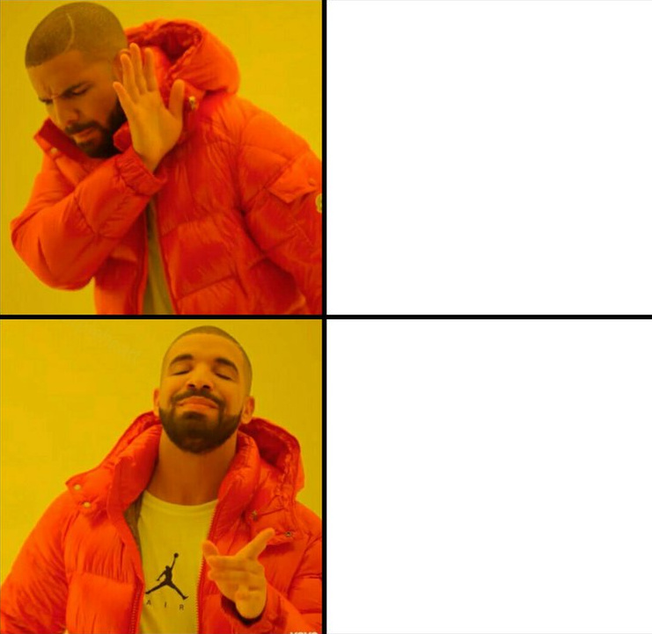
The Deployment Arc 🌐
'Streamlit Cloud is free?! Say less.'
Paying for Cloud Hosting
Free Steamlit Cloud

Slide 10

Meme-Fuelled Debugging 🧠
Me fixing one bug and creating five more

Slide 11


The World Meets EchoMood 🌍
It's not a phase, mum. It's a platform.
Build a small app
Test on a Localhost
Mum still calls it a phase
Deploy to Steamlit

Slide 12

“When it Finally Worked”
404 Errors? More like 200 OK.
The moment EchoMood loaded without crashing
Auth worked
API calls went through
Sliders actually slid
"I don’t know how it works, but I’m not touching anything anymore."

Slide 13

The EchoMood Algorithm™
Totally Not Just a Weighted Score
Me, pretending it’s AI when it’s just maths
Weighted genres ✅
Familiarity metrics ✅
Mood slider? ✅
“Why train a model when you can vibe with one?”

Slide 14

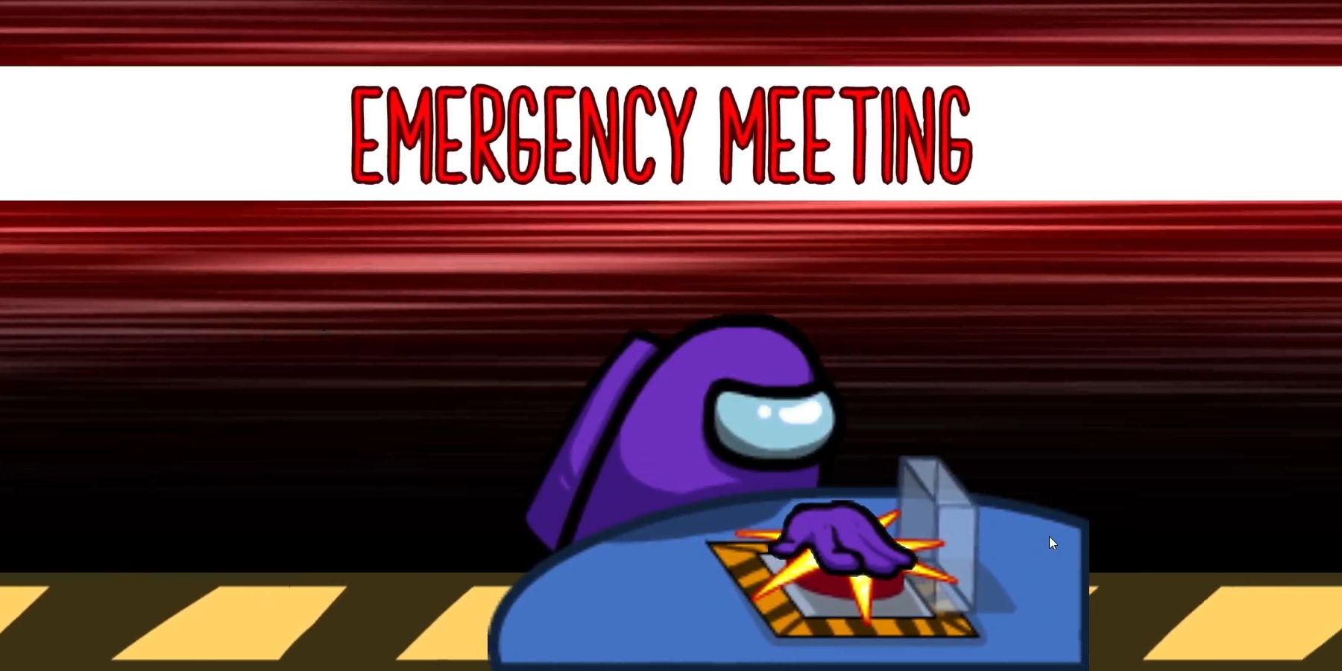
“Beta Testers”
My Friends:
Me.
Me.
Me.
mes
Stress testing EchoMood like it’s Doom Eternal
My subconscious be like
found another bug
“What happens if I click this 50 times?”
“It says ‘Error 429’ – is that good?”
“I broke it. You’re welcome.”

Slide 15

“The Latency Arc”
Every millisecond tells a story...
...a story of fear, regret, and questionable API design.
“Waiting 12 minutes for the response to load….”
... Returns an error message
"Running function... please wait." – Streamlit, probably forever
Spotify: “I need a moment.”
Streamlit: “Sure, take your time.”
Me: 😬 watching the spinner do laps
🧠 Fun Fact: The real Echo in EchoMood is the response delay.

Slide 16

They Laughed When I Said I Was Making a Mood-Based Playlist App...
But Now I Laugh.
As it loads…
eventually….
Didn’t know what a callback was 🧠
Accidentally nuked main.py once 💥
Survived the spinner of doom 🔄
Learned OAuth and cried a bit 😭
Now?

Slide 17
You can try it
With Terms and Conditions....
🧠 Section 3: The Algorithm
📄 Section 1: General Use
💽 Section 2: Account & Data
The EchoMood Algorithm™ is a highly advanced system based on complex math, emotional intuition, and the developer's mood at the time.
By accessing EchoMood, you agree that music should match vibes and that vibes are serious business.
EchoMood uses Spotify's API, which means we technically never see your data. But we spiritually bond with your playlists.
You agree not to use EchoMood while operating heavy machinery, doing exams, or engaging in existential crises.
You must have a Spotify account. If you don’t have one, we recommend sitting in silence and rethinking your life choices.
If a playlist doesn’t match your mood, consider changing your mood to match the playlist.
(Except the last one — that's kind of the whole point.)
Any attempt to use EchoMood while your WiFi is acting like it's 2003 dial-up is at your own risk.
Your music taste may be judged by an algorithm. It has no chill
The “Familiarity Score” does not mean the app is familiar with you personally. Yet.

Slide 18
It keeps going!
The Terms and Conditions... Not the benefits
Section 4: Bugs, Glitches & Existential Dread
🚫 Section 5: Things You Can’t Do
🕓 Section 6: Latency
If the app is slow, please assume it is deep in thought. Genius takes time
If EchoMood crashes, that’s a feature. It’s called a “Reflection Break.”
Do not reverse-engineer EchoMood. That path leads to madness (and lots of unreadable Python).
You agree not to open 47 tabs of EchoMood simultaneously unless you enjoy chaos.
You agree not to summon Cthulhu through excessive slider dragging.
Do not use EchoMood to summon a demon DJ. You know who you are.
If you encounter a bug, please do not feed it. Report it politely or just call it “quirky.”
EchoMood will not be held responsible for existential pondering during loading spinners.
Do not attempt to use EchoMood to generate country playlists if you're sad. It will only make it worse.
.
🎁 Section 7: Easter Eggs
Typing “lo-fi beats to debug to” may or may not unlock a hidden feature.
If you listen to Never Gonna Give You Up through EchoMood, Rick Astley personally thanks you.
If you find the hidden dancing frog, name him. He deserves it.

Slide 19
We’re almost done...
Just trust me on this one
🎶 Section 8: Playlists & Mood Matching
Section 9: Legal Stuff That Sounds Important
🧀 Section 10: Cheese Clause
Mood filtering may cause spontaneous jam sessions.
EchoMood is provided “as-is,” “when-I-get-around-to-it,” and “sometimes-on-Sundays.”
By continuing to use EchoMood, you agree that this whole project is legit, vibey, and way too emotional for a Python app.
EchoMood is not liable for any dance-offs, air guitar battles, or emotional breakthroughs.
Developer is not responsible for code-related existential crises. Try yoga.
If EchoMood thinks your mood is “chaotic-neutral,” please seek immediate vibes.
You also agree to always skip the song only after the chorus — basic respect.
These Terms may change, but you probably won’t read them anyway
Section 11: Contact & Complaints
In case of musical emergency, please vibe responsibly.
🧠 Final Clause:
By scrolling this far, you are now morally obligated to:
All complaints may be submitted in the form of a musical number, preferably in F# minor.
Tell your friends about EchoMood
And accept that sometimes, just sometimes, the algorithm knows you better than you know yourself.
Tech support is powered by hope, duct tape, and an overworked print() function.
Make a dramatic playlist titled “Running Through the Rain in a Movie Scene”

Slide 20
Okay.... You can try it now
https://echomood-ydeurclvwvw8u7zvpeedjc.streamlit.app
It will probably work
In all likelihood
Presumably
Conceivably
Perchance
Kinda
Sort of

Slide 21
When you get AI to make your final slide
Absolutely, Pierce — here are some cool slogan options for EchoMood,
each with a slightly different vibe:
🎧 Music + Mood Themed
“Feel it. Hear it. Live it.”
“Your mood, your music, your moment.”
“EchoMood: Where emotion meets sound.”
“Turn feelings into playlists.”
“Because every mood deserves a soundtrack.”
💡 Techy & Slick
“Mood-synced. AI-tuned. You-defined.”
“Smart playlists for emotional humans.”
“EchoMood: The algorithm that gets you.”
🧠 Reflective & Deep
“What you feel is what you hear.”
“Mood isn’t random. Neither is your music.”
😂 Cheesy & Meme-Worthy
“Crying? Bopping. Vibing? Still bopping.”
“Powered by vibes and a suspicious amount of caffeine.”
“EchoMood: Spotify said ‘You okay?’ and we answered.”
Let me know which direction you want to lean in (deep, serious, funny, techy),
and I can polish or combine them!

