Slide 1
Amrita Vishwa Vidyapeetham, Amaravati Campus
Autonomous Mobile Robot Path Tracking
Using Pure Pursuit and Stanley
Presented by,
Name of the Student | Roll No.
S.THARUN | AV.SC.U4AIE24055
J.SRINESH D.RITHESH | AV.SC.U4AIE24020 AV.SC.U4AIE24013
Under the Guidance of
Dr Ravishankar Prakash Desai

Slide 2
Introduction
Autonomous mobile robots must follow their intended route while responding to objects around them. This becomes harder when an obstacle moves during the robot’s approach.
PATH TRACKING
Follow a predefined trajectory while keeping lateral and heading errors under control.
OBSTACLE RESPONSE
Change speed or direction when the nominal path would lead to an unsafe approach.
MOVING OBSTACLES
Consider how the robot and obstacle positions may change over the next few seconds.
THE CORE CHALLENGE
Avoid an unsafe approach without losing the intended route or giving up progress toward the goal.
This project compares Pure Pursuit and Stanley with a predictive safety supervisor between the controller and robot model.

Slide 3
Problem Statement, Objectives and Tools
PROBLEM STATEMENT
Following the reference path alone is not enough when an obstacle enters the route. Avoidance can increase tracking error, reduce speed, or leave the robot short of its goal. Moving obstacles add the need to consider future separation.
PROJECT OBJECTIVES
1. Model differential-drive motion in MATLAB and Simulink.
2. Implement Pure Pursuit and Stanley as alternative path trackers.
3. Add a predictive safety supervisor for obstacle-related risks.
4. Test five static and dynamic obstacle scenarios.
5. Compare tracking error, clearance, collision status and goal reaching.
MATLAB
Controller calculations, simulation scripts and trajectory plots.
SIMULINK
Robot-motion model and integration of control-system components.

Slide 4
Methodology
Both controllers generate a nominal command; the safety layer checks predicted motion before it is applied.
PURE PURSUIT
Targets a look-ahead point and turns toward it.
ω = 2v sin(α) / Ld
STANLEY
Combines heading error with cross-track error to correct orientation and lateral deviation.
PREDICTIVE SAFETY
Evaluates candidate commands relative to predicted obstacle positions; may reduce speed or change turning.
CONTROL PIPELINE
Reference path
+ robot pose
→
Pure Pursuit
or Stanley
→
Safety
supervisor
→
Differential-drive
robot model
→
Updated state
+ logs
FIVE SIMULATION SCENARIOS
01 No obstacle
Baseline
02 Static
At (6.00, 0.45) m
03 Slower
0.10 m/s
04 Equal speed
0.22 m/s
05 Faster
0.30 m/s
Nominal robot speed: 0.22 m/s. Safety supervision reduces predicted collision risk but cannot guarantee a safe path in every case.

Slide 5
Flow-chart
START
Initialize robot, reference path and scenario
Calculate nominal command (Pure Pursuit or Stanley)
Predict robot motion and obstacle separation
Safety constraint
met?
YES
NO
Retain nominal command
Evaluate alternative velocity commands
Select final command • Update robot state • Record data
Goal or time limit reached?
YES → Analyse tracking, clearance, collision and goal metrics | NO → Repeat the control loop

Slide 6
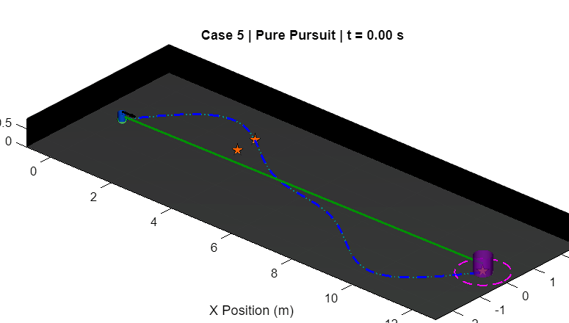
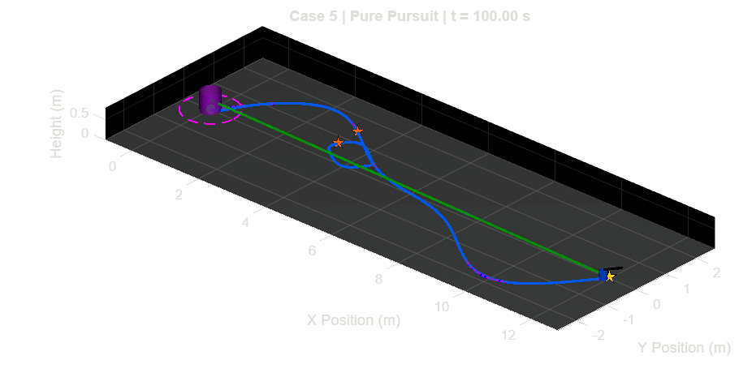
Simulation Result
INITIAL STATE • t = 0 s
RECORDED VIEW • t = 100 s
Case 5 • Pure Pursuit • Initial robot and obstacle positions
Case 5 • Pure Pursuit • Later recorded positions
TRACKING
Cross-track RMSE and maximum error
CLEARANCE
Minimum surface gap to obstacle
SAFETY
Collision-detected status flag
COMPLETION
Goal reached and completion time
Interpret the trajectory together with tracking, clearance, collision and goal-status data.

Slide 7
Conclusion
CONCLUSION
Good navigation is a balance between following the intended route and maintaining separation from obstacles.
• Pure Pursuit and Stanley correct path deviation in different ways.
• The safety supervisor checks predicted motion before a command is applied.
• Tracking error, obstacle clearance, collision status and goal completion must be considered together.
FUTURE IMPROVEMENTS
• Improve the prediction of moving-obstacle trajectories.
• Tune look-ahead distance, controller gain and safety thresholds.
• Test more starting positions and obstacle paths.
• Validate the approach on a physical mobile robot.
The comparison should be based on recorded metrics; no controller is assumed to be the best in every scenario.

Slide 8
References
[1] Coulter, R. C. (1992).
Implementation of the Pure Pursuit Path Tracking Algorithm. Robotics Institute, Carnegie Mellon University, Technical Report CMU-RI-TR-92-01.
[2] Thrun, S., et al. (2006).
Stanley: The Robot That Won the DARPA Grand Challenge. Journal of Field Robotics, 23(9), 661–692.
[3] Hoffmann, G. M., Tomlin, C. J., Montemerlo, M., & Thrun, S. (2007).
Autonomous Automobile Trajectory Tracking for Off-Road Driving: Controller Design, Experimental Validation and Racing. Proceedings of the 2007 American Control Conference, 2296–2301.
[4] Fox, D., Burgard, W., & Thrun, S. (1997).
The Dynamic Window Approach to Collision Avoidance. IEEE Robotics & Automation Magazine, 4(1), 23–33.
References provide the background for the path-tracking and obstacle-avoidance methods used in this project.

Slide 9
Thank You

