Slide 1

521147S – Mobile & Social Computing Aware IO Detector
Furqan Ahmed

Slide 2
Related Work
IO Detector
http://www.ntu.edu.sg/home/limo/papers/SenSys12_IODetector.pdf
TagSense
http://dl.acm.org/citation.cfm?id=1999997
Indoor location sensing using geo-magnetism
http://dl.acm.org/citation.cfm?id=2000010
PBN
http://dl.acm.org/citation.cfm?id=2070968

Slide 3
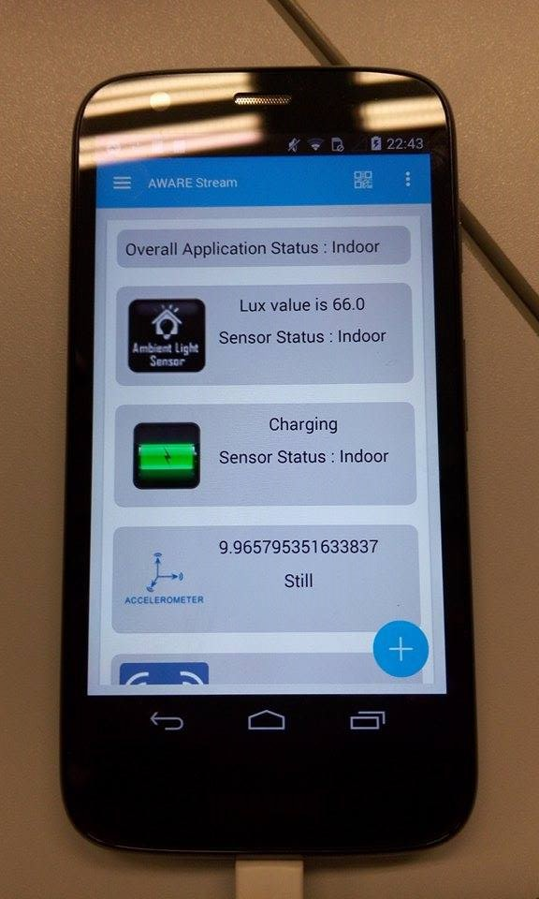
Implementation
Light Sensor
Battery Sensor
Accelerometer
Magnetometer

Slide 4
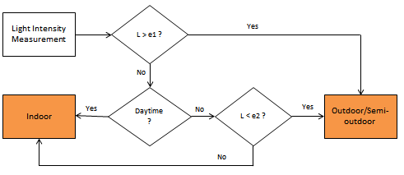
Implementation
Light Sensor

Slide 5
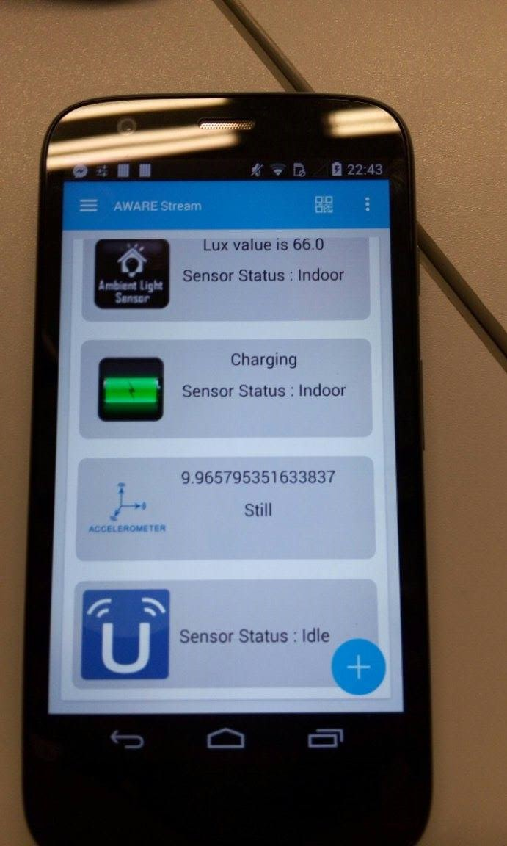
Implementation
Battery Sensor
If Charging Indoor
If not charging check other sensor statuses
Accelerometer and Magnetometer
Check Accelerometer for device state
Collect Magnetometer Data as soon as the user
starts walking/running
High Variance in Magnetic field outside
Low Variance in Magnetic field inside

Slide 6
Implementation
Check Individual sensor status
Ratio b/w Indoor and Outdooor statuses
Update overall application status

Slide 7
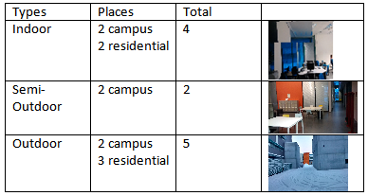
Evaluation

Slide 8
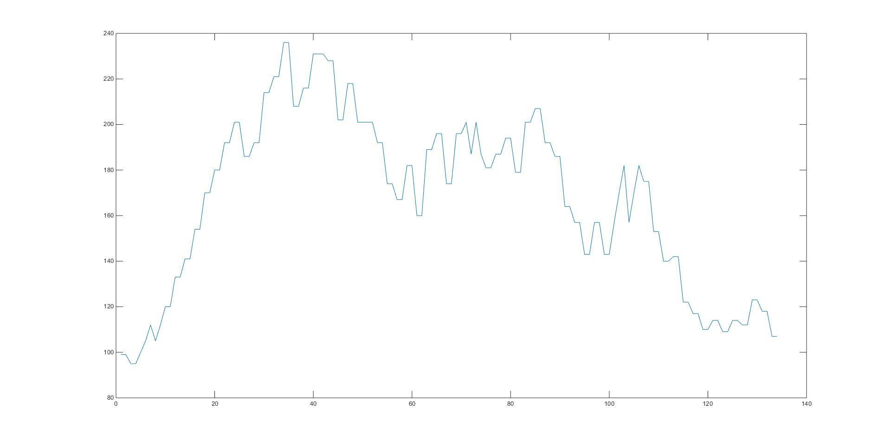
Evaluation
Light Intensity plot (Indoor)

Slide 9
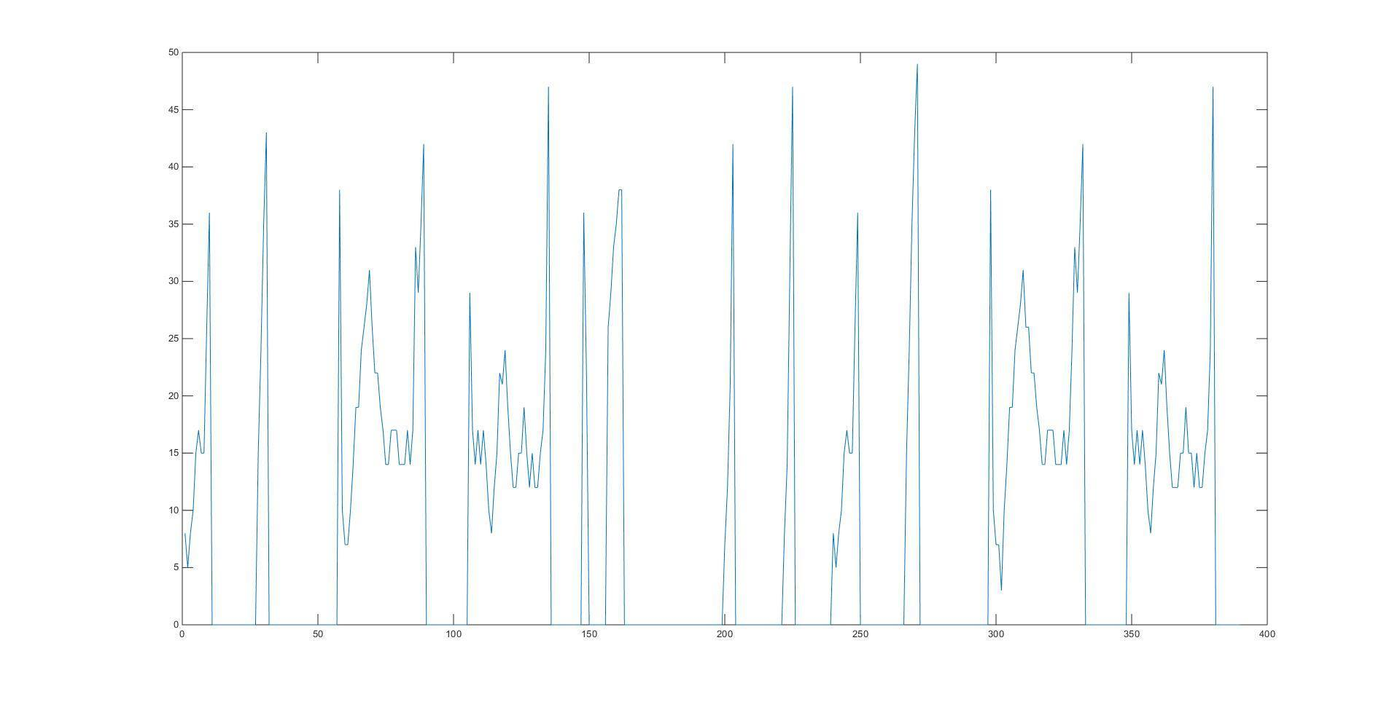
Evaluation
Light Intensity Plot Outdoor

Slide 10
Discussion
Light Sensor giving 70-80% accurate result
Magnetometer Sensor result is not consistent
For future development GPS and WiFi sensors could be used

Slide 11
Any Questions??

