Slide 1
Ch. 6 - Approximation via Reweighting
Presentation by Eran Kravitz

Slide 2
Definitions
Crossing Number
Given a set of segments, its crossing number is the maximal number of segments that can be crossed by a single line.
In the following example the crossing number is 5:

Slide 3
Definitions
Crossing Distance
Given a weighted set of lines L, the crossing distance d(p, q) between two points p & q is the minimum weight of the lines one has to cross to get from p to q.
In the following example, d(p, q) = 4 (Assuming all weights are 1):
Pseudometric Space:
d_{c}(p, p) = 0
d_{c}(p, q) = d_{c}(q, p)
d_{c}(p, q) ≤ d_{c}(p, r) + d_{c}(r, q)
d_{c}(p, q) = 0 does NOT necessarily mean p=q!
p
q

Slide 4

The Problem
Given a set P of n points in the plane, compute a tree T that spans the points of P such that the crossing number of the tree is at most $O(\sqrt{n})$.

Slide 5
The Observation
Two lines l & l’ to be equivalent if the half-plane above l and the half-plane above l’ contain the same set of points in P.
l
l’
Let L be a set of lines such that no two lines are equivalent (simply choose one representative line for each group of equivalent lines). Note that |L| = O(n²).

Slide 6
The Idea
An iterative algorithm: Choose one edge of the tree at a time.
How?
Each line in L is assigned a weight based on the number of edges it already crosses.
Each potential edge is assigned a weight based on the weights of the lines that cross it.
The higher the weight, the less desirable the edge becomes.

Slide 7
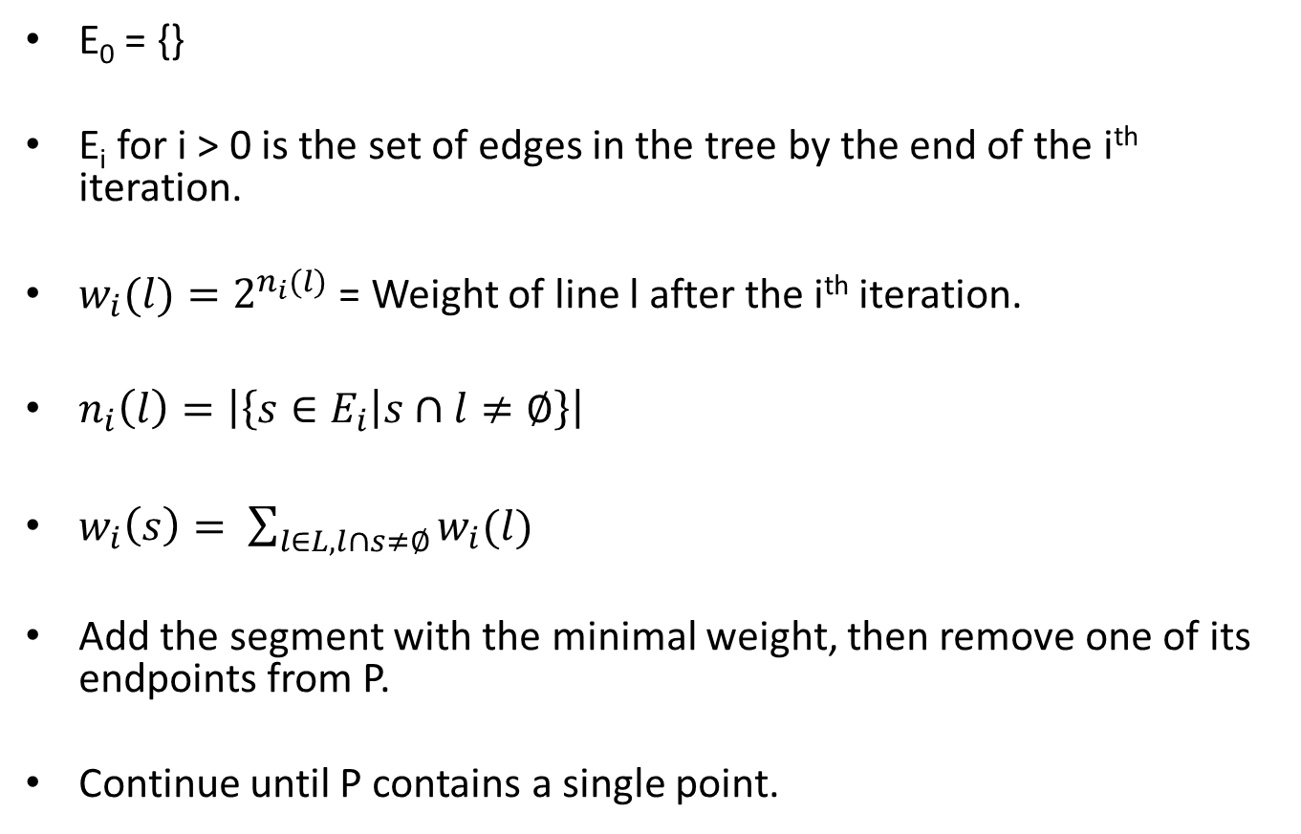
The Algorithm
E₀ = {}
E_{i} for i > 0 is the set of edges in the tree by the end of the i^{th} iteration.
$w_{i}(l)=2^{n_{i}(l)}$ = Weight of line l after the i^{th} iteration.
$n_{i}\left(l\right)=\left|\left\{s∈E_{i} | s∩l≠∅\right\}\right|$
$w_{i}\left(s\right)= \sum_{l∈L, l∩s≠∅}{w_{i}(l)}$
Add the segment with the minimal weight, then remove one of its endpoints from P.
Continue until P contains a single point.

Slide 8
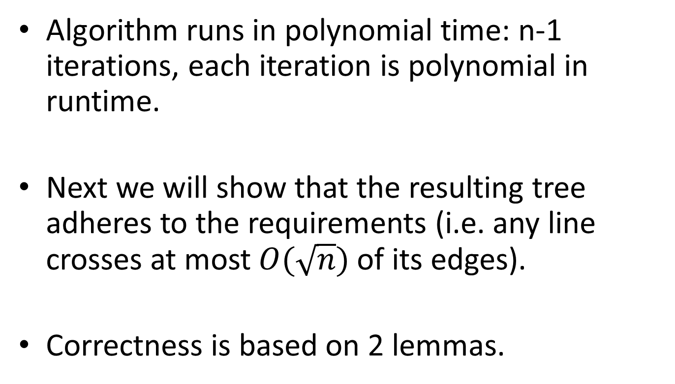
Analysis
Algorithm runs in polynomial time: n-1 iterations, each iteration is polynomial in runtime.
Next we will show that the resulting tree adheres to the requirements (i.e. any line crosses at most $O(\sqrt{n})$ of its edges).
Correctness is based on 2 lemmas.

Slide 9
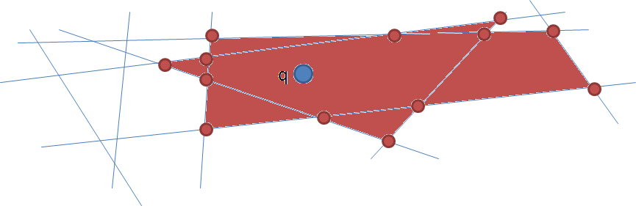
Lemma 1
Definition: Given a point q and a set of lines L, b(q, r) = The set of vertices that are at crossing distance ≤ r from point q.
q
b(q, 1) = Set of red vertices

Slide 10
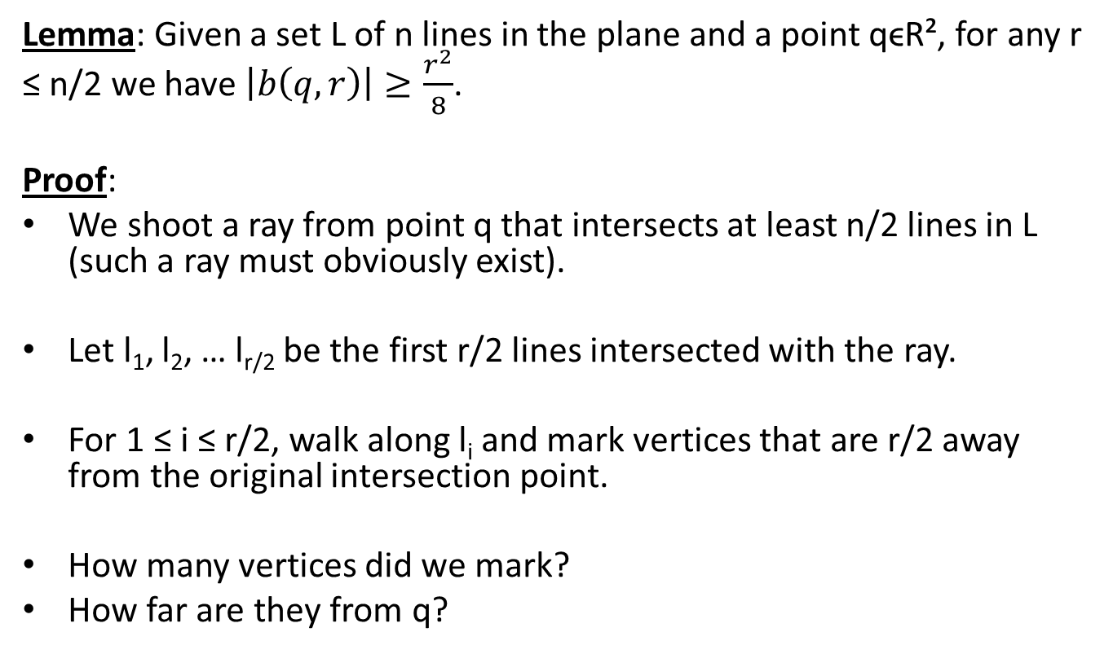
Lemma 1 – Cont.
Lemma: Given a set L of n lines in the plane and a point qϵR², for any r ≤ n/2 we have $\left|b\left(q, r\right)\right|≥\frac{r^{2}}{8}$.
Proof:
We shoot a ray from point q that intersects at least n/2 lines in L (such a ray must obviously exist).
Let l₁, l₂, … l_{r/2} be the first r/2 lines intersected with the ray.
For 1 ≤ i ≤ r/2, walk along l_{i} and mark vertices that are r/2 away from the original intersection point.
How many vertices did we mark?
How far are they from q?

Slide 11
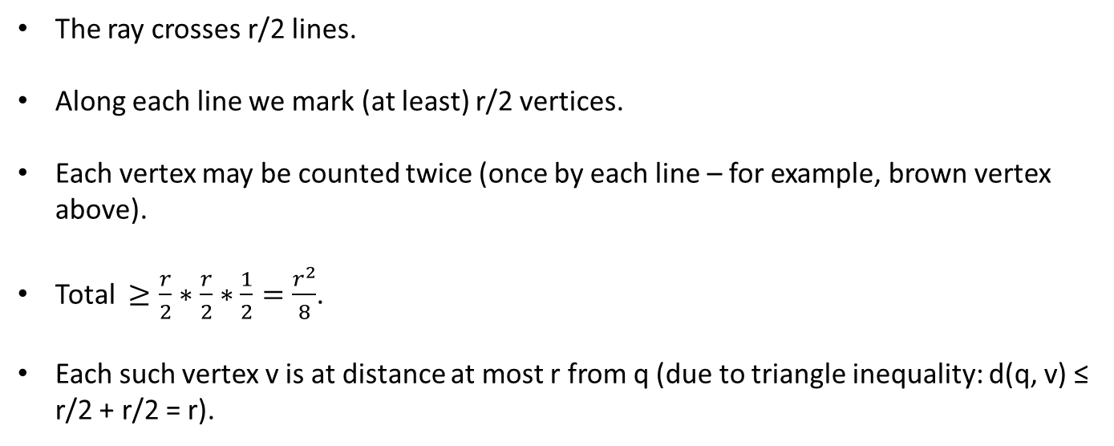
q
The ray crosses r/2 lines.
Along each line we mark (at least) r/2 vertices.
Each vertex may be counted twice (once by each line – for example, brown vertex above).
Total $≥\frac{r}{2}∗\frac{r}{2}∗\frac{1}{2}=\frac{r^{2}}{8}$.
Each such vertex v is at distance at most r from q (due to triangle inequality: d(q, v) ≤ r/2 + r/2 = r).

Slide 12
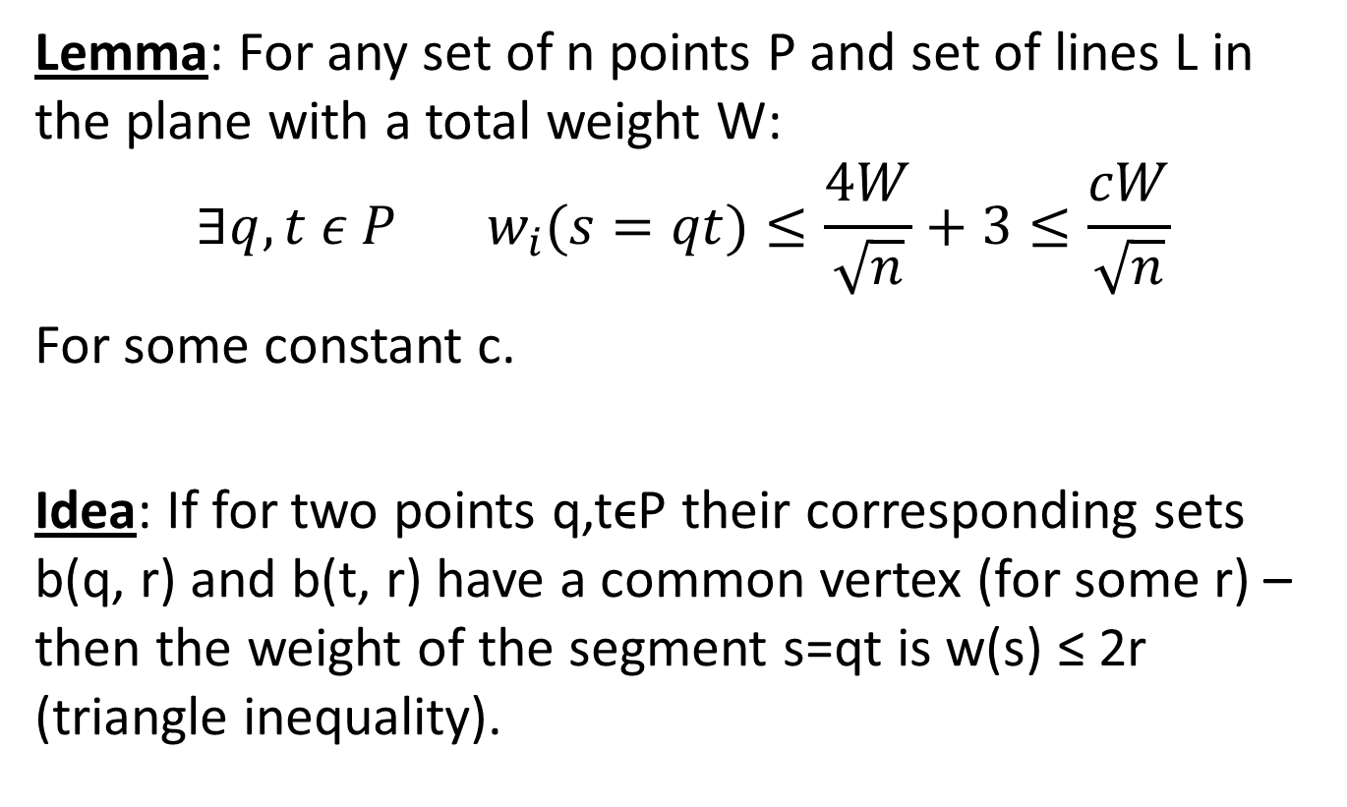
Lemma 2
Lemma: For any set of n points P and set of lines L in the plane with a total weight W:
$$∃q, t ε P w_{i}(s=qt)≤\frac{4W}{\sqrt{n}}+3≤\frac{cW}{\sqrt{n}}$$
For some constant c.
Idea: If for two points q,tϵP their corresponding sets b(q, r) and b(t, r) have a common vertex (for some r) – then the weight of the segment s=qt is w(s) ≤ 2r (triangle inequality).

Slide 13
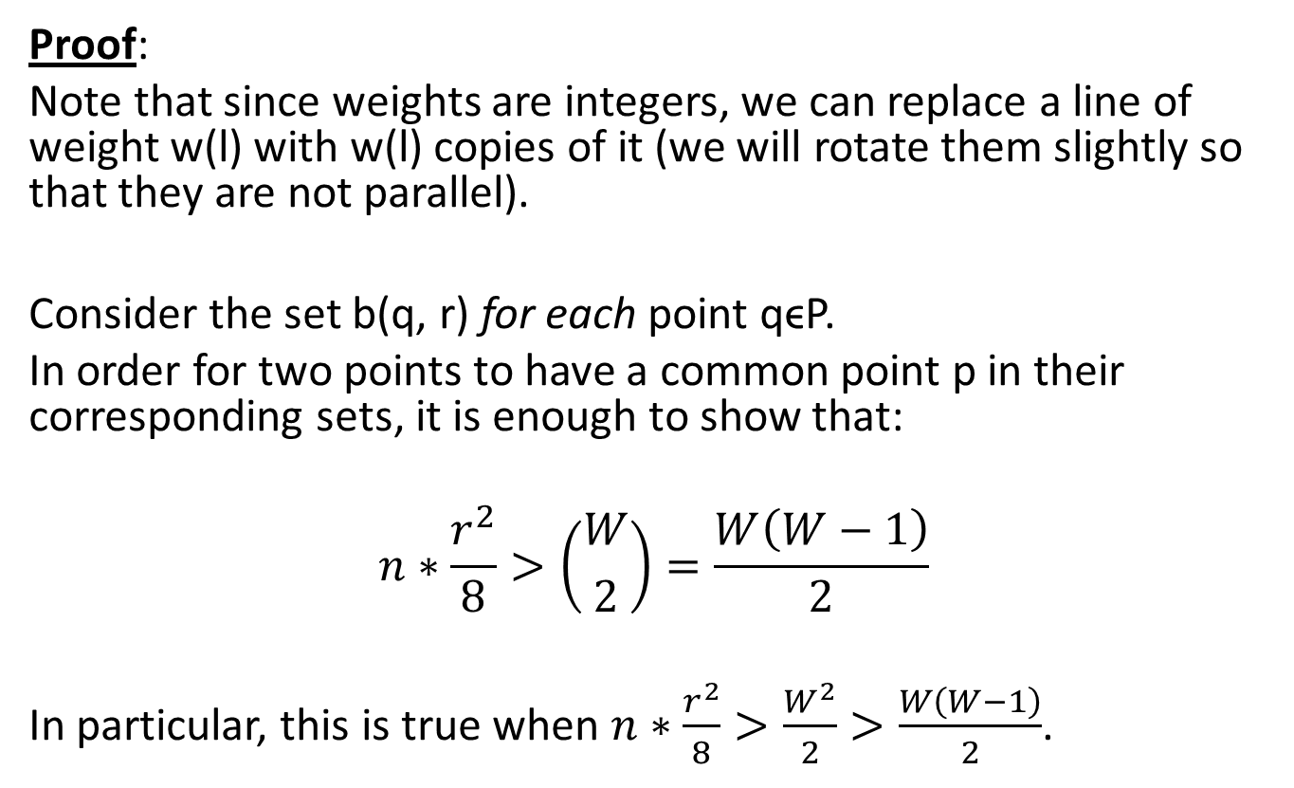
Lemma 2- Cont.
Proof:
Note that since weights are integers, we can replace a line of weight w(l) with w(l) copies of it (we will rotate them slightly so that they are not parallel).
Consider the set b(q, r) for each point qϵP.
In order for two points to have a common point p in their corresponding sets, it is enough to show that:
$$n∗\frac{r^{2}}{8}>\left({W \atop 2}\right)=\frac{W\left(W−1\right)}{2}$$
In particular, this is true when $n∗\frac{r^{2}}{8}>\frac{W^{2}}{2}>\frac{W\left(W−1\right)}{2}$.

Slide 14
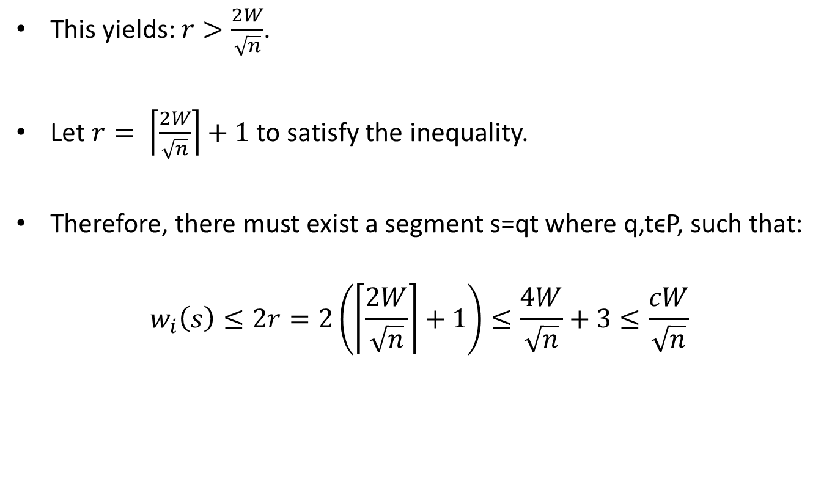
Lemma 2- Cont.
This yields: $r>\frac{2W}{\sqrt{n}}$.
Let $r= \left\lceil \frac{2W}{\sqrt{n}}\right\rceil +1$ to satisfy the inequality.
Therefore, there must exist a segment s=qt where q,tϵP, such that:
$$w_{i}\left(s\right)≤2r=2\left(\left\lceil \frac{2W}{\sqrt{n}}\right\rceil +1\right)≤\frac{4W}{\sqrt{n}}+3≤\frac{cW}{\sqrt{n}}$$

Slide 15
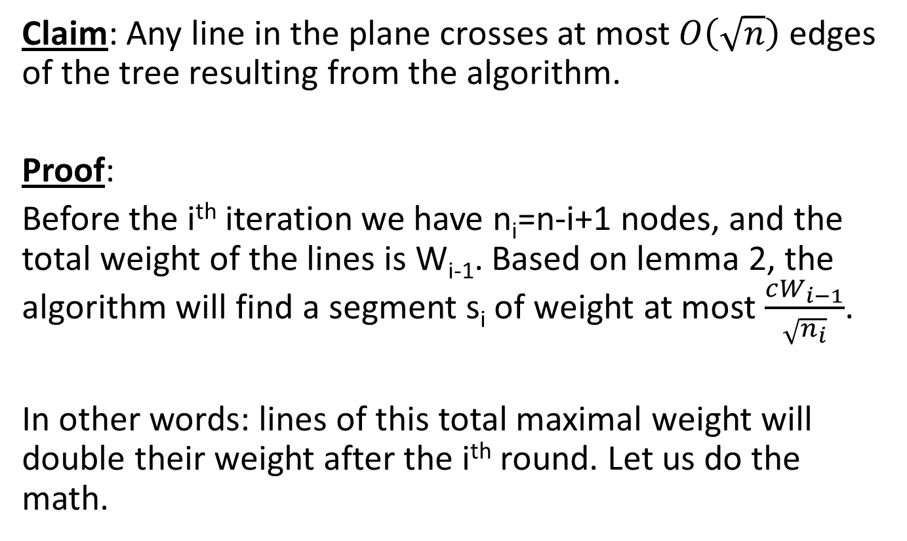
Final Claim
Claim: Any line in the plane crosses at most $O\left(\sqrt{n}\right)$ edges of the tree resulting from the algorithm.
Proof:
Before the i^{th} iteration we have n_{i}=n-i+1 nodes, and the total weight of the lines is W_{i-1}. Based on lemma 2, the algorithm will find a segment s_{i} of weight at most $\frac{cW_{i−1}}{\sqrt{n_{i}}}$.
In other words: lines of this total maximal weight will double their weight after the i^{th} round. Let us do the math.

Slide 16
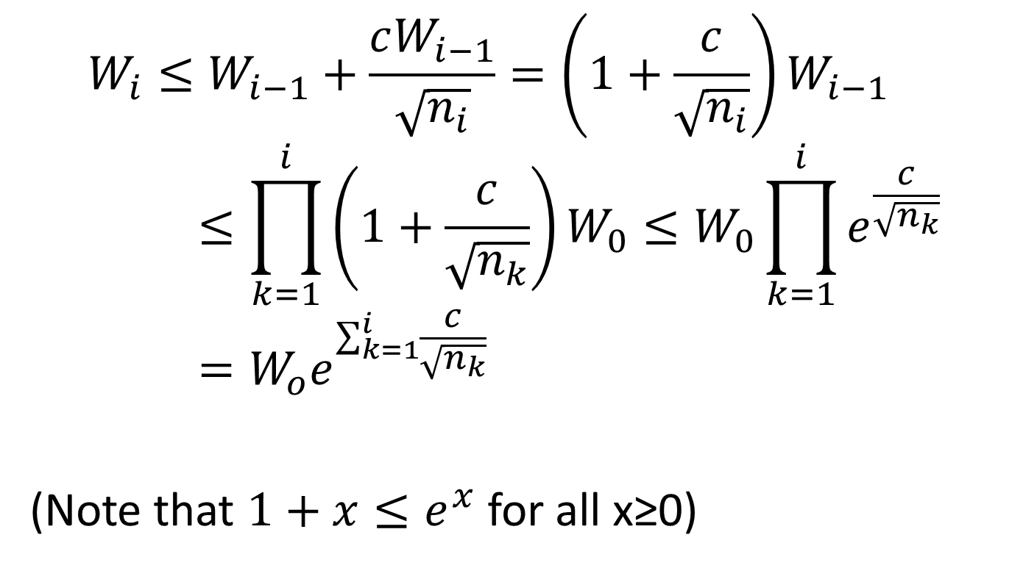
Final Claim – Cont.
$$W_{i}≤W_{i−1}+\frac{cW_{i−1}}{\sqrt{n_{i}}}=\left(1+\frac{c}{\sqrt{n_{i}}}\right)W_{i−1}≤\prod_{k=1}^{i}{\left(1+\frac{c}{\sqrt{n_{k}}}\right)W_{0}}≤W_{0}\prod_{k=1}^{i}{e^{\frac{c}{\sqrt{n_{k}}}}}=W_{o}e^{\sum_{k=1}^{i}{\frac{c}{\sqrt{n_{k}}}}}$$
(Note that $1+x≤e^{x}$ for all x≥0)

Slide 17
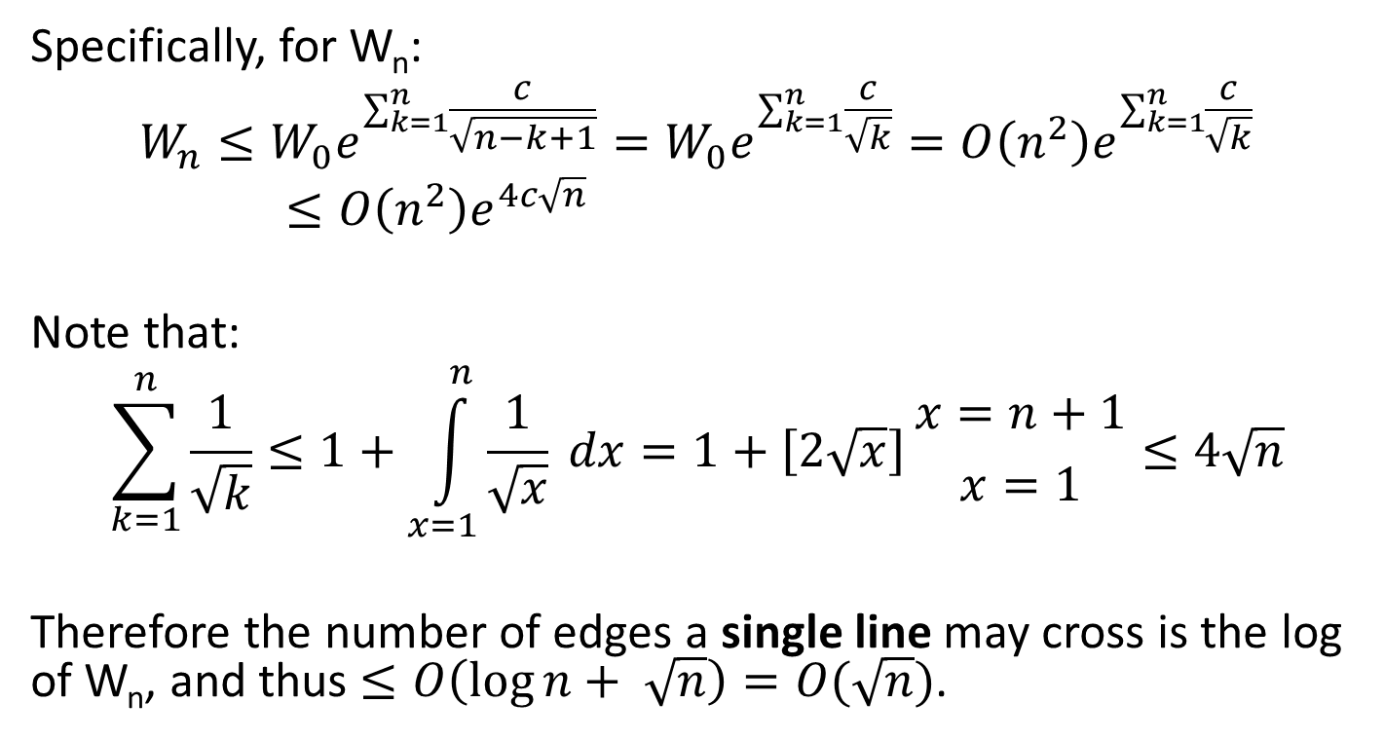
Final Claim – Cont.
Specifically, for W_{n}:
$$W_{n}≤W_{0}e^{\sum_{k=1}^{n}{\frac{c}{\sqrt{n−k+1}}}}=W_{0}e^{\sum_{k=1}^{n}{\frac{c}{\sqrt{k}}}}=O\left(n^{2}\right)e^{\sum_{k=1}^{n}{\frac{c}{\sqrt{k}}}}≤O\left(n^{2}\right)e^{4c\sqrt{n}}$$
Note that:
$$\sum_{k=1}^{n}{\frac{1}{\sqrt{k}}}≤1+\int_{x=1}^{n}{\frac{1}{\sqrt{x}}} dx=1+\left[2\sqrt{x}\right]{x=n+1 \atop x=1}≤4\sqrt{n}$$
Therefore the number of edges a single line may cross is the log of W_{n}, and thus $≤O\left(\log{n}+ \sqrt{n}\right)=O(\sqrt{n})$.

Slide 18
Geometric Set Cover
Given a range space S=(X, R) with bounded VC dimension, e.g. X is a set of n points in the plane, R is a set of m disks – find the minimal set of disks (out of R) that cover all points in X.

Slide 19
Geometric Set Cover – Cont.
General version of Set Cover is NP-Hard.
Greedy algorithm gives an approximation of O(log n).
Can we do better?

Slide 20
Geometric Set Cover
NO! It has been shown that it is NP-Hard to approximate to within a factor of Ω(log n).
However… We can take a subset of the problem where S has a bounded dual shattering dimension δ*.
We can use a variation of the algorithm shown to compute a set cover of size O((δ*/ε)log(δ*/ε)), where ε=1/4k.

Slide 21
Dual Space
For a range space S = (X, R), its dual space is S* = (R, X*) where X*={R_{p} | p ϵ X}.
r₁
s
q
p
t
r₂
r₃
S* = {R, X*} where R = {r₁, r₂, r₃} and X* = {{r₁, r₂, r₃}, {r₁, r₃}, {r₃}}

Slide 22
Geometric Set Cover – The Algorithm
Initially, all sets weigh 1.
Randomly select a subset of size O((δ*/ε)log(δ*/ε)) according to weights.
If the subset is a set cover – we are done.
Otherwise, for a point pϵX that is not covered by the subset, if the weight of all sets in R that cover p W(R_{p}) is less than εW(R), double the weight for those sets.
Repeat until a set cover is found!

Slide 23
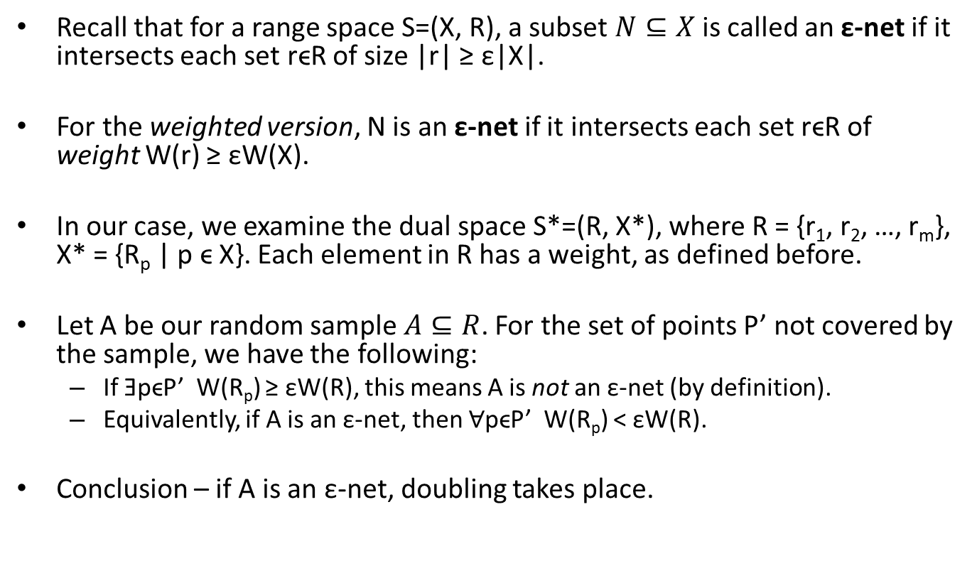
Intuition
Recall that for a range space S=(X, R), a subset $N⊆X$ is called an ε-net if it intersects each set rϵR of size |r| ≥ ε|X|.
For the weighted version, N is an ε-net if it intersects each set rϵR of weight W(r) ≥ εW(X).
In our case, we examine the dual space S*=(R, X*), where R = {r₁, r₂, …, r_{m}}, X* = {R_{p} | p ϵ X}. Each element in R has a weight, as defined before.
Let A be our random sample $A⊆R$. For the set of points P’ not covered by the sample, we have the following:
If ƎpϵP’ W(R_{p}) ≥ εW(R), this means A is not an ε-net (by definition).
Equivalently, if A is an ε-net, then $∀$pϵP’ W(R_{p}) < εW(R).
Conclusion – if A is an ε-net, doubling takes place.

Slide 24
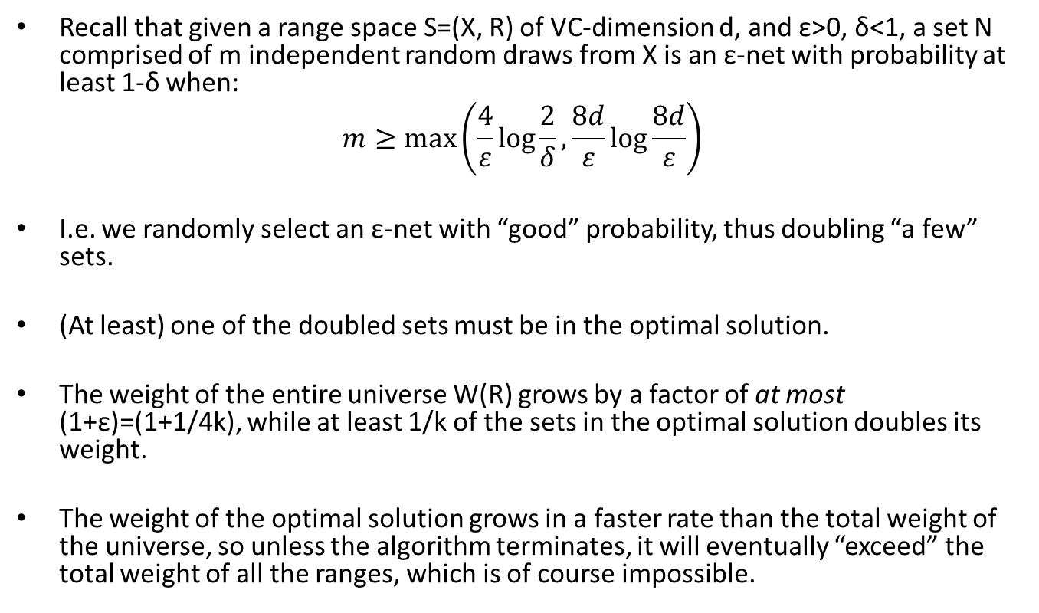
Intuition – Cont.
Recall that given a range space S=(X, R) of VC-dimension d, and ε>0, δ<1, a set N comprised of m independent random draws from X is an ε-net with probability at least 1-δ when:
$$m≥\max\left(\frac{4}{ε}\log{\frac{2}{δ}},\frac{8d}{ε}\log{\frac{8d}{ε}}\right)$$
I.e. we randomly select an ε-net with “good” probability, thus doubling “a few” sets.
(At least) one of the doubled sets must be in the optimal solution.
The weight of the entire universe W(R) grows by a factor of at most (1+ε)=(1+1/4k), while at least 1/k of the sets in the optimal solution doubles its weight.
The weight of the optimal solution grows in a faster rate than the total weight of the universe, so unless the algorithm terminates, it will eventually “exceed” the total weight of all the ranges, which is of course impossible.

Slide 25
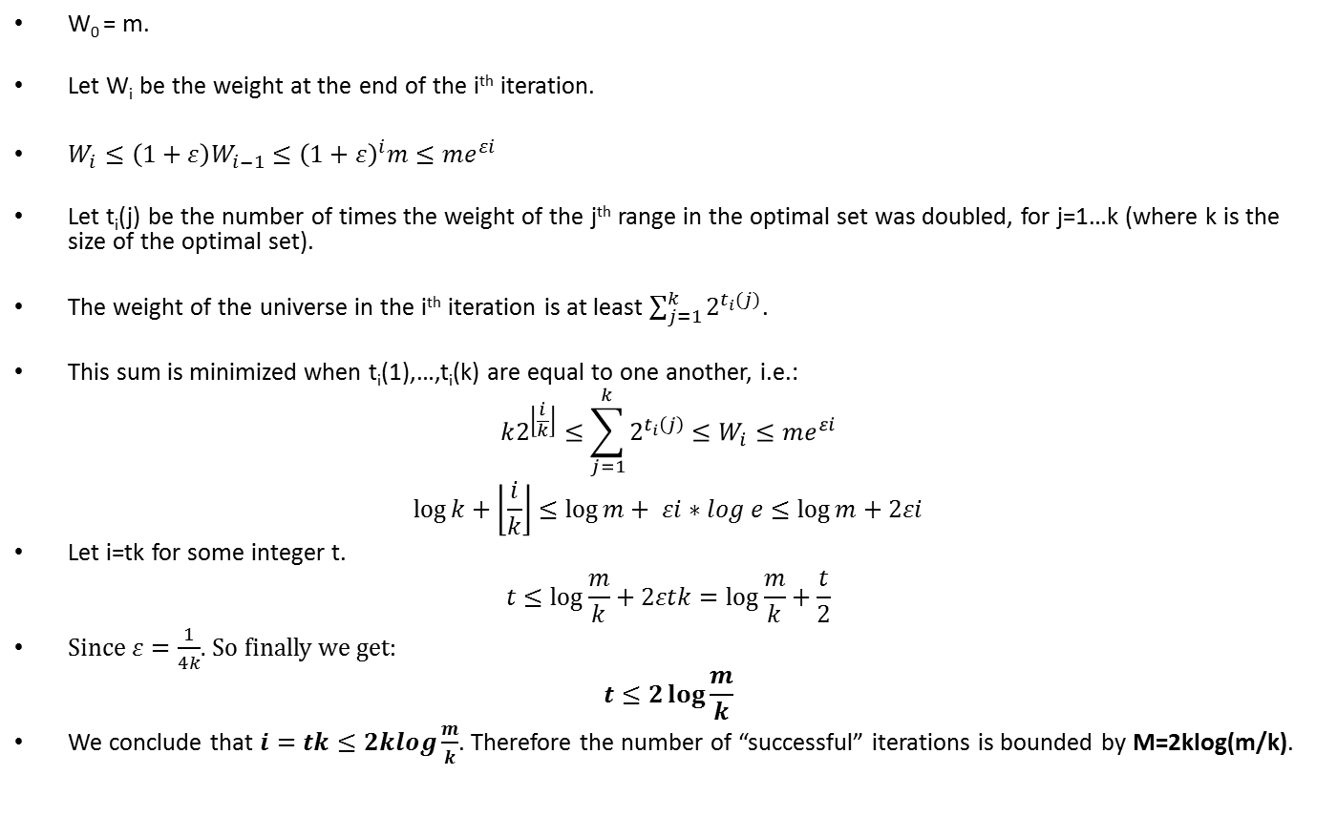
Proof
W₀ = m.
Let W_{i} be the weight at the end of the i^{th} iteration.
$W_{i}≤\left(1+ε\right)W_{i−1}≤{\left(1+ε\right)}^{i}m≤me^{εi}$
Let t_{i}(j) be the number of times the weight of the j^{th} range in the optimal set was doubled, for j=1…k (where k is the size of the optimal set).
The weight of the universe in the i^{th} iteration is at least $\sum_{j=1}^{k}{2^{t_{i}(j)}}$.
This sum is minimized when t_{i}(1),…,t_{i}(k) are equal to one another, i.e.:
$$k2^{\left\lfloor \frac{i}{k}\right\rfloor }≤\sum_{j=1}^{k}{2^{t_{i}\left(j\right)}}≤W_{i}≤me^{εi}$$
$$\log{k}+\left\lfloor \frac{i}{k}\right\rfloor ≤\log{m}+ εi∗log e≤\log{m}+2εi$$
Let i=tk for some integer t.
$$t≤\log{\frac{m}{k}}+2εtk=\log{\frac{m}{k}}+\frac{t}{2}$$
Since $ε=\frac{1}{4k}$. So finally we get:
$$t≤2\log{\frac{m}{k}}$$
We conclude that $i=tk≤2klog\frac{m}{k}$. Therefore the number of “successful” iterations is bounded by M=2klog(m/k).

Slide 26
Finding K
The algorithm assumes we have knowledge of k, the size of the optimal solution (or at least a close upper bound for k).
We perform an exponential search: start by guessing k=k’. We run the algorithm, and if it exceeds c*log(m/k) iterations without terminating, we double k and try again.

Slide 27
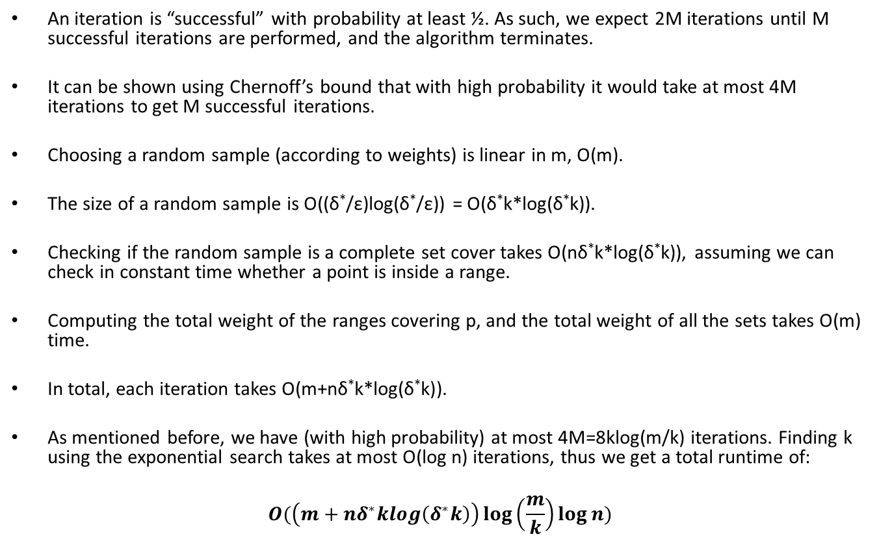
Analysis
An iteration is “successful” with probability at least ½. As such, we expect 2M iterations until M successful iterations are performed, and the algorithm terminates.
It can be shown using Chernoff’s bound that with high probability it would take at most 4M iterations to get M successful iterations.
Choosing a random sample (according to weights) is linear in m, O(m).
The size of a random sample is O((δ*/ε)log(δ*/ε)) = O(δ*k*log(δ*k)).
Checking if the random sample is a complete set cover takes O(nδ*k*log(δ*k)), assuming we can check in constant time whether a point is inside a range.
Computing the total weight of the ranges covering p, and the total weight of all the sets takes O(m) time.
In total, each iteration takes O(m+nδ*k*log(δ*k)).
As mentioned before, we have (with high probability) at most 4M=8klog(m/k) iterations. Finding k using the exponential search takes at most O(log n) iterations, thus we get a total runtime of:
$$O(\left(m+nδ^{∗}klog\left(δ^{∗}k\right)\right)\log\left(\frac{m}{k}\right)\log{n})$$

Slide 28
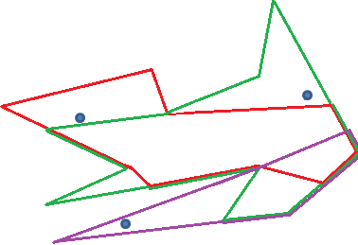
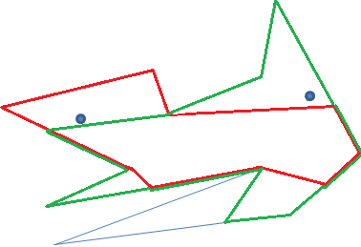
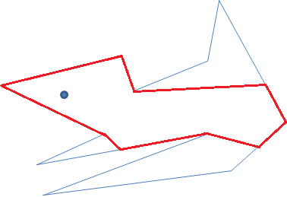
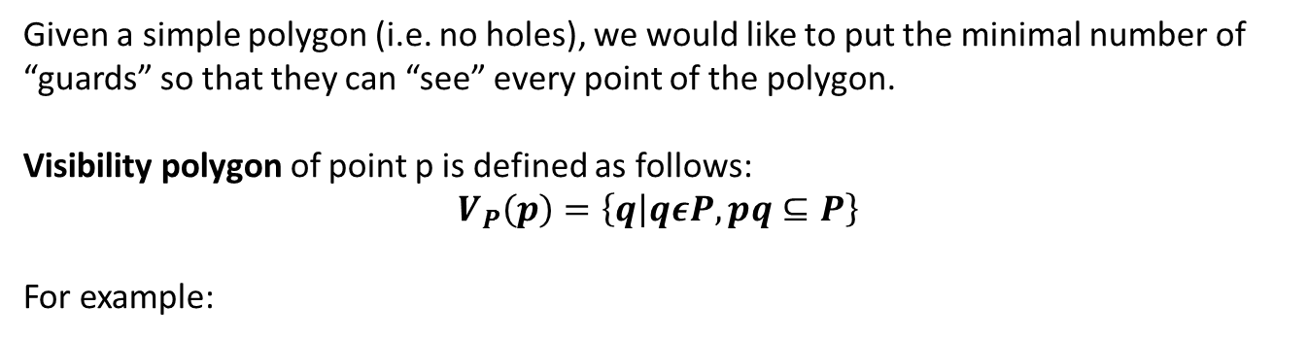
Application – Guarding an Art Gallery
Given a simple polygon (i.e. no holes), we would like to put the minimal number of “guards” so that they can “see” every point of the polygon.
Visibility polygon of point p is defined as follows:
$$V_{P}\left(p\right)=\left\{q | qεP, pq⊆P\right\}$$
For example:

Slide 29
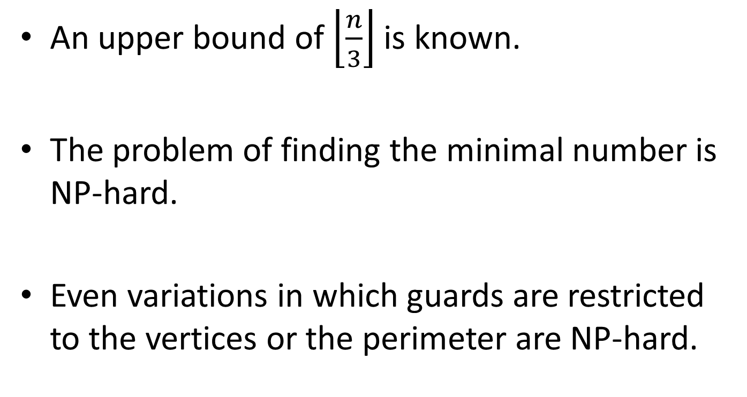
Application – Guarding an Art Gallery
An upper bound of $\left\lfloor \frac{n}{3}\right\rfloor$ is known.
The problem of finding the minimal number is NP-hard.
Even variations in which guards are restricted to the vertices or the perimeter are NP-hard.

Slide 30
Application – Guarding an Art Gallery
Consider the problem where guards may only be on vertices.
We can show a reduction to set-cover, for which we have a O(klog k) sized solution.
The VC dimension of the range space formed by all visibility polygons inside a polygon P is a constant.
Thus, the dual shattering dimension is bounded.

Slide 31
Application – Guarding an Art Gallery
The reduction: Let S=(P, R). P is the polygon, R is the set of visibility polygons formed by each of the vertices.
We place a single point somewhere inside each of the faces of arrangement of the polygons in R in P.

Slide 32
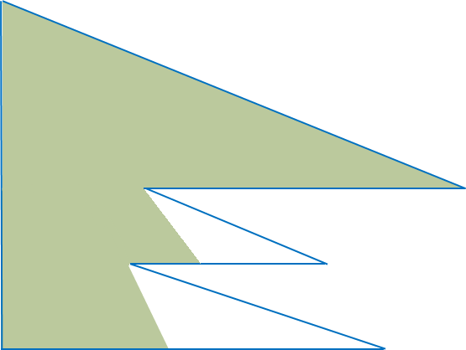
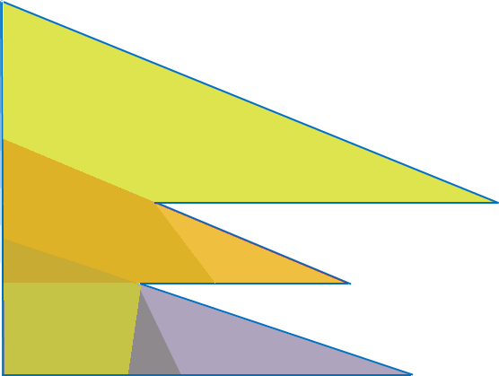
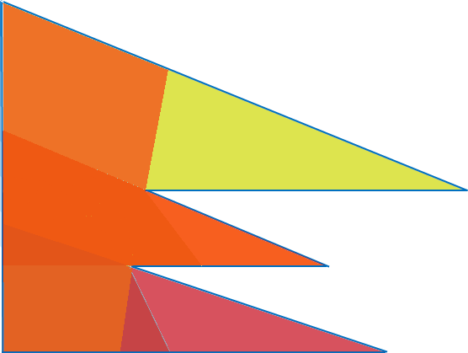
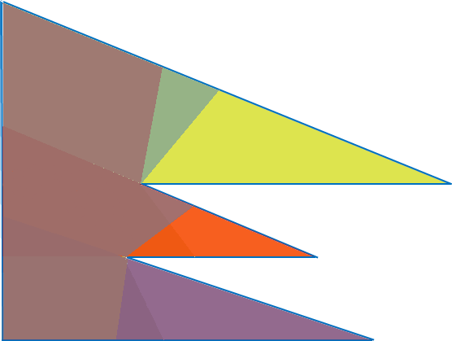
Application – Guarding an Art Gallery
Run the set-cover algorithm where the points are as portrayed and the sets are induced by the visibility polygons.

