Slide 1
  On Complexity, Sampling, and
  є-Nets and є-Samples.
  Present by: Shay Houri

Slide 2
GOALS
We will try to quantify the notion of geometric complexity.
We show that one can capture the structure of a distribution/point set by a small subset.
The size here would depend on the complexity of the shapes/ranges .
It is independent of the size of the point set.

Slide 3
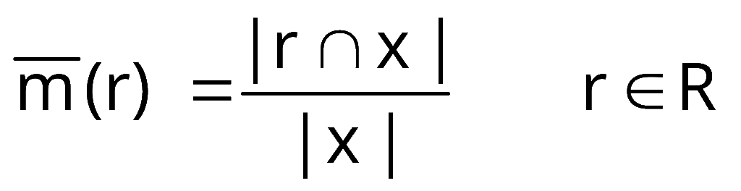
VC Dimension
A range space S is a pair (X,R):
  X- is set of points (finite or infinite).
  R - is a family of subsets of X (finite or infinite). elements of R are ranges .
Measure quantity: Let (X,R) be a range space, and let x be a finite subset of X:

Slide 4
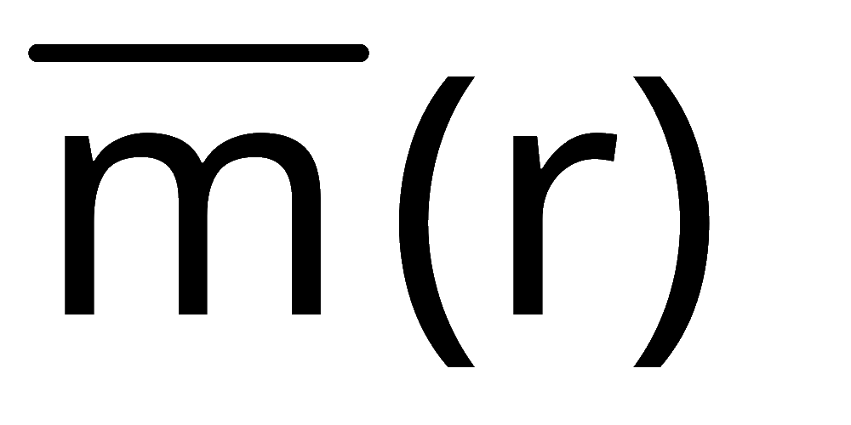
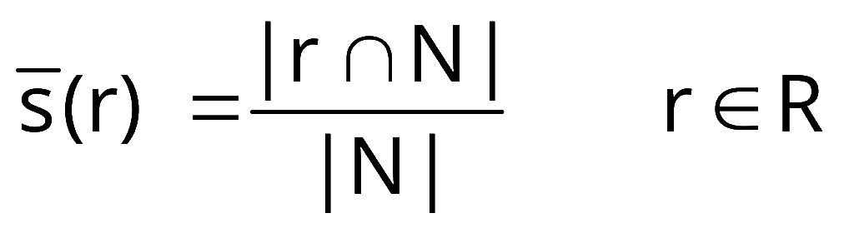
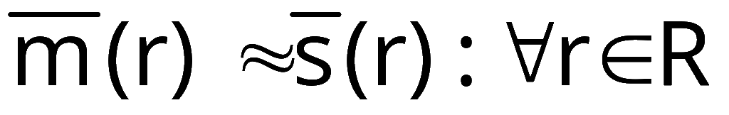
VC Dimension
We want a good estimate to by using a more compact set to represent the range space. (While x is finite, it might be very large).
Let (X,R) be a range space, for a subset N of x, its estimate of the measure :
We look for methods to generate a sample N, such that :

Slide 5
VC Dimension
In the worst case no sample can capture the measure of all ranges:
The range x \ N is being completely missed by N.
  We need to concentrate on range spaces where not all subsets are allowable ranges.
  The notion of VC dimension is one way to limit the complexity of a range space.

Slide 6

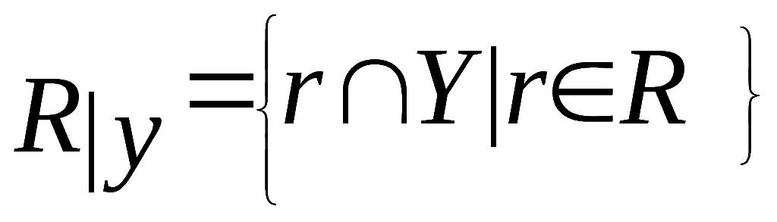
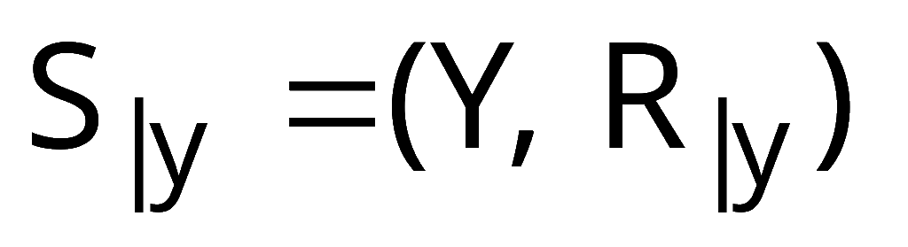

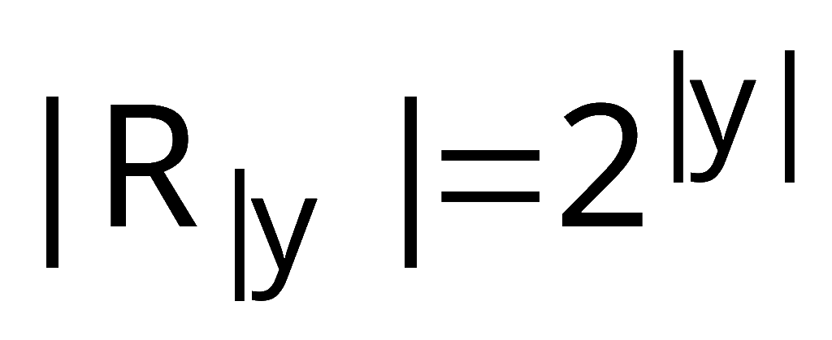
VC Dimension
Let S=(X,R) be a range space, For ,let:
denote the projection of R on Y.
The range space S projected to Y is
If contains all subsets of Y (if Y is finite, we have
) then Y is shattered by R (or equivalently Y is shattered by S).

Slide 7
VC Dimension
The Vapnik-Chervonenkis dimension (or VC dimension) of S, denoted by dimVC(S ) is :
  Maximum cardinality of a shattered subset of X.
If there are arbitrarily large shattered subsets then dimVC(S )=∞

Slide 8

Example of VC Dimension
Intervals:
  X - be the real line.
  R - be set set of all intervals on the real line.
  Y be the set {1,2}.
We can find 4 intervals that contain all possible subsets of Y.
Formally, the projection
This is false for a set of three points B ={p, q, s}.

Slide 9

Example of VC Dimension
There is no interval that can contain the two extreme points p and s without also containing q.
The subset {p,s} is not realizable for intervals.
The largest shattered set by the range space (real line, intervals) is of size 2. (dimVC=2).

Slide 10
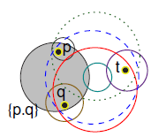
Example of VC Dimension
Disks:
  X = R²
  R be the set of disks in the plane.
For any three points p,q,s (in general Position)
we can find 8 disks that realize all possible 2 different subsets.

Slide 11
Example of VC Dimension
Can disks shatter a set with 4 points?
Consider such a set P of 4 points:
  If the convex-hull of P has only 3 points on its boundary then the subset X having only those 3 vertices (which does not include the middle point) is impossible, by convexity.
  if all 4 points are vertices of the convex hull
  (They are a, b, c, d along the boundary of the convex hull).

Slide 12
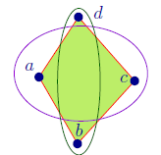
Example of VC Dimension
  Either the set {a, c} or the set {b, d} is not realizable.
  If both options are realizable, then consider the two disks D1 and D2 that realize those assignments.
  D1 and D2 must intersect in four points, but this is not possible, since two circles have at most 2 intersection points.
Hence dimVC = 3.

Slide 13
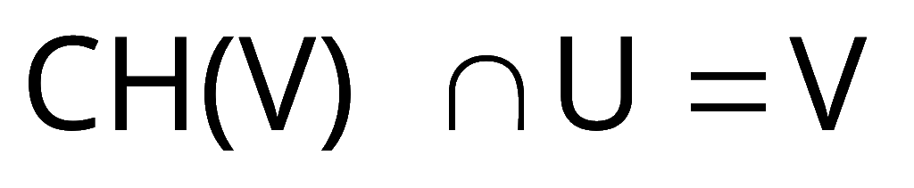
Example of VC Dimension
  Convex sets:
    Range space S = (R²,R).
    R is the set of all (closed) convex sets in the plane.
  Consider a set U of n points P1,….,Pn all lying on the boundary of the unit circle in the plane.
  Let V be any subset of U, and consider the convex-hull CH(V).
  CH(V)єR, and .
  Any subset of U is realizable by S.

Slide 14
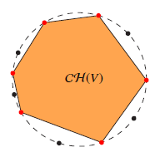
Example of VC Dimension
  S can shatter sets of arbitrary size, and its VC dimension is unbounded.
  dimVC(S) = ∞.

Slide 15
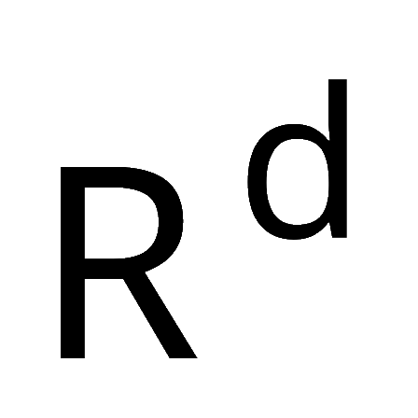
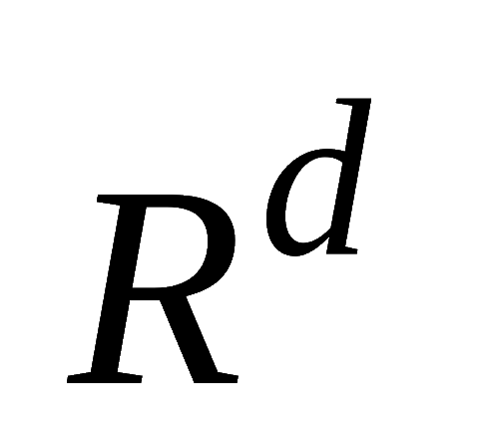
Example of VC Dimension
Half spaces: Let S = (X,R):
  X =
  R is the set of all (closed) halfspaces in .
dimVC(S ) = d + 1.

Slide 16
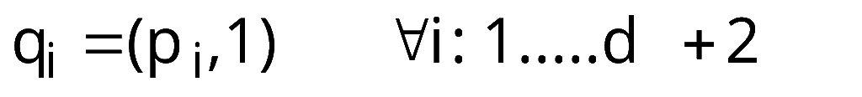
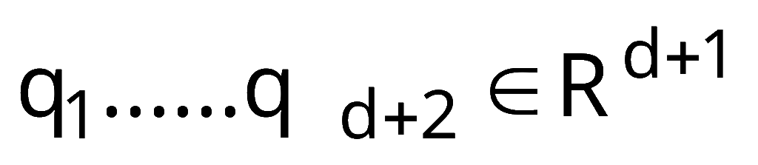
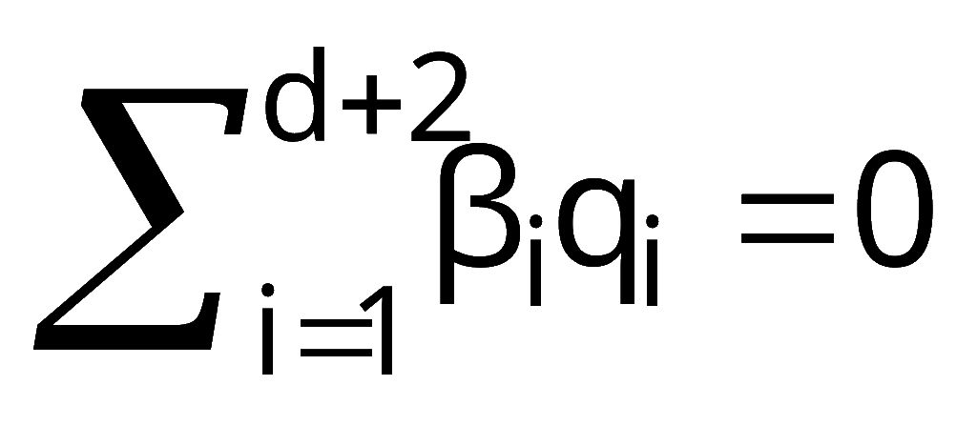
Example of VC Dimension
Set
The points are linearly dependent
There are coefficient β1….βd+2 not all of them
0 such that

Slide 17
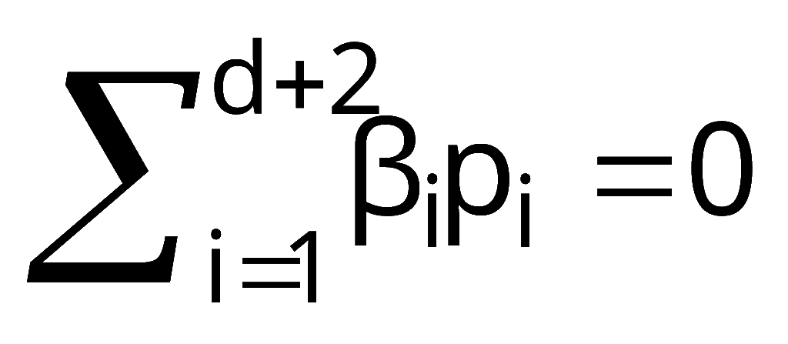
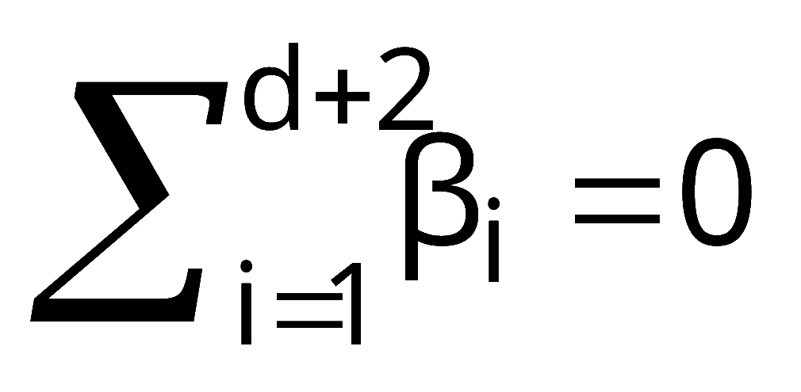
Example of VC Dimension
Considering only the first d coordinates of these points implies that
Similarly, by considering only the (d + 1)th coordinate of these points:

Slide 18

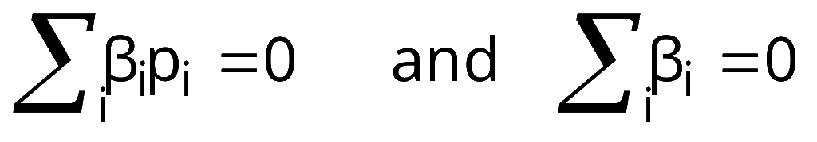
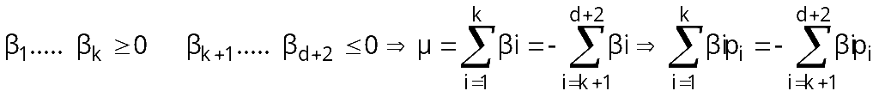
Example of VC Dimension
By the previous claim:
  There are real number β1….βd+2 not all of them
0 such that
  And so there are:

Slide 19
Example of VC Dimension
Convex-hull
In particular:
For the same point v we have :
Conclude that v is in the intersection of the two convex hulls, as required.

Slide 20
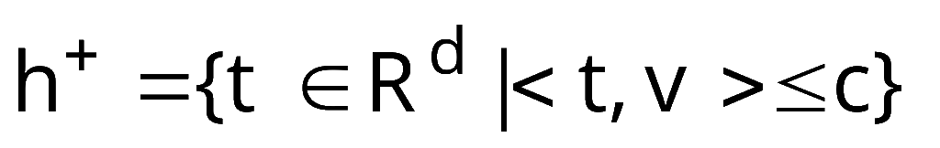
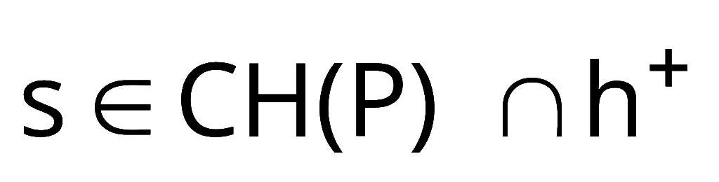
Example of VC Dimension
The half space can be written as :
And :
  As such there are numbers :

Slide 21

Example of VC Dimension
By the linearity of the dot-product:
Setting βi = <Pi,v>, for i = 1…..m, The above implies that β is a weighted average of β1…. βm.
In particular there must be a βi that is no larger than the average, that is βi ≤c.
This implies that <Pi,v> ≤c. Namely, Pi є h+ as claimed.

Slide 22
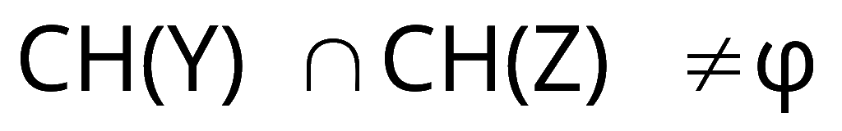
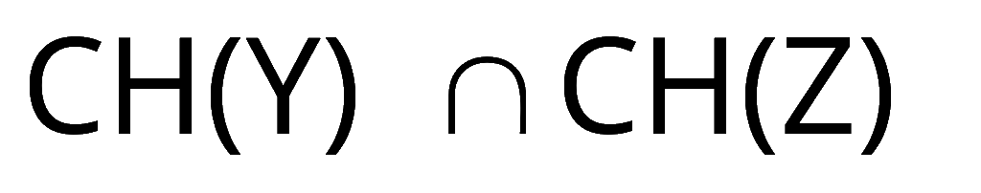
Example of VC Dimension
Half spaces: Let S = (X,R):
  X =
  R is the set of all (closed) halfspaces in .
Radon’s theorem implies that:
  if a set Q of d+2 points is being shattered by S.
  Then we can partition this set Q into two disjoint sets Y and Z such that
  In particular, let s be a point of

Slide 23
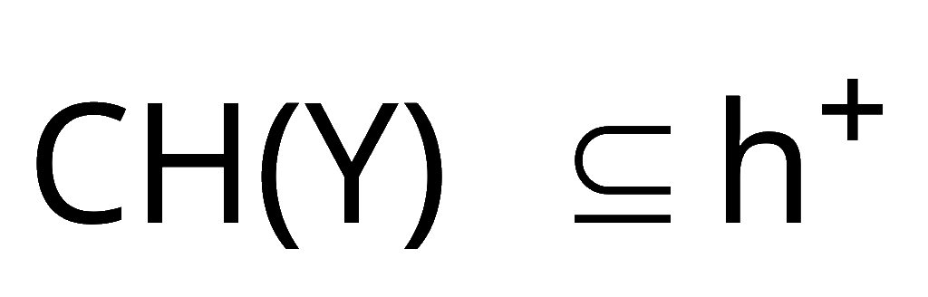
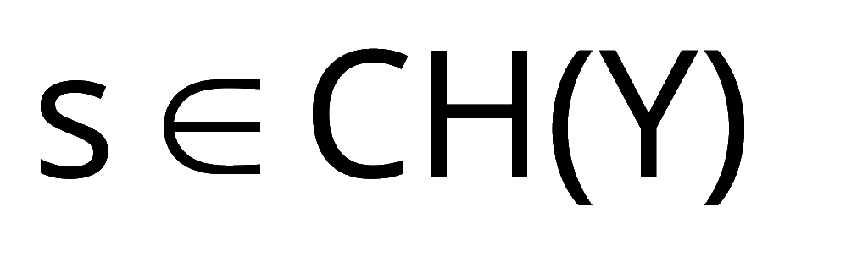
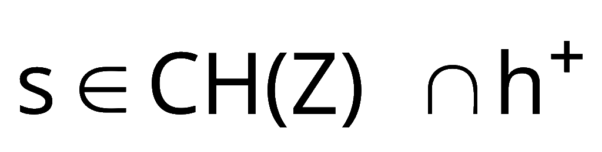
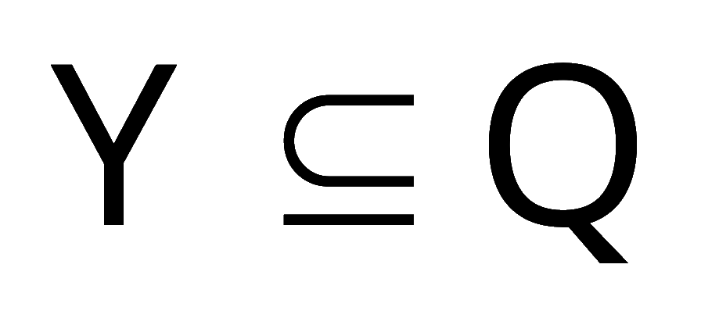
Example of VC Dimension
If a halfspace h+ contains all the points of Y
  Then since a halfspace is a convex set.
  Thus, any halfspace h+ containing all the points of Y, will contain the point
  But and this implies that a point of Z must lie in h+.(by Lemma 5.8)
The subset can not be realized by a halfspace, which implies that Q can not be shattered.
Thus dimVC(S ) < d +2.

Slide 24
Example of VC Dimension
Regular simplex with d + 1 vertices is shattered by S.
Thus, dimVC(S ) = d + 1.

Slide 25
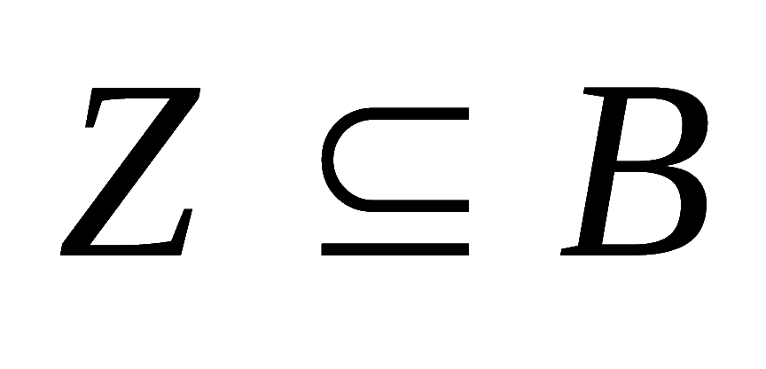
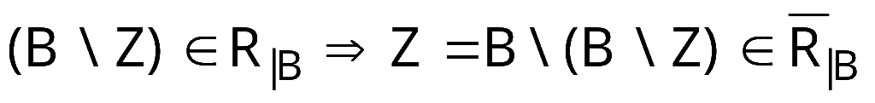
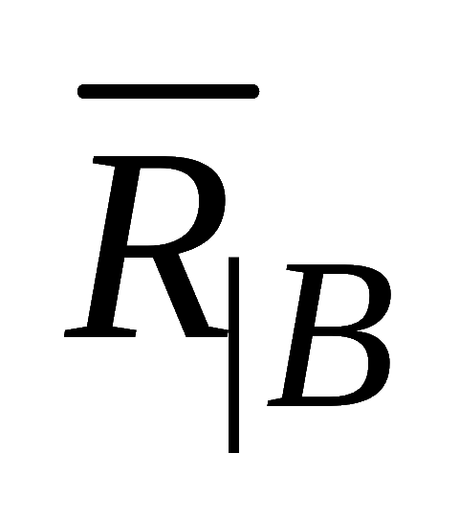
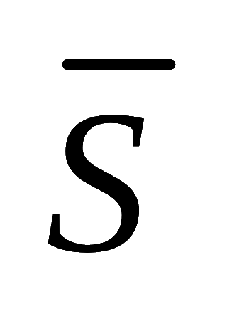
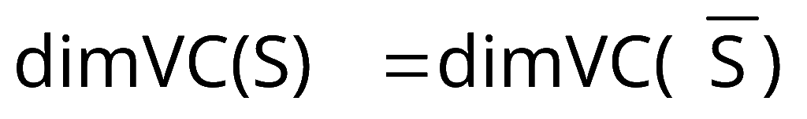
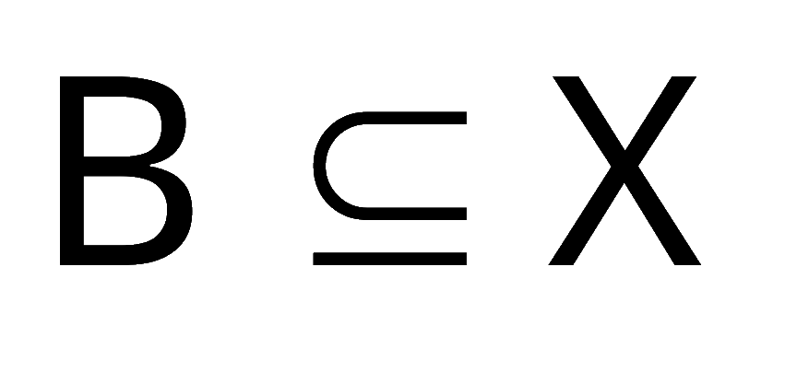
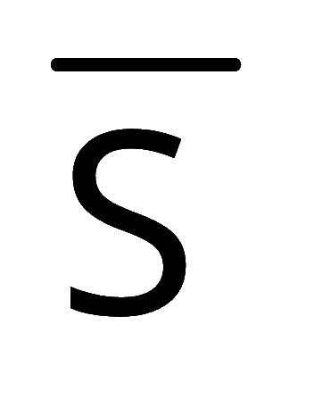
VC Dimension
  Let S = (X,R) with dimVC(S).
  We Define the complement of the ranges in s :
  if S shatters B, then for any , we have that:
  contains all the subsets of B, and shatters B.
  A set is shattered by if and only if it is shattered by S.

Slide 26

VC Dimension
The property of a range space with bounded VC dimension is:
  The number of ranges for a set of n elements, grows polynomially in n (with the power being the
  VC dimension).
  Formally, let the growth function be:

Slide 27

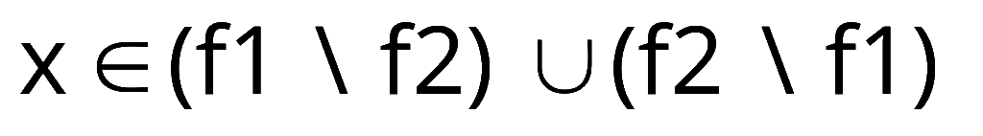
VC Dimension
For a range space S we will write :
  d(S) - for VCdim(S)
  n(S) - for |X|
The proof will be by induction on d(S)+n(S).
  When d(S)+n(S) = 0 we have |R|≤1 :
    Because if R contains two elements f1 and f2 then any element is shattered and then VCdim ≥1.

Slide 28
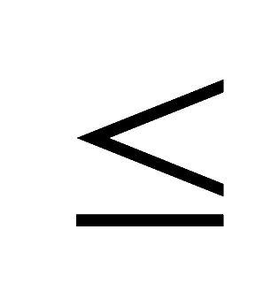



VC Dimension
Assume the result holds for all n(S) + d(S) r.
Let x be any element of X, and consider the sets:
Then
  Because we charge the elements of R to their corresponding element in R \ x.
  The only “bad” case is when there is a range r such that both

Slide 29
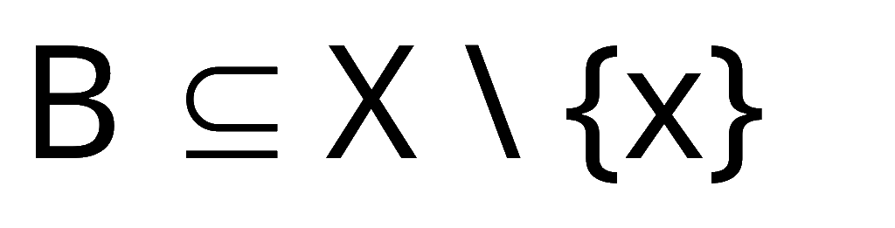

VC Dimension
  Then these two distinct ranges get mapped to the same range in R/x.
  But such ranges contribute exactly one element to Rx.
  Similarly, every element of Rx corresponds to two such “twin” ranges in R.
(X\{x} ,Rx) has VC dimension δ-1, as the largest set that can be shattered is of size δ-1.
(Any set shattered by Rx, implies that is shattered in R).

Slide 30
VC Dimension
Thus, we have:
We have
  counting argument: is just the number of different subsets of size at most δ out of n elements.
  we either decide to not include the first element in these subsets
  or, alternatively, we include the first element in these subsets, but then there are only δ-1 elements left to pick

Slide 31

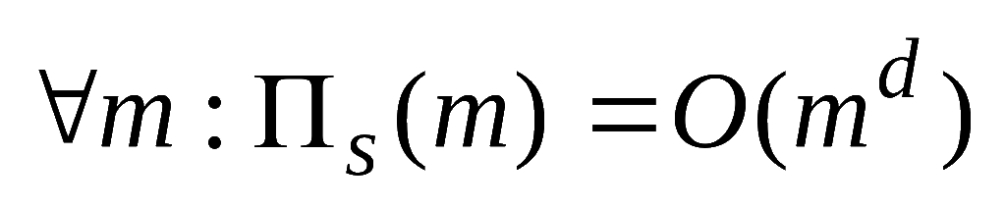
Shattering Dimension
The shattering dimension of S is:
  The smallest d such that
The shattering dimension is bounded by the dimVC.
  Proof.
    Let n = |B|:
    By definition the shattering dimension of S is at most δ.

Slide 32


Shattering Dimension
Let be the largest set shattered by S.
δ denote its cardinality.
We have that :
(where c is a fixed constant).
As such, we have that:

Slide 33
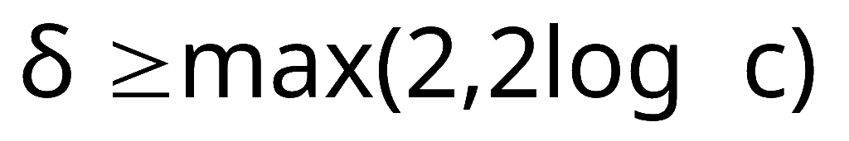

Shattering Dimension
Assuming :
We use here the fact that:

Slide 34
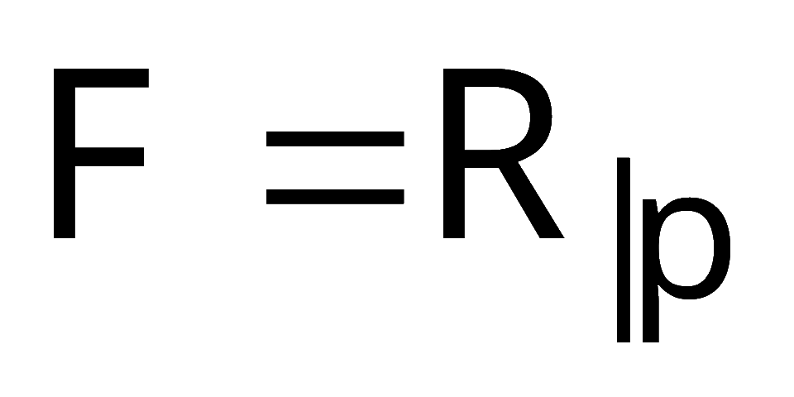
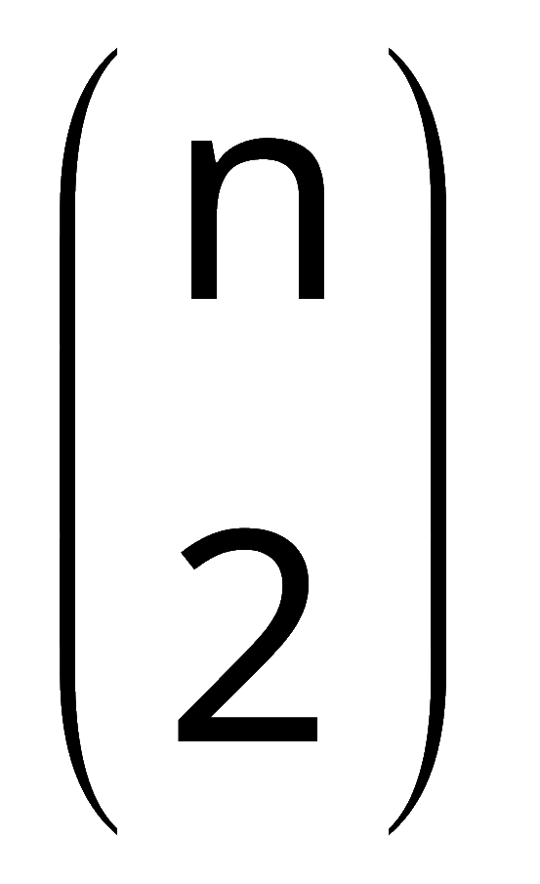
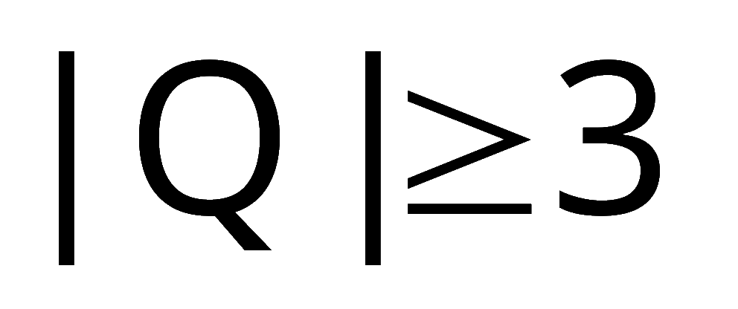
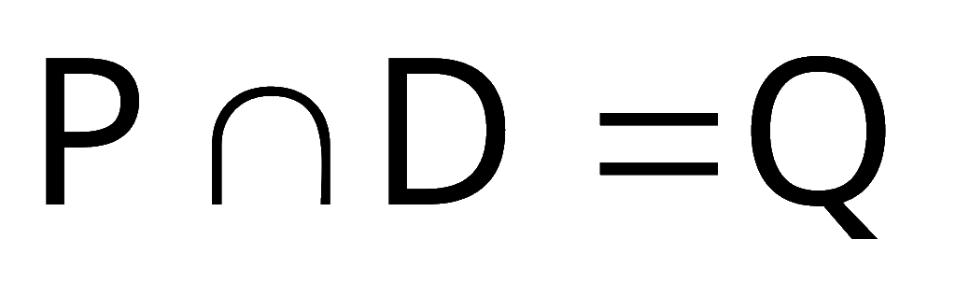
Shattering Dimension
Consider any set P of n points in the plane, and consider the set .
The set F contains only:
  n sets with a single point in them.
  sets with two points in them.
So, fix Q є F such that .
There is a disk D that realizes this subset.( )
For the sake of simplicity of exposition, assume that P is in general position.

Slide 35
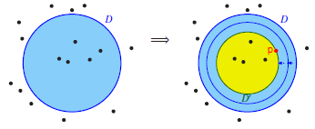
Shattering Dimension
Shrink D till its boundary passes through a point p of P.
Now, continue shrinking the new disk D’, in such a way that its boundary passes through the point p.
This can be done by moving the center of D’ towards p.
Continue in this continuous deformation till the new boundary hits another point q of P.

Slide 36
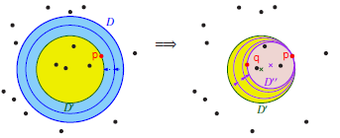
Shattering Dimension
Next, we continuously deform D’’ so that it has both pєQ and qєQ on its boundary.
This can be done by moving the center of D’’ along the bisector linear between p and q. Stop as soon as the boundary of the disk hits a third point s є P.

Slide 37
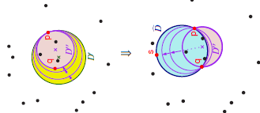
Shattering Dimension
We have freedom in choosing in which direction to move the center. As such, move in the direction that causes the disk boundary to hit a new point s.
The boundary of D is the unique circle passing through points p q s.

Slide 38
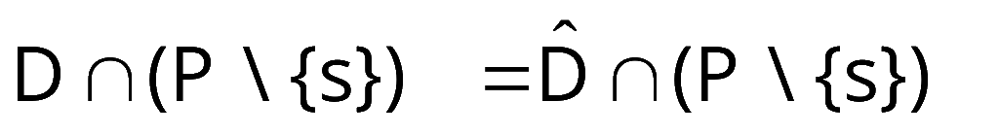
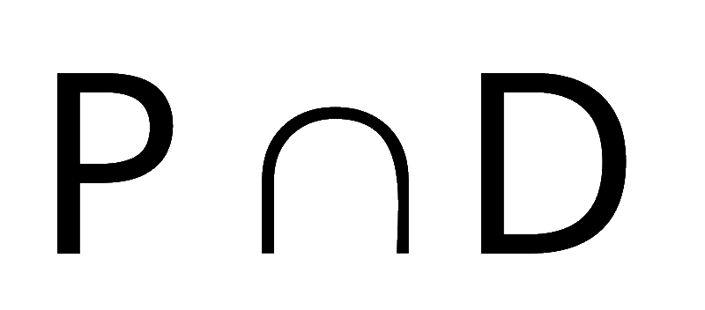
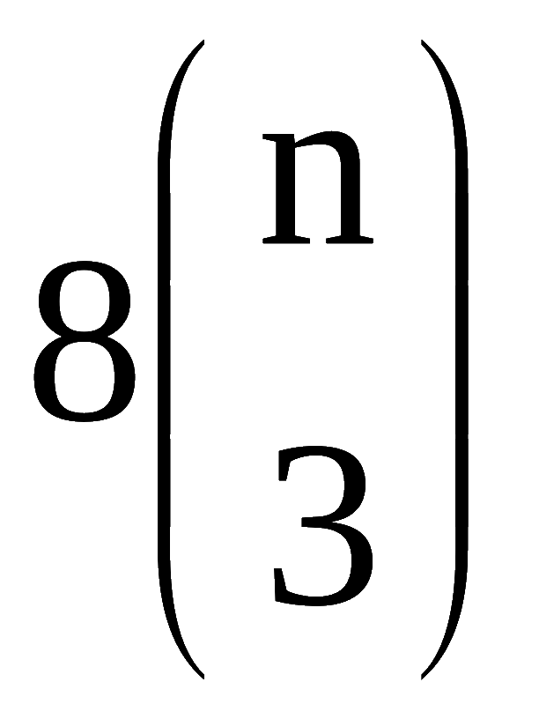

Shattering Dimension
That is, we can specify the point set by specifying the three points p, q, s .
Thus specifying the disk D, and the status of the three special points.
We specify for each point p, q, s whether or not it is inside the generated subset.
As such, there are at most different subsets in F containing more than 3 points:
  Each such subset maps to a “canonical” disk, there are at most different such disks.
  Each such disk defines at most 8 different subsets.

Slide 39


Shattering Dimension
Similar argumentation implies that there are at most subsets that are defined by a pair of points that realizes the diameter of the resulting disk.
Overall, we have that:
Since there is one empty set in F, n sets of size 1, and the rest of the sets are counted as described above.

Slide 40
Shattering Dimension
The shattering dimension of a range space defined by a family of shapes :
  Always bounded by the number of points that determine a shape in the family.
Thus, the shattering dimension of arbitrarily oriented rectangles in the plane is bounded by 5.

Slide 41

Shattering Dimension
Since such a rectangle is uniquely determined by 5 points.
  if a rectangle has only 4 points on its boundary,
  then there is one degree of freedom left.
  since we can rotate the rectangle “around” these points,

Slide 42

Dual Shattering Dimension
  Given a range space S = (X,R):
    There is a set of ranges of R associated with p.
    The set of all ranges of R that contains p:
    Naturally, the dual range space to S* is the original S.
    (In other words, the dual to the dual is the primal.)

Slide 43

Dual Shattering Dimension
  The easiest way to see it, is to think about this as an abstract set system realized as an incidence matrix.
  Now, it is easy to verify that the dual range space is the transposed matrix.

Slide 44
Dual Shattering Dimension
  Consider X to be the plane, and R to be a set of m disks.
    Then, in the dual range space S* = (R ,X*), every point p in the plane has a set associated with it in X*
    which is the set of disks of R that contains p.
    If we consider the arrangement formed by the m disks of R, then all the points lying inside a single face of this arrangement correspond to the same set of X*.
    The number of ranges in X* is bounded by the complexity of the arrangement of these disks, which is O(m²).

Slide 45




Dual Shattering Dimension
  Proof:
  Assume that S* shatters a set F = {r1….. rk} R of k ranges.
  Then, there is a set P X of m = points that shatter F.
  Consider the matrix M (of dimensions ) having the points of P as the columns.

Slide 46

Dual Shattering Dimension
  Every row is a set of F.
  Where the entry in the matrix corresponding to a point p є P and a range r є F is 1 if and only if p є r, and zero otherwise.
  Since P shatters F, we know that this matrix has all possible binary vectors as columns.

Slide 47


Dual Shattering Dimension
  Where the i-th row is the binary representation of the number i - 1

Slide 48

Dual Shattering Dimension
  Clearly, the log k’ columns of M’ are all different.
  We can find log k’ columns of M that are identical to the columns of M’.

Slide 49


Dual Shattering Dimension
  Each such column corresponds to a point p є P.
  let Q P be this set of log k’ points.
  Note, that for any subset Z Q, there is a row t in M’ that encodes this subset.
  Consider the corresponding row in M that is, the range rt є F.
  Since M and M’ are identical (in the relevant log k’ columns of M) on the first k’, we have that
  The set of ranges F shatters Q.
  But since the original range space has VC dimension δ, it follows that

Slide 50


Dual Shattering Dimension
  which implies that:
  which in turn implies that:

Slide 51
Dual Shattering Dimension
  Proof.
  The shattering dimension of the dual range space S* is bounded by δ , and as such, by Lemma 5.14:
  Its VC dimension is bounded by δ’ = O(δlogδ)

Slide 52

Dual Shattering Dimension
  Since the dual range space to S* is S, we have by Lemma 5.18 :
  That the VC dimension of S is bounded by

Slide 53
Dual Shattering Dimension
  Consider a the range space S =(R²,R):
    where R is a set of shapes in the plane, such that the boundary of any pair of them intersect at most s times.
  The dual shattering dimension of S is O(1), since the
  complexity of the arrangement of n such shapes is O(sn²).
  As such, by Lemma 5.19, the VC dimension of S is O(1).

Slide 54


-nets and -samples.
  As such, an Є-sample is a subset of x that “captures” the range space up to an error of Є.
  Specifically, to estimate the fraction of the ground set covered by a range r, it is sufficient to count the points of C that falls inside r.

Slide 55

-nets and -samples.

Slide 56


-nets and -samples.
  The above 2 theorems also hold for spaces with shattering dimension at most δ , in which case the sample size is slightly larger
  Specifically, for Theorem 5.28, the sample size needed is:

Slide 57
Some Applications
  Range searching:
    Consider a (very large) set of points P in the plane.
    We would like to be able to quickly decide how many points are included inside a query rectangle.
    Let us assume that we allow ourselves 1% error.
  What Theorem 5.26 tells us, is that:
    There is a subset of constant size (that depends only on Є) that can be used to perform this estimation.
    And it works for all query rectangles (we used here the fact that rectangles in the plane have finite dimVC).
    In fact, a random sample of this size works with
    constant probability.

Slide 58
Some Applications
  Learning a concept:
    Assume that we have a function f defined in the plane that returns ‘1’ inside an (unknown) disk Dunknown, and ‘0’ outside it.
    There is some distribution D defined over the plane, and we pick points from this distribution.
    Furthermore, we can compute the function for these labels (i.e., we can compute f for certain values, but it is expensive).

Slide 59

Some Applications
  For a mystery value Є > 0, to be explained shortly.
  Theorem 5.28 tells us to pick (roughly) :
  random points in a sample R from this distribution, and compute the labels for the samples.

Slide 60

Some Applications
  This is demonstrated in the figure where black dots are the sample points for which f returned 1.

Slide 61

Some Applications
  So, now we have positive examples and negative examples.
  We would like find a hypothesis that agrees with all the samples we have and hopefully is close to the true unknown disk underlying the function f .
  We compute the smallest disk D that contains the sampled labeled by ‘1’ and does not contain any of the ‘0’ points.
  Let be the function g that returns ‘1’ inside the disk and ‘0’ otherwise

Slide 62

Some Applications
  We claim that g classifies correctly all but Є-fraction of the points.
  The probability of misclassifying a point picked according to the given distribution is smaller than Є.
  That is :

Slide 63

Some Applications
  Geometrically, the region where g and f disagree are all the points in the symmetric difference between the two disks.
  That is
  Thus, consider the range space S having the plane as the ground set, and the symmetric difference between any two disks as its ranges.

Slide 64

Some Applications
  By Corollary 5.24, this range space has finite VC dimension.
  Now, consider the (unknown) disk D’ that induces f and the region
  Clearly, the learned classifier g returns incorrect answers only for points picked inside r.

Slide 65
Some Applications
  Thus, the probability of a mistake in the classification is the measure of r under the
  distribution D.
  So, if PrD|r|>Є:
  The probability that a sample point falls inside r .
  Then by the Є-net Theorem:
    The set R is an Є-net for S (ignore for the time being the possibility that the random sample fails to be an Є-net) and as such, R contains a point q inside r.

Slide 66
Some Applications
    But, it is not possible that g (which classifies correctly all the sampled points of R) makes a mistake on q.
    A contradiction, because by construction, the
    range r is where g misclassifies points.
    We conclude that PrD|r|>Є as desired.

Slide 67
Some Applications
  Little lies:
  First, Theorem 5.28 might fail, and the above conclusion might not hold (This is of course true).
  In real applications we use a much larger sample to guarantee that the probability of failure is so small that it can be practically ignored.
  A more serious issue is that Theorem 5.28 is defined only for finite sets.
  No where does it speak about a continuous distribution.

Slide 68
Some Applications
  Intuitively, one can approximate a continuous distribution to an arbitrary precision using a huge sample, and apply the theorem to this sample as our ground set.

Slide 69


A Naive Proof of the Є-Sample Theorem
  Consider a finite range space S = (x,R) with shattering dimension δ.
  And consider a range r that contains a p fraction of the points of x, where
  Consider a random sample S of s points from x, picked with replacement.
  Let Pi be the i-th sample point, and let Xi be an indicator variable which is one if and only if
  Clearly:

Slide 70


A Naive Proof of the Є-Sample Theorem
  We would like this estimate to be within ± Є of p, and with confidence .
  As such, the sample failed if:
  :

Slide 71


A Naive Proof of the Є-Sample Theorem
We have that:

Slide 72

A Naive Proof of the Є-Sample Theorem
  We proved that the sample works correctly for a single range.
  Namely, we proved that for a specific range r Є R, we have that :
  However, we need to prove that:
  We can overcome this by using a union bound on the bad probability.

Slide 73



A Naive Proof of the Є-Sample Theorem
  If there are k different ranges then we can use a sample that is large enough such that the probability of it to fail for each range is at most .
  In particular, let be the bad event that sample fails for the i-th range.
  We have that :

Slide 74

A Naive Proof of the Є-Sample Theorem
  By the union bound that is, the sample works for all ranges with good probability.
  However, the number of ranges that we need to prove the theorem for is ∏s(|x|).
  In particular, if we plug in confidence φ/ ∏s(|x|) to the above analysis, and use the union bound, we get that for:
  The sample estimates correctly (up to ±ε) the size of all ranges with confidence ≥ 1 - φ.
  Bounding :

Slide 75


A Naive Proof of the Є-Sample Theorem
  we can bound the required size of r by:
  We summarize the result:
  Namely, the “naive” argumentation gives us a sample bound which depends on the underlying size of the ground set.
  However, the sample size in the ε-sample Theorem
  is independent of the size of the ground set.

