Slide 1
OPEN AGENT HACKATHON 2026 · TRACK 02
The Agent That Can Explain Why
An evidence-intelligence agent: it grounds every clinical claim in real data — and deletes the ones it can't prove.
Fylaktis Fylaktou · UCLA Semel Institute Zetaris · Meterless · NVIDIA Nemotron · Cursor

Slide 2
THE PROBLEM · IMPACT
Confident, uncited, and wrong
▸ LLMs fabricate clinical citations. Published studies report 19.9–91% inaccurate or invented references.
▸ An unverifiable answer is worse than none. In medicine and regulation you must know what's grounded.
▸ Evidence synthesis is slow. Reconciling trial registries against device clearances is manual and costly.
▸ Users: clinical & regulatory evidence teams, pharma competitive-intelligence, researchers — who need an auditable answer, not a chatbot guess.
Evidence-Intelligence Agent · Open Agent Hackathon 2026 · Track 02 · Fylaktis Fylaktou · UCLA Semel Institute

Slide 3
THE DEMO QUESTION
“What neuromodulation is being trialed for anorexia nervosa, and is any of it FDA-cleared for that use?”
A real cross-source question where the honest answer is nuanced — and easy to get confidently wrong.
Evidence-Intelligence Agent · Open Agent Hackathon 2026 · Track 02 · Fylaktis Fylaktou · UCLA Semel Institute

Slide 4
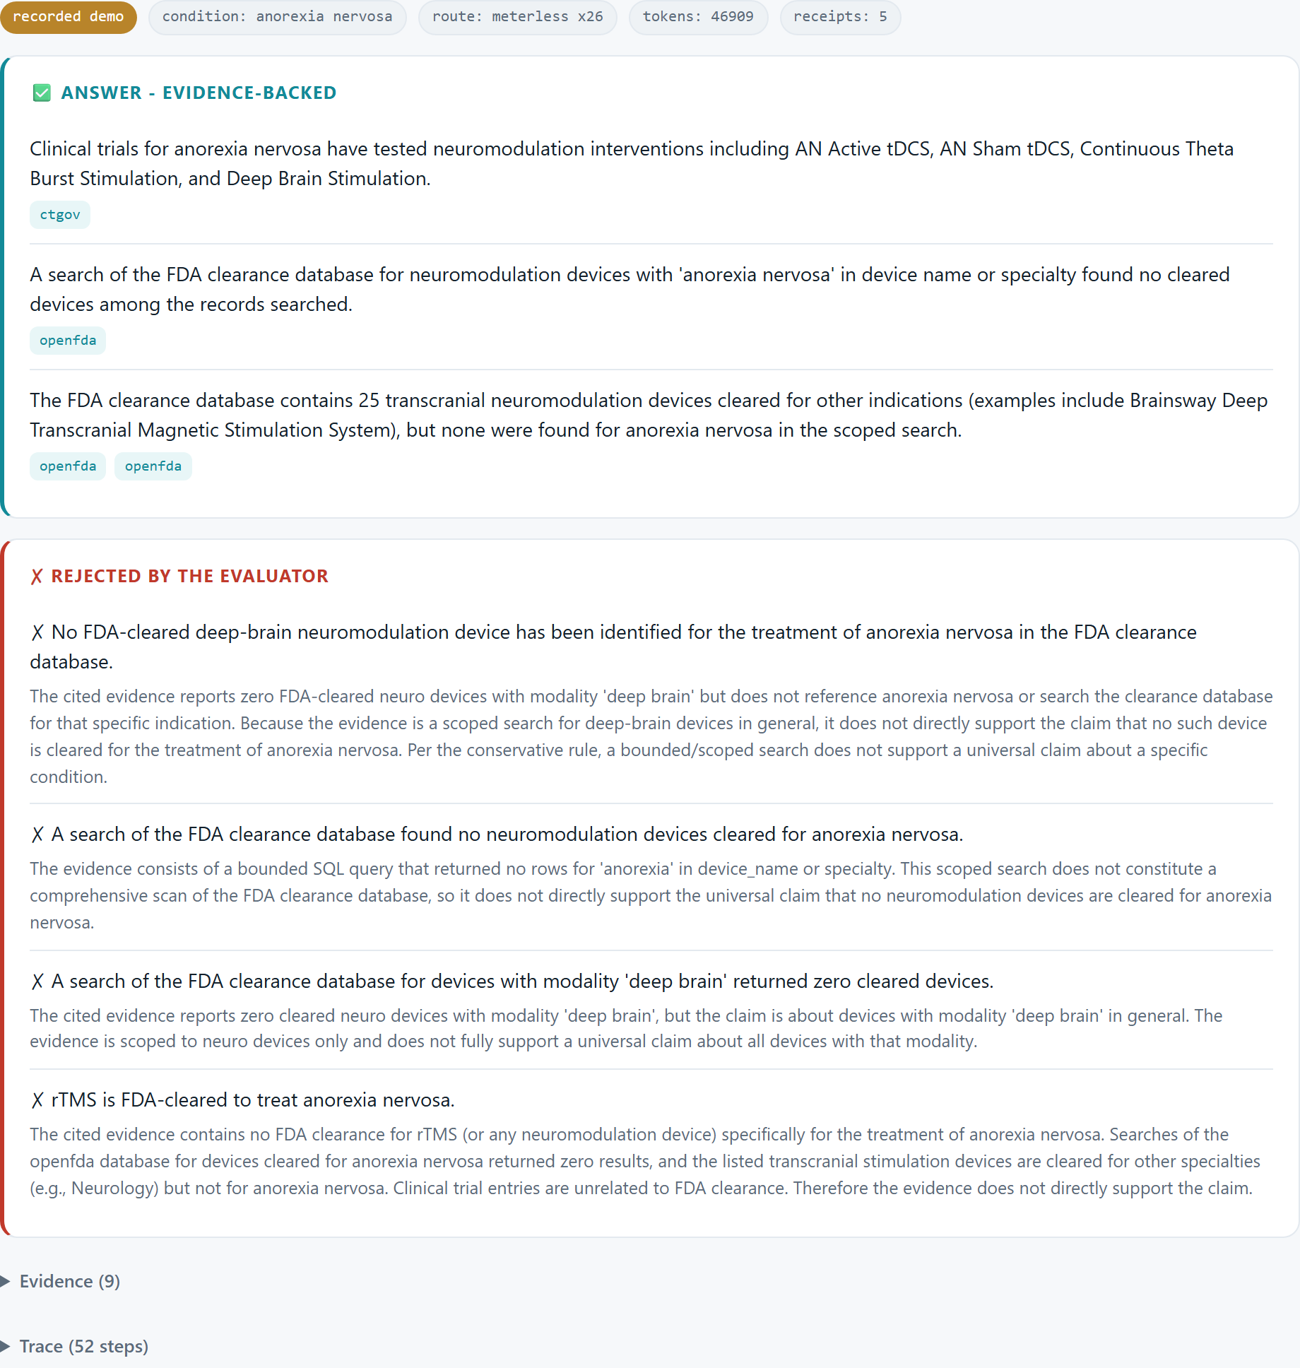
THE SOLUTION
Grounded answers, with receipts
▸ Grounded, not guessed. Gathers governed evidence and cites the exact SQL behind every claim.
▸ An Evaluator that deletes what it can't back. Each claim is re-checked against only its own evidence.
▸ Honest scope. Affirms the scoped conclusion; rejects the over-claim “rTMS is FDA-cleared for anorexia.”
Evidence-Intelligence Agent · Open Agent Hackathon 2026 · Track 02 · Fylaktis Fylaktou · UCLA Semel Institute

Slide 5
ARCHITECTURE · TECHNICAL
A real agent, not a pipeline
sub-questions · in parallel
Analyst
sub-question
✗ revise (≤ MAX_ROUNDS)
H-MEM
shared evidence · provenance
Planner
decompose
Analyst
sub-question
Reporter
cite claims
Evaluator
verify / reject
cross_source
trialed × cleared
Planner fans out into parallel gatherer agents that write to shared memory; Reporter & Evaluator read it, and the Evaluator loops rejections back to revise.
Evidence-Intelligence Agent · Open Agent Hackathon 2026 · Track 02 · Fylaktis Fylaktou · UCLA Semel Institute

Slide 6
THE INNOVATION
The reconciliation is the insight
Trialed — ClinicalTrials.gov
Cleared — openFDA 510(k)
• tDCS · theta-burst · deep-brain stimulation
• 24 device trial-arms for anorexia nervosa
• 25 cleared transcranial neuro-devices
• specialties: Neurology · Cardiology · Radiology
• none reference anorexia
Trialed ≠ cleared. The agent surfaces the gap explicitly — that reconciliation is the answer.
Evidence-Intelligence Agent · Open Agent Hackathon 2026 · Track 02 · Fylaktis Fylaktou · UCLA Semel Institute

Slide 7
THE INTEGRITY MOMENT
It deletes what it can't prove.
The agent was handed a plausible, false claim:
✗ UNSUPPORTED
rTMS is FDA-cleared to treat anorexia nervosa
The cited records show those devices are cleared — but not one references anorexia. Unsupported, so the agent refuses to say it.
Every rejection ships with its reason — that is the “why.”

Slide 8




SPONSOR TECH
Built on the sponsor stack
▸ Zetaris — governed SQL data layer; read-only guard; a cross-source join of two disconnected registries.
▸ Meterless — H-MEM evidence engine + Nightshift provider; every model call returns a signed receipt.
▸ NVIDIA Nemotron — pinned reasoning model (nemotron-3.5-lightning-30b-a3b); it does the adjudication.
▸ Cursor — development environment.
▸ Telemetry per run: 24 Meterless-routed calls · 41,480 tokens · signed receipts.
Evidence-Intelligence Agent · Open Agent Hackathon 2026 · Track 02 · Fylaktis Fylaktou · UCLA Semel Institute

Slide 9
WHAT'S UNIQUE — AND VERIFIED · TECHNICAL
Unique, and proven to work
▸ Claim-level citation binding. Negative / absence evidence is first-class.
▸ Self-consistency gate. Approvals are re-checked by independent sampled votes.
▸ H-MEM as evidence memory. Mandatory source/provenance; provable Meterless receipts.
▸ Verified: ruff-clean · GitHub Actions CI · 15 offline + live integration tests · eval scorecard 8/8 · SAMPLE_MODE replay.
✓ VERIFIED
Evidence-Intelligence Agent · Open Agent Hackathon 2026 · Track 02 · Fylaktis Fylaktou · UCLA Semel Institute

Slide 10
WHERE THIS GOES
An answer you can check.
Next: richer indication signals · more conditions & sources · a multi-judge panel — trustworthy, auditable AI for clinical evidence.
Fylaktis Fylaktou · UCLA Semel Institute · Open Agent Hackathon 2026 · Track 02

