Slide 1












Slide 2

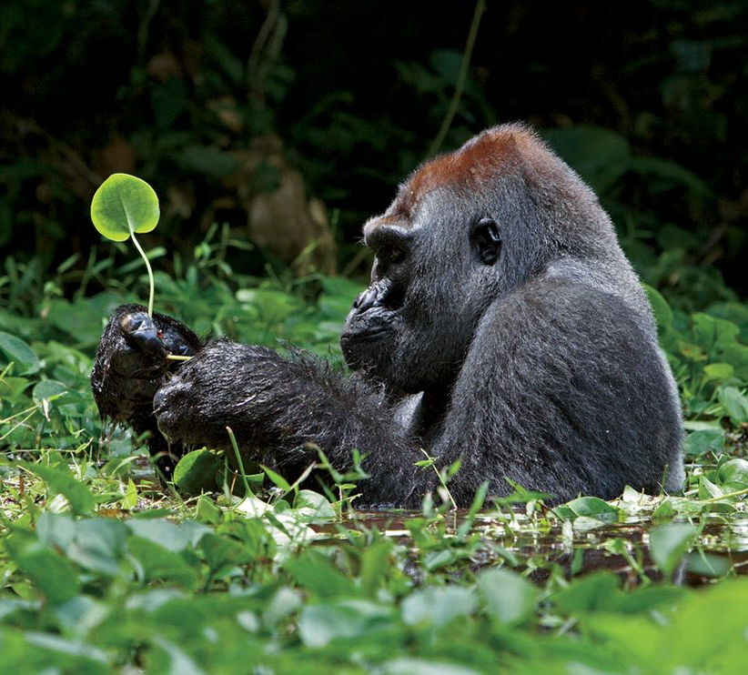
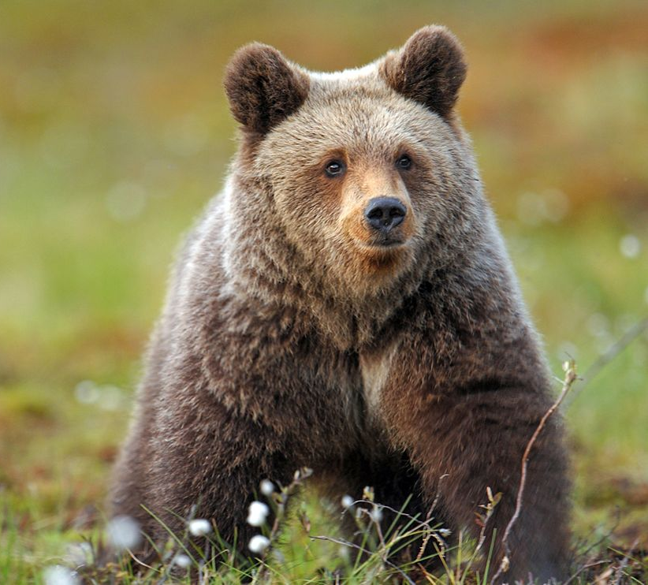
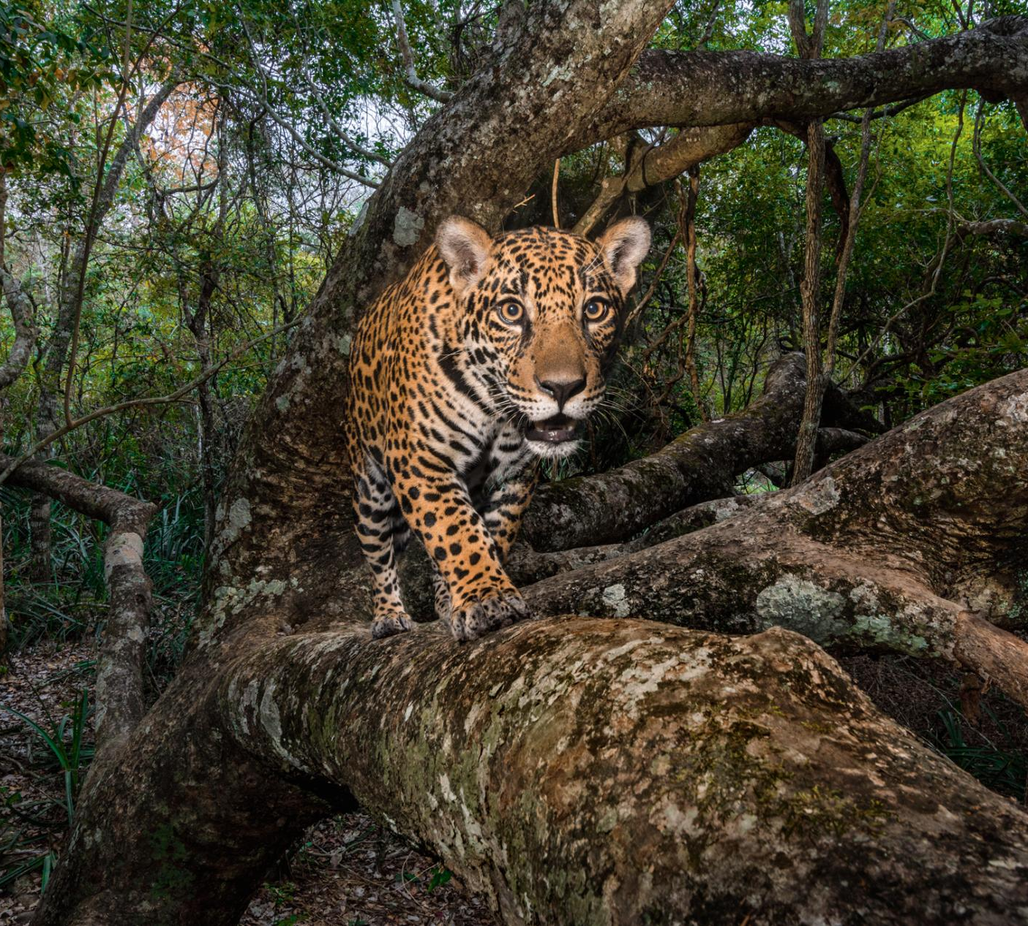

Slide 3
Niche axis 2
Niche axis 1

Slide 4
Niche axis 2
Niche axis 1

Slide 5
RELATIVE ABUNDANCE
TRAIT AXIS

Slide 6
RELATIVE ABUNDANCE
TRAIT AXIS

Slide 7
RELATIVE ABUNDANCE
TRAIT AXIS

Slide 8
A)
FPOS
FRANGE
FDIS
ENV_VAR
ENV_VAR
ENV_VAR
B)
FPOS
FRANGE
FDIS
ENV_VAR
ENV_VAR
ENV_VAR

Slide 9
SPECIES
ENV. VAR
Y
X
~
SITES
SITES

Slide 10
SPECIES
ENV. VAR
Y
Y
X
~
SITES
SITES

Slide 11
TRAITS
ENV. VAR
Y
X
~
SITES
SITES

Slide 12
SPECIES
TRAITS
TRAITS
SITES
x
=
SITES
SPECIES

Slide 13
