Slide 1
AI-written vs Human-written abstract: text mining classification
Francesco Galardi

Slide 2
Introduction
Since AI is becoming increasingly present in everyone's daily life, it is becoming difficult to distinguish whether a text is written by a human or generated by artificial intelligence. Here we will consider as texts some abstracts associated to medical-scientific articles.
The idea is to train a classification model in order to classify scientific abstract into human written or ai-written taking into account how the abstract is written

Slide 3
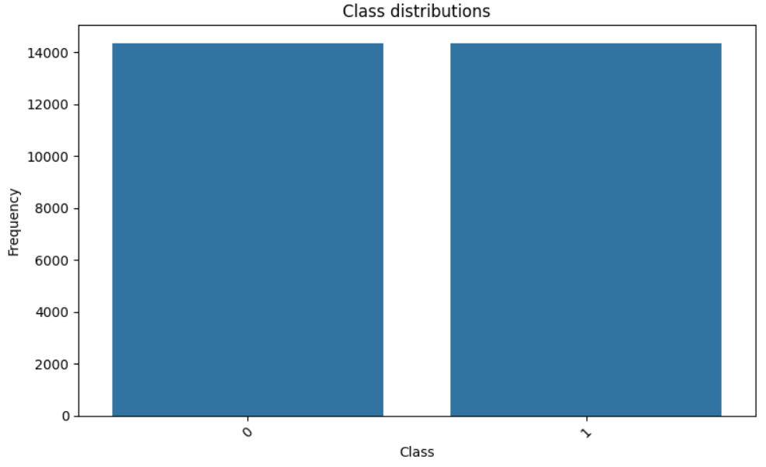
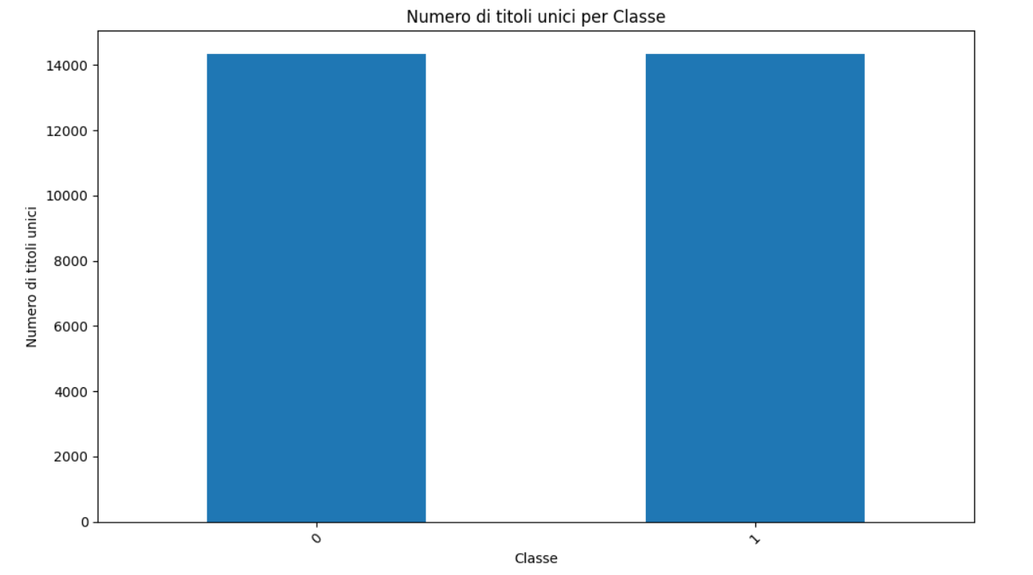

Dataset
Features: title,abstract,label
28662 observations
14331 different titles

Slide 4
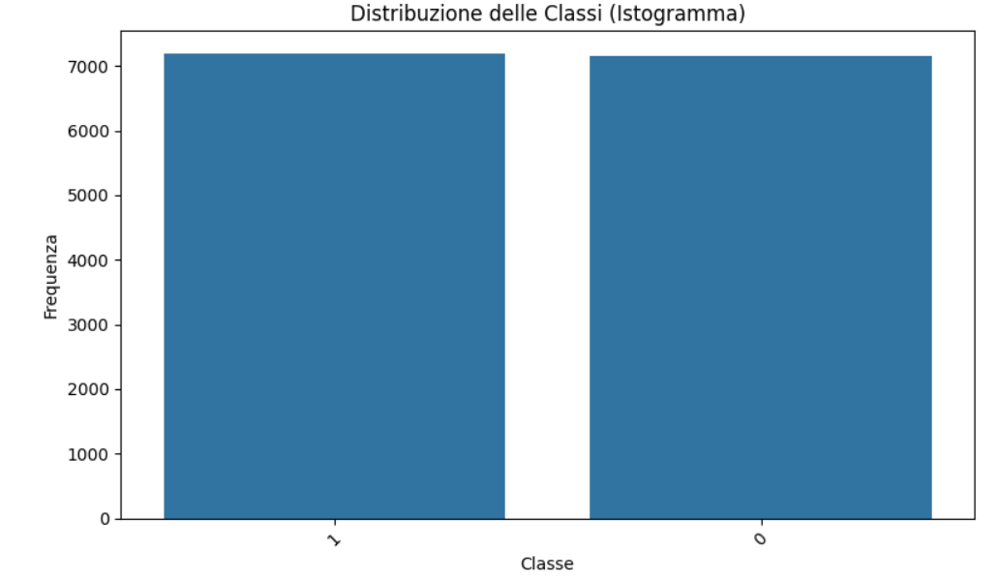
Preprocessing
For each title, randomly selection of one of the two observations (this still ensure balance)
Elimination of feature title

Slide 5
Pipeline
Tokenization
Stopwords remover
Text representation: tf-idf and word2Vec models are taken into account
Classification model: logistic regression, naive-bayes,decision tree,svc,random forest and xgboost are taken into account

Slide 6
Model selection phase
Each possible combination (text representation model+classification model) is validated via nested loop cross validation on accuracy score
Best 3 classification models for both tf-idf and word2Vec are chosen
The resultant 6 combinations (alogside with their hyperparams founded during first step) are tested 2 by 2 against wilcoxon test or t-test based on wheter the differences of the accuracies fold-by-fold of the two models are gaussian or not

Slide 7
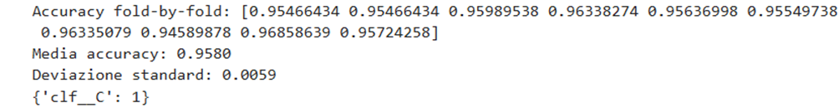
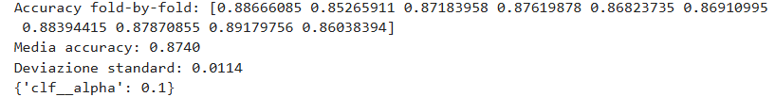




Tf-idf+logistic regression:
Tf-idf+nayve-bayes:
Tf-idf+decision tree:
Tf-idf+svc:
Tf-idf+random forest:
Tf-idf+xgboost:

Slide 8





W2Vec+logistic regression:
W2Vec+decision tree:
W2Vec+svc:
W2Vec+random forest:
W2Vec+xgboost:

Slide 9
Final model construction
We now select the 6 best models (with hyperparameters founded during nested cv) basing our decision on the accuracies founded during the validation:
Tf-idf: logistic regression, svc and xgboost
word2Vec: logistic regression, svc and xgboost
After comparing the models exploiting statistical tests, the idea is to create an ensemble with the statistically different configurations in order to maximize the accuracy and to generalyze better on unseen data

Slide 10
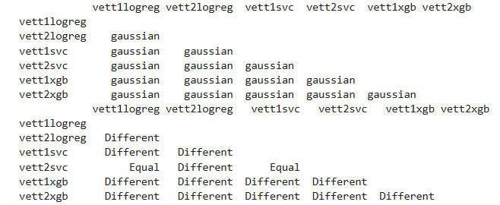
Final model construction

Slide 11
Final model construction
Taking into account only the statistically different models to create the ensemble, we have two ways:
Create an ensemble with all models without counting tf-idf+logistic regression and tf-idf+svc
Create an ensemble with all models without counting word2Vec+svc
We are going to validate both configurations in order to choose the best one

Slide 12
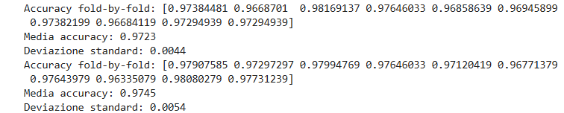
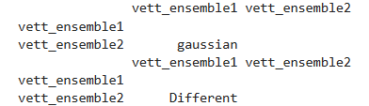
Final model construction
We see from the statistical
test that the two ensembles
are different, so we choose
the second one as our
final model because it
ensure slitghly better
accuracy

Slide 13
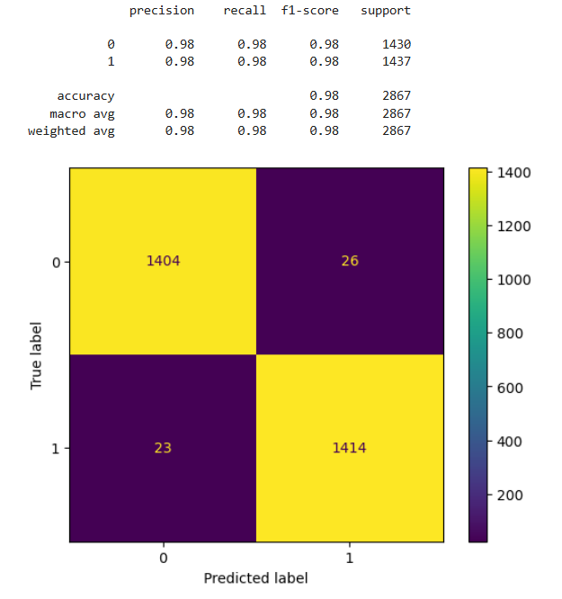
Final model performance evaluation

Slide 14

Interface

Slide 15
Related work
[1] Theocharopoulos, P. C., Anagnostou, P., Tsoukala, A., Georgakopoulos, S. V., Tasoulis, S. K., & Plagianakos, V. P. (2023, April 12). Detection of fake generated scientific abstract

