Slide 1

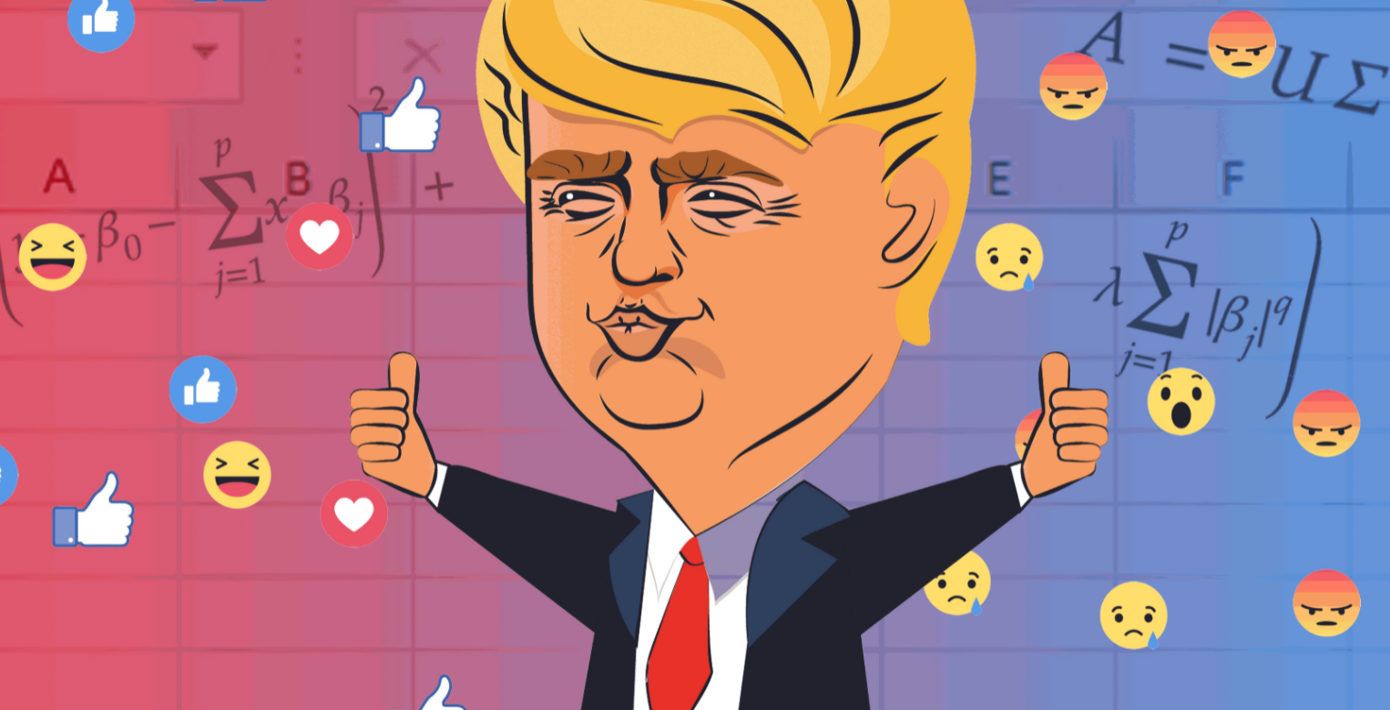
Donald Trump’s 2016 Campaing
DAFT OCT 2021 - Filipe Gardete

Slide 2
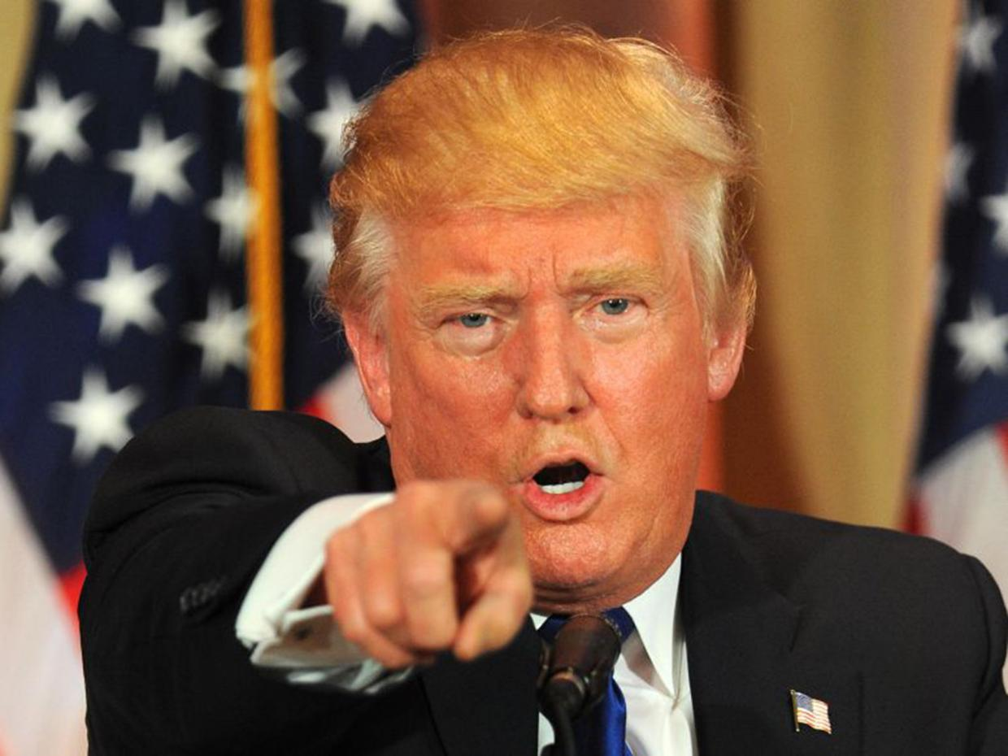
Did Donald Trump use Artificial Intelligence to Win the Presidential Election?
The answer might surprise you, because…!

Slide 3
“According to Scout.ai, a publication of journalists, professors, and science fiction authors, the answer is a resounding YES.”
Trent Lapinski (https://hackernoon.com/)
Marketing Technology Executive

Slide 4
Trent Lapinski states in his article that:
Machine Learning,
Echo Chambers, and
Micro Targeting
were the tools used to influence the election.

Slide 5
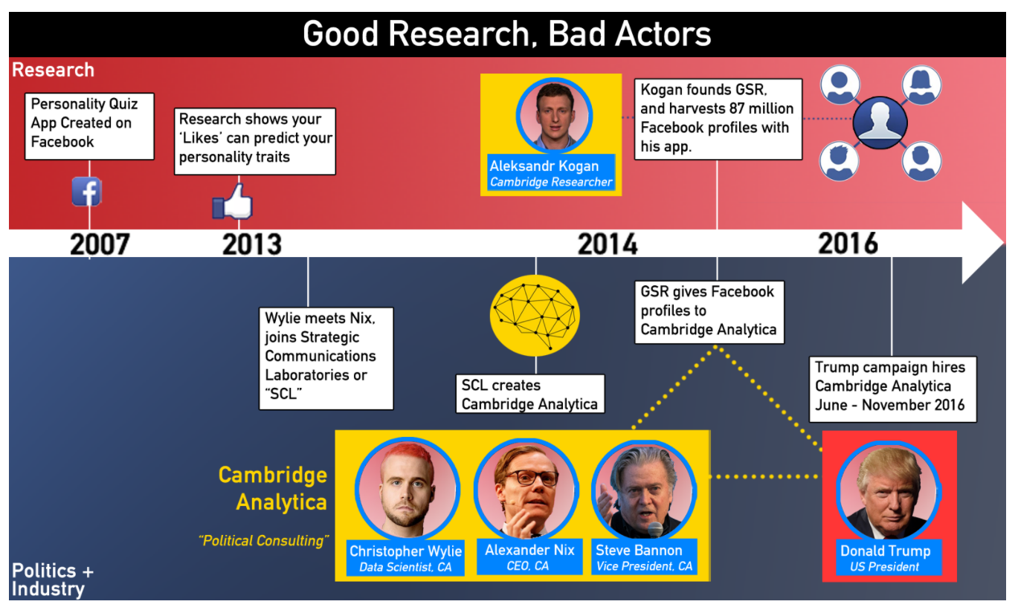
The Movie

Slide 6
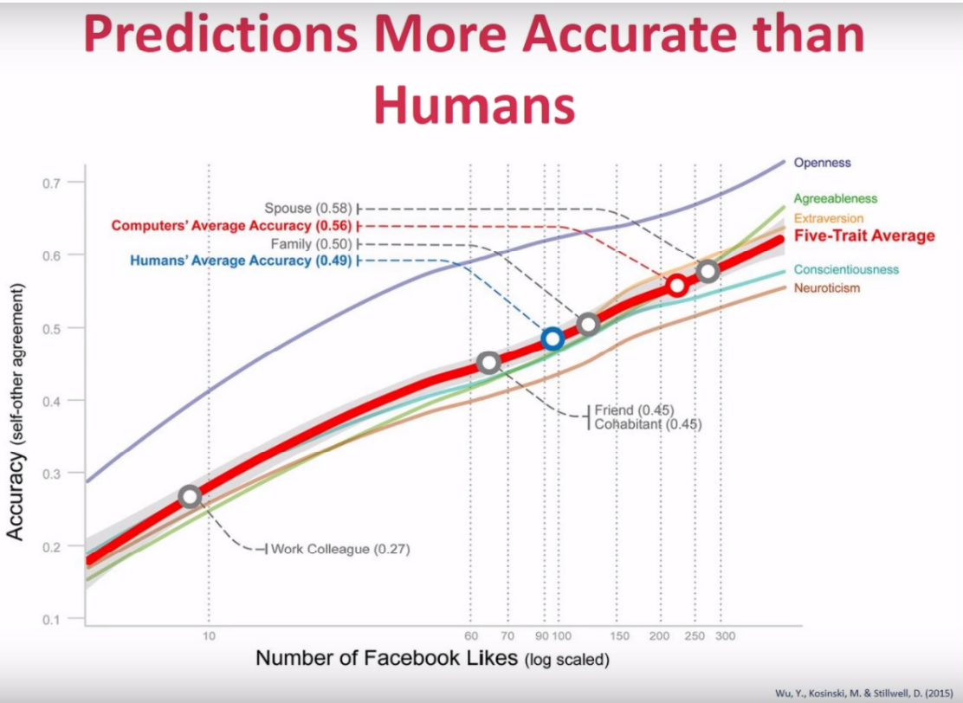
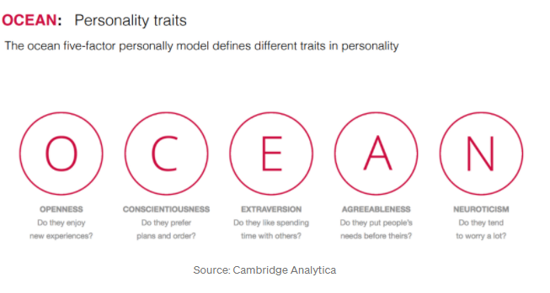
The Research
With 10 likes a computer can predict your personality as well as a colleague.
With 70 likes, better than a close friend,
With 100 likes, better than your family members,
With 300 likes, better than your husband or wife

Slide 7
CA (Expected) Model
Dave Smith
Merging mankind with machine

Slide 8
1st Tool -Machine Learning
The MODEL → A sort of correlation between Likes and personality quiz scores. For instance, Liberalism is correlated with high openness and low conscientiousness.

Slide 9
2nd Tool -Echo Chambers
“Steve Bannon figured out that social networks such as Twitter and Facebook put everyone into echo chambers.”
Trent Lapinski (https://hackernoon.com/)
Marketing Technology Executive
“An echo chamber refers to situations in which beliefs are amplified or reinforced by communication and repetition inside a closed system and insulated from rebuttal. By participating in an echo chamber, people are able to seek out information that reinforces their existing views without encountering opposing views, potentially resulting in an unintended exercise in confirmation bias. Echo chambers may increase social and political polarization and extremism.” - Wikipedia

Slide 10
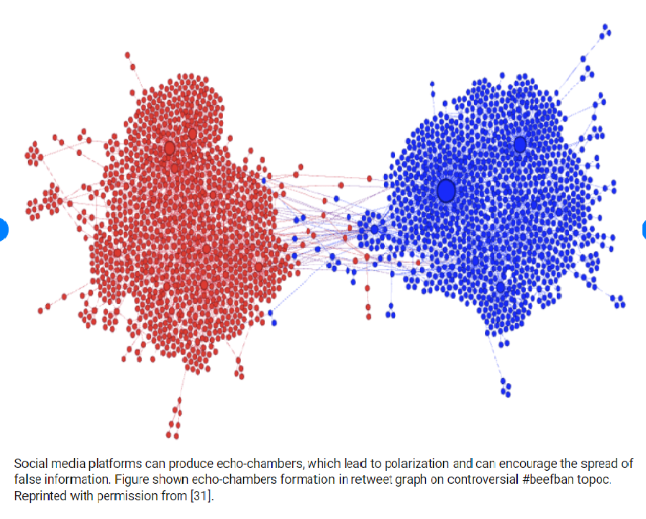
2nd Tool - Echo Chambers

Slide 11
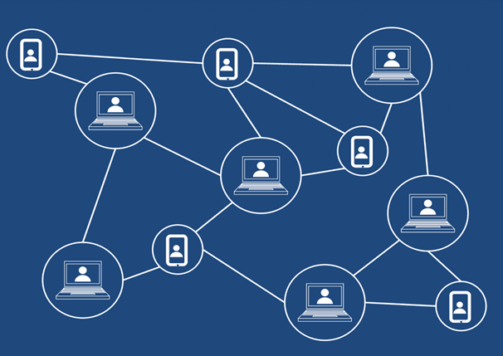
3rd Tool – Micro Targeting Propaganda
In addition, Trump used intelligent robots, like media boots (automatic programs with the ability to produce language), to spread propaganda through the ECHO CHAMBERS.
It is even possible they paid to use existing Russian or Ukrainian botnets to do the same task.

Slide 12
Conclusion
CA analyzed and categorized individuals personalities based on purchased data and Facebook.
Then, they grouped the individuals according to their political classification.
Finally, they used that analysis to display specifically tailored ads or “news” on Facebook and other websites targeted to different audiences in an effort to manipulate the voting behavior of undecided voters and persuade Hillary Clinton’s supporters not to vote.

Slide 13
Youtube
https://www.youtube.com/watch?v=Q91nvbJSmS4

Slide 14
THANKS!

