Slide 1

Machine Learning
in Epidemiology
with R — Part 2
From Trees to Neural Networks
Federica Gazzelloni
23 October 2026
Two-hour online, hands-on R workshop
Notes:
EXPLANATION
Reconnect with Part 1: prediction tasks, preparation, logistic regression, trees, random forests and evaluation. Today develops a clinical teaching example.
DEMONSTRATION / QUESTION
Invite participants to open the root RStudio project.
TRANSITION
Show the route and how R practice fits into it.
SOURCE
Part 1 deck; Part 2 notebook introduction.
SUGGESTED TIME
0–3 min

Slide 2
01
Learning objectives and session route
Understand the data and define the task
Fit a tree and examine pruning
Explore a network through saved results
Evaluate predictions and thresholds
Discuss limitations and next steps
By the end: explain the fit, read the errors and justify an evaluation choice.
Machine Learning in Epidemiology with R — Part 2
Notes:
EXPLANATION
Use sections 1–4 live. Suggested allocation: 40 minutes explanation, 60 minutes R demonstrations and participant practice, 20 minutes discussion and questions. Appendix is follow-up material.
DEMONSTRATION / QUESTION
Ask participants to keep RStudio open beside the workshop.
TRANSITION
Reconnect the examples before reading the data.
SOURCE
part2/ml-workflow-2.qmd: Session route.
SUGGESTED TIME
3–6 min

Slide 3
02
West Nile surveillance and heart disease
Part 1 | Part 2
West Nile surveillance | Clinical measurements
Define a prediction unit and outcome | One patient and existing disease
Preparation and evaluation | The same workflow, new learners
The setting changes. The need to define the task and protect evaluation remains.
Machine Learning in Epidemiology with R — Part 2
Notes:
EXPLANATION
Part 1 used West Nile surveillance. Do not transfer its unit or outcome automatically to clinical data. Ask what each row and each prediction mean here. Retain the discipline of using appropriate information and separating fitting from evaluation.
DEMONSTRATION / QUESTION
Recall one reason a split can give misleading results.
TRANSITION
Inspect the patient data.
SOURCE
Notebook introduction; Part 1 teaching context.
SUGGESTED TIME
6–10 min

Slide 4
03
Meet the heart-disease data
270
13
2
patients
original predictors
outcome classes
heart_disease: 150 absent, 120 present
Examples: age, chest pain, cholesterol, exercise measurements
Checkpoint: What does one row represent? Which column is the outcome?
Machine Learning in Epidemiology with R — Part 2
Notes:
EXPLANATION
One row represents one patient. There are 14 columns including the outcome, 13 predictors, no missing values and no removed rows. The positive class is present. Read the raw data and preparation mapping before discussing models.
DEMONSTRATION / QUESTION
Run source("R/01-data.R"), dim(heart), table(heart$heart_disease), str(heart). Allow 8 minutes practice.
TRANSITION
State precisely what we classify.
SOURCE
Notebook §1; R/01-data.R; data/README.md; outputs/VALIDATION.md.
SUGGESTED TIME
10–20 min

Slide 5
04
The classification task
Clinical measurements are the predictors.
heart_disease is the outcome.
“present” is the positive class.
target = "heart_disease", positive = "present"
We classify existing disease. This example does not predict future cardiovascular risk.
Machine Learning in Epidemiology with R — Part 2
Notes:
EXPLANATION
Classification assigns an observation to a category. Positive is the class whose detection we focus on, not a judgement of desirability. The outcome describes disease status in this teaching sample, without a future-event horizon. No clinical validation is established.
DEMONSTRATION / QUESTION
Find target = "heart_disease" and positive = "present" in the script.
TRANSITION
A tree learns a sequence of questions from these measurements.
SOURCE
Notebook §1; R/02-trees-and-evaluation.R, as_task_classif; data/README.md.
SUGGESTED TIME
20–25 min

Slide 6
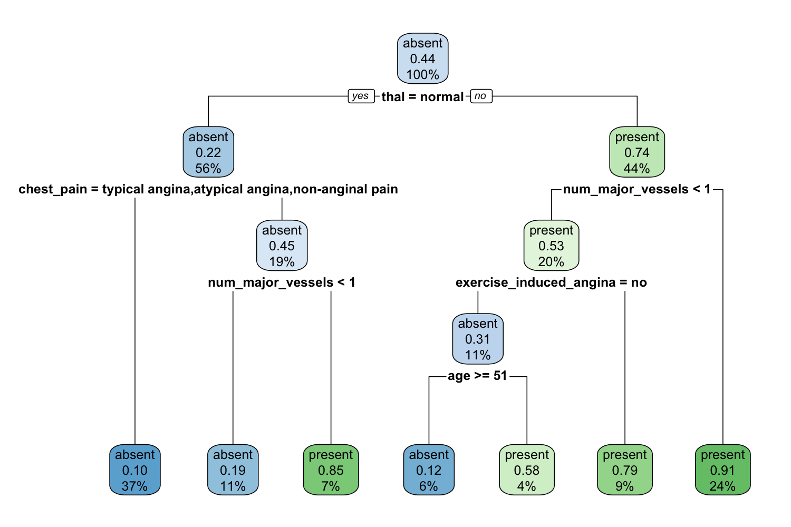
05
How a classification tree splits patients
A split asks a question
about one predictor.
Follow a branch until
you reach a leaf.
A leaf gives a class
and fitted proportions.
Default tree: fitted on all 270 patients to illustrate learning.
Machine Learning in Epidemiology with R — Part 2
Notes:
EXPLANATION
Read the root question on the saved tree and trace one path. A tree recursively separates patients into groups that are more similar in outcome. A leaf is a terminal group. The proportions and row percentages describe this fitted sample. Fitted accuracy is not a new-patient performance estimate.
DEMONSTRATION / QUESTION
Run the cart fitting expression. Trace one branch together, then let participants choose another.
TRANSITION
Compare the extra flexibility of a deep tree with pruning.
SOURCE
Notebook §2; R/02-trees-and-evaluation.R, article-trees; figures/01-tree.png.
SUGGESTED TIME
25–33 min

Slide 7
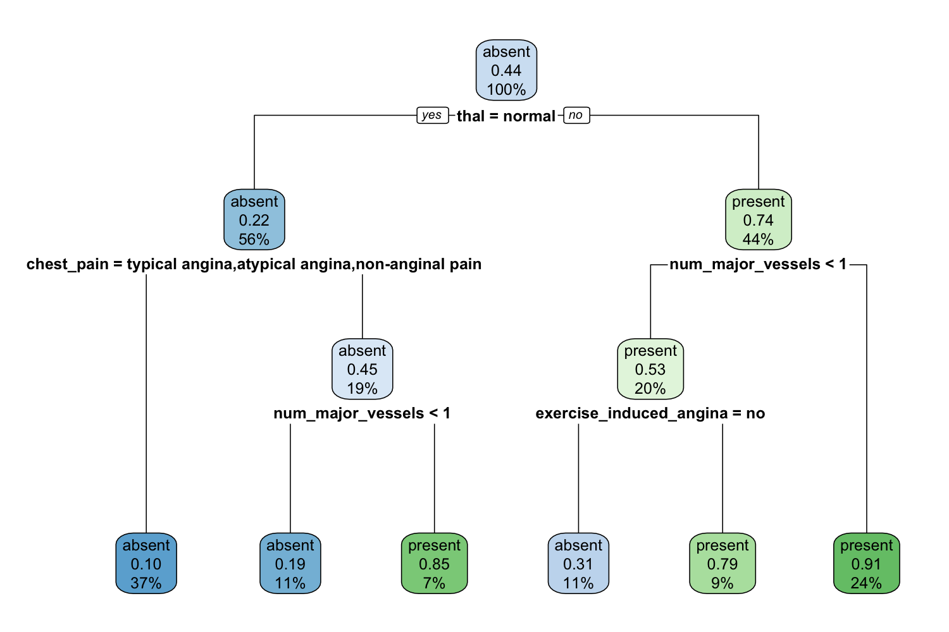
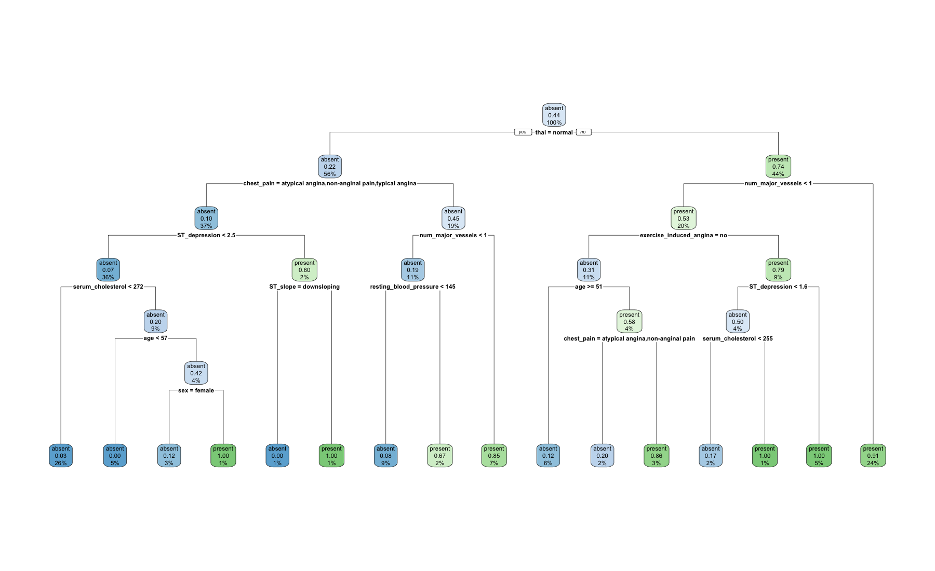
06
Deep and pruned trees
Deep tree: minsplit = 2
Pruned tree: cp = 0.031
Compare both with the default tree. More branches can fit details of this sample.
Machine Learning in Epidemiology with R — Part 2
Notes:
EXPLANATION
The left illustration is newly rendered from the supplied deep-tree fitting expression using the prepared local data. It is a fitting illustration, not another evaluation result. The right figure is the supplied pruned tree. Small leaf labels in the deep overview are for structure only; inspect the full image or R plot during the demonstration. minsplit sets the minimum observations required to attempt a split.
DEMONSTRATION / QUESTION
Fit deep_cart and pruned_cart. Ask: which structure would be easier to explain?
TRANSITION
The complexity plot helps explain why branches may be removed.
SOURCE
Notebook §2; R/02-trees-and-evaluation.R; deep_cart and pruned_cart.
SUGGESTED TIME
33–39 min

Slide 8
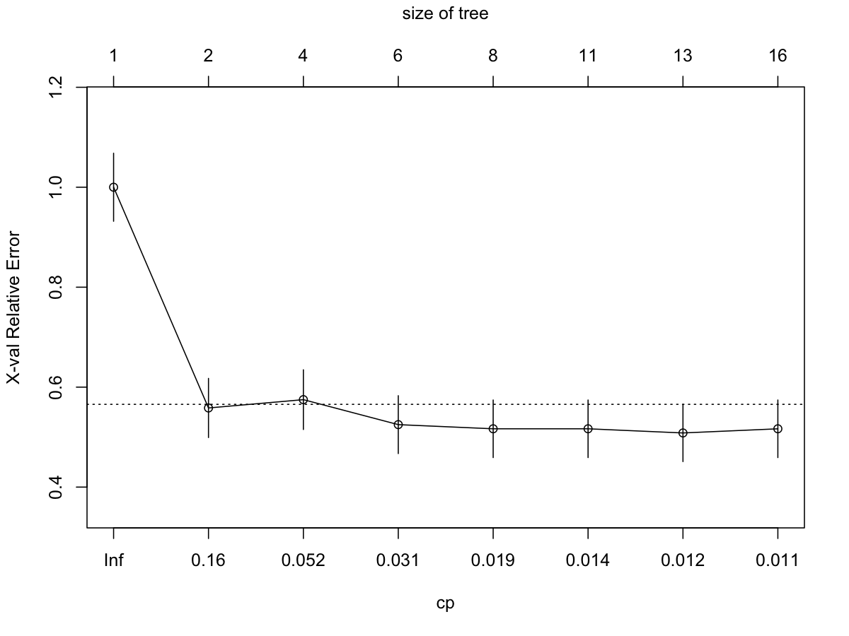
07
Overfitting and pruning
Overfitting learns sample
details that may not repeat.
Pruning removes branches
to limit complexity.
cp = 0.031 retains the
article’s replication setting.
Checkpoint: Why might pruning help predictions on new patients?
Machine Learning in Epidemiology with R — Part 2
Notes:
EXPLANATION
Explain the relative cross-validation error and tree-size axes. Complexity parameter cp controls the tradeoff between fit and complexity. The fixed 0.031 is retained for replication, not claimed to be universally optimal or selected by our test set. The initial trees use all rows, so even their internal complexity assessment is not the held-out evaluation introduced later.
DEMONSTRATION / QUESTION
Ask participants to locate cp in prune(). Discuss whether the smallest training error settles the question.
TRANSITION
A neural network offers a different way to learn patterns.
SOURCE
Notebook §2; R/02-trees-and-evaluation.R; figures/02-complexity.png.
SUGGESTED TIME
39–50 min

Slide 9
08
A neural network learns weighted combinations
Inputs | Hidden layers | Output
Encoded measurements | Weighted combinations | Probability of present
Numbers the network receives | ReLU transforms learned signals | Sigmoid maps to 0–1
Training adjusts weights to reduce a loss: a measure of prediction error.
Machine Learning in Epidemiology with R — Part 2
Notes:
EXPLANATION
A unit combines inputs with learned weights. A hidden layer sits between inputs and output. ReLU is an activation that keeps positive values and sets negative values to zero, allowing nonlinear patterns. Sigmoid converts the final signal into a probability between zero and one. This is a conceptual diagram, not an observed result.
DEMONSTRATION / QUESTION
Read the layer_dense calls together. Use saved results today; full training needs a configured Python/Keras backend.
TRANSITION
Count the inputs separately from the original variables.
SOURCE
Notebook §3; R/03-neural-network.R.
SUGGESTED TIME
50–55 min

Slide 10
09
13 predictors become 22 encoded inputs
Input | Hidden layer 1 | Hidden layer 2 | Output
22 columns | 64 units, ReLU | 32 units, ReLU | 1 unit, sigmoid
6 numeric + 3 binary + 13 indicators | Dropout 0.4 | Dropout 0.4 | P(disease present)
Dropout temporarily omits 40% of units during training.
Encoding is an explicit local reconstruction. The article does not specify its implementation.
Machine Learning in Epidemiology with R — Part 2
Notes:
EXPLANATION
Six numeric predictors remain numeric, three binary predictors become 0/1, and four other categorical predictors expand into 13 indicator columns. This gives 22 inputs from 13 original predictors. Both hidden layers use dropout 0.4 during training. Numeric scaling estimates its centre and spread from inner training rows only, excluding validation and test rows. Do not treat scaling or this encoding as a published detail.
DEMONSTRATION / QUESTION
Inspect ncol(x), stopifnot(ncol(x) == 22L), and the network definition.
TRANSITION
Training and validation losses show different aspects of learning.
SOURCE
R/03-neural-network.R; data/README.md; replication-notes.md.
SUGGESTED TIME
55–61 min

Slide 11
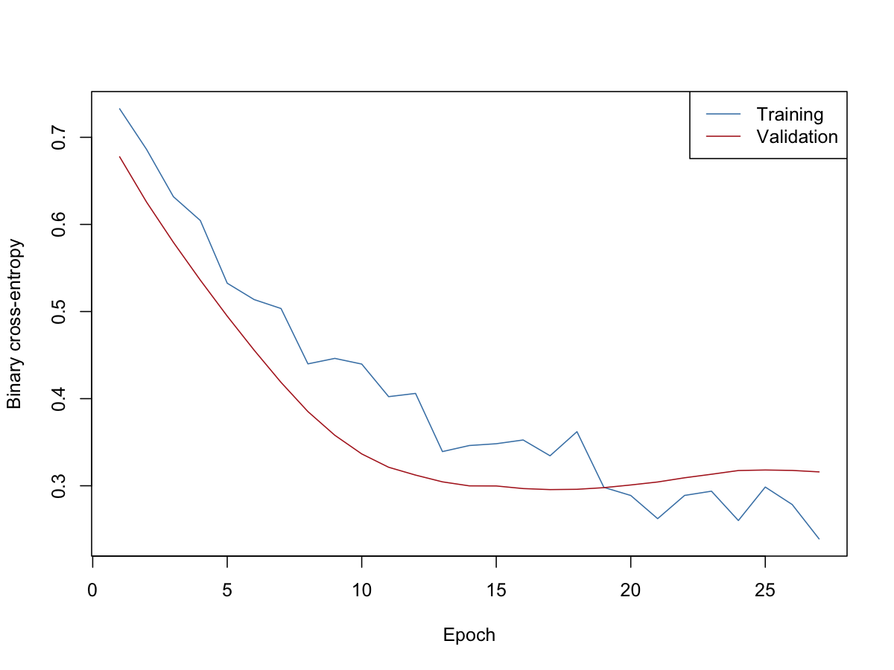
10
Training and validation loss: local run
Training loss measures fit
on rows used for learning.
Validation loss monitors
rows kept out of updates.
Early stopping restores
the best validation weights.
Checkpoint: What does falling training loss with rising validation loss suggest?
Machine Learning in Epidemiology with R — Part 2
Notes:
EXPLANATION
Loss here is binary cross-entropy: it penalises incorrect probabilities, especially confident errors. An epoch is one pass through training data. The supplied run allowed 50 epochs, batch size 32, Adam rate 0.002, validation_split 0.2 and patience 10. Of 180 training rows, 144 fit weights and 36 monitor validation. It stopped after 27 epochs; saved test accuracy is 77/90 = 0.8556. This is local replication, not the article result or a guarantee. Do not rank it against a forest from one score.
DEMONSTRATION / QUESTION
Inspect the saved curve, then discuss overfitting and patience. Training remains optional.
TRANSITION
Keep fitting and final evaluation separate.
SOURCE
Notebook §3; R/03-neural-network.R; outputs/neural-loss.csv, neural-accuracy.csv, neural-predictions.csv.
SUGGESTED TIME
61–70 min

Slide 12
11
Random-forest holdout evaluation
270 patients
180 training observations | 90 test observations
Fit the random forest | Predict held-out patients
Learner default tree count | Read probabilities and errors
Test observations stay outside model fitting and model selection.
Machine Learning in Epidemiology with R — Part 2
Notes:
EXPLANATION
The supplied probability-producing forest trains on split$train and predicts split$test. A holdout is a reserved sample for evaluation. The seed is 20261023. The split is disjoint and covers all 270 rows. This main forest uses the learner default; later resampling uses 100 trees. Do not substitute the separate 100-tree AUC output for the main forest.
DEMONSTRATION / QUESTION
Run the article-evaluation block up to forest_pred, then inspect the split lengths. Allow 7 minutes practice.
TRANSITION
A confusion matrix records the kinds of error at a chosen threshold.
SOURCE
Notebook §4; R/02-trees-and-evaluation.R, article-evaluation; outputs/split.csv.
SUGGESTED TIME
70–79 min

Slide 13
12
The confusion matrix records consequences
Observed outcome | Predicted present | Predicted absent
Present | 30 true positives | 7 false negatives
Absent | 8 false positives | 45 true negatives
False positive: predicts disease for a patient whose outcome is absent.
Local holdout: What does a false negative mean for a patient in this example?
Machine Learning in Epidemiology with R — Part 2
Notes:
EXPLANATION
Rows are observed outcomes, columns are predictions. The CSV stores response, truth and Freq, so explicitly orient the displayed table. A false negative predicts absent when the observed outcome is present. Clinical consequences depend on the intended pathway and need separate investigation. Counts total 90: 37 observed present and 53 absent, 38 predicted present and 52 absent. These are local holdout results.
DEMONSTRATION / QUESTION
Ask participants to point to the seven missed positives and calculate the total correct.
TRANSITION
Each metric answers a different question about these counts.
SOURCE
Notebook §4; outputs/confusion.csv; R/02-trees-and-evaluation.R.
SUGGESTED TIME
79–87 min

Slide 14
13
Five measures, five questions
Measure | Question / denominator | Local result
Sensitivity | Among disease present: 30 / 37 | 81.1%
Specificity | Among disease absent: 45 / 53 | 84.9%
Positive predictive value | Among predicted present: 30 / 38 | 78.9%
Negative predictive value | Among predicted absent: 45 / 52 | 86.5%
Accuracy | Among all patients: 75 / 90 | 83.3%
Predictive values depend on the frequency of disease in the population being assessed.
Machine Learning in Epidemiology with R — Part 2
Notes:
EXPLANATION
Sensitivity measures detection of present disease; specificity measures correct rejection of absent disease. PPV is also called precision. NPV asks how often a negative prediction is correct. Accuracy gives equal count to all correct classifications and can hide error types. Round the saved values to one decimal percent; these are the same holdout predictions and threshold as the confusion matrix.
DEMONSTRATION / QUESTION
Calculate one fraction in R. Ask which denominator changes for PPV versus sensitivity.
TRANSITION
Probability scores can also be evaluated across thresholds.
SOURCE
outputs/holdout-measures.csv; outputs/confusion.csv; notebook §4.
SUGGESTED TIME
87–95 min

Slide 15
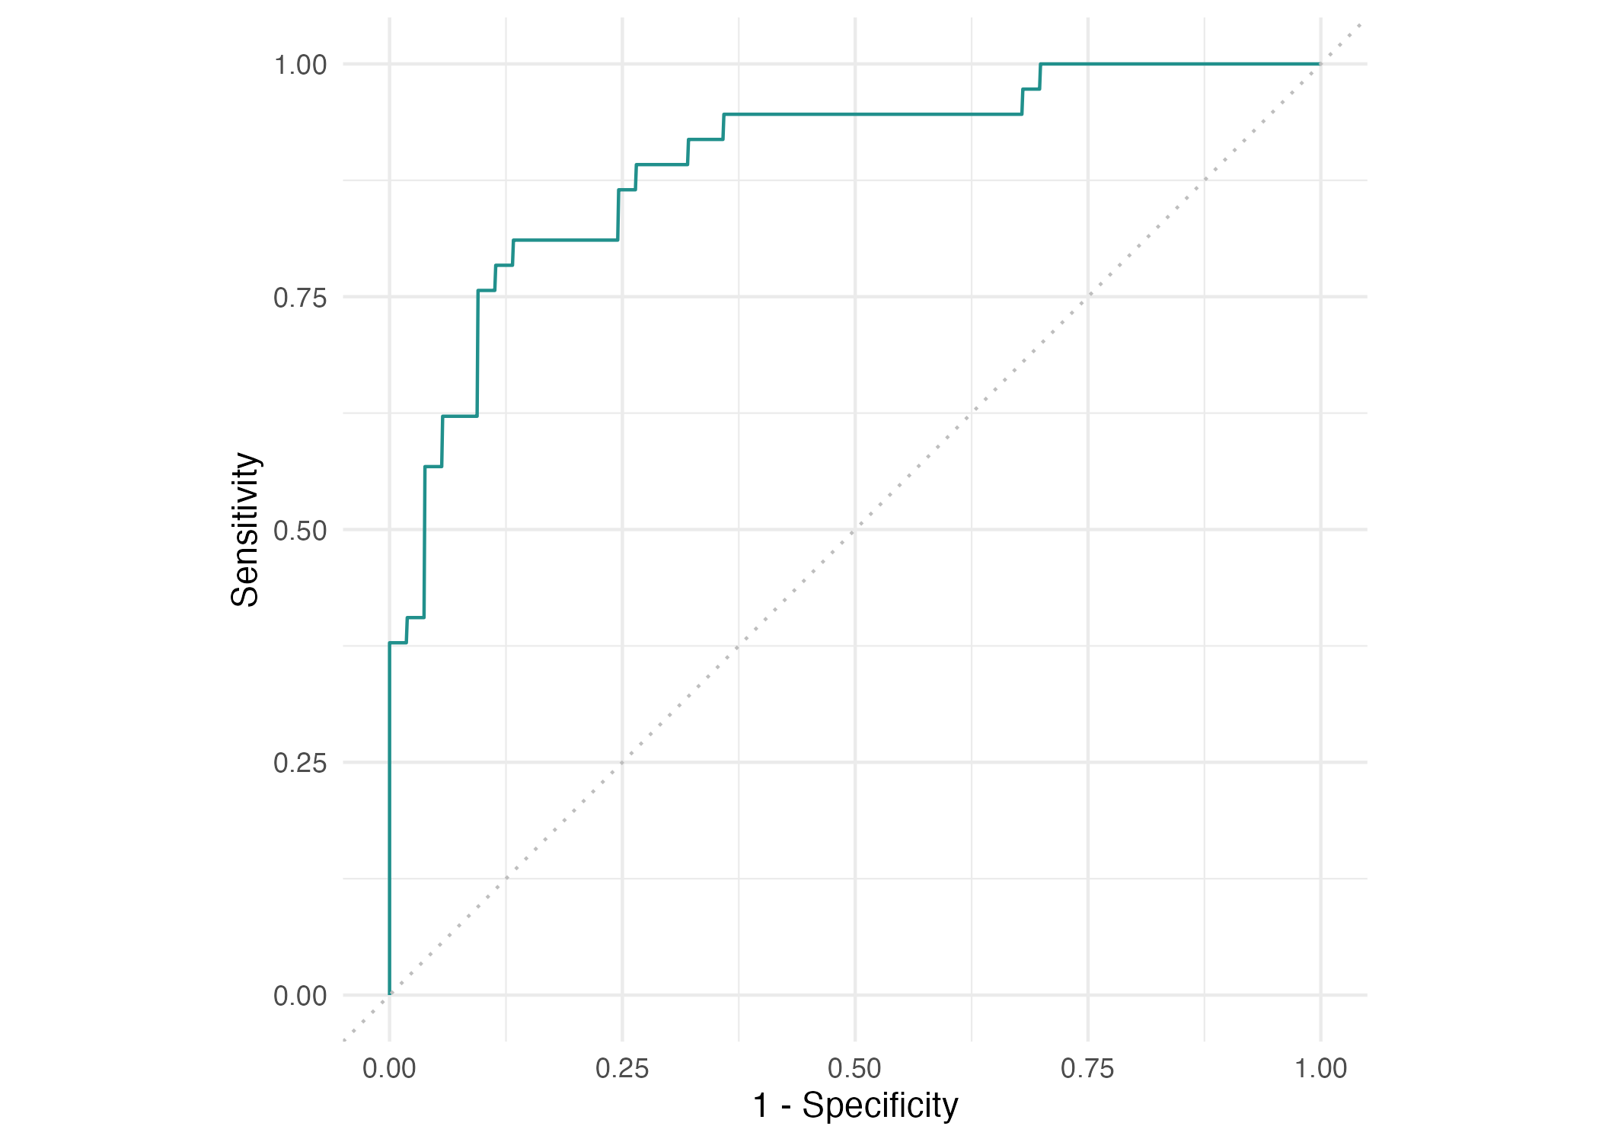
14
ROC and AUC describe ranking
ROC compares sensitivity
with false-positive rate.
False-positive rate
= 1 − specificity.
AUC summarises ranking
across thresholds.
AUC alone does not choose a threshold or establish clinical usefulness.
Machine Learning in Epidemiology with R — Part 2
Notes:
EXPLANATION
At each threshold ROC shows true-positive rate against false-positive rate. AUC, area under this curve, summarises how well scores rank a positive above a negative, with ties counted half. We display the saved main-forest ROC without borrowing the AUC from the separate 100-tree experiment. Curves on only 90 patients have sampling uncertainty.
DEMONSTRATION / QUESTION
Inspect autoplot(forest_pred, type = "roc"). Ask why a curve contains many operating points.
TRANSITION
Precision–recall focuses attention on positive predictions.
SOURCE
Notebook §4; figures/04-roc.png; R/02-trees-and-evaluation.R.
SUGGESTED TIME
95–100 min

Slide 16
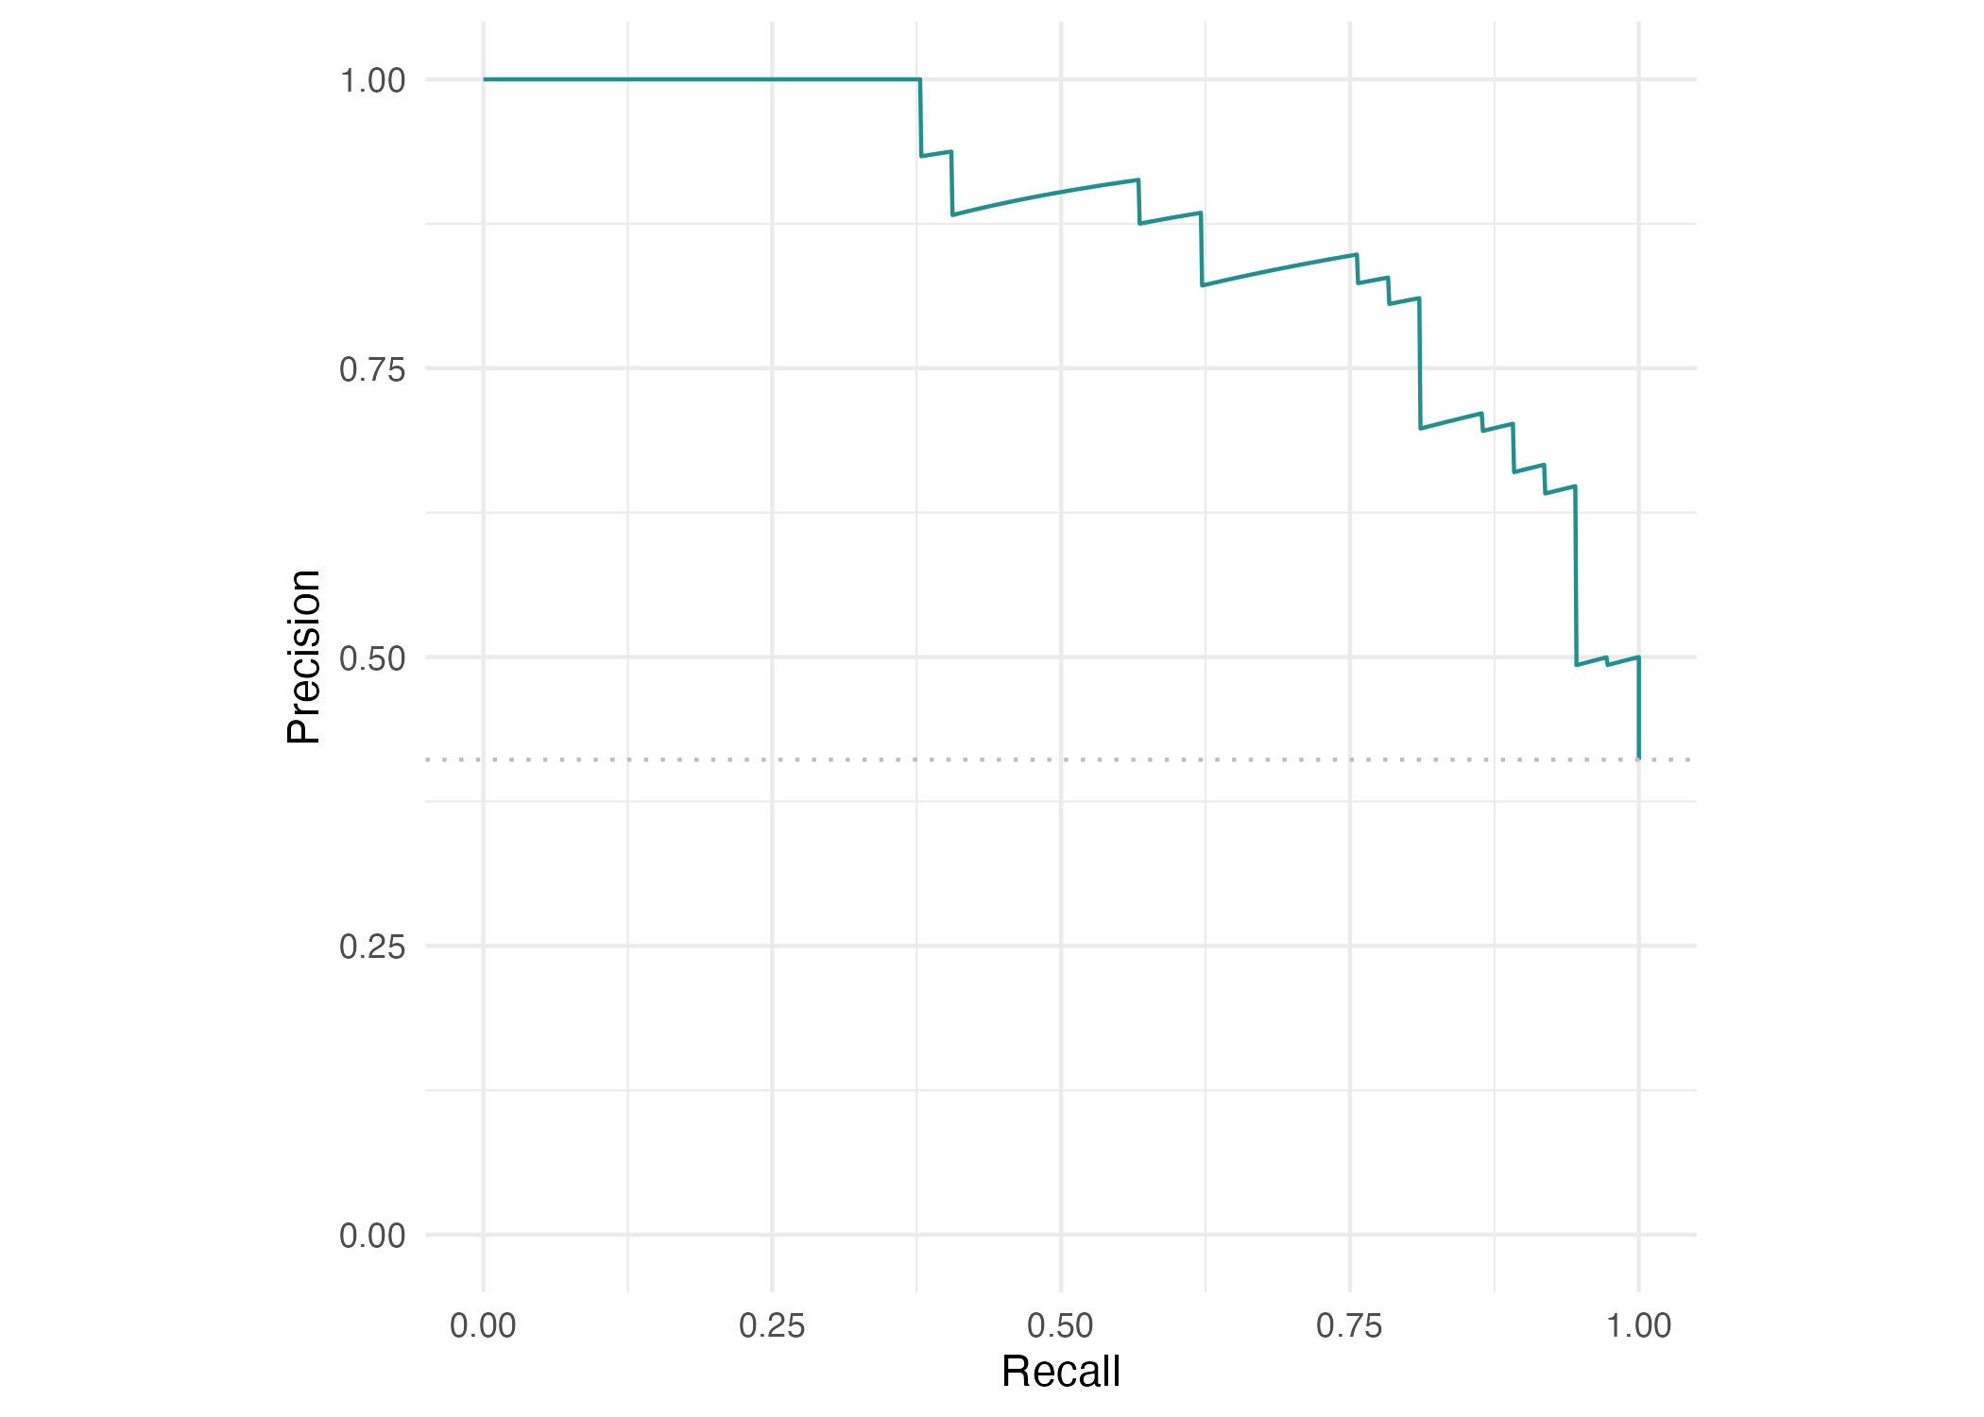
15
Precision–recall focuses on positive predictions
Recall = sensitivity.
Precision = positive
predictive value.
The curve shows their
tradeoff across thresholds.
Disease frequency matters when interpreting precision and comparing datasets.
Machine Learning in Epidemiology with R — Part 2
Notes:
EXPLANATION
Recall asks what fraction of actual positives we detect. Precision asks what fraction of predicted positives really have present disease. Read several points as thresholds change. Neither curve measures causal effects, calibration or clinical benefit. Avoid comparing precision across datasets without considering prevalence.
DEMONSTRATION / QUESTION
Ask participants to restate precision in patient terms.
TRANSITION
Choose an operating threshold with explicit error consequences.
SOURCE
Notebook §4; figures/04-prc.png; outputs/holdout-measures.csv.
SUGGESTED TIME
100–104 min

Slide 17
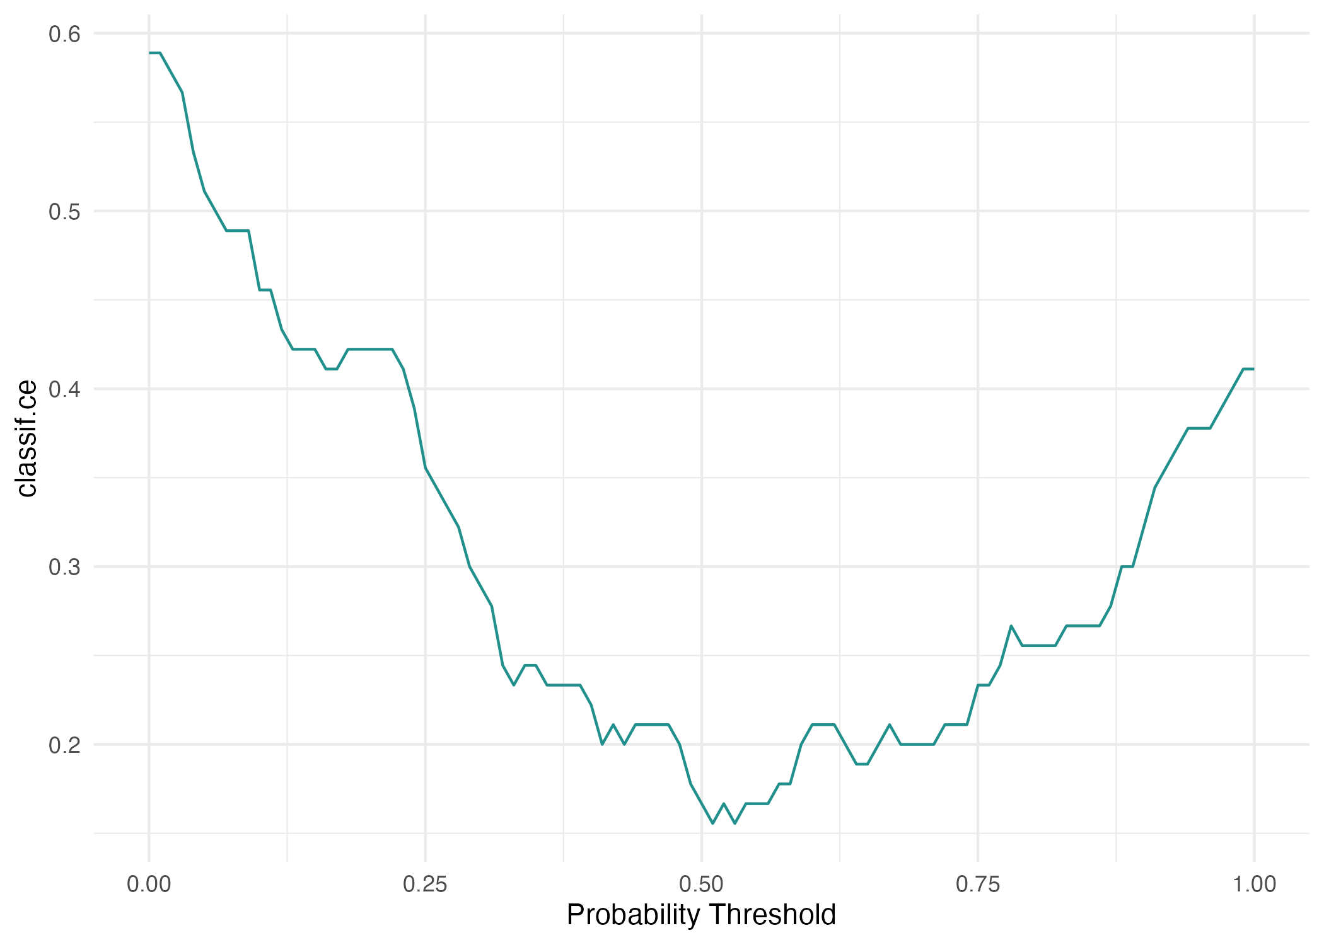
16
Probability thresholds change the errors
Lower threshold usually
raises sensitivity and
reduces specificity.
Higher threshold usually
reduces sensitivity and
raises specificity.
Checkpoint: How would lowering the threshold affect missed disease and false alarms?
Machine Learning in Epidemiology with R — Part 2
Notes:
EXPLANATION
The saved plot shows classification error across thresholds, not separate sensitivity and specificity curves. Lowering the threshold labels more patients present, so sensitivity cannot decrease and specificity cannot increase on fixed scores. Error rate alone weighs the two mistakes equally. Use validation/training data and intended consequences to select a threshold, then assess it on untouched data. Exploring this test plot is educational; selecting from it would require new independent evaluation.
DEMONSTRATION / QUESTION
Discuss a lower threshold without claiming an optimal value. Give participants time to explain the tradeoff.
TRANSITION
Return to the complete workflow and its limits.
SOURCE
Notebook §4; figures/04-threshold.png; R/02-trees-and-evaluation.R.
SUGGESTED TIME
104–110 min

Slide 18
17
Workflow and limits
Define the patient, predictors and existing-disease outcome.
Fit models using training data and control complexity.
Evaluate held-out probabilities and explain the errors.
Check uncertainty, population differences and data quality.
These teaching results establish neither clinical validation nor causation.
Machine Learning in Epidemiology with R — Part 2
Notes:
EXPLANATION
Summarise the distinction between the all-row tree fitting demonstration, network training/validation and forest holdout evaluation. Do not rank models using isolated scores with differing conditions. The dataset is small, external validity is untested and the clinical setting needs separate validation. Appendix topics are optional.
DEMONSTRATION / QUESTION
Ask: what evidence would you need before using this model in a different population? Reserve 10 minutes discussion.
TRANSITION
Invite final questions, then point to optional extensions.
SOURCE
Notebook §§1–4 and Reproducibility; outputs/VALIDATION.md.
SUGGESTED TIME
110–120 min

Slide 19
18
Appendix: resampling
Cross-validation rotates which fold stays out of fitting.
Repeated subsampling draws different training/test splits.
Bootstrap samples training rows with replacement.
Completed locally: 3-fold CV, 100 subsamples and 40 bootstrap repetitions.
Machine Learning in Epidemiology with R — Part 2
Notes:
EXPLANATION
Resampling estimates variation across data partitions. The supplied extension uses a 100-tree forest. Bootstrap samples repeat some training patients; evaluation uses observations kept out according to the resampling design. Keep dependent patients, places or times together if the setting requires it.
DEMONSTRATION / QUESTION
Optional: inspect the three resampling objects.
TRANSITION
Tuning adds a selection step within training data.
SOURCE
Notebook §5; R/02-trees-and-evaluation.R, article-resampling; outputs/resampling-summary.csv and cv3.csv.
SUGGESTED TIME
Follow-up study

Slide 20
19
Appendix: tuning and nested cross-validation
A hyperparameter controls how a model learns.
Inner resampling selects settings within training data.
Outer folds assess the whole selection procedure.
Full grid search and full-budget nested CV remain unexecuted. Only reduced smoke runs passed.
Machine Learning in Epidemiology with R — Part 2
Notes:
EXPLANATION
Random search completed 500 configurations and Bayesian tuning 30, each with ten-fold inner CV. A smoke run is a small execution check, not the requested full analysis. The resolution-10 grid can reach 10,000 configurations. Full nested CV specifies 10 outer and 10 inner folds and 100 evaluations per inner search. The nested script uses outer folds for evaluation; in ordinary search modes the fixed test set remains outside selection.
DEMONSTRATION / QUESTION
Optional: trace train_task and compare nested versus ordinary search branches.
TRANSITION
Interpretation asks what a fitted model has learned.
SOURCE
Notebook §6; R/04-tuning.R; outputs/VALIDATION.md.
SUGGESTED TIME
Follow-up study

Slide 21
20
Appendix: interpretation
Approach | Question
Feature importance | Which predictors contribute to this fitted model?
Feature effects | How do predictions vary with a predictor?
Local explanation | What helps explain this one prediction?
Conceptual extension. No computed feature ranking or local explanation is supplied.
Machine Learning in Epidemiology with R — Part 2
Notes:
EXPLANATION
Predictive associations do not establish intervention effects. Correlated features may share or mask importance. Effects can extrapolate into implausible combinations and local explanations depend on method and reference choice. No executable iml example appears in the supplied paper record, and this workshop section remains conceptual.
DEMONSTRATION / QUESTION
Optional: ask what an explanation can and cannot tell us about causation.
TRANSITION
Generated observations need their own interpretation.
SOURCE
Notebook §7; replication-notes.md, article §5 status.
SUGGESTED TIME
Follow-up study

Slide 22
21
Appendix: synthetic observations
A generator learns patterns from the observed data.
ARF fits the generator; FORDE estimates density.
FORGE samples 270 synthetic observations.
Generated rows are synthetic examples. They are not additional observed patients.
Machine Learning in Epidemiology with R — Part 2
Notes:
EXPLANATION
ARF means adversarial random forest. FORDE estimates a probability distribution from the fitted forest and FORGE samples from it. The saved output contains 270 synthetic rows. Synthetic generation does not increase the number of independent observed patients, guarantee privacy or establish clinical validity.
DEMONSTRATION / QUESTION
Optional: inspect the synthetic file separately and retain its label.
TRANSITION
Close with the sources and reproducible record.
SOURCE
Notebook §8; R/05-synthetic-data.R; outputs/synthetic-heart.csv; outputs/VALIDATION.md.
SUGGESTED TIME
Follow-up study

Slide 23
22
Appendix: sources and reproducibility
Wright et al. (2026), Machine Learning in Epidemiology
arXiv:2602.16352v1, sections 2–6
OpenML heart-statlog, dataset 53, version 1
Local notebook, scripts, saved figures and output records
Source details, timing and evidence gaps accompany this deck.
Machine Learning in Epidemiology with R — Part 2
Notes:
EXPLANATION
Article settings and locally observed results are different evidence categories. Source links: https://arxiv.org/html/2602.16352v1 and https://www.openml.org/d/53. Reproducibility files save split membership, seeds and session information. The local encoding and scaling are explicit reconstructions. Main performance numbers are from supplied CSV files. No new full training, tuning or external validation was performed to make this deck.
DEMONSTRATION / QUESTION
Point to SOURCE-AND-TEACHING-NOTES.md for exact file mapping and gaps.
TRANSITION
End or return to participant questions.
SOURCE
part2/ml-workflow-2.qmd; data/README.md; references/replication-notes.md; outputs/VALIDATION.md.
SUGGESTED TIME
Follow-up study

