Slide 1

Machine Learning
in Epidemiology
with R — Part 2
Heart data and neural networks
Federica Gazzelloni
23 October 2026
Two-hour online, hands-on R workshop
Notes:
EXPLANATION
Read an existing forest result, then fit a neural network to the same heart-disease task. Forest fitting is not part of the live session.
DEMONSTRATION / QUESTION
Open the root RStudio project and the Part 2 notebook. Confirm the Keras backend before class.
TRANSITION
Introduce the learning sequence.
SOURCE
part2/ml-workflow-2.qmd; part2/README.md
SUGGESTED TIME
0–3 min

Slide 2
01
Learning objectives and session route
Meet the heart data
Read the saved random forest results
Prepare inputs and build a network with Keras
Fit the network and evaluate it with mlr3
Compare mistakes and discuss the results
Explain the forest results, fit a neural network, and interpret its predictions.
Machine Learning in Epidemiology with R — Part 2
Notes:
EXPLANATION
Follow notebook sections 1–7. Most practical time is for neural-network preparation, fitting and evaluation. Trees, extra curves, resampling, tuning and synthetic records are follow-up material.
DEMONSTRATION / QUESTION
Keep RStudio beside the slides. Run the notebook blocks in order.
TRANSITION
Reconnect with Part 1.
SOURCE
part2/ml-workflow-2.qmd; part2/README.md
SUGGESTED TIME
3–5 min

Slide 3
02
West Nile surveillance and heart disease
Part 1 | Part 2
West Nile surveillance | Clinical measurements
Define a prediction unit and outcome | One patient and existing disease
Preparation and evaluation | The same workflow, new learners
Use the same learning and evaluation ideas with a new dataset.
Machine Learning in Epidemiology with R — Part 2
Notes:
EXPLANATION
Part 1 concerned surveillance observations; Part 2 uses one row per patient and existing heart disease. Reuse the ideas of defining an outcome and separating learning from evaluation.
DEMONSTRATION / QUESTION
Ask what one prediction means in each setting.
TRANSITION
Inspect the heart data.
SOURCE
part1/R/workshop.R; part2/ml-workflow-2.qmd §1
SUGGESTED TIME
5–8 min

Slide 4
03
Meet the heart-disease data
270
13
2
patients
original predictors
outcome classes
heart_disease: 150 absent, 120 present
Examples: age, chest pain, cholesterol, exercise measurements
Checkpoint: What does one row represent? Which column is the outcome?
Machine Learning in Epidemiology with R — Part 2
Notes:
EXPLANATION
There are 270 patients, 13 predictors and the outcome heart_disease. Present is the class we want to detect. This is existing-disease classification, not future cardiovascular risk.
DEMONSTRATION / QUESTION
Run source("R/01-data.R") and table(heart$heart_disease). Ask which column must be excluded from the inputs.
TRANSITION
Read results from the forest already fitted to these patients.
SOURCE
part2/R/01-data.R; part2/data/README.md
SUGGESTED TIME
8–15 min

Slide 5
04
Saved random forest results
270 patients
180 training patients | 90 test patients
The forest learned from these rows | These rows were kept aside
Training is already complete | Read the saved predictions today
Use the saved results today. We will not fit another random forest.
Machine Learning in Epidemiology with R — Part 2
Notes:
EXPLANATION
A forest combines many decision trees. The recorded run learned from 180 patients and predicted the other 90. The main lesson loads its saved results. Do not run R/02-trees-and-evaluation.R during the live session: it refits models and runs resampling.
DEMONSTRATION / QUESTION
Open the saved confusion matrix through notebook section 2.
TRANSITION
Count correct predictions and the two types of mistake.
SOURCE
part2/outputs/split.csv; part2/outputs/confusion.csv; part2/ml-workflow-2.qmd §2
SUGGESTED TIME
15–19 min

Slide 6
05
Correct predictions and mistakes
Observed outcome | Predicted present | Predicted absent
Present | 30 true positives | 7 false negatives
Absent | 8 false positives | 45 true negatives
False positive: predicts disease for a patient whose outcome is absent.
Discuss: what could a missed case or a false alarm mean for a patient?
Machine Learning in Epidemiology with R — Part 2
Notes:
EXPLANATION
Rows on this slide are recorded outcomes; columns are predictions. Counts are 30 true positives, 7 false negatives, 8 false positives and 45 true negatives. The notebook displays the transpose: predictions in rows and outcomes in columns. Counts are identical; point out the labels.
DEMONSTRATION / QUESTION
Find the 7 missed cases and the 8 false alarms. Calculate 75 correct predictions out of 90.
TRANSITION
Summarise the counts using three measures.
SOURCE
part2/outputs/confusion.csv; part2/ml-workflow-2.qmd §2
SUGGESTED TIME
19–25 min

Slide 7
06
Accuracy, sensitivity and specificity
Measure | What does it count? | Saved result
Accuracy | Correct predictions: 75 / 90 | 83.3%
Sensitivity | Cases detected: 30 / 37 | 81.1%
Specificity | Non-cases identified: 45 / 53 | 84.9%
Accuracy alone can hide which patients the model gets wrong.
Machine Learning in Epidemiology with R — Part 2
Notes:
EXPLANATION
Accuracy covers all patients. Sensitivity is the fraction of patients with disease detected; specificity is the fraction without disease correctly identified. Use only these three measures in the main lesson.
DEMONSTRATION / QUESTION
Ask students to explain the denominator of one measure in their own words.
TRANSITION
Probabilities allow different cut-offs for a positive prediction.
SOURCE
part2/outputs/holdout-measures.csv; part2/outputs/confusion.csv
SUGGESTED TIME
25–30 min

Slide 8
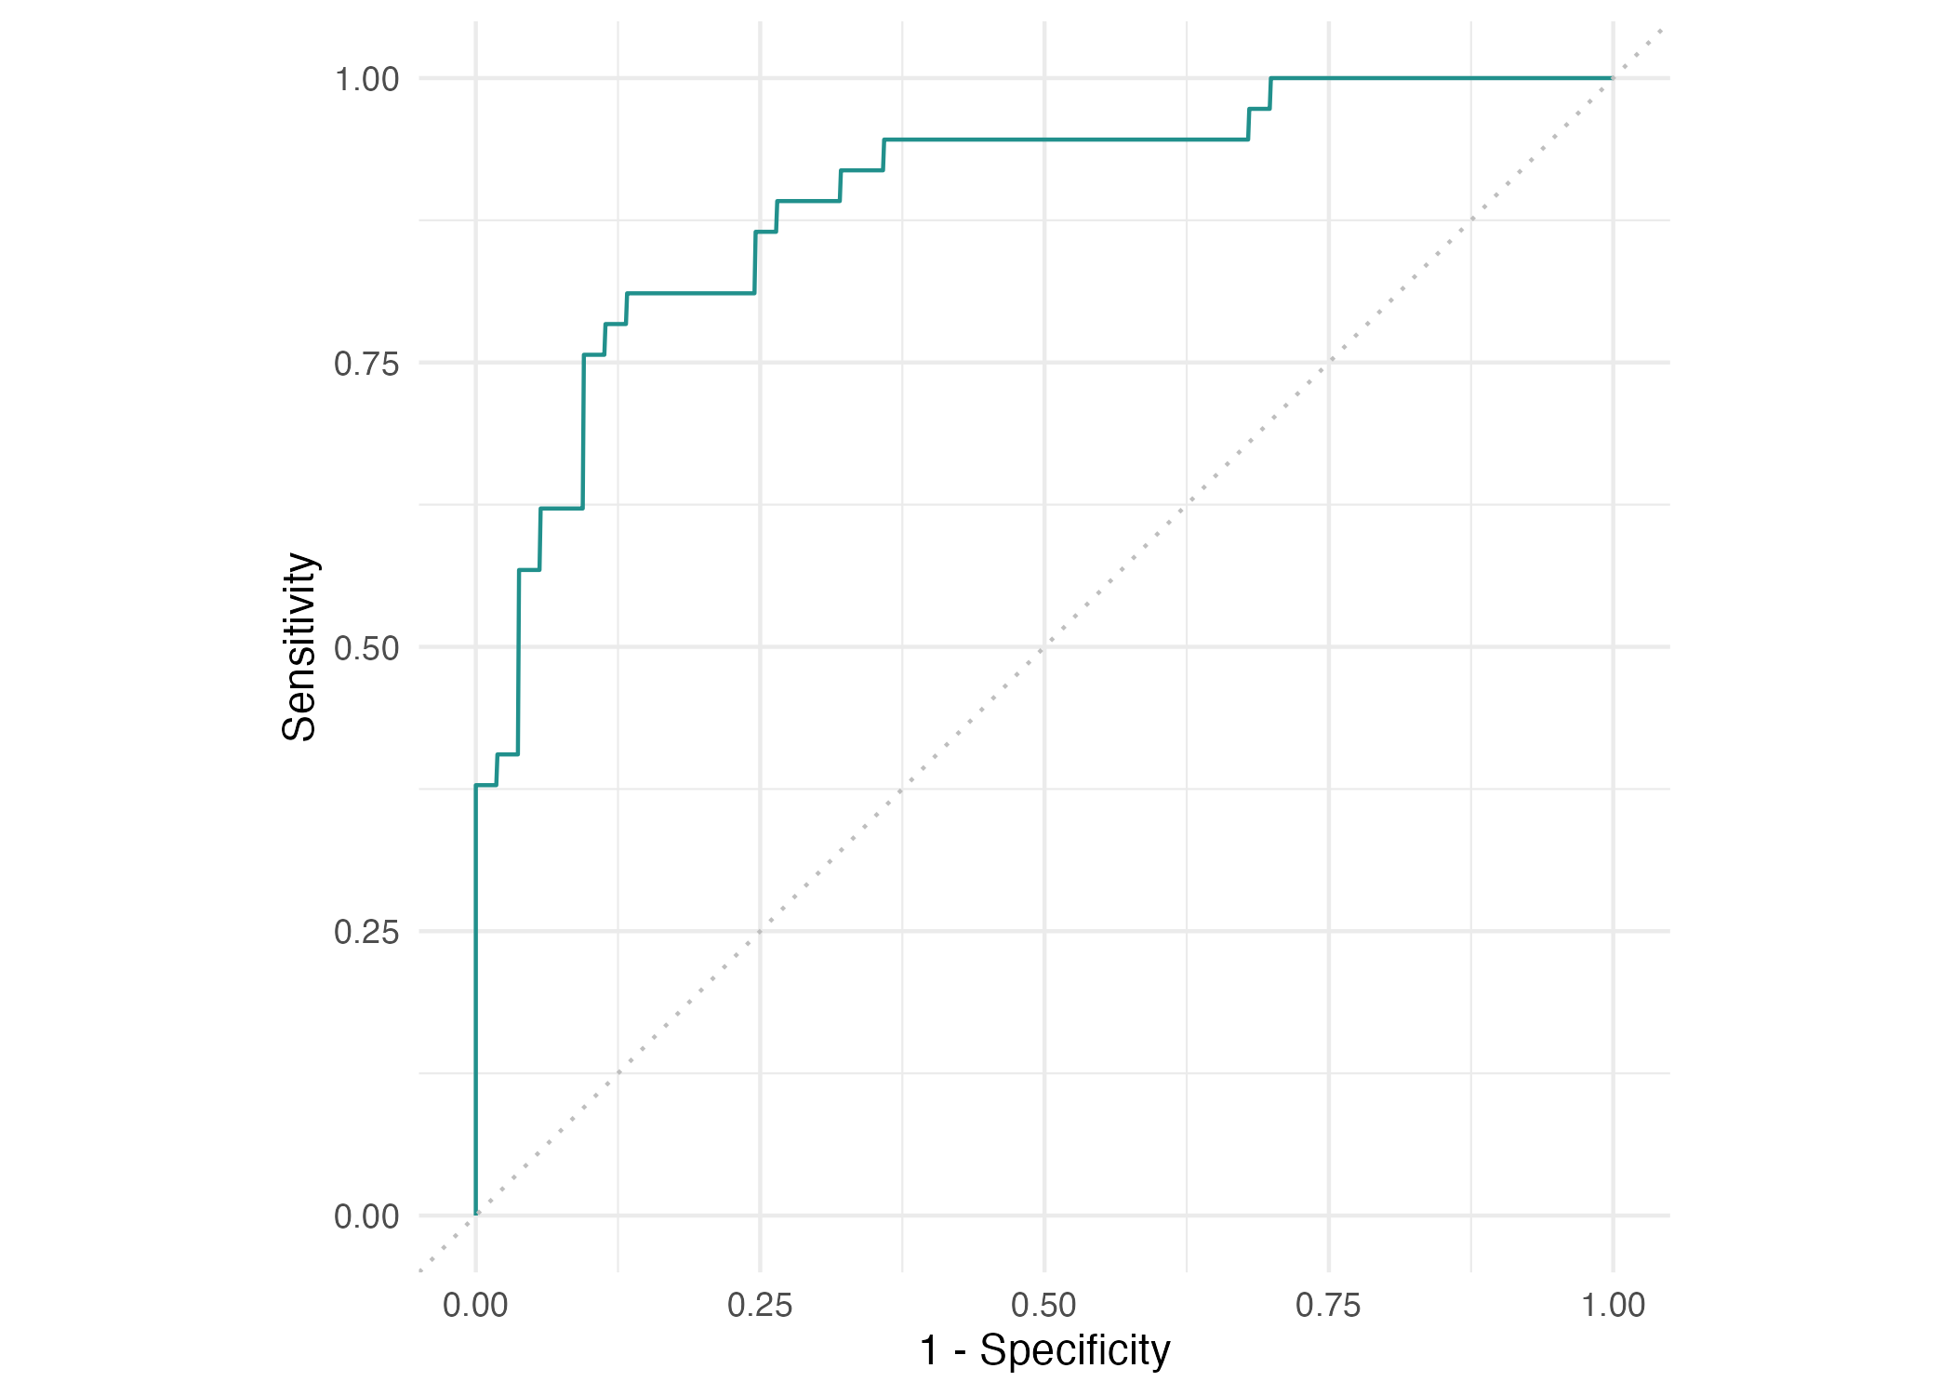
07
Probability thresholds and the ROC curve
Lowering the cut-off
usually catches more cases.
It also produces
more false alarms.
The curve compares choices
across different cut-offs.
Discuss: would accuracy alone tell us which cut-off to choose?
Machine Learning in Epidemiology with R — Part 2
Notes:
EXPLANATION
A threshold is the cut-off for predicting present. The saved ROC plots sensitivity against the false-positive rate. A lower cut-off catches at least as many positives and labels at least as many negatives positive on fixed scores. Use the curve conceptually, without selecting an optimal clinical threshold.
DEMONSTRATION / QUESTION
Discuss missed cases versus false alarms. No forest code is run.
TRANSITION
Fit a different model using the same training and test patients.
SOURCE
part2/figures/04-roc.png; part2/ml-workflow-2.qmd §2
SUGGESTED TIME
30–35 min

Slide 9
08
Organise the task with mlr3
Define the outcome, then reuse the saved training and test groups.
library(mlr3)
heart_task <- as_task_classif(
heart,
target = "heart_disease",
positive = "present",
id = "heart"
)
split_record <- read.csv("outputs/split.csv")
In notebook section 3, load the same 180 training and 90 test row numbers.
Machine Learning in Epidemiology with R — Part 2
Notes:
EXPLANATION
mlr3 stores the data and outcome in a classification task. Present is the positive class. The excerpt shows the task and loading the split file; the complete notebook block constructs split$train and split$test. Both models are evaluated on the same 90 patients.
DEMONSTRATION / QUESTION
Run the full neural-task block in notebook section 3. Inspect length(split$train) and length(split$test).
TRANSITION
Prepare numerical inputs for Keras.
SOURCE
part2/ml-workflow-2.qmd §3; part2/R/03-neural-network.R: neural-task
SUGGESTED TIME
35–43 min

Slide 10
09
Prepare numerical inputs
Keep the outcome separate from the predictors.
Turn categories into 0/1 values and indicator columns.
Scale measurements using fitting patients only.
Check: ncol(x) is 22; y is 1 for present and 0 for absent.
Run the input-preparation block in notebook section 4.
Machine Learning in Epidemiology with R — Part 2
Notes:
EXPLANATION
Keras receives numbers. Six measurements stay numeric, three binary predictors become 0/1, and four other categories expand to 13 indicators: 22 inputs. An indicator marks whether a category applies. Scaling subtracts a mean and divides by a standard deviation; estimate these using the 144 fitting rows only. The other 36 training patients are used for validation.
DEMONSTRATION / QUESTION
Run the complete neural-inputs block, then ncol(x) and table(y). Read the plain-language comments together.
TRANSITION
See how the network combines these inputs.
SOURCE
part2/ml-workflow-2.qmd §4; part2/R/03-neural-network.R: neural-inputs; part2/data/README.md
SUGGESTED TIME
43–55 min

Slide 11
10
A neural network learns weighted combinations
Inputs | Hidden layers | Output
Encoded measurements | Weighted combinations | Probability of present
Numbers the network receives | ReLU transforms learned signals | Sigmoid maps to 0–1
Training adjusts weights to reduce a loss: a measure of prediction error.
Machine Learning in Epidemiology with R — Part 2
Notes:
EXPLANATION
A neural network learns weighted combinations of the numerical inputs. Hidden layers lie between the inputs and output. The final sigmoid output is a probability between 0 and 1.
DEMONSTRATION / QUESTION
Trace measurements through the layers to the output. Ask what the output means for one patient.
TRANSITION
Count the inputs and units in the network we will build.
SOURCE
part2/ml-workflow-2.qmd §5; part2/R/03-neural-network.R: neural-build
SUGGESTED TIME
55–60 min

Slide 12
11
13 predictors become 22 encoded inputs
Input | Hidden layer 1 | Hidden layer 2 | Output
22 columns | 64 units, ReLU | 32 units, ReLU | 1 unit, sigmoid
6 numeric + 3 binary + 13 indicators | Dropout 0.4 | Dropout 0.4 | P(disease present)
Dropout temporarily omits 40% of units during training.
The 13 measurements become 22 numerical input columns.
Machine Learning in Epidemiology with R — Part 2
Notes:
EXPLANATION
The network uses hidden layers of 64 and 32 units. ReLU sets negative signals to zero and retains positive signals. Dropout temporarily switches off units during fitting to help limit overfitting. Keep the exact architecture in code; students need to understand the role of each layer. Encoding and scaling are workshop reconstruction choices.
DEMONSTRATION / QUESTION
Identify the input width and the single output in the table before running the Keras definition.
TRANSITION
Define this network in R.
SOURCE
part2/ml-workflow-2.qmd §§4–5; part2/R/03-neural-network.R
SUGGESTED TIME
60–64 min

Slide 13
12
Build the network with Keras
Each layer passes its learned signals to the next layer.
library(keras3)
set_random_seed(20261023)
network <- keras_model_sequential(input_shape = c(22)) |>
layer_dense(units = 64, activation = "relu") |>
layer_dropout(rate = 0.4) |>
layer_dense(units = 32, activation = "relu") |>
layer_dropout(rate = 0.4) |>
layer_dense(units = 1, activation = "sigmoid")
Run this definition after preparing x and y in the notebook.
Machine Learning in Epidemiology with R — Part 2
Notes:
EXPLANATION
Keras is used directly to build and train the network; it is not being fitted through an mlr3 learner. The Keras R package and a working Python backend must be ready before class. A seed fixes the random starting point but does not guarantee identical results across environments.
DEMONSTRATION / QUESTION
Run the network definition in the neural-build block, stopping before compile(). Locate the hidden layers and output activation.
TRANSITION
Choose how the network learns.
SOURCE
part2/ml-workflow-2.qmd §5; part2/R/03-neural-network.R: neural-build; part2/README.md
SUGGESTED TIME
64–70 min

Slide 14
13
Choose how the network learns
The optimiser updates weights; the loss measures prediction error.
compile(network,
optimizer = optimizer_adam(learning_rate = 0.002),
loss = "binary_crossentropy", metrics = "accuracy"
)
Binary cross-entropy measures error for this two-class outcome.
Machine Learning in Epidemiology with R — Part 2
Notes:
EXPLANATION
Adam is the optimiser: the method for updating weights. The learning rate controls update size. Binary cross-entropy penalises wrong probabilities; accuracy reports the share of correct class predictions. Explain roles rather than listing many settings.
DEMONSTRATION / QUESTION
Run compile(). Ask which argument specifies the error measure.
TRANSITION
Fit the network and monitor validation loss.
SOURCE
part2/ml-workflow-2.qmd §5; part2/R/03-neural-network.R: neural-build
SUGGESTED TIME
70–75 min

Slide 15
14
Fit the network
Keep 20% of the training group for validation while the network learns.
training <- fit(
network,
x[split$train, ],
y[split$train],
epochs = 50,
batch_size = 32,
validation_split = 0.2,
verbose = 1,
callbacks = list(callback_early_stopping(patience = 10, restore_best_weights = TRUE))
)
144 patients update weights; 36 monitor learning; 90 remain for final testing.
Machine Learning in Epidemiology with R — Part 2
Notes:
EXPLANATION
An epoch is one pass through the fitting data. Batches group 32 rows for weight updates. Validation loss uses the final 20% of supplied training rows, excluded from fitting updates. Early stopping waits 10 epochs without improvement and restores the best validation weights. Training is now a main live activity.
DEMONSTRATION / QUESTION
Run the fit() block. Let students watch the reported loss and validation loss. If their backend is unavailable, use the clearly labelled saved curve and results while others complete fitting.
TRANSITION
Inspect the history from the completed run.
SOURCE
part2/ml-workflow-2.qmd §6; part2/R/03-neural-network.R: neural-fit; https://keras.io/guides/training_with_built_in_methods/
SUGGESTED TIME
75–88 min

Slide 16
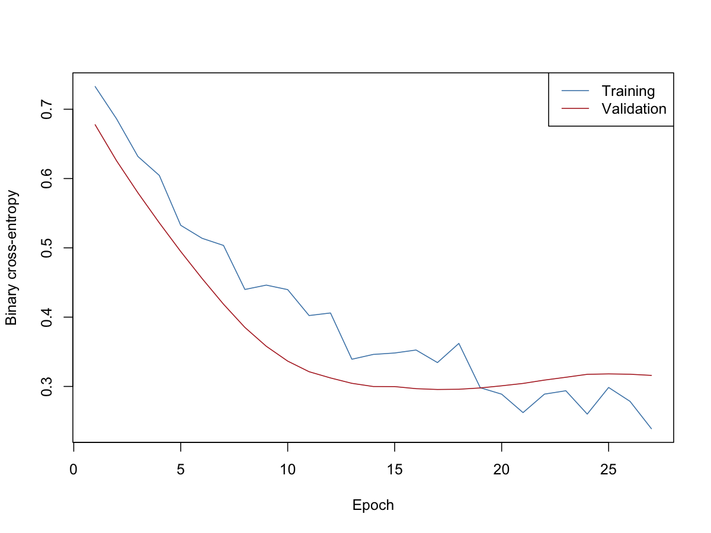
15
Read the training and validation loss
Training loss measures fit
on rows used for learning.
Validation loss monitors
rows kept out of updates.
Early stopping restores
the best validation weights.
Run plot(training). The displayed figure is the saved workshop run.
Machine Learning in Epidemiology with R — Part 2
Notes:
EXPLANATION
Plot your own training history with plot(training). The figure on this slide is the saved run, which stopped after 27 epochs. Lower loss means smaller prediction error. Falling training loss alongside rising validation loss suggests overfitting. Your run may differ.
DEMONSTRATION / QUESTION
Run plot(training). Ask why validation patients are needed as well as test patients.
TRANSITION
Predict the untouched test patients and evaluate with mlr3.
SOURCE
part2/ml-workflow-2.qmd §6; part2/figures/05-neural-loss.png; part2/outputs/neural-loss.csv
SUGGESTED TIME
88–95 min

Slide 17
16
Evaluate Keras predictions with mlr3
Predict the 90 test patients, then compare predictions with their outcomes.
prob <- as.numeric(predict(network, x[split$test, ], verbose = 0))
class <- ifelse(prob >= 0.5, "present", "absent")
network_pred <- PredictionClassif$new(
task = heart_task, row_ids = split$test,
truth = heart_task$truth(rows = split$test),
response = class,
prob = cbind(present = prob, absent = 1 - prob)
)
network_pred$confusion
network_pred$score(msrs(c("classif.acc", "classif.tpr", "classif.tnr")))
The same three measures let us compare the network with the saved forest.
Machine Learning in Epidemiology with R — Part 2
Notes:
EXPLANATION
The network returns probabilities; 0.5 is the example cut-off. PredictionClassif stores row numbers, the true labels, predicted classes and class probabilities. Supplying the true labels for the test rows avoids including the full dataset. Accuracy, sensitivity and specificity use the same definitions as the forest.
DEMONSTRATION / QUESTION
Run neural-predict in notebook section 7. Explain one cell in network_pred$confusion and read the three scores. The script keeps results in R; the later neural-save section replaces saved files only if explicitly run.
TRANSITION
Compare your result with the clearly labelled saved reference.
SOURCE
part2/ml-workflow-2.qmd §7; part2/R/03-neural-network.R: neural-predict; https://mlr3.mlr-org.com/reference/PredictionClassif.html
SUGGESTED TIME
95–105 min

Slide 18
17
Compare the saved model results
Measure | Random forest | Neural network
Accuracy | 83.3% | 85.6%
Sensitivity | 81.1% | 78.4%
Specificity | 84.9% | 90.6%
The saved network is more accurate overall, but misses one more case.
Machine Learning in Epidemiology with R — Part 2
Notes:
EXPLANATION
Both saved runs use the same 90 test patients. The forest has 75 correct, 7 missed cases and 8 false alarms; the network has 77 correct, 8 missed cases and 5 false alarms. Higher accuracy does not mean better sensitivity. A difference of two correct predictions in one split does not establish that one method is generally better. Distinguish saved scores from each student's new run.
DEMONSTRATION / QUESTION
Ask which model detects more cases and which raises fewer false alarms. Discuss whether one accuracy score settles the choice.
TRANSITION
Summarise the learning sequence and invite questions.
SOURCE
part2/outputs/confusion.csv; part2/outputs/holdout-measures.csv; part2/outputs/neural-predictions.csv; part2/ml-workflow-2.qmd §7
SUGGESTED TIME
105–115 min

Slide 19
18
Workflow and limits
Read the saved forest results and explain its mistakes.
Prepare inputs, then build and fit the Keras network.
Use mlr3 to evaluate predictions on the same test patients.
Compare accuracy and error types before drawing conclusions.
These teaching results establish neither clinical validation nor causation.
Machine Learning in Epidemiology with R — Part 2
Notes:
EXPLANATION
The main sequence is saved forest interpretation, live neural-network fitting, then evaluation with mlr3. The forest is not retrained. The small dataset and one train/test split limit conclusions; no clinical validation or causal finding is established. All remaining slides are optional follow-up.
DEMONSTRATION / QUESTION
Ask students to explain one lesson they can reuse in another prediction problem.
TRANSITION
End the main session; use the appendix only for follow-up questions.
SOURCE
part2/ml-workflow-2.qmd §§1–7; part2/README.md
SUGGESTED TIME
115–120 min

Slide 20
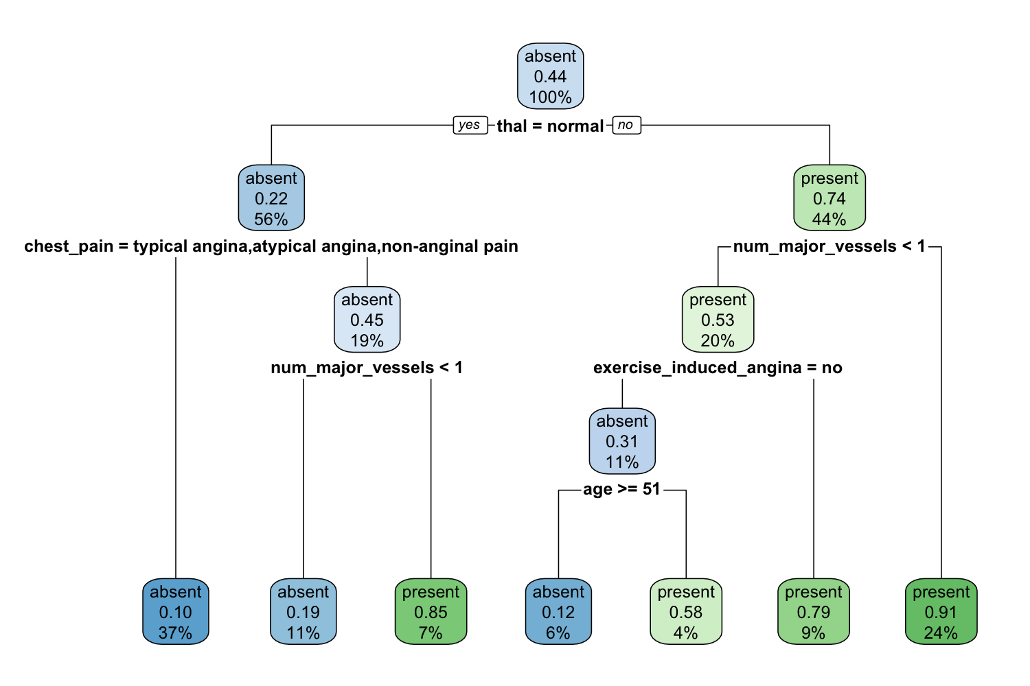
19
Appendix: how a decision tree works
A split asks a question
about one predictor.
Follow a branch until
you reach a leaf.
A leaf gives a class
and fitted proportions.
Default tree: fitted on all 270 patients to illustrate learning.
Machine Learning in Epidemiology with R — Part 2
Notes:
EXPLANATION
Read the root question on the saved tree and trace one path. A tree recursively separates patients into groups that are more similar in outcome. A leaf is a terminal group. The proportions and row percentages describe this fitted sample. Fitted accuracy is not a new-patient performance estimate.
DEMONSTRATION / QUESTION
Optional follow-up: run the cart expression in R/02-trees-and-evaluation.R. Trace one branch together, then let participants choose another.
TRANSITION
Compare the extra flexibility of a deep tree with pruning.
SOURCE
Part 2 follow-up materials; R/02-trees-and-evaluation.R, article-trees; figures/01-tree.png.
SUGGESTED TIME
Optional follow-up; outside the two-hour main session.

Slide 21
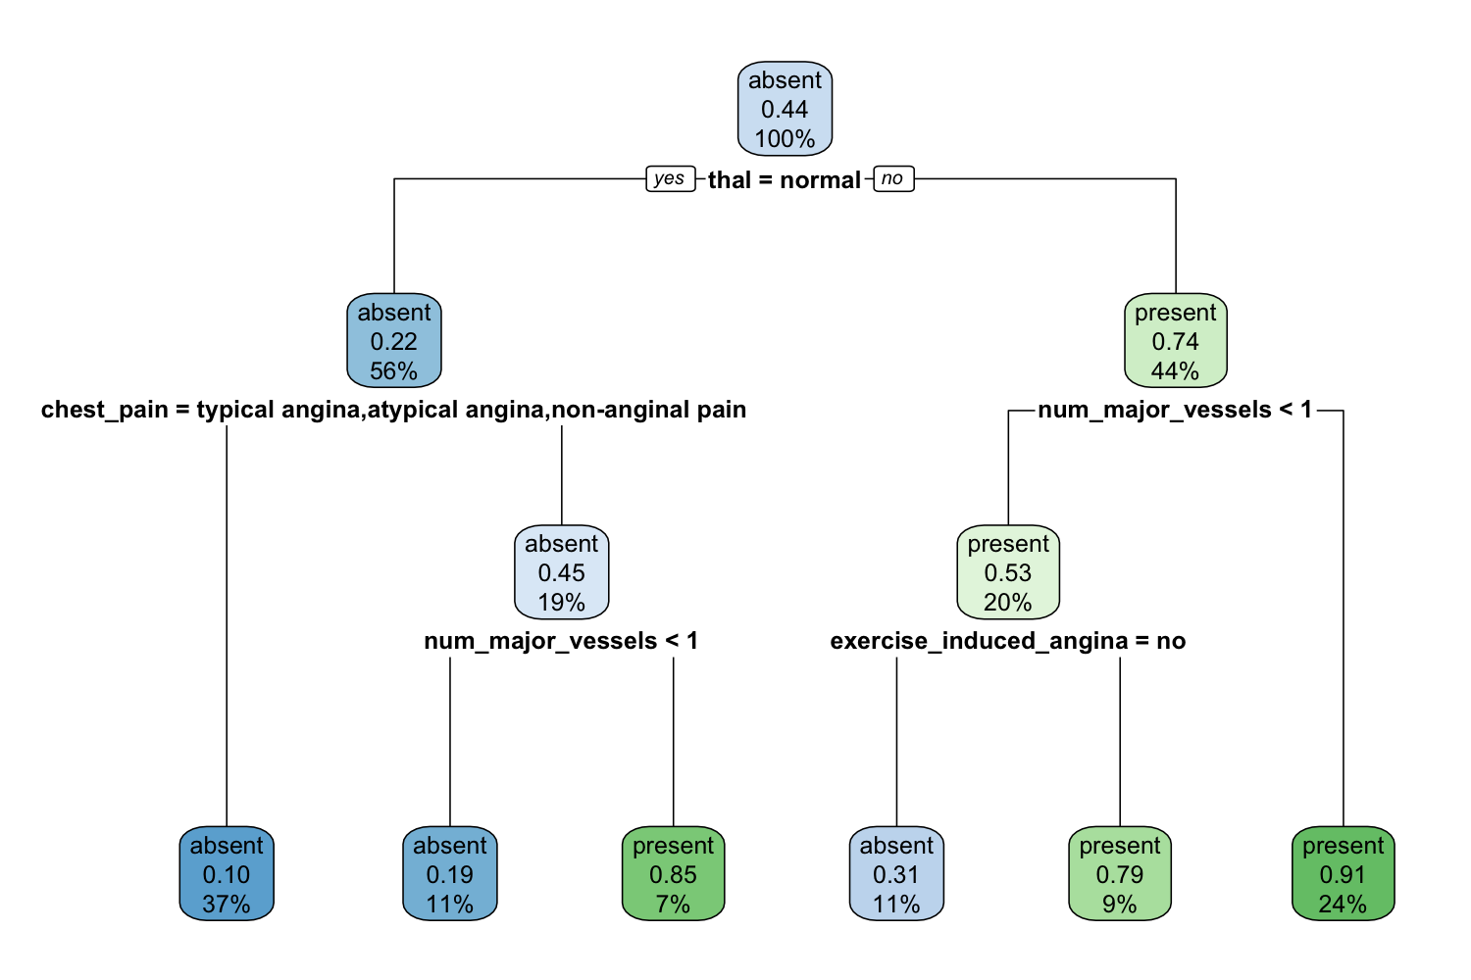
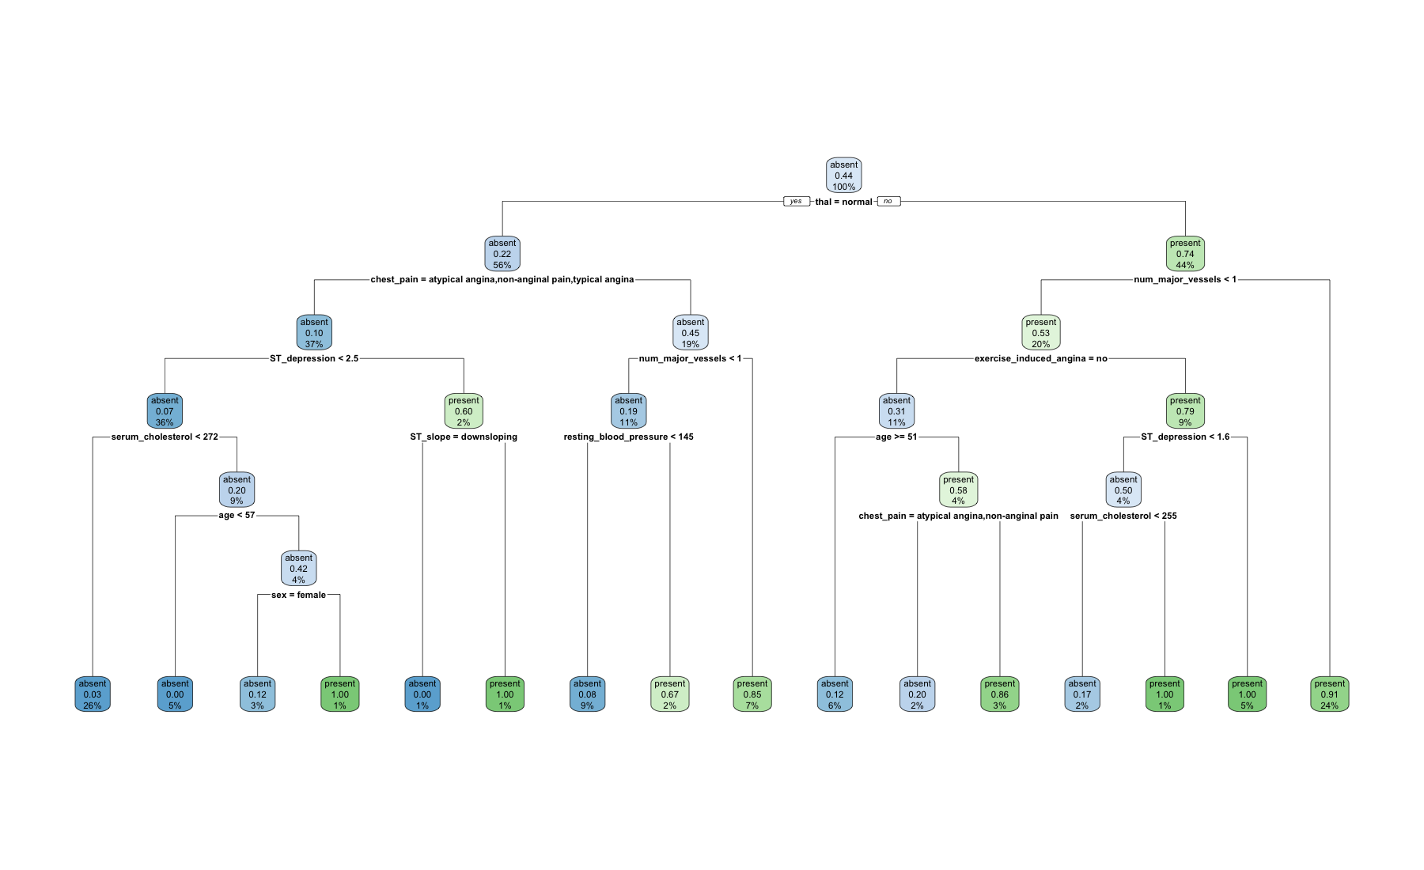
20
Appendix: deep and pruned trees
Deep tree: minsplit = 2
Pruned tree: cp = 0.031
Compare both with the default tree. More branches can fit details of this sample.
Machine Learning in Epidemiology with R — Part 2
Notes:
EXPLANATION
The left illustration is newly rendered from the supplied deep-tree fitting expression using the prepared local data. It is a fitting illustration, not another evaluation result. The right figure is the supplied pruned tree. Small leaf labels in the deep overview are for structure only; inspect the full image or R plot during the demonstration. minsplit sets the minimum observations required to attempt a split.
DEMONSTRATION / QUESTION
Optional follow-up: fit deep_cart and pruned_cart separately. Ask: which structure would be easier to explain?
TRANSITION
The complexity plot helps explain why branches may be removed.
SOURCE
Part 2 follow-up materials; R/02-trees-and-evaluation.R; deep_cart and pruned_cart.
SUGGESTED TIME
Optional follow-up; outside the two-hour main session.

Slide 22
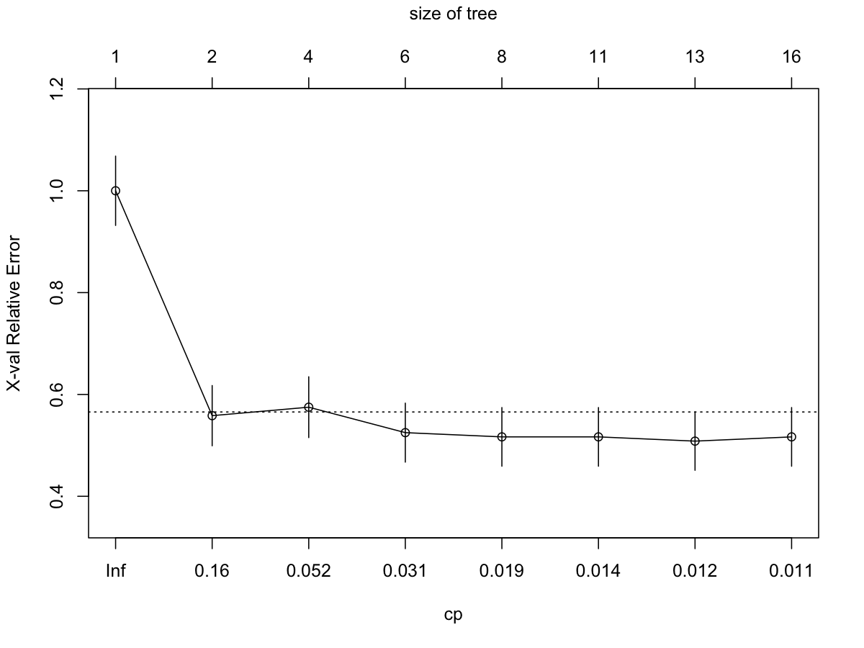
21
Appendix: overfitting and pruning
Overfitting learns sample
details that may not repeat.
Pruning removes branches
to limit complexity.
cp = 0.031 retains the
article’s replication setting.
Checkpoint: Why might pruning help predictions on new patients?
Machine Learning in Epidemiology with R — Part 2
Notes:
EXPLANATION
Explain the relative cross-validation error and tree-size axes. Complexity parameter cp controls the tradeoff between fit and complexity. The fixed 0.031 is retained for replication, not claimed to be universally optimal or selected by our test set. The initial trees use all rows, so even their internal complexity assessment is not the held-out evaluation introduced later.
DEMONSTRATION / QUESTION
Ask participants to locate cp in prune(). Discuss whether the smallest training error settles the question.
TRANSITION
A neural network offers a different way to learn patterns.
SOURCE
Part 2 follow-up materials; R/02-trees-and-evaluation.R; figures/02-complexity.png.
SUGGESTED TIME
Optional follow-up; outside the two-hour main session.

Slide 23
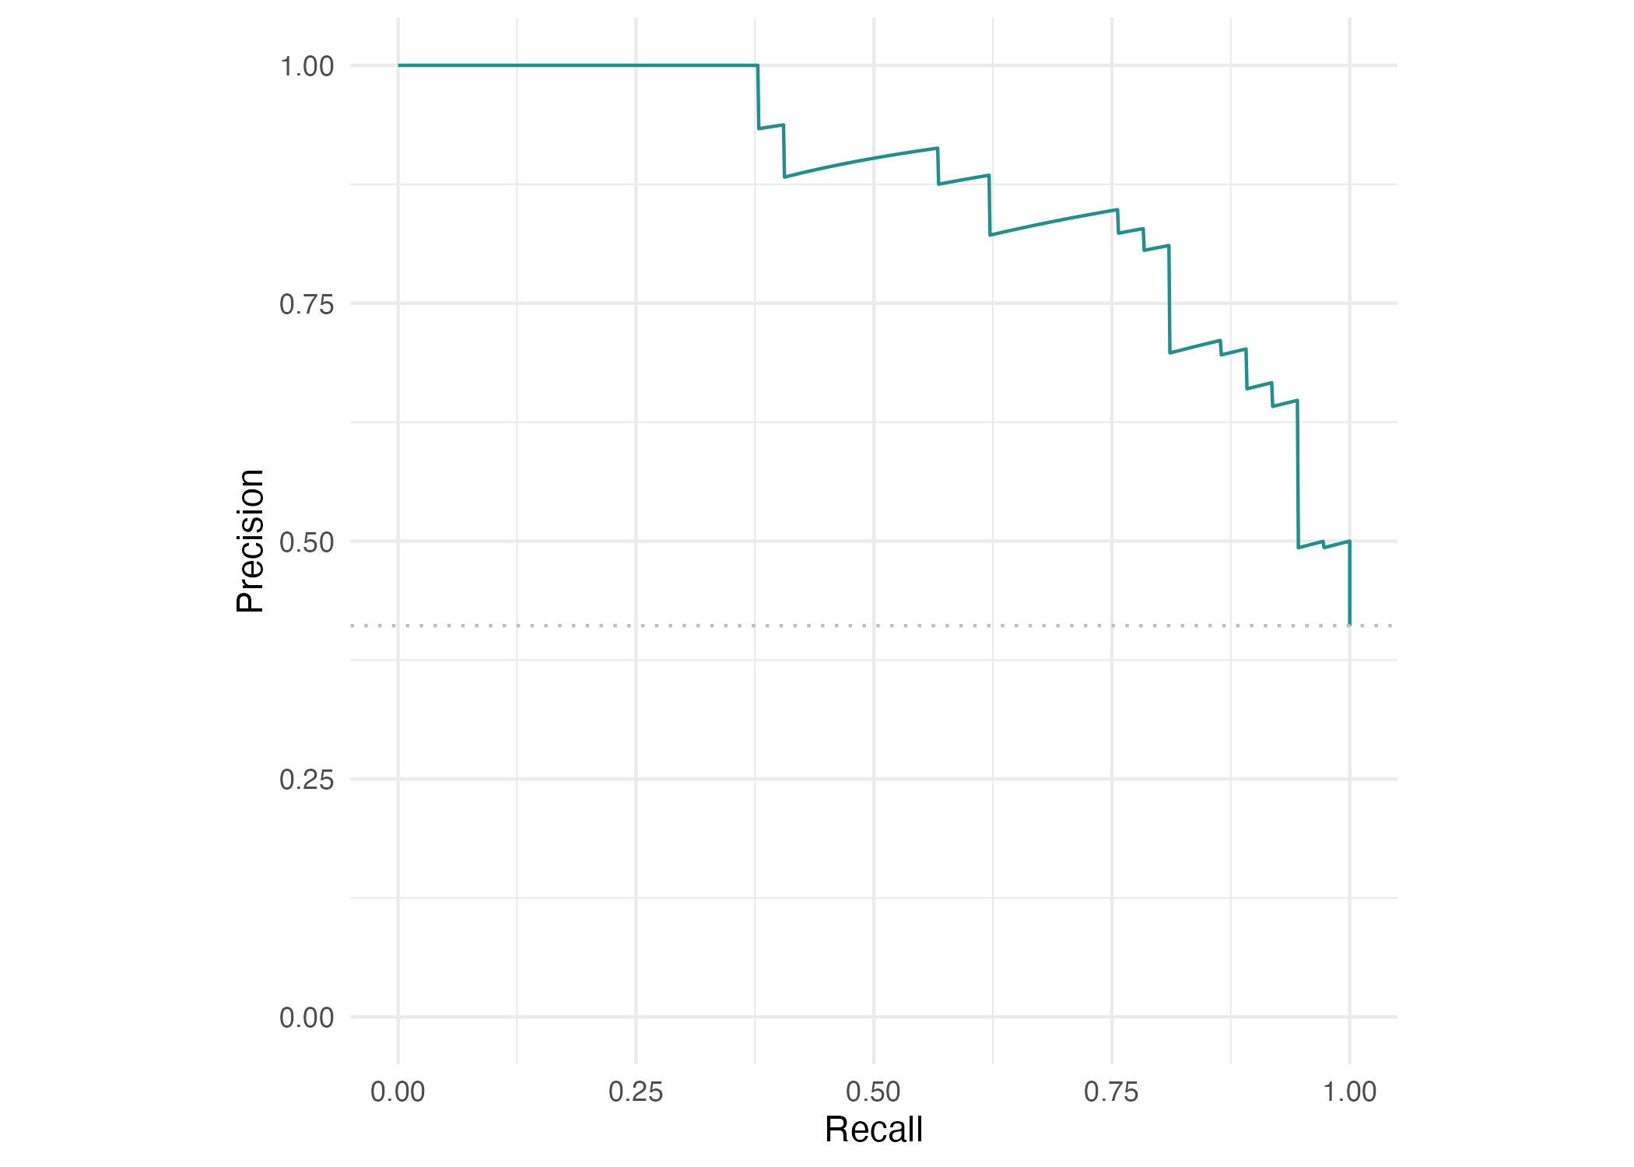
22
Appendix: precision and recall
Recall = sensitivity.
Precision = positive
predictive value.
The curve shows their
tradeoff across thresholds.
Disease frequency matters when interpreting precision and comparing datasets.
Machine Learning in Epidemiology with R — Part 2
Notes:
EXPLANATION
Recall asks what fraction of actual positives we detect. Precision asks what fraction of predicted positives really have present disease. Read several points as thresholds change. Neither curve measures causal effects, calibration or clinical benefit. Avoid comparing precision across datasets without considering prevalence.
DEMONSTRATION / QUESTION
Ask participants to restate precision in patient terms.
TRANSITION
Choose an operating threshold with explicit error consequences.
SOURCE
Part 2 follow-up materials; figures/04-prc.png; outputs/holdout-measures.csv.
SUGGESTED TIME
Optional follow-up; outside the two-hour main session.

Slide 24
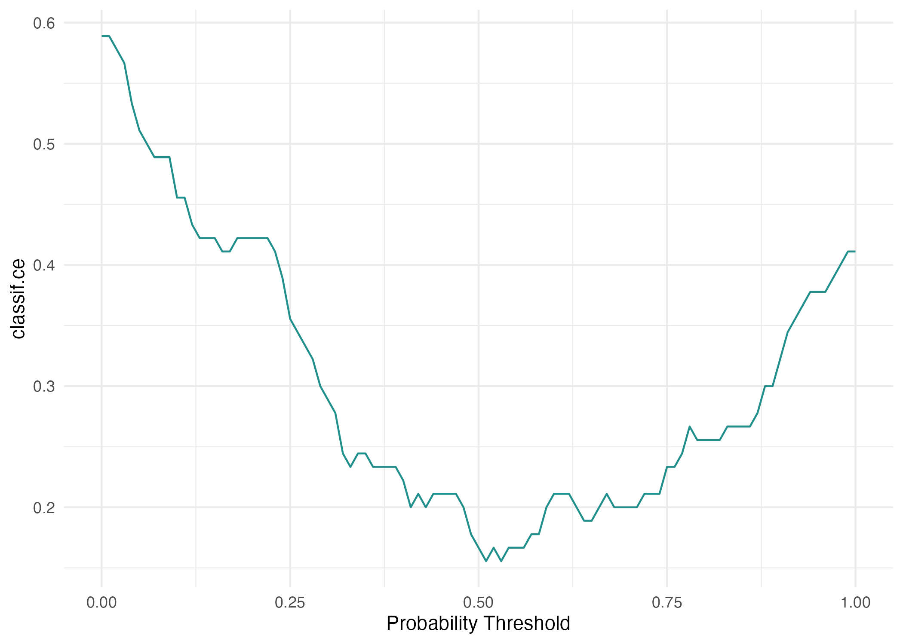
23
Appendix: probability thresholds
Lower threshold usually
raises sensitivity and
reduces specificity.
Higher threshold usually
reduces sensitivity and
raises specificity.
Checkpoint: How would lowering the threshold affect missed disease and false alarms?
Machine Learning in Epidemiology with R — Part 2
Notes:
EXPLANATION
The saved plot shows classification error across thresholds, not separate sensitivity and specificity curves. Lowering the threshold labels more patients present, so sensitivity cannot decrease and specificity cannot increase on fixed scores. Error rate alone weighs the two mistakes equally. Use validation/training data and intended consequences to select a threshold, then assess it on untouched data. Exploring this test plot is educational; selecting from it would require new independent evaluation.
DEMONSTRATION / QUESTION
Discuss a lower threshold without claiming an optimal value. Give participants time to explain the tradeoff.
TRANSITION
Return to the complete workflow and its limits.
SOURCE
Part 2 follow-up materials; figures/04-threshold.png; R/02-trees-and-evaluation.R.
SUGGESTED TIME
Optional follow-up; outside the two-hour main session.

Slide 25
24
Appendix: resampling
Cross-validation rotates which fold stays out of fitting.
Repeated subsampling draws different training/test splits.
Bootstrap samples training rows with replacement.
Completed locally: 3-fold CV, 100 subsamples and 40 bootstrap repetitions.
Machine Learning in Epidemiology with R — Part 2
Notes:
EXPLANATION
Resampling estimates variation across data partitions. The supplied extension uses a 100-tree forest. Bootstrap samples repeat some training patients; evaluation uses observations kept out according to the resampling design. Keep dependent patients, places or times together if the setting requires it.
DEMONSTRATION / QUESTION
Optional: inspect the three resampling objects.
TRANSITION
Tuning adds a selection step within training data.
SOURCE
Part 2 follow-up materials; R/02-trees-and-evaluation.R, article-resampling; outputs/resampling-summary.csv and cv3.csv.
SUGGESTED TIME
Optional follow-up; outside the two-hour main session.

Slide 26
25
Appendix: tuning and nested cross-validation
A hyperparameter controls how a model learns.
Inner resampling selects settings within training data.
Outer folds assess the whole selection procedure.
Full grid search and full-budget nested CV remain unexecuted. Only reduced smoke runs passed.
Machine Learning in Epidemiology with R — Part 2
Notes:
EXPLANATION
Random search completed 500 configurations and Bayesian tuning 30, each with ten-fold inner CV. A smoke run is a small execution check, not the requested full analysis. The resolution-10 grid can reach 10,000 configurations. Full nested CV specifies 10 outer and 10 inner folds and 100 evaluations per inner search. The nested script uses outer folds for evaluation; in ordinary search modes the fixed test set remains outside selection.
DEMONSTRATION / QUESTION
Optional: trace train_task and compare nested versus ordinary search branches.
TRANSITION
Interpretation asks what a fitted model has learned.
SOURCE
Part 2 follow-up materials; R/04-tuning.R; outputs/VALIDATION.md.
SUGGESTED TIME
Optional follow-up; outside the two-hour main session.

Slide 27
26
Appendix: interpretation
Approach | Question
Feature importance | Which predictors contribute to this fitted model?
Feature effects | How do predictions vary with a predictor?
Local explanation | What helps explain this one prediction?
Conceptual extension. No computed feature ranking or local explanation is supplied.
Machine Learning in Epidemiology with R — Part 2
Notes:
EXPLANATION
Predictive associations do not establish intervention effects. Correlated features may share or mask importance. Effects can extrapolate into implausible combinations and local explanations depend on method and reference choice. No executable iml example appears in the supplied paper record, and this workshop section remains conceptual.
DEMONSTRATION / QUESTION
Optional: ask what an explanation can and cannot tell us about causation.
TRANSITION
Generated observations need their own interpretation.
SOURCE
Part 2 follow-up materials; replication-notes.md, article §5 status.
SUGGESTED TIME
Optional follow-up; outside the two-hour main session.

Slide 28
27
Appendix: synthetic observations
A generator learns patterns from the observed data.
Generate artificial records with the fitted distribution.
Compare age summaries and outcome proportions with heart.
Generated rows are synthetic examples. They are not additional observed patients.
Machine Learning in Epidemiology with R — Part 2
Notes:
EXPLANATION
The synthetic-data script learns a generator, estimates the data distribution, then samples 270 artificial records. These do not add observed patients. Keep them separate from the main model comparison.
DEMONSTRATION / QUESTION
Optional: run R/05-synthetic-data.R and compare summary(heart$age) with summary(synthetic_heart$age), plus outcome proportions.
TRANSITION
Return to sources or finish.
SOURCE
part2/R/05-synthetic-data.R; part2/ml-workflow-2.qmd: Where to go next
SUGGESTED TIME
Optional follow-up

Slide 29
28
Appendix: sources and reproducibility
Wright et al. (2026), Machine Learning in Epidemiology
arXiv:2602.16352v1, sections 2–6
OpenML heart-statlog, dataset 53, version 1
Local notebook, scripts, saved figures and output records
Source details, timing and evidence gaps accompany this deck.
Machine Learning in Epidemiology with R — Part 2
Notes:
EXPLANATION
Article settings and locally observed results are different evidence categories. Source links: https://arxiv.org/html/2602.16352v1 and https://www.openml.org/d/53. Reproducibility files save split membership, seeds and session information. The local encoding and scaling are explicit reconstructions. Main performance numbers are from supplied CSV files. No new full training, tuning or external validation was performed to make this deck.
DEMONSTRATION / QUESTION
Point to SOURCE-AND-TEACHING-NOTES.md for exact file mapping and gaps.
TRANSITION
End or return to participant questions.
SOURCE
part2/ml-workflow-2.qmd; data/README.md; references/replication-notes.md; outputs/VALIDATION.md.
SUGGESTED TIME
Optional follow-up; outside the two-hour main session.

