Slide 1
Trellis plots for time series data
Endre Laczko

Slide 2
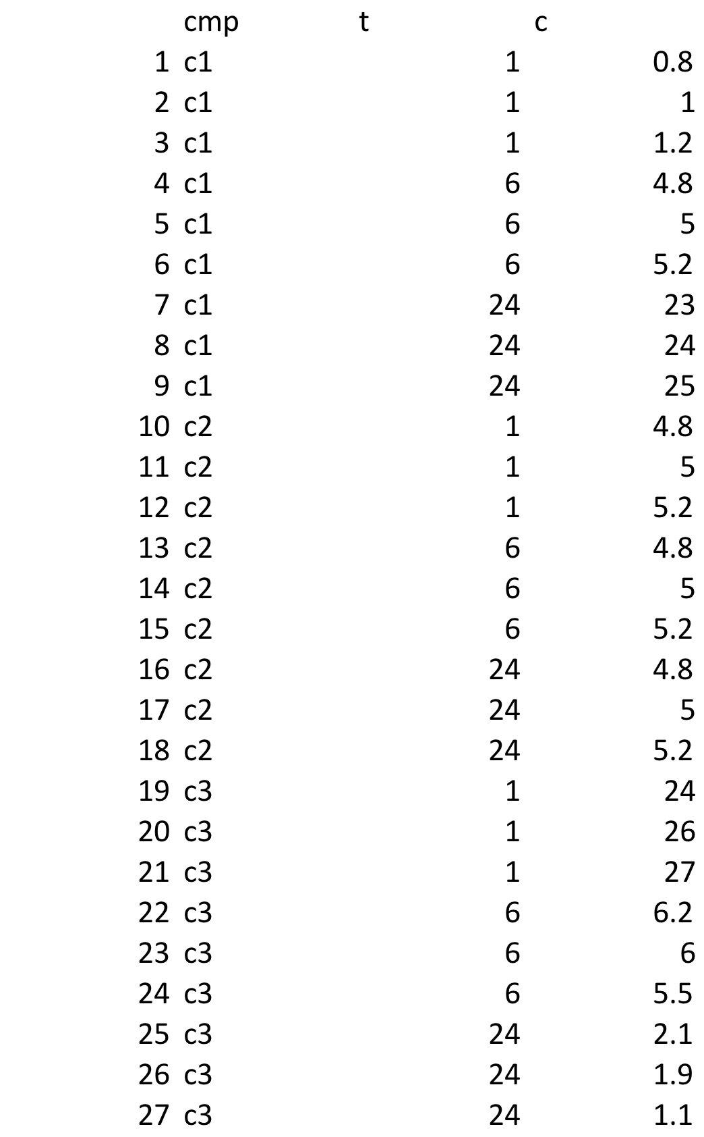
Data matrix in long format

Slide 3
Package lattice
#Trellis plots
library(lattice)
trellis.device(width=8,height=4)
# Examples of scatter plots
xyplot(c~t|cmp,data=df)
# do not use xyplot(c~t|cmp,data=df,type = "b")
xyplot(c~t|cmp,data=df,pch=c(1,2,3))
xyplot(c~t|cmp,data=df,pch=c(1,2,3),col=c(1,2,3))

Slide 4
xyplot(c~t|cmp,data=df)

Slide 5
xyplot(c~t|cmp,data=df,pch=c(1,2,3))

Slide 6
xyplot(c~t|cmp,data=df,pch=c(1,2,3),col=c(1,2,3))

