Slide 1

A practical introduction to EXSLT 2.0
XML Prague, March 22nd, 2009
Florent Georges fgeorges@fgeorges.org

Slide 2
XSLT 1.0
Released as a W3C recommendation on November 11th, 1999
Great tool to transform XML
Hard to make complex transform because of Result Tree Fragments
Missing features: regex, date and time manipulation, dynamic evaluation, user-written functions...

Slide 3
EXSLT 1.0
Community project launched in the beginning of 2001
Centralized repository of extensions to XSLT 1.0 for various processors
Modules: dates and times, dynamic, common, functions, math, random, regular expressions, sets, and strings
The common module defines the famous exsl:node-set and exsl:document extensions

Slide 4
XSLT 2.0
Released as a W3C recommendation on January 23rd, 2007
Includes several features provided by EXSLT 1.0
Has a much more complete function library
Introduces its own issues and limitations: no first-class functions, no dynamic evaluation, no parsing nor serializing facility, no nested sequences, no ZIP file handling for ODF...

Slide 5
EXSLT 2.0
In the same spirit of EXSLT 1.0, tries to improve XSLT 2.0
There is a demand for “standardized” extensions to enrich XSLT 2.0 features
This is a great place to test changes to XSLT 2.0 on a large scale before XSLT Next Generation

Slide 6
And XQuery?
Most extensions are XPath functions
XSLT 2.0 and XQuery both build on XPath 2.0
XQuery processors have interesting extension function libraries, but each different
EXSLT provides a unique function on all processors
Ability to write more complex library modules in a processor-independent way

Slide 7
Challenges
Multi-processor implementations
Extensions must be defined to work in several, different environments
How to deliver?
  Vital point for a successful EXSLT 2.0
  I hope XQuery implementers won't reproduce errors from the SQL world, and will understand interoperability benefits

Slide 8
Delivery
eXist
import module namespace ns = "..."
at "xmldb:exist:///db/.../module.xq";
MarkLogic
import module namespace ns = "..."
at "/on/db/module.xq";
Saxon
declare namespace ns = "java:com.sample.JavaClass";

Slide 9
Stop theory!
...and show me some cool code

Slide 10
HTTP Client
Send HTTP requests and provide responses
Based on XProc step p:http-request
Implementation for Saxon, partial implementations for eXist and MarkLogic
Enable to query REST services, Google services, Web services, or simply to retrieve resources on the Web

Slide 11
http:send-request()
http:send-request($request as element(http:request)) as item()+
<http:request href="http://www.example.com/..." method="post">
<http:header name="X-Header" value="some value"/>
<http:body content-type="application/xml">
<hello>World!</hello>
</http:body>
</http:request>
<http:response status="200" message="Ok">
<http:header name="..." value="..."/>
...
<http:body content-type="application/xml"/>
</http:request>

Slide 12
http:send-request()
http:send-request(
<http:request href="http://www.xmlprague.cz/" method="get"/>)
⇒
(
<http:response status="200" message="OK">
<http:header name="Server" value="Apache/1.3.37 (Unix)"/>
...
<http:body content-type="text/html"/>
</http:response>
,
<html xmlns="http://www.w3.org/1999/xhtml">
<head>
<title>XML Prague 2009</title>
...
)

Slide 13
HTTP Client samples
XQuery samples (Saxon, MarkLogic & eXist)
GData samples
WSDL Compiler
Notes:
/samples/simple/saxon.xq
/exist/test/exist-test.xq
/marklogic/test/marklogic-test.xq
(show /exist/http-client.xq & /marklogic/http- client.xq)
/prague/gdata/gdata-auth.xsl
/prague/gdata/backup-pim.xsl
/exist/test/soap-test.xq
/marklogic/test/soap-test.xq
/samples/weather-service/weather.wsdl
/samples/weather-service/weather-test.xsl

Slide 14
ZIP file handling
Extract entries
Update entries
Create new ZIP files
Well suited for OpenDocument (aka ODF, from OASIS) and Office Open XML (from Microsoft)

Slide 15
ZIP functions
zip:xml-entry($href, $path) as document-node()
zip:html-entry($href, $path) as document-node()
zip:text-entry($href, $path) as xs:string
zip:binary-entry($href, $path) as xs:base64Binary
zip:entries($href) as element(zip:file)
zip:zip-file($zip) as empty()
zip:update-entries($zip, $output) as empty()

Slide 16
<zip:file>
<zip:file href="some.zip">
<zip:entry name="file.xml" output="xml">
<hello>World!</hello>
</zip:entry>
<zip:entry name="index.html" output="html" href="/some/file.html"/>
<zip:entry name="dir">
<zip:entry name="file.txt" output="text">
Hello, world!
</zip:entry>
</zip:entry>
</zip:file>

Slide 17
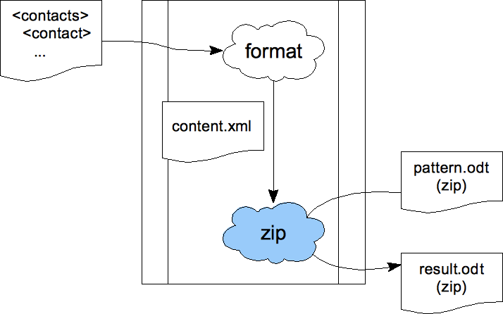
OpenDocument Pattern
Notes:
/prague/contacts-odf/contacts.xml

Slide 18
Putting it all together
Google Contacts
  Retrieve contacts from Google Contacts
  Retrieve their pictures and maps
  Format them based on a pattern content.xml
  Create an ODT file based on a pattern

Slide 19
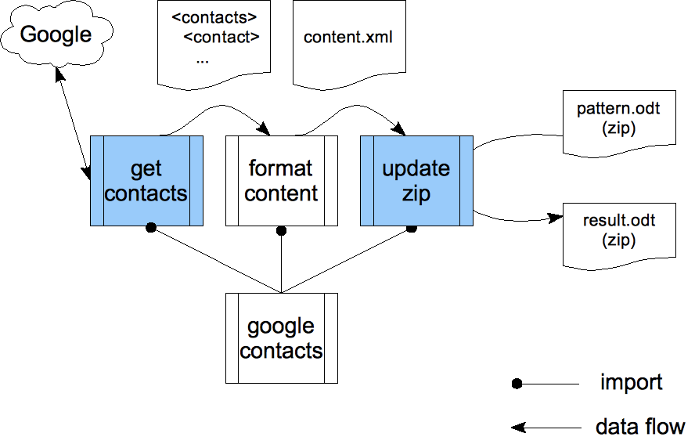
Google Contacts

Slide 20
That's all Folks!
Plenty of other potential extensions
More low-level, general purpose: nested sequences and first-class function objects

Slide 21

Join the community!
http://www.exslt.org/list/
http://community.zepheira.com/wiki/exslt/
http://www.fgeorges.org/exslt2/

