Slide 1
Introducing
The Verlocity
Growth System
July 15, 2026

Slide 2
WHO IS VERLOCITY
We deliver profitable, predictable growth at scale.
Verlocity delivers profitable, predictable growth at scale — helping community banks acquire, nurture, and retain high-value relationships so they can compete and win.
70+
30+
6
BMAP
Institutions Served
Years FI Experience
Connected Components
Market Truth First
Community banks & credit unions
Banker-led, not vendor-led
One system from insight to retention
Know where to invest before you spend

Slide 3
THE PROBLEM
The hardest part isn’t saying “no” to marketing.
It’s saying yes without knowing whether you’re investing wisely.
Most community banks still allocate growth capital by tradition — equal investment across unequal opportunities, wasted spend where the battle is already lost, and missed growth where conditions are ripe to win.
Fragmented Data
Guesswork Allocation
Unclear ROI
Marketing data, deposit data, and branch performance live in separate systems. No one owns the connection.
Budgets follow history, internal advocacy, or equal splits — not opportunity or competitive vulnerability.
Leadership cannot see which investments actually move deposit growth and profitability.

Slide 4
THE SOLUTION
Six components. Three phases. One compounding system.
Foundation pairs Brand Clarity (what makes you worth choosing) with BMAP / Market Truth (where the opportunity is). Together they give the growth engine real horsepower.
FOUNDATION
ACTIVATION
MOMENTUM
Builds strategic clarity
Turns strategy into execution
Compounds growth
01
03
05
Brand Clarity
AudienceFinder
CRM & Engagement
What you credibly own
Who to win
How to onboard
02
04
06
BMAP
MediaPredict
Retention & Deepening
Where to invest capital
How to convert
How to grow share

Slide 5
FOUNDATION · MARKET TRUTH
BMAP — Know exactly where to invest before you spend
Branch Market Assessment Platform
A proprietary, data-driven system that scores every branch in your network for deposit growth opportunity, competitive vulnerability, and the best actions to take.
24+
DATA SOURCES
1
Opportunity Score
Fused into one scoring engine
0–100 growth potential vs. state peers
2
Strategic Zones
FDIC
FFIEC
Invest · Analyze · Defend · Justify
NCUA
US Census
3
Competitor Vulnerability
Who is exposed — and why
US Labor
US Housing
4
Named Plays
Zillow
PostGIS
Next-best actions for media & budget

Slide 6
HOW BMAP WORKS
Every branch receives a clear capital-allocation role
INVEST
ANALYZE
DEFEND
JUSTIFY
Top 25%
50–75th
25–50th
Bottom 25%
Concentrate acquisition resources now — before a competitor beats you to it.
Validate the signal, then commit spend with confidence.
Protect existing share. Do not over-allocate.
Right-size resources. Redirect capital higher.

Slide 7
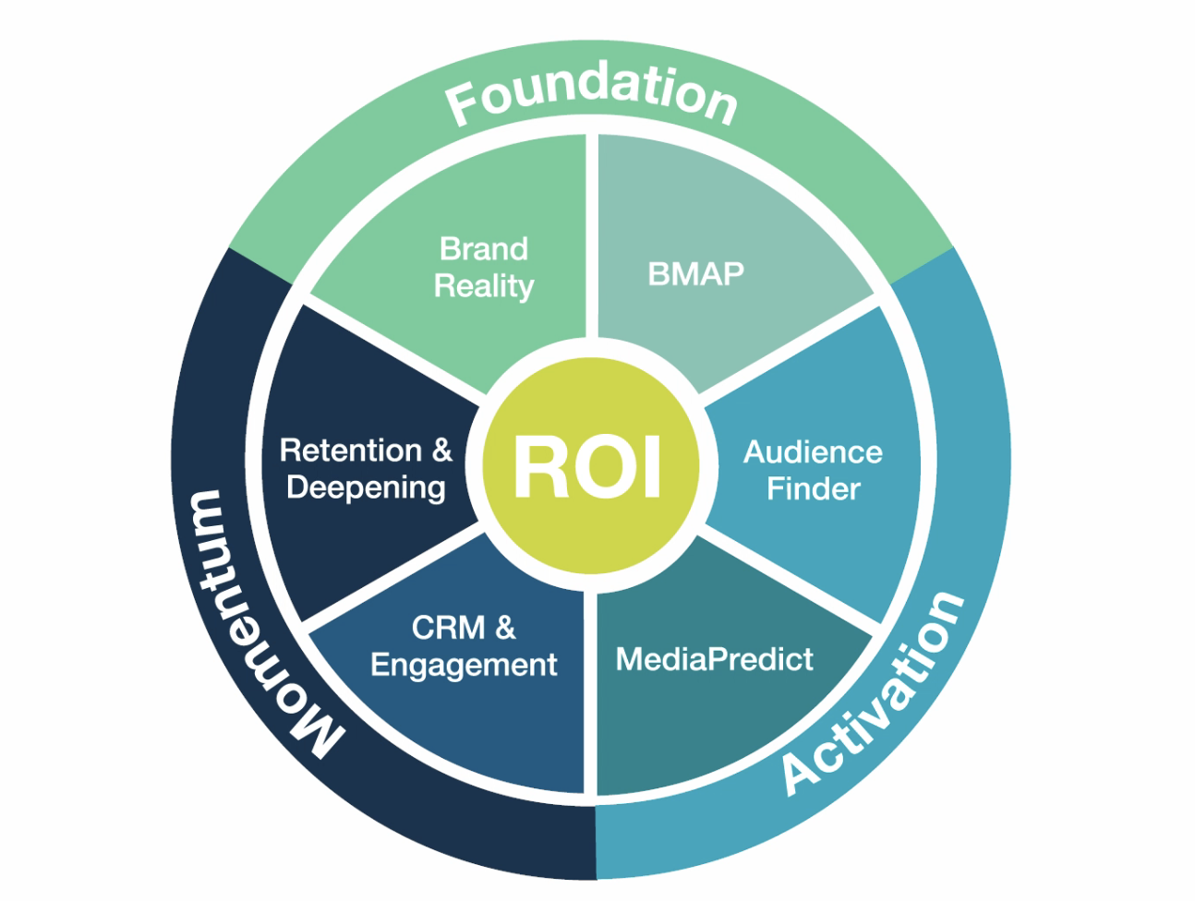
FROM INSIGHT TO COMPOUNDING GROWTH
BMAP is the entry point. The full system turns clarity into results.
1
BMAP Snapshot
See where capital should go — and where it should not.
2
AudienceFinder
Identify households and businesses most likely to open and fund.
3
MediaPredict
Project relationships, CAC, and marginal economic contribution before spend.
4
CRM & Deepening
Convert, onboard, retain, and grow share of wallet.

Slide 8
PROVEN OUTCOMES
What disciplined allocation and a connected system deliver
$630MM
77%+
300%+
70+
18 Month Deposit Production
Retention
New Deposits
Institutions Served
New relationships, new money
Proven customer nurturing & retention strategies
Exceeded client goals at lowest budget tier
30+ years FI experience
Not more marketing. Not less. Clarity.
With data at the core, leadership can see which investments move the institution toward its strategic goals.

Slide 9
YOUR NEXT STEP
Start with clarity. Then activate the full system.
1
2
3
BMAP Snapshot
Growth Lab
Full System Activation
Complimentary branch-level scoring & zone map for qualifying institutions.
Base value $12,000.
Structured assessment across all six components — the natural next step after your Snapshot.
Foundation → Activation → Momentum. Predictable, profitable deposit growth at scale.

Slide 10
Appendix

Slide 11
OMNI BRANCH | OUR DIGITAL FIRST DEPOSIT GROWTH ENGINE
What is Omni Branch?
Omni Branch is our proven digital-forward bank growth engine that cost-effectively acquires, nurtures, retains, and grows new retail customers and deposits at scale.
Omni Branch seamlessly blends:
Competitive rates with polished digital experiences
Precision hyperlocal performance marketing media strategy and execution
Streamlined, trustworthy omnichannel digital account opening and funding
Data-driven funnel optimization and continuous testing
Branch and banker activation playbooks to nurture and expand relationships
Targeted nurturing strategies that build primacy and drive long-term retention
Core Omni Branch Goal: Acquire digitally native customers who want modern, self-service online banking — while delivering the trusted, high-touch service and FDIC-insured security of a traditional bank.

Slide 12
OMNI BRANCH | OUR DIGITAL FIRST DEPOSIT GROWTH ENGINE
Acquisition Model Comparison
Shifting from high-cost checking bonuses to high-value savings acquisition
Savings-First
Savvy Savers
Checking-First
Bonus Chasers
$75,000
$10,000
Average balance | >75% Retention
Average balance | <35% Retention
Savings-first customers deliver significantly higher deposit value
per acquisition and retain at higher rates than checking bonus customers

Slide 13
OMNI BRANCH | OUR DIGITAL FIRST DEPOSIT GROWTH ENGINE
Savings vs Checking Model Comparison
Metric | Checking Bonus Model | Savings-First (Digital Branch) | Advantage
Customer Acquisition Cost (CAC) | $900 – $1,800+ | $502 | 45–70% lower
Avg. Initial Balance per New Account | $10k – $30k | $75k+ | 2.5–7.5x higher
12-Month Retention | 35–55% | >77% | Much higher
Effective CAC per $1,000 Retained | $60 – $225 | $8.69 | 7–26x better
Months to Break Even | 12 – 36+ months | 3.6 months (Full Bank) 10.7 months (FTP) | 3–10x faster
Est. Net Customer Lifetime Value | Low | $6,835 (Full Bank 2.25%) $1,900 (FTP 0.75%) | 4–14x CAC

Slide 14
OMNI BRANCH | OUR DIGITAL FIRST DEPOSIT GROWTH ENGINE
Competitive Model Comparison
Approach | Typical CAC | Avg. Initial Balance | Retention | Example Competitors | Omni Branch Advantage
Omni Branch (Savings-First) | $502 | $75k | >77% | — | —
Pure Digital / Online Banks | $290 – $400 | Lower | Lower | Ally, Marcus by Goldman Sachs, Capital One 360 | Higher balances + better retention
Traditional Retail Banking | $561 | $10k – $30k | 35–55% | Chase, Bank of America, Wells Fargo | Lower CAC + 2.5–7.5x higher balances
Checking Bonus Campaigns | $900 – $1,800+ | Lower | Lower | Chase Total Checking ($400), Bank of America Advantage ($500), Huntington ($400–$600) | 45–70%+ lower CAC
Fintech / High-Competition | $1,450 – $2,140 | Varies | Varies | SoFi, Marcus, broader fintech avg. | Significantly lower
Credit Unions | $428 | Varies | Higher | Various regional CUs | Comparable CAC with stronger digital execution

Slide 15
OMNI BRANCH | OUR DIGITAL FIRST DEPOSIT GROWTH ENGINE
Retail Deposit Forecast with Media Budget
Target Deposit Production | New Accounts Needed | $500 CAC | $750 CAC | $1000 CAC
$25 Million | 333 | $167k | $250k | $333k
$50 Million | 667 | $333k | $500k | $667k
$75 Million | 1,000 | $500k | $750k | $1.0M
$100 Million | 1,333 | $667k | $1.0M | $1.33M
$150 Million | 2,000 | $1.00M | $1.50M | $2.0M
$200 Million | 2,667 | $1.33M | $2.00M | $2.68M
This table shows the power of our model. Even if CAC rises to $750–$1,000, we can still raise $150–$200 million in deposits with reasonable media budgets.

Slide 16
OMNI BRANCH | OUR DIGITAL FIRST DEPOSIT GROWTH ENGINE
Mandatory Program Components
Key foundational elements for building a successful and sustainable Omni Branch program
Rate competitive savings products (CD, HYS, MMA, Interest Checking)
Dedicated savings offer site in place
Digital online account opening capabilities
Alignment with retail branches and bankers to engage and convert walk-ins exposed to ads
Clearly defined email and call onboarding/cross-sell journeys
All bank customer exclusion lists in place to mitigate cannibalization
Funded media spend based on forecasted targets
Core Omni

