Slide 1
Electrical and Computer Engineering Department
Tarbiat Modares University
Z Transform
Foad Ghaderi, PhD

Slide 2
In general, any sequence that passes through a LTI system changes shape, i.e if x[n] is an arbitrary sequence
there is no direct relation between the waveforms of x[n] and y[n]:
Question:
Is there any sequence that retains its shape when it passes through an LTI system?

Slide 3
Question:
Is there any sequence that retains its shape when it passes through an LTI system?
Consider the complex exponential sequence:
is a complex variable defined everywhere on the complex plane.

Slide 4
If the summation inside the parentheses converges, the result is a function of z
Then the output sequence is given by
The output sequence is the same complex exponential as the input sequence, multiplied by a constant H(z) that depends on the value of z. H(z) is called System function (transfer function):
The complex exponential sequences x[n] = z^{n} are eigenfunctions of LTI systems.
The constant H(z), for a specified value of the complex variable z, is the eigenvalue associated with the eigenfunction z^{n}.
In contrast to impulse sequences, whose shape changes when they pass through LTI systems, complex exponential sequences retain their shape.
Notes:
This property, which is an exclusivity of LTI systems and complex exponential sequences, provides the basis for the analysis of LTI systems using the z-transform.

Slide 5

If the input to a LTI system can be expressed as a linear combination of complex exponentials
the output will be
The z-transform of a sequence x[n] is a function X(z) defined by
where the independent variable z can represent any complex number.

Slide 6
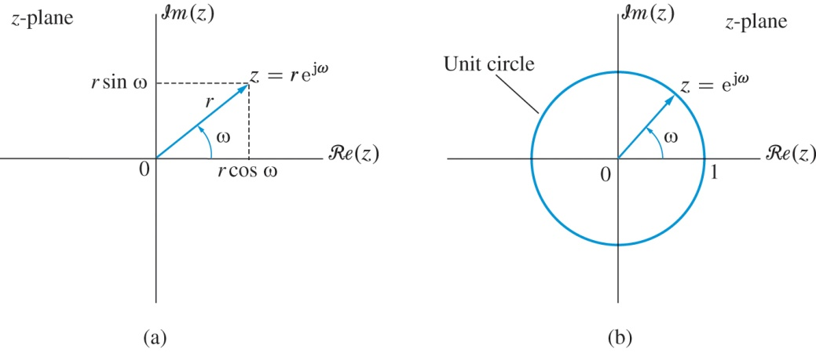
It is convenient to interpret the z-transform using the correspondence
between complex numbers and points in the plane.
(a) A point z = re^{jω} in the complex plane can be specified by the distance r from the origin and the angle ω with the positive real axis (polar coordinates) or the rectangular coordinates r cos(ω) and r sin(ω). (b) The unit circle, |z| = 1, in the complex plane.

Slide 7
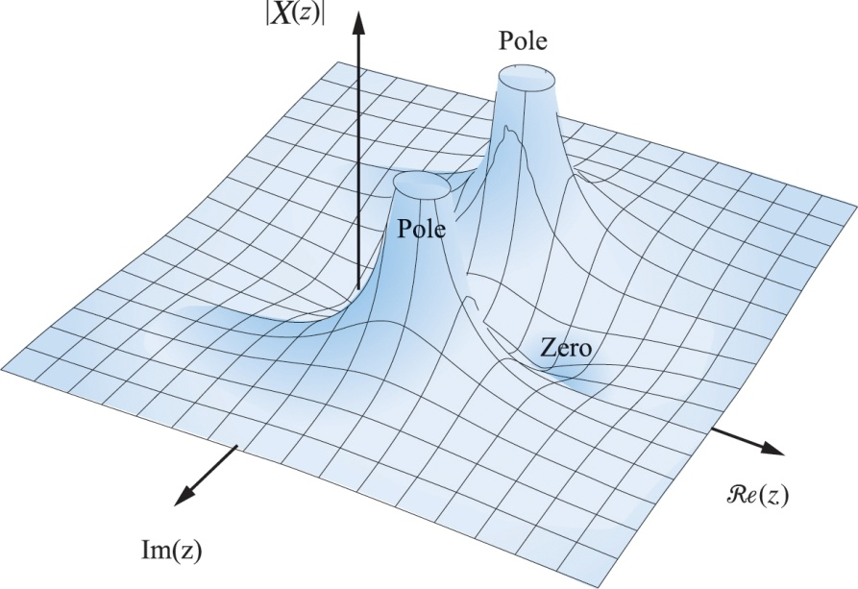
The set of values of z for which the series
converges is known as the
region of convergence (ROC) of the z-transform. The values of z for which X(z) = 0 are called zeros of X(z), and the values of z for which X(z) is infinite are known as poles.
The magnitude |X(z)| of the z-transform represents a surface in the z-plane. There are two zeros at z₁ = 0, z₂ = 1 and two poles at p_{1,2} = 0.9e^{±jπ/4}.
Notes:
By definition, the ROC cannot include any poles.
The ROC is an essential part of the z-transform.

Slide 8
Example: Unit sample sequence
The z-transform of the unit sample sequence is given by
Example: Square-pulse sequence
The z-transform of the square-pulse sequence
is given by

Slide 9
Example: Exponential-pulse sequence
The z-transform of the exponential-pulse sequence
is given by

Slide 10
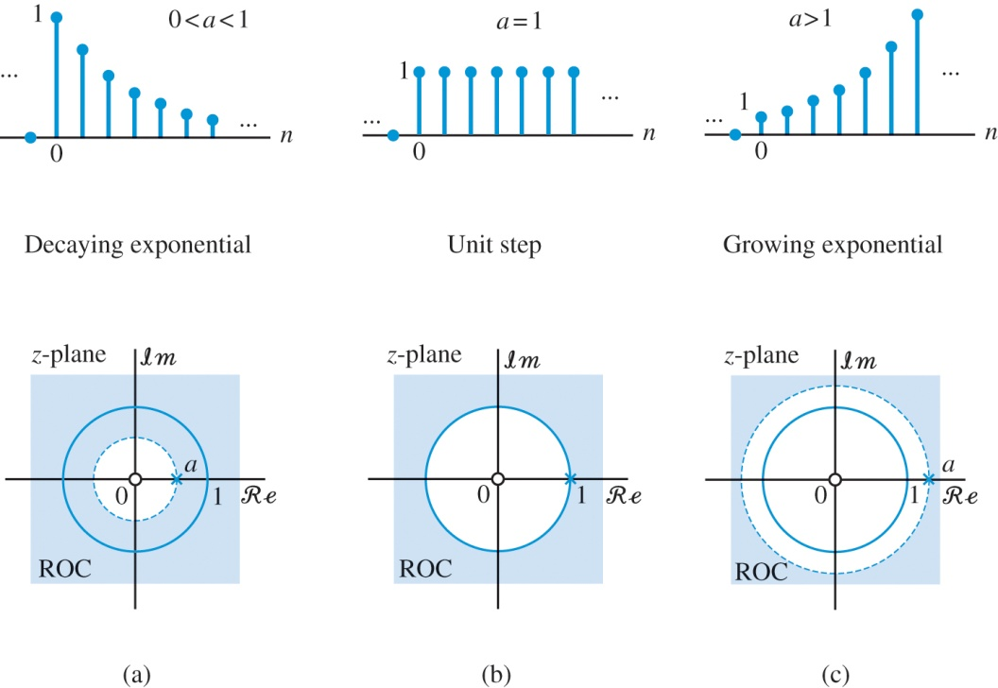
Example: Causal exponential sequence
The z-transform of the causal exponential sequence x[n] = a^{n}u[n] is given by
Pole-zero plot and region of convergence of a causal exponential sequence x[n] = a^{n}u[n] with (a) decaying amplitude (0 < a < 1), (b) fixed amplitude (unit step sequence), and (c) growing amplitude (a > 1).

Slide 11
Example: Anticausal exponential sequence
The z-transform of the anticausal exponential sequence
is given by
The infinite geometric series inside the parenthesis converges if |b⁻¹z| < 1 or |z| < |b|.
The z-transform function Y(z) has a zero at z = 0 and a pole at p = b.
Notes:
For b = a we have Y(z) = X(z), even if x[n] ≠ y[n]! Hence, the unique specification of a sequence x[n] requires both the function X(z)and its ROC.

Slide 12
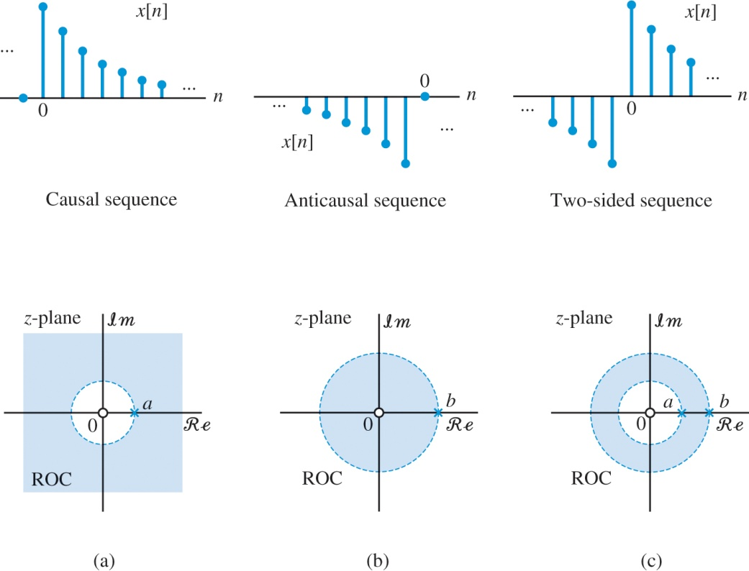
Example: Two-sided exponential sequence
The z-transform of the two-sided exponential sequence
is given by
Pole-zero plot and region of convergence for the (a) causal, (b) anticausal, and (c) two-sided exponential sequences

Slide 13
Example: Exponentially oscillating sequence
Consider a causal sinusoidal sequence with exponentially varying amplitude:
Using the identity
Since |e^{±jω0}| = 1, both sums converge if |rz⁻¹| < 1, or, equivalently, |z| > r.

Slide 14
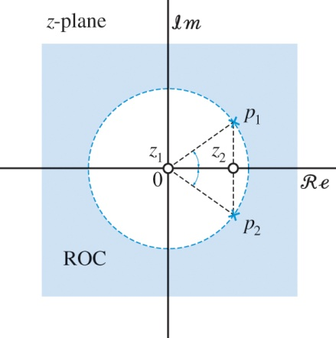
X(z) has two zeros at z₁ = 0, z₂ = r cos ω₀ and two complex-conjugate poles at p₁ = re^{jω0} , p₂ = re^{−jω0}.
Pole-zero plot and region of convergence

Slide 15
Some common z-transform pairs

Slide 16
ROC Properties
The ROC cannot include any poles.
The ROC is a connected (that is, a single contiguous) region.
For finite duration sequences the ROC is the entire z-plane, with the possible exception of z = 0 or z=∞.
For infinite duration sequences the ROC can have one of the following shapes:
The z-transform of a sequence consists of an algebraic formula and its associated ROC. Thus, to uniquely specify a sequence x[n] we need both X(z) and its ROC.
The function X(z) is legitimate only for z within its ROC. We stress that X(z) is not defined when z is outside the ROC, even if the formula for X(z) yields meaningful results for these values.

Slide 17
The inverse z-transform
The recovery of a sequence x[n] from its z-transform (X(z) and ROC) can be formally done using the formula:
Simpler procedures
For most sequences and z-transforms encountered in the analysis of LTI systems the following simple procedure is enough:
Expansion into a series of terms in the variables z and z⁻¹ and picking their coefficients.
Partial fraction expansion and table look-up.

Slide 18

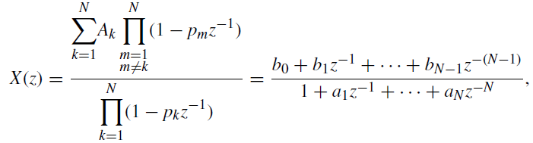
The inverse z-transform
The z-transform of a linear combination of distinct exponentials (that is, p_{k} ≠p_{m}, k ≠ m) is given by:
ROC: the intersection of the ROCs of the individual exponential sequences
→
which is a proper rational function because the degree of the numerator is less than the degree of the denominator.

Slide 19



The inverse z-transform
Example: Real and distinct poles
1- Decompose the sequence into partial fractions:
distinct poles p₁ = 1 and p₂ = 0.5
→
z = 1 → A₁ = 4
z = 0.5 → A₂ = −3

Slide 20
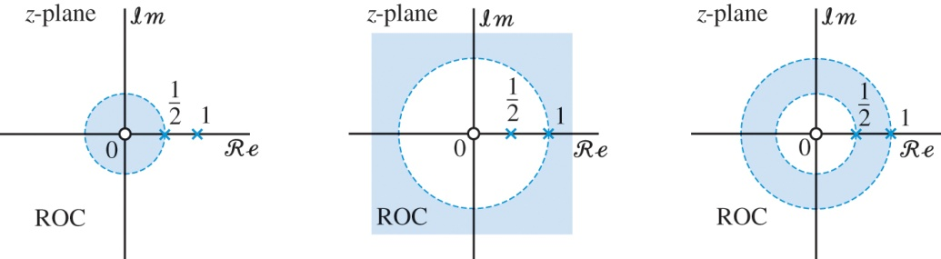
The inverse z-transform
Example: Real and distinct poles
2- Find the sequences corresponding to the partial fractions,
A ROC cannot include any poles, so there are three possible choices for valid ROCs.

Slide 21



The inverse z-transform
Example: Real and distinct poles
|z| > 1, both fractions are the z-transform of causal sequences. Hence
0.5 < |z| < 1, this can be obtained as the intersection of ROC: |z| < 1 and ROC:|z| > 0.5.
|z| < 0.5, both fractions are the z-transform of anticausal sequences.
Notes:
Causal sequence A sequence that is zero for negative n, i.e. n < 0. Also called a right-sided sequence.
Anticausal sequence A sequence that is zero for positive n, i.e. n > 0. Also called a left-sided sequence.
Noncausal sequence A sequence that is nonzero for positive as well as negative values of n. Also called a two-sided sequence.

Slide 22


The inverse z-transform
Example: Complex conjugate distinct poles
Consider a causal sequence x[n] with z-transform
z² − z + 0.5 = 0 →
p1 ≠ p2 →
z + 1 = A₁(z − p₂) + A₂(z − p₁), setting z = p₁ and z = p₂
Since x[n] is causal →
Notes:
Note that, because the polynomial has real coefficients, p1 = p₂∗ and A1 = A₂∗.

Slide 23





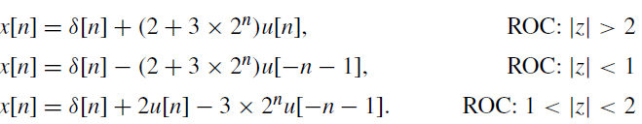
The inverse z-transform
If we have a rational function with distinct poles
the complete partial fraction expansion takes the form
Example Partial fraction expansion (using scipy.signal.residuez)
import scipy.signal as sig
b = [6, -10, 2]
a = [1, -3, 2]
[B, A, C] = sig.residuez(b,a)

Slide 24

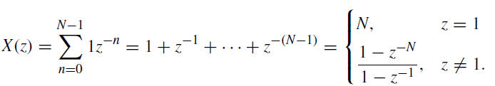

Properties of the z-transform
Linearity
Time shifting
Example
The ROC is the entire z-plane, except z = 0.
Alternative approach:
x[n] = u[n] − u[n − N].
Notes:
Since there is a unique correspondence between a sequence x[n] and its z-transform X(z),
we can change a sequence by manipulating its z-transform.

Slide 25




Properties of the z-transform
Convolution of sequences
Multiplication by an exponential sequence
Since a and z take complex values, the result is scaling (expansion or shrinking) and rotation of the z-plane, the ROC, and the pole-zero pattern.
Differentiation of the z-transform
Both sequences have the same ROC.
Example Second-order pole
→

Slide 26



Properties of the z-transform
Conjugation of a complex sequence
Time reversal
Initial-value theorem
If x[n] is a causal sequence, that is, x[n] = 0 for n < 0, then

Slide 27
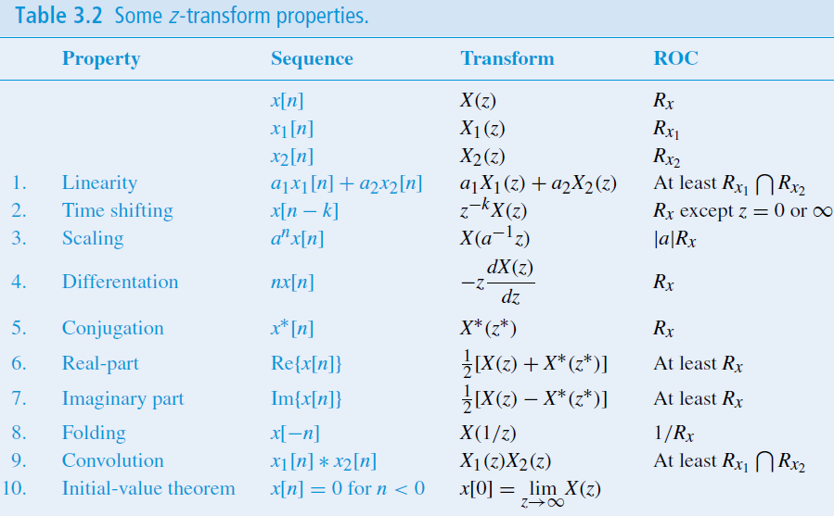
Summary of the z-transform properties

Slide 28







System function of LTI systems
Every LTI system can be completely characterized in the time domain by its impulse response h[n].
→
Since there is a unique relation between h[n] and H(z) many properties of the system can be inferred from H(z) and its ROC.
Example
Determine the response of a system with impulse response h[n] = a^{n}u[n], |a| < 1 to the input x[n] = u[n] using the convolution theorem.
→
Determining the output sequence y[n]
→
Notes:
X(z), Y(z), and H(z) are the z-transforms of the system input, output, and impulse response, respectively.

Slide 29


System function of LTI systems
Causality
A causal LTI system has an impulse response h[n] that is zero for n < 0. Therefore, for causal systems the power series H(z) does not include any positive powers of z and its ROC extends outside of a circle for some radius r, that is, |z| > r.
A system function H(z) with the ROC that is the exterior of a circle, extending to infinity, is a necessary condition for a discrete-time LTI system to be causal but not a sufficient one.
Stability
For a LTI system to be stable,
This is equivalent to the condition
for |z| = 1
A LTI system is stable if and only if the ROC of the system function H(z) includes the unit circle |z| = 1.

Slide 30
System function of LTI systems
Causal and stable system
An LTI system with rational H(z) is both causal and stable if and only if all poles of H(z) are inside the unit circle and its ROC is on the exterior of a circle, extending to infinity.
Stability
A causal LTI with a rational system function is stable if and only if all poles of H(z) are inside the unit circle in the z-plane. The zeros can be anywhere.

Slide 31


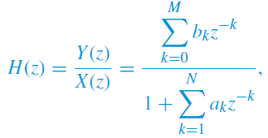
Linear constant-coefficient difference equations
Consider a linear constant-coefficient difference equation
Using the properties of linearity and time shifting
Therefore the system function is given by
Notes:
In signal processing applications, we assume that the system is initially at rest, that is,
x[n] = y[n] = 0 for n < 0. Therefore, we can set the initial conditions at n = 0 to zero,
that is, x[−1] = · · · = x[−M] = 0 and y[−1] = · · · = y[−N] = 0, and then recursively
compute the output values y[0], y[1], . . . , y[L].

Slide 32

Linear constant-coefficient difference equations
Example
Find the difference equation corresponding to the system function
→
→

Slide 33
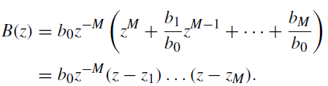
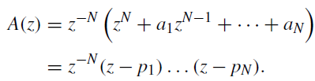
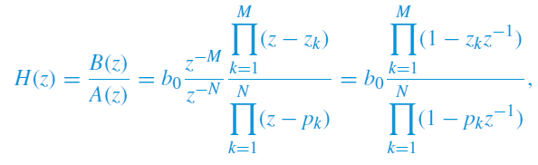
Linear constant-coefficient difference equations
Poles and zeros
if z₁, z₂, . . . , z_{M} and p₁, p₂, . . . , p_{N} are the roots of the numerator and the denominator polynomial, respectively
→
where b₀ is a constant gain term.
Each of the factors (1 − z_{k}z⁻¹) contributes a zero at z = z_{k} and a pole at z = 0.
Each of the factors (1 − p_{k}z⁻¹) contributes a pole at z = p_{k} and a zero at z = 0.
Poles and zeros at the origin are not counted.

Slide 34


Linear constant-coefficient difference equations
Impulse response
Any rational function of z⁻¹ with distinct poles can be expressed in the form
If we assume that the system is causal, then the ROC is the exterior of a circle starting at the outermost pole, and the impulse response is

Slide 35

Linear constant-coefficient difference equations
System classifications
LTI systems can be classified into different classes:
Length of impulse response
Infinite Impulse Response (IIR)
If at least one nonzero pole of H(z) is not canceled by a zero, there will a term of the form A_{k}(p_{k})^{n}u[n]. In this case h[n] has infinite duration.
Finite Impulse Response (FIR)
If N = 0, the system function becomes a polynomial.

Slide 36
Linear constant-coefficient difference equations
System classifications
LTI systems can be classified into different classes:
Feedback in implementation
Recursive systems
If N ≥ 1 the output of the system is fed back into the input.
Nonrecursive systems
If N = 0 the output is a linear combination of the present and previous inputs, only.
Poles and zeros
If a_{k} = 0, for k = 1, . . . , N, the system has M zeros (all-zero systems).
If b_{k} = 0, for k = 1, . . . ,M, the system has N poles (all-pole systems).

Slide 37

Connections between pole-zero locations and time-domain behavior
The roots of a polynomial with real coefficients either must be real or must occur in complex conjugate pairs.
Any system with a rational H(z) is equivalent to a parallel combination of
an FIR system, K₁ first-order systems with real poles, and K₂ second-order systems with complex conjugate poles, where N = K₁ + 2K₂:

Slide 38

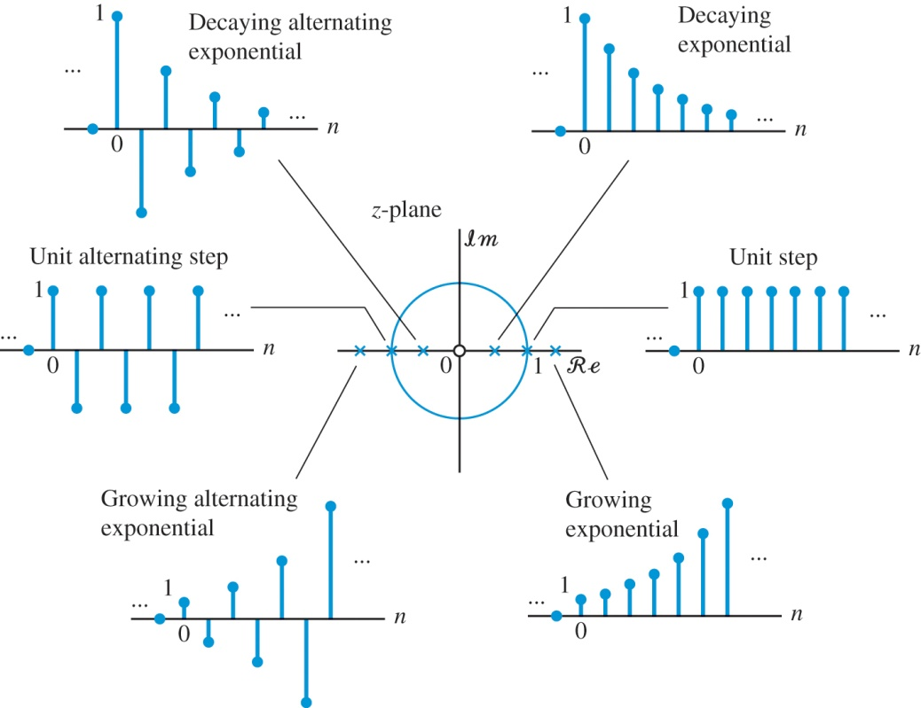
Connections between pole-zero locations and time-domain behavior
First-order systems
Assuming a causal system, the impulse response is given by the following real exponential sequence:
h[n] = ba^{n}u[n]

Slide 39

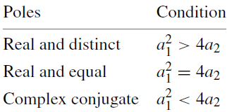

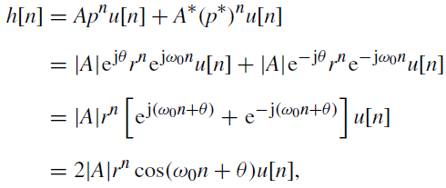
Connections between pole-zero locations and time-domain behavior
Second-order systems
Zeros:
z₁ = 0 and z₂ = −b₁/b₀
Poles:
The impulse response of a causal system with a pair of complex conjugate poles

Slide 40
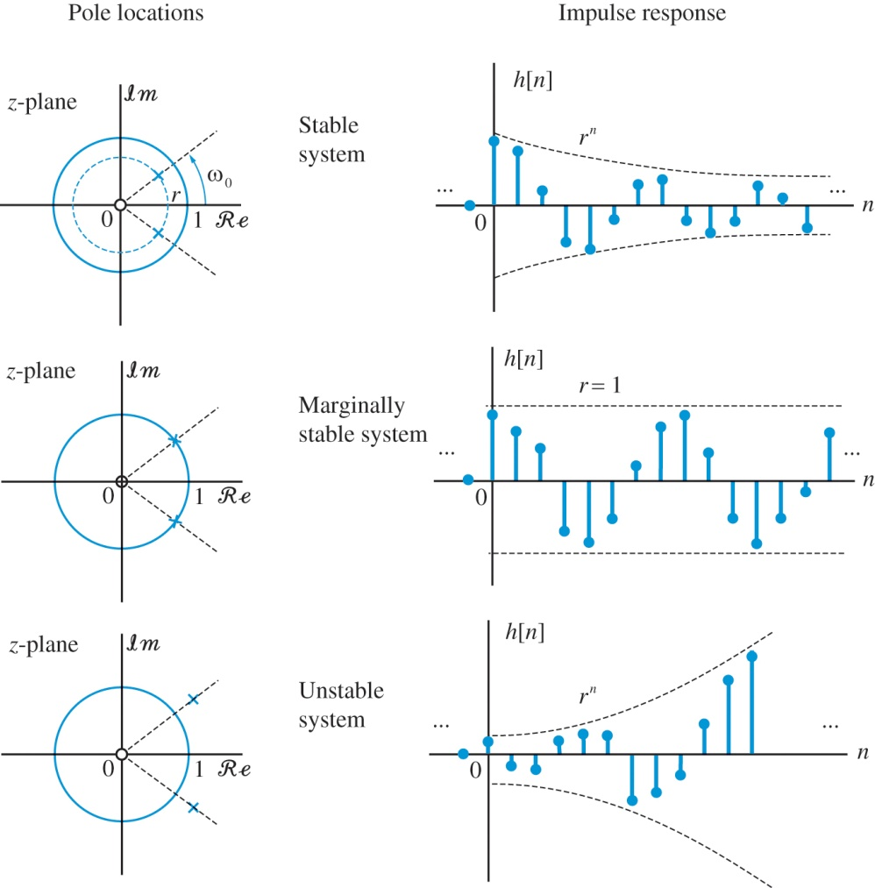
Connections between pole-zero locations and time-domain behavior

