Slide 1
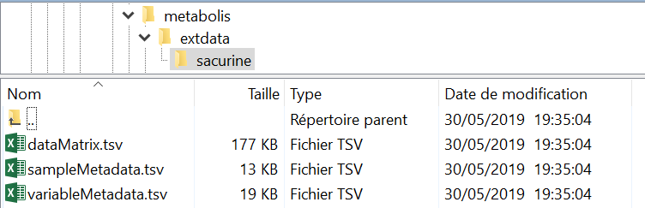
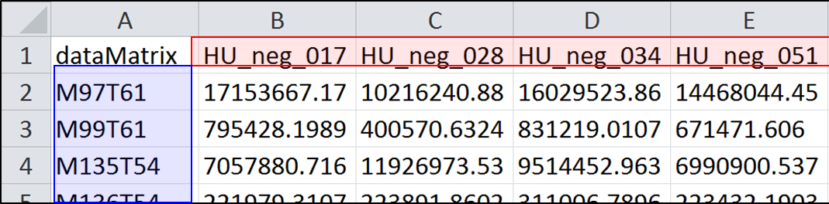
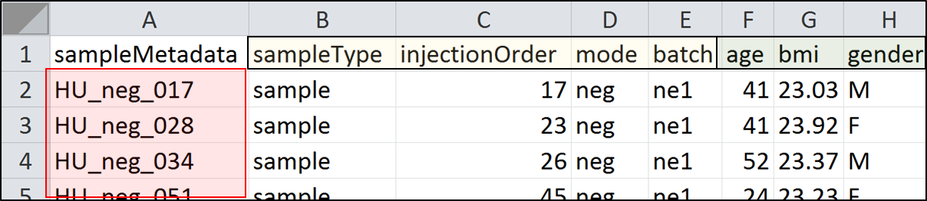
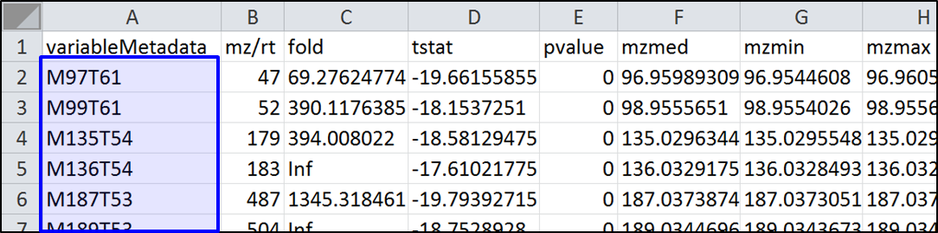
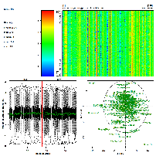
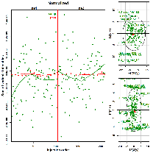
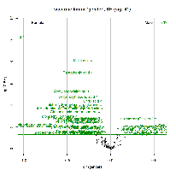
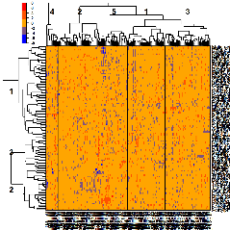
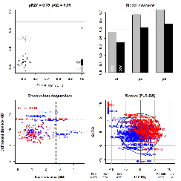
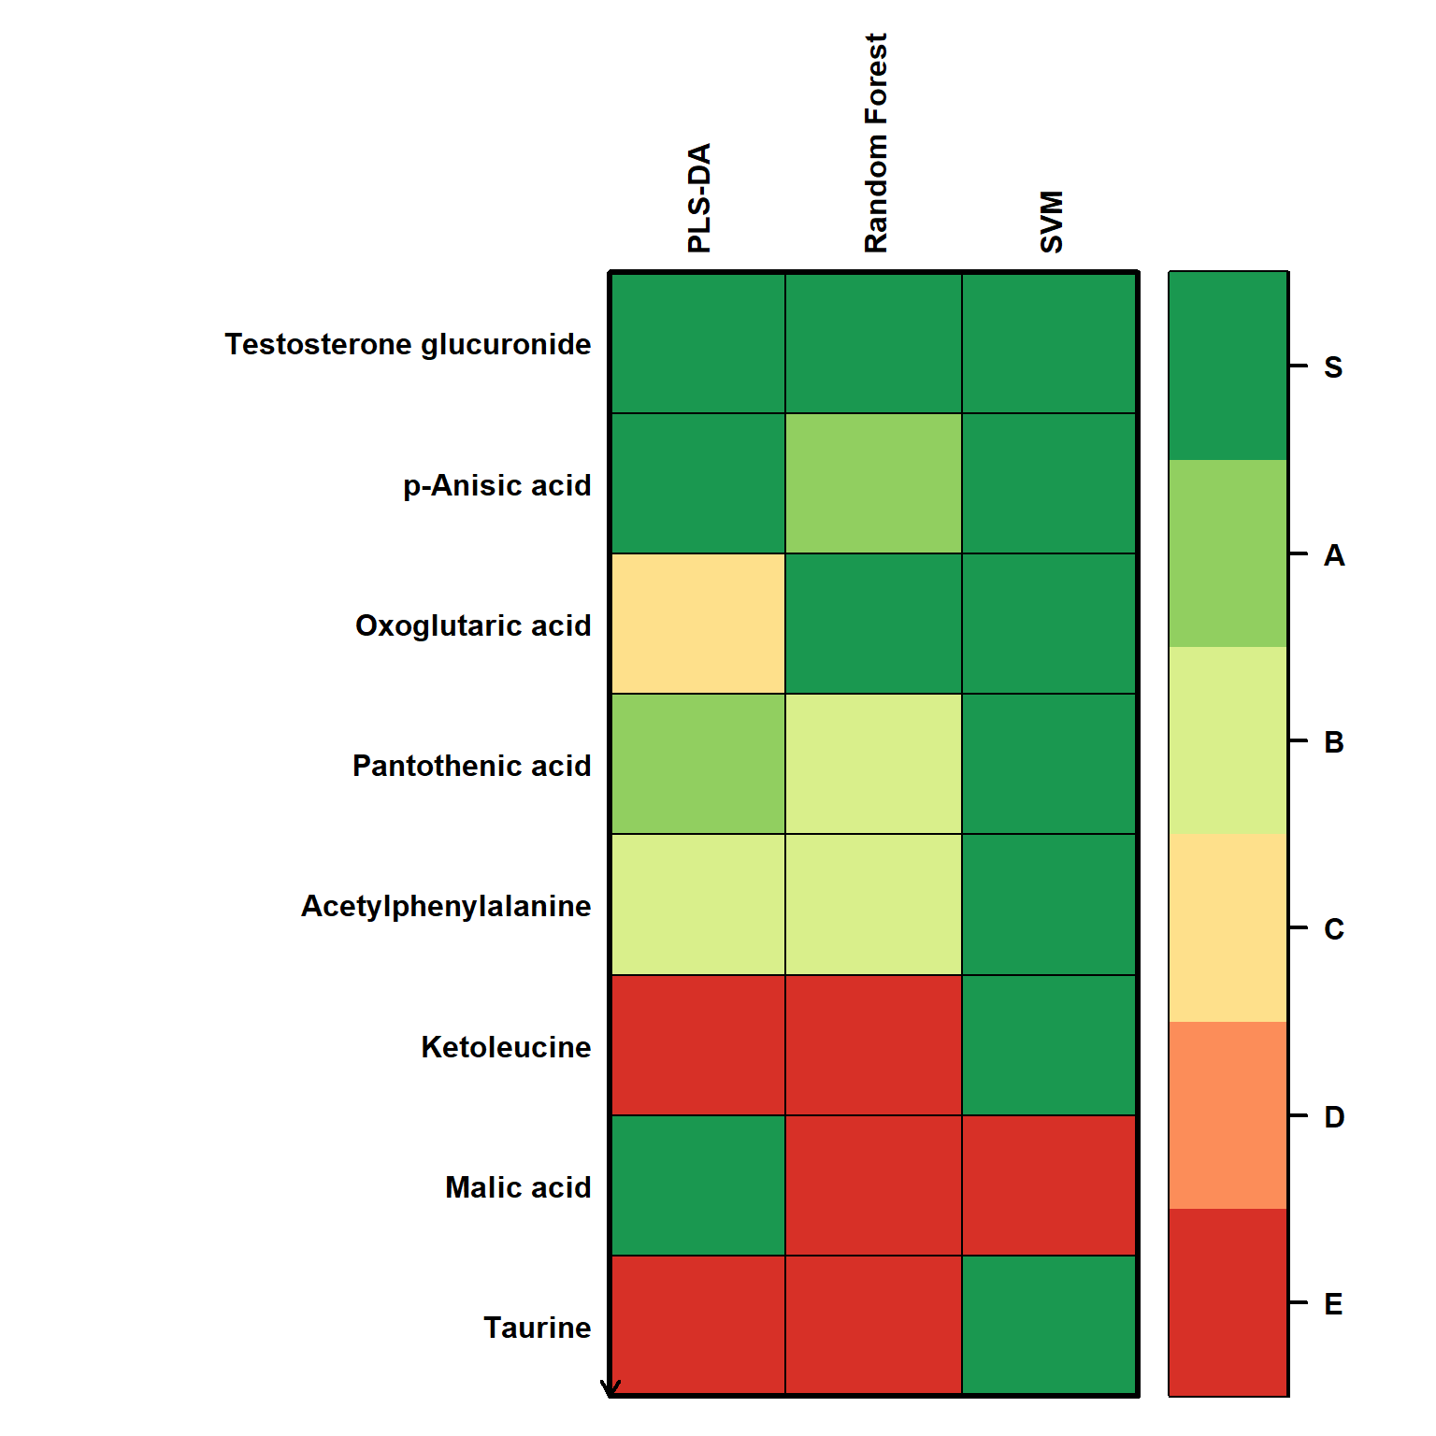
Importing
eSet <- metRead(dirC)
Post-processing
Quality control
eSet <- metView(eSet)
Signal drift and batch effect correction
eSet <- metCorrect(eSet)
Transformation
eSet <- metTransform(eSet, methodC = ‘log2’)
Univariate hypothesis testing
eSet <- metTest(eSet, factorC = ‘gender’,
testC = ‘limma’, adjustC = ‘BH’)
Unsupervised modeling
setPca <- ropls::opls(eSet)
ropls::plot(setPca, parAsColFcVn = ‘gender’, typeVc = ‘x-score’)
eSet <- ropls::getEset(setPca)
PCA
Heatmap
eSet <- metHeatmap(eSet, clustVi = c(2, 2))
Supervised modeling
setPlsda <- ropls::opls(eSet, ‘gender’)
eSet <- ropls::getEset(setPlsda)
(O)PLS(-DA)
set.seed(123)
setBiosign <- biosigner::biosign(eSet, ‘gender’)
set.seed(NULL)
eSet <- biosigner::getEset(setBiosign)
Feature selection
Exporting
metWrite(eSet, dirC = getwd())

Slide 2
1. The dataMatrix.tsv (tabular) file must contain:
the names of your samples in the first row
the names of your variables in the first column
numbers (or NA) in all the other cells
2. The sampleMetadata.tsv file must contain:
the names of the factors to be used in statistical analyzes in the first row
the names of your samples in the first column which must exactly match those of dataMatrix.tsv
3. The variableMetadata.tsv file must contain:
the names of the metadata (e.g. mzmed, rtmed) in the first row
the names of your variables in the first column which must exactly match those of dataMatrix.tsv

